Slide 1
The GPM-GLOBE Student Field Campaign
Introductory Webinar
Kristen Weaver
GPM Education Specialist
January 21st, 2015

Slide 2

Agenda
Introduction to the Global Precipitation Measurement Mission
Resources to use with your students and events during the campaign
Review of data collection and entry
Notes:
Presentation adapted slightly from original version for posting on GPM-GLOBE community page - removed interactive segments specific to the webinar format.

Slide 3
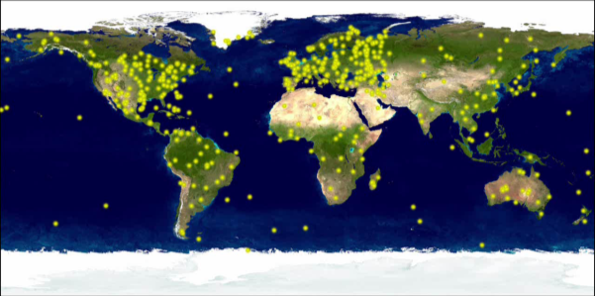
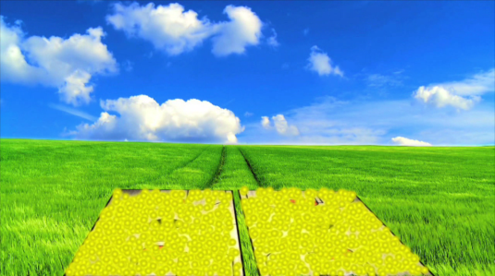
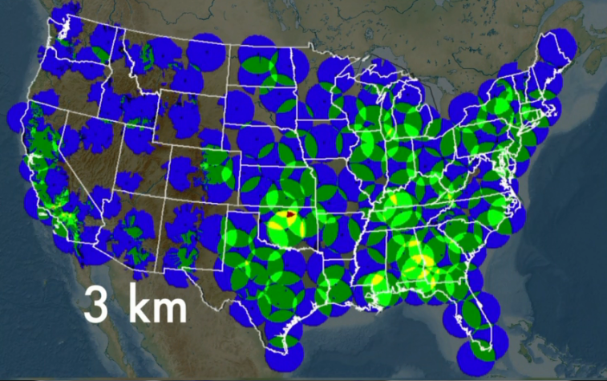
Measuring Precipitation: Why Look From Space?
Rain gauges: very useful, but not evenly distributed over the Earth, and there are none over oceans and few in developing countries
Ground-based radar – still doesn’t cover everywhere, and not far out over oceans
Notes:
Talking points:
Why can’t we a global picture of precipitation from the ground?
All the gauges (shown here in yellow) in the world would only fit into 2 basketball courts
Radar has better coverage but there is an severe absence of radars in developing countries, over mountain areas and no coverage over the oceans
70% of the earth is covered by water where radar and gauges are very sparse. Even the coverage of gauges on land is quite small!
Need global measurements at fine resolution from space to tell us how much rain or snow is falling in our backyards and how rain and snow is distributed globally.
Precipitation is felt locally, but interacts with large-scale circulation patterns. Precipitation links the Earth’s ENERGY and WATER cycles.
Space-borne remote sensing can provide both the space and time coverage needed for measuring and evaluating precipitation across the globe, particularly in areas without ground-based instruments (e.g. rain gauges, radar).

Slide 4
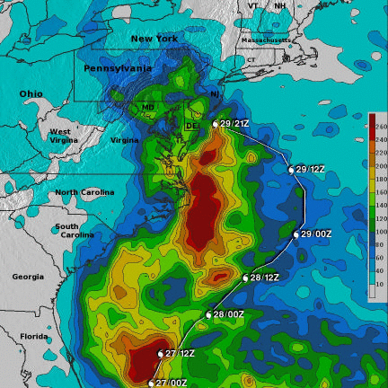
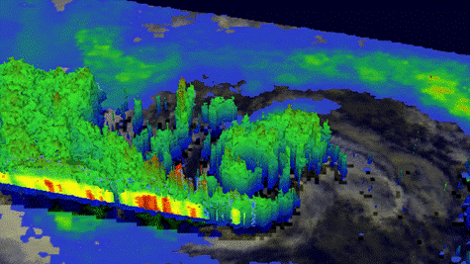
Tropical Rainfall Measuring Mission
Hurricane Sandy (Oct. 22-31st, 2012)
Launched in 1997
Partnership between NASA and JAXA
TRMM image on Oct. 28th
October 28th, 2012
TRMM extent
http://youtu.be/0_2pcVIJvBM
Notes:
Talking points:
GPM Mission is building off of the highly successful TRMM mission
Shows a view of hurricane sandy as it is a Category 1 and the eye walls are forming on October 28th
The right image shows rainfall accumulation for Hurricane Sandy using many different satellites as inputs including TRMM (red shows areas of high rainfall accumulations, in mm)
TRMM has provided the first 3-D picture of precipitation from space (Image on the bottom left shows a 3-D profile of Hurricane Sandy on Oct. 28th, 2012 with the color indicating height and below indicating intensity)
The instruments on TRMM have provided unprecedented data for 16 years. TRMM’s coverage of the tropics and mid-latitudes is critical to understanding how hurricanes are intensifying and providing data to hurricane forecasters to project where they may move
But, TRMM only orbits in the tropics and mid-latitudes and thus was not able to observe the rainfall during Hurricane Sandy as it made landfall over NY/NJ and could not fully observe this storm

Slide 5
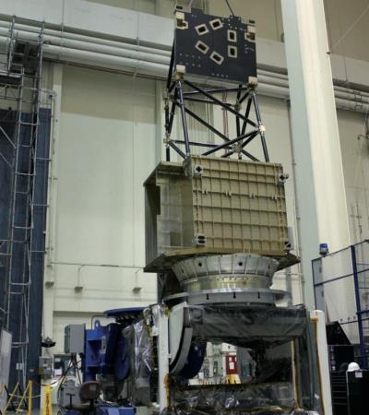
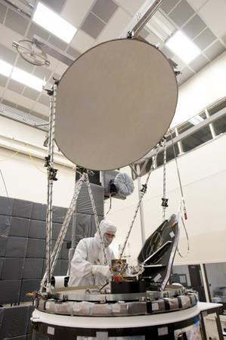
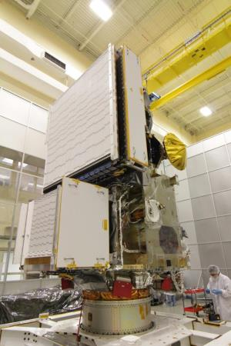
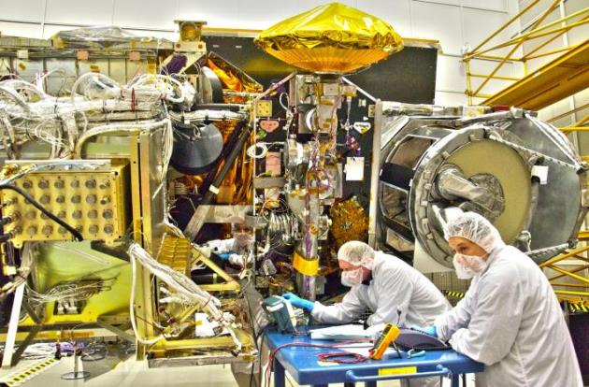
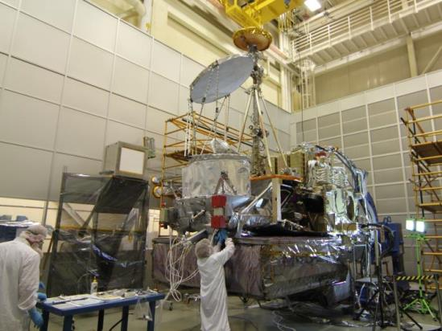
Construction of GPM
Notes:
Talking points:
GPM is the largest satellite built to data at NASA’s Goddard Space Flight Center
Some components were built in Japan (the Dual Precipitation Radar), other parts in the U.S. (the GPM Microwave Imager, by Ball Aerospace in Colorado), then everything was assembled at Goddard in Greenbelt, Maryland.

Slide 6
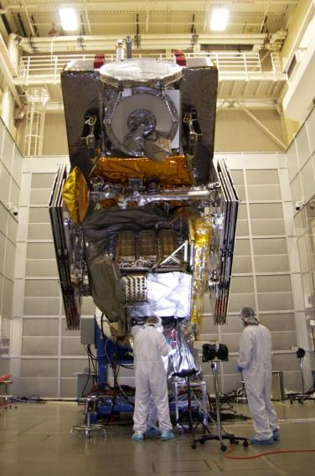
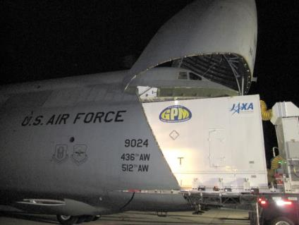
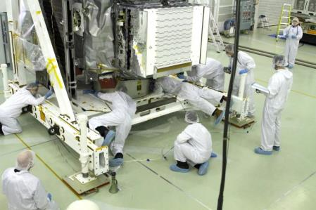
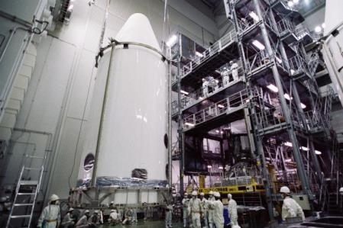
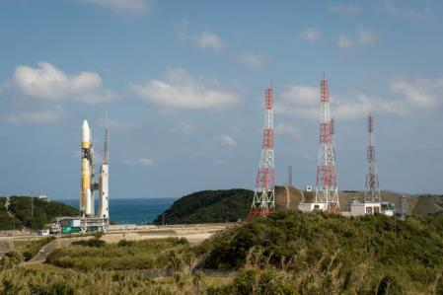
Transport for Launch
Notes:
Talking points:
GPM was shipped to Japan for launch (see the crate in the top middle picture barely fitting inside the U.S. Air Force cargo plane)
It was loaded into a fairing to go on top of a Japanese H2A rocket (bottom middle and bottom right)
For more: http://pmm.nasa.gov/node/925

Slide 7
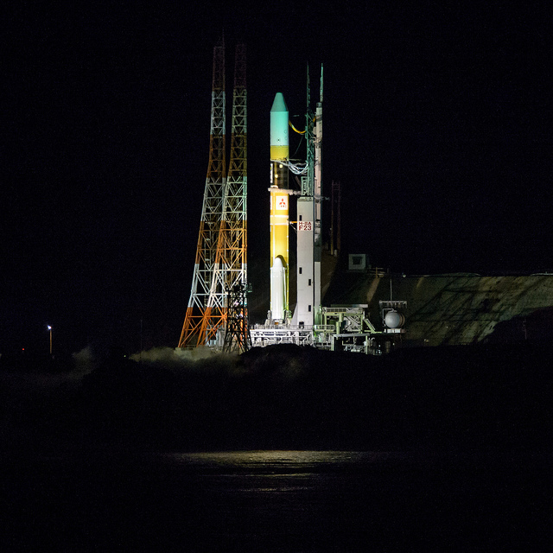
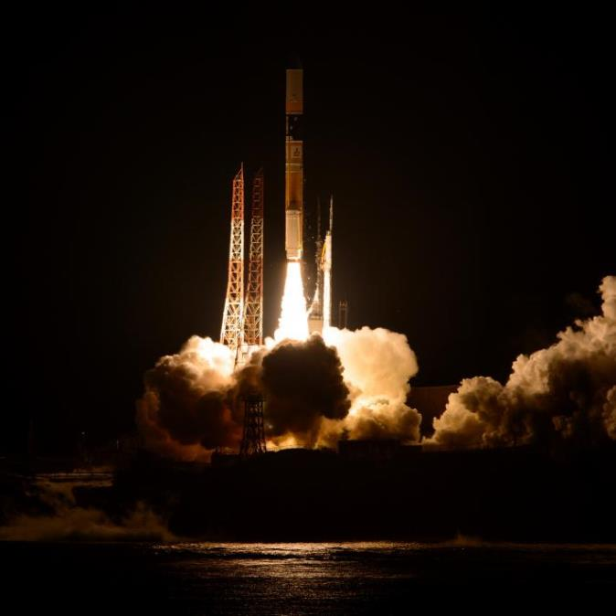
Launch
Launched at 1:37 p.m. EST, Feb 27, 2014
Notes:
For more: http://pmm.nasa.gov/index.php?q=launch

Slide 8
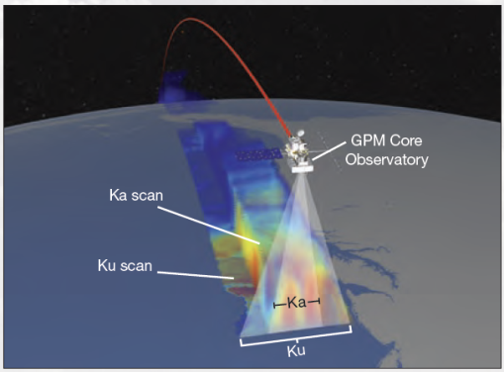
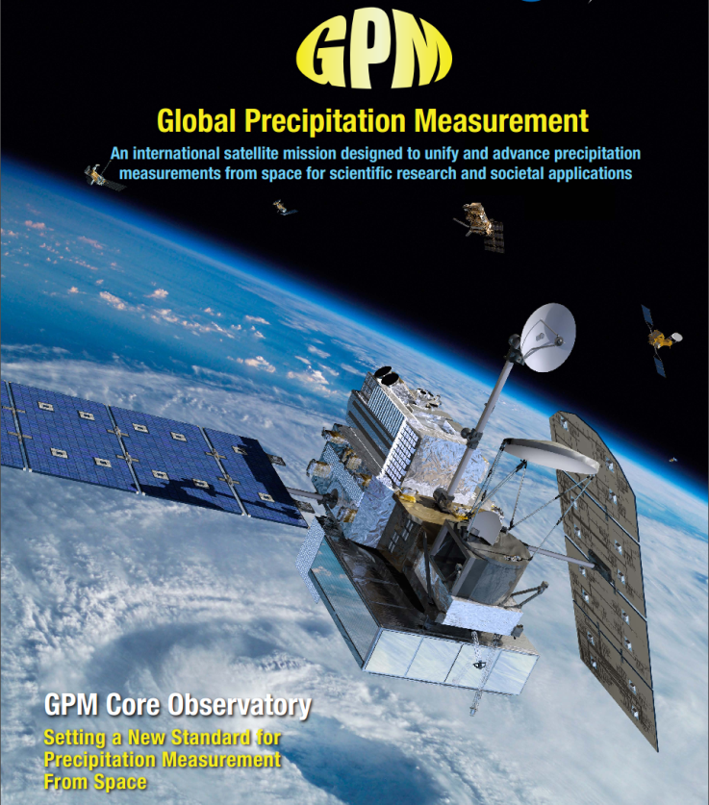
GPM Core Observatory
The GPM Core Observatory has two instruments that can view precipitation (rain, snow, ice) in new ways and connect measurements to those taken on other partner satellites
GPM Microwave Imager (GMI): 10-183 GHz
13 channels that provides an integrated picture of energy emitted by precipitation, including light to heavy rain to falling snow (Ball Aerospace)
Dual-frequency Precipitation Radar (DPR): Ku-Ka bands
Two different radar frequencies that can look at precipitation in 3-D throughout the atmospheric column (JAXA)

Slide 9
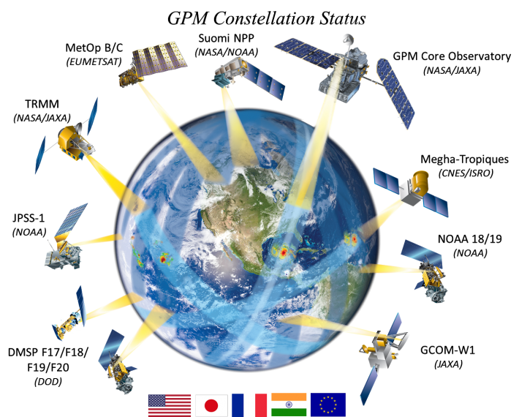




















GPM’s International Scope
Partner satellites from:
NOAA
DOD
EUMETSAT
ISRO/CNES (India/France)
JAXA
Active Joint Projects (19 PI’s from 13 countries)
Notes:
GPM is an international mission which will use inputs from a constellation of satellites to improve precipitation estimation globally
GPM will provide precipitation information every 3 hours
Non-Sun-Synchronous orbit from Arctic to the Antarctic Circle at 407 km (~250 miles)

Slide 10

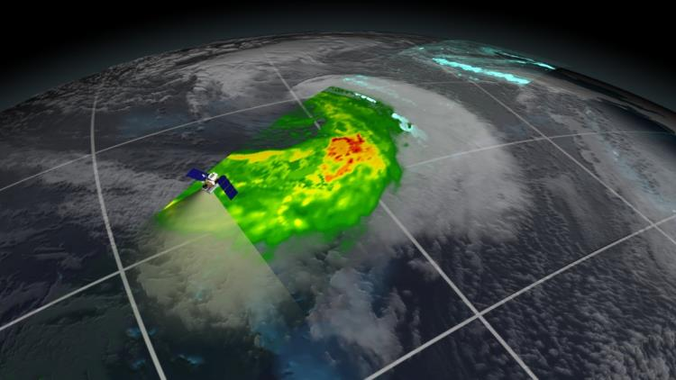
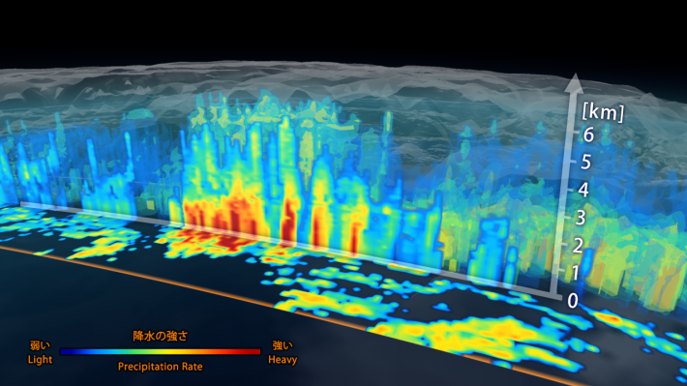
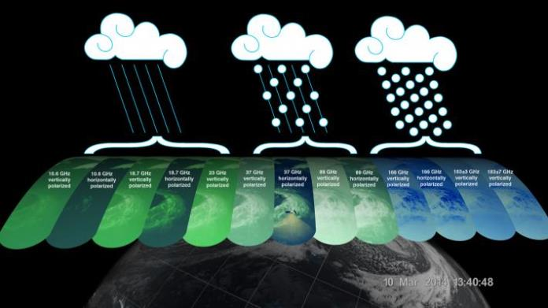
First Light Images, March 25th 2014
Precipitation falling inside a March 10 cyclone over the northwest Pacific Ocean, approximately 1,000 miles east of Japan.
Below: 3D view of precipitation rate inside the extra-tropical cyclone as viewed by the DPR.
Bottom Right: The GMI instrument has 13 channels, each sensitive to different types of precipitation.
Above: Image from GMI showing rain rates across a 885 kilometer swath of an extra-tropical cyclone observed on March 10, 2014.

Slide 11
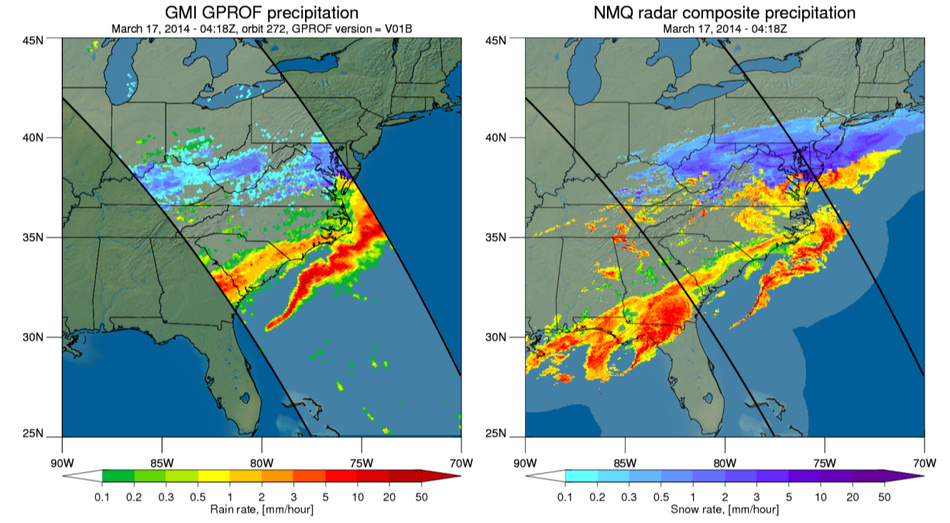

Falling Snow as Observed by GMI
The images show that NASA's GPM Microwave Imager (GMI) is able to detect and estimate both liquid rain and falling snow over land. This event occurred March 17, 2014 at 04:18 UTC and it caused more than 7” of snow in Washington, DC.
GMI retrievals of liquid rain (greens to reds indicate light to heavy rain) and falling snow (blue shading).
Ground “truth” from NOAA’s National Mosaic & Multi-Sensor QPE (CONUS 3D radar mosaic at 1km resolution).
Notes:
These images represent one of the first good cases of falling snow as observed by GMI.
The GMI retrieval (GPROF) is still undergoing validation and the NMQ ground data is not a perfect representation of the ground truth, however the rain and snow structures are similar as are the rates. Retrievals of mixed precipitation (melting snow or rain and snow together) still need additional efforts.

Slide 12
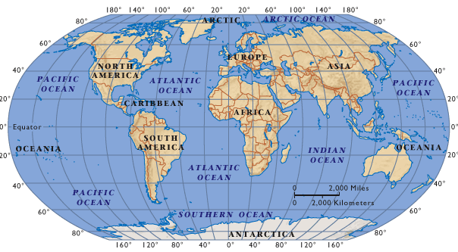

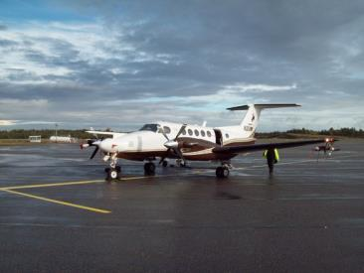
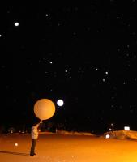
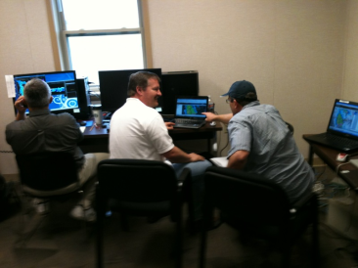
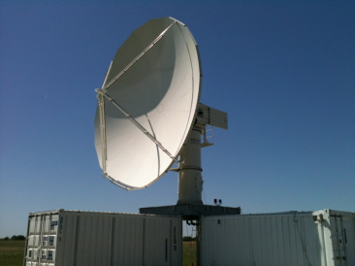
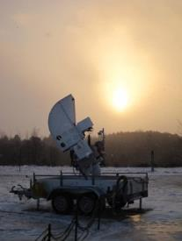
Ground Validation and Field Campaigns
Connecting the dots between what the satellite “sees” from space and what we observe on the ground
Light Rain-Finland (2010)
Flooding and Hydrology-Iowa (2013)
Snowfall-Canada (2012)
Convective Storms -Oklahoma (2011)
12
Permanent ground validation effort at Wallops Flight Facility, Maryland
Mountain rain and hydrology- Appalachians (2014)
Warm Rain - Brazil (2010)
NASA-EC GCPEX (2012)
Notes:
Different field campaigns look at different types of data that need to be accounted for in the algorithm.
A campaign for the Olympic Mountains in Washington State is planned for later in 2015.
For more: http://pmm.nasa.gov/science/ground-validation

Slide 13
Societal Benefit Areas
Extreme Events and Disasters
• Landslides • Floods
• Tropical cyclones • Re-insurance
Water Resources and Agriculture
Famine Early Warning System • Drought
Weather, Climate & Land Surface Modeling
Numerical Weather Prediction • Land System Modeling • Global Climate Modeling
Public Health and Ecology
Disease tracking • Animal migration
Water Resource management • Agriculture
Food Security
Notes:
Talking points:
GPM provides an example of how we work with interagency and other partners to facilitate use of data in decision-making and forecasting– in this case it provides information of use to water resource managers or emergency responders who require information about precipitation.
These are just a selection of the many societal applications where TRMM data has already been used and GPM data will expand and improve these applications

Slide 14
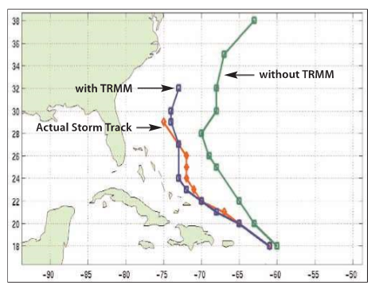
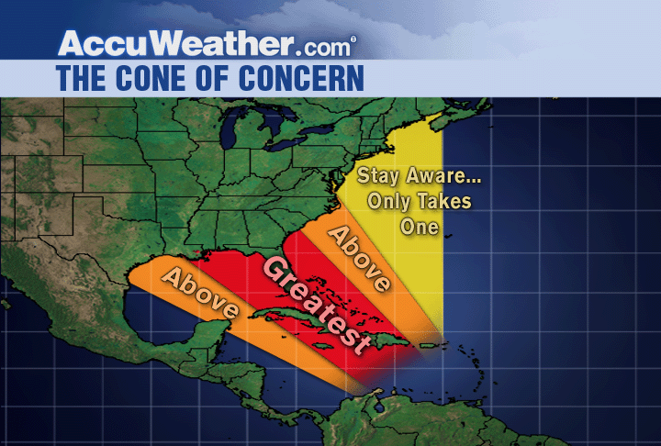
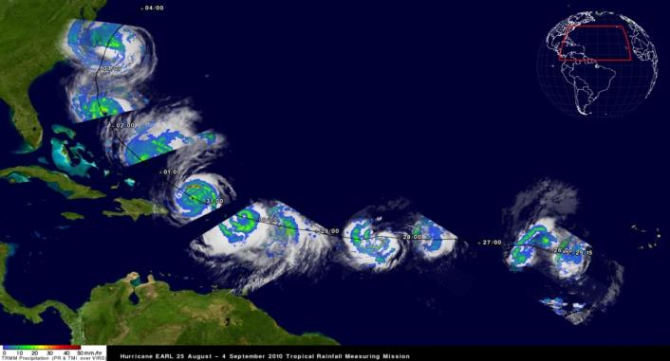
Severe Storms
TRMM/GPM data are used by many tropical cyclone forecasting centers worldwide to detect the location and intensity of tropical cyclones.
Hurricane Bonnie, August 1998: 5-Day Forecasts vs. Actual Storm Track.
GPM’s orbit will enable observation of tropical cyclones as they progress from tropical to mid-latitude systems
Notes:
In 2004, more than 600 tropical cyclone fixes were made using TRMM.

Slide 15
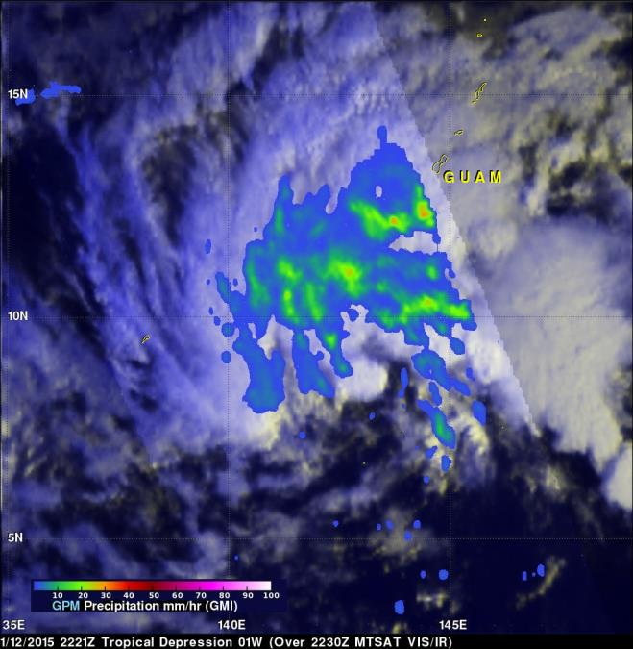
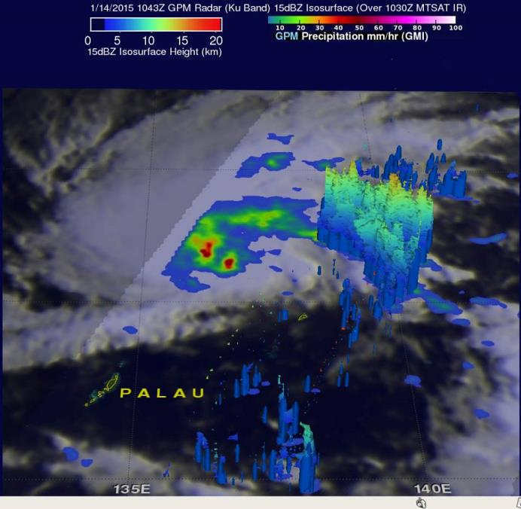
One Recent Storm
January 12 – Tropical Depression 01W
January 14 – Becomes more organized, named Mekkhala
Notes:
http://pmm.nasa.gov/mission-updates/trmm-news/two-satellites-measured-rainfall-tropical-depression-mekkhala
http://pmm.nasa.gov/mission-updates/trmm-news/tropical-depression-mekkhala-organizes

Slide 16
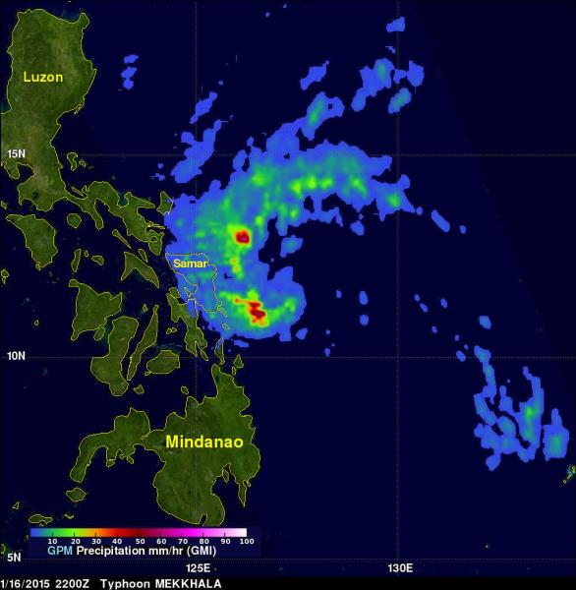
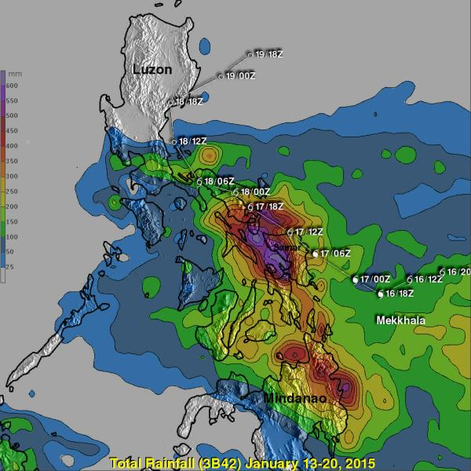
Typhoon Mekkhala
On January 16, 2015 tropical storm Mekkhala became the first western Pacific typhoon of the year just before hitting the eastern Philippines. This image shows rainfall derived from data captured by the GPM (core satellite) on January 16, 2015 at 2200 UTC. This was only about four hours after Mekkhala was upgraded to a typhoon. GPM's Microwave Imager (GMI) found rain falling at a rate of over 70.7 mm (about 2.8 inches) per hour in storms southwest of the typhoon's eye.
Notes:
http://pmm.nasa.gov/mission-updates/trmm-news/mekkhala-becomes-typhoon-drenches-philippines

Slide 17
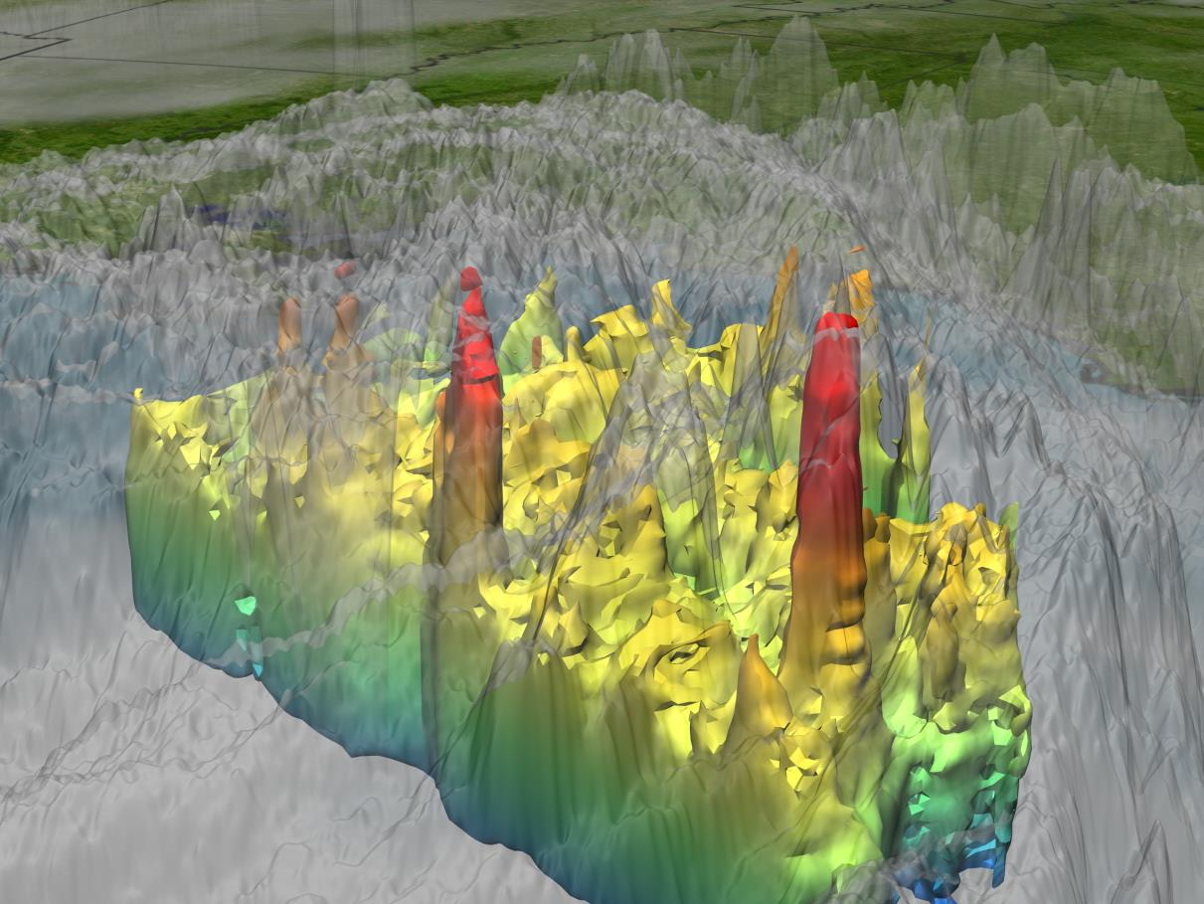
Severe Storms
http://svs.gsfc.nasa.gov/goto?3253
Notes:
Talking points:
Example from Hurricane Katrina showing hot towers, structures that suggest a storm may intensify
TRMM was the first satellite to see these, In 2004, more than 600 tropical cyclone fixes were made using TRMM.
TRMM data are used by many tropical cyclone forecasting centers worldwide to detect the location and intensity of tropical cyclones.
GPM will be able to observe these structures as storms transition from tropical to extra-tropical systems, such as Sandy, and provide hurricane forecasters with the important tools to forecast storm tracks and make the necessary evacuations.
http://svs.gsfc.nasa.gov/goto?3253

Slide 18
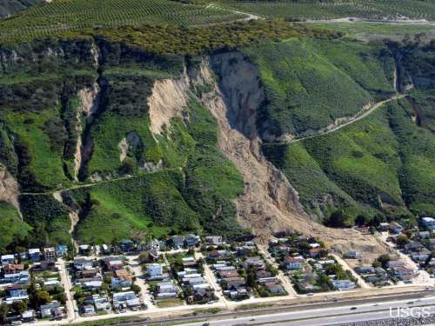
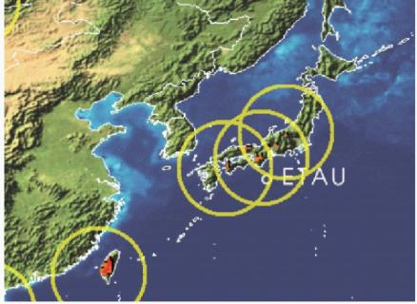
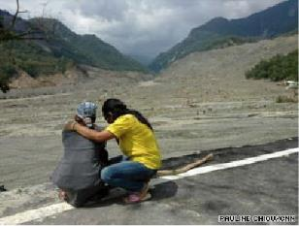
Landslides
GPM will provide rain accumulation and distribution data at high resolution to advance predictions of high-impact natural hazard events
Landslide Hazard Forecasting (Using TRMM)
Typhoon Morakot (Etau) August 8th, 2009
Over 500 people killed in Shiao Lin, triggered numerous and massive landslides throughout Southern and Central Taiwan
http://trmm.gsfc.nasa.gov/publications_dir/potential_landslide.html
GPM will enhance modeling capabilities to estimate potentially susceptible areas to rainfall-triggered landslides.

Slide 19
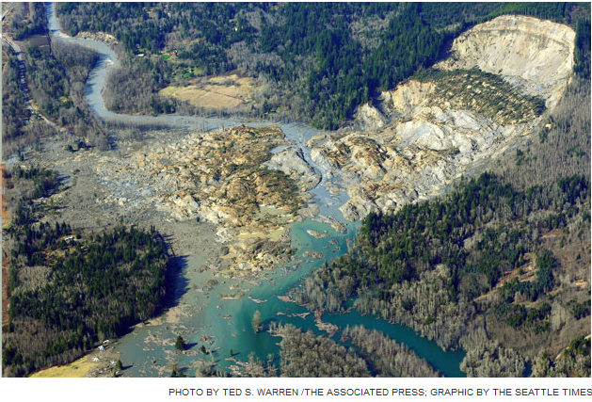
Landslides
GPM provides rainfall data at high resolution to advance predictions of high-impact natural hazard events
Landslide Hazard Forecasting
Oso, Washington landslide March 22, 2014. 41 fatalities, 50 houses destroyed
TRMM V7 RT data: Cumulative Distribution for rainy season at Oso, Washington
Notes:
The lower right image shows rain accumulation through the season for the years 2000 to 2014. The red line is 2014. Notice that it starts out as among the driest seasons, and remains that way until the middle of February, when there is a noticeable increase in precipitation and the season ends as the third-wettest of that fifteen year period. It was not just one severe rain event, but a series of them, that saturated the soil on the slope and made it more susceptible to landslides.

Slide 20
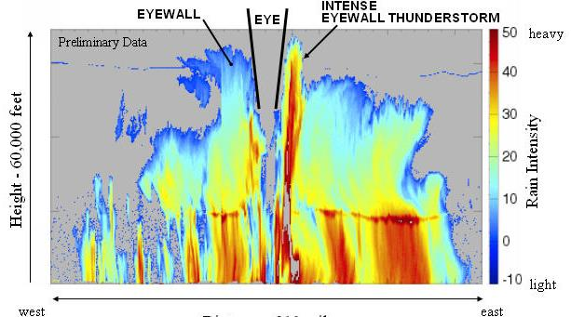
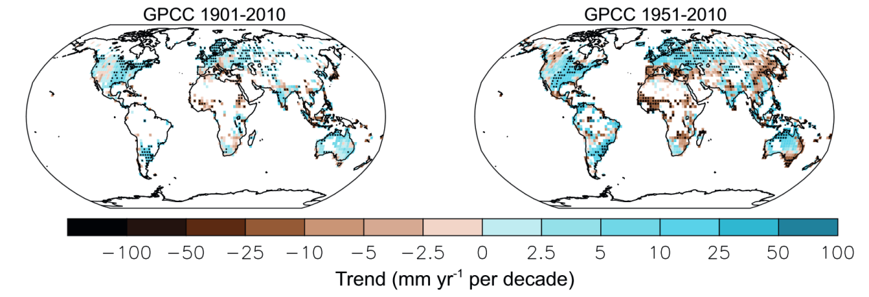
Improved modeling capabilities
Improving Weather Forecasts
through assimilation of accurate global precipitation data
Understanding precipitation’s role in a changing climate
IPCC AR5 5th Assessment Report
Chapter 2, Figure 2.29
Global climate models predict significant changes in precipitation amount and intensity over the 21st century. We need global measurements to improve and validate these models.
Notes:
Trends calculated for greater than 70% complete records, white areas have incomplete or missing data, black dot indicates boxes where trends are significant (> 90% confidence), http://www.climatechange2013.org/images/report/WG1AR5_Chapter02_FINAL.pdf

Slide 21
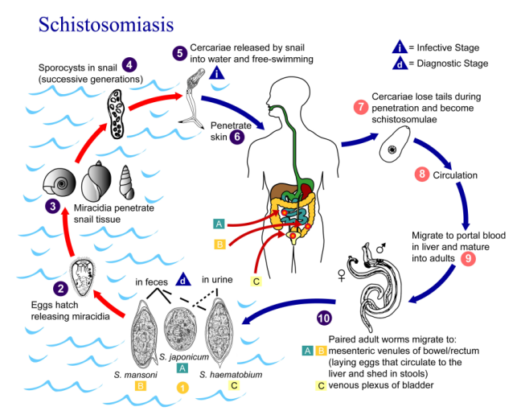
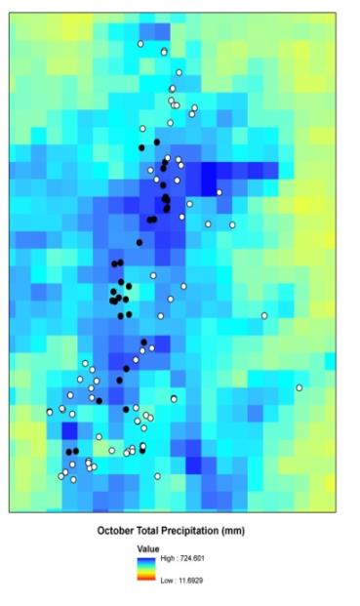
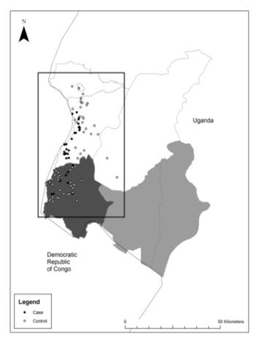

Disease Tracking
TRMM data has been used to estimate and trace the source areas of vector and river-borne diseases around the world. GPM will enable higher resolution evaluation of these disease source areas.
Observed Plague Cases in Uganda
Schistosomiasis (snail-spread) in Ethiopia
Courtesy of Bitew and Gebremichael
Studies have found a relationship between TRMM rain and the onset of this disease in local populations due to contact with snails in irrigation channels
Cases are associated with wetter, cooler regions
Monaghan et al. 2012; MacMillan et al., 2012

Slide 22
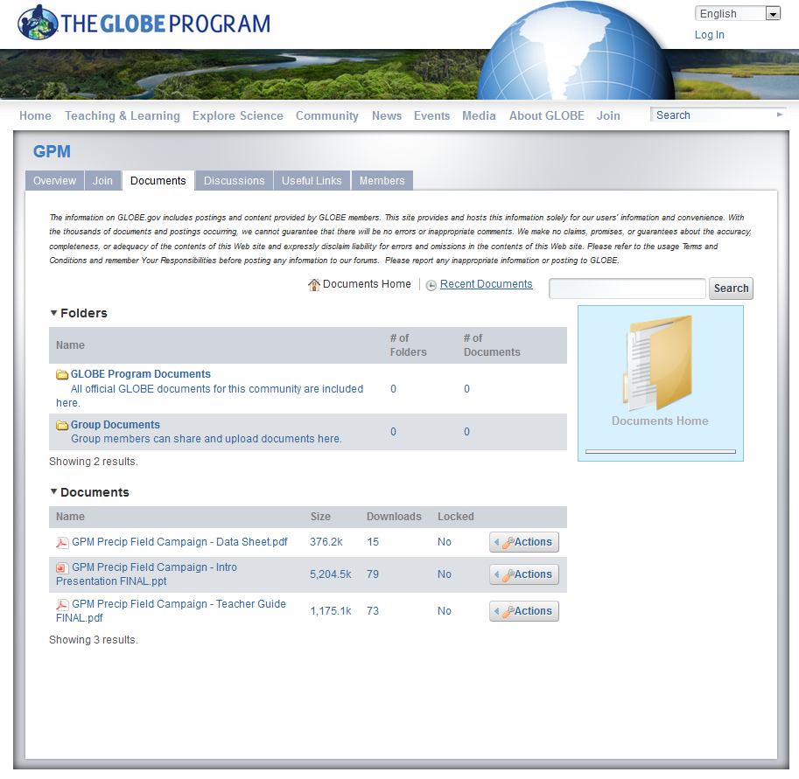
Presentation for Students
Notes:
http://www.globe.gov/web/gpm/documents

Slide 23
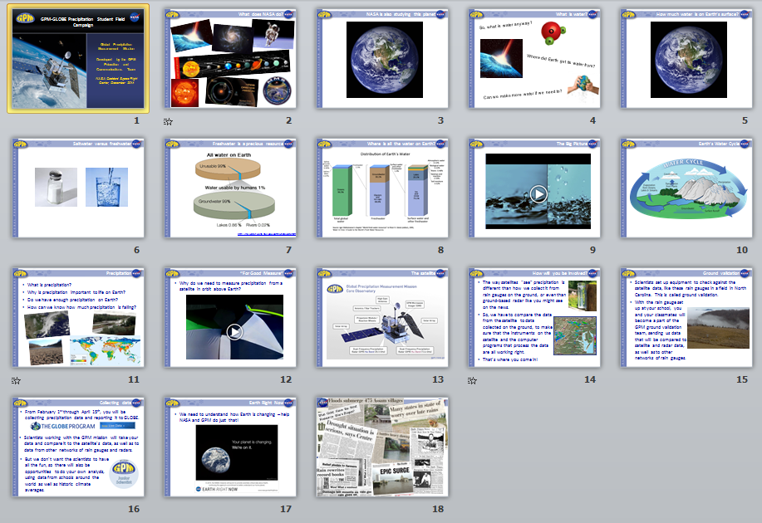
Presentation for Students
Includes notes about points to discuss for each slide.
Notes:
http://www.globe.gov/documents/10102689/318bcab7-b619-4d29-b4bc-1802430cfbae

Slide 24
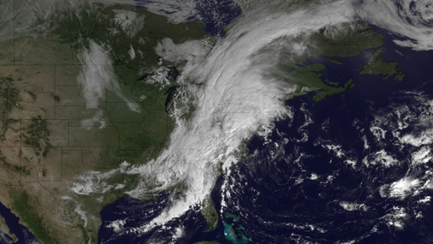



Precipitation
What is precipitation?
Why is precipitation important to life on Earth?
Do we have enough precipitation on Earth?
How can we know how much precipitation is falling?
Notes:
Lead students in a discussion about each of these questions. Help them to understand that the water we drink comes from various sources- depending on where you live- but by and large it originates from precipitation which falls into rivers, lakes, and streams, and enters local reservoirs. Talk about how scientists, called meteorologists, measure how much precipitation falls in certain locations. You could show part of the daily weather clip if time permits, or show them the local paper’s weather report and tell them what it says about how much precipitation fell the day before. Talk about whether the precipitation would be in the form of rain or snow, depending on where you are located. You might talk about some of the extreme events related to precipitation- some places have too much sometimes (floods) and others have too little (drought).

Slide 25

“For Good Measure”
Why do we need to measure precipitation from a satellite in orbit above Earth?
Notes:
Short video (1:54) that ties everything up and explains why we need to study precipitation from space. The video can be downloaded from: http://pmm.nasa.gov/education/videos/for-good-measure.

Slide 26

The satellite
Notes:
Show them this image of the GPM satellite, and explain a few things to them about the Core Observatory. It is about as big as a fire engine, and has no people on it. People control it from Earth, using the high gain antenna to give signals and retrieve data. The satellite was launched in a rocket on Feb. 27th, 2014 from Japan, as Japan and the US are working together on this mission. GPM flies all day and all night, and is about 250 above Earth’s surface. They might be able to see it flying overhead at night if they stare at the sky for awhile. You can tell if it is an airplane and not a satellite if it has lights on it, as satellites look more like stars that are moving across the sky in a steady motion, but have no lights that blink. The solar arrays use the sun’s energy to give the satellite power, and the star tracker helps it to know where it is going because there aren’t any street signs in space! GPM uses two main instruments to measure precipitation that is falling down to Earth- the GMI and the two DPR instruments.

Slide 27


How will you be involved?
The way satellites “see” precipitation is different than how we collect it from rain gauges on the ground, or even than ground-based radar like you might see on the news.
So, we have to compare the data from the satellite to data collected on the ground, to make sure that the instruments on the satellite and the computer programs that process the data are all working right.
That’s where you come in!
Notes:
More detail about the mission and how the instruments work can be found in the GPM Mission brochure, http://pmm.nasa.gov/sites/default/files/document_files/GPM%20Mission%20Brochure.pdf

Slide 28

Ground validation
Scientists set up equipment to check against the satellite data, like these rain gauges in a field in North Carolina. This is called ground validation.
With the rain gauge set up at your school, you and your classmates will become a part of the GPM ground validation team, sending us data that will be compared to satellite and radar data, as well as to other networks of rain gauges.
Notes:
For an article about how rain gauges work, written to be accessible for students, see the article at http://gpm.nasa.gov/education/articles/reading-rain-gauge.

Slide 29



Collecting data
From February 1st through April 15th, you will be collecting precipitation data and reporting it to GLOBE.
Scientists working with the GPM mission will take your data and compare it to the satellite’s data, as well as to data from other networks of rain gauges and radars.
But we don’t want the scientists to have all the fun, so there will also be opportunities to do your own analysis, using data from schools around the world as well as historic climate averages.
Notes:
For more information, see the GPM-GLOBE collaboration site, http://www.globe.gov/web/gpm.

Slide 30

Earth Right Now
We need to understand how Earth is changing – help NASA and GPM do just that!
Notes:
http://www.nasa.gov/content/earth-right-now/

Slide 31









Water Headlines
Blue Gold: Have the Next Resource Wars Begun?
Notes:
Use these newspaper headlines as a way to reinforce why it is important to measure precipitation, both when we have too much of it and when we have too little of it.

Slide 32


Educator Resources
http://pmm.nasa.gov/education

Slide 33

Teacher Guide
Notes:
A list of specific GPM and GLOBE resources relevant to the campaign can be found in the Teacher Participation Guide.

Slide 34



Rain Gauge Design Challenge
http://pmm.nasa.gov/education/interactive/rain-gauge-design-challenge

Slide 35






Building

Slide 36





Testing

Slide 37


Getting GPM Data
http://pmm.nasa.gov/data-access

Slide 38

Google Earth
http://pmm.nasa.gov/node/18 9
Notes:
http://pmm.nasa.gov/node/189

Slide 39


My NASA Data
http://mynasadata.larc.nasa.gov/

Slide 40



Join the GPM-GLOBE Community
http://www.globe.gov/web/gpm
https://lists.nasa.gov/mailman/listinfo/gpm-globe-field-campaign

Slide 41

Events During the Campaign
Webinars:
February 2nd: Student Kick-Off
February 18th: Ground Validation and Satellite Measurement
March 18th: Getting and Analyzing Precipitation Data
April 15th: Satellite Data and Extreme Events
Notes:
http://www.globe.gov/web/gpm/overview/webinars

Slide 42

Events During the Campaign
Scientist (and a few educator) blogs:
Every Monday starting February 2nd – topics include ground validation, the accuracy of rain gauges, snow measurement, analyzing data, various applications of satellite data (landslides, hurricanes, etc.), weather versus climate
Notes:
http://www.globe.gov/web/gpm/overview/webinars

Slide 43




Data Collection
The best site is away from trees, buildings, and other structures. An open area with nothing to block the rain will give you the most precise measurements.
It also needs to be a location your students can easily access – it can be a trade-off.

Slide 44




Adding an Observation Site
Starting from www.globe.gov:

Slide 45




Reading the Rain Gauge
Read bottom of the meniscus
Estimate to the nearest 0.1 mm/0.01 in*
*convert before entering in GLOBE
0 = None, T= Trace, M=Missing

Slide 46



Data Sheets

Slide 47


Data Entry
Starting from www.globe.gov:

Slide 48

Contribute to the Discussion Board
Notes:
http://www.globe.gov/web/gpm/discussions

Slide 49

For more information on the TRMM and GPM Missions:
http://gpm.nasa.gov
http://www.nasa.gov/gpm
Twitter: NASA_Rain Facebook: NASA.Rain
GLOBE Community Page: http://www.globe.gov/web/gpm

