Slide 1

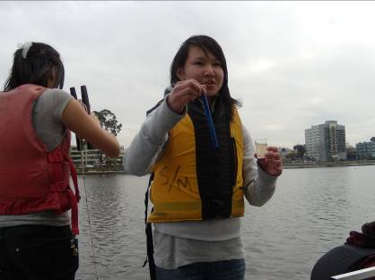
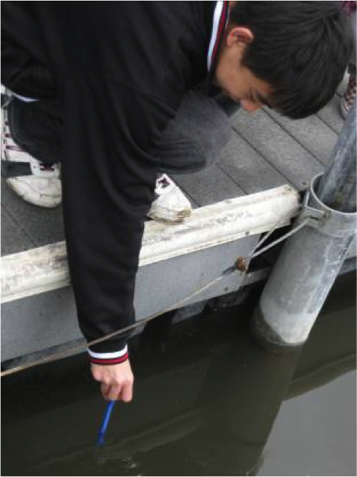
Template with Rubrics
Title of the GLOBE Research Study
Collaboration Team Names
School Name
School Logo
Abstract
Research Methods
GLOBE Data
Data Analysis
A complete analysis of the data is performed, that:
Is clearly explained, is relevant to the research question(s), presents sufficient mathematics and equations to clearly define the analysis, and briefly mentions any uncertainties or limitations present in the dataset.
An insightful and meticulous analysis of the data is performed, that Is scientifically valid, Completely addresses the question(s) posed to the extent possible for the grade level, and
Clearly discusses any uncertainties or limitations present in the dataset.
The problem,
Questions asked,
Objectives set,
Conclusions made, and
Recommendations for a way
forward.
Full advantage is taken of a combination of GLOBE protocols, and:
there is a direct link provided between the datasets and research question(s), and
the scope of research is fully detailed, including how the data were analyzed (e.g. time period, geographic area, or specific sites involved).
GLOBE data use includes all GLOBE data that were collected, and:
GLOBE data are entered into the GLOBE database.
Data from other GLOBE school(s) are included in the project.
and:
All sources of data not collected by submitting group are cited.
Tables and/or graphical representations of data are present, including: Maps, Time series plots, or Other visualizations of the data that
Display enough of the data to support the conclusion,
Provide comparisons between data.
Data are orderly, well labeled, and easy to interpret.
Data are of high quality, well presented, and enable the reader to easily grasp the key points of the paper.
Research Question
Conclusions
Include why important,
Require a thoughtful research plan, and
Area of scientific interest. Include a well-written description of background information,
Provide significant insight into both the topic of investigation and the research process, and
Answering them requires an advanced understanding of the subject matter.
The conclusion is supported by the data.
A thoughtful conclusion is present gives a thorough and insightful explanation as to how the conclusion was reached, and recommends future research.
Field Photos ((requires release forms)
Hypothesis
Additional Research Information
Data Summary
Proposes a possible explanation to a phenomenon or problem, and
Defines how it is testable and Measureable.
Limitations/
Sources of Error
Figure #1
A clear, complete and insightful discussion of the limitations of the methods used is present and a description is provided explaining the significance of these analyses.
Investigation Plan
GLOBE BADGES
Collaboration All team members are listed, along with clearly defined roles, how these roles support one another, and descriptions of each student’s contribution. The descriptions clearly indicate the advantages of the collaboration.
Community Impact The report clearly describes how a local issue led to the research questions and makes connections between local and global impacts.
Connection to Scientist The report clearly describes collaboration with a scientist that enhanced the research methods, contributed to improved precision, and supported more sophisticated analyses and interpretations of results.
Interscholastic Connection The report describes a carefully planned interscholastic or international collaboration that describes rationales for data collection in different regions and the advantages of comparing results.
Engineering Solution The report includes all of the components for level 3, and: Describes the relative priority of the criteria for solving the problem, and Describes tradeoffs considered in designing the solution.
A clear and complete investigation plan is present that includes
A description of a student-led research process, and
Lists the steps to complete project.
Clearly outlines the steps to complete project, and
Describes the collaboration process.
Bibliography
Materials used are cited completely and correctly, including any graphics, tables, or figures not created by students.

Slide 2
Modify for Research Study
Title of the GLOBE Research Study
Collaboration Team Names
School Name
School Logo
Abstract
Research Methods
GLOBE Data
Data Analysis
A complete analysis of the data is performed, that:
Is clearly explained, is relevant to the research question(s), presents sufficient mathematics and equations to clearly define the analysis, and briefly mentions any uncertainties or limitations present in the dataset.
An insightful and meticulous analysis of the data is performed, that Is scientifically valid, Completely addresses the question(s) posed to the extent possible for the grade level, and
Clearly discusses any uncertainties or limitations present in the dataset.
The problem,
Questions asked,
Objectives set,
Conclusions made, and
Recommendations for a way
forward.
Full advantage is taken of a combination of GLOBE protocols, and:
there is a direct link provided between the datasets and research question(s), and
the scope of research is fully detailed, including how the data were analyzed (e.g. time period, geographic area, or specific sites involved).
GLOBE data use includes all GLOBE data that were collected, and:
GLOBE data are entered into the GLOBE database.
Data from other GLOBE school(s) are included in the project.
and:
All sources of data not collected by submitting group are cited.
Tables and/or graphical representations of data are present, including: Maps, Time series plots, or Other visualizations of the data that
Display enough of the data to support the conclusion,
Provide comparisons between data.
Data are orderly, well labeled, and easy to interpret.
Data are of high quality, well presented, and enable the reader to easily grasp the key points of the paper.
Research Question
Conclusions
Include why important,
Require a thoughtful research plan, and
Area of scientific interest. Include a well-written description of background information,
Provide significant insight into both the topic of investigation and the research process, and
Answering them requires an advanced understanding of the subject matter.
The conclusion is supported by the data.
A thoughtful conclusion is present gives a thorough and insightful explanation as to how the conclusion was reached, and recommends future research.
Field Photos ((requires release forms)
Hypothesis
Additional Research Information
Data Summary
Proposes a possible explanation to a phenomenon or problem, and
Defines how it is testable and Measureable.
Limitations/
Sources of Error
Figure #1
A clear, complete and insightful discussion of the limitations of the methods used is present and a description is provided explaining the significance of these analyses.
Investigation Plan
GLOBE BADGES
Collaboration All team members are listed, along with clearly defined roles, how these roles support one another, and descriptions of each student’s contribution. The descriptions clearly indicate the advantages of the collaboration.
Community Impact The report clearly describes how a local issue led to the research questions and makes connections between local and global impacts.
Connection to Scientist The report clearly describes collaboration with a scientist that enhanced the research methods, contributed to improved precision, and supported more sophisticated analyses and interpretations of results.
Interscholastic Connection The report describes a carefully planned interscholastic or international collaboration that describes rationales for data collection in different regions and the advantages of comparing results.
Engineering Solution The report includes all of the components for level 3, and: Describes the relative priority of the criteria for solving the problem, and Describes tradeoffs considered in designing the solution.
A clear and complete investigation plan is present that includes
A description of a student-led research process, and
Lists the steps to complete project.
Clearly outlines the steps to complete project, and
Describes the collaboration process.
Bibliography
Materials used are cited completely and correctly, including any graphics, tables, or figures not created by students.

