Slide 1
GLOBE Visualize and Retrieve Your Data
Three steps to Visualization
Data Counts
Advanced Vis Features
Advanced Data Access Tool (ADAT)
GLOBE API

Slide 2
Introduction
You should have completed Part 1 for Teachers – Creating a Data Entry Site and Part 2 for Teachers – Entering Measurement Data
The visualization system uses Production Data only. You will not see any data entered into the training system
This presentation is available online as well as a video which walks you through the steps
There is a section for you to try things for yourself after the demonstration and a section to test your knowledge at the end.
Questions – contact help@globe.gov

Slide 3
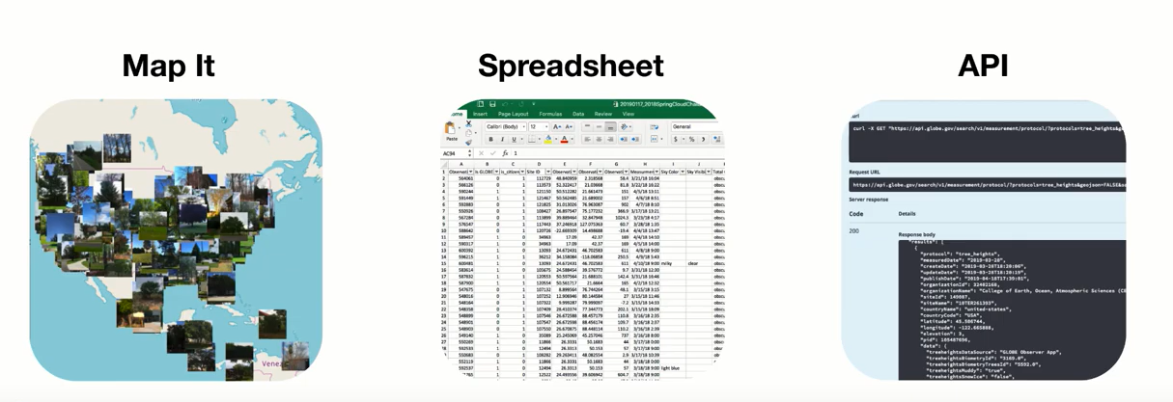
Three Ways to Access GLOBE Data on the website
Visualization System
ADAT
GLOBE API

Slide 4
Visualize and Retrieve your Data
Now that you’ve input your data, how can you find it?
Topics - Visualization
Navigate to the visualization system
The pieces of the visualization system
Layers, Dates, Filters, Legend, Graphs
How to view data from a specific protocol on the map
How to graph and retrieve data for a specific protocol
Advanced Features
How to use data counts to find schools that are active in a given protocol

Slide 5
The Basics of the Visualization System
Select Goto-> from the top and “Visualize Data”
Or Go to the homepage and select “Visualize Data”
Or http://vis.globe.gov
Three Steps to Visualize your Data:
Select the protocol data you want to see (Add Layers)
Select the Date you want to see the data for
Click on a data point on the map to receive table and graph information

Slide 6
Step 1 – Add Data Layers
Select Which Data to Plot
Start by selecting the Protocol Layers icon, then the sphere your data is in

Slide 7
Step 1 – Add Data Layers
Select Which Data to Plot
Select your protocol and “SUBMIT”

Slide 8
Step 2 – Select the Date
Select the Date
Days which have data will have a small data icon on them

Slide 9
Step 3 – Select the Data Point
Select the Data Point
Click on the data point to see the data at that location

Slide 10
Vis system popup window
See All Atmosphere Data
Go to this School’s Page
See Plot Data in a Table
Add this Data to a Multi-site Plot
Change the X-axis Timeline

Slide 11
Advanced Features
Use Filters - Location/Site/Elevation to find specific locations – school, country, city etc.
Create an animation
Use the graph with the + icon to select multiple data sets to graph
Allows you to overlay data from multiple sites
Export layers to KMZ format for using with Google Earth and other similar tools

Slide 12
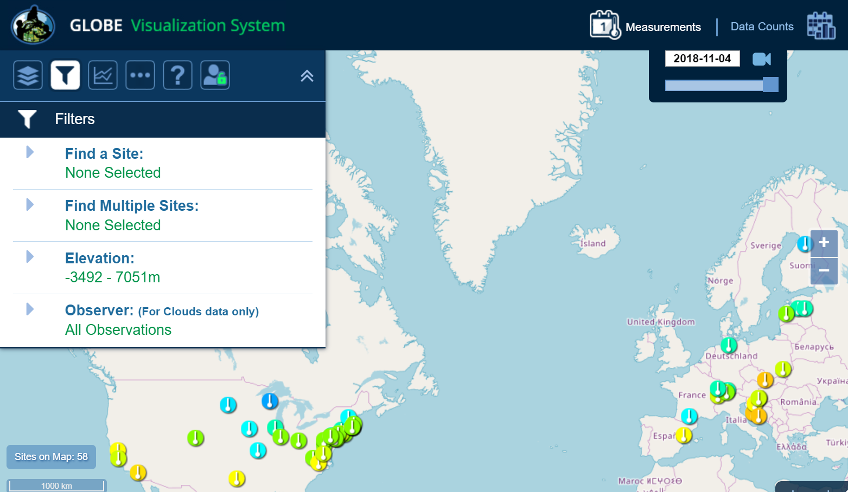
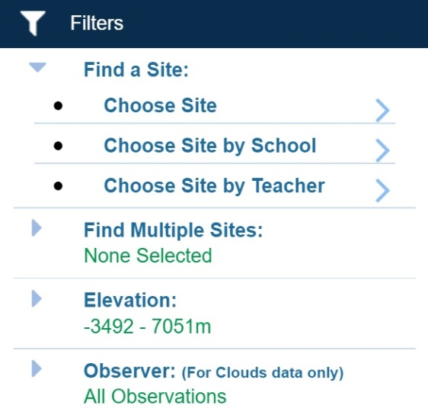
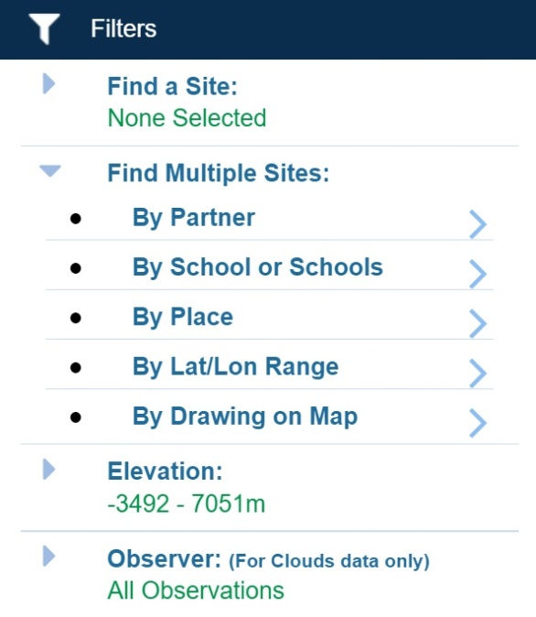
Filter your results
Select Filter Icon
Filter by teacher, school, country, lat/long or other options

Slide 13
Export Layer
Select Vertical Circles
Any Data Layer can be exported as a table, or downloaded as a KMZ file.

Slide 14
Setup Multi-Site Plot
Overlay multiple plots
Click on the “+” icon in the popup window to select multiple datasets to plot.

Slide 15
Setup Multi-Site Plot
Multiplot up to 6 data sets
Manual or Auto scale
Choose the time duration you want

Slide 16
My Vis Select “My Vis” to show all of my sites, filter the display by my measurements, or share/save/load a set of filters and protocols

Slide 17
Animating Vis
1) Click on the camera to create an animation
3) Press Play or use the record icon to save your animation
2) Use the sliders to adjust the date range

Slide 18
Why use Data Counts?
The Data Counts tab tells you how much data a given location has entered in a particular period of time for a given protocol.
Looking for someone to collaborate with? Looking for the most current data? Use Data Counts.

Slide 19
How to Use Data Counts
Select Data Counts on the top menu of the vis system
Select the protocol(s) you are interested in (ie Solar Noon Temperature Dailies)
The map will show the total number of measurements which have occurred at any location since the beginning of the GLOBE program.
Use the Date Range Filter to adjust the date range
Select a site which has data
You can find the school and teacher if you are interested in collaborating.

Slide 20
Data Counts
Data counts show how much data was entered at any site for the selected period of time
Bigger dots = More Data
Select Data Counts and a Time Range
Data Counts
Use Data Counts to see which sites have the most data in the selected time frame

Slide 21
Your Turn
What school reported the coldest solar noon temperature in Poland on
2/16/2014? What was the temperature?
What was the temperature for the one school which reported data in Argentina on that date?
Make a chart showing the Solar Noon Temperature Dailies for 1 year with data from the school in Poland and the school in Argentina.
What do you see happening?
Why does it happen
Try checking and un-checking the “Auto Y-Axis” button to see what happens
Find someone in another country that is doing the clouds protocol this year (or a protocol of your choice) and request to be a friend

Slide 22
Your Turn - Answers
What school reported the coldest temperature in Poland on 2/16/2014? What was the temperature?
If you did solar noon dailies - Gymnasium No 1, daily average -1C, minimum daily, -5C
If you did minimum - Gimnazium por. J.Czumy in Celestynów -6C
What was the average temperature for the one school which reported data in Argentina on that date?
--- 21.7 C
Make a chart showing the Solar Noon Temperature Dailies for 1 year with data from the school in Poland and the school in Argentina.
What do you see happening?
Why does it happen
Try checking and un-checking the “Auto Y-Axis” button to see what happens
--- The temperature cycles are shifted relative to each other…because they are in the north/south latitudes
Find someone in another country that is doing the clouds protocol this year (or a protocol of your choice) and request to be a friend

Slide 23
Retrieving Data Using the Advanced Data Access Tool (ADAT)
Tool allows you to download GLOBE data from multiple protocols, schools, regions or dates without using the map
Used for downloading large quantities of data – multiple protocols and multiple sites
Select GLOBE Data -> Retrieve GLOBE Data or http://datasearch.globe.gov/
Three Steps –
Select the Protocols you’re interested in
Select Filters
Date Range, Country, School or Teacher etc.
Select “Download Measurement Data” (may take a little while!)

Slide 24
Select your protocols
Select Protocols
Up to 5 protocols can be selected

Slide 25
Select the date range
Select Date Range
Use sliders or enter a date range

Slide 26
Add other filters if needed then “Apply Filter”
Apply Filters
Select any additional filtering, then click “Apply Filter” to see how much data is available for download

Slide 27
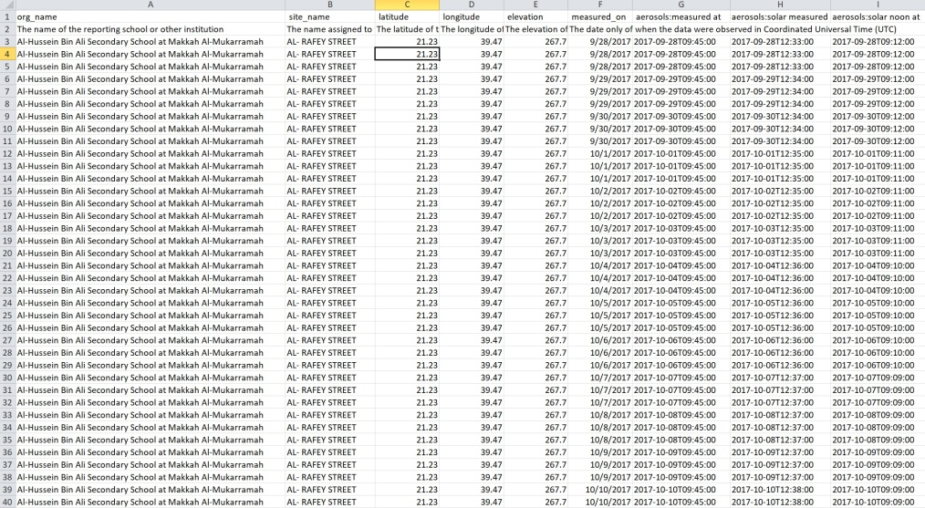
Download the Measurement Data
Download Data
Select Obtain Measurement data and download the data

Slide 28
ADAT – Your Turn
How many sites measured Soil Moisture (SMAP) during the Northern Hemisphere Fall and Winter periods (9/1/2015 – 2/29/2016) – 87 Sites
How many data points were taken
Which school and site had the highest gravimetric soil moisture (g/g), when was it measured, and what was the value?
Export all Precipitation and SMAP data from the Ramey School for the period 9/1/2015 thought 5/17/2016
Plot the data – Is there a correlation between precipitation and Soil Moisture?

Slide 29
Answers - ADAT
How many sites measured Soil Moisture (SMAP) during the Northern Hemisphere Fall and Winter periods (9/1/2015 – 2/29/2016) – 87 Sites
How many data points were taken (1168)
Which school and site had the highest gravimetric soil moisture (g/g), when was it measured, and what was the value?
Srednja skola Vela Luka, 1/15/2016, 0.85 g/g
Export all Precipitation and SMAP data from the Ramey School for the period 9/1/2015 thought 5/17/2016
Plot the data – Is there a correlation between precipitation and Soil Moisture? [see next page – what do you think?]

Slide 31
Retrieving Data – the GLOBE API
API - allows users to pull data from GLOBE programmatically
Programmatically = something I can call via a program/script/URL
Simple but useful interface
Fast
Provides support for getting data that is similar to ADAT
Info: https://www.globe.gov/globe-data/globe-api
Tool: https://api.globe.gov/search/swagger-ui.html

Slide 32
Main Interface
Divided into different paths depending on what type of query you want to make

Slide 33
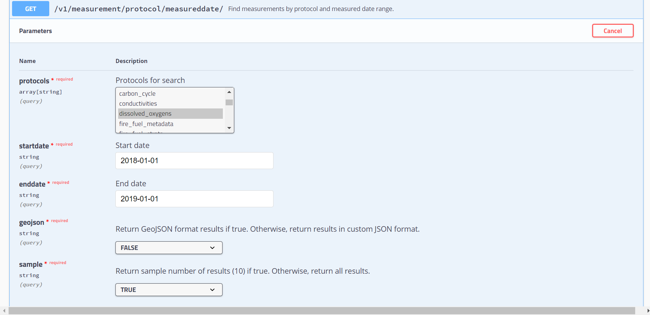
Use the interface to build your query
https://api.globe.gov/search/v1/measurement/protocol/measureddate/?protocols=dissolved_oxygens&startdate=2018-01-01&enddate=2019-01-01&geojson=FALSE&sample=TRUE

Slide 34
API – Tips on inputs
Use Sample=“TRUE” to return 10 records to make sure your query is correct BEFORE trying it “for real” (Sample=“FALSE”)
Use GeoJSON=TRUE to return data in GeoJSON format. Use GeoJSON=FALSE to return data in custom JSON format (this response includes the total records which will be returned)
Currently limited to 1,000,000 records

Slide 35
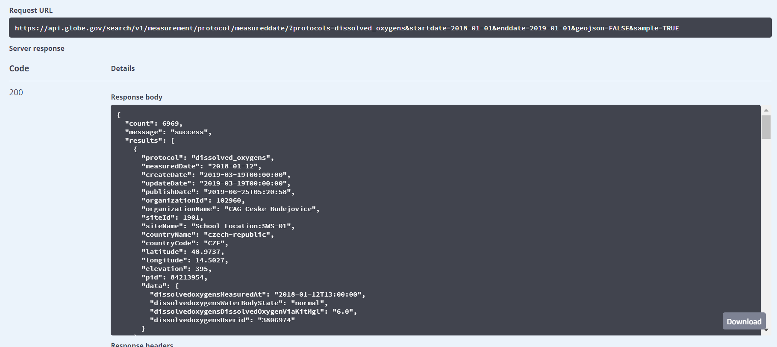
API – Download your data
We recommend putting the URL directly into the browser for larger datasets, otherwise use the “Download button” in the response window

Slide 36
Your Turn
Which query would you use to find all dissolved oxygen measurements between 1/01/2010 and 1/01/2011
Which format option would you use to determine how many measurements there are in that time frame?
Download the dissolved oxygen data using the GeoJSON format, save the file and plot it at geojson.io

Slide 37
Answers
Which query would you use to find all dissolved oxygen measurements between 1/01/2010 and 1/01/2011
Use /measurement/protocol/measureddate
Which format option would you use to determine how many measurements there are in that time frame?
Use GeoJSON=“FALSE” and Return sample results=“TRUE” to get a count of how many measurements there are in that timeframe:
https://api.globe.gov/search/v1/measurement/protocol/measureddate/?protocols=dissolved_oxygens&startdate=2010-01-01&enddate=2011-01-01&geojson=FALSE&sample=TRUE
[Answer: count: 3096]
Download the dissolved oxygen data using the GeoJSON format, save the file and plot it at geojson.io (Note geojson=“True” and sample=“false”
https://api.globe.gov/search/v1/measurement/protocol/measureddate/?protocols=dissolved_oxygens&startdate=2010-01-01&enddate=2011-01-01&geojson=TRUE&sample=FALSE

Slide 38
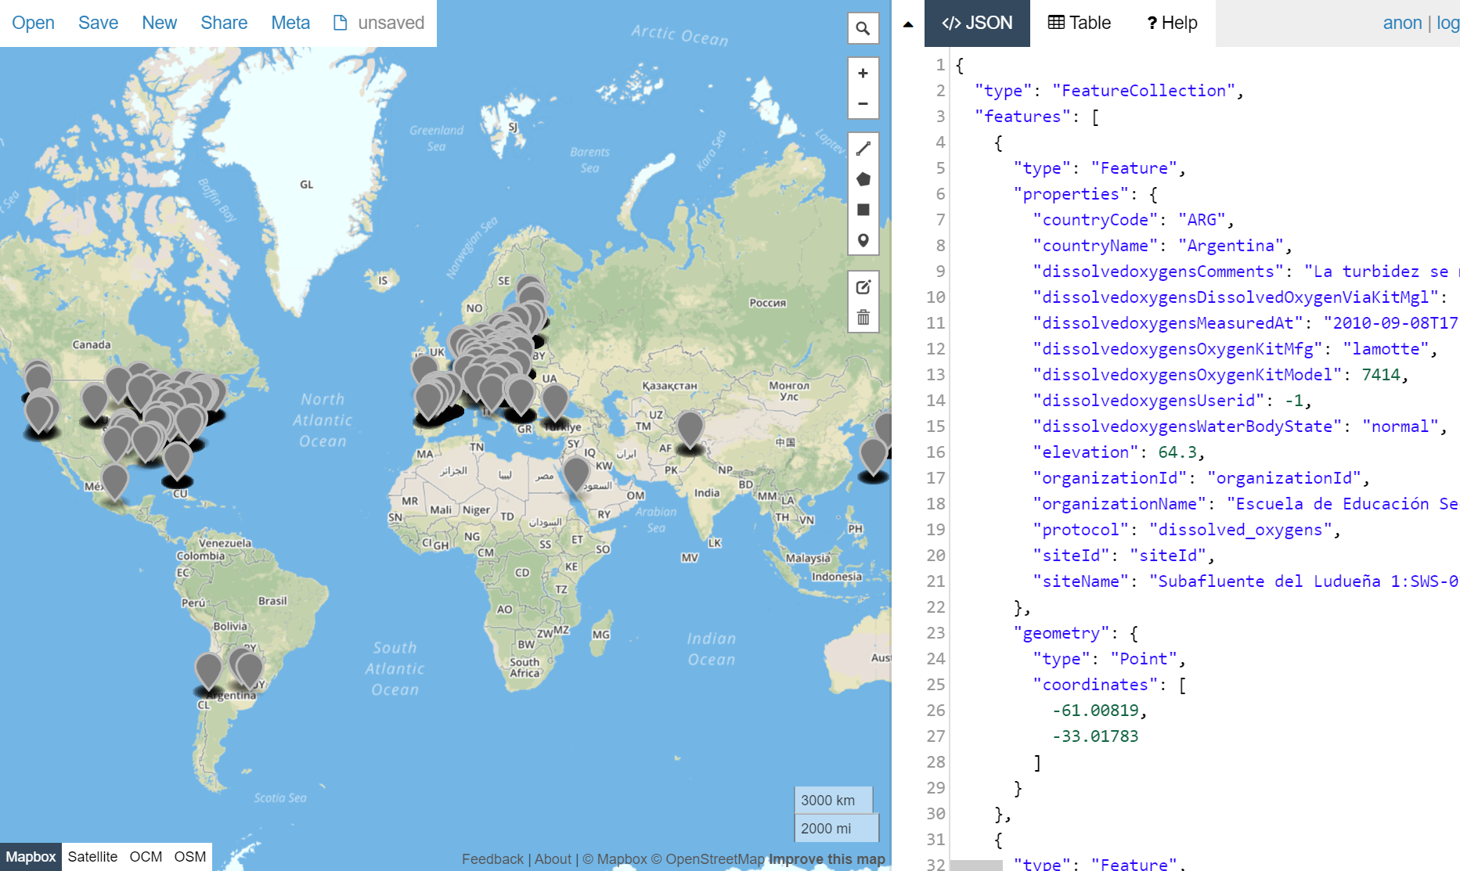
Geojson.io plot

Slide 39
Next Steps
Congratulations – you should:
Know how to find your school data
Know how to find data from other schools around the world
Know how to find schools and teachers who are entering data so you can collaborate with them
You can now
Start creating sites and entering data into the GLOBE system
Next Training – 4. Teachers - How to use Setup your GLOBE account
Questions – contact the GLOBE Helpdesk – help@globe.gov

Slide 40
ADAT Case Study

Slide 41
ADAT Case Study - What would be a good filter to setup to see if GLOBE data “saw” El Nino?
Background
El Nino is a phenomenon that happens approximately every 7 years that results in increased rain along the western side of the US, Latin and South America. The last El Nino occurred in 2015/2016.
Which protocol to measure?
Precipitation
Date Range?
Compare 2013/2014 to 2015/2016 (El Nino Year)

Slide 42
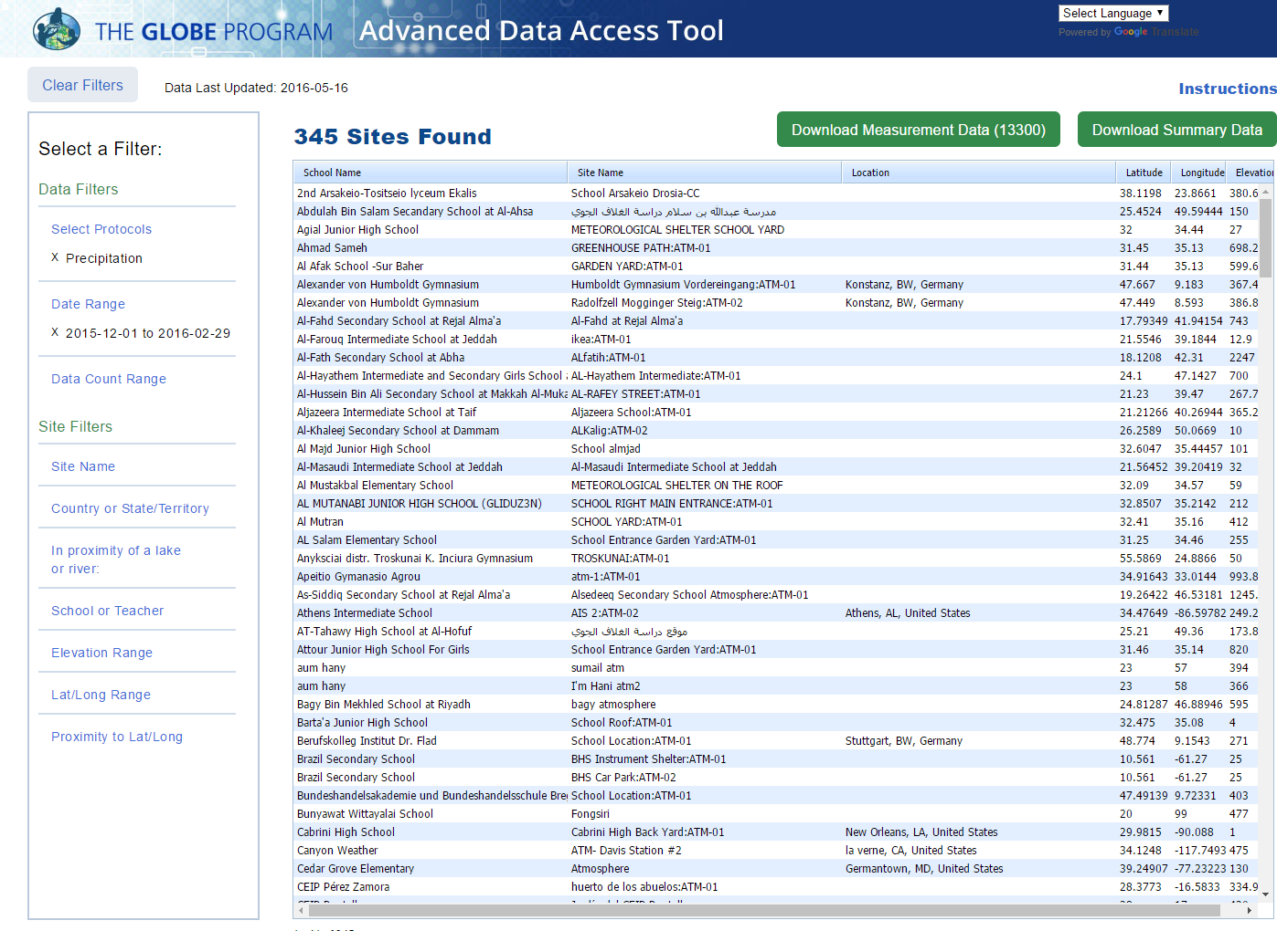
Protocol
Date Range

Slide 43
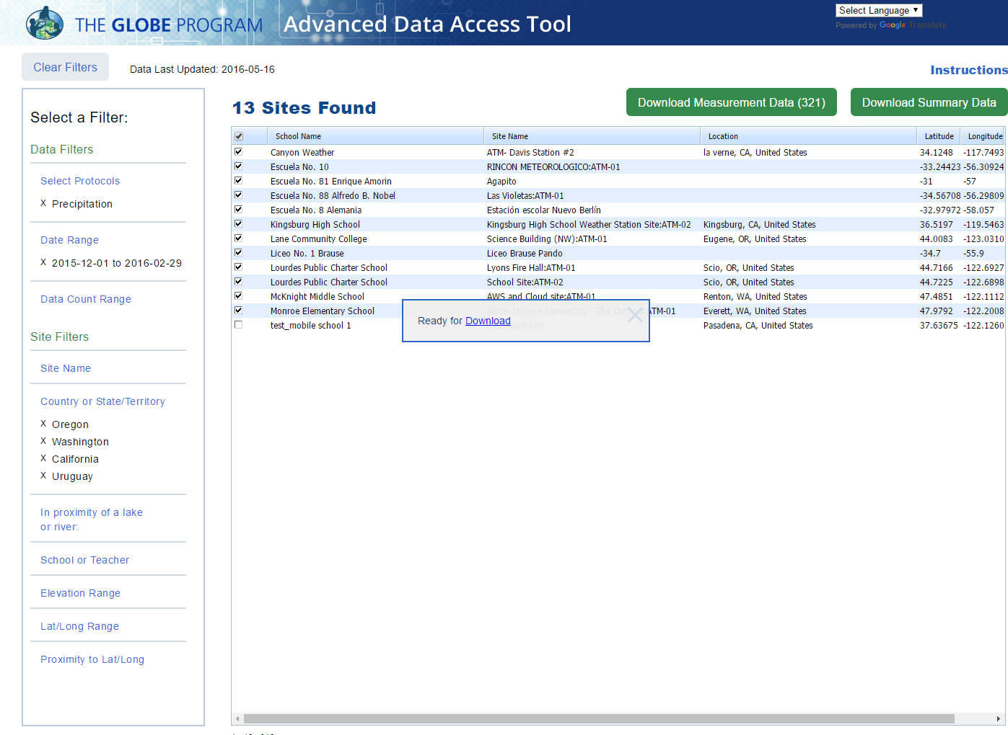
Locations

Slide 44
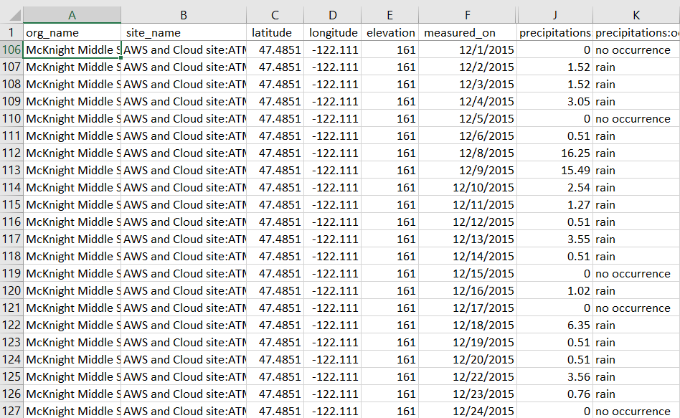
McKnight Middle School – Data from 2013 and 2015 - Download to Excel

