Slide 1
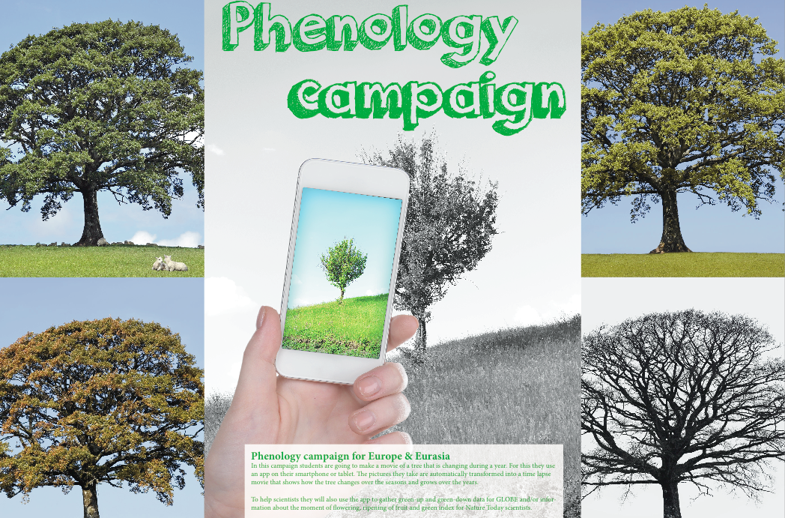
Phenology app
www.globe.gov/web/european-phenology-campaign

Slide 2
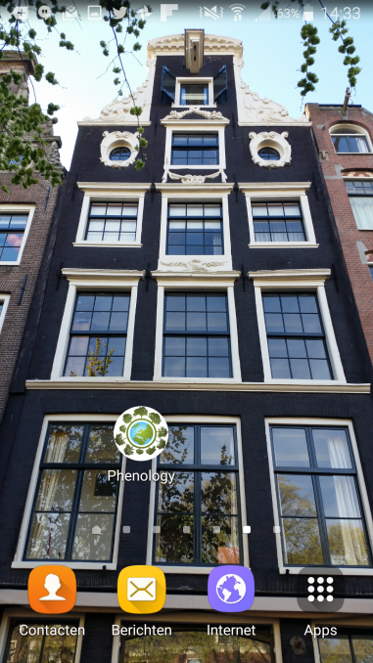
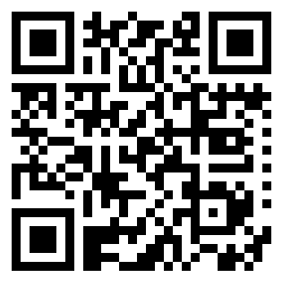
Download app
www.globe.gov/web/european-phenology-campaign
tinyurl.com/phenocampaign

Slide 3
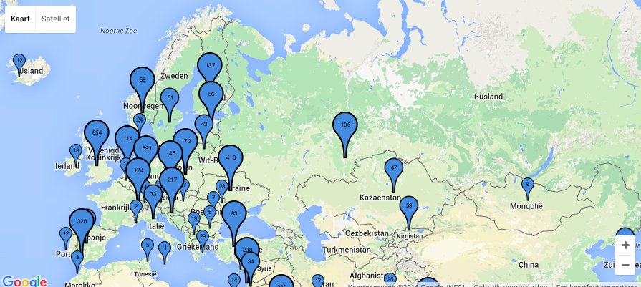
European campaign
Investigate 5 species with a Europe wide distribution

Slide 4
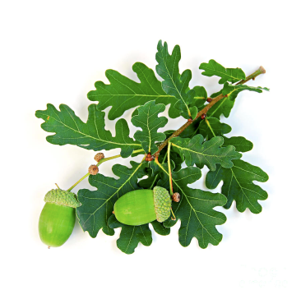
Oak (Quercus robur)

Slide 5
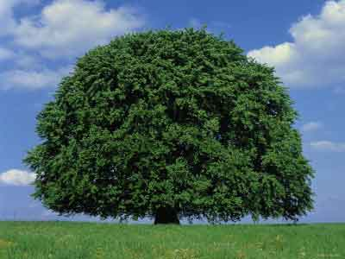
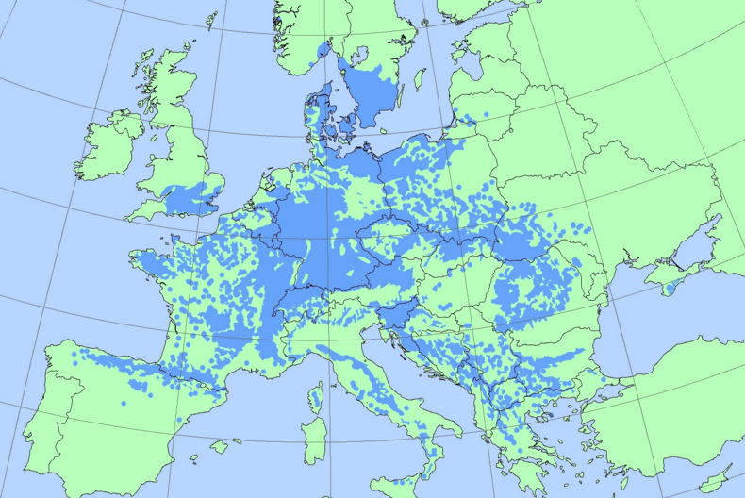
Beech (Fagus sylvatica)

Slide 6
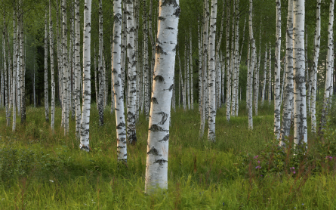
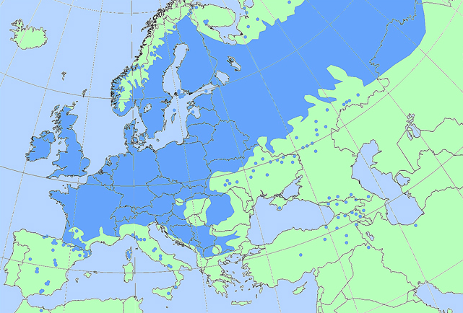
Birch (Betula pendula)

Slide 7
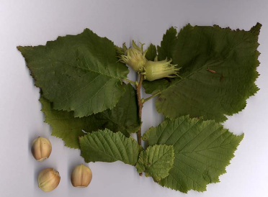
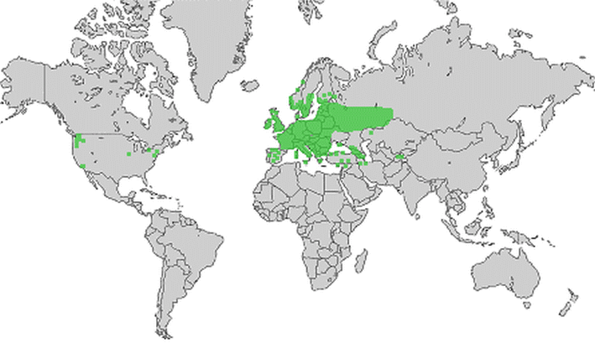
Hazel (Corylus avellana)

Slide 8
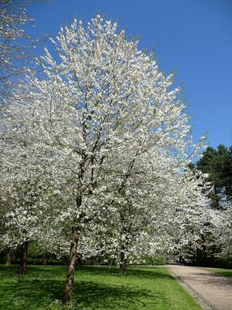
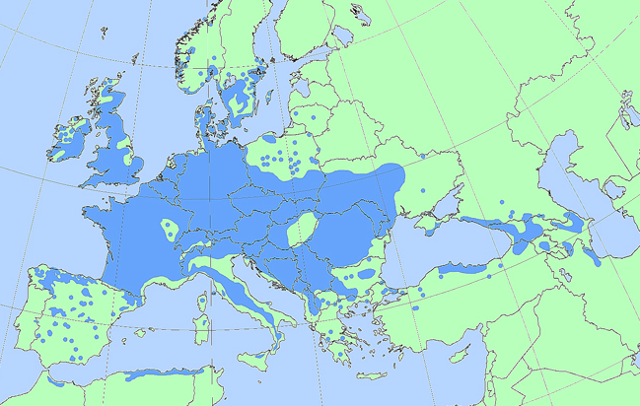
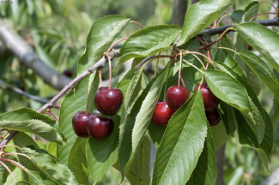
Wild cherry (Prunus avium)

Slide 9
School project (1)
Pick one or more (of the 5) species and consider:
Is it common in your area;
When is greening-up and greening-down to be expected
Identify different individuals of the chosen species in your area.
Make sure that they are in a location that you see (almost) every day.
Try to pick individuals in different habitats in order to find out what influences the phenology events. Think about:
Shade/sun
Dry/wet
In the city / out of the city
Temperature
Soil type

Slide 10
School project (2)
Make sure to take a first picture when the tree is still completely bare.
As soon as you see that the tree is starting to green-up:
Take follow up pictures at least every 2 days (or as often as you can. The more pictures the better your video will be)
Enter the green up information by following the GLOBE green up protocols
When the tree is completely green you don’t need to take so many pictures anymore. Once a week would be nice, but less is also ok. Remember: more pictures is a better movie! You also don’t need to add GLOBE data.
As soon as the tree is starting to green down:
Start to take pictures at least every 2 days
Follow the GLOBE green down protocols
When the tree is completely bare again, you don’t need to take so many pictures anymore. Again, once a week would be nice, but less is ok. When it is snowing or there is another event that looks pretty, take pictures every day again.

Slide 11
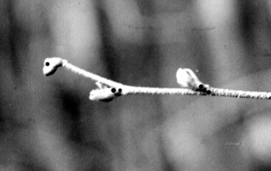
GLOBE protocols: Green-up
Determine whether there are more than one green down cycles
Select a healthy and relatively large branch
south side of the plant in the Northern Hemisphere
north side of the plant in the Southern Hemisphere
Mark the branch with flagging tape (beginning at least two weeks prior to the anticipated start of green-up)
Label 4 buds closest to the end of branch
Examine each bud and record (at least twice a week,):
“dormant” if the bud is unchanged.
“swelling” if the bud is getting bigger.
“budburst” the first day you see the green tips of leaves.
“lost” if something happens to the bud and you cannot continue observations.
After each budburst measure the length of the leaf or leaves.

Slide 12
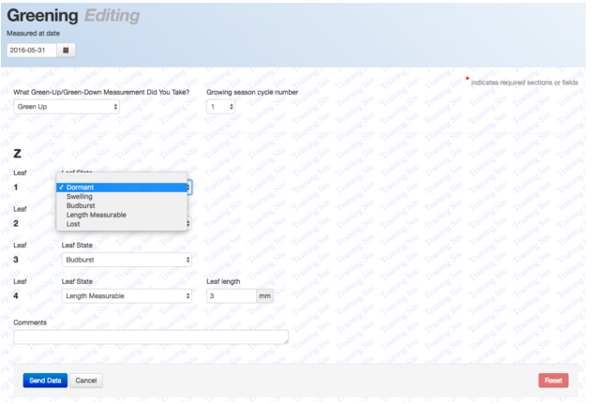
Data entry Green up

Slide 13
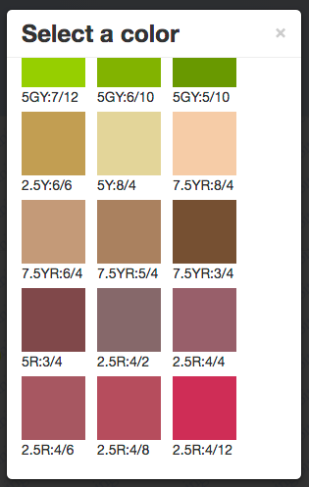
GLOBE protocol: Green down
Find a tree of one of the 5 species
Tag a branch with flagging tape
Determine whether there are more than one green down cycles
Label the 4 leafs at the end of the branch with 1,2,3 or 4 dots
Check the colour of the leafs at least twice a week until they have fallen of
Start at least 2 weeks prior to the expected start of green down
Use the GLOBE Plant Color Guide to estimate the dominant color of each leaf

Slide 14
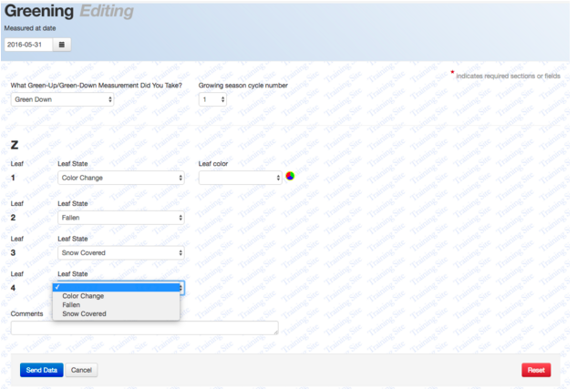
Data entry Green down

Slide 15
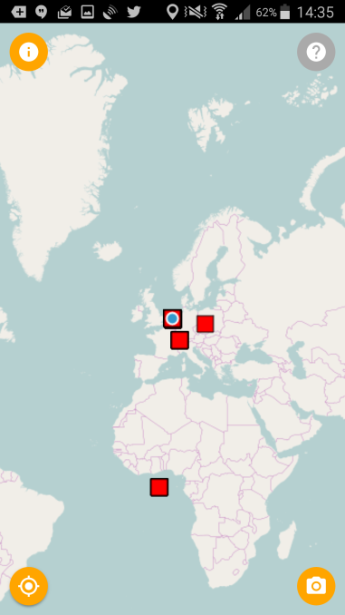
Exercise outside
Open app
Put on GPS
Make sure you have internet connection
Take a picture of a tree (everyone take another tree)

Slide 16
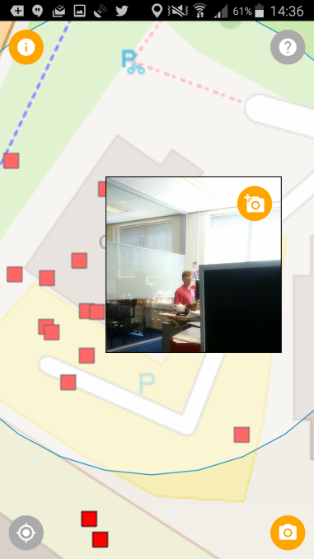
Add a picture to a picture location of somebody else

Slide 17
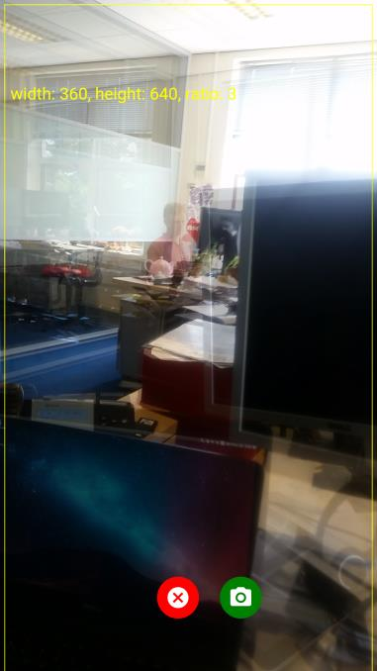
Show camera preview on top of picture
'Onion Skinning'

Slide 18
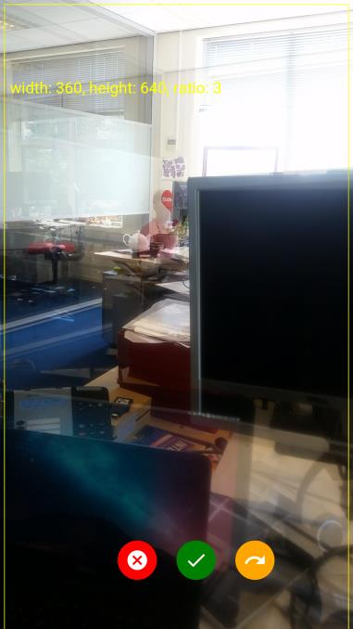
Picture taken!
Cancel, Upload or Redo?

Slide 19
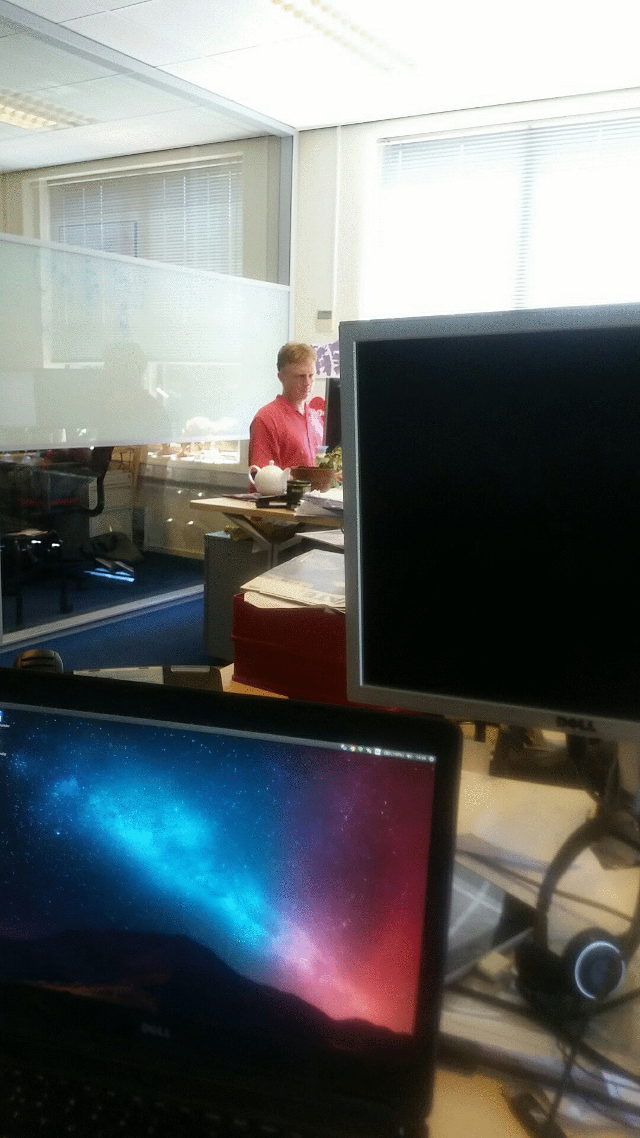
New (office) animation generated

Slide 20
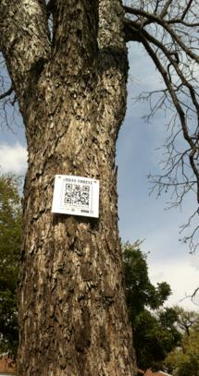
QR code
Collaborate with multiple people on one tree

Slide 21
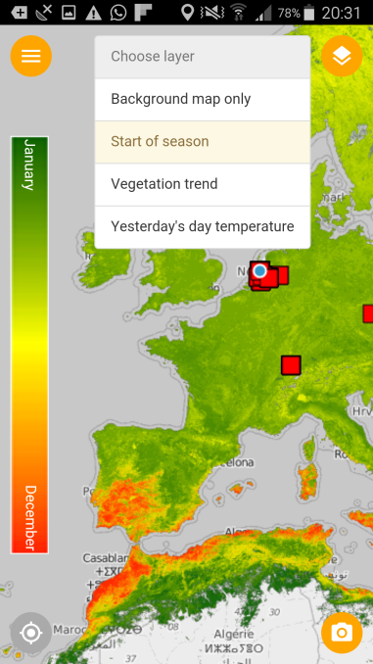
Extra reference map layers:
start of vegetation season

Slide 22
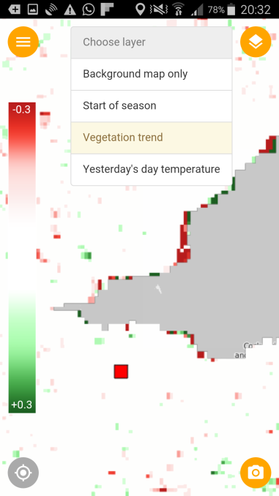
Extra reference map layers:
vegetation trend

Slide 23
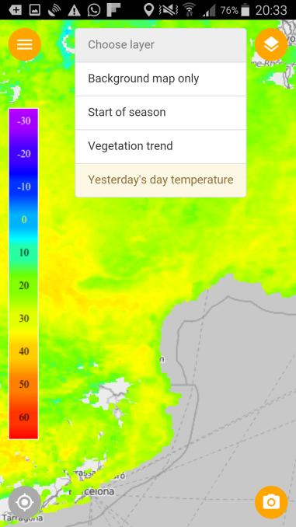
Extra reference map layers:
yesterday's surface temperature

Slide 24
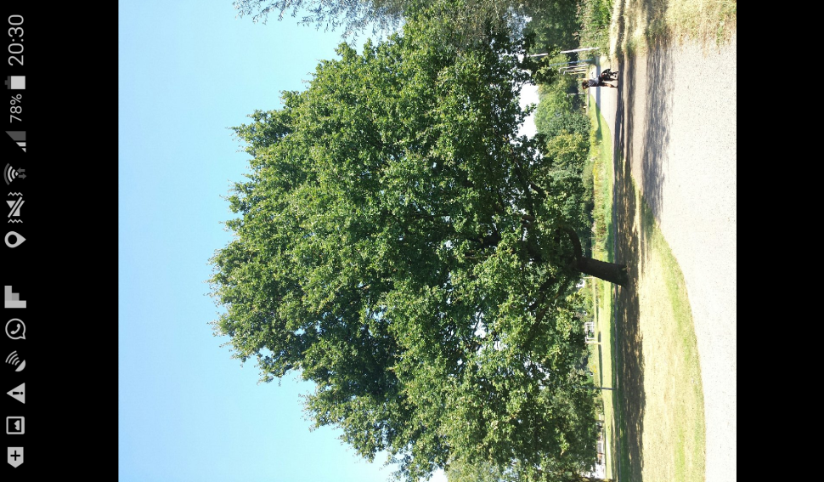
Inspiration
Click photo for full screen view

Slide 25
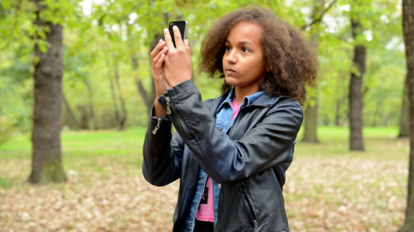
Let’s go outside!

Slide 26
How to join?
Go to www.globe.gov/web/european-phenology-campaign
Sign in to your account and click on
Download app and learning materials

Slide 27
How to prepare your national campaign?
Find national scientist to help you:
Train teachers
Use data for research
Help students with their research and give feedback
Be a judge during science fair
Inform your schools and prepare them for campaign in January
Translate learning materials and app
Promote to upload reports and join virtual science symposium (deadline april 3rd)
Find (outreach) partners (media, Disney, environmental education centres)
Let us know how we can help each other to make the campaign a success, by using the ‘participation form’ on the website
www.globe.gov/web/european-phenology-campaign

Slide 28
Planning
September 27th 2016: workshop and discussion Cologne
October 2016: announce campaign to schools (in Europe & Eurasia)
Sept-Oct-Nov: test the app in autumn (green down)
November: Learning materials ready (for translation)
December 2016: app available for iPhone & Android (ready for translation)
January 2017: official start (exact date to be determined in Cologne)

Slide 29
Discussion
How can you use the app in your country?
If you’re a teacher:
How can you integrate it into your teaching practice?
Whom of your colleagues at school would like to join?
Would you like to collaborate with another school? How?
What do you need from us? How can we help you to make this a success?
If you’re a cc or other:
Do you wish to set up a campaign in your country? How? When?
How do you want to communicate this to your schools?
What knowledge or partners do you need (for example collaboration with university, research institute….)?
What do you think could be improved in the app?
What do you need from us? How can we help you to make this a success?

Slide 30
We look forward to your movies! Please help testing this autumn

Slide 31
Partners
EU (MYGEOSS)| funding building app
Ministry of environment | funding learning materials & outreach
GLOBE Europe & Eurasia board | organisation and outreach
Wageningen University | science
Leiden University | strategy app development
Geodan | development app
GLOBE | connection to database (API) and visualisation
GLOBE Netherlands foundation | coordination

