Slide 1
The El Niño Student
Research Campaign
´
Claudia Caro
Magda Machinko-Nagraebcka
David Overoye

Slide 2
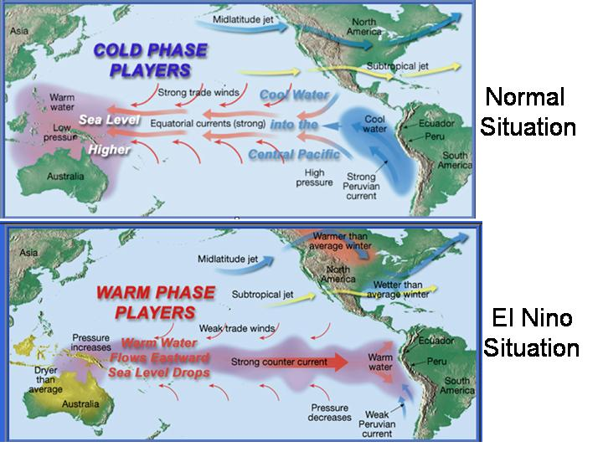
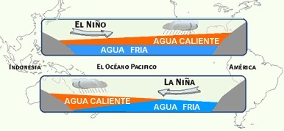
What is El Niño?
El Niño and La Niña are important climatic phenomena (Climate variability) that can have effects on the global climate, affecting places in different way.
Involve Oceanic and Atmospheric conditions
STRONGEST WINDS

Slide 3
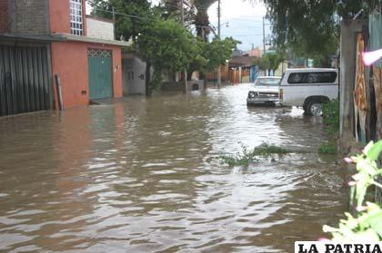
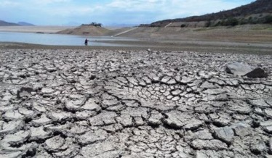
In the Atmosphere!

Slide 4
Understanding El Niño Locally
What are the main differences between a normal year and a El Niño year?
Is the effect of El Niño the same in all parts of the world?

Slide 5
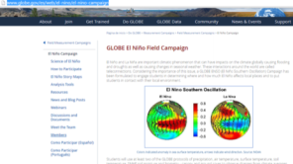
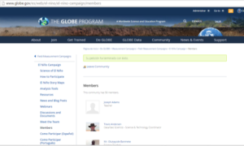
How can you participate? – Become a GLOBE School
1. Become a member of the Community of El Niño :
  Click on Log in: Enter your username and password
  Go to the El Niño Student Research Campaign website: http://www.globe.gov/es/web/el-nino/el-nino-campaign
  Select the " members" link of the left menu
On the "member " page click on "join community" you will see a message in green when you successfully joined the group

Slide 6
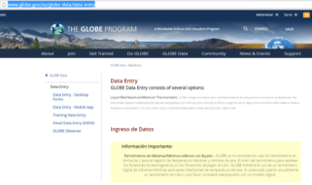
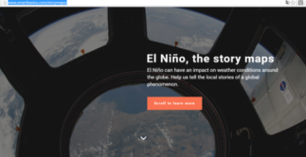
Next Steps to Participate
Record data for at least two of the six protocols in the GLOBE Data Entry for 21 days per season
Fill the form to participate in the webinars (optional, but highly recommended) https://docs.google.com/forms/d/e/1FAIpQLSc3kwd0hHXG--39z2ADxi7-blg11wAx1RUG42GVHgsG12BP6g/viewform?c=0&w=1&usp=send_form
Everyone can share their stories on Story Maps and the H2yOu Project:
  http://www.smartbasins.com/storymaps/

Slide 7
Protocols that are part of the campaign: Collect Data for at least two of six protocols
2
Precipitation
Air temperature
Surface temperature
Soil temperature
SMAP Soil Moisture
Biometry- Canopy and Ground Cover, phenology

Slide 8
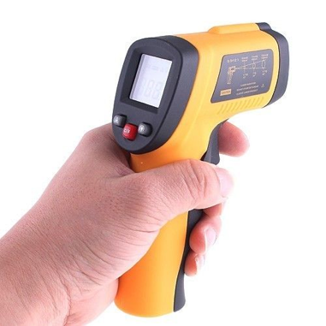
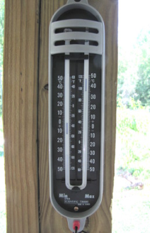
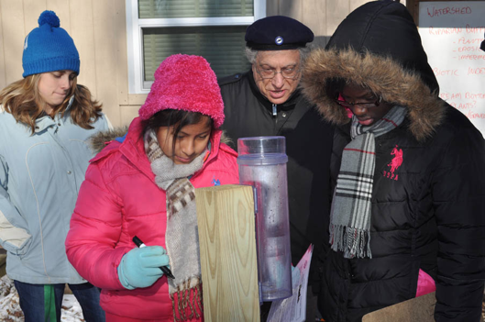
Protocols that are part of the campaign: Collect Data for at least two of six protocols
Precipitation
Maximum/Minimum/
Actual Air Temperature
Surface Temperature

Slide 9
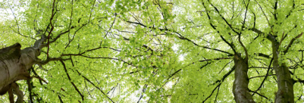
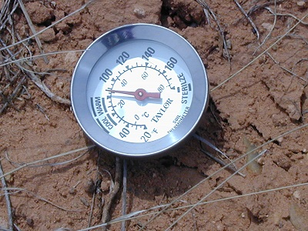
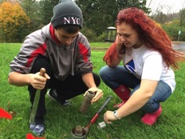
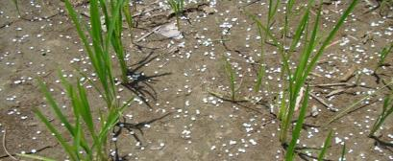
Soil Temperature
SMAP Soil Moisture
Biometry: Canopy and Ground Cover

Slide 10
Seasons
Dates | Northern Hemisphere | Southern Hemisphere
March 1 - May 31 | Spring | Fall Wet/Dry
June 1 – August 31 | Summer | Winter Dry
September 1 - November 30 | Fall | Spring Dry/Wet
December 1 - February 28/29 | Winter | Summer Wet

Slide 11
Taking the Data to the Next Level

Slide 12

Story Tellers:
How Does El Niño Affect Us?
We want to invite you to investigate more about what happens with El Niño in your region and to tell a story about it
The stories can be amazing educational tools because they connect with the student, involve the use of metaphors and are emotionally significant
As frequently you want
ENSO: Japanese character that means circle. Absolute symbolizes enlightenment, fortune, elegance and creativity.

Slide 13
Sharing Stories
Tales
Activity with science students
Observations
Testimonies
Collaborative Projects

Slide 14
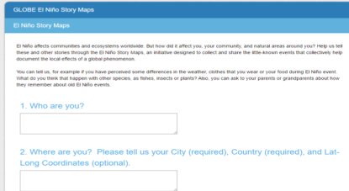
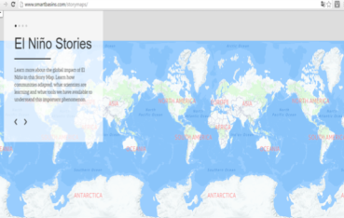
Share Your Stories: Story Maps
https://www.surveymonkey.com/r/LFVK7H3
If you have links to photos or videos you can do it through this link.
You can also share your photos and stories by sending an email to
stories@smartbasins.com

Slide 15
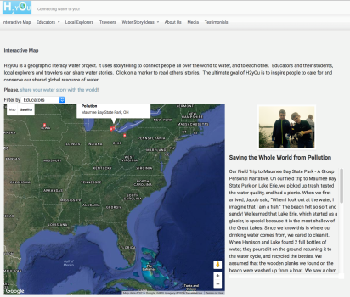
Sharing Stories: H2yOu Project
How does water affect you and your region?
Educators and their students, local explorers and travelers can share water stories
Read others’ stories from around the world and compare and contrast your stories
http://h2youproject.com

Slide 16
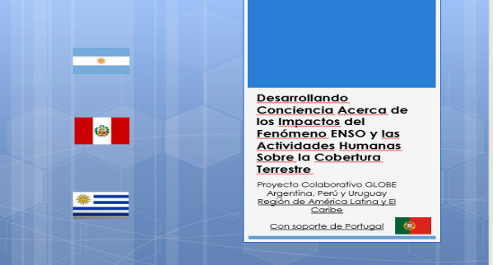
An Example of a Story and Research
Developing awareness of the impacts of ENSO and human phenomenon activities on land cover

Slide 17









Collaborative Project: El Niño
Video conferences
Online Collaborative Tools
Workshop in Buenos Aires
Workshop in Junín de los Andes
Notes:
To organize and work we used the online collaborative tools, videoconferences and we made two face to face workshops to meet us, know more about every studied area and agree working methodologies and inform redaction methodologies.
17

Slide 18

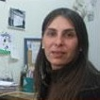

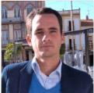
Scientist support
Dr. Madeleine Renom from Uruguay (Meteorology Specialist)
Dr. Ricardo Chrobak from Argentina (Specialist on Science Teaching)
Dr. Vasco Mantas from Portugal (Remote Sensing Specialist)
Notes:
The work had the support of Meteorology, Science Teaching and Remote Sensing specialists. They are from different countries too.
18

Slide 19
The BIG Questions
  How does the ENSO phenomenon affect each country?
  Does the ENSO phenomenon affect all countries in the same way?
  How does ENSO affect human activities and land cover?

Slide 20

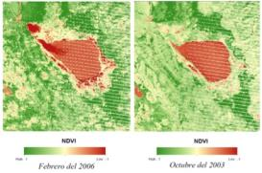
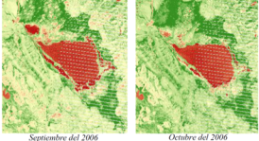
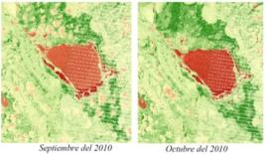
Peru
Data Analysis - NDVI
Annual precipitation 940 mm
Annual precipitation 655 mm
Annual precipitation 1476 mm
February 2006
October 2003
Neutral Period
September 2006
October 2006
September 2010
October 2010
El Niño period
La Niña period
Notes:
The NDVI results show that in the Niño period there’s a slight decrease of the vegetation tan in a Neutral period. But in two thousand and ten in which La Niña presented, shows a decrease in the Junin lake standard, which it made the vegetal cover expanded on the free land that the lake lost. Also in this zone there’s a big human influence over the Junin lake standard and over the rangeland management that could affect the results to affirm the effects of the vegetal change are only because the ENSO phenomenon presence.
20

Slide 21
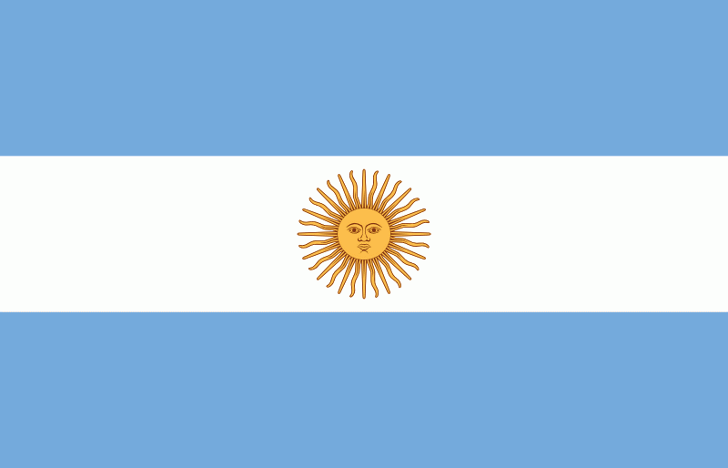

Argentina
Data Analysis - NDVI
Annual precipitation 840 mm
Neutral Period - 2003
Current - September 2013
Annual precipitation 1059 mm
Annual precipitation 745 mm
El Niño Period - 2002
La Niña Period - 1999
Notes:
The images show more vegetal cover for the Niño’s year tan for the Niña’s year and for the Neutral year. This differences happens with the annual rainfalls. Also, in la Niña’s period got registered more fire number probably for a lower precipitation quantity.
21

Slide 22
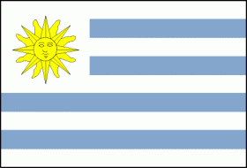
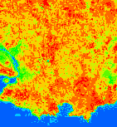
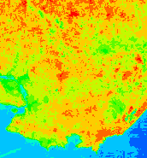
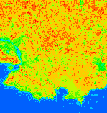
Uruguay
Data Analysis - NDVI
Neutral Period - 2003
Niño Period - 2009
Niña Period - 1999
Annual precipitation 1240 mm
Annual precipitation 1350 mm
Annual precipitation 1240 mm
Notes:
In these images we see that the NDVI of the Niño’s period presents more vegetation areas comparing with the Niña’s period, where the Green areas decrease. The neutral period is which it shows the most vegetal cover decrease. The annual precipitations show this same pattern.
22

Slide 23
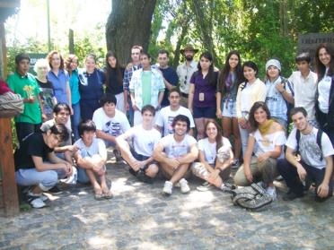
Conclusions
Vegetation cover decreases during the period of La Niña in Argentina and Uruguay and increases in Peru
During El Niño , rainfall is much higher in Argentina and Uruguay, while in Peru rainfall is decreased
The ENSO does not have the same effect on Argentina , Uruguay and Peru

Slide 24
The Team
Brian Campbell NASA Wallops Flight Facility, Lead (Virginia)
Dorian Janney NASA Goddard Space Flight Center (Maryland)
Kristen Weaver NASA Goddard Space Flight Center (Maryland)
Peter Falcon NASA Jet Propulsion Laboratory (California)
Matt Pearce NASA Goddard Institute for Space Studies (New York)
Ann Martin NASA Langley Research Center/SSAI (Virginia)
Kevin Czajkowski University of Toledo (Ohio)
Oluwafemi Olawale Nigerian Space Agency’s CGG (Nigeria)
Claudia Caro National Agrarian University (Peru)
Vasco Mantas University of Coimbra (Portugal)
Kristin Wegner GLOBE Implementation Office (Colorado)
Julie Malmberg GLOBE Implementation Office (Colorado)

Slide 25
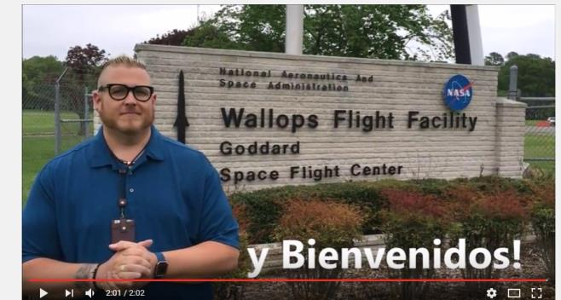
Thank You!
and Welcome!

Slide 26
Let´s Go to the Website!

Slide 27
The 2015-2016 El Niño Event
Using GLOBE Visualization Tools and Data for Analysis
David Overoye

Slide 28
Two GLOBE tools to retrieve data
GLOBE Advanced Data Access Tool (ADAT) - http://datasearch.globe.gov/
  Used to find and return data from across sites and protocols
  Allows you to filter by location, date and other parameters
  Focus in on retrieving data across sites or locations
GLOBE Visualization system - http://vis.globe.gov/GLOBE/
  Used to see data points on a map
  See a particular day’s data – Show me the temperature today
  Can also show data observed and graph over a period of time.
  Focus is on specific set of data at a specific site

Slide 29
Using the Advanced Data Access Tool (ADAT)
Tool allows you to download GLOBE data from multiple protocols, schools, regions or dates without using the map
Select GLOBE Data -> Retrieve GLOBE Data or http://datasearch.globe.gov/
Two Steps –
  Select Filters
    Protocol, Date Range, Country, School or Teacher etc.
  Select “Download Measurement Data” (may take a little while!)

Slide 30
Think you already know how to use ADAT?
There are two schools in the US state of Washington that collected precipitation data from 12/1/2015 – 2/28/2016 and 12/1/2013 – 2/28/2014.
  Retrieve the data from these schools.
  Which school do you think is better to use for analysis? Why?
    What are the problems caused when a school doesn’t report “no rainfall”?
  Examine the data for the school with the most data to see if the school recorded any El Niño effect

Slide 31
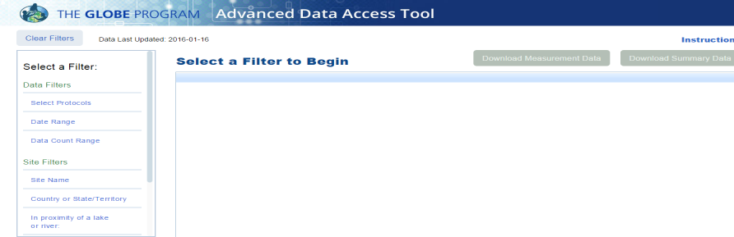
Select Filters from the left to see matching sites

Slide 32
What would be a good filter to setup for El Niño data?
Protocols?
Date Range?

Slide 33
What would be a good filter to setup for El Niño data?
Protocols?
  Precipitation – one of the campaign protocols
Date Range?
  A campaign data collection time range - December 1, 2015 – February 28/29, 2016

Slide 34
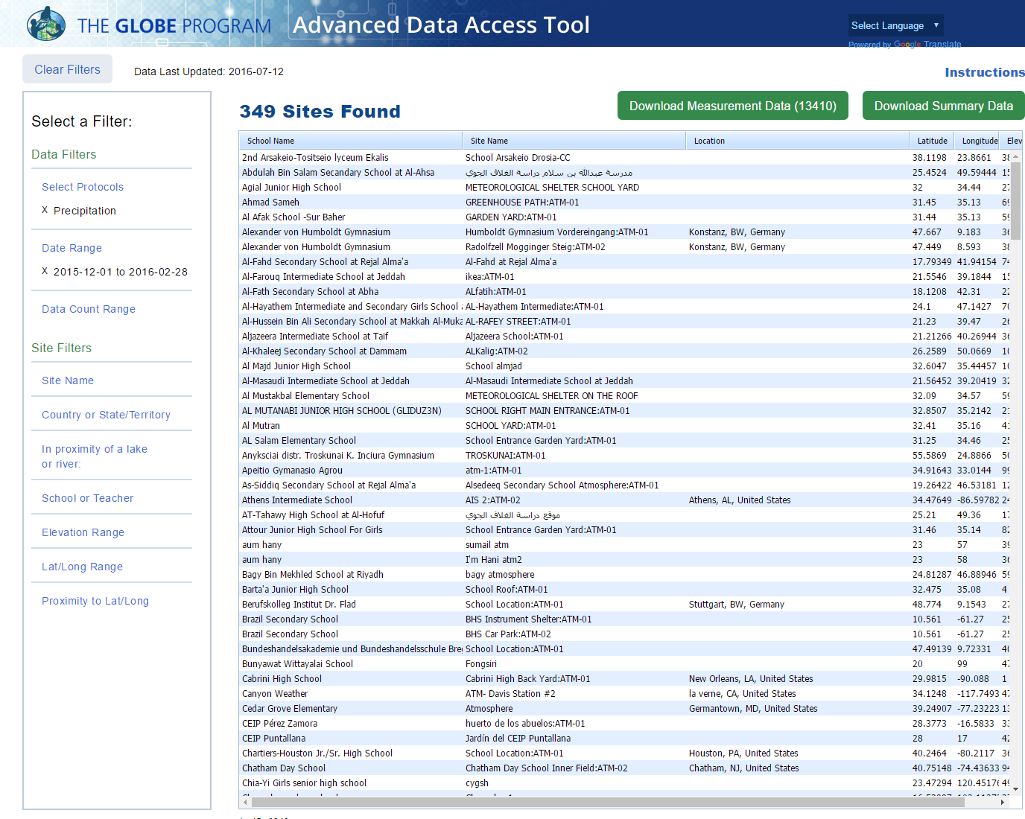
Protocol
Date Range

Slide 35
What would be a good filter to setup for El Niño data?
Protocols?
  Precipitation – one of the campaign protocols
Date Range?
  December 1, 2015 – February 28/29, 2016 – a campaign data collection time range
Location too!
  California, Oregon, Washington (US West Coast)

Slide 36
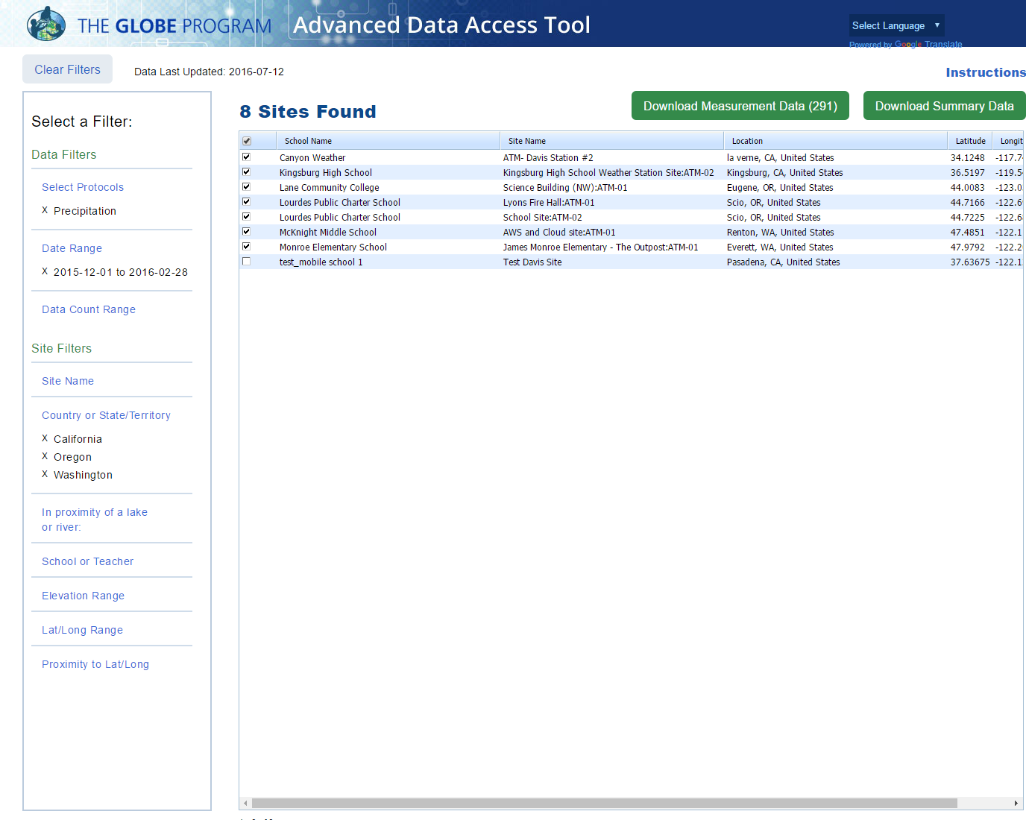
Locations

Slide 37
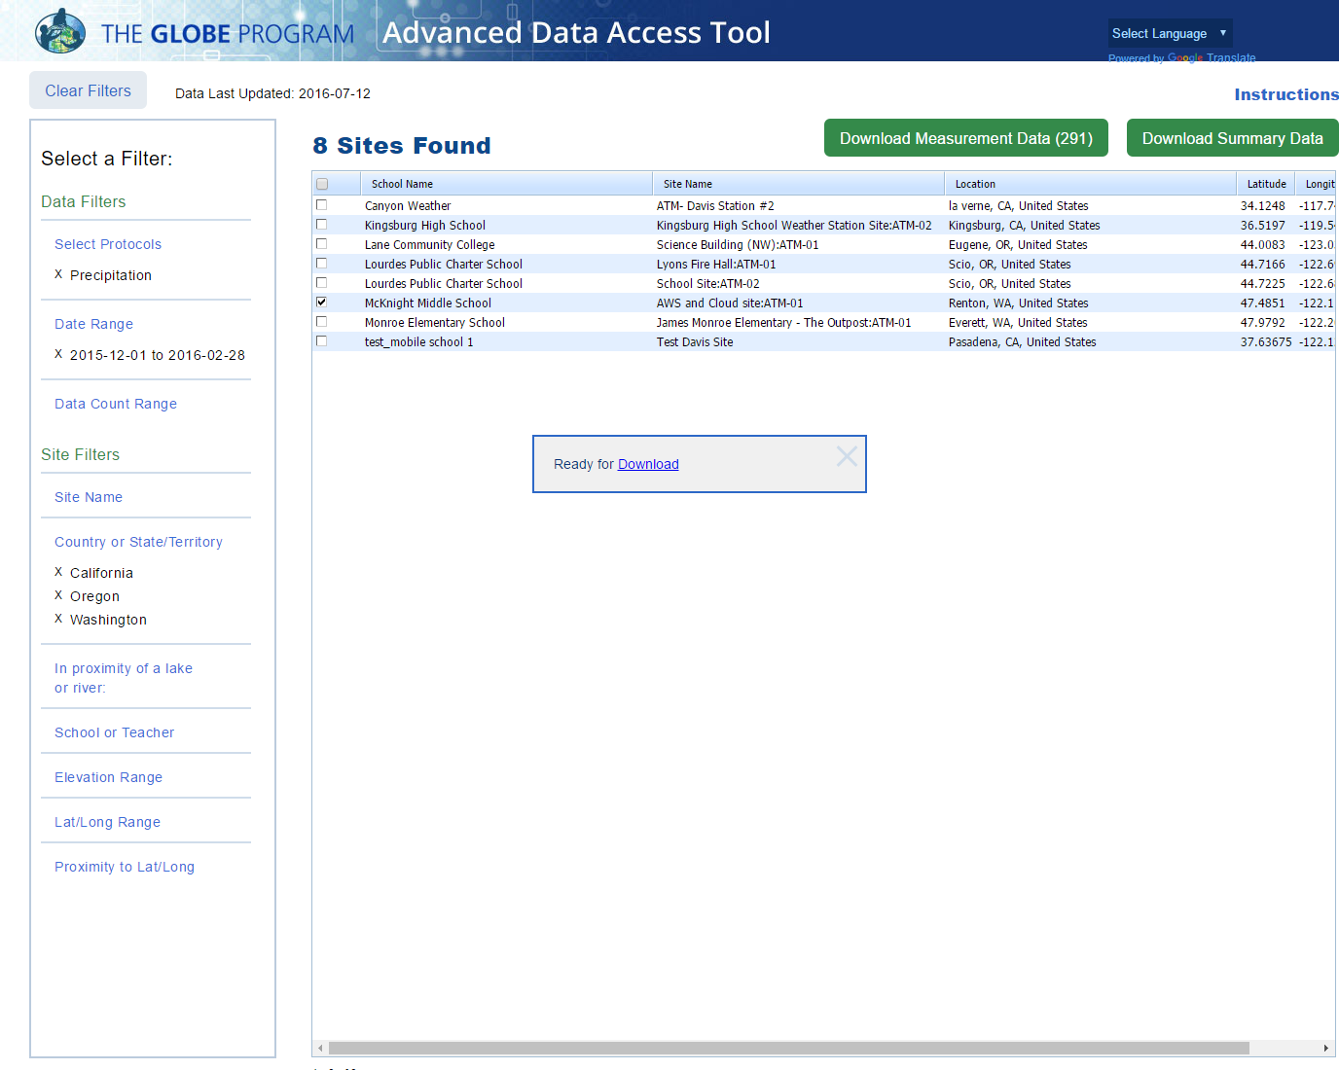

Slide 38
What would be a good filter to setup for El Niño data?
Protocols?
  Precipitation – one of the campaign protocols
Date Range?
  December 1, 2015 – February 28/29, 2016 – a campaign data collection time range
  Compare to 2013/2014
Location too?
  California, Oregon, Washington (US West Coast)

Slide 39
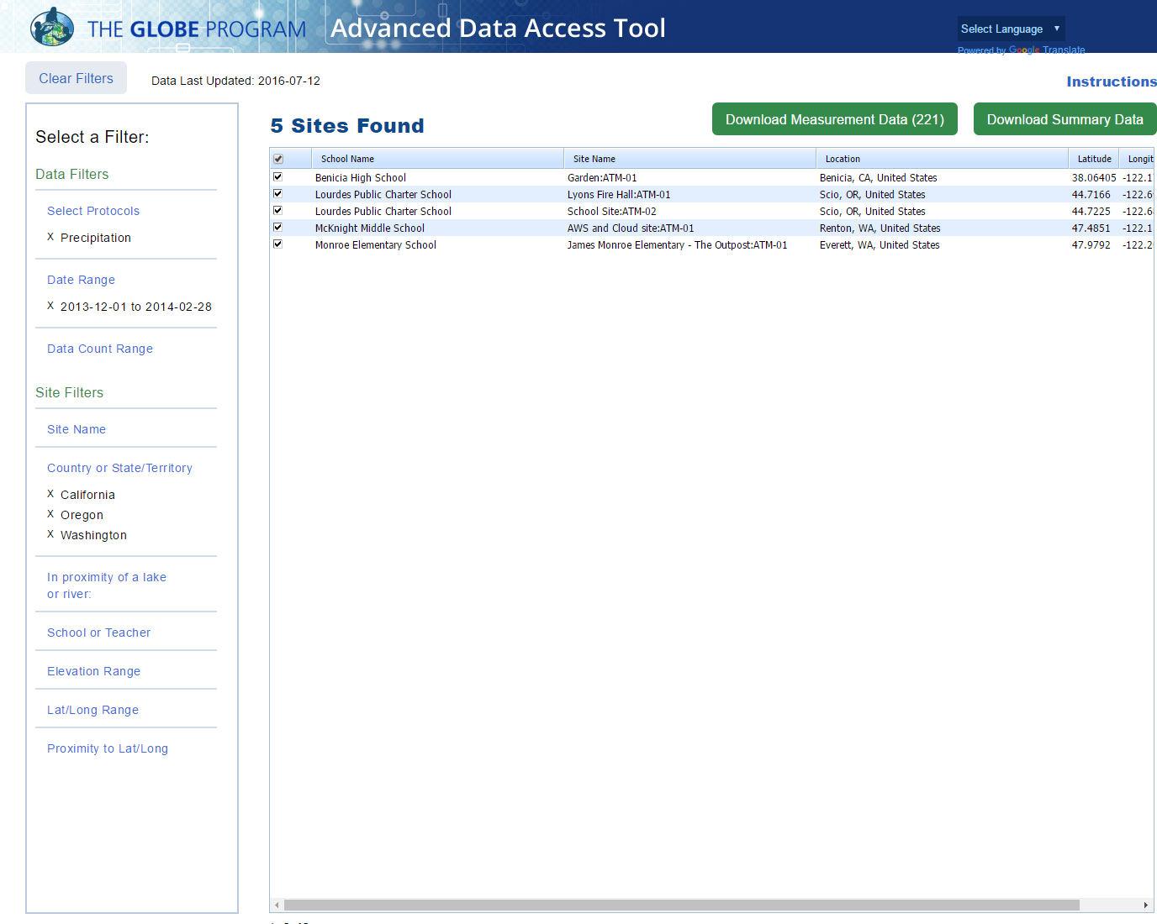
New Date Range
Data 2013 and 2015

Slide 40
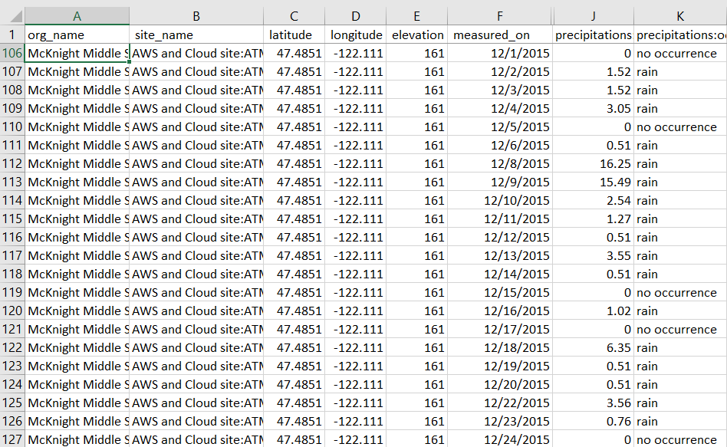
McKnight Middle School – Data 2013 and 2015
Download to Excel

Slide 41
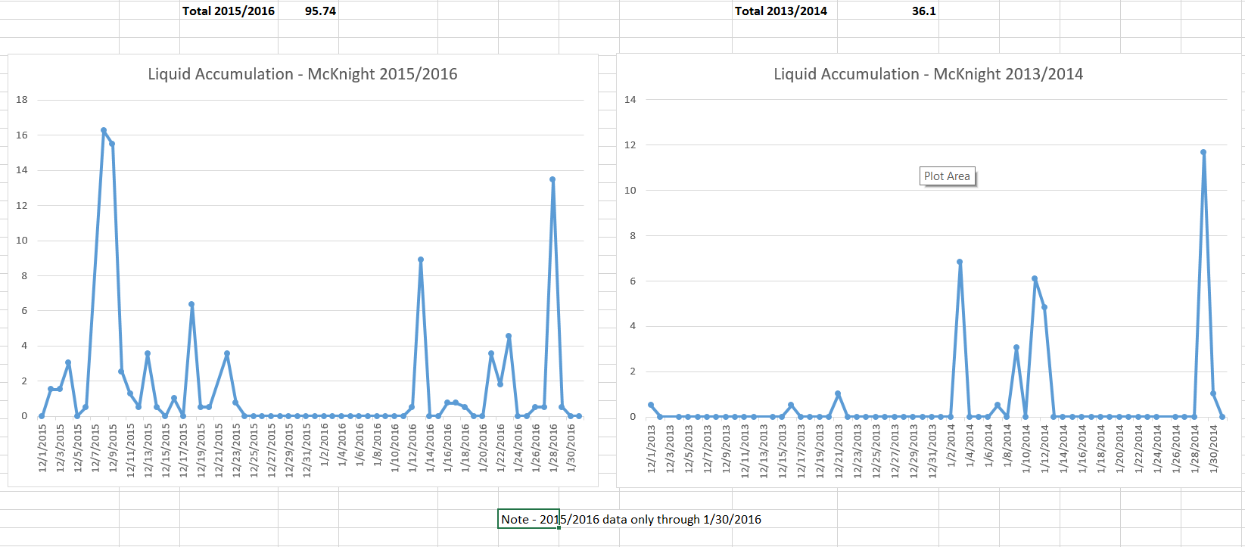
Comparison 2013 and 2015 Precipitation

Slide 43
Using the Visualization System to examine El Nino protocols
Is there a correlation between precipitation and soil moisture?

Slide 44
Think you know the vis system?
The Ramey School in Puerto Rico has done an excellent job of monitoring precipitation and Soil Moisture during the El Niño Campaign
  Start with 9/9/2015
  Add Soil Moisture – SMAP Block Pattern
  Plot the data from the Ramey School for the period 9/1/2015 – 5/31/2016
  Add the data to a combined plot
  Switch to precipitation for the same period and add it to the multi-site plot
  View the multi-site plot for this period and determine if there is a correlation between the two variables

Slide 45
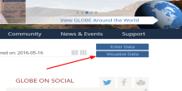
The Basics of the Visualization System
Go to the homepage and select “Visualize Data”
Three Steps to Visualize your Data:
  Select the type of data you want to see (Add Layers)
  Select the Date you want to see the data for
  Click on a data point on the map to receive table and graph information
Full Training material – slides and video available at: http://www.globe.gov/get-trained/using-the-globe-website/retrieve-and-visualize-your-data

Slide 46
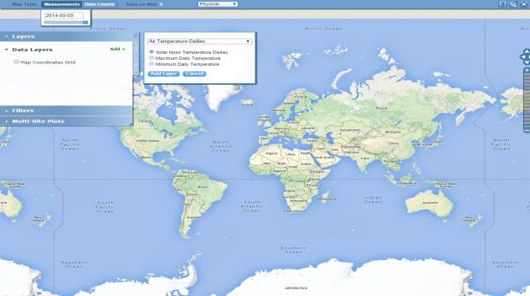
Step 1 – Add Data Layers – Choose the Protocol

Slide 47
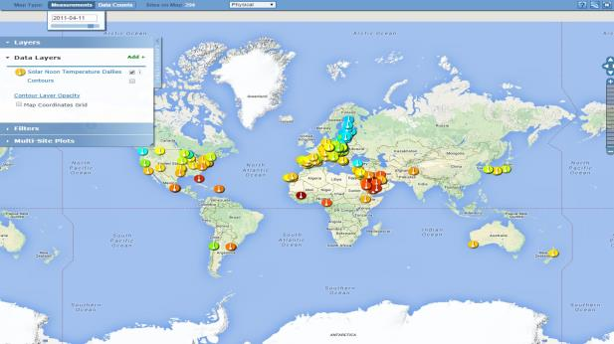
Step 2 – Select the Date

Slide 48
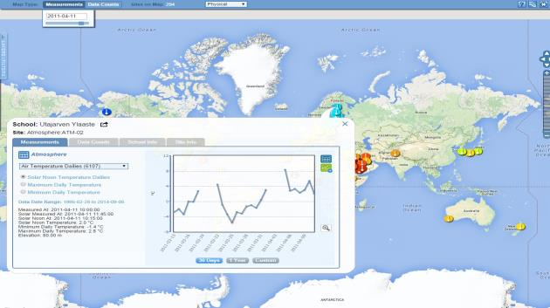
Step 3 – Click on the Data Point

Slide 49
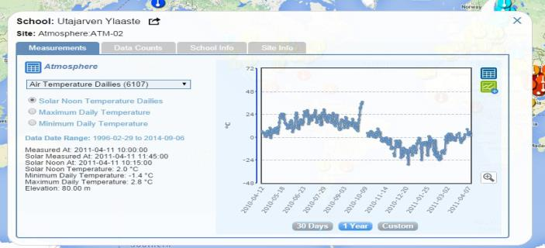
Vis system popup window
See all Atmosphere Data
Go to this school’s page
See Plot Data in a Table
Add this Data to a multi-site Plot
Change the X axis Timeline

Slide 50
Advanced Features
Use Filters - Location/Site/Elevation to find specific locations – school, country, city etc.
Use the graph with the + icon to select multiple data sets to graph
  Allows you to overlay data from multiple sites
Export layers to KMZ format for using with Google Earth and other similar tools
Use “Data Counts” to see schools which have entered the most data during a particular period of time
Full Training material – slides and video available at: http://www.globe.gov/get-trained/using-the-globe-website/retrieve-and-visualize-your-data

Slide 51
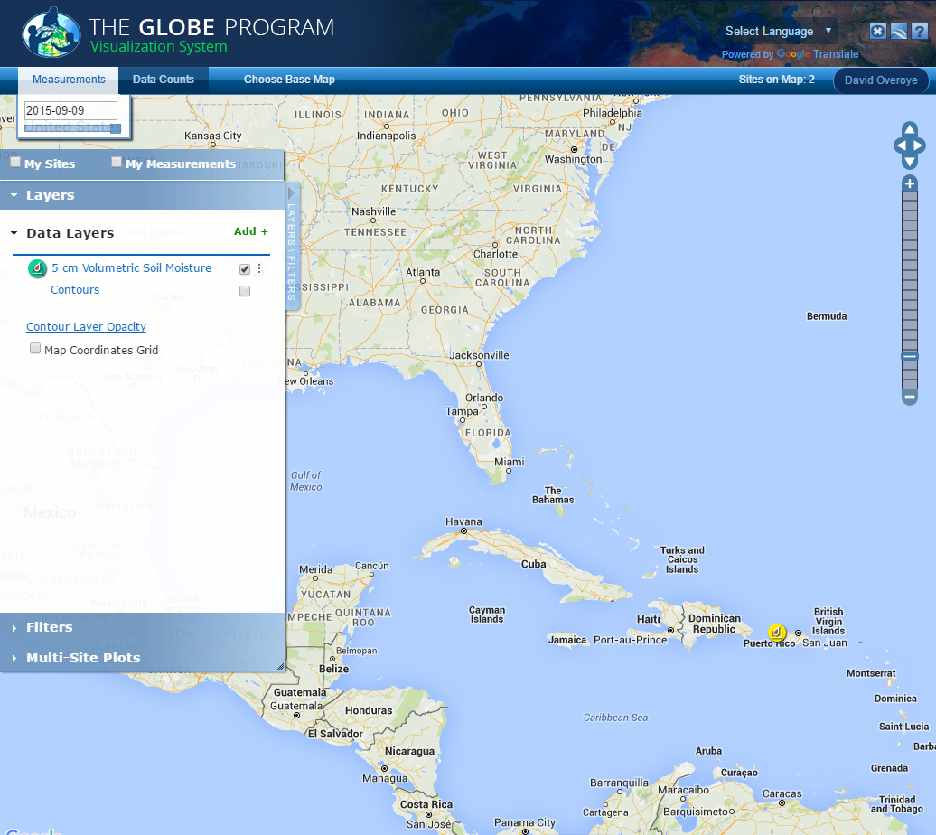
SMAP Measurement-Ramey School 9/9/2015

Slide 52
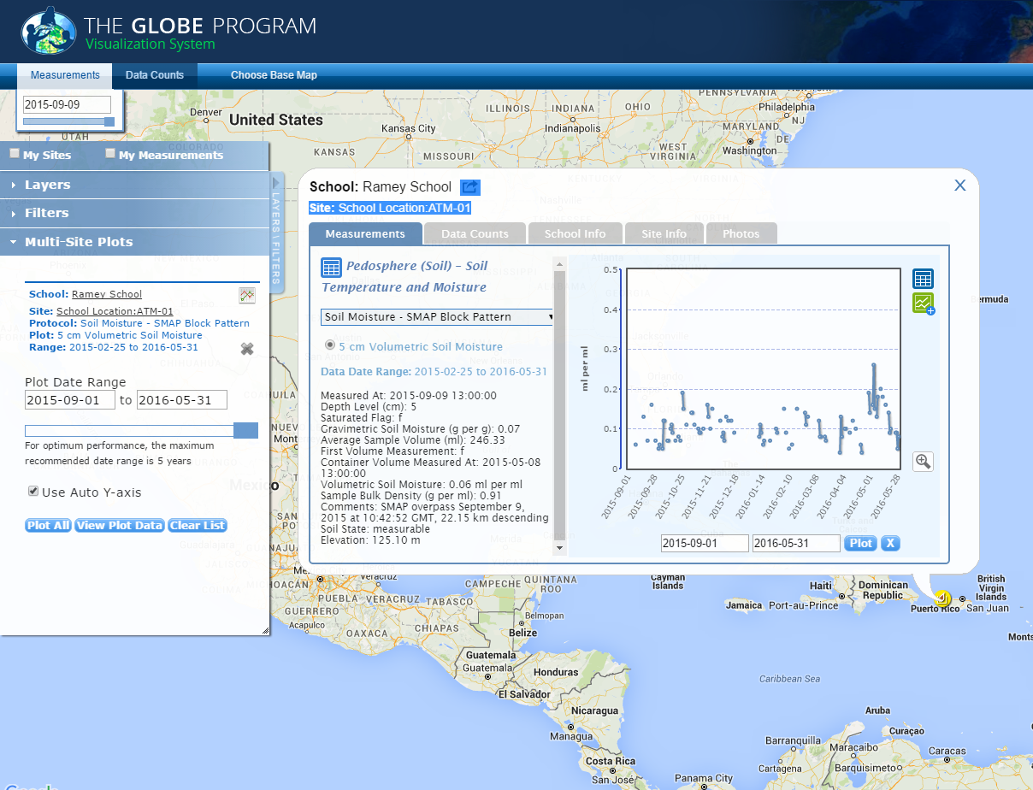
PLOT of measured SMAP data with multi-site setup

Slide 53
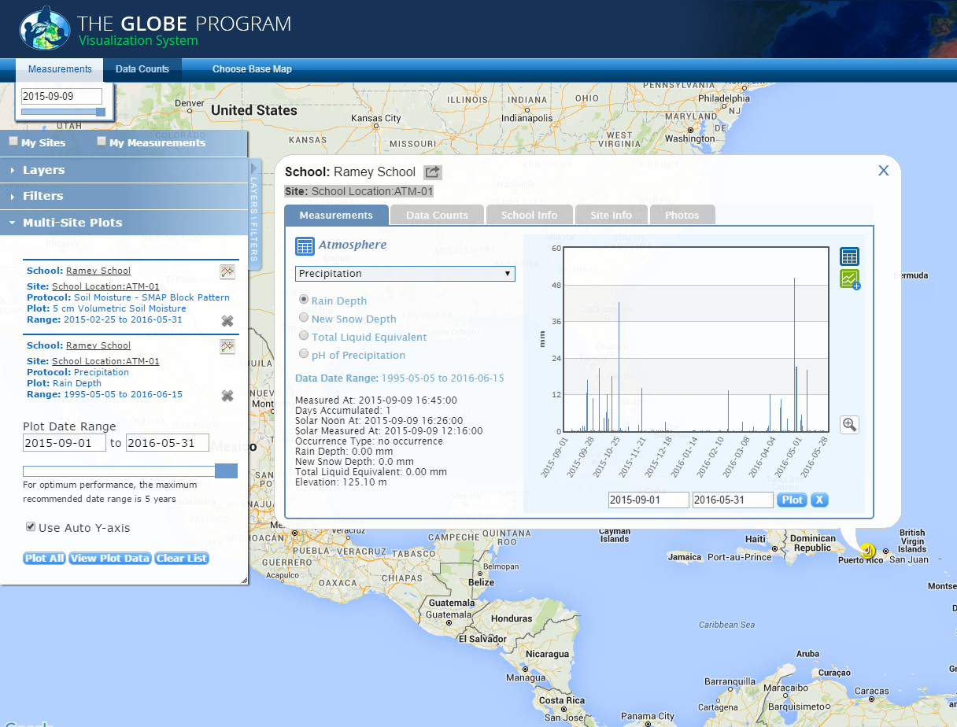
PLOT of measured SMAP data with multi-site setup

Slide 54
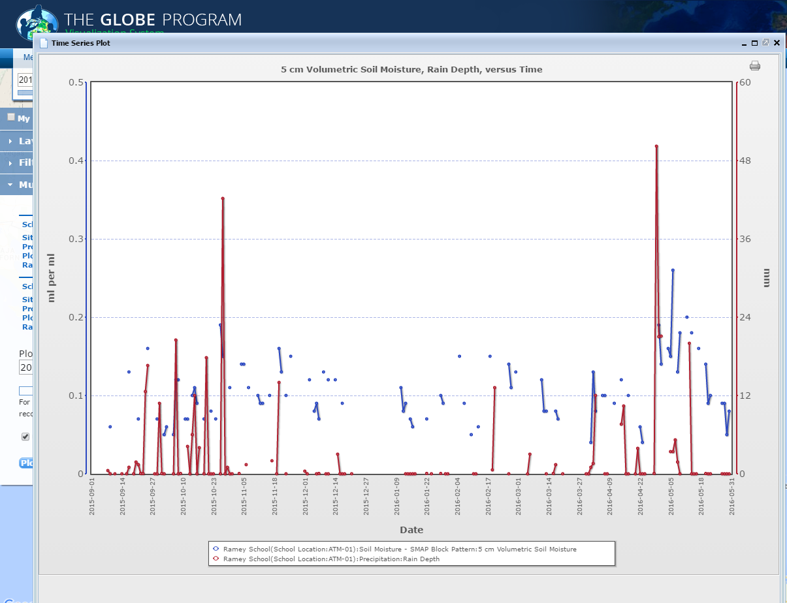
Data Comparison – do you see a correlation?

Slide 55
Questions?
Thank you!

Slide 56
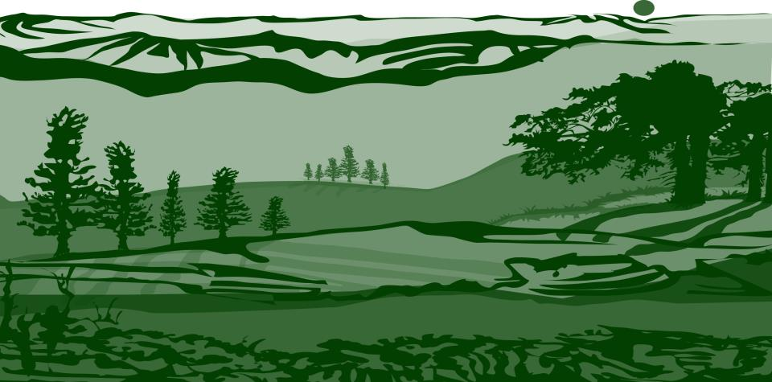

Slide 57

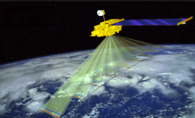
Mapping
An important objective of the land cover investigation to assess the accuracy of maps created by satellite images and aerial photographs.
Terra’s Terra’s five instruments provide measurements of plant (vegetation) composition, structure, extent, and change. Image: NASA.

Slide 58

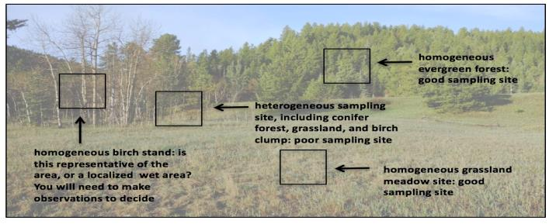
Site Selection in the Field:
Locate the approximate center of the 90 m x 90 m homogeneous site.
Note: The site can be much larger than 90 m x 90 m as long as it is homogeneous.

Slide 59


Diagram of Sample Site Considerations

Slide 60


To Describe Canopy Cover and Ground Cover, You Will Need the Following Equipment:

Slide 61

To Describe Canopy Cover and Ground Cover, You Will Need the Following Documents:
Canopy Cover and Ground Cover Field Guide
Land Cover Tree and/or Shrub Canopy and Ground Cover Data Sheet
Biosphere Investigation Instruments: Denisometer
Biometry Protocol

Slide 62

Make Notes and Photograph the Site
You are done!

Slide 63

Canopy Cover and Ground Cover Protocol Steps
After you identify your sampling area, continue to follow the Canopy Cover and Ground Cover Field Guide, beginning with step 2 in the guide. You will be able to determine the dominant canopy cover through calculations at the end of the protocol.
Note: The protocol steps have been simplified, there is now only one shared data sheet for canopy and ground cover. The Protocol instructions in the GLOBE Teacher’s Guide will be updated soon.

Slide 64

Measuring Ground Cover
(3) If the vegetation is green (alive), record a (G) on the data sheet
If the vegetation is green, record if it is graminoid (grasslike) (GD), other green vegetation (OG), Shrub (SB) or Dwarf Shrub (DS).
If the vegetation is brown but still attached, record a (B).
If there is no vegetation, record a (-) on the data sheet.
In this photo, the field scientist recorded Graminoid (GD) (on leg) and Other Green vegetation (OG) by big toe on left foot.

Slide 65


Understand the DATA You Collect:
The Canopy Cover and Ground Cover Field Guide Protocol gets us one step further toward being able to determine the correct MUC Class of the sampling site.
The MUC Field Guide: A Key to Land Cover Classification is available for download on mobile devices- consult your app store.

Slide 66

MUC Guide has a dichotomous key structure
.
When classifying land cover using the MUC System, always begin with the most general classes (Level 1) and proceed sequentially to the more detailed (higher level) classes. For example, the Level 2 classes within Closed Forest are Mainly Evergreen, Mainly Deciduous, and Extremely Xeromorphic (Dry). These Level 2 classes contain more detail than the Level 1 class, Closed Forest, and they may all be collapsed into the Closed Forest class. In other words, any member of one of these three Level 2 classes is always a member of the Closed Forest Level 1 class. See table below. This is a condensed version of MUC, showing only the Level 1 and Level 2 classes, and how your biometry measurements are needed to determine the appropriate MUC class. Conduct the appropriate biometry protocols to determine the MUC class of your sample site. You will likely be able to determine Level 3 or Level 4 classes once you have collected sufficient data.

Slide 67

Phenology simple as possible

Slide 68

Protocol Training Slides for
Surface Temperature
Photo credit: Kevin Czajkowski

Slide 69



Calibrate your Infrared Thermometer
Calibrate once per year to ensure proper performance!
Calibrate with an ice water bath. Wait until the water reaches 0° C, then see if the infrared thermometer shows a similar reading.
If the temperature observed is more than +2° C or less than -2° C, try changing the battery. If the calibration still is off, the IRT needs to be replaced.
Photo credit: Sara Mierzwiak
Photo credit: Sara Mierzwiak
Notes:
Calibrate with bucket of ice water
-point IRT perpendicular to water surface about 5 cm away
-reading should be within –2° C to +2° C
The IRT sensor is susceptible to large differences in air temperature. If you enclose the IRT in the adapted oven mitt (thermal glove), this will ensure the IRT stays insulated and will provide accurate readings.
Some IRT units are equipped with a laser that will shine from the front of the thermometer along the approximate line of sight, causing a red dot to appear where the surface temperature is measured. Make sure students do not aim this laser beam directly at eyes or off surfaces that could reflect in someone’s eyes.
Wrap your IRT in the Thermal Glove when the air temperature at your study site varies more than 5 degrees Celsius from the air temperature of where the IRT has been stored. The IRT with the thermal glove has been tested to work for 30 minutes. The thermal glove is made from a standard oven mitt. The oven mitt used to make the thermal glove MUST be constructed of 100% terry cloth; inside and outside. An actual-size pattern of the thermal glove with hole designations for the IRT’s sensing eye and digital display screen is shown in the Surface Temperature Protocol section of the 2003 Teacher’s Guide.

Slide 70


Collecting Data using an Infrared Thermometer
HOW?
Hold your arm at arms length and point the instrument at the ground. After you pull the trigger then read the value including the tenths of a degree Celsius.
WHEN?
Surface temperature measurements can be taken any time during the day.
Photo credit: Kevin Czajkowski
Notes:
Calibrate with bucket of ice water
-point IRT perpendicular to water surface about 5 cm away
-reading should be within –2° C to +2° C
The IRT sensor is susceptible to large differences in air temperature. If you enclose the IRT in the adapted oven mitt (thermal glove), this will ensure the IRT stays insulated and will provide accurate readings.
Some IRT units are equipped with a laser that will shine from the front of the thermometer along the approximate line of sight, causing a red dot to appear where the surface temperature is measured. Make sure students do not aim this laser beam directly at eyes or off surfaces that could reflect in someone’s eyes.
Wrap your IRT in the Thermal Glove when the air temperature at your study site varies more than 5 degrees Celsius from the air temperature of where the IRT has been stored. The IRT with the thermal glove has been tested to work for 30 minutes. The thermal glove is made from a standard oven mitt. The oven mitt used to make the thermal glove MUST be constructed of 100% terry cloth; inside and outside. An actual-size pattern of the thermal glove with hole designations for the IRT’s sensing eye and digital display screen is shown in the Surface Temperature Protocol section of the 2003 Teacher’s Guide.

Slide 71

2. Collect GPS data of the center of each study area.
Record latitude, longitude and elevation.
GPS Protocol
Notes:
Calibrate with bucket of ice water
-point IRT perpendicular to water surface about 5 cm away
-reading should be within –2° C to +2° C
The IRT sensor is susceptible to large differences in air temperature. If you enclose the IRT in the adapted oven mitt (thermal glove), this will ensure the IRT stays insulated and will provide accurate readings.
Some IRT units are equipped with a laser that will shine from the front of the thermometer along the approximate line of sight, causing a red dot to appear where the surface temperature is measured. Make sure students do not aim this laser beam directly at eyes or off surfaces that could reflect in someone’s eyes.
Wrap your IRT in the Thermal Glove when the air temperature at your study site varies more than 5 degrees Celsius from the air temperature of where the IRT has been stored. The IRT with the thermal glove has been tested to work for 30 minutes. The thermal glove is made from a standard oven mitt. The oven mitt used to make the thermal glove MUST be constructed of 100% terry cloth; inside and outside. An actual-size pattern of the thermal glove with hole designations for the IRT’s sensing eye and digital display screen is shown in the Surface Temperature Protocol section of the 2003 Teacher’s Guide.

Slide 72

3. Take 9 random surface temperature readings
Take 9 random surface temperature readings within each study area. The 9 random observations ensure a good average for the site is observed.
Notes:
Calibrate with bucket of ice water
-point IRT perpendicular to water surface about 5 cm away
-reading should be within –2° C to +2° C
The IRT sensor is susceptible to large differences in air temperature. If you enclose the IRT in the adapted oven mitt (thermal glove), this will ensure the IRT stays insulated and will provide accurate readings.
Some IRT units are equipped with a laser that will shine from the front of the thermometer along the approximate line of sight, causing a red dot to appear where the surface temperature is measured. Make sure students do not aim this laser beam directly at eyes or off surfaces that could reflect in someone’s eyes.
Wrap your IRT in the Thermal Glove when the air temperature at your study site varies more than 5 degrees Celsius from the air temperature of where the IRT has been stored. The IRT with the thermal glove has been tested to work for 30 minutes. The thermal glove is made from a standard oven mitt. The oven mitt used to make the thermal glove MUST be constructed of 100% terry cloth; inside and outside. An actual-size pattern of the thermal glove with hole designations for the IRT’s sensing eye and digital display screen is shown in the Surface Temperature Protocol section of the 2003 Teacher’s Guide.

Slide 73

Caution!
Do not mix cover types in one study area.
In this case, the study area mistakenly has grass and bare ground.
.
Notes:
Calibrate with bucket of ice water
-point IRT perpendicular to water surface about 5 cm away
-reading should be within –2° C to +2° C
The IRT sensor is susceptible to large differences in air temperature. If you enclose the IRT in the adapted oven mitt (thermal glove), this will ensure the IRT stays insulated and will provide accurate readings.
Some IRT units are equipped with a laser that will shine from the front of the thermometer along the approximate line of sight, causing a red dot to appear where the surface temperature is measured. Make sure students do not aim this laser beam directly at eyes or off surfaces that could reflect in someone’s eyes.
Wrap your IRT in the Thermal Glove when the air temperature at your study site varies more than 5 degrees Celsius from the air temperature of where the IRT has been stored. The IRT with the thermal glove has been tested to work for 30 minutes. The thermal glove is made from a standard oven mitt. The oven mitt used to make the thermal glove MUST be constructed of 100% terry cloth; inside and outside. An actual-size pattern of the thermal glove with hole designations for the IRT’s sensing eye and digital display screen is shown in the Surface Temperature Protocol section of the 2003 Teacher’s Guide.

Slide 74

Caution!
Do not take the temperature of shadowed areas including the shadow that your body may cast.
Notes:
Calibrate with bucket of ice water
-point IRT perpendicular to water surface about 5 cm away
-reading should be within –2° C to +2° C
The IRT sensor is susceptible to large differences in air temperature. If you enclose the IRT in the adapted oven mitt (thermal glove), this will ensure the IRT stays insulated and will provide accurate readings.
Some IRT units are equipped with a laser that will shine from the front of the thermometer along the approximate line of sight, causing a red dot to appear where the surface temperature is measured. Make sure students do not aim this laser beam directly at eyes or off surfaces that could reflect in someone’s eyes.
Wrap your IRT in the Thermal Glove when the air temperature at your study site varies more than 5 degrees Celsius from the air temperature of where the IRT has been stored. The IRT with the thermal glove has been tested to work for 30 minutes. The thermal glove is made from a standard oven mitt. The oven mitt used to make the thermal glove MUST be constructed of 100% terry cloth; inside and outside. An actual-size pattern of the thermal glove with hole designations for the IRT’s sensing eye and digital display screen is shown in the Surface Temperature Protocol section of the 2003 Teacher’s Guide.

Slide 75

Caution!
Extend your arm in front of you to take the observations. You don’t want to measure the temperature of your feet.
.
Notes:
Calibrate with bucket of ice water
-point IRT perpendicular to water surface about 5 cm away
-reading should be within –2° C to +2° C
The IRT sensor is susceptible to large differences in air temperature. If you enclose the IRT in the adapted oven mitt (thermal glove), this will ensure the IRT stays insulated and will provide accurate readings.
Some IRT units are equipped with a laser that will shine from the front of the thermometer along the approximate line of sight, causing a red dot to appear where the surface temperature is measured. Make sure students do not aim this laser beam directly at eyes or off surfaces that could reflect in someone’s eyes.
Wrap your IRT in the Thermal Glove when the air temperature at your study site varies more than 5 degrees Celsius from the air temperature of where the IRT has been stored. The IRT with the thermal glove has been tested to work for 30 minutes. The thermal glove is made from a standard oven mitt. The oven mitt used to make the thermal glove MUST be constructed of 100% terry cloth; inside and outside. An actual-size pattern of the thermal glove with hole designations for the IRT’s sensing eye and digital display screen is shown in the Surface Temperature Protocol section of the 2003 Teacher’s Guide.

Slide 76

4. Record cloud and contrail data using the GLOBE Cloud Protocol
The GLOBE Cloud Chart can help you identify the clouds.
.
Notes:
Calibrate with bucket of ice water
-point IRT perpendicular to water surface about 5 cm away
-reading should be within –2° C to +2° C
The IRT sensor is susceptible to large differences in air temperature. If you enclose the IRT in the adapted oven mitt (thermal glove), this will ensure the IRT stays insulated and will provide accurate readings.
Some IRT units are equipped with a laser that will shine from the front of the thermometer along the approximate line of sight, causing a red dot to appear where the surface temperature is measured. Make sure students do not aim this laser beam directly at eyes or off surfaces that could reflect in someone’s eyes.
Wrap your IRT in the Thermal Glove when the air temperature at your study site varies more than 5 degrees Celsius from the air temperature of where the IRT has been stored. The IRT with the thermal glove has been tested to work for 30 minutes. The thermal glove is made from a standard oven mitt. The oven mitt used to make the thermal glove MUST be constructed of 100% terry cloth; inside and outside. An actual-size pattern of the thermal glove with hole designations for the IRT’s sensing eye and digital display screen is shown in the Surface Temperature Protocol section of the 2003 Teacher’s Guide.

Slide 77

Record the sky condition.
If you can’t see the sky, check the reason.
Caution – If you click obscured, clouds cannot be entered.
Notes:
Calibrate with bucket of ice water
-point IRT perpendicular to water surface about 5 cm away
-reading should be within –2° C to +2° C
The IRT sensor is susceptible to large differences in air temperature. If you enclose the IRT in the adapted oven mitt (thermal glove), this will ensure the IRT stays insulated and will provide accurate readings.
Some IRT units are equipped with a laser that will shine from the front of the thermometer along the approximate line of sight, causing a red dot to appear where the surface temperature is measured. Make sure students do not aim this laser beam directly at eyes or off surfaces that could reflect in someone’s eyes.
Wrap your IRT in the Thermal Glove when the air temperature at your study site varies more than 5 degrees Celsius from the air temperature of where the IRT has been stored. The IRT with the thermal glove has been tested to work for 30 minutes. The thermal glove is made from a standard oven mitt. The oven mitt used to make the thermal glove MUST be constructed of 100% terry cloth; inside and outside. An actual-size pattern of the thermal glove with hole designations for the IRT’s sensing eye and digital display screen is shown in the Surface Temperature Protocol section of the 2003 Teacher’s Guide.

Slide 78


Slide 79
Use the nail to make a 5 cm deep pilot hole for the thermometer
5 cm, 7 cm, 10 cm and 12 cm from its point
Move 25 cm between points and try again
Gently push the thermometer into the soil.
Wait 2 minutes. Record the temperature and time
Wait 1 minute. Record the temperature and time
If the 2 readings are within 1.0˚ C of each other Is good

Slide 80
School Science Project

Slide 81

Science
A process that produce knowledge
Step by step in good arragemend
Curiosity awake science
Collaboration

Slide 82


Slide 83

Observation
Curiosity
Look for possible explanations
Search information
Take notes about observations

Slide 84
Observation
Observe your environment
Watch VIDEOS
Make simple experiments
I know | I do not know | I would like to know

Slide 85

El Niño

Slide 86

Research questions
Frequent excercise to wonder:
  What
  Where
  Why
  How
Your question is…

Slide 87
Hipothesis – Possible answers
Try to explain
Confirm something in advance
Based on real facts: General – particular / Particular – general
Possible to verify

Slide 88

A Plan!
Beforte to test and hypothesis, much better have a plan
.
  What: Observation/ Hipothesis
  Where: Description
  Who: Collaborations
  How: Materials and methodology
  When: Time
  How much does it cost?
Notes:
Una ruta, un mapa!

Slide 89

Experimentation
Repeat measurements (at least 3 times)
Take notes of data : Fill data sheets

Slide 90


Results
Analyse data
Make an interpretation of data
Generalize
Write the report

Slide 91

El proceso de abstracción
Observe
Reality
take
Data
compare
Abstraction
Predicciones
knowledge
Modelo 1
Modelo 2
Modelo 3
Modificado de Puccia y Levins (1985)
Notes:
Notas para el profesor:
El proceso de abstracción

Slide 92


Share information
2017 GLOBE International Virtual Science Symposium
http://www.globe.gov/es/news-events/globe-events/virtual-conferences/2017-international-virtual-science-symposium

Slide 93

STORY TELLING
El Niño phenomenon can cause devastating inundation with catastrophicsocial and economic impacts. Evidence for multiple second-millennium BC El Niño events is present as laminated sediment layers at Huaca Cortada, a large Initial Period monument of the Caballo Muerto Complex in the Moche Valley, Peru. These indicate that one response to this period of climatic flux was the renewal and expansion of temple architecture, perhaps in an effort to demonstrate control over nature, and to maintain a symbol of community permanence. The final abandonment of Huaca Cortada is also associated with an El Niño event around 1000–900 BC.

Slide 94
Stories and Science
Storytelling and science have things in common:
  Both need a storyteller (observer)
  Scenery (study site)
  One story (conection of facts by cause-effect analysis about the most important observations)
  Both improve discussion and the post of hypothesis, relation between characters in a context and a natural curiosity to discover what will happen after, and
  Good ending (results and conclusion).

Slide 95
Story Maps
Maps have the power to tell stories interconnecting the world in just one image.
Improve the visualization capacity
Allow the stablishment of comparisons between facts along space and time, highlighting the local in a worldwide framework

Slide 96



Why Stories
Science is presented just as collection of facts, demanding a big memory at the same time
Stories are not just facts, they are also creation, inspiration and fun. Emotions and memory
Stories help to establish a sequence of events with certain feeling
People love stories, help to discover what is important to students
“Translate” science to be more appealing

Slide 97

Steps to Create a Story: (Ritchie, et al., 2008)
List facts related to El Niño in the world and in your locality.
  Start with scientific observations.
  Read a blog,
  Watch a documental
  Ask scientist.
Define the protagonist of the story (Characters).
  How do they look?
  Use anthropomorphic characters (fishes, birds, plants)

Slide 98
More Steps
Define the Scenary:
  Where does your story happen? Choose a place in the world and put it on the map.
  How is the place where you story happen
Connect characters with listed facts in the scenary (Body of story):
  What do they do
  How characters are related with facts listed - Stablish a sequence of cause - effects
  Use of metaphors or comparisons are ideal
  What do we expect that happen at the end?
Review the story:
  Contrast your story with some facts.
  This step increases the consttuctivism and metacognition.

Slide 99
ccaro@lamolina.edu.pe

