Slide 1

Global Weather Watchers
Extreme/Weather and the Climate System
An Earth SySTEM Project
John D. Moore
GLOBE Distinguished Educator Fellow
GLOBE Scientist mr.moore.john@gmail.com

Slide 2
As we face future natural and human generated hazards and disasters, the Geosciences have a critical role in the public awareness, safety, and national security of our nation. This past year, we have experienced volcanoes, earthquakes, tsunamis, hurricanes, tornadoes, and severe flooding, yet it is becoming increasing more difficult to find opportunities in K-12 education for students to engage in relevant related studies. What implications will this have on the 21st Century workforce? Teachers are using satellite and remote sensing technologies to incorporate imagery, data, and real time observations in the classroom. Geographic Information Systems content is being taught as a technical skill, and is used to develop “Geospatial Thinking” in problem solving. Today, pre-college students and teachers are collaborating with the commercial aerospace industry and NASA to build “CubeSats”, ready for spaceflight, creating authentic science experiences. Students are engaged in observing the Earth and visualizing their future. Our community has an opportunity to inform policy makers in the development of emerging national STEM Education initiatives. The interdisciplinary nature of our discipline lends itself to providing the required leadership. Therefore, it is imperative that any plan for “Creating a National Strategy for Environmental Intelligence” highlight education as a fundamental component.
(Moore, John D., Alliance for Earth Observation, “The Forum on Earth Observations”, 2011.)

Slide 3
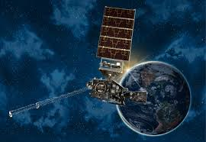
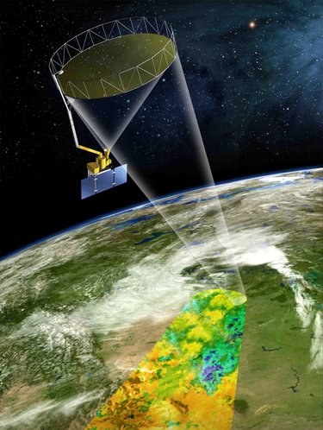
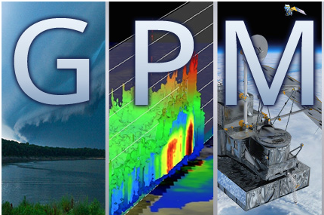
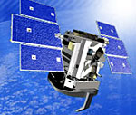
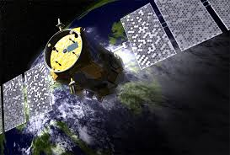
Introducing a NEW Satellite to the
GLOBE Satellite Partnerships Program
SMAP – Soil Moisture
GPM – Global Water Budget/Rainfall
CloudSat
Calipso
GOES-R* - Clouds, Lightning, Ice

Slide 4
  GOES-R, a new Geostationary Operational Environmental Satellite (GOES) … is scheduled for launch in June 2016. The GOES-R Education Proving Ground (http://cimss.ssec.wisc.edu/education/goesr/) features the design and development of pre- and post-launch lesson plans and activities for G6-12 teachers and students to ensure that the education community will be “launch ready” for new satellite imagery and improved products in the upcoming GOES-R era. A key element of this effort is a core group of educators working with Education and Outreach staff at the Cooperative Institute for Meteorological Satellite Studies (CIMSS) in Madison Wisconsin in close coordination with NOAA scientists at CIMSS. This team has a dynamic plan to engage the nation in STEM education (Science, Technology, Engineering and Math) by leveraging the GOES-R launch, as well as the subsequent GOES-R satellite series.
Notes:
*Only trained teachers and students can currently enter data. Later this year GLOBE will expand to non K-12 formal community to allow other adults and kids to enter data through a new app.

Slide 5





Geoscience Literacy
Science for All Citizens
Earth
Oceans
Atmosphere
Climate
Energy

Slide 6
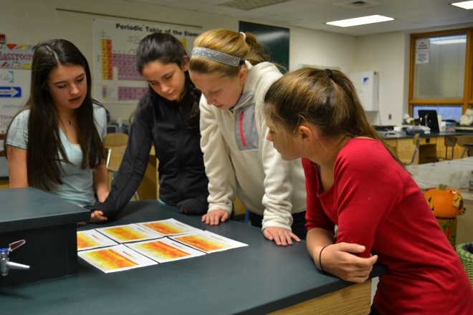
Impacts on Precollege Education
foster an interest and understanding of STEM disciplines and their relationship to Earth system science
encourage students to pursue a career in STEM disciplines, including earth system science
promote a lifelong understanding and appreciation of STEM and its role in advancing social and economic well-being
increase STEM literacy to establish an informed public
expand opportunities to broaden participation and enhance diversity
ensure focused, rigorous, and articulated as a sequence of topics and performances
encourages institutions of higher learning to examine their admissions requirements

Slide 7
Earth SySTEM Education*
Applications of the Geosciences*
in Science, Technology, Engineering, and
Mathematics (STEM) Education
Earth SySTEM utilizes satellite imagery, remote sensing technology, real-time data, and computer visualizations to facilitate interactions between STEM disciplines in the study of Earth as a system.
* Geoscience as defined by the NSF …
Earth-Oceans-Atmosphere/Space
AMS Earth System STEM Education Policy Statement
https://www.ametsoc.org/POLICY/2014Earth_STEM_Education.html

Slide 8
Earth SySTEM
Earth and Space Science
Geosciences
Environmental Science
Earth System Science

Slide 9
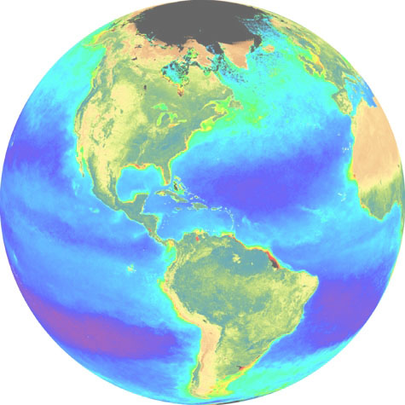
Earth SySTEM:
Observe the Earth and
Visualize the Future
Real-Time Data
Image Analysis
SEES Model
Study Earth as a System
Monitoring
Geographic Information System (GIS)
Field Observations and Data Collection

Slide 10
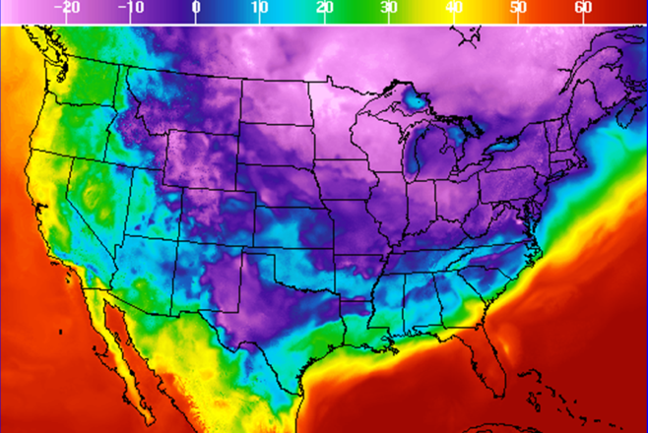
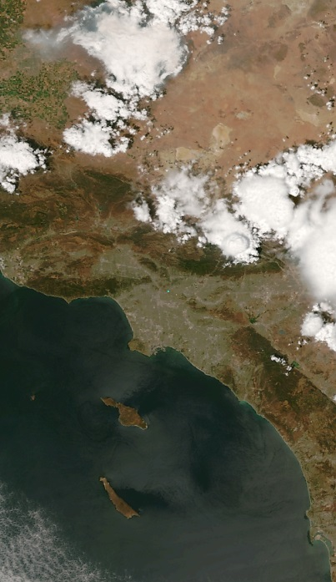
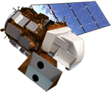
Geoscience and Remote
Sensing Laboratory
Real-Time Data
Google Earth Display
Geographic Information System (GIS)
Image Analysis
Study Earth as a System
Monitoring
Field Observations and Data Collection

Slide 11
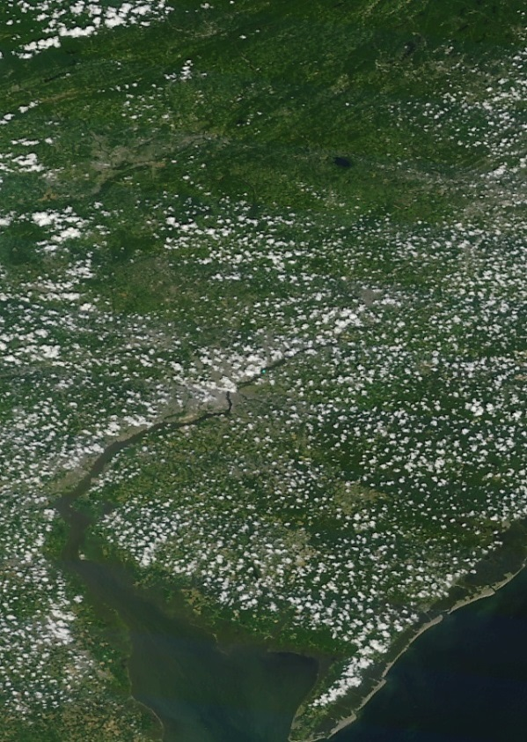
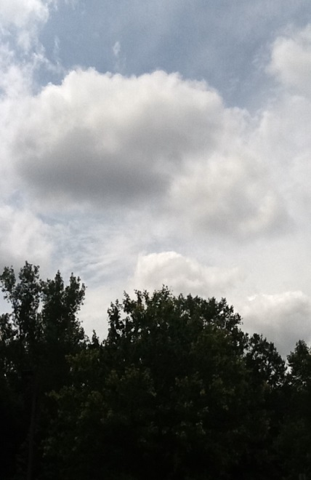
SPACE-EARTH : EARTH-SPACE
Students now have the ability to
examine a geo-referenced location from the
top-down and bottom-up
An Integrated “SEES”
Earth SySTEM Educational Model
Fosters Geospatial Thinking
Identifies geo-referenced data
points/sources
Creating Environmental
Intelligence
Incorporates Real-time Data
Develops Geoscience and Remote Sensing content and applications

Slide 12
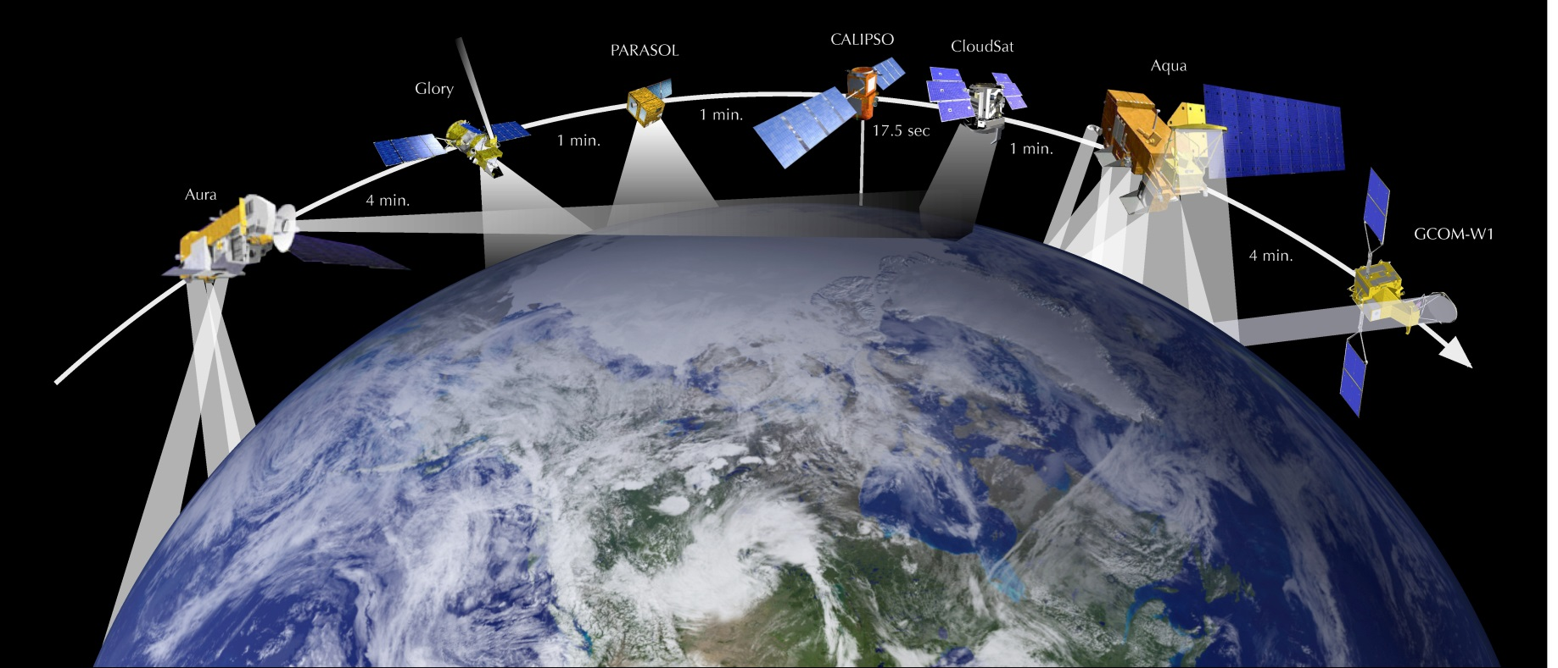
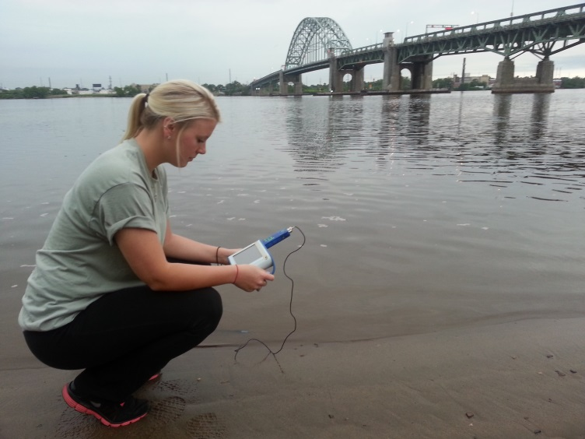
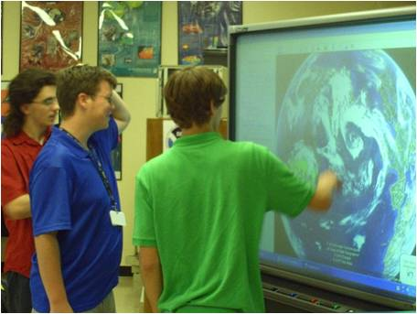

SPACE TO EARTH : EARTH TO SPACE (SEES)

Slide 13
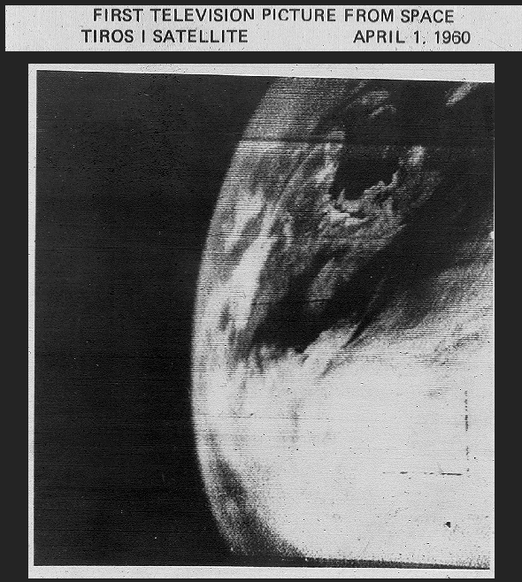
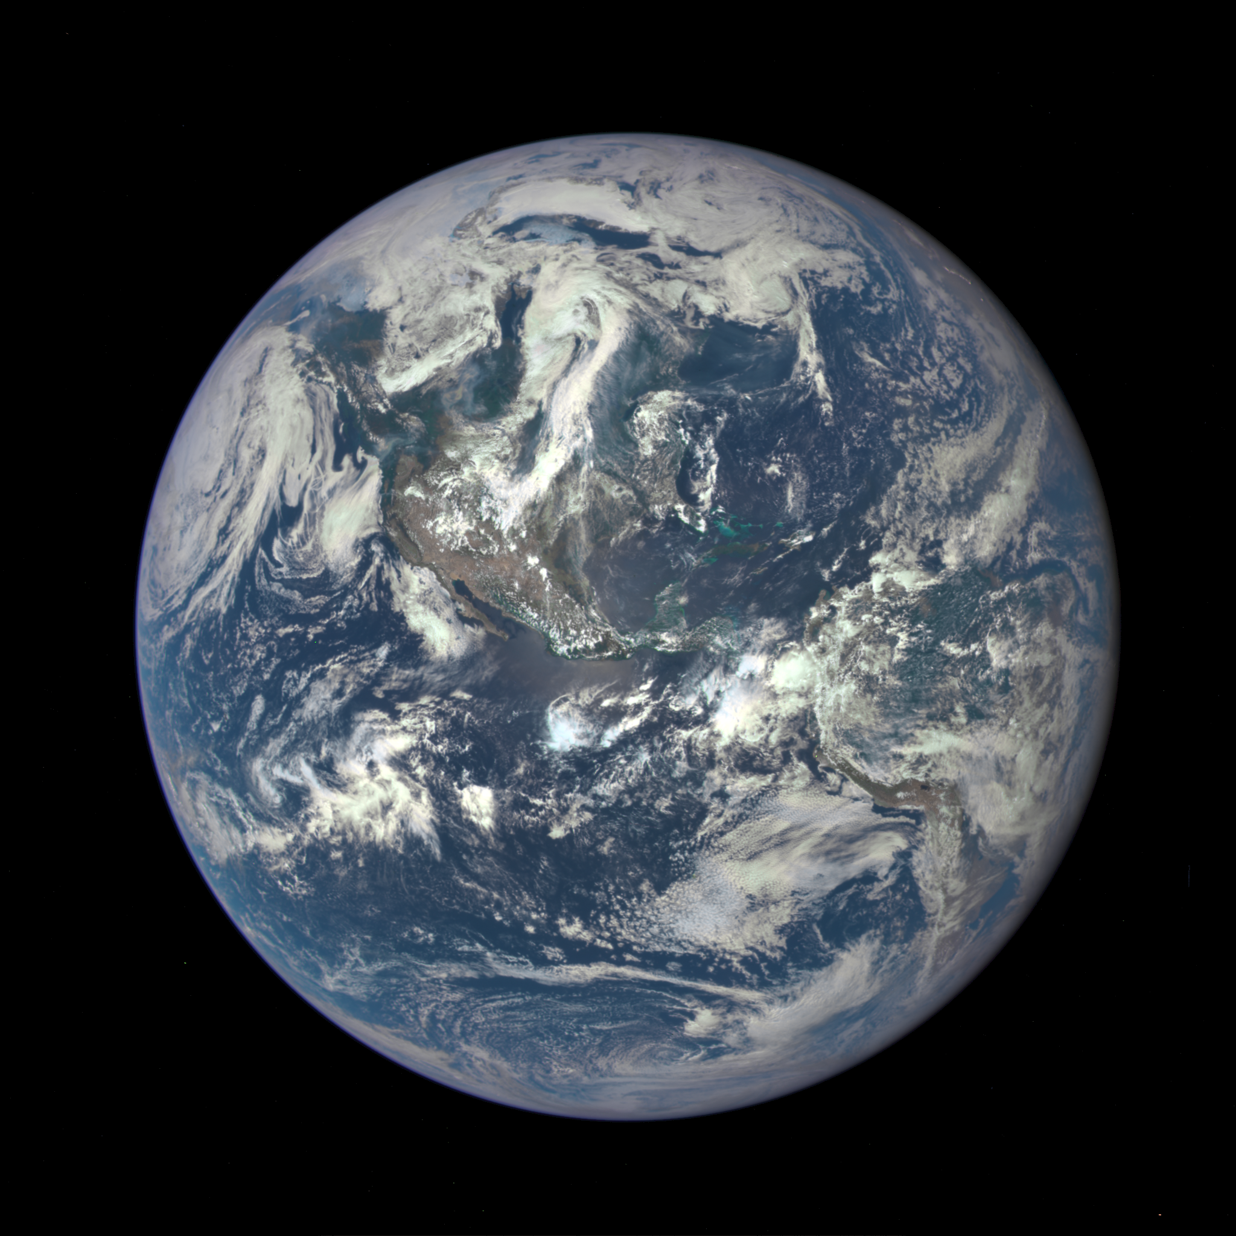
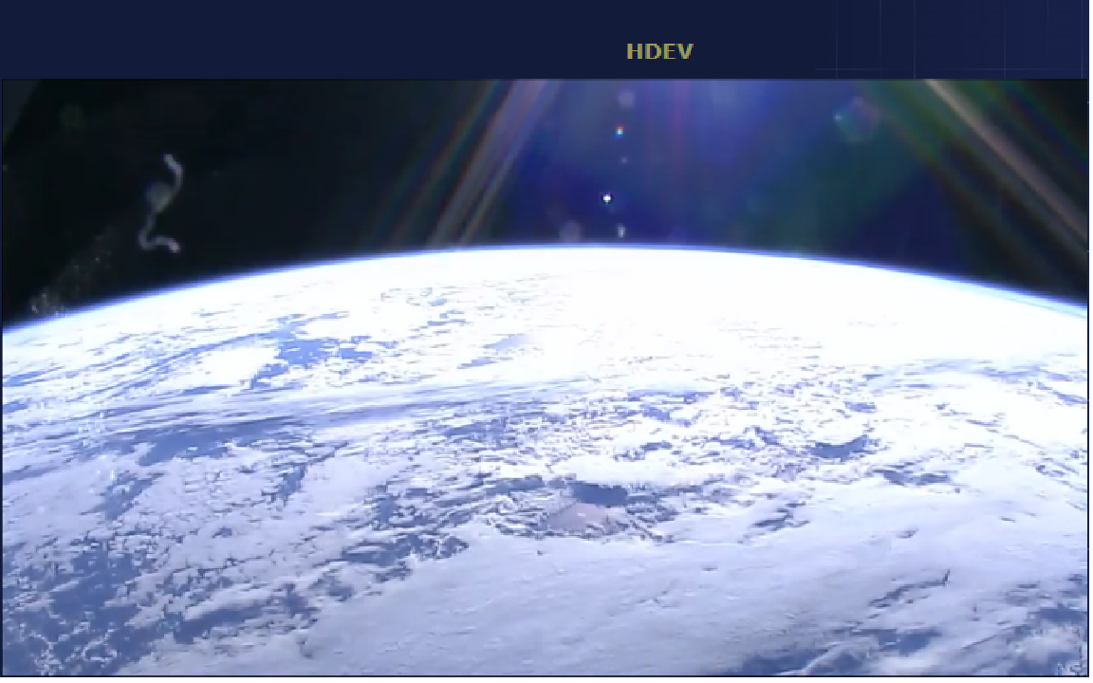
History of Images of Earth from Space
LIVE HD Imagery from the ISS
First Satellite Television Picture from Space April 1, 1960 -
TIROS 1
Nation’s first operational satellite in deep space reaches final orbit June 8, 2015 -
Deep Space Climate Observatory (DSCOVR)

Slide 14
What will students do?
Collect atmospheric data using GLOBE scientific protocols
Collect SatCam Satellite Imagery creating a Digital Library
Document Weather events … photos, media, video
Prepare Metadata analysis
Provide Environmental Intelligence

Slide 15
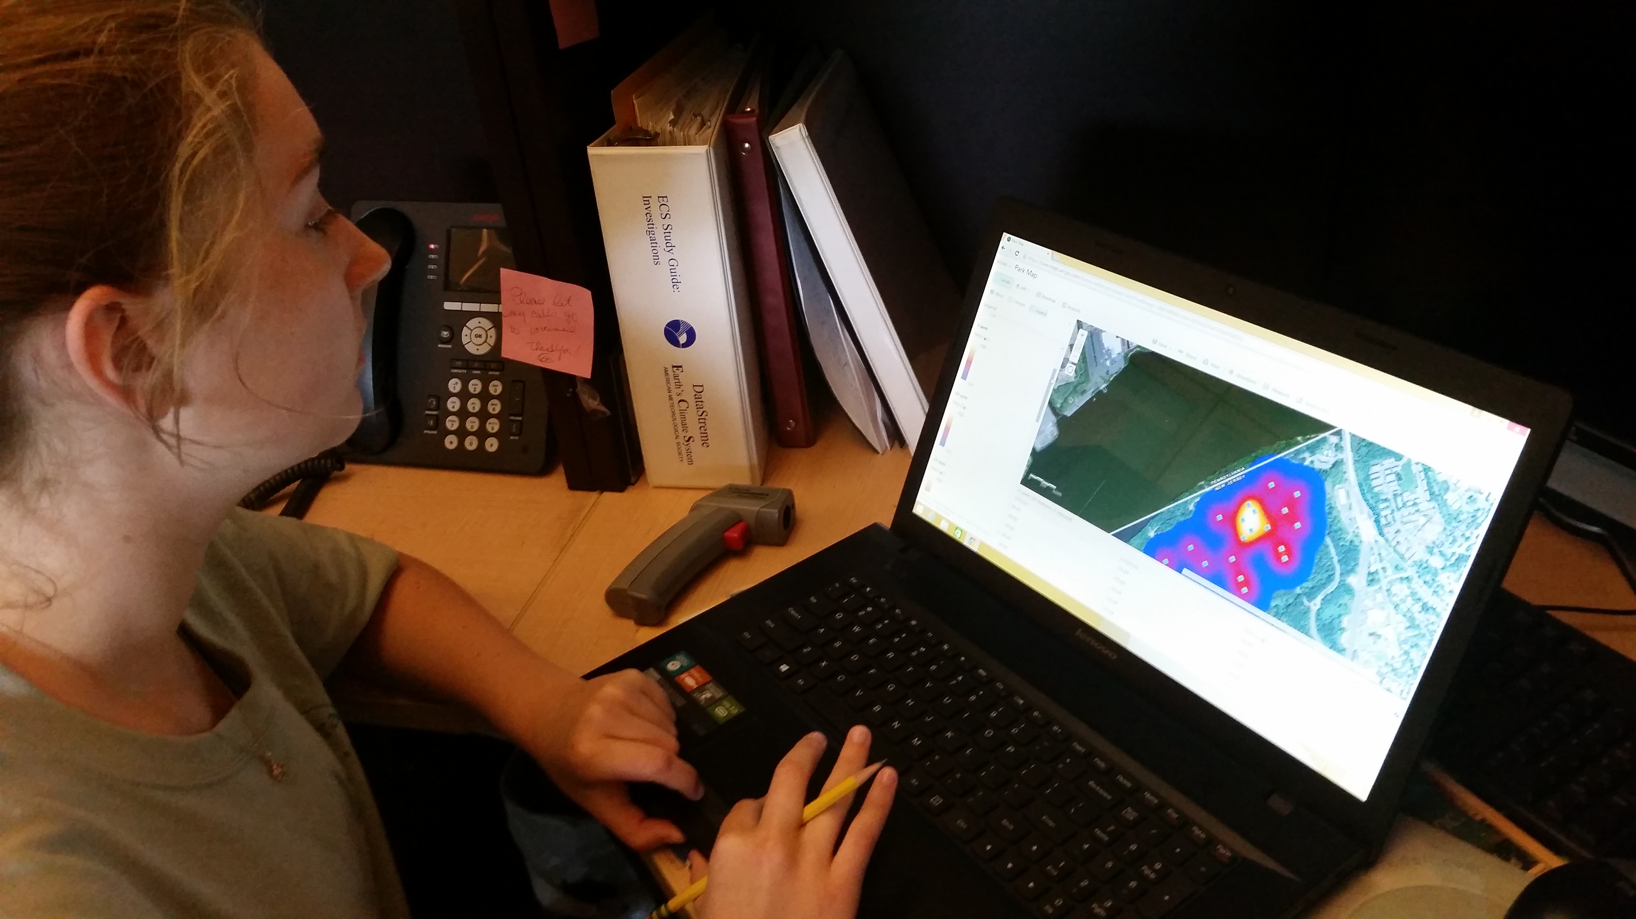
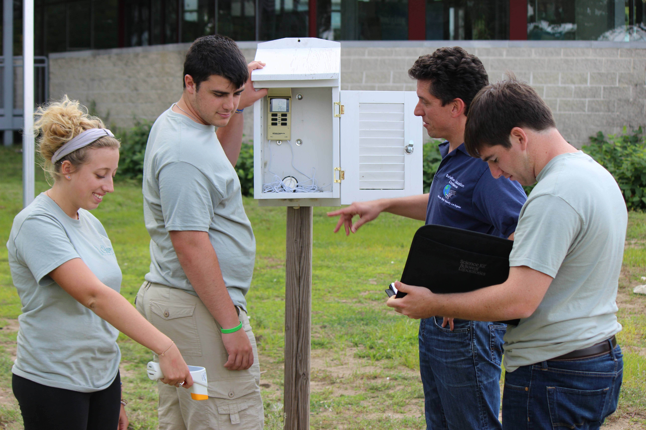
GLOBE Protocols and Metadata
Complete Atmosphere protocols
Participate in the Green-up and Down protocols
Monitor and Collect event photography from Local Media coverage sources
Journal/Blog personal experiences
Capture Radar and Satellite Imagery

Slide 16
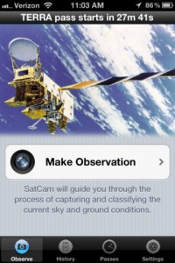
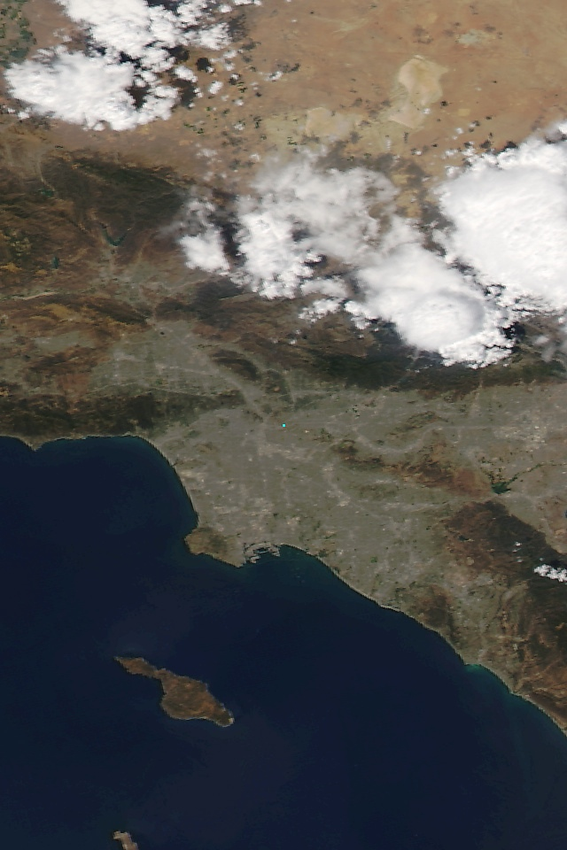
SatCam App : Track Satellites and Make Observations –
Send Images and Data!

Slide 17
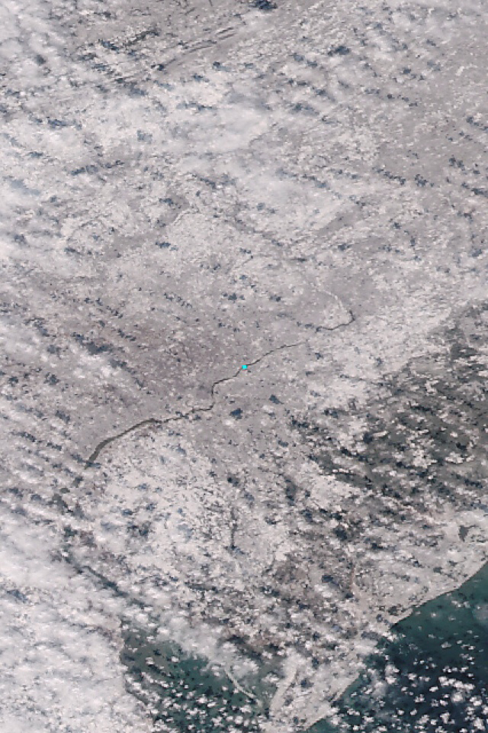
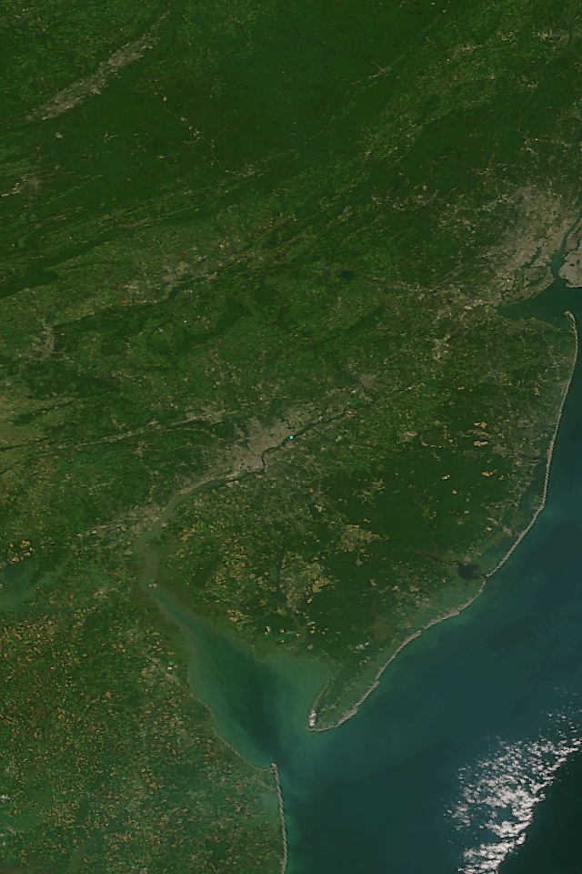
Observations from Space of New Jersey, USA
Winter Storm
Summer Vegetation

Slide 18
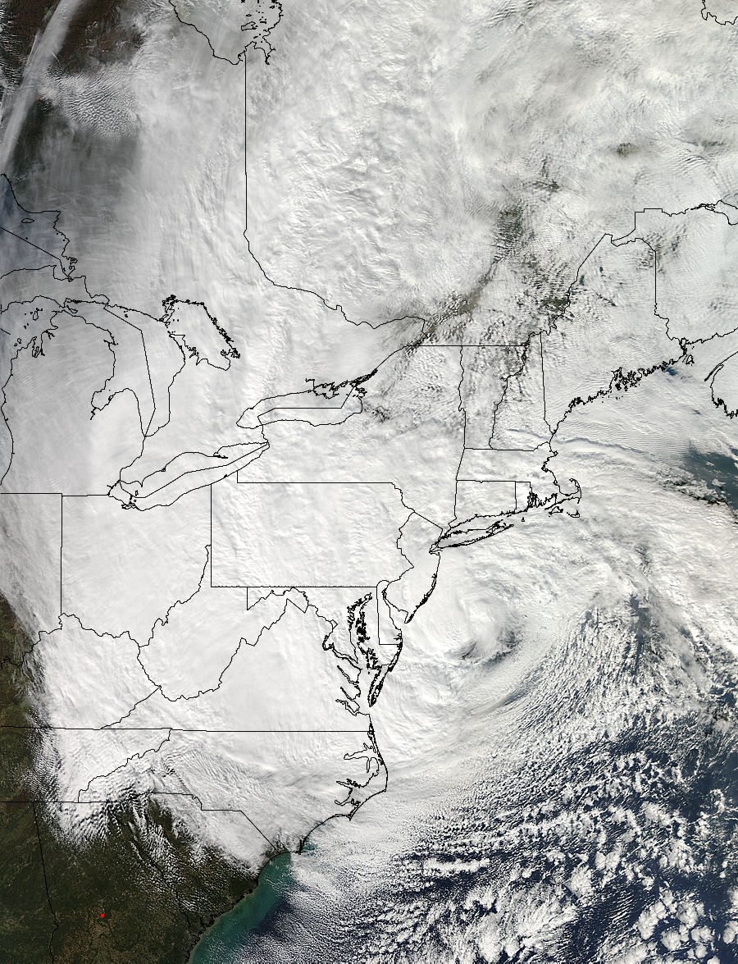
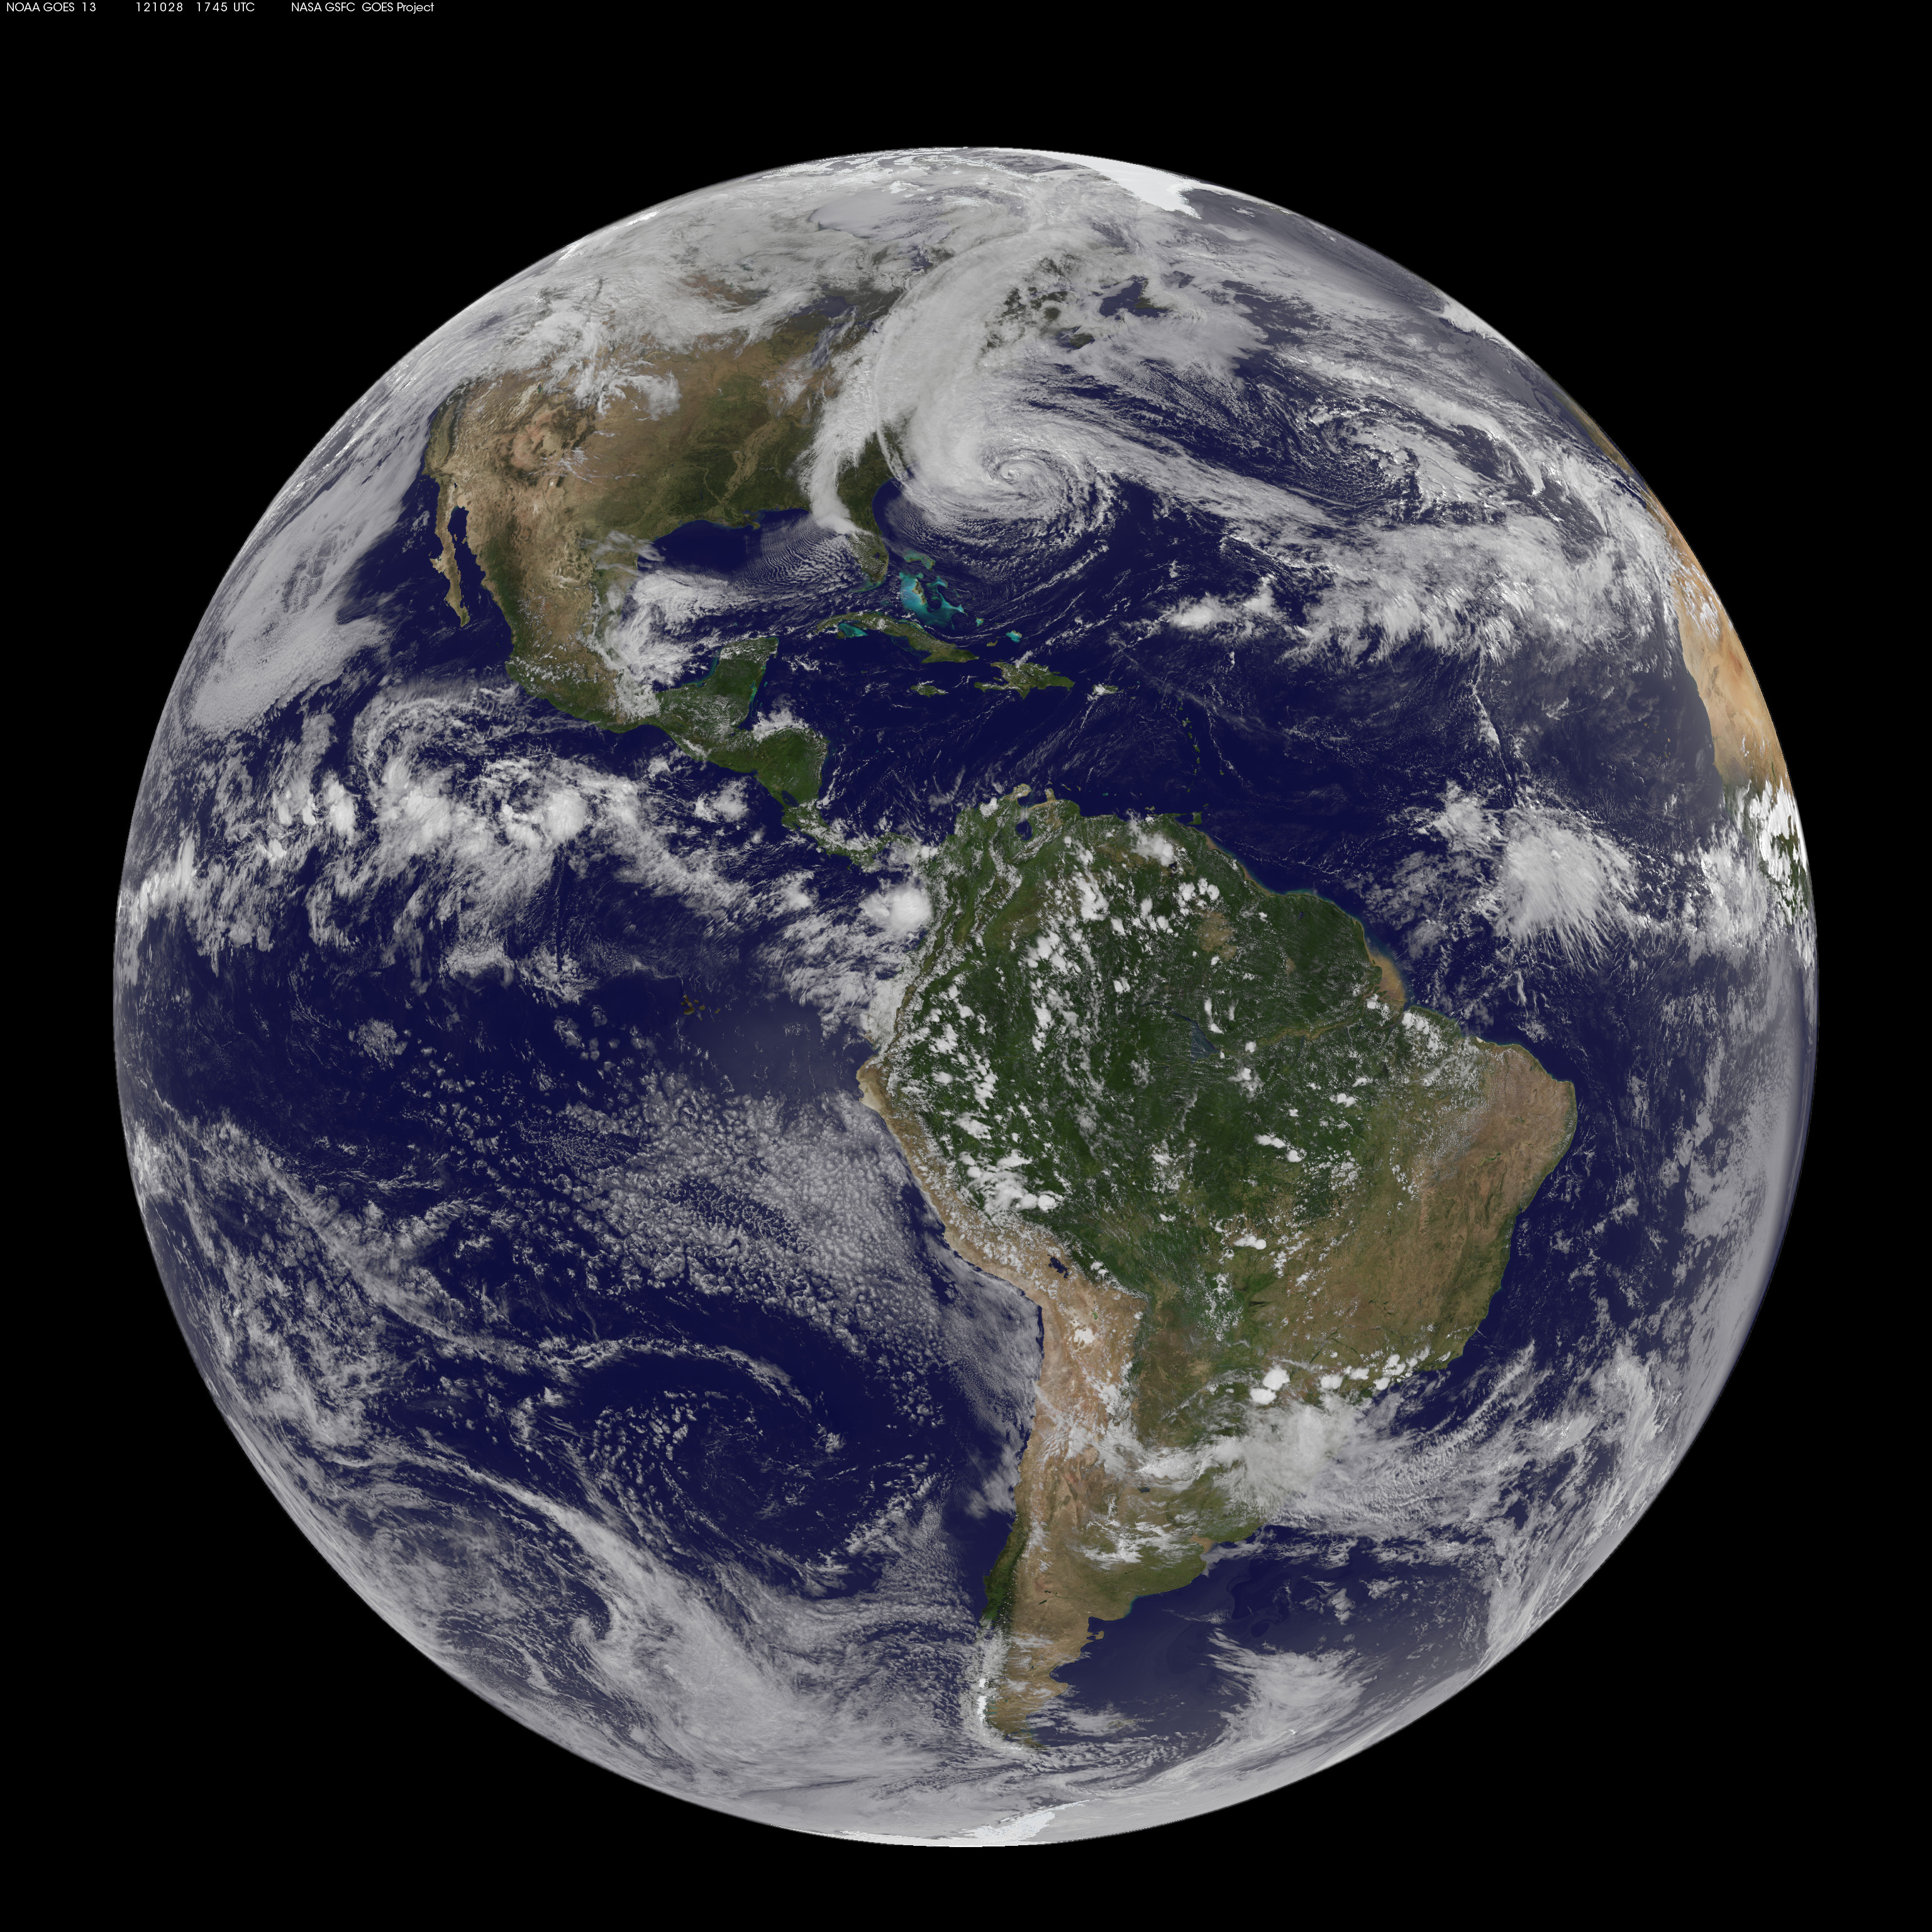
Two Views of Hurricane Sandy from SPACE

Slide 19
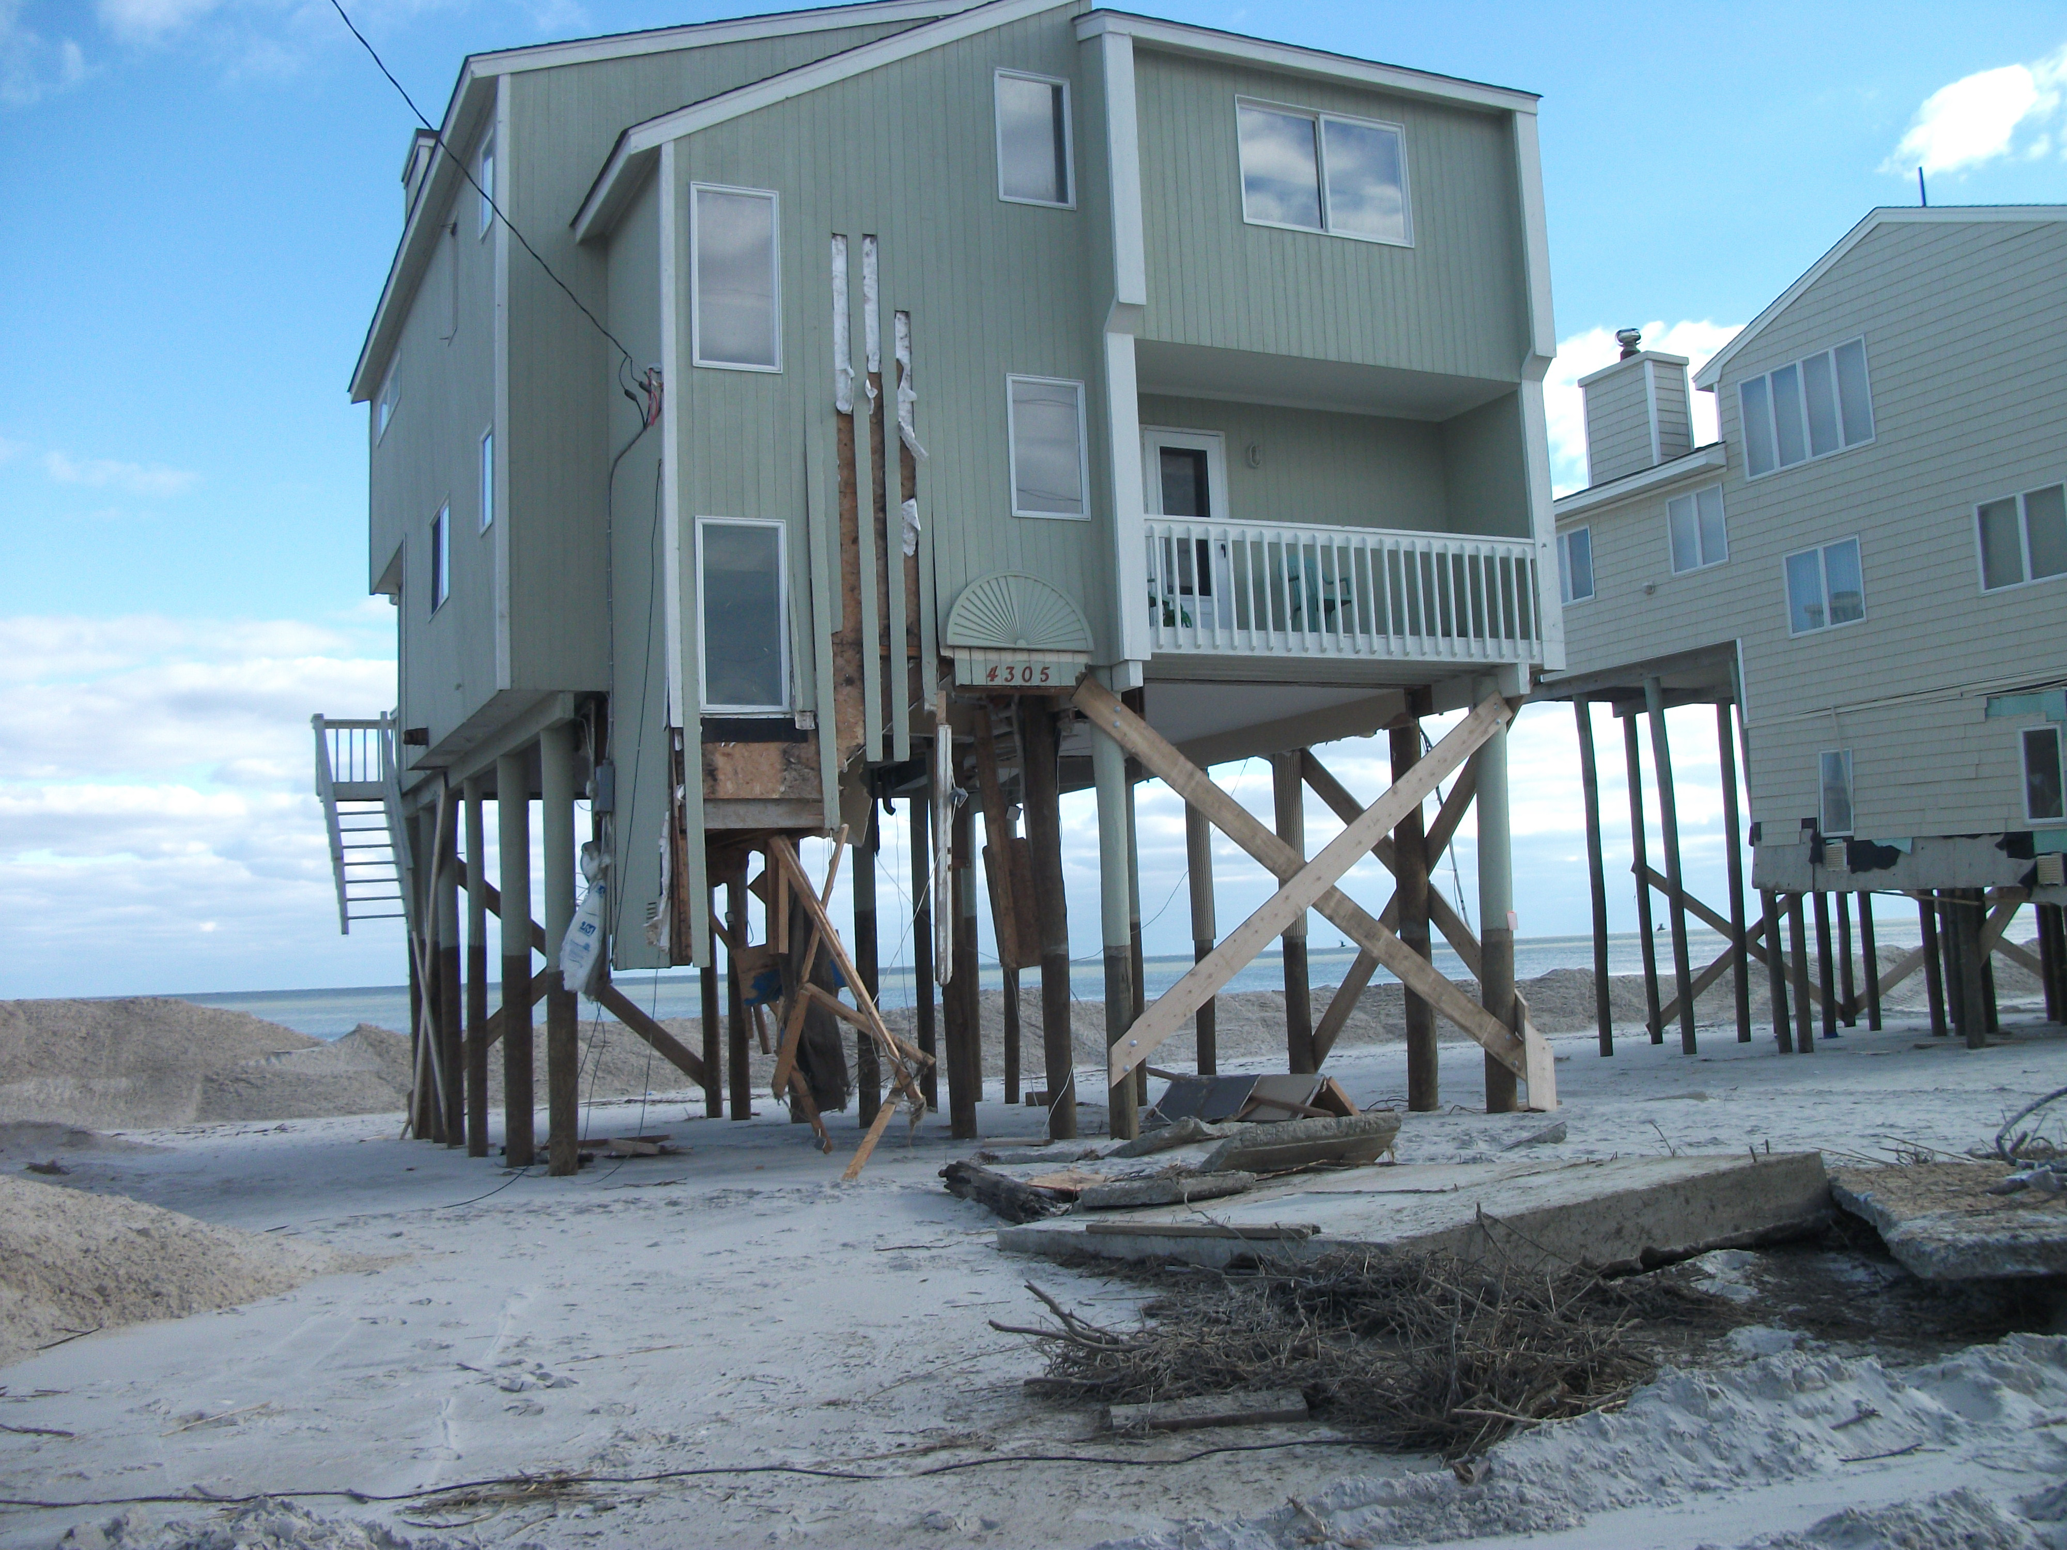
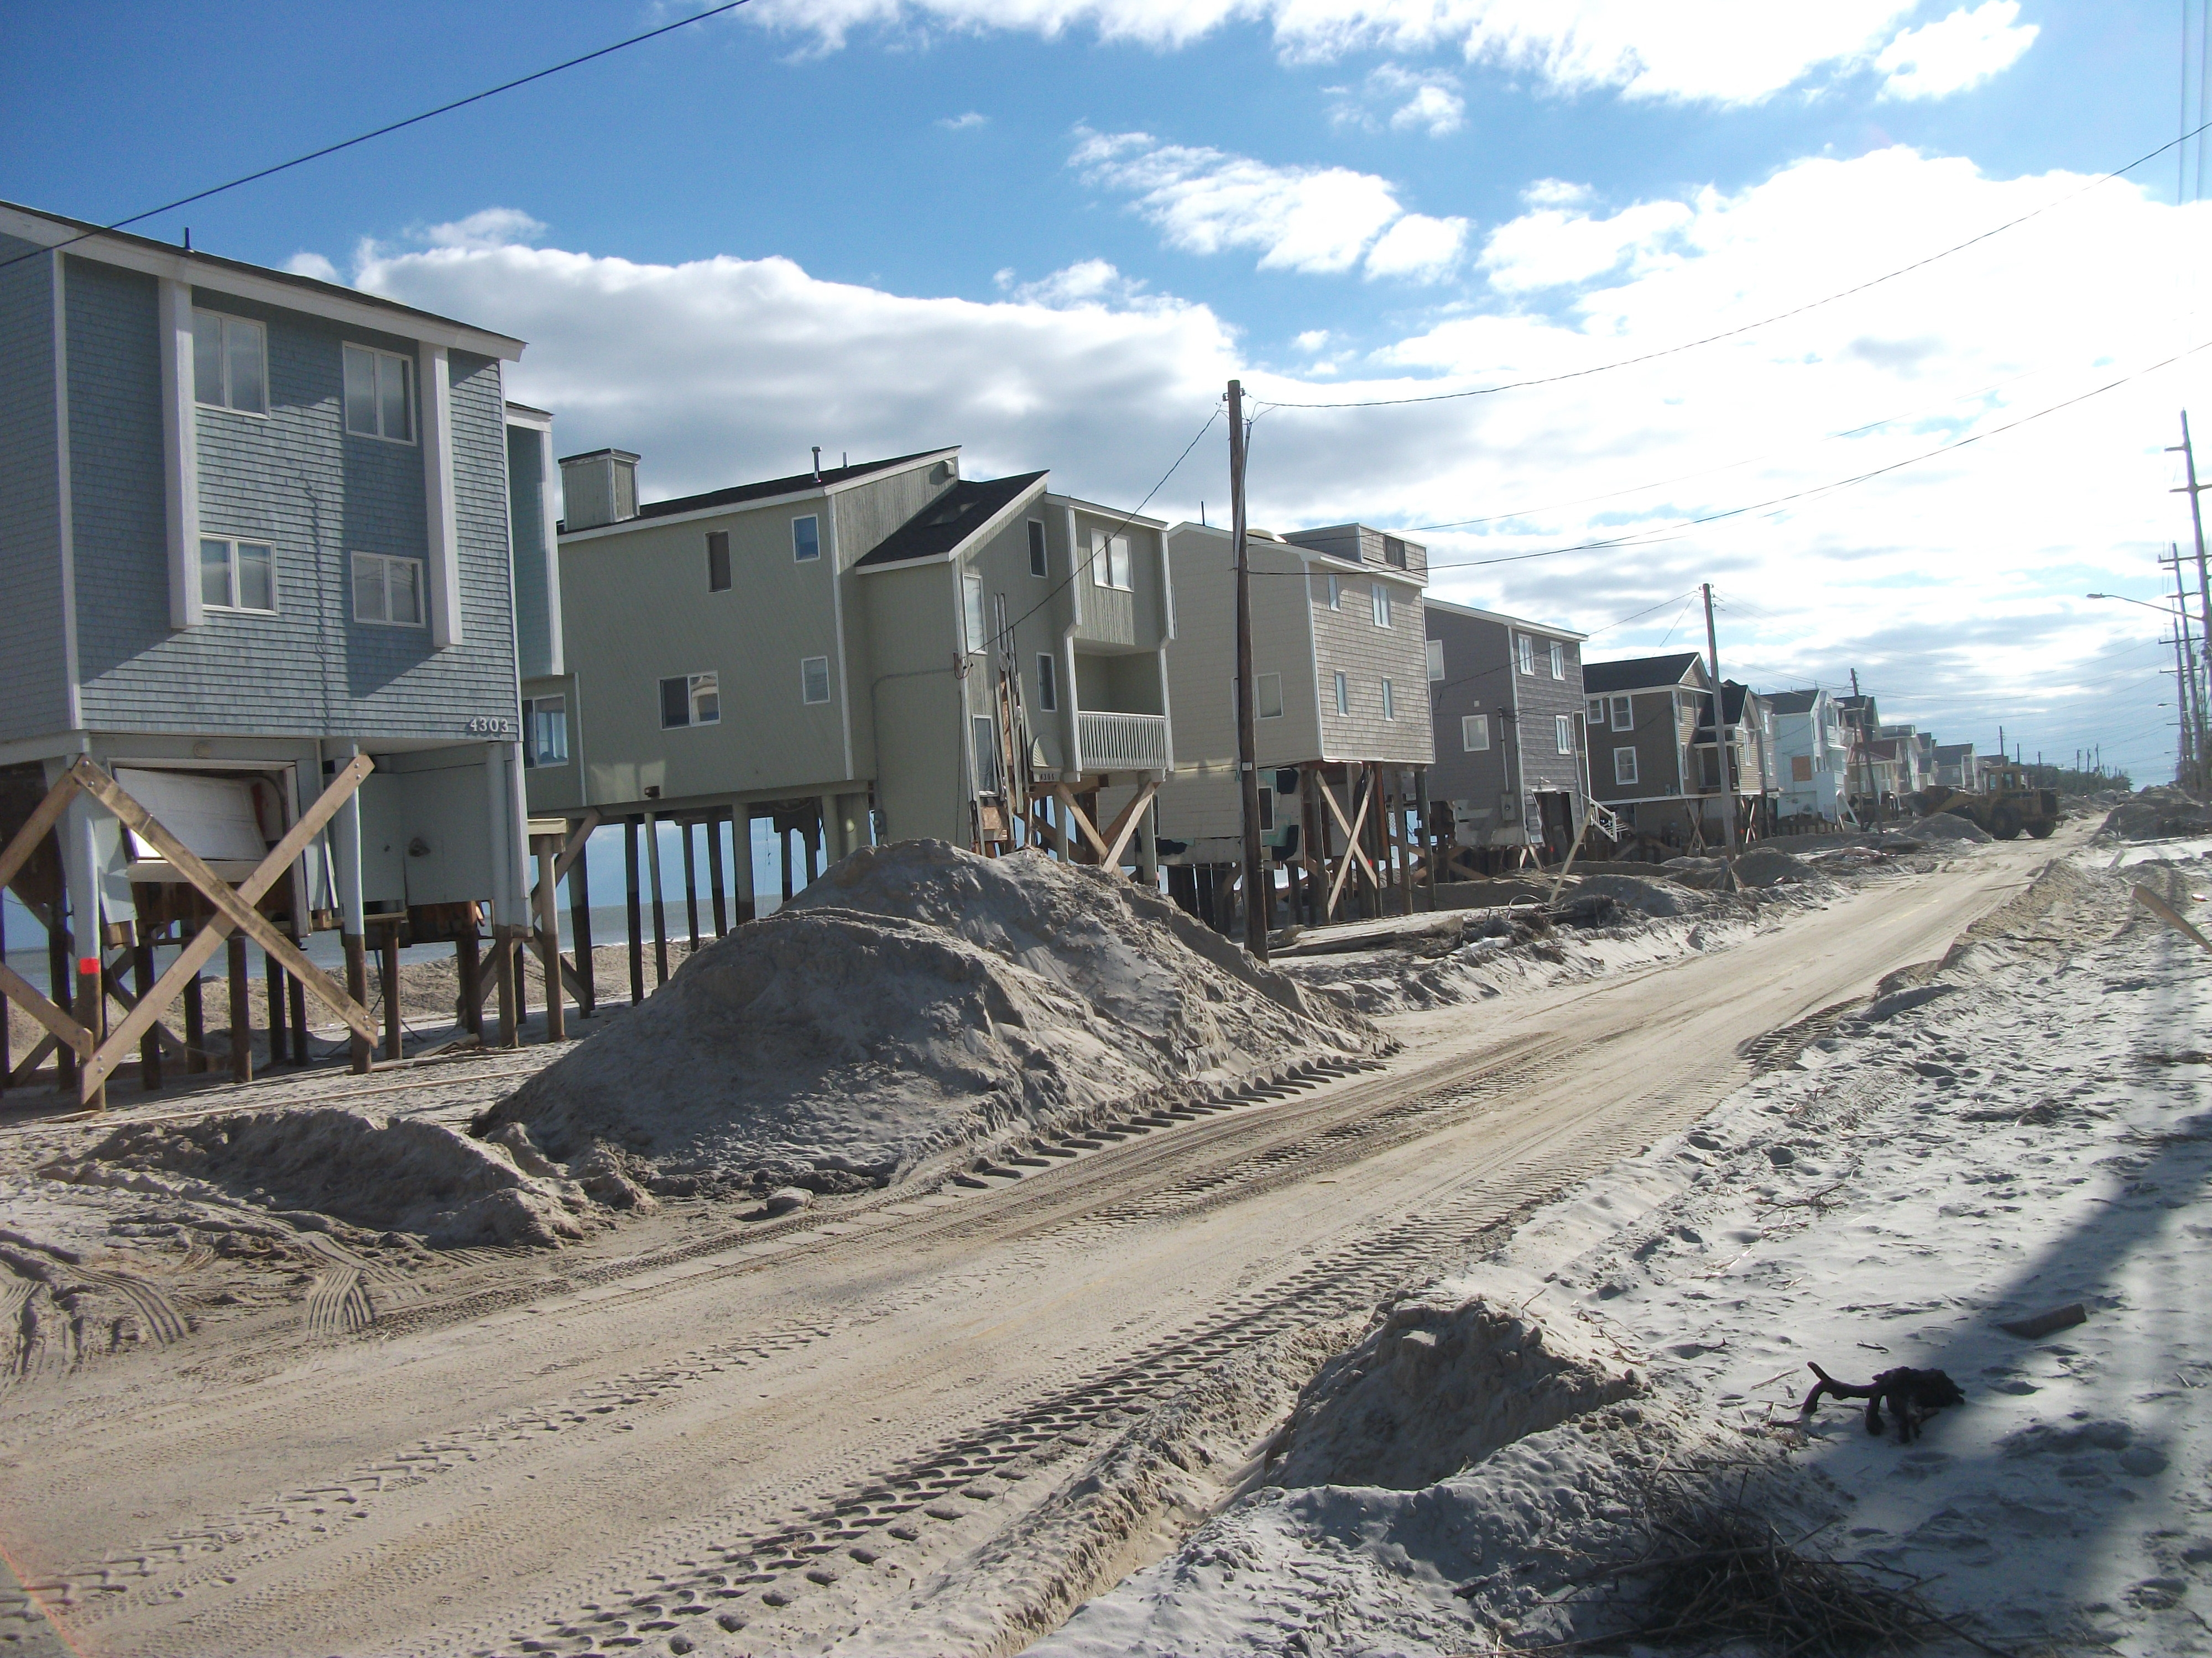
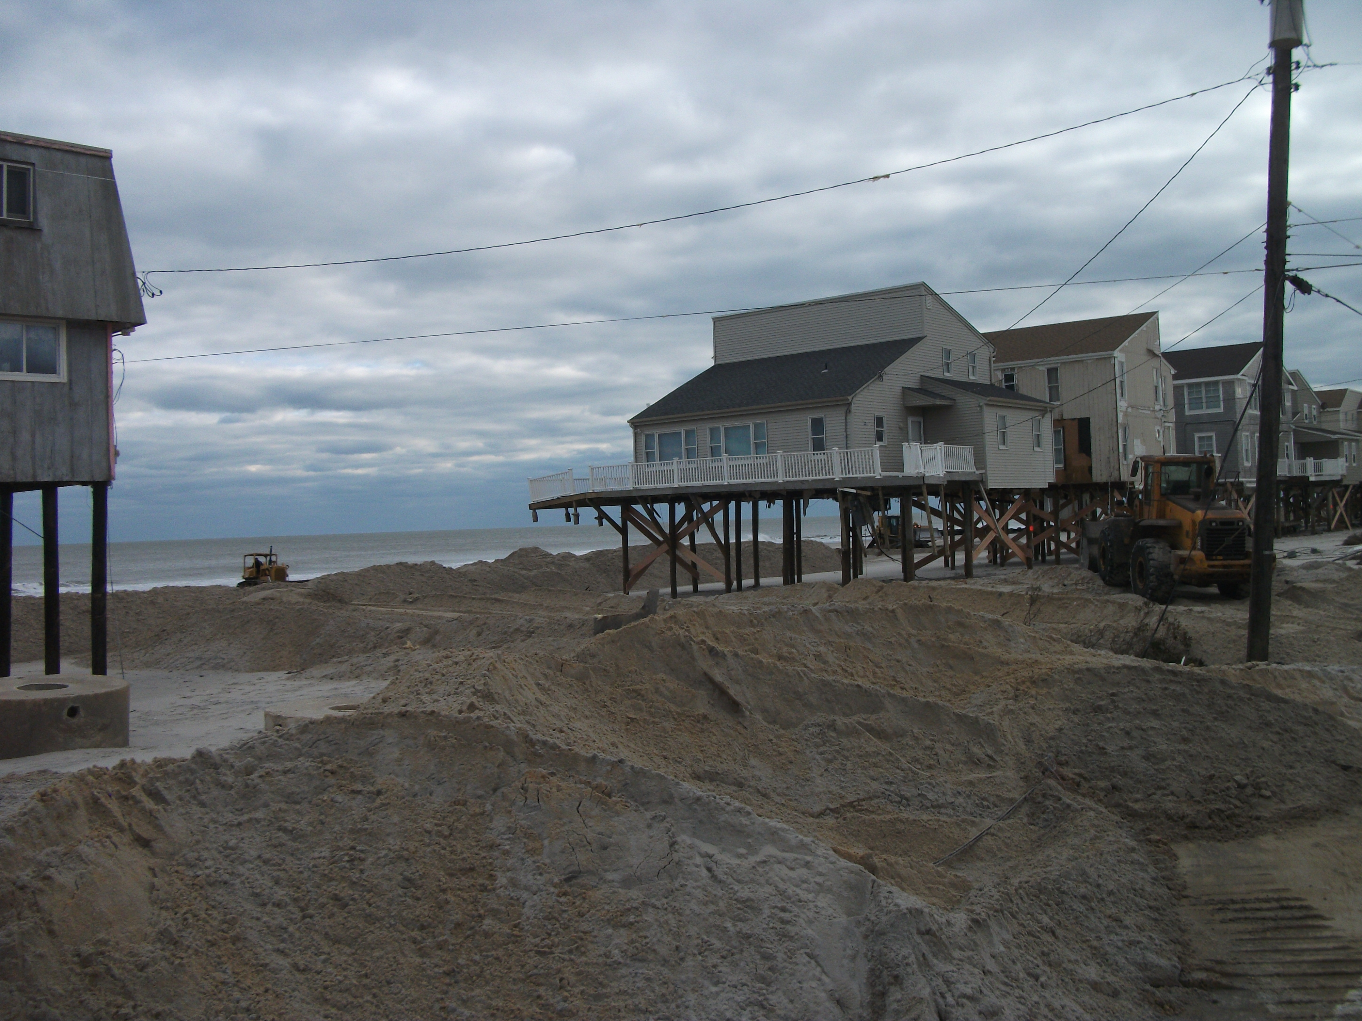
Results of Hurricane Sandy:
Beach Erosion in New Jersey

Slide 20
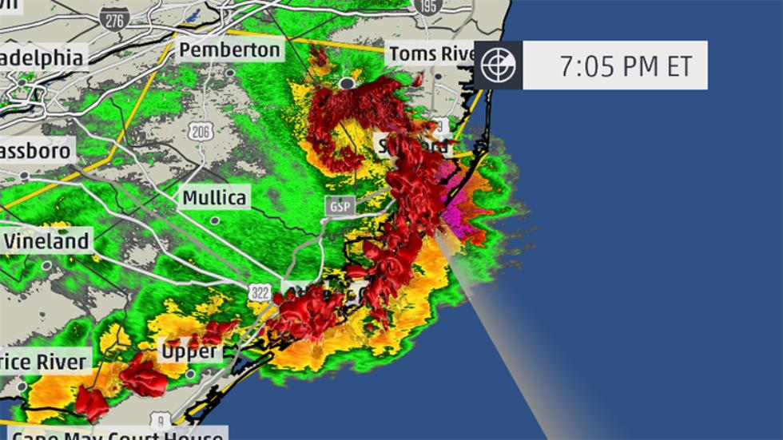
...SUMMARY...
THE NATIONAL WEATHER SERVICE IN MOUNT HOLLY NJ HAS CONFIRMED A MACROBURST /STRAIGHT LINE WIND DAMAGE/ NEAR EAST GREENWICH TOWNSHIP IN GLOUCESTER COUNTY NEW JERSEY ON JUNE 23 2015.
A NATIONAL WEATHER SERVICE SURVEY TEAM ACCOMPANIED THE GLOUCESTER COUNTY EMERGENCY MANAGEMENT OFFICIALS AS THEY ASSESSED DAMAGE IN EAST GREENWICH TOWNSHIP. POWER POLES WERE SNAPPED IN SEVERAL LOCATIONS WITH MANY TOPPLED TREES AND DEBRIS ACROSS THE REGION. MANY ROADS WERE IMPASSABLE THROUGHOUT THE TOWNSHIP AS A RESULT OF
DOWNED TREES AND POWER LINES. SOME OF THE MOST SIGNIFICANT DAMAGE OCCURRED ALONG EAST COHAWKIN
ROAD NEAR PINE MILL ROAD AND ALONG KINGS HIGHWAY, JUST NORTH OF EAST COHAWKIN ROAD. POWER POLES WERE TOPPLED ONTO THESE ROADWAYS MAKING THEM IMPASSABLE. DAMAGE TO PRIVATE RESIDENCES INCLUDED MINOR SHINGLE DAMAGE AND A BLOWN OVER SHED IN THE CLARKSBORO SECTION.
THIS SURVEYED AREA WAS CONSIDERED TO BE THE HARDEST HIT PART OF THE COUNTY. HOWEVER, THE STORM CONTINUED TO PRODUCE WIDESPREAD DAMAGE AS IT MOVED FURTHER EAST, IMPACTING AREAS INCLUDING MANTUA, WASHINGTON TOWNSHIP AND SICKLERVILLE. ONCE AGAIN, THIS DATA IS CONSIDERED TO BE PRELIMINARY. WE
CONTINUE TO REVIEW ALL THE DATA COLLECTED AND MAY UPDATE THIS
STATEMENT AT A LATER DATE. THIS INFORMATION CAN ALSO BE FOUND ON OUR WEBSITE AT WEATHER.GOV/PHI.
National Weather Service –Doppler Radar
June 23, 2015

Slide 21
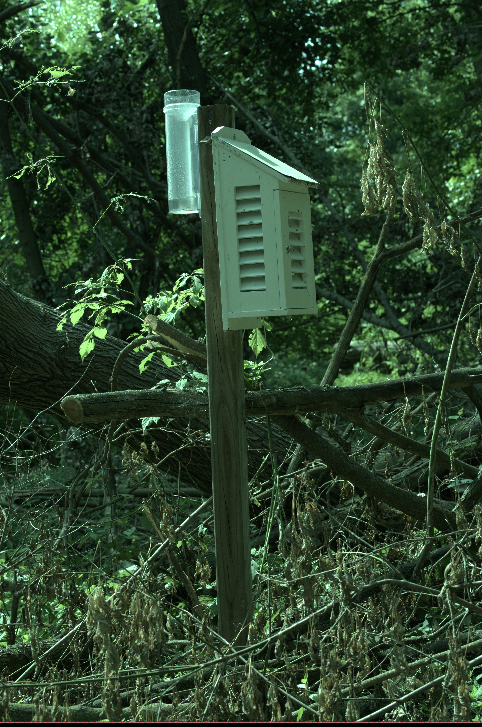
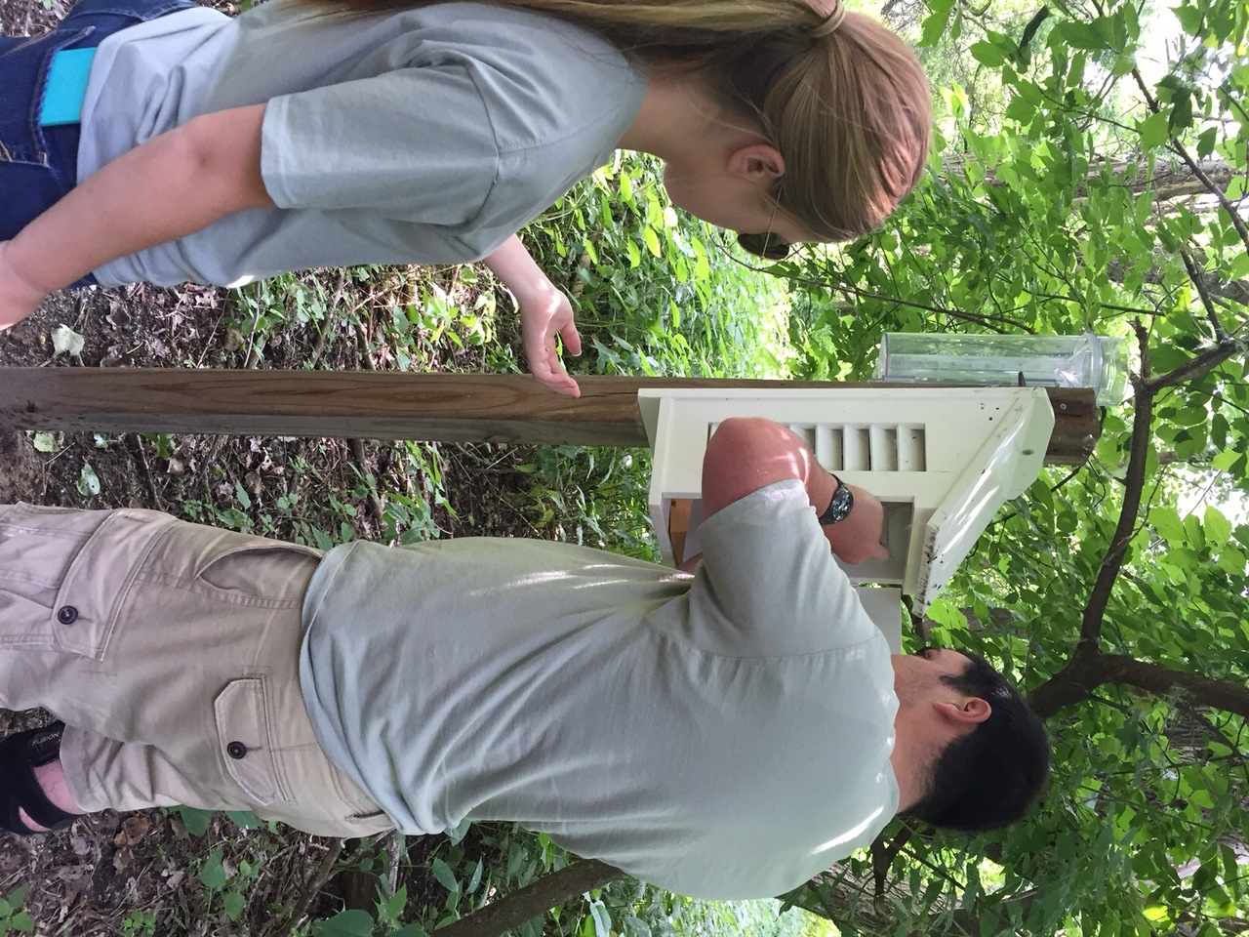
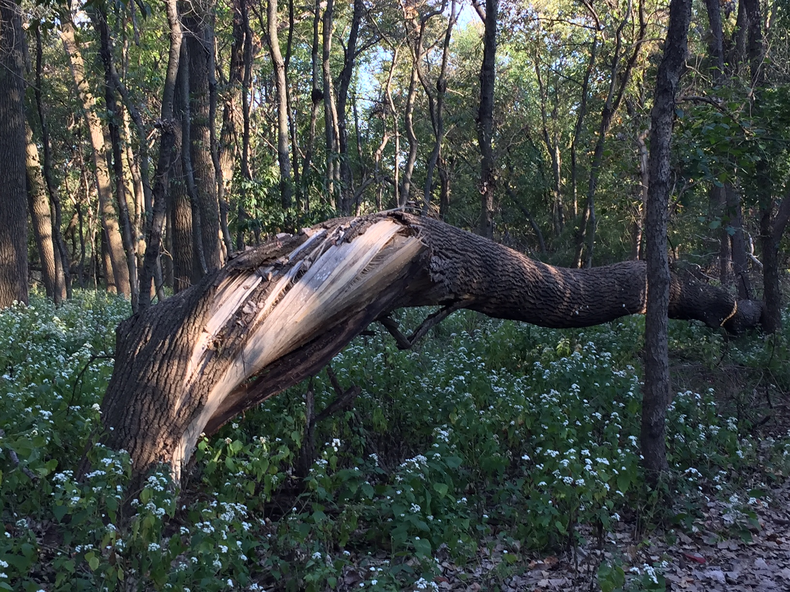
Heavy Storms Pass through New Jersey
(Palmyra Cove Nature Park)
Before
After

Slide 22
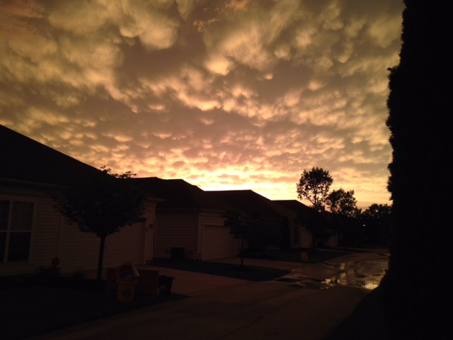
Can you identify these cloud types?
(Voorhees, NJ)

Slide 23
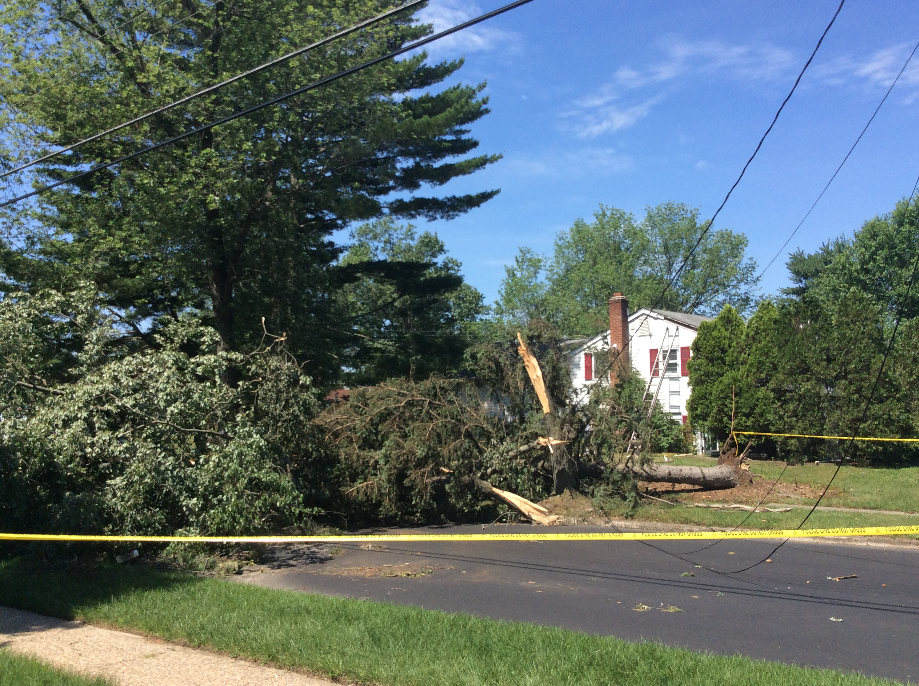
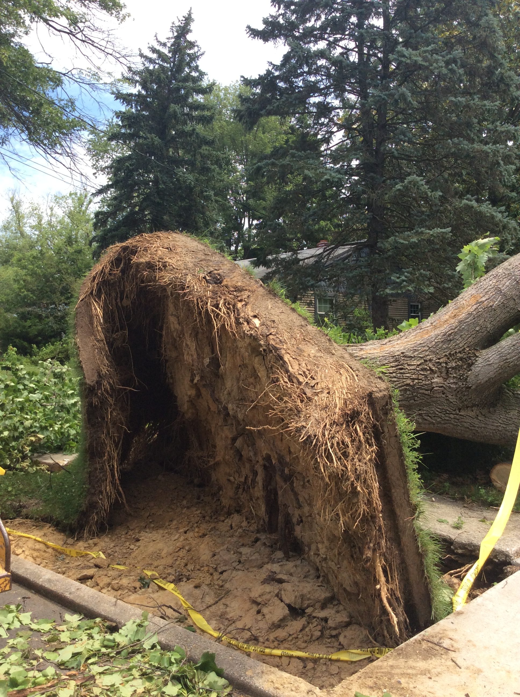
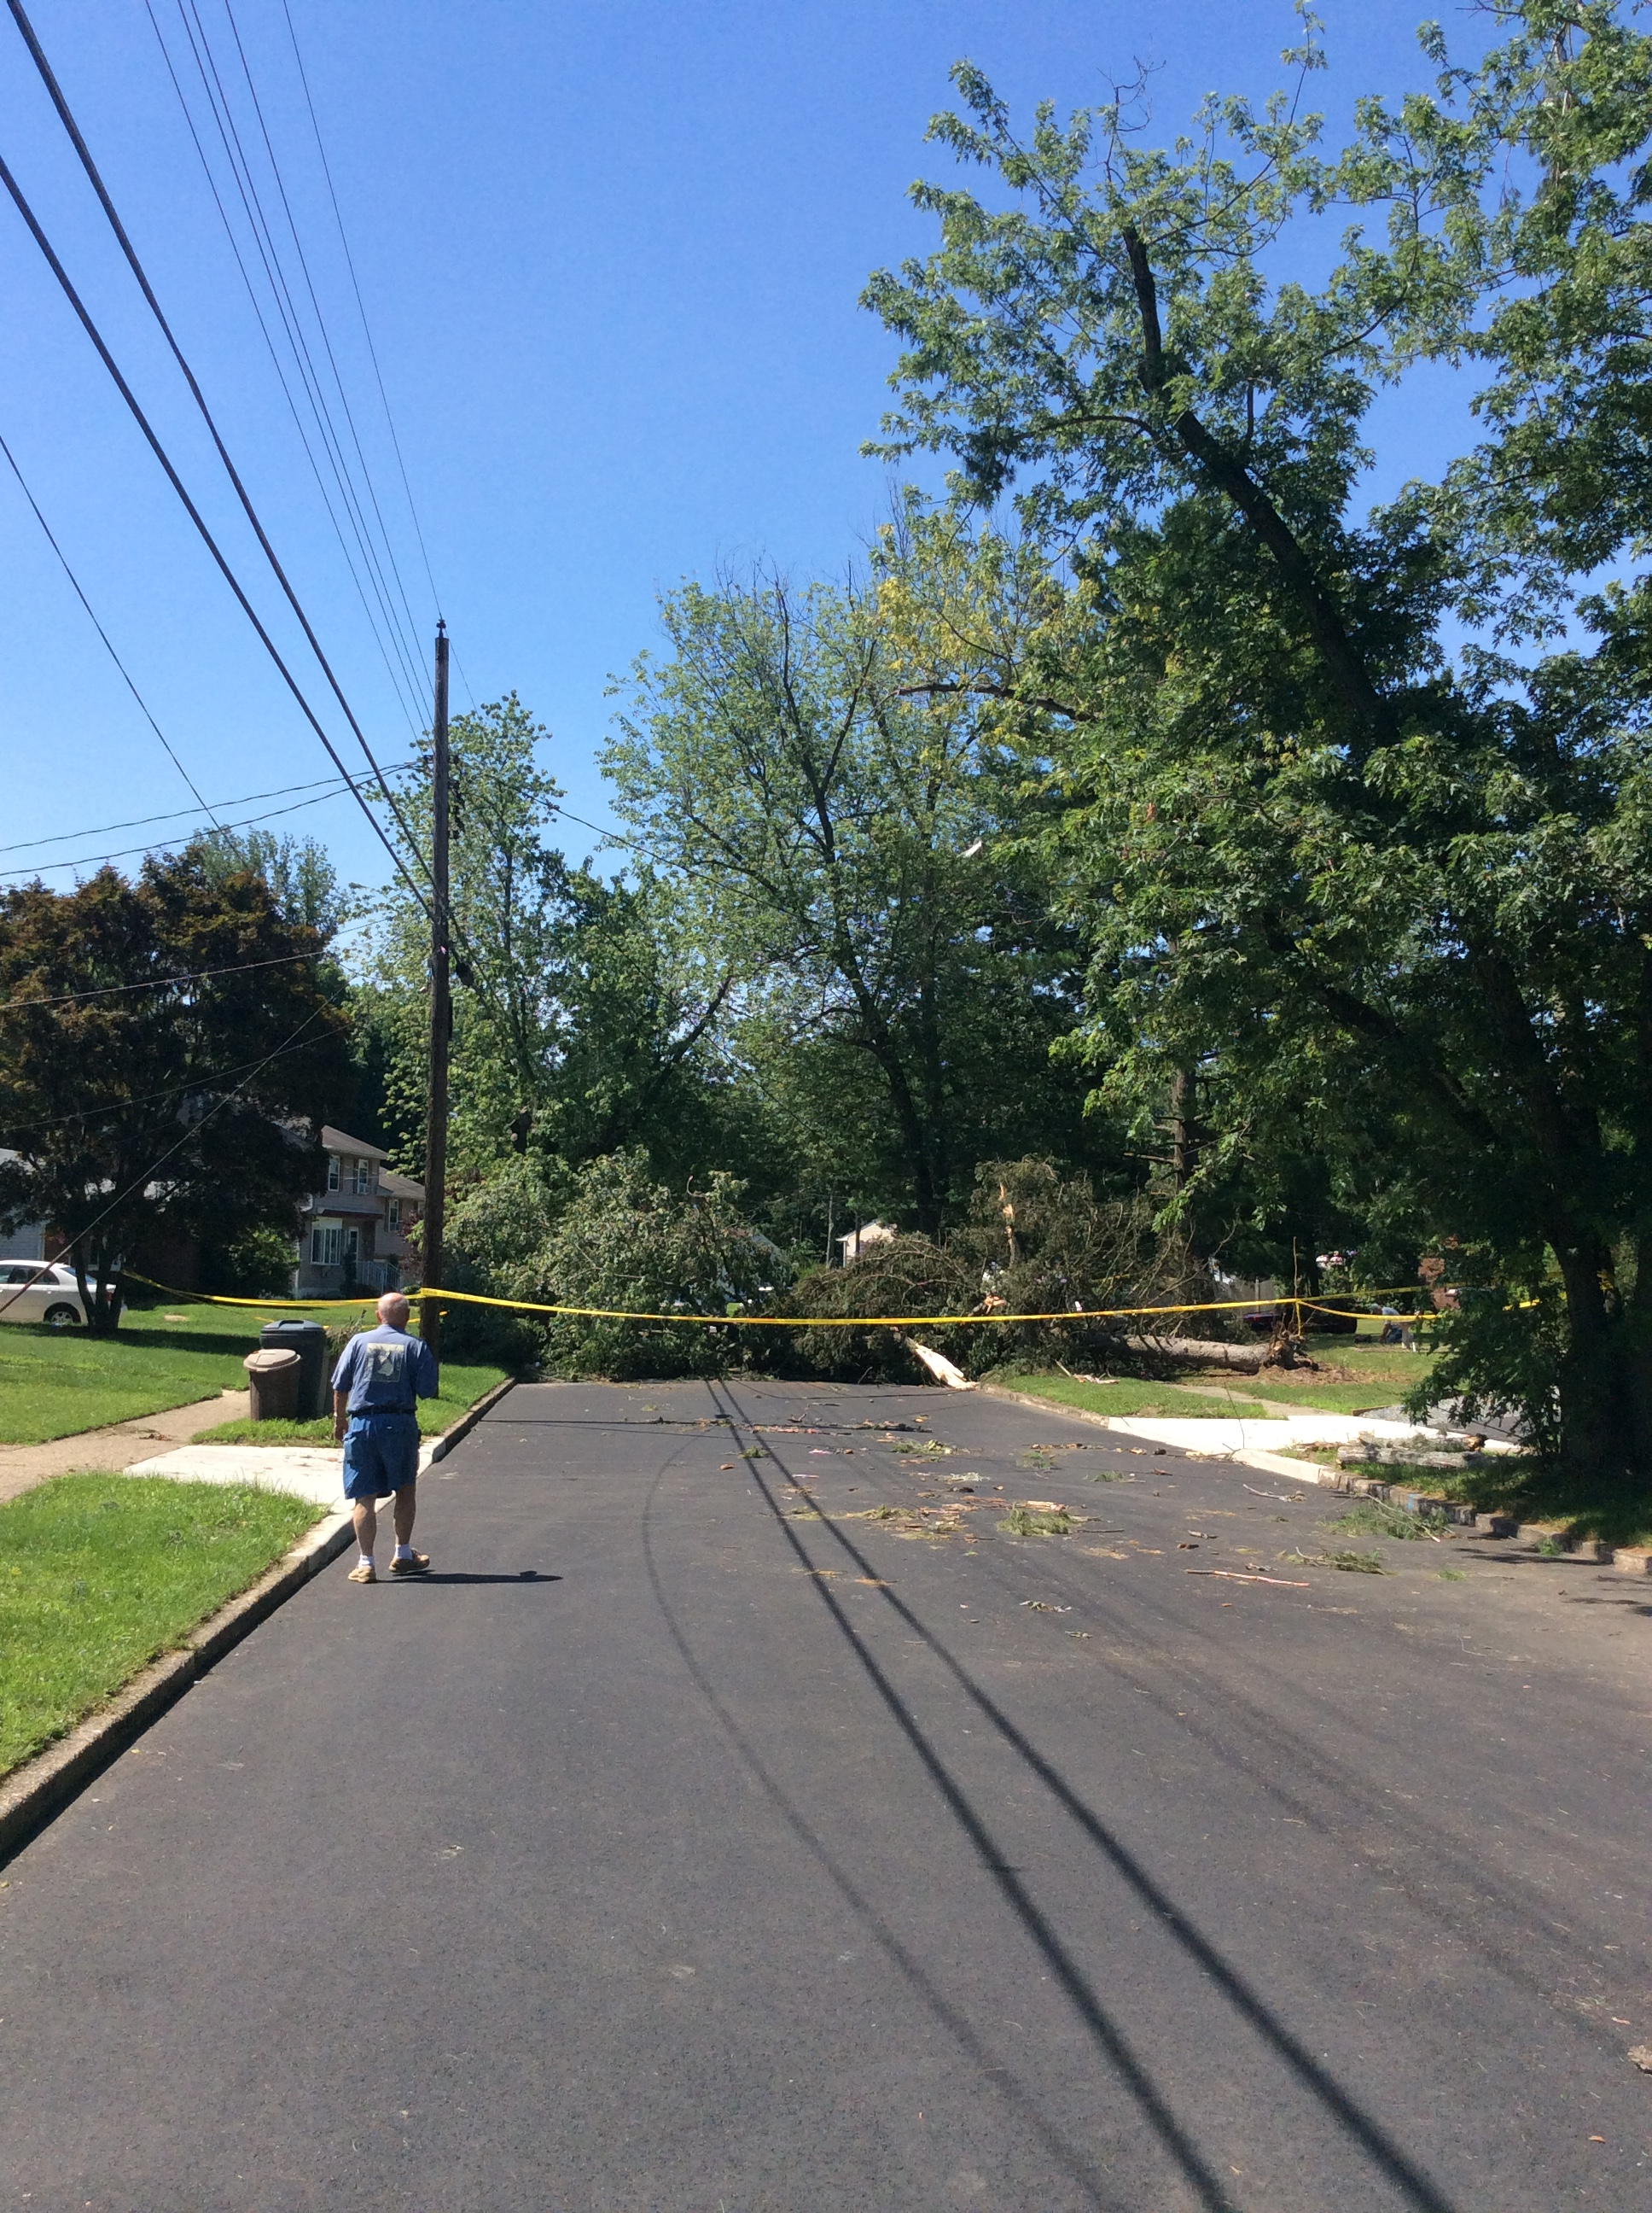
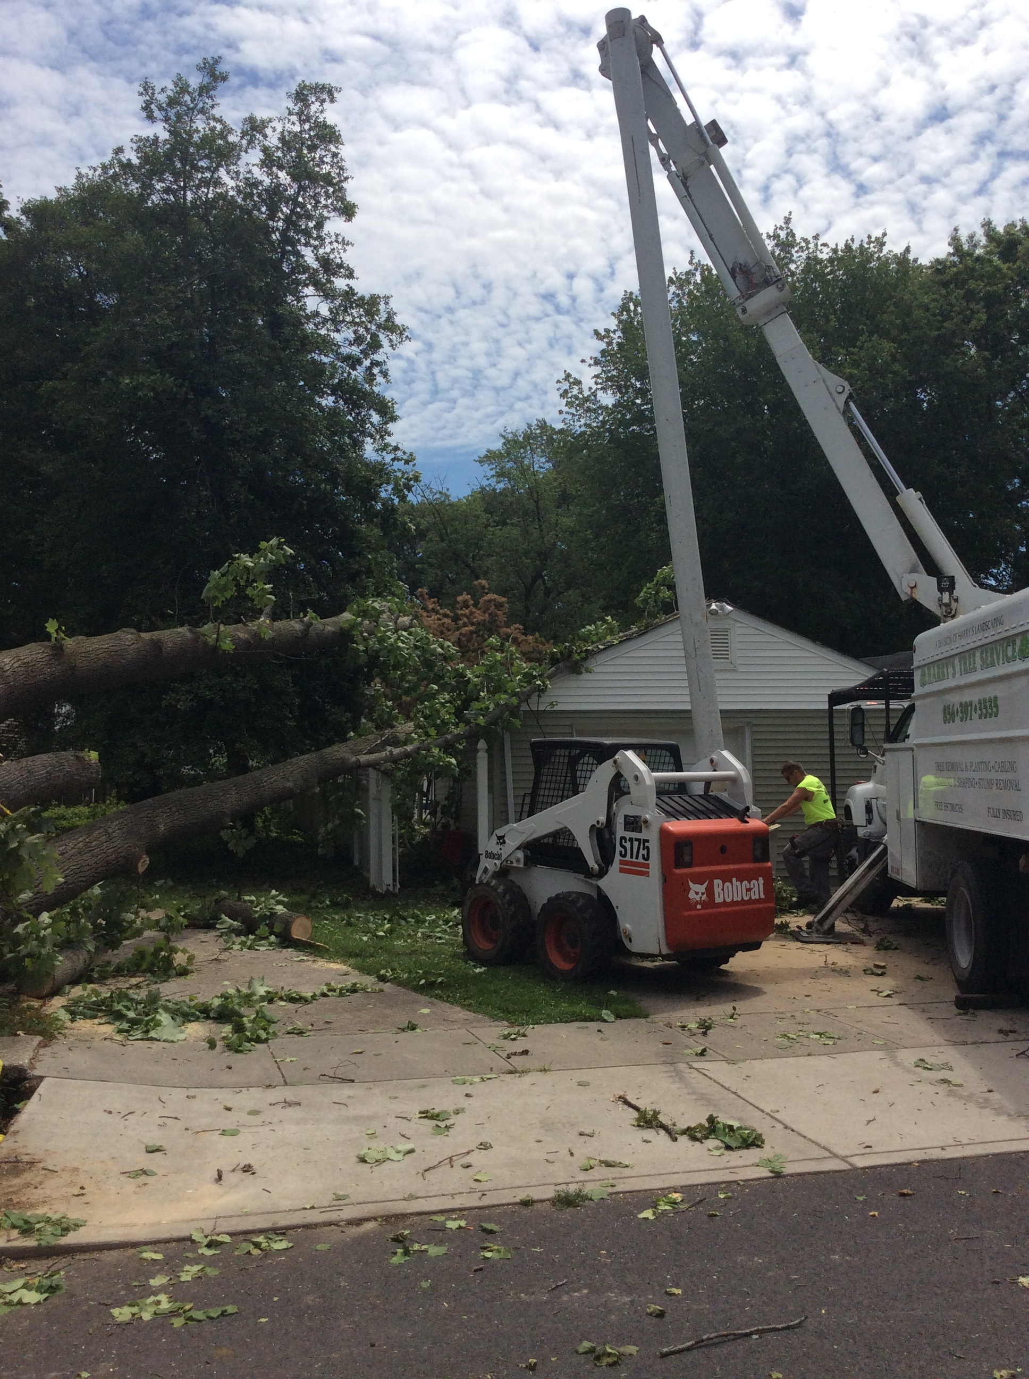
Storm Damage
(Stratford, New Jersey)

Slide 24
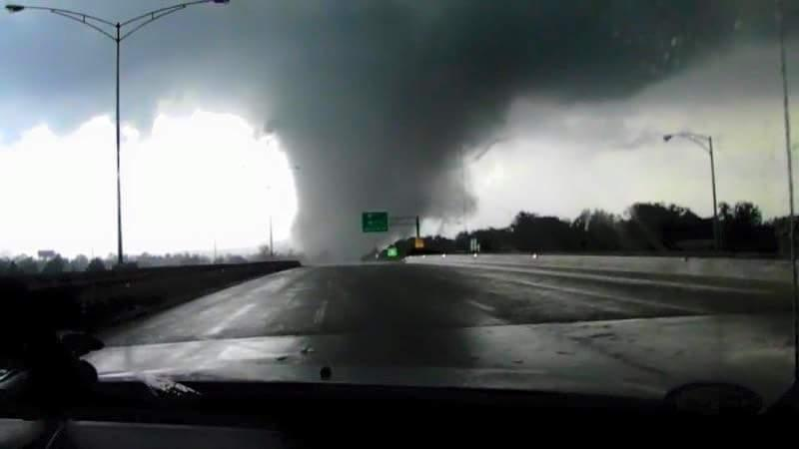
Storms continue to pass trough New Jersey
(Berlin, NJ)

