Slide 1

Global Weather Watchers
Extreme/Weather and the Climate System
An Earth SySTEM Project
CASE STUDY
New Jersey Event
23 June 2015
John D. Moore
GLOBE Distinguished Educator Fellow
GLOBE Scientist mr.moore.john@gmail.com

Slide 2
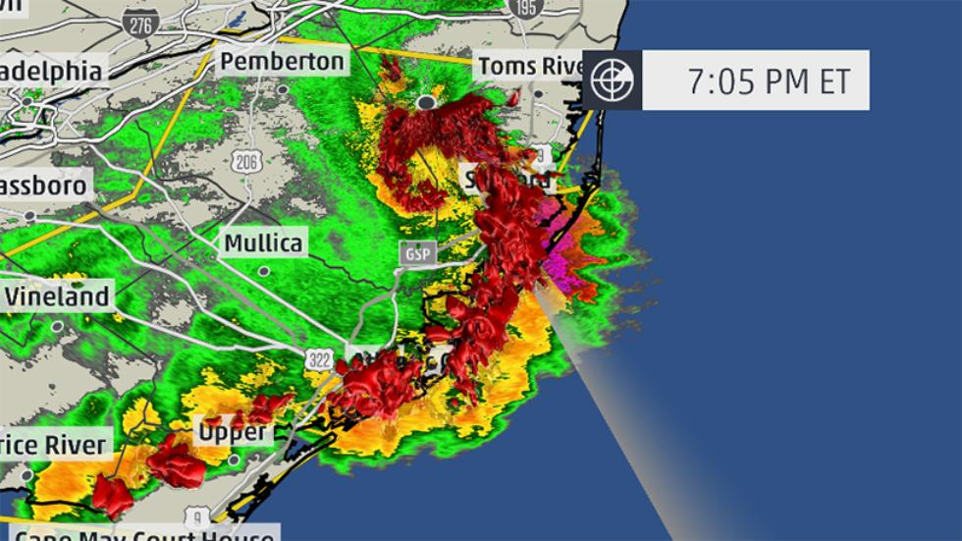
...SUMMARY...
THE NATIONAL WEATHER SERVICE IN MOUNT HOLLY NJ HAS CONFIRMED A MACROBURST /STRAIGHT LINE WIND DAMAGE/ NEAR EAST GREENWICH TOWNSHIP IN GLOUCESTER COUNTY NEW JERSEY ON JUNE 23 2015.
A NATIONAL WEATHER SERVICE SURVEY TEAM ACCOMPANIED THE GLOUCESTER COUNTY EMERGENCY MANAGEMENT OFFICIALS AS THEY ASSESSED DAMAGE IN EAST GREENWICH TOWNSHIP. POWER POLES WERE SNAPPED IN SEVERAL LOCATIONS WITH MANY TOPPLED TREES AND DEBRIS ACROSS THE REGION. MANY ROADS WERE IMPASSABLE THROUGHOUT THE TOWNSHIP AS A RESULT OF
DOWNED TREES AND POWER LINES. SOME OF THE MOST SIGNIFICANT DAMAGE OCCURRED ALONG EAST COHAWKIN
ROAD NEAR PINE MILL ROAD AND ALONG KINGS HIGHWAY, JUST NORTH OF EAST COHAWKIN ROAD. POWER POLES WERE TOPPLED ONTO THESE ROADWAYS MAKING THEM IMPASSABLE. DAMAGE TO PRIVATE RESIDENCES INCLUDED MINOR SHINGLE DAMAGE AND A BLOWN OVER SHED IN THE CLARKSBORO SECTION.
THIS SURVEYED AREA WAS CONSIDERED TO BE THE HARDEST HIT PART OF THE COUNTY. HOWEVER, THE STORM CONTINUED TO PRODUCE WIDESPREAD DAMAGE AS IT MOVED FURTHER EAST, IMPACTING AREAS INCLUDING MANTUA, WASHINGTON TOWNSHIP AND SICKLERVILLE. ONCE AGAIN, THIS DATA IS CONSIDERED TO BE PRELIMINARY. WE
CONTINUE TO REVIEW ALL THE DATA COLLECTED AND MAY UPDATE THIS
STATEMENT AT A LATER DATE. THIS INFORMATION CAN ALSO BE FOUND ON OUR WEBSITE AT WEATHER.GOV/PHI.
National Weather Service –Doppler Radar
June 23, 2015

Slide 3
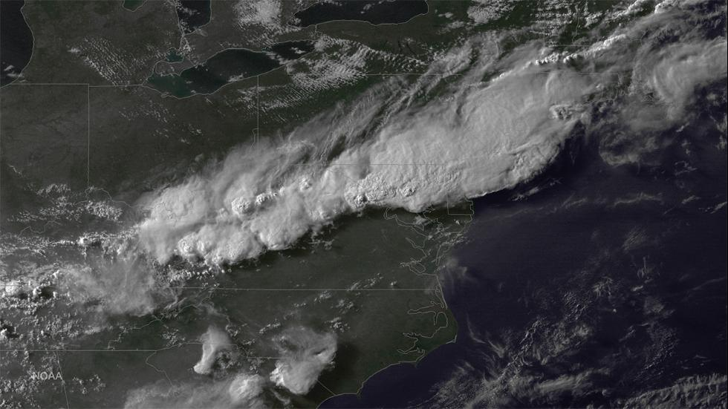

Slide 4
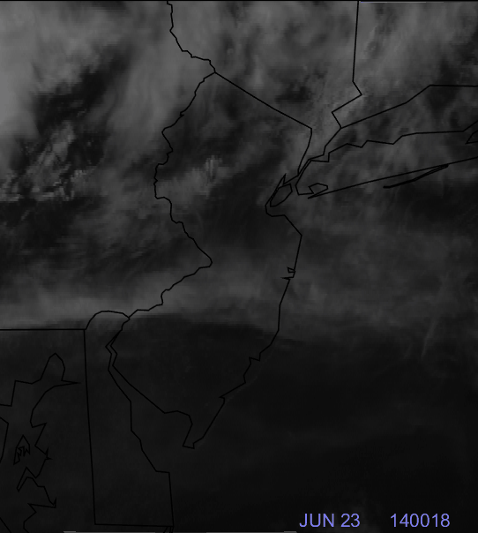
GOES Animation of
23 June 2015 Storm over
New Jersey, USA

Slide 5
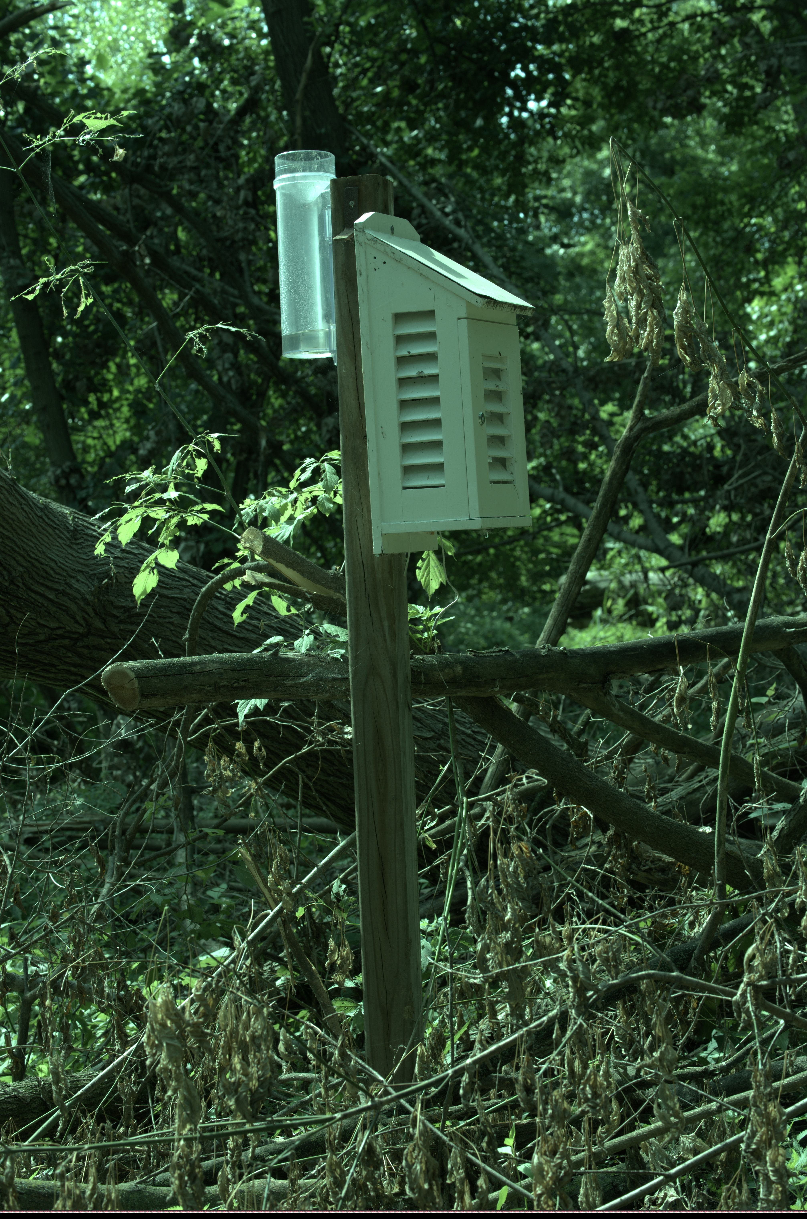
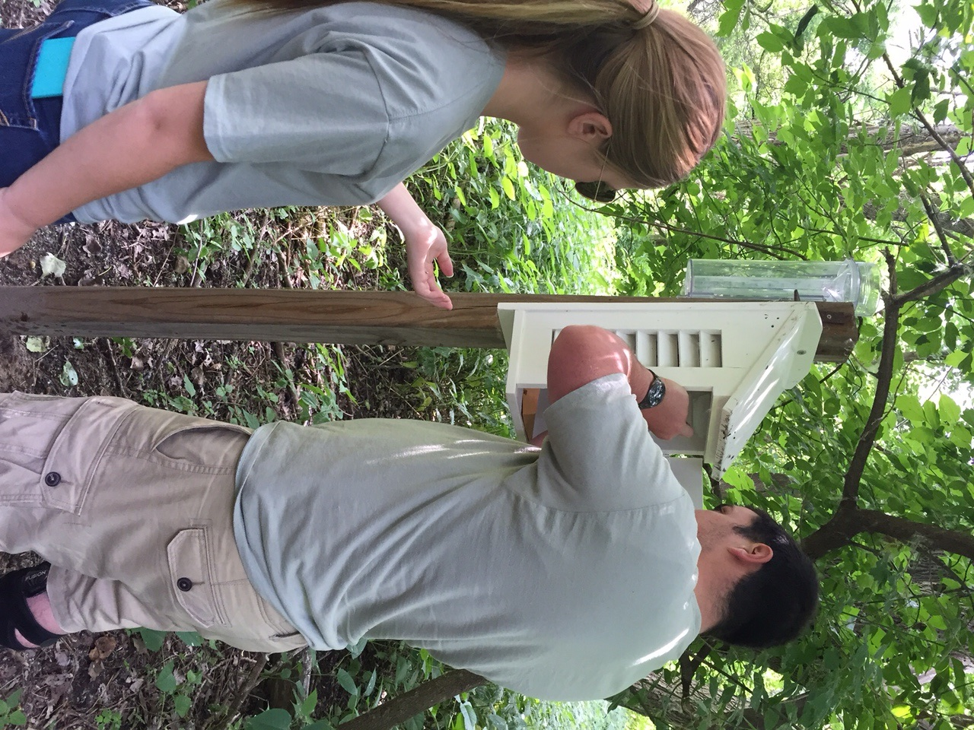
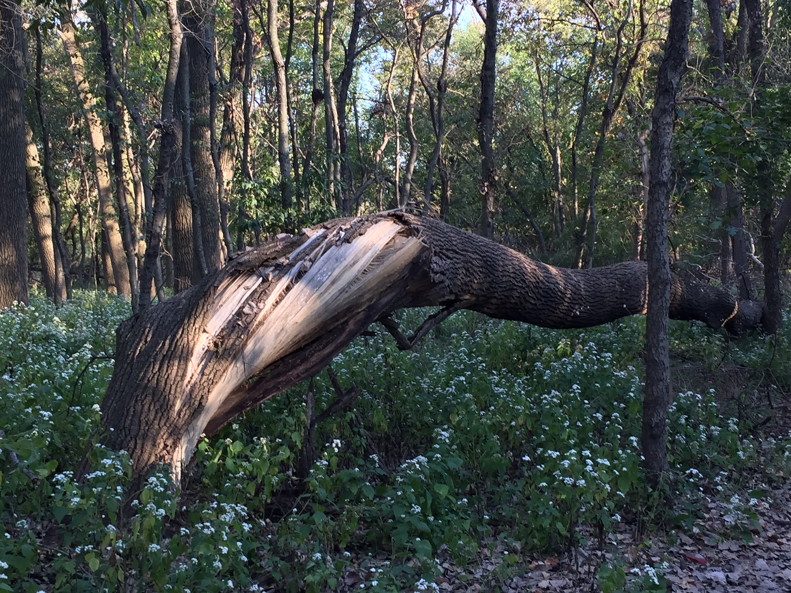
Heavy Storms Pass through New Jersey
Palmyra Cove Nature Park (40.00 N 75.02 W)
Before
After

Slide 6
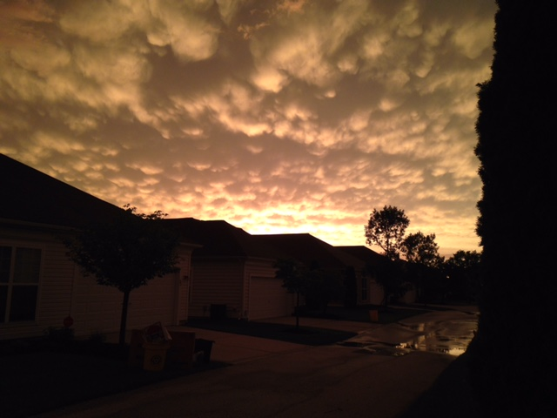
Can you identify these cloud types?
Voorhees, NJ (39.51 N 74.57W)

Slide 7
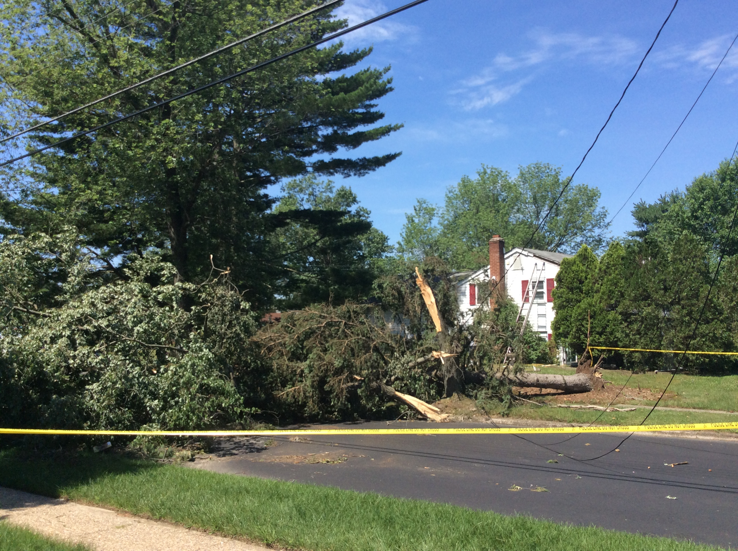
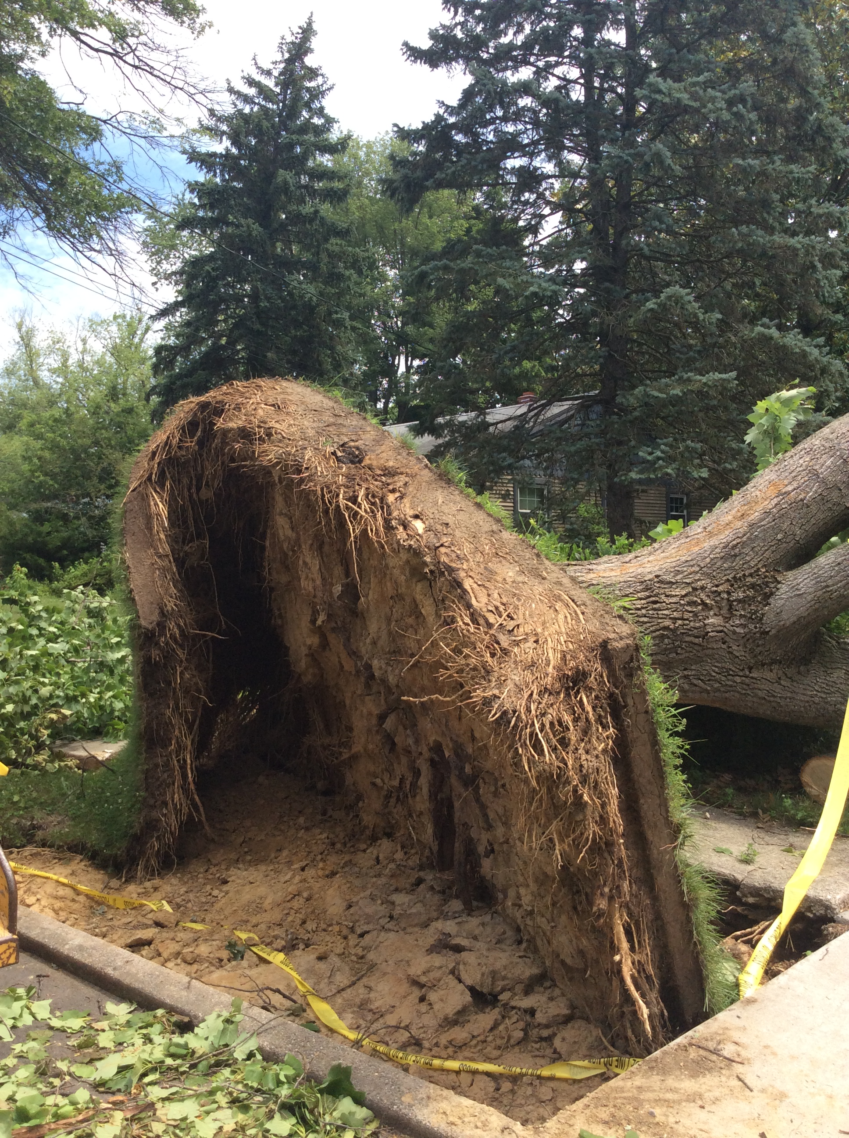
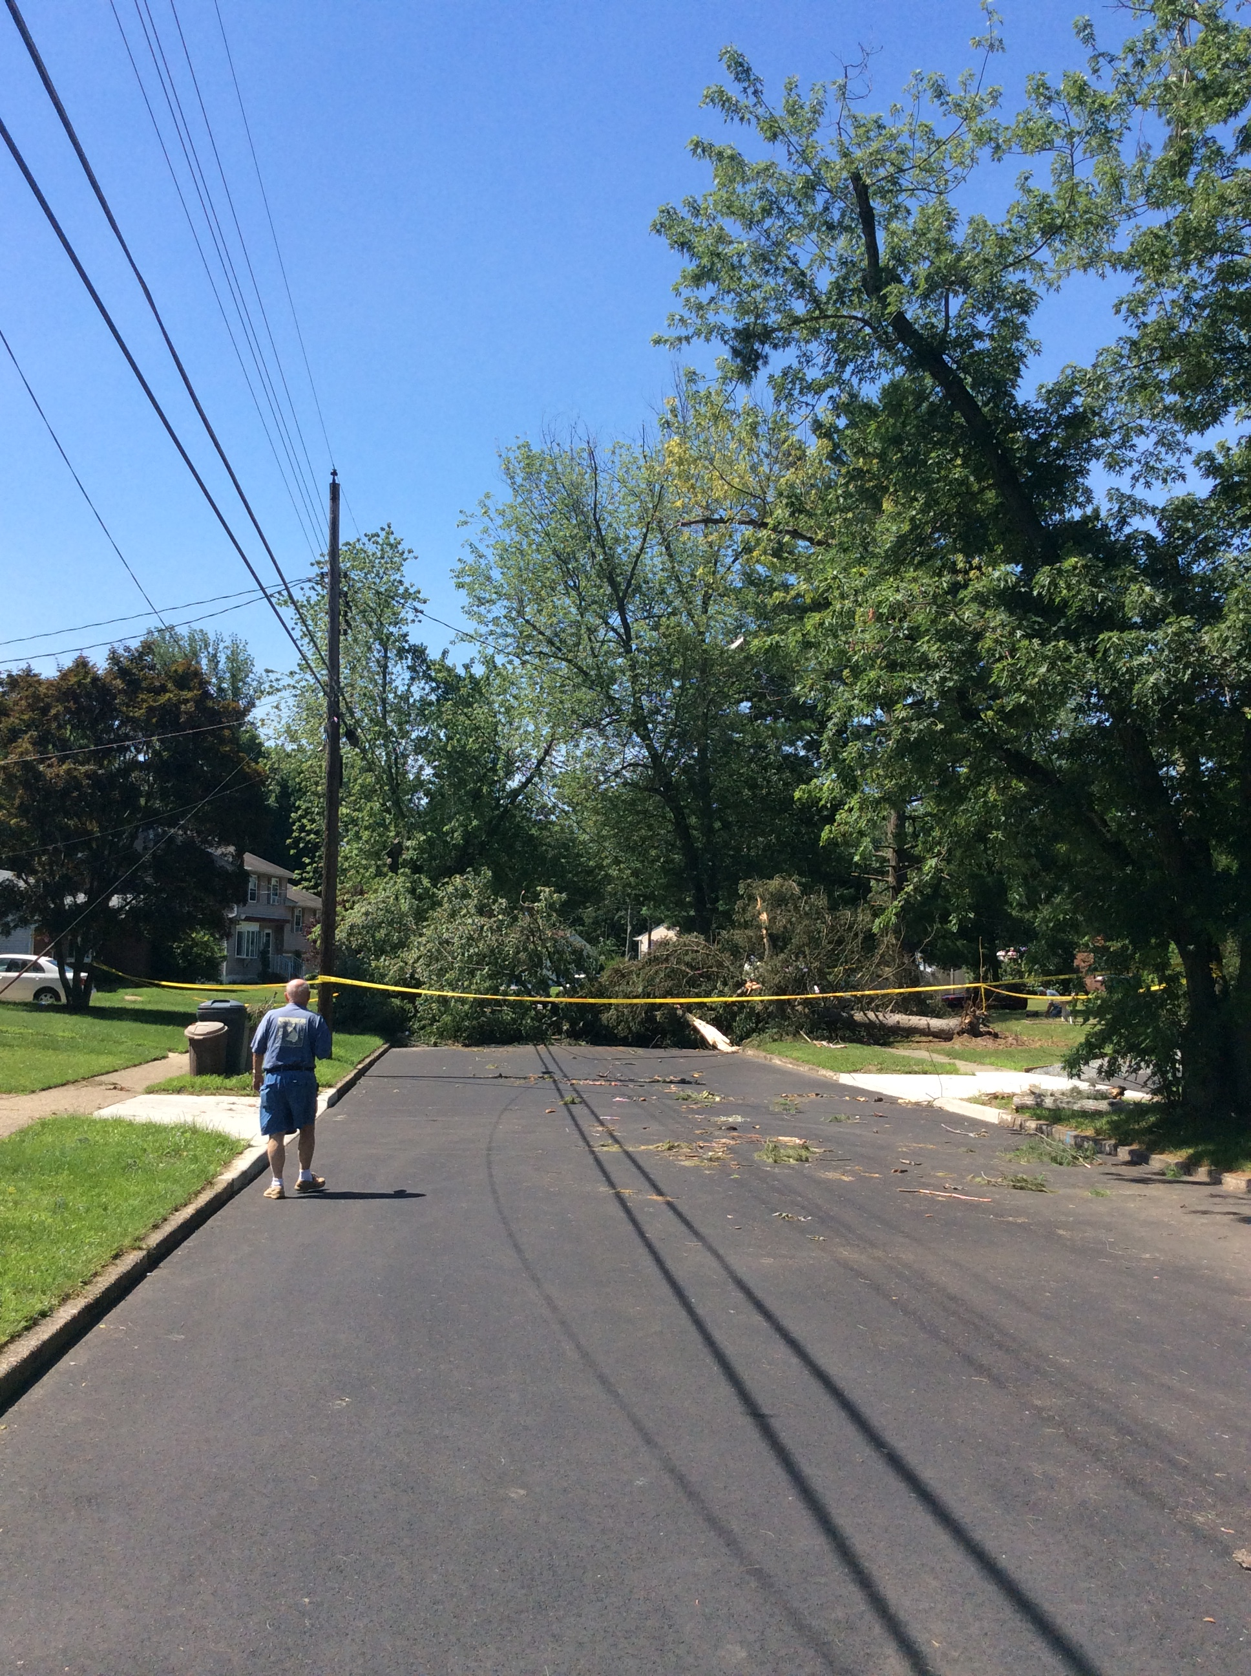
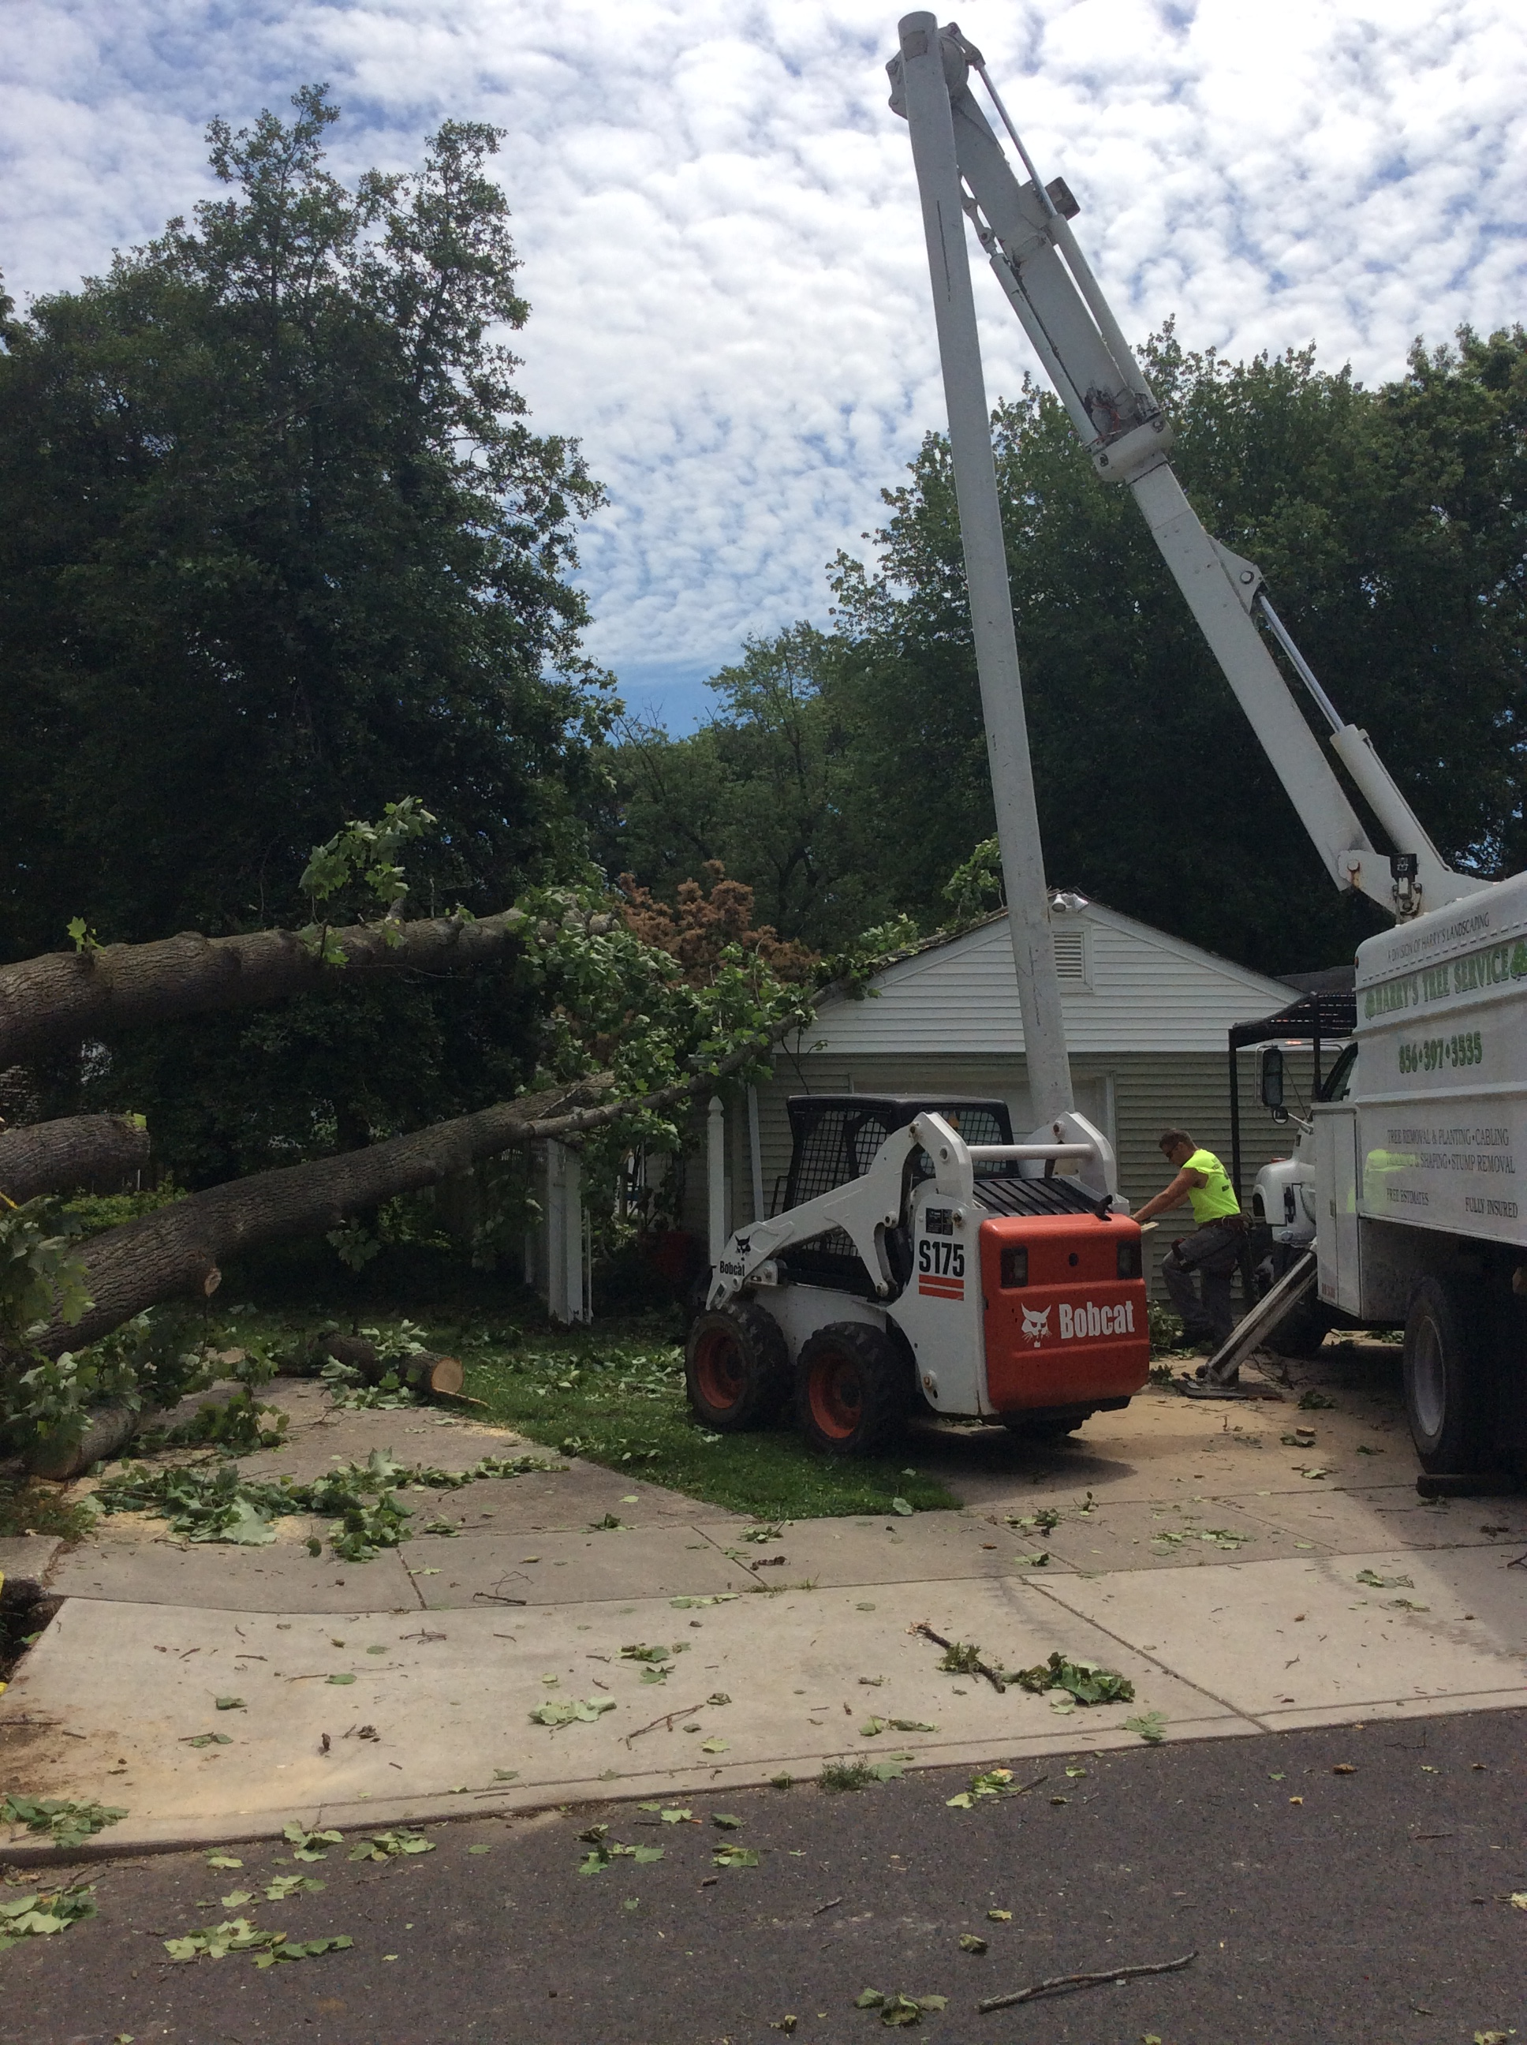
Storm Damage
Stratford, New Jersey (39.49 N 27.99 W)

Slide 8
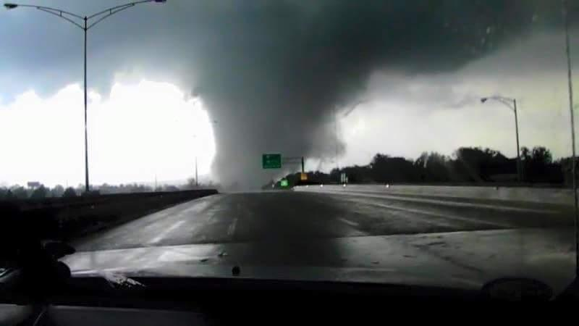
Storms continue to move East through New Jersey
Berlin, NJ (39.46 N 74.54 W)

