Slide 1
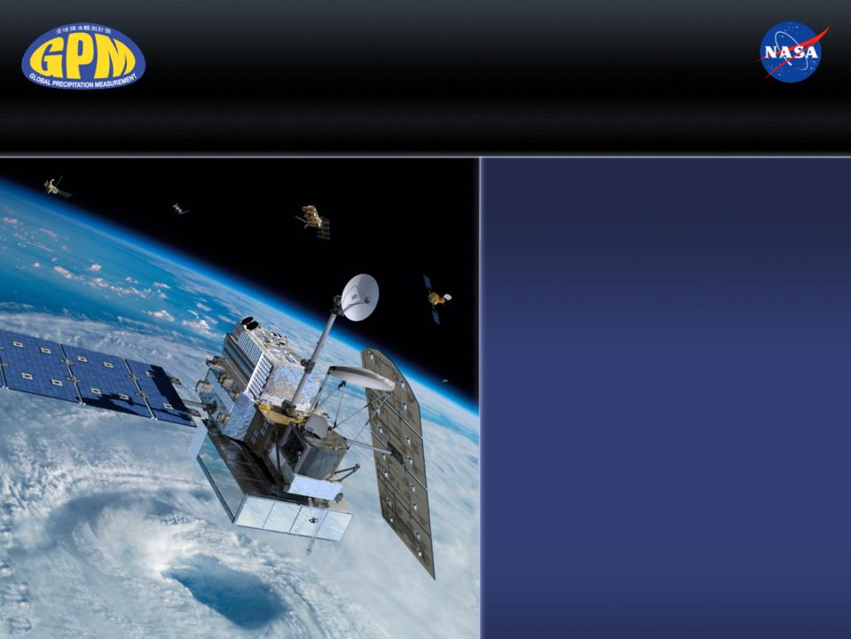
Precipitation and Temperature
El Nino Webinar #4:
March 22nd, 2016
Dr. Dalia Kirschbaum
NASA Research Scientist
GPM Applications Science Lead

Slide 2
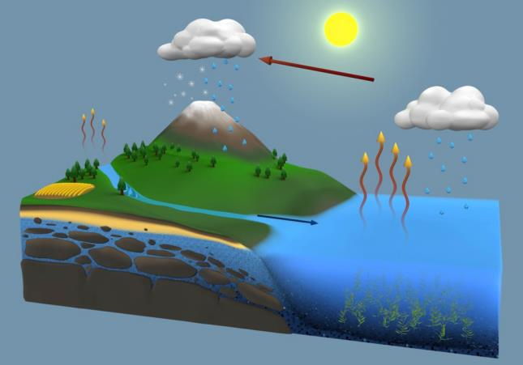
The Global Water Cycle
The continuous movement of water within, on, and above Earth’s surface
45.9 ±4.4
116.5 ±5.1
70.6 ±5.0
449.5 ±22.2
403.5 ±22.2
45.9 ±4.4
Global mean water fluxes (1,000 km³/yr) at the start of the 21st century, based on satellite and ground-based observations and data integrating models.
The most noticeable impacts of climate change will be
changes in the water cycle

Slide 3
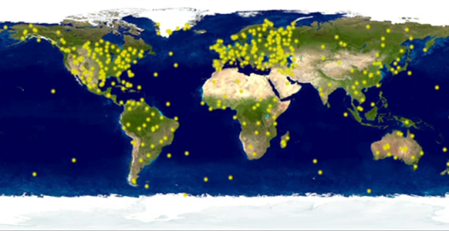
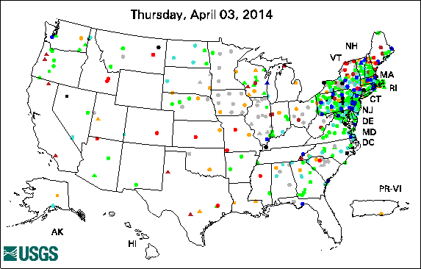
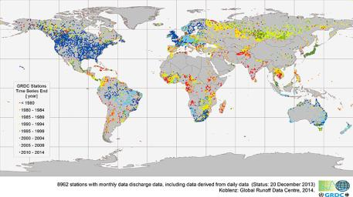
Inadequacy of Surface Observations
Issues:
- Spatial coverage of existing stations
- Temporal gaps and delays
- Many governments unwilling to share
- Measurement inconsistencies
- Quality control
- (Un)Representativeness of point obs
http://svs.gsfc.nasa.gov/goto?11165
USGS Groundwater Climate Response Network. Very few groundwater records available outside of the U.S.
River flow observations from the Global Runoff Data Centre. Warmer colors indicate greater latency in the data record.

Slide 4
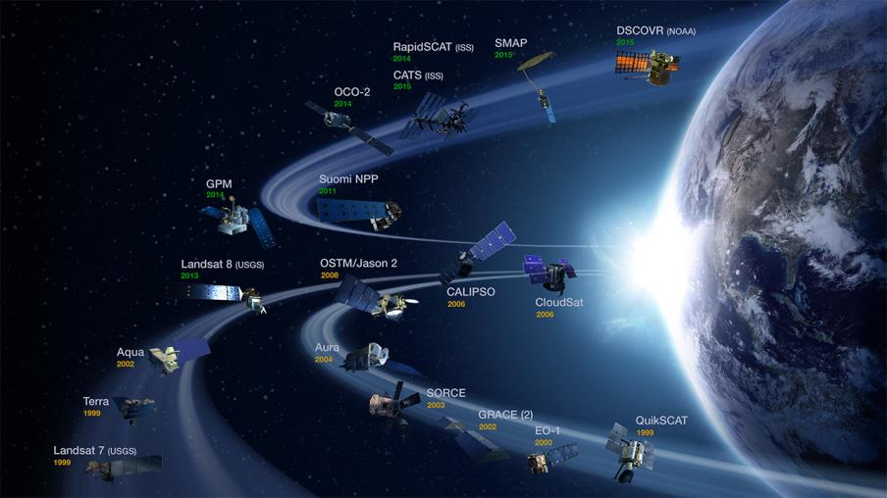
NASA Earth Observing satellites
Advancing Earth System Science to meet the challenges of climate and environmental change.
Evaporation
Ground water
Soil Moisture
Transpiration
Temperature
Ice extent
Weather
Climate
And more…

Slide 5
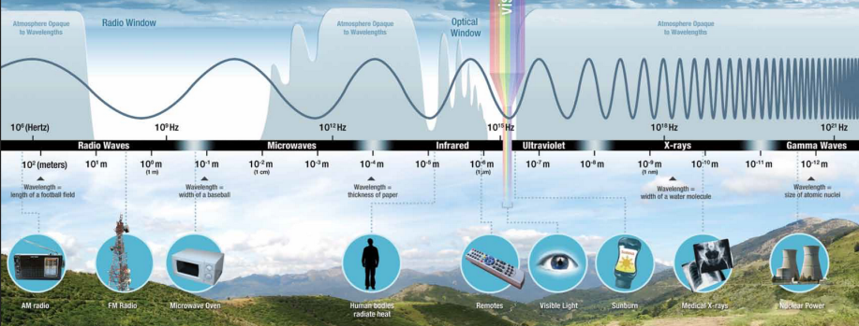
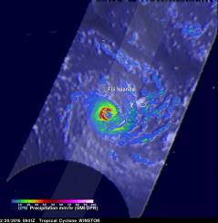
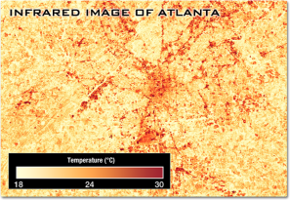
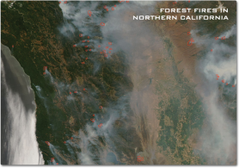
Electromagnetic Spectrum
GPM precipitation
Landsat 7 Surface Temperature
MODIS Infrared data

Slide 6
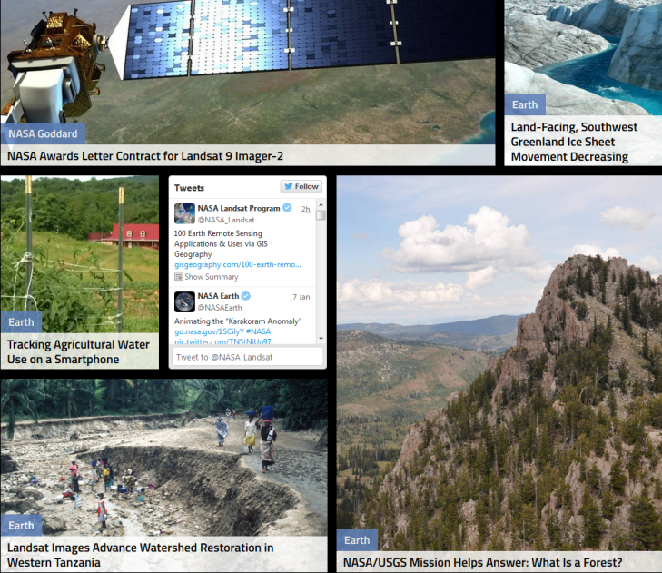
Longest Record of Earth Observation
The Landsat program provides the longest continuous space-based record of Earth’s land in existence (starting July 23, 1972). Every day, Landsat satellites provide essential information to help land managers and policy makers make wise decisions about our resources and our environment.

Slide 7
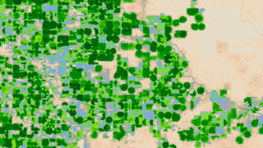


Measuring Evaporation From Space

Slide 8
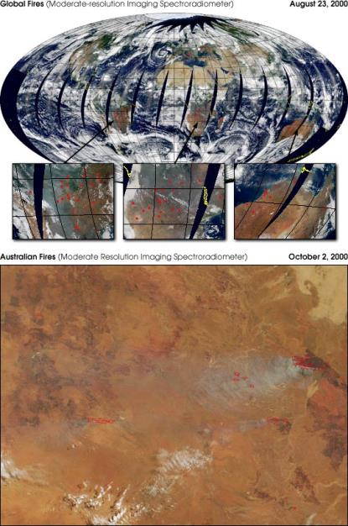
MODIS
Terra and Aqua Moderate Resolution Imaging Spectroradiometer (MODIS)
  Data Products
  surface temperature
  chlorophyll fluorescence
  vegetation/land-surface cover, conditions, and productivity:
    net primary productivity, leaf area index, and intercepted photosynthetically active radiation
    land cover type, change detection and identification;
    vegetation indices;
  cloud mask, cirrus cloud cover, cloud properties characterized by cloud phase, optical thickness, droplet size, cloud-top pressure, and temperature;
  aerosol properties
  fire occurrence, temperature, and burn scars;
  total precipitable water
  sea ice cover
  snow cover
  derived evapotranspiration
http://earthobservatory.nasa.gov/IOTD/view.php?id=1048

Slide 9
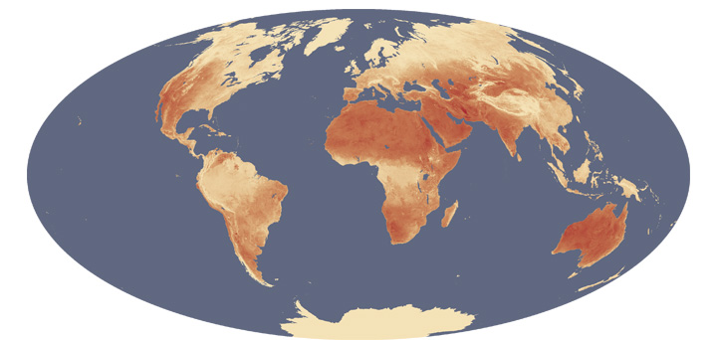
MODIS Maximum Land Surface temperature
Shows global maximum land surface “skin” temperature from 2003-2009 measured by MODIS onboard NASA’s Terra and Aqua satellites. Some of the 36 groups of wavelengths onboard detect thermal radiance, or the amount of infrared energy emitted by the land surface

Slide 10
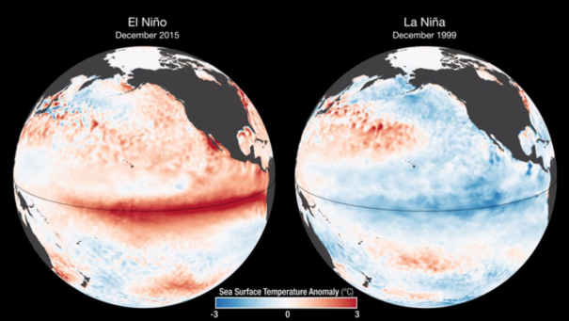
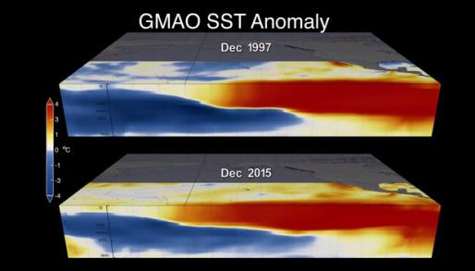
Sea Surface Temperature
NOAA Optimum Interpolation Sea Surface Temperature (OISST) data
https://www.ncdc.noaa.gov/oisst
Global Modeling and Assimilation Office (GMAO) models SST Anomalies comparing December 1997 to 2015
https://svs.gsfc.nasa.gov/cgi-bin/details.cgi?aid=4433

Slide 11
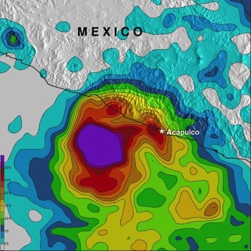
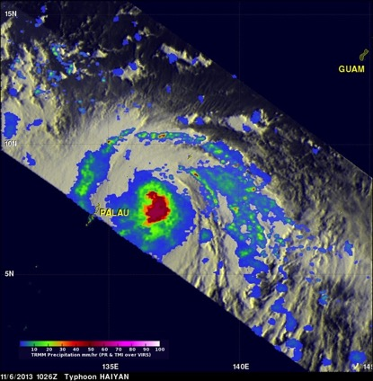
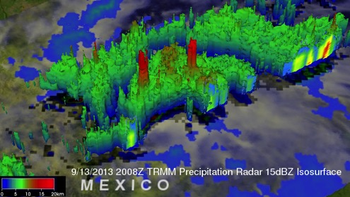
Tropical Rainfall Measuring Mission
Launched in 1997
First space-borne precipitation radar
Data vital for research and applications (natural hazards, agriculture, disease tracking, etc.)
Hurricane Raymond, October 13th, 2013
Supertyphoon Haiyan, Nov. 6th 2013
Tropical Storm Ingrid on Friday, Sept. 13th,2013

Slide 12
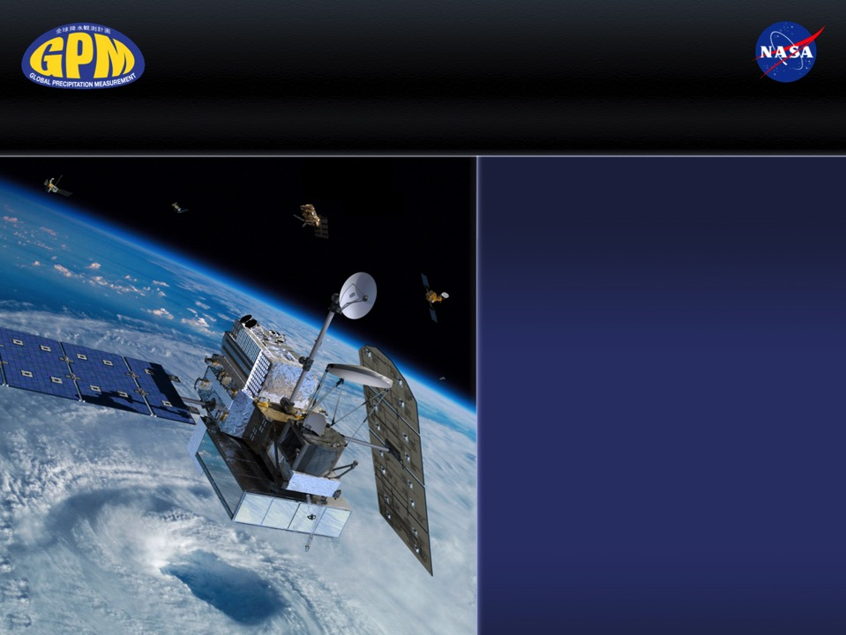
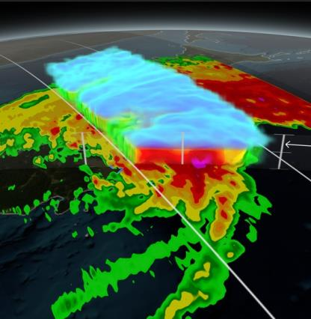
Global Precipitation Measurement (GPM) Mission
Typhoon Phanfone over Japan, Oct. 2014
Notes:
Introduce ourselves

Slide 13
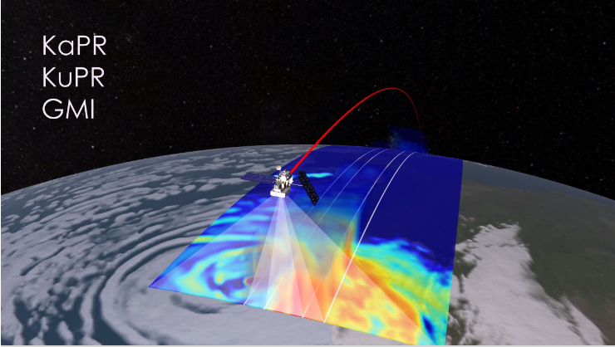
Measuring Precipitation
http://svs.gsfc.nasa.gov/cgi-bin/details.cgi?aid=4016
The GPM instruments show heavy rainfall in red and light rainfall in blue. The DPR shows 3D precipitation from two overlapping swaths and the GMI shows precipitation including light rain, heavy rain and falling snow

Slide 14
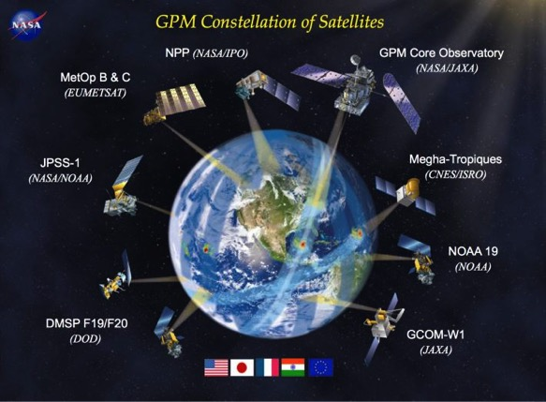




















GPM’s International Scope
Partner satellites from:
NOAA
DOD
EUMETSAT
ISRO/CNES (India/France)
JAXA
Active Joint Projects (19 PI’s from 13 countries)
Notes:
GPM is an international mission which will use inputs from a constellation of satellites to improve precipitation estimation globally
GPM will provide precipitation information every 3 hours
Non-Sun-Synchronous orbit from Arctic to the Antarctic Circle at 407 km (~250 miles)

Slide 15
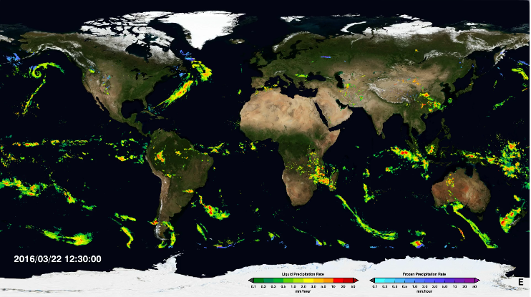
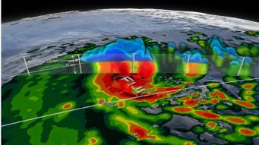
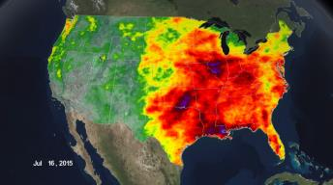
Looking at precipitation from space
http://svs.gsfc.nasa.gov/Gallery/GPM.html

Slide 16
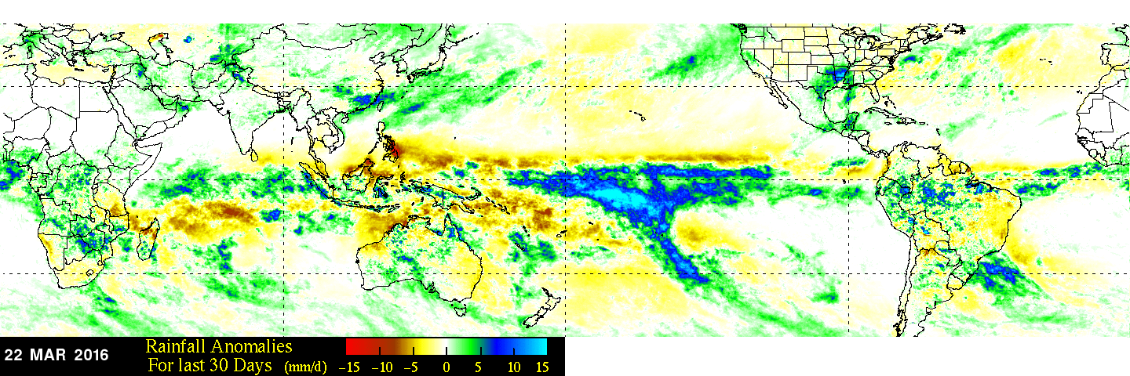
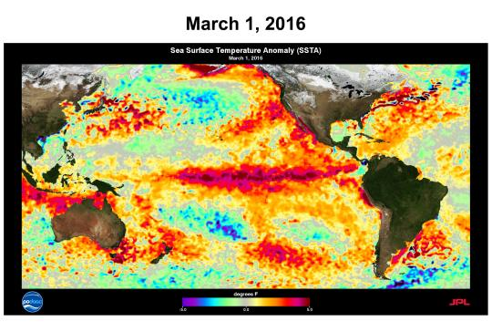
Observations of Precipitation and SST
TOP: Rainfall anomaly compares rainfall data compiled from 2001-2012 to "near real-time" Multi-satellite Precipitation Analysis (TMPA-RT 3B42RT) data collected in the past 30 days.
LEFT: Sea Surface Temperature Anomalies (SSTA) derived from the Advanced Very High Resolution Radiometer (AVHRR) Optimally Interpolated SST

Slide 17
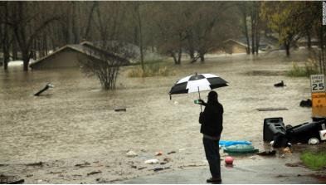
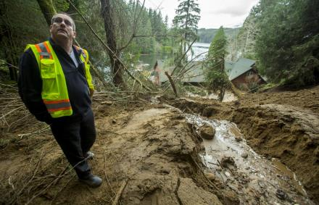
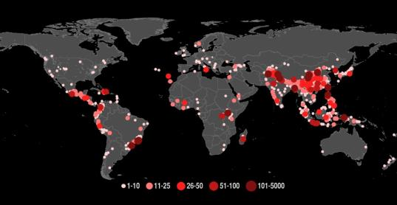
Why it matters?
Deadly flooding across Louisiana and Mississippi, March 2016
Andy Nelson/The Register-Guard
Heavy rainfall in Oregon causes a major landslide, resulting in 1 fatality, road blockages and property damage (December 2015)
A NASA-compiled Global Landslide Catalog shows reported rainfall-triggered landslides with fatalities from 2007-2013.

Slide 18
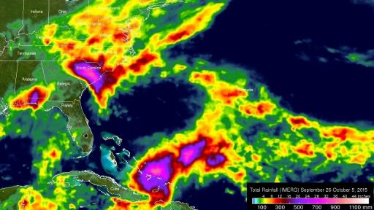
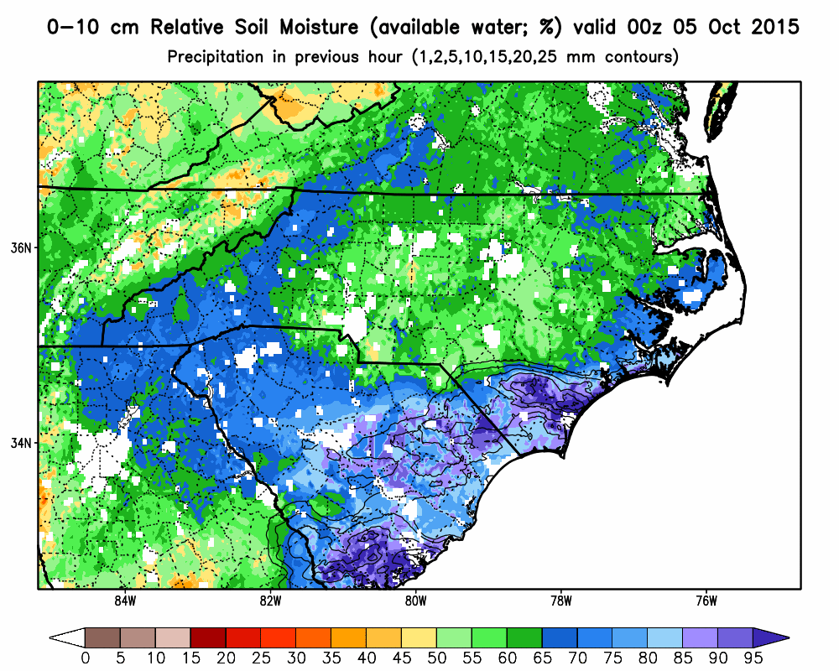
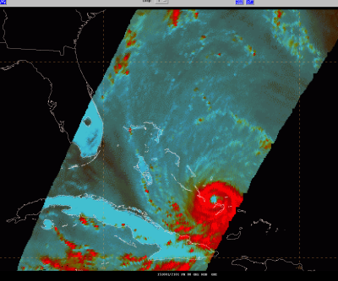
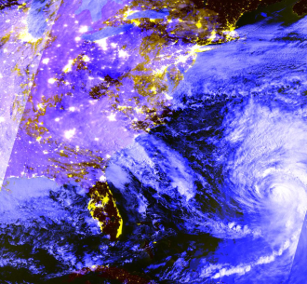
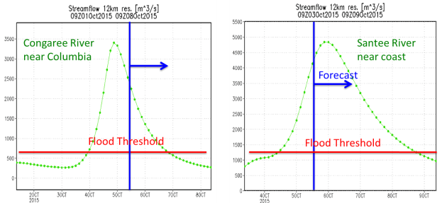
GPM Observes Nor’easter and Joaquin
89 GHz RGB image of Hurricane Joaquin in N-AWIPS (1 Oct 2015 2101 UTC)

Slide 19
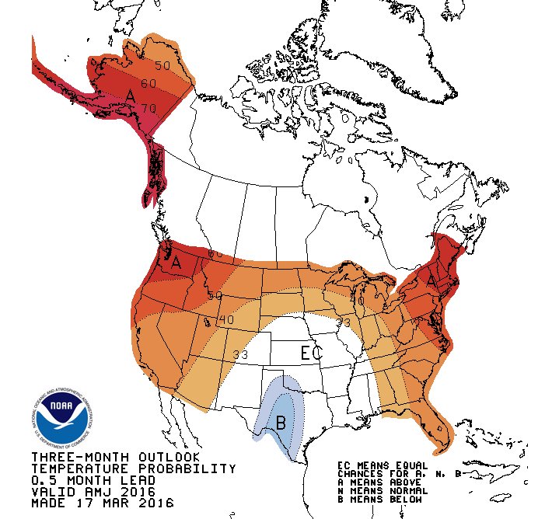
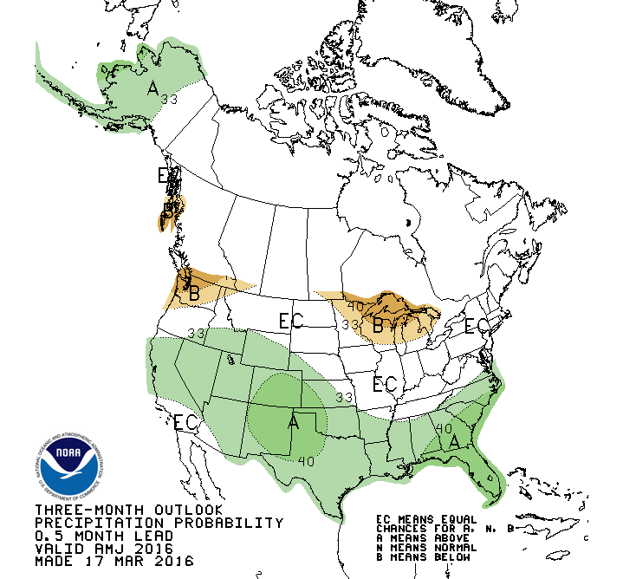
3-month outlook
90-day temperature and precipitation outlook
http://www.cpc.ncep.noaa.gov/products/predictions/90day/

Slide 20
Predicted Climate Change Impacts on Precipitation
IPCC AR5 multi-model mean precipitation changes (%) in 2081-2100 relative to 1986-2005 for scenarios RCP2.6, RCP4.5, RCP6.0 and RCP8.5.
Hatching: multi-model mean <1 standard deviation of internal variability.
Stippling: multi-model mean >2 standard deviations of internal variability and ≥90% of models agree on the sign.
Notes:
From http://www.climatewizard.org/#

Slide 21
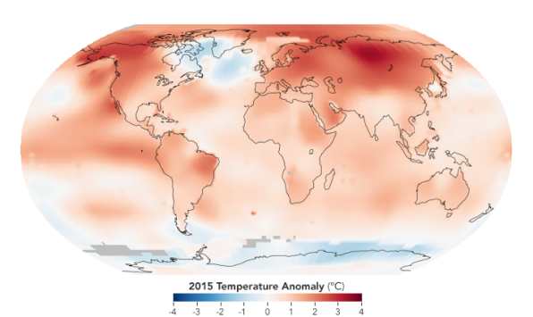
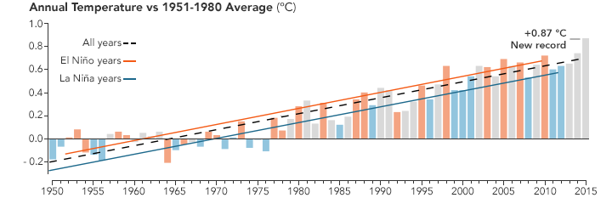
2015 Warmest Year on Record
The NASA team found that globally averaged temperatures from January through December 2015 were 0.87 degrees Celsius (1.57° Fahrenheit) above the norm (defined as a 1951–1980 base period). The previous record—set last year—was 0.74°C (1.34°F) above the norm. For the planet, 2015 was more than a full degree Celsius (1.8°F) warmer than temperatures in 1880, when consistent record-keeping began.
http://earthobservatory.nasa.gov/IOTD/view.php?id=87359
Notes:
Earth’s 2015 surface temperatures were the warmest since modern record keeping began in 1880, according to independent analyses by NASA and the National Oceanic and Atmospheric Administration (NOAA).
Globally-averaged temperatures in 2015 shattered the previous mark set in 2014 by 0.23 degrees Fahrenheit (0.13 Celsius). Only once before, in 1998, has the new record been greater than the old record by this much.
Note that while El Niño conditions dominated the Pacific Ocean for most of 2015, it was not officially an El Niño year in strict climatological terms because ocean conditions did not manifest themselves until April 2015. In the past, the highest global temperature records were often set in El Niño years, which suggests that 2016—with El Niño going strong as of mid-January—appears likely to be another very warm year.

Slide 22

Questions?

