Slide 1

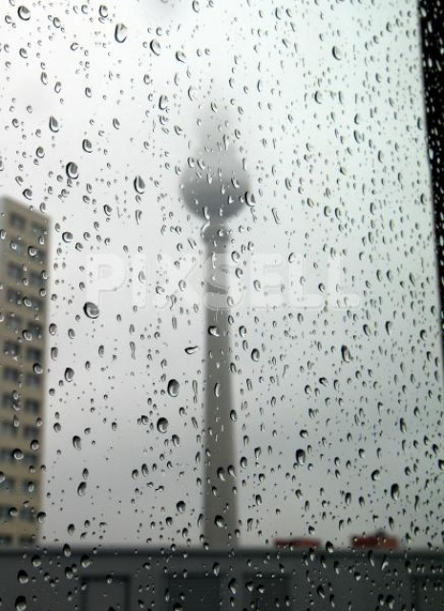
GLOBE PROTOCOLS:
PRECIPITATION MEASUREMENTS
AIR TEMPERATURE MEASUREMENTS

Slide 2

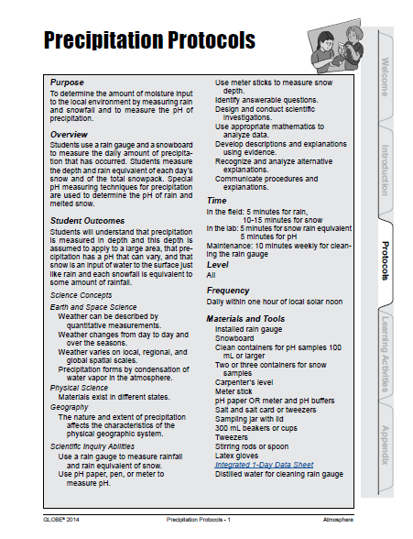
PRECIPITATION MEASUREMENTS
Measuring of the local quantity of moisture input from atmosphere to environment
Measurements of rain and snow as well as pH of precipitation
Frequency: Daily measurements – within one hour of local solar noon

Slide 3
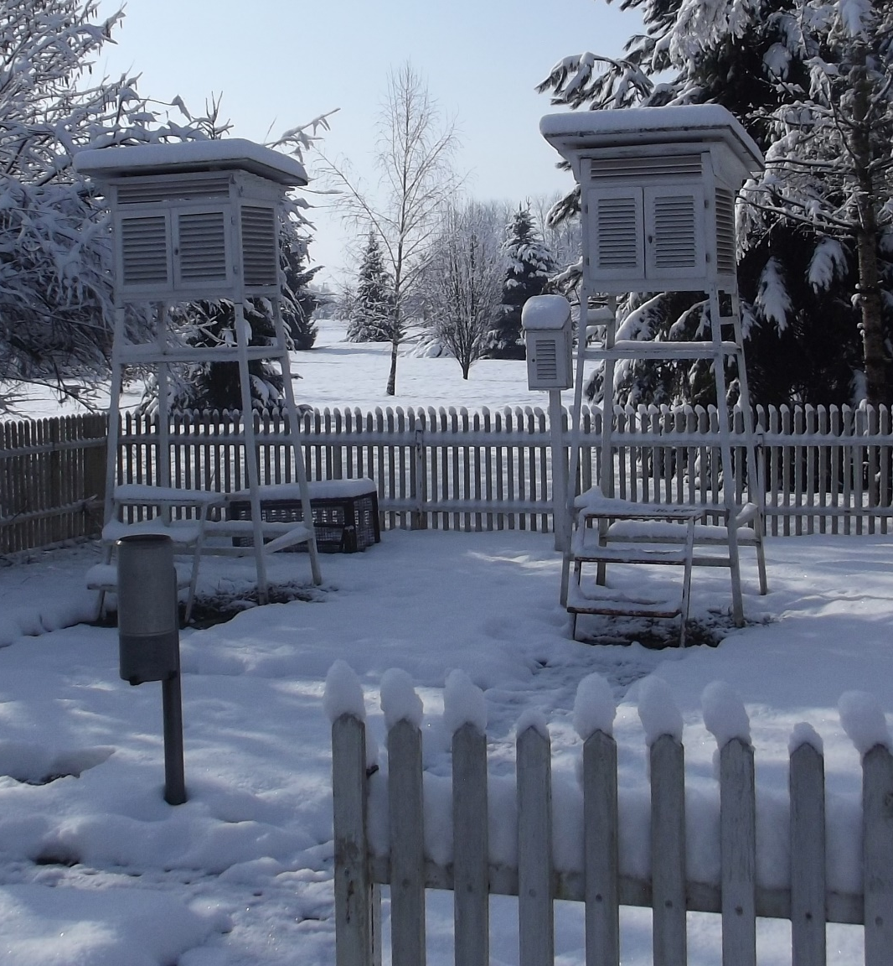
MEASUREMENTS AREA,
INSTRUMENTS AND TOOLS
MEASUREMENTS AREA
If possible flat surface and surrounded with fence
BASIC INSTRUMENTS:
GLOBE rain gauge or/and
Hellman's rain gauge or/and
Seesaw rain gauge (for example Vantage Proplus2)
Snow board and meter stick
Containers for snow samples
Containers for pH samples
pH paper or meter

Slide 4
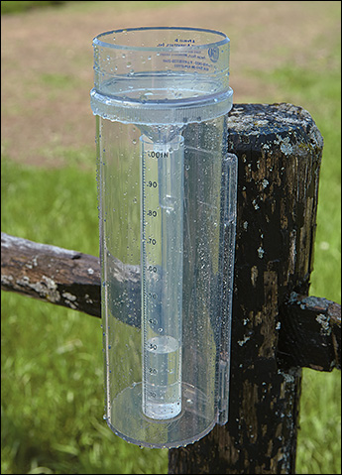
MEASUREMENTS AREA,
INSTRUMENTS AND TOOLS
OTHER USEFULL TOOLS
Sampling jar with lid
300 mL beakers or cups
Tweezers
Stirring rods or spoon
Latex gloves
Distilled water for cleaning rain gauge
Data sheet or memo pad

Slide 5
DEFINITION OF PHENOMENON
AND MEASUREMENTS
LIQUID PRECIPITATION QUANITY MEASUREMENTS
includes rainfall of any intensity and drizzle
measurements of thickness of precipitation layer
SOLID PRECIPITATION QUANITY MEASUREMENTS
includes snow, ice pellets and hail
measurements of thickness of snow layer
PH MEASUREMENTS
include acidity measurements any kind of precipitation

Slide 6
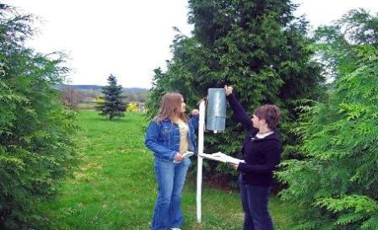
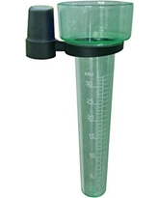
Liquid precipitation measurements
Measurements daily at Local Solar Noon
Possibility of multiday measurements (up to 7 days)
The precipitation quantity is measured with precision of 0,1 mm

Slide 7
MEASUREMENTS PROCEDURE
Read the level of the water in rain gauge; your eyes are level with the water in the measuring tube. Read the level at the bottom of the meniscus.
Record the rainfall amount to the nearest one-tenth of a millimeter.
Pour the water into the sampling jar and cover it for the pH measurement.
Record the number of days rain has accumulated in the gauge.
Perform the appropriate Precipitation pH Lab Guide (depending on which type of Ph measuring device and salt you are using).
Dry the rain gauge and remount it on its post.

Slide 8
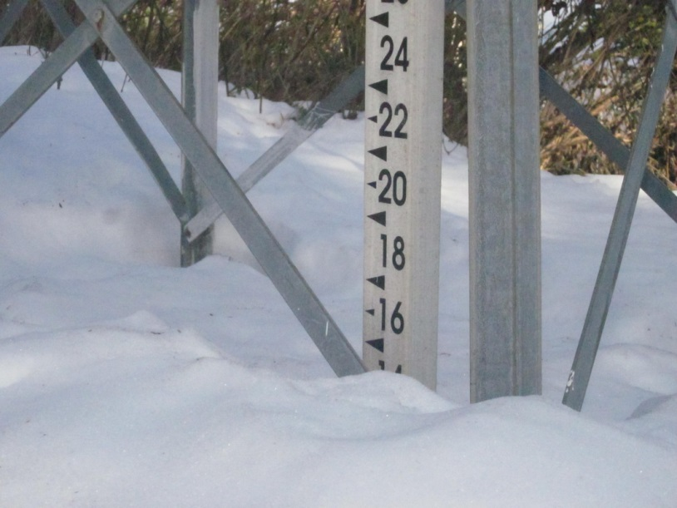
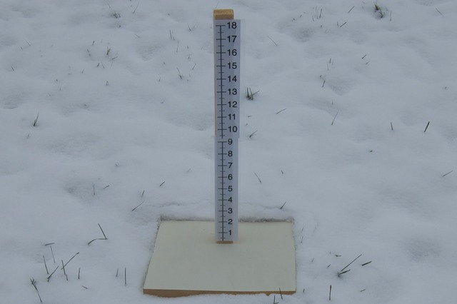
Snow height measurements
Measurements of height of total snow cover
Measurements of height of new snow cover

Slide 9
MEASUREMENTS PROCEDURE
Insert the measuring stick vertically into the snow until it rests on the ground. Read and record the depth of the snowpack.
Repeat the measurement in at least two more places where the snow is least affected by drifting.
Report all three of these numbers as the total snowfall. If depth cannot be read, record the letter “T” (for trace) for total snowpack.
After a new snow has fallen on earlier snow, insert the measuring stick vertically into the snow until it touches the snowboard. Read and record the depth of new snow.
If there is new snow, take at least two more measurements at different spots on the snowboard.
Report these numbers as the depth of new snow. If the snowfall is so small that a depth cannot be read, record the letter “T”. If the snow on the snowboard has been disturbed report “M” for missing.
Record the number of days since the last reading of snow.

Slide 10
IN THE LAB
Save this sample in a clean container, cover it, label it “snowpack pH”.
Save this sample in your tube or another container, cover it, label it “snowpack rain equivalent”.
Hold a straight-sided container straight up and down over the snowboard. Push the container down until it almost touches the board’s surface.
Slide something flat and clean under the container just above the board and turn the container right side up.
Save this sample in a clean container, cover it, label it “new snow pH”.
Once you have taken your samples, place the snowboard on top of existing undisturbed snow. Push the snowboard gently into the snow so that its surface is even with the surface of the snow. Place a flag or other marker nearby to help you locate the snowboard after the next snowfall.
Take your labeled samples inside to melt and measure rain equivalent.

Slide 11
PRECIPITATION PH USING PH PAPER
Pour a 50 mL (or less if you do not have 50 mL) sample of rain or melted snow from your sample jar into a clean beaker. You must have at least 30 mL of sample to measure pH.
Put on latex gloves.
Use tweezers to add one salt crystal into the beaker. Stir the beaker’s contents thoroughly with stirring rod or spoon until salt is dissolved.
Follow the instructions that came with the pH paper to measure the pH of the sample and record the pH value.
If you have at least 30 mL your sample jar then repeat these steps to attain additional pH measurements. A total of 3 pH measurements is recommended providing there is sufficient rain or melted snow in the jar.
Calculate the average of the 3 pH measurements checking that each measurement is within 1.0 pH unit of the average. If they are not then repeat the measurements.
Discard used pH paper in a waste container and rinse the beakers and sample jar three times with distilled water.

Slide 12
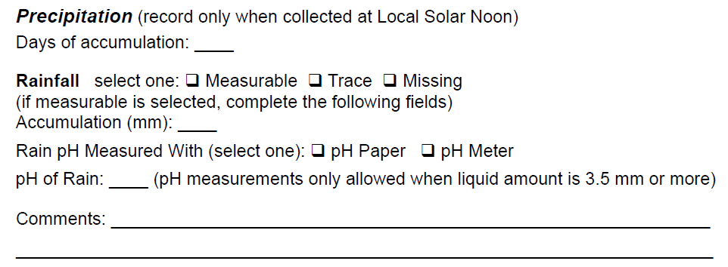
Precipitation data registration:

Slide 13
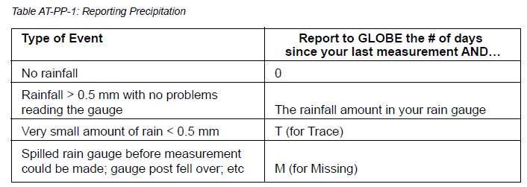
Type of precipitation report for input:

Slide 14
PRECIPITATION INSTRUMENT MAINTENANCE
EXTREMLY IMPORTANT!
daily check of instruments
regularly cleaning
clean water is recommended and detergents are not allowed bearing in mind pH measurements
rain gauges with glass tubes should be taken inside in the winter

Slide 15
AIR TEMPERATURE MEASUREMENTS
Measuring the current air temperature
Measuring maximum and minimum air temperatures for the previous 24 hours
Measurements precision 0.5°C

Slide 16
DEFINITIONS
Current, maximum, and minimum temperatures measured and recorded from a thermometer
Reseting the maximum and minimum indicators to start a new 24-hour measurement period
FREQUENCY
Daily

Slide 17
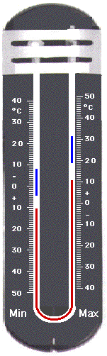
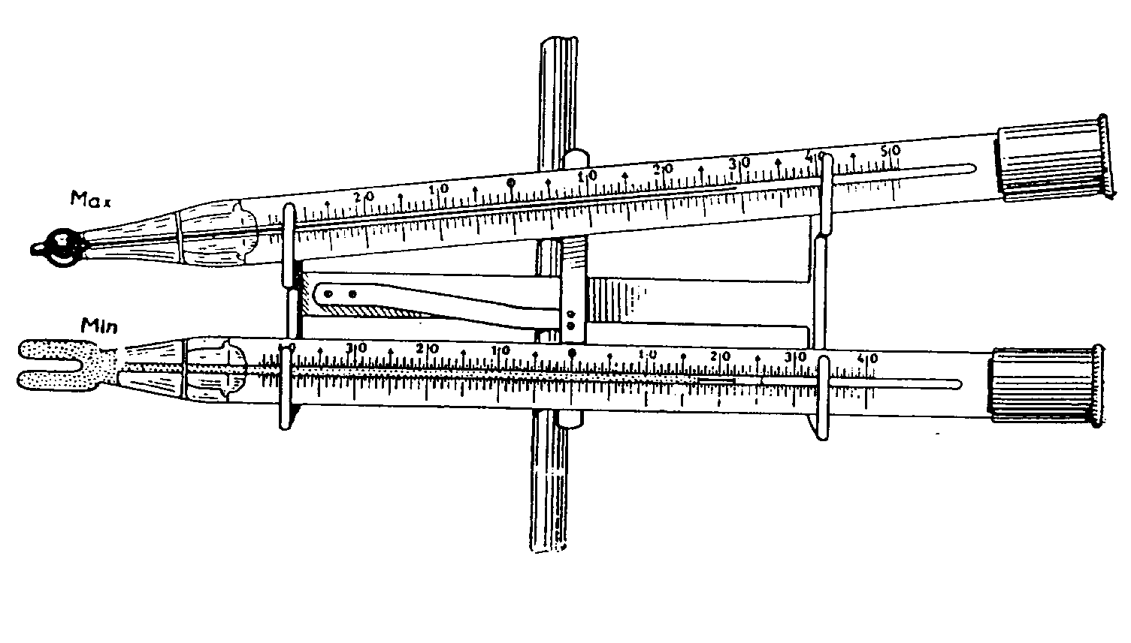
MEASUREMENTS AREA,
INSTRUMENTS AND TOOLS
MEASUREMENTS AREA
If possible flat surface and surrounded with fence, if possible the same as for precipitation.
BASIC INSTRUMENTS:
Alcohol-filled thermometers for current, minimum and maximum temperature measurements.
OTHER USEFULL TOOLS
Instruments shelter.
A clock or watch.

Slide 18
MEASUREMENTS PROCEDURE
A) CURRENT PROCEDURE
Tie one end of a piece of string securely to the end of the calibration thermometer and
the other end to a rubber band.
Slip the rubber band around the wrist so that the thermometer is not broken if it is
accidentally dropped on the ground.
OR
Use the dry bulb thermometer on your sling psychrometer.
Hold the thermometer at chest height, in the shade, and away from your body for
three minutes.
At the end of three minutes, record the temperature reading.
Hold the thermometer the same way for another minute.
At the end of the minute, record the temperature once again. If the temperature is
within 0.5˚C of the previous reading, record the reading on your Data Sheet.
If the two temperature readings differ by more than 0.5˚ C, repeat steps 5 and 6 again.
If two consecutive temperature readings are not within 0.5˚ C of one another after 7
minutes, record the last measurement on the Data Sheet and report your other four
measurements in the comments section along with a note that your reading wasn’t
stable after 7 minutes.

Slide 19
MEASUREMENTS PROCEDURE
B) MAXIMUM AND MINIMUM TEMPERATURE
Record the time and date of measurements.
Open the instrument shelter being careful not to touch or breathe on the thermometer.
Reading eye should be at level with the alcohol in the thermometer.
Read the level of the alcohol on the maximum side of the thermometer to the nearest 0.5˚ C.
Record this reading as the current temperature.
Read the bottom of the indicator on the maximum side of the thermometer to the nearest 0.5˚ C.
Record this reading as the maximum temperature.
Read the bottom of the indicator on the minimum side of the thermometer to the nearest 0.5˚ C. Remember that the temperature scale is upside down.
Record this reading as the minimum temperature.
Use the magnet to gently move the maximum and minimum indicators down until they just touch the alcohol.
Close the instrument shelter.

Slide 20
THERMOMETERS AND SHELTER
MAINTENANCE
EXTREMLY IMPORTANT!
shelter should be kept clean both inside and outside
roughly once a week, check that both sides of the maximum/minimum thermometer read the same
approximately every three months check the calibration of maximum/minimum thermometer against calibration thermometer
before using the maximum/minimum thermometer, make sure that the column of alchocol is continuous.
Most common error in the temperature data in the GLOBE data base is the reporting of temperature read in degrees Fahrenheit as if it were a reading in degrees Celsius.

Slide 21
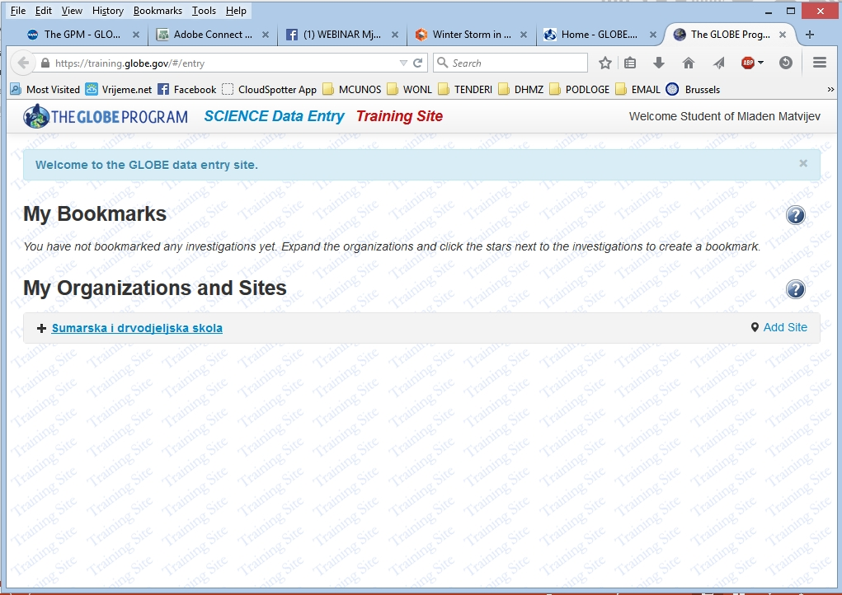
SENDING DATA

Slide 22
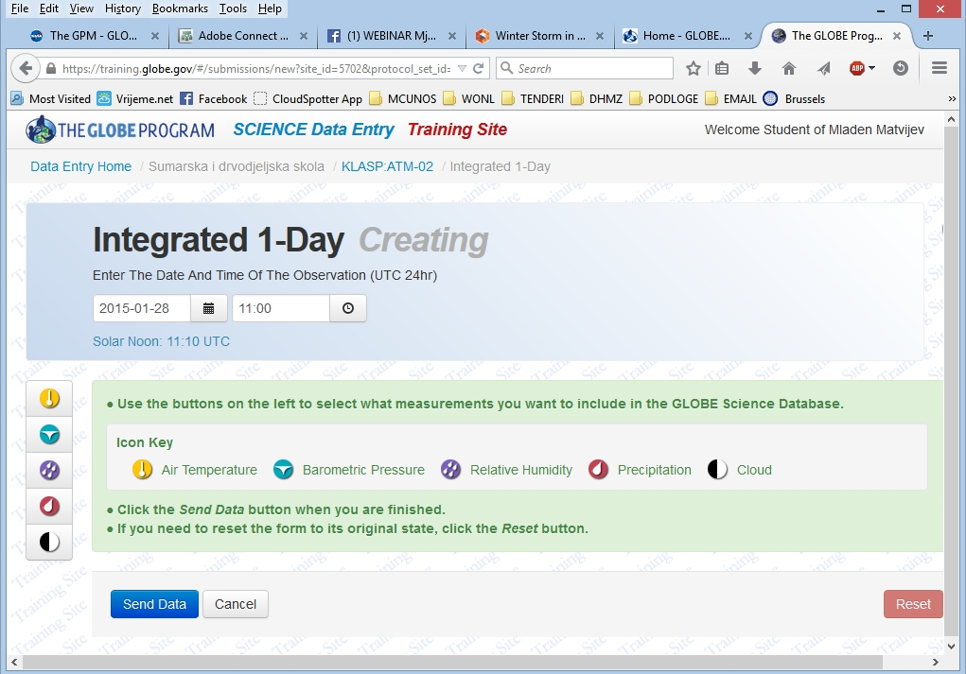

Slide 23
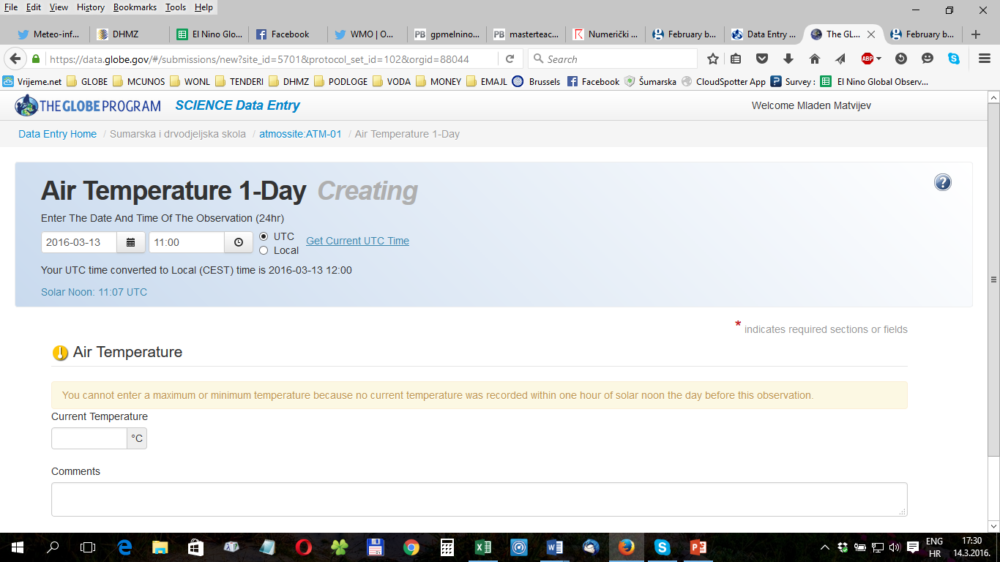

Slide 24
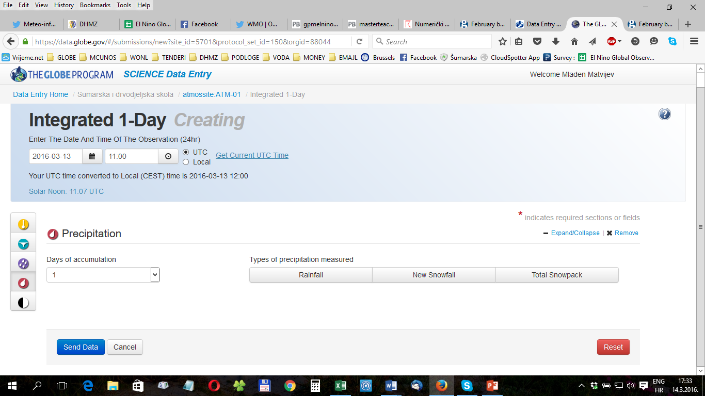

Slide 25
USEFUL LINKS
http://www.globe.gov/documents/348614/97b9939c-7fb5-4b12-8113-59f988781bf5
http://www.globe.gov/documents/348614/93d4bb3c-79e3-4255-9fc8-537fc4f870dc

