Slide 1
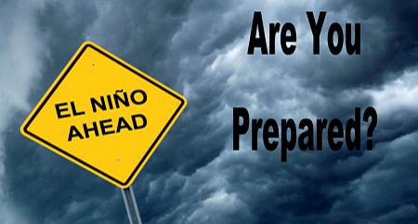
Was El Niño
2015-2016
Normal?
Muchas Gracias
GLOBE
Educators!
Bill Patzert
wpatzert@jpl.nasa.gov
17 May 2016

Slide 2
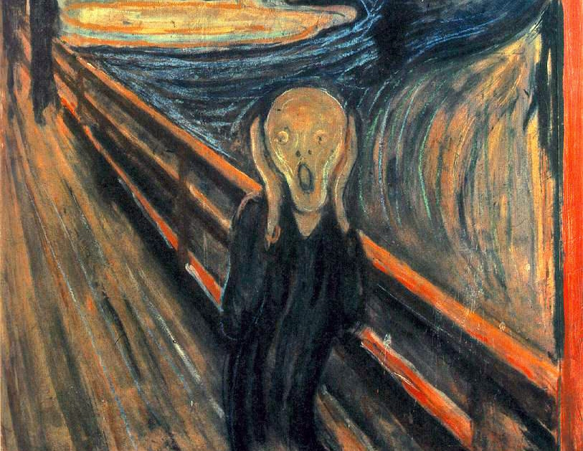
Here Comes
Godzilla El Niño!
Hola La Niña?
Climate Whiplash!
From Deep Drought
To Godzilla El Niño.
To La Niña?
It’s a Super Drought!

Slide 3
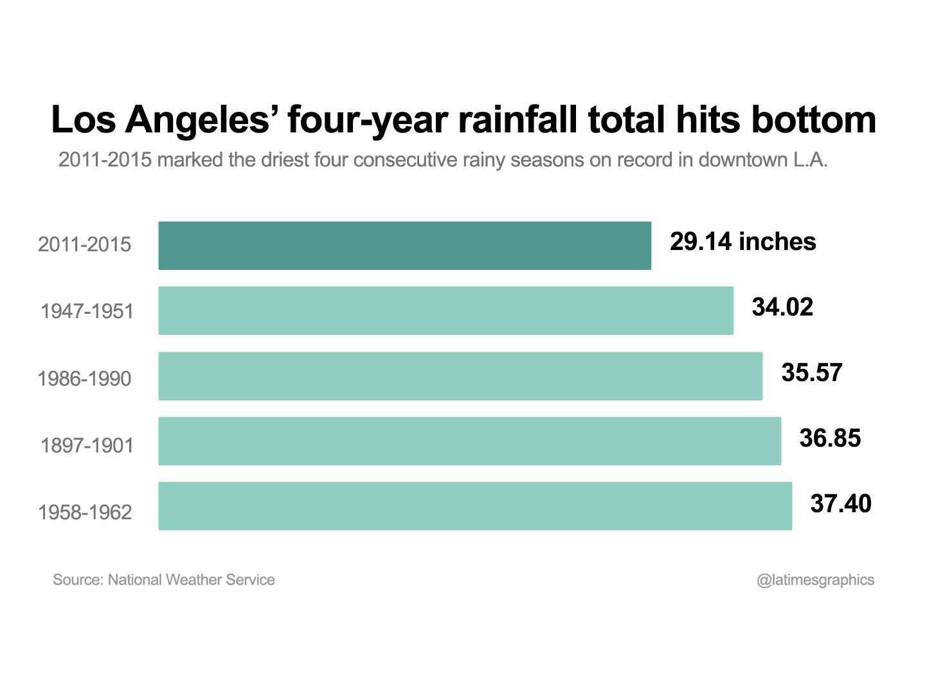
IN L.A. & CA,
THIS PUNISHING
DROUGHT BEGAN
15 YEARS AGO!
Driest 4 years - Record
Record Drought Continues
for 2015-2016
Rain = 9.65” (so far)
Will be Driest 5 years!

Slide 4
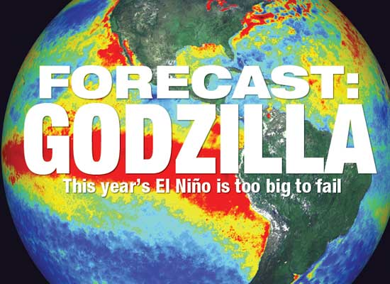
The Great Wet Hope
Or
Mucho Mud & Flood?
OR
EL NO Show?

Slide 5
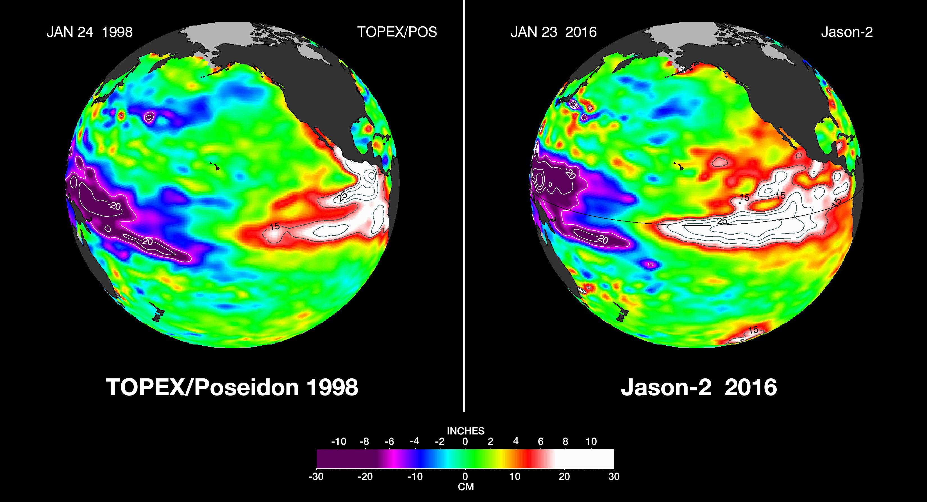
Was El Niño a Godzilla this winter?
Absolutely!

Slide 6
38.32"
’05
What’s ‘Normal’?
7 of 10 Years
Drier than ‘Average’
‘Normal’ is
not ‘Average’!
Godzilla Los Niños
Can Double Rain

Slide 7
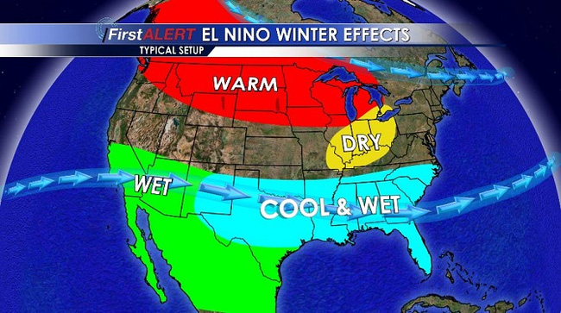

Slide 8
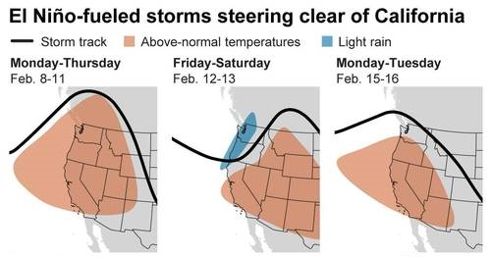
Why? High Pressure Spoilers!
H
H
H

Slide 9
Feb ’98
Los Angeles (13.68”)
Pasadena (16.87”)

Slide 10
Feb ’98
Los Angeles (13.68”)
Pasadena (16.87”)
Not “Normal”
Puny Rain!
•
•
•
•

Slide 11
DROUGHTS ARE LONG!
DRY
12.9”

Slide 12
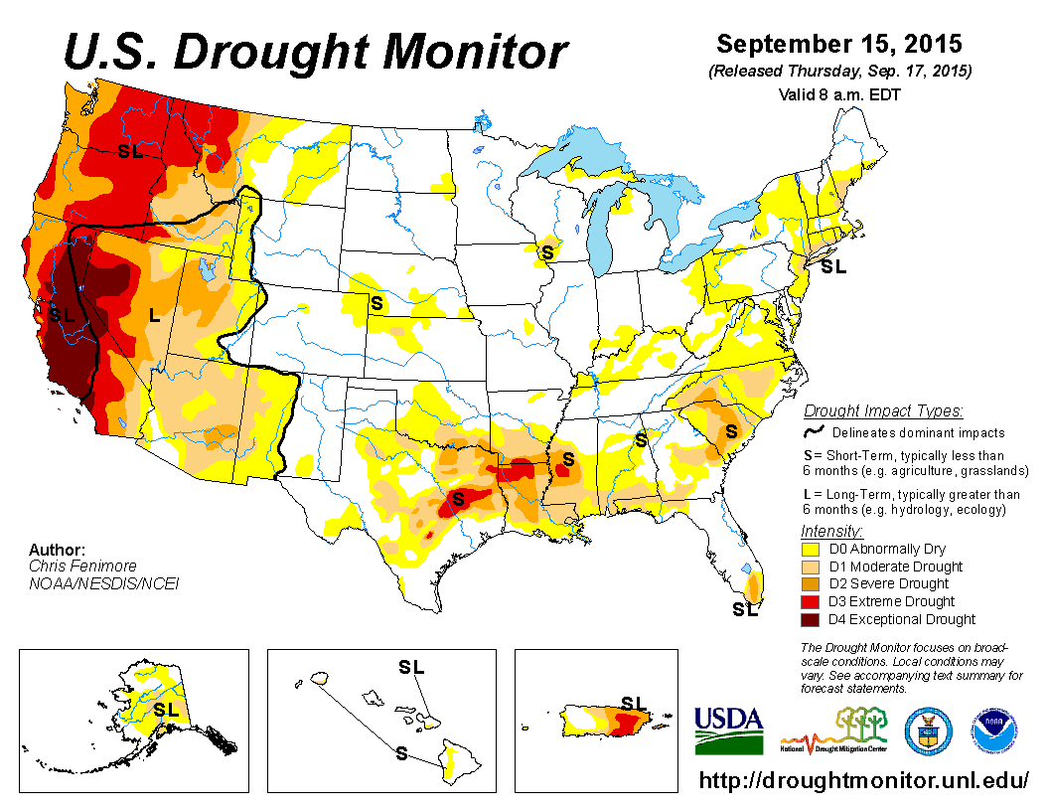
DROUGHTS ARE LARGE!

Slide 13
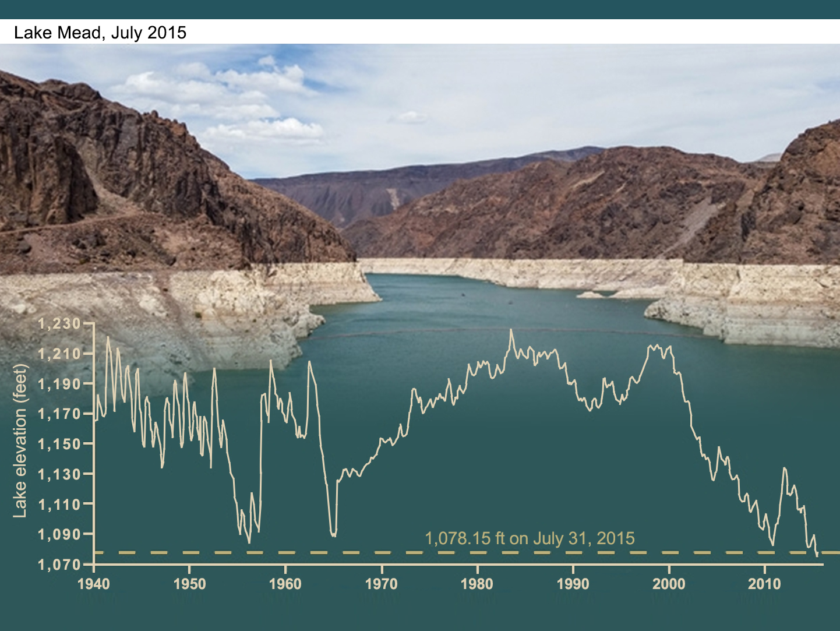
Lake Mead = Bill’s Drought Barometer
15 Year Drop!
Hits Lowest Level in History!

Slide 14
Godzilla
Gecko
Godzilla
El Niño – Regional
Winners & Losers!

Slide 15
CA Still on Drought Alert!

Slide 16
Forecasts were
for a Statistically
“NORMAL” El Niño?

Slide 17
“Normal is a cycle on
a washing machine.”
- Emmylou Harris -

Slide 18
El Niño is fading!
Can we expect La Nina?
Yes - 75% “Probability”!

Slide 19
Preview of Coming Attractions?

Slide 20
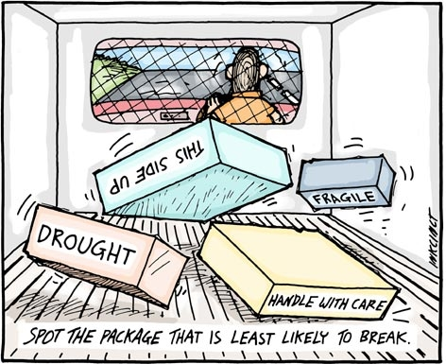
SPOT THE PACKAGE
THAT “PROBABLY”
WON’T BREAK!

Slide 21
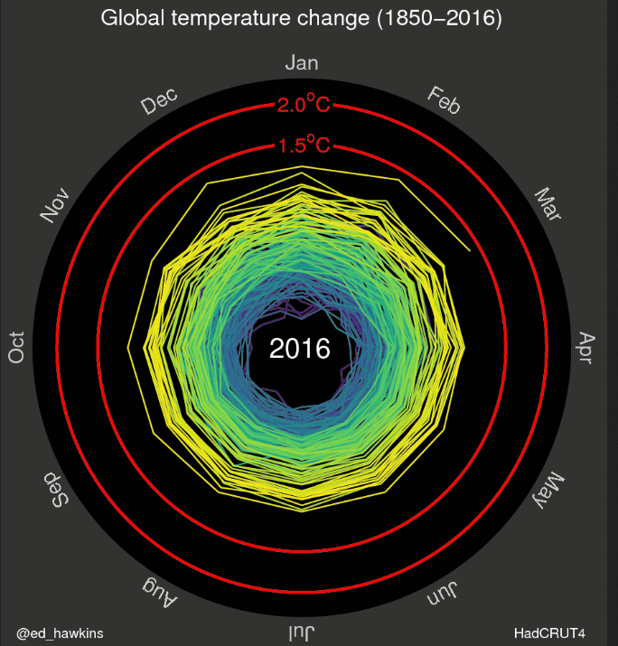
http://www.climate-lab-book.ac.uk/files/2016/05/spiral_optimized.gif

Slide 22
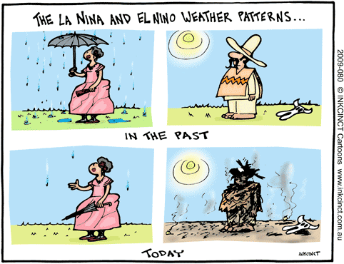
Changing El Niño & La Niña Weather Patterns …
“New Normal” in
a Warming World?

Slide 23
Forecasting El Niño Rains for California
Ain’t for Sissies!

