Slide 1
The 2015-2016 El Niño Event
Using GLOBE Visualization Tools
David Overoye
5/17/2016

Slide 2
Agenda
What are we trying to do?
How to use the GLOBE tools to retrieve and visualize data
Examples

Slide 3
What are we trying to do?
“Collect data for at least two of the following six protocols”
Precipitation
Air Temperature
Surface Temperature
Soil Temperature
SMAP Soil Moisture
Biometry – Canopy and Ground Cover
“Take observations at least 21 days per season”
March 1 – May 31
June 1 – August 31
September 1 – November 30
December 1 – February 28/29

Slide 4
What are we trying to do?
Now we’ve collected the data…How we retrieve it?

Slide 5
Two GLOBE tools to retrieve data
GLOBE Visualization system - http://vis.globe.gov/GLOBE/
Used to see data points on a map
See a particular day’s data – Show me the temperature today
Can also show data observed and graph over a period of time.
Focus is on specific set of data at a specific site
GLOBE Advanced Data Access Tool (ADAT) - http://datasearch.globe.gov/
Used to find and return data from across sites and protocols
Allows you to filter by location, date and other parameters
Focus in on retrieving data across sites or locations

Slide 6
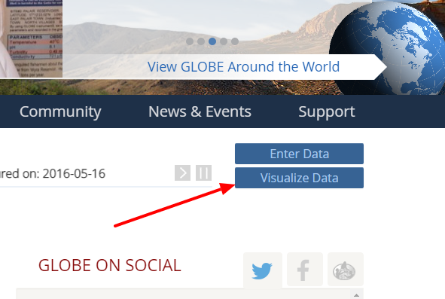
The Basics of the Visualization System
Go to the homepage and select “Visualize Data”
Three Steps to Visualize your Data:
Select the type of data you want to see (Add Layers)
Select the Date you want to see the data for
Click on a data point on the map to receive table and graph information
Full Training material – slides and video available at: http://www.globe.gov/get-trained/using-the-globe-website/retrieve-and-visualize-your-data

Slide 7
Step 1 – Add Data Layers – Choose the Protocol

Slide 8
Step 2 – Select the Date

Slide 9
Step 3 – Click on the Data Point

Slide 10
Vis system popup window
See all Atmosphere Data
Go to this school’s page
See Plot Data in a Table
Add this Data to a multi-site Plot
Change the X axis Timeline

Slide 11
Advanced Features
Use Filters - Location/Site/Elevation to find specific locations – school, country, city etc.
Use the graph with the + icon to select multiple data sets to graph
Allows you to overlay data from multiple sites
Export layers to KMZ format for using with Google Earth and other similar tools
Use “Data Counts” to see schools which have entered the most data during a particular period of time
Full Training material – slides and video available at: http://www.globe.gov/get-trained/using-the-globe-website/retrieve-and-visualize-your-data

Slide 12
Using the Advanced Data Access Tool (ADAT)
Tool allows you to download GLOBE data from multiple protocols, schools, regions or dates without using the map
Select GLOBE Data -> Retrieve GLOBE Data or http://datasearch.globe.gov/
Two Steps –
Select Filters
Protocol, Date Range, Country, School or Teacher etc.
Select “Download Measurement Data” (may take a little while!)

Slide 13
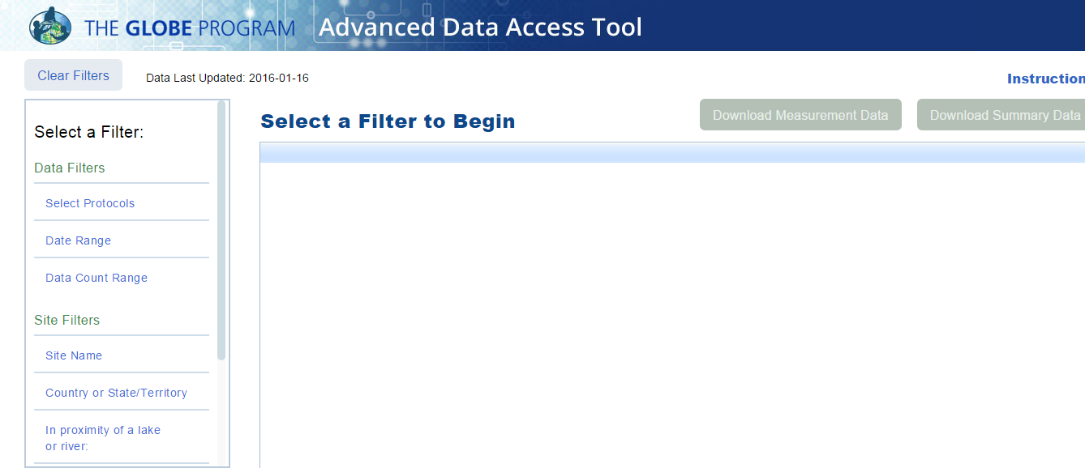
Select Filters from the left to see matching sites

Slide 14
What would be a good filter to setup for El Nino?
Protocols?
Date Range?

Slide 15
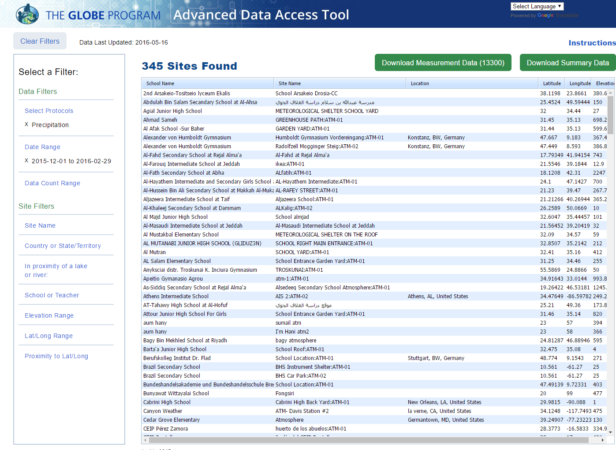
Protocol
Date Range

Slide 16
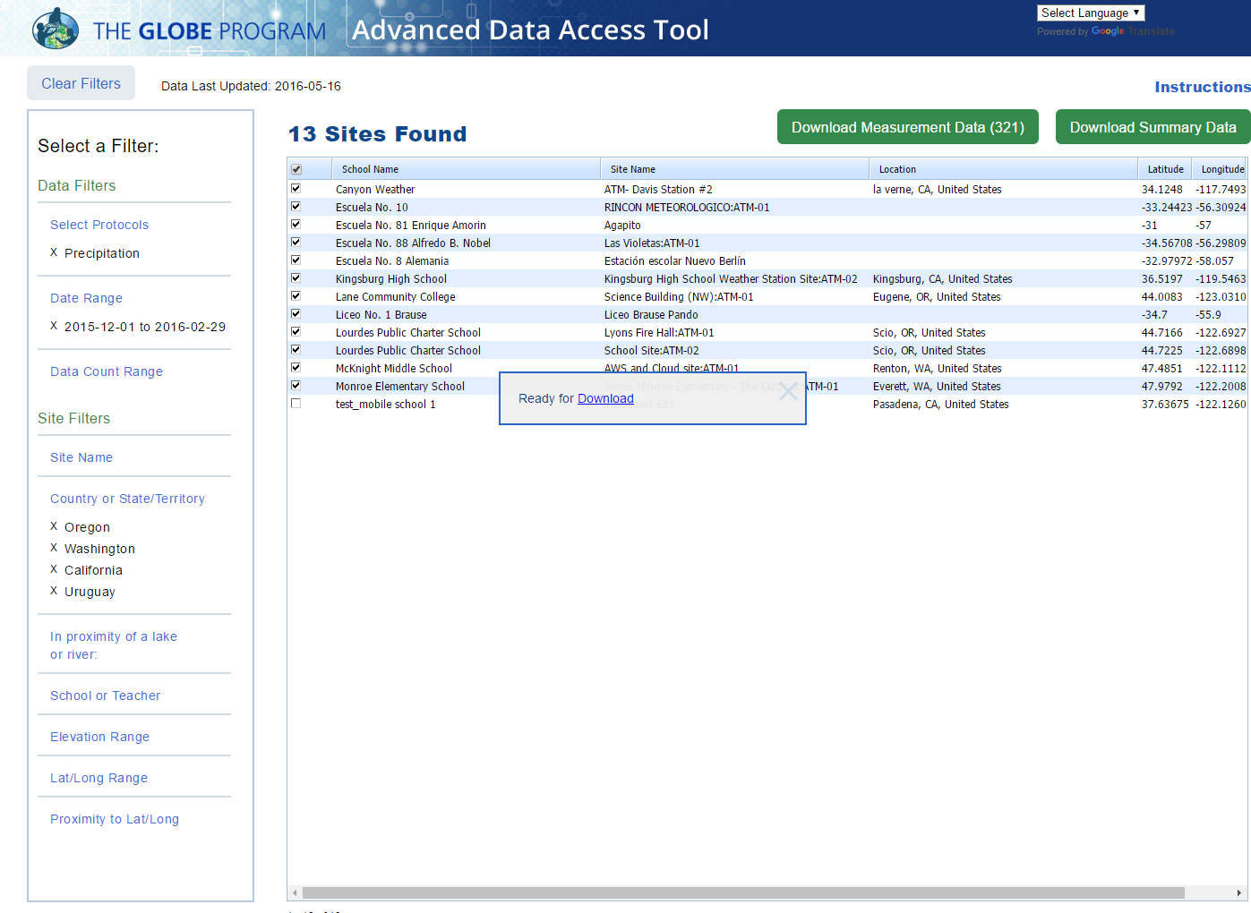
Locations

Slide 17
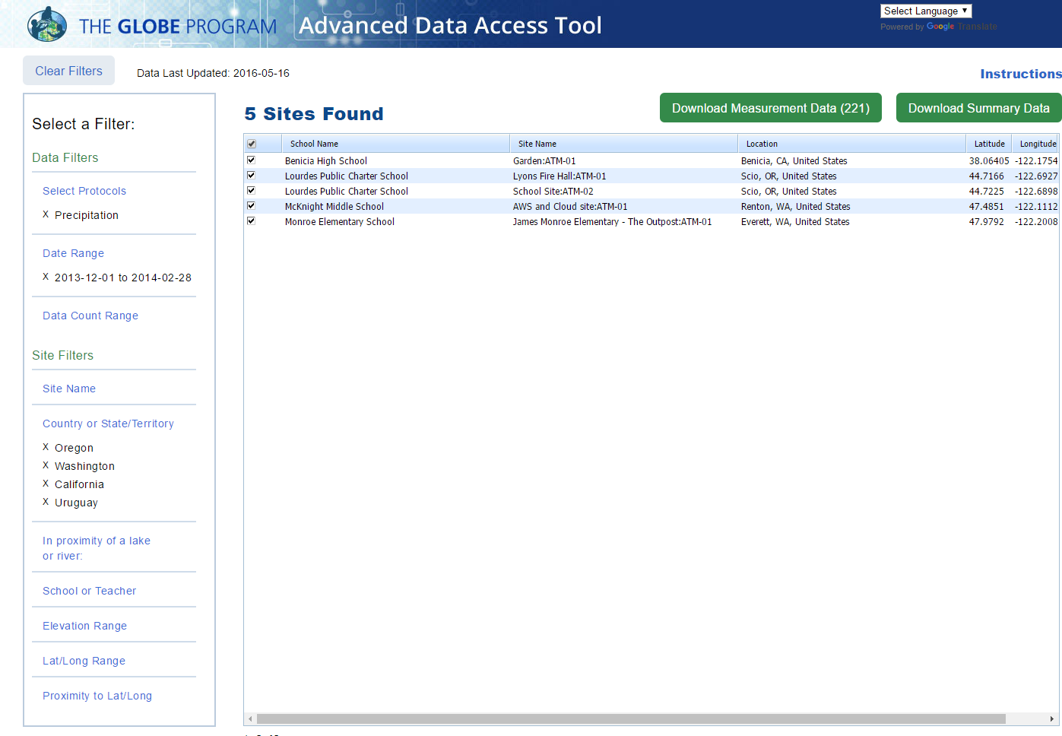
New Date Range
Data 2013 and 2015

Slide 18
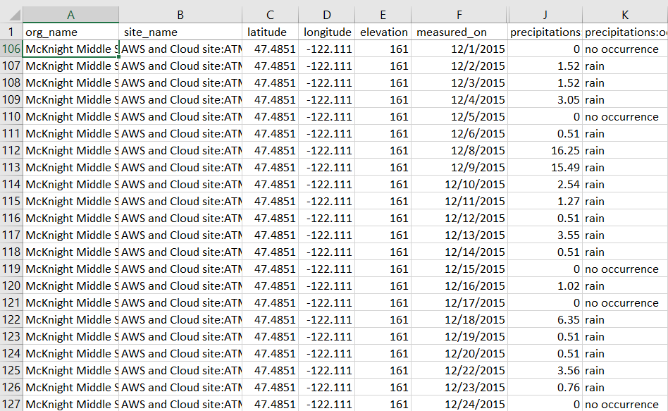
McKnight Middle School – Data 2013 and 2015 Download to Excel

Slide 20
Things to Try…

Slide 21
Visualization System – Your Turn
What school reported the coldest solar noon temperature in Poland on
2/16/2014? What was the temperature?
What was the temperature for the one school which reported data in Argentina on that date?
Make a chart showing the Solar Noon Temperature Dailies for 1 year with data from the school in Poland and the school in Argentina.
What do you see happening?
Why does it happen
Try checking and un-checking the “Auto Y-Axis” button to see what happens
Find someone in another country that is doing the clouds protocol this year (or a protocol of your choice) and request to be a friend

Slide 22
Answers- GLOBE Vis
What school reported the coldest temperature in Poland on 2/16/2014? What was the temperature?
If you did solar noon dailies - Gymnasium No 1, daily average -1C, minimum daily, -5C
If you did minimum - Gimnazium por. J.Czumy in Celestynów -6C
What was the average temperature for the one school which reported data in Argentina on that date?
--- 21.7 C
Make a chart showing the Solar Noon Temperature Dailies for 1 year with data from the school in Poland and the school in Argentina.
What do you see happening?
Why does it happen
Try checking and un-checking the “Auto Y-Axis” button to see what happens
--- The temperature cycles are shifted relative to each other…because they are in the north/south latitudes
Find someone in another country that is doing the clouds protocol this year (or a protocol of your choice) and request to be a friend

Slide 23
ADAT – Your Turn
How many sites measured Soil Moisture (SMAP) during the Northern Hemisphere Fall and Winter periods (9/1/2015 – 2/29/2015) – 88 Sites
How many data points were taken (1291)
Which school and site had the highest gravimetric soil moisture (g/g), when was it measured, and what was the value?
Srednja skola Vela Luka, 1/15/2016, 0.85 g/g
Export all Precipitation and SMAP data from the Ramey School for the period 9/1/2015 thought 5/17/2016
Plot the data – Is there a correlation between precipitation and Soil Moisture?

Slide 24
Answers - ADAT
How many sites measured Soil Moisture (SMAP) during the Northern Hemisphere Fall and Winter periods (9/1/2015 – 2/29/2015) – 88 Sites
How many data points were taken (1291)
Which school and site had the highest gravimetric soil moisture (g/g), when was it measured, and what was the value?
Srednja skola Vela Luka, 1/15/2016, 0.85 g/g
Export all Precipitation and SMAP data from the Ramey School for the period 9/1/2015 thought 5/17/2016
Plot the data – Is there a correlation between precipitation and Soil Moisture? [see next page – what do you think?]

Slide 26
Questions?
Thank you!

