Slide 1


Aerosol Measurement Campaign
9 Mars / 9 May

Slide 2
Introduction
The main objective is to inspire teachers and students to bring their local project to an international level by sharing their data with other schools, by using satellite data and by receiving scientific feedback.

Slide 3
Schools List
AGEN – Lycée Bernard Palissy
ARETTE - Collège de Barétous
BEDOUS - Collège d'Aspe
CAMBO LES BAINS - Collège Errobi
FUMEL - Lycée Marguerite Filhol
GUJAN-MESTRAS - Lycée de la mer
HYERES - Cours Maintenon
LANGON - Collège Jules Ferry
LORMONT Collège George Lapierre
MIMIZAN - Collège Jacques Prévert
PAU - Collège M. de Navarre
PODENSAC - Collège Georges Brassens
POIX-DE-PICARDIE - Collège des fontaines
RABASTENS - Collège Gambetta
SAILLAGOUSE - École élémentaire publique

Slide 4
1. Schools (II) - Map

Slide 5
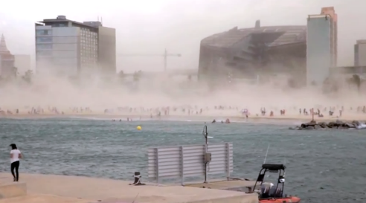
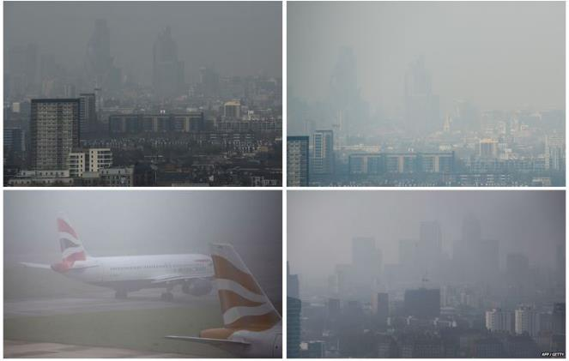
Interesting Case
Dust Storm in:
Barcelona, Paris,
London…

Slide 6
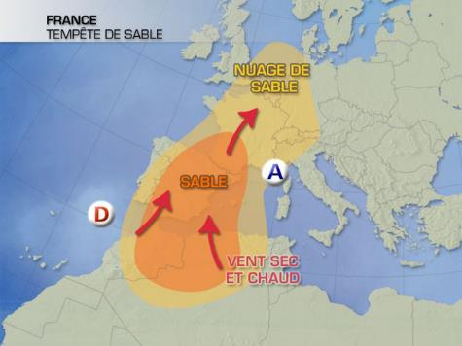
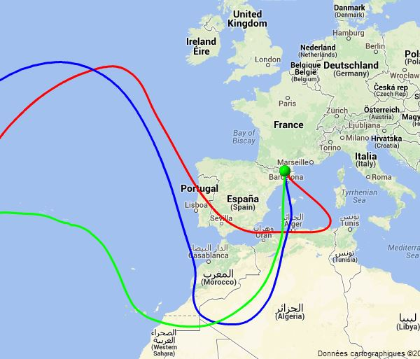
Interesting Case
« The weather channel » April 2nd, 2014

Slide 7
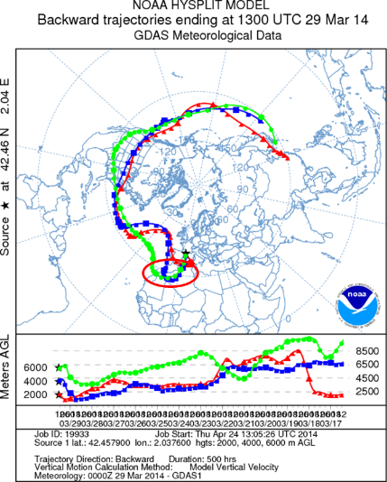
Interesting Case
Using the tool provided by NOAA, it follows the movement of the particles at different altitudes (2000m red line, blue line to 4000 m and 6000 m green curve).
We chose April 1st and we went back 13 days before.

Slide 8
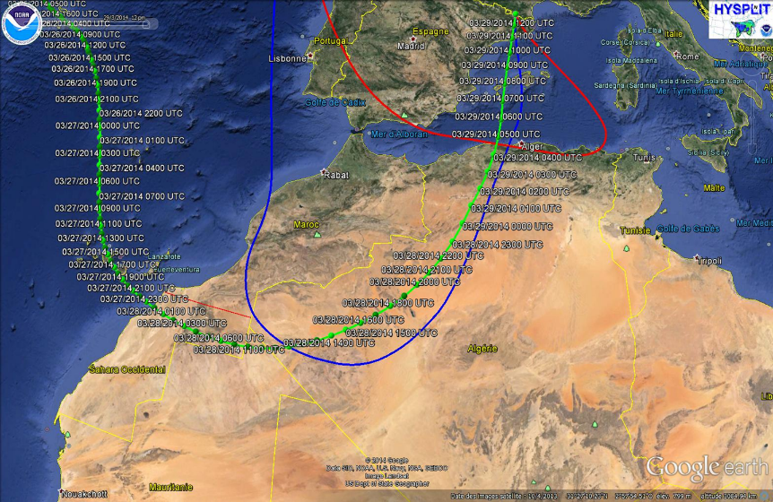
Interesting Case

