Slide 1


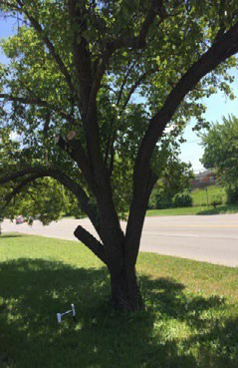
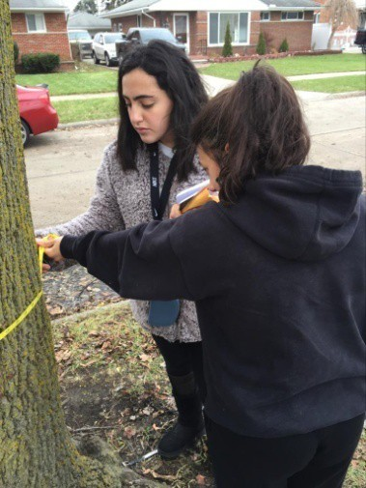
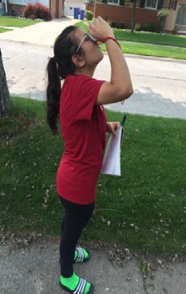
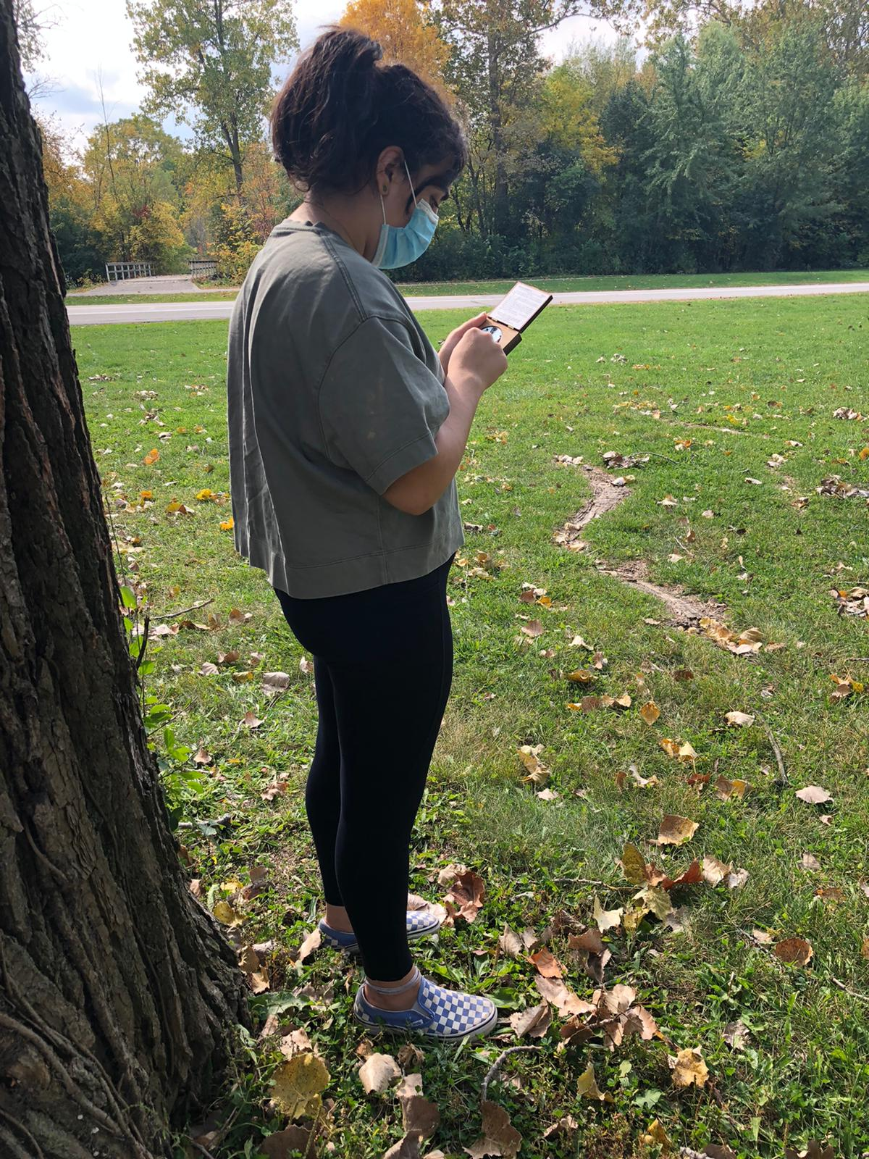
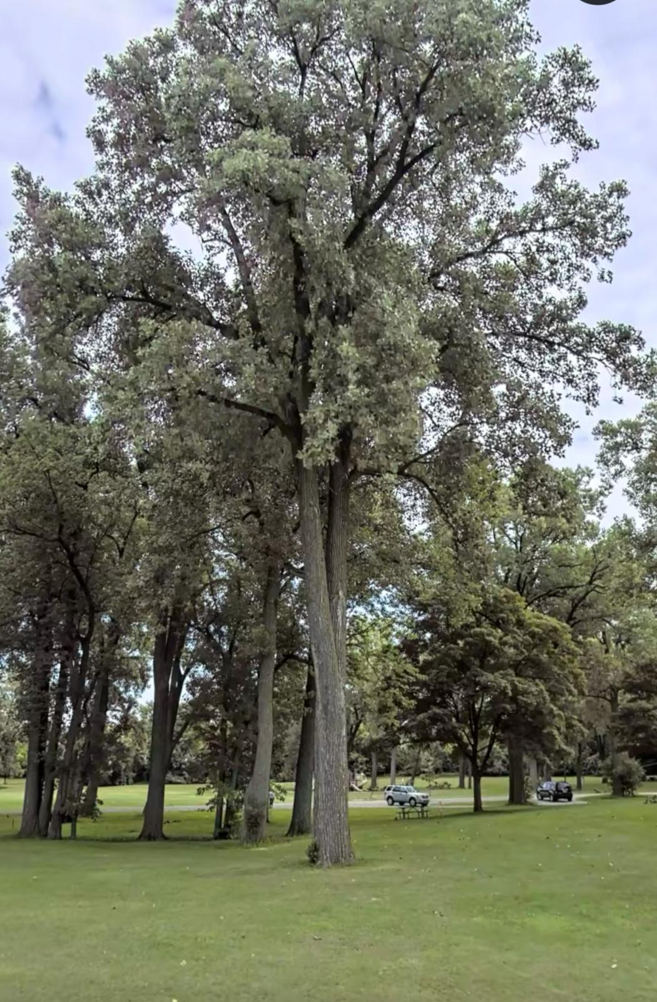
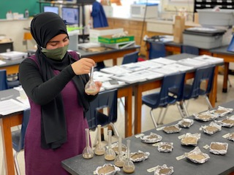
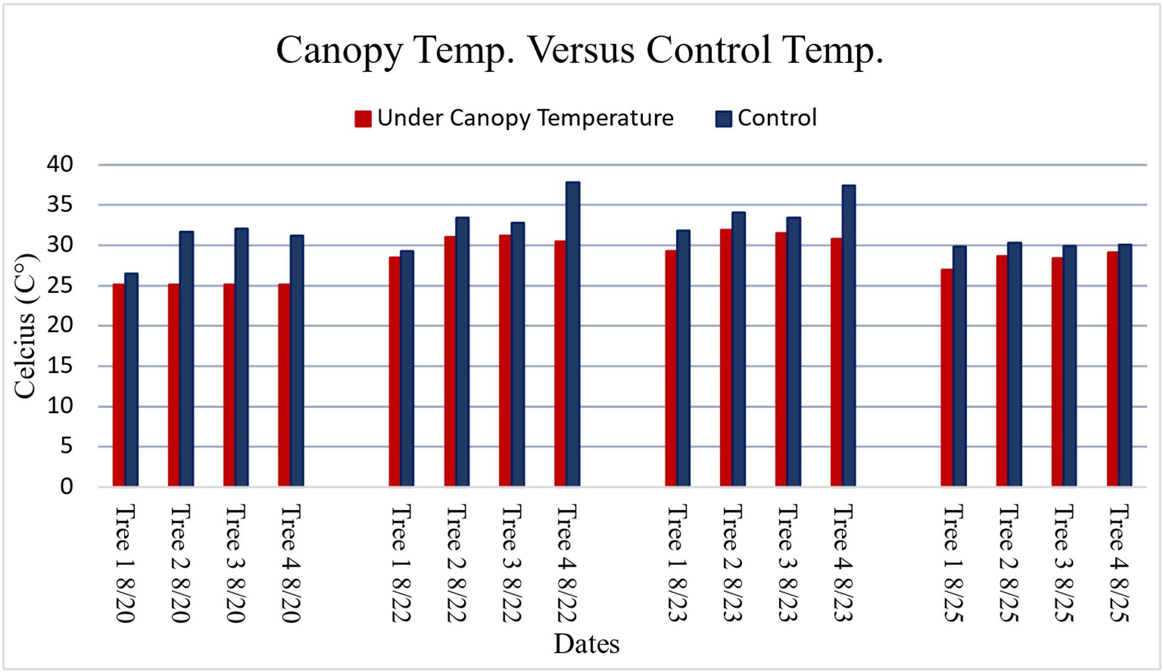
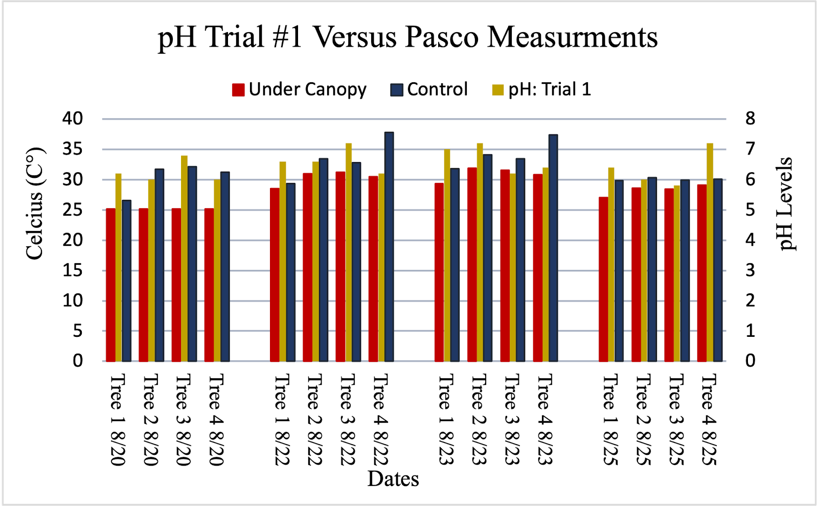
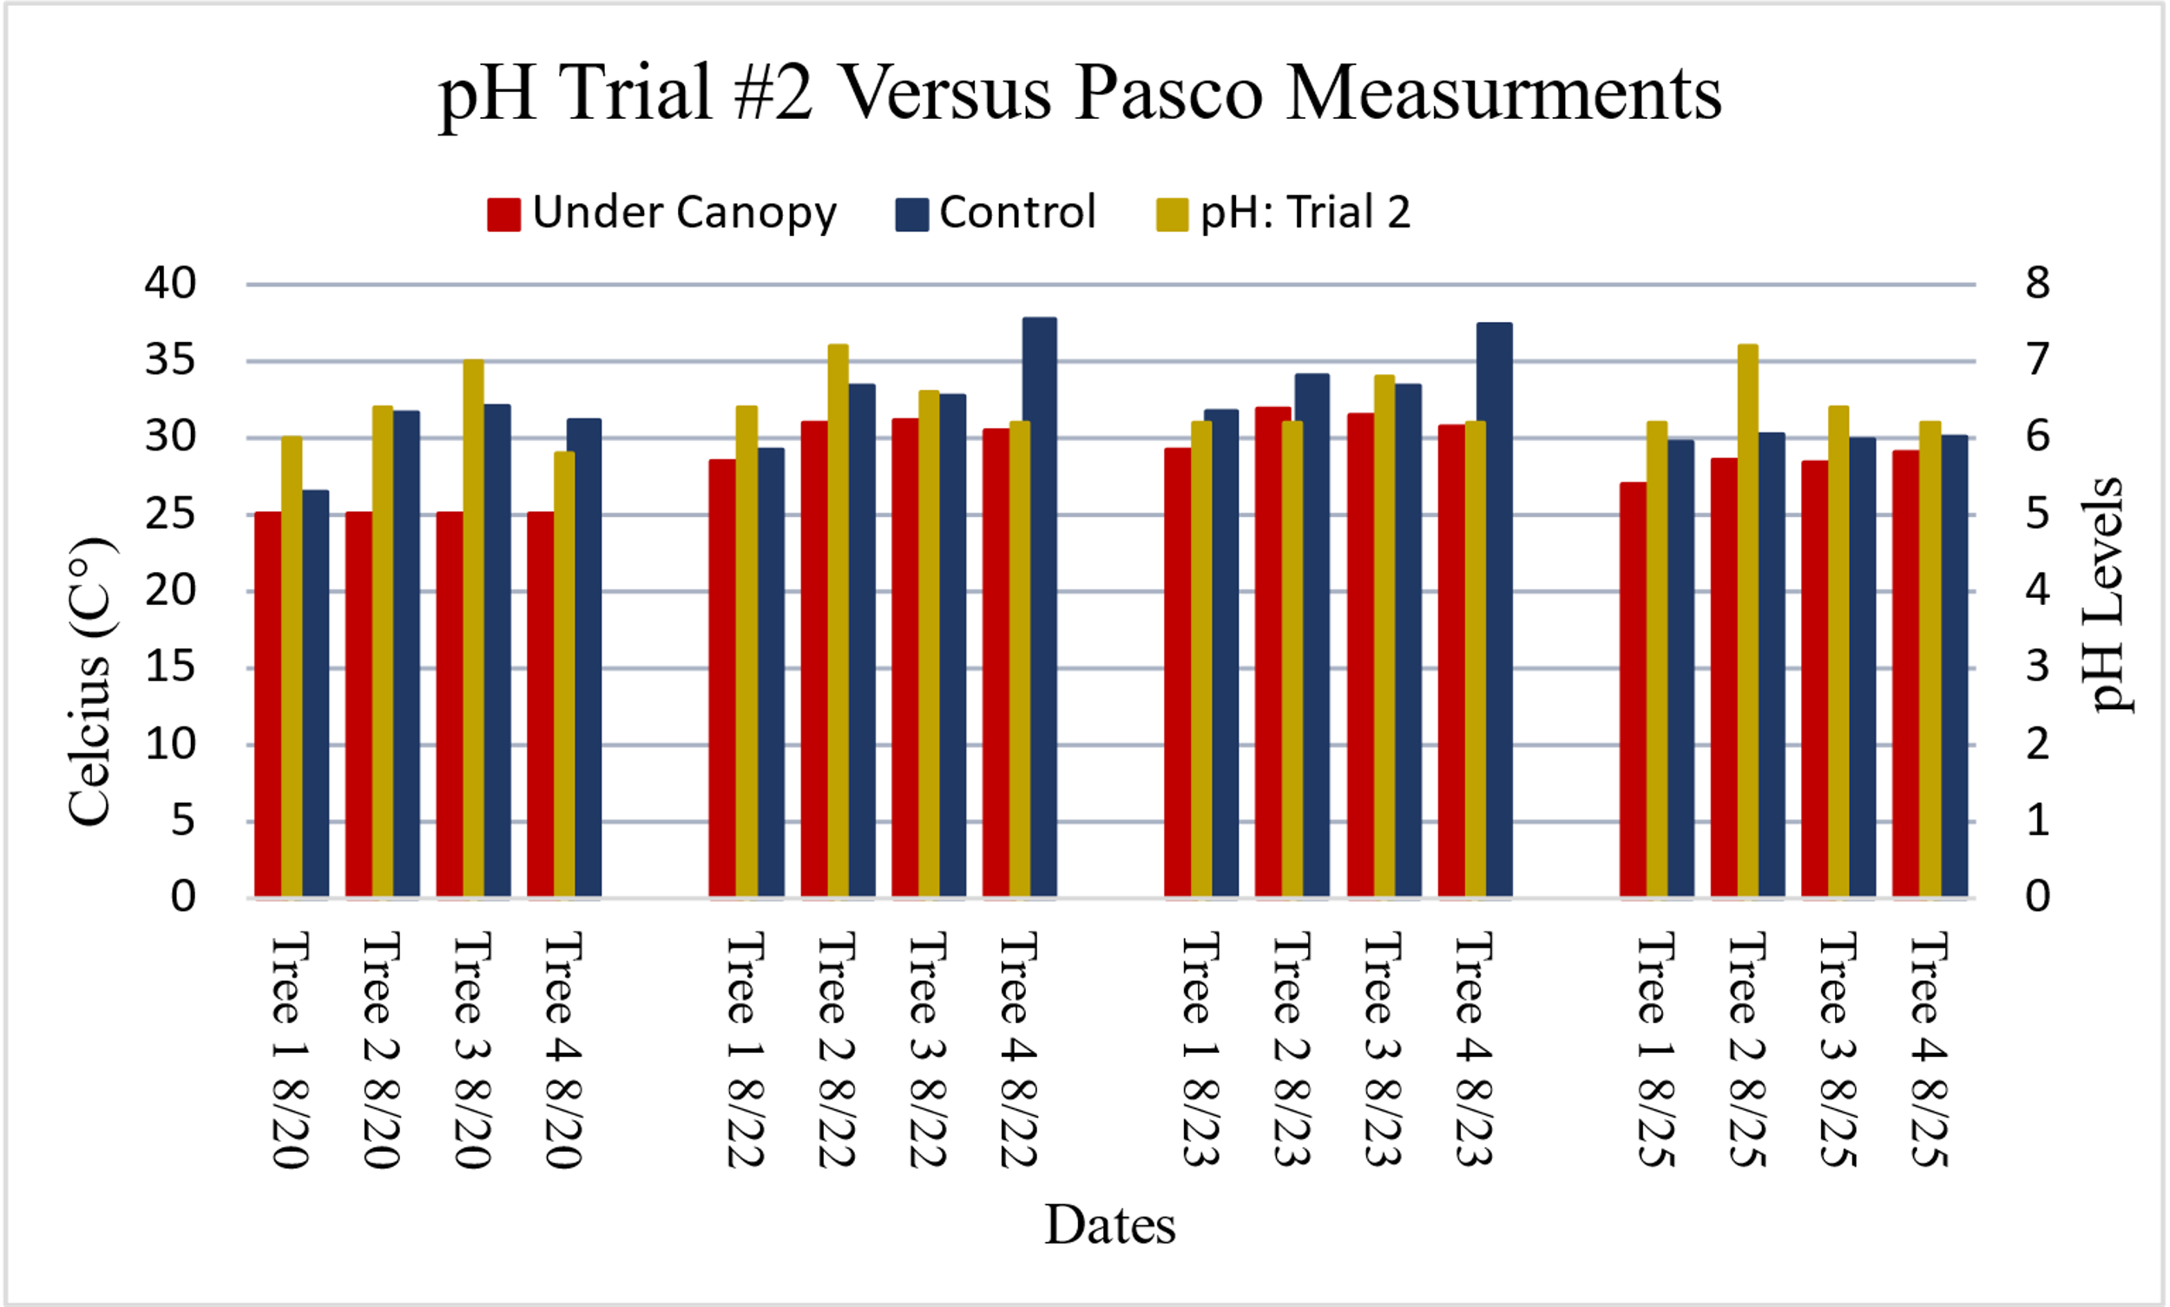
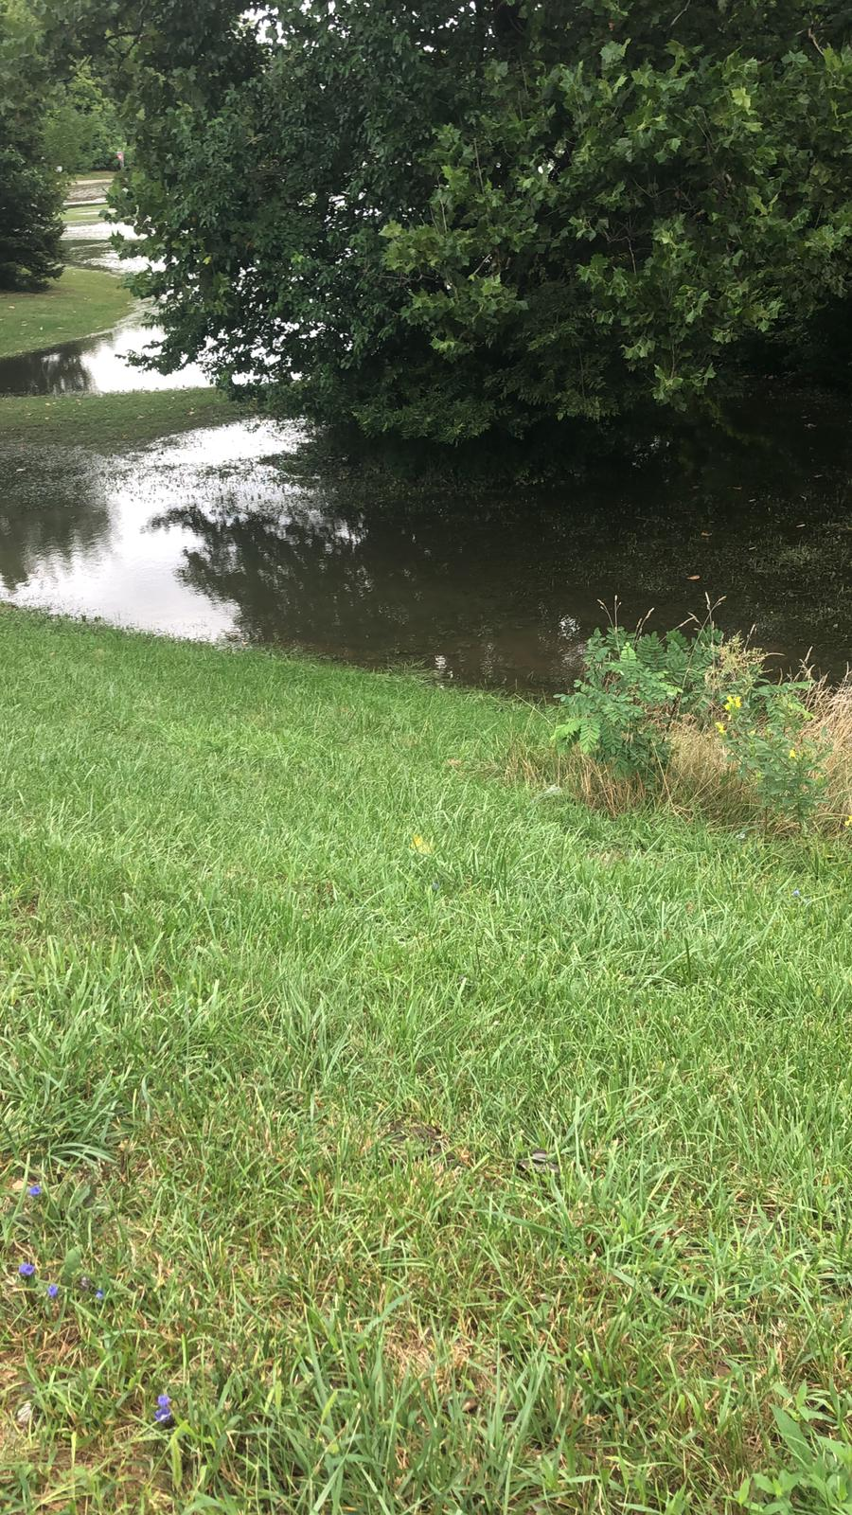
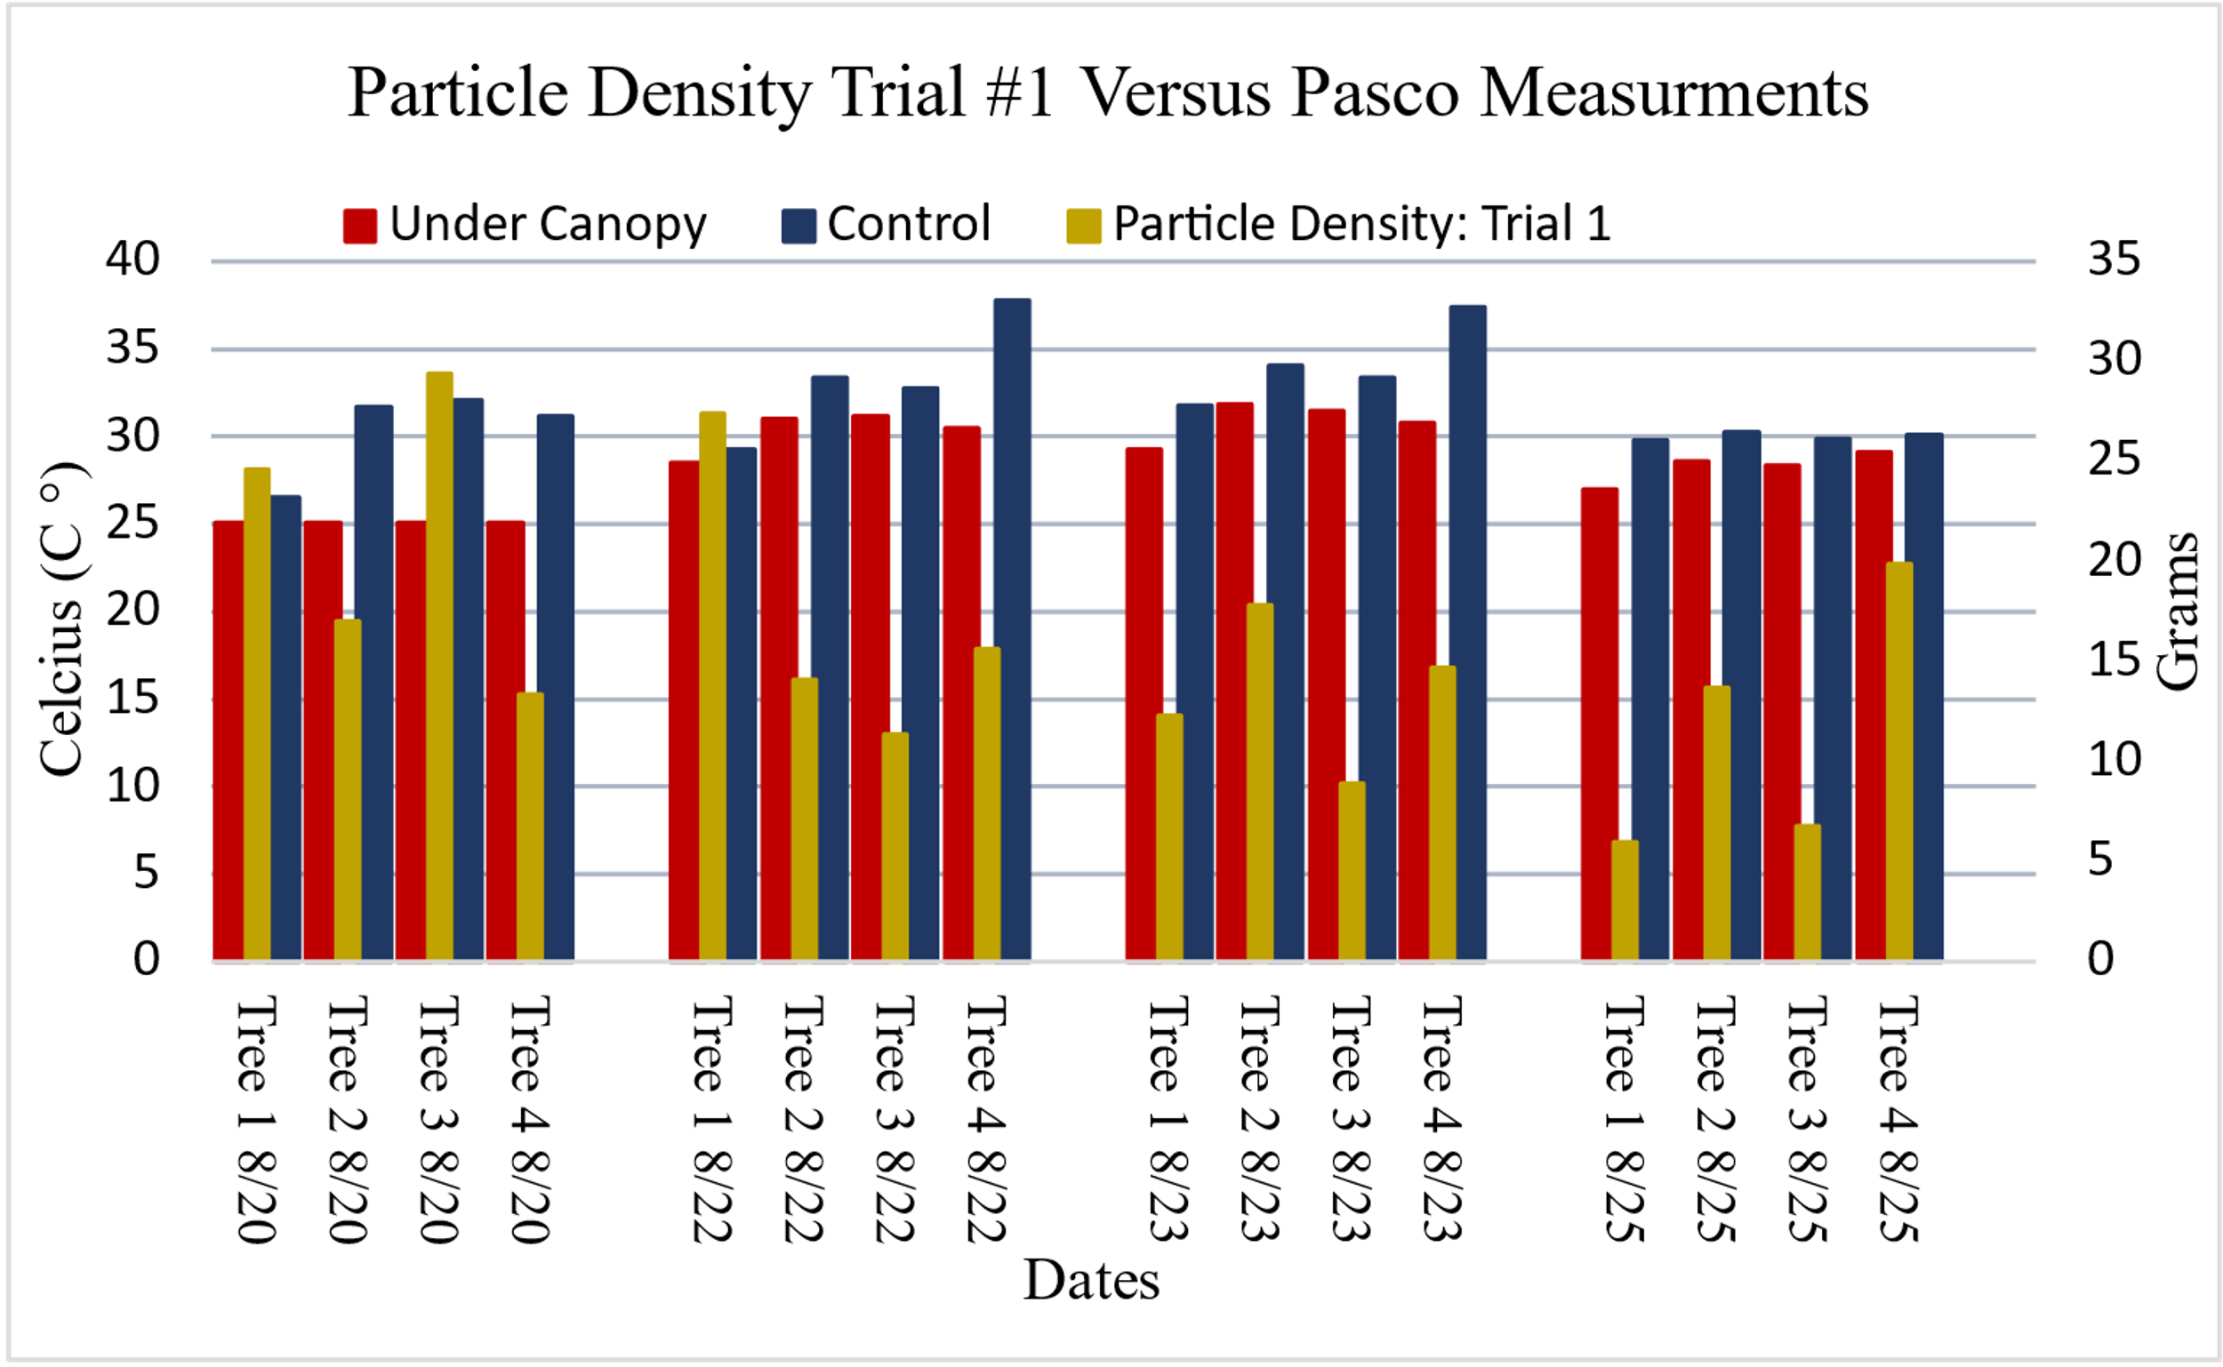
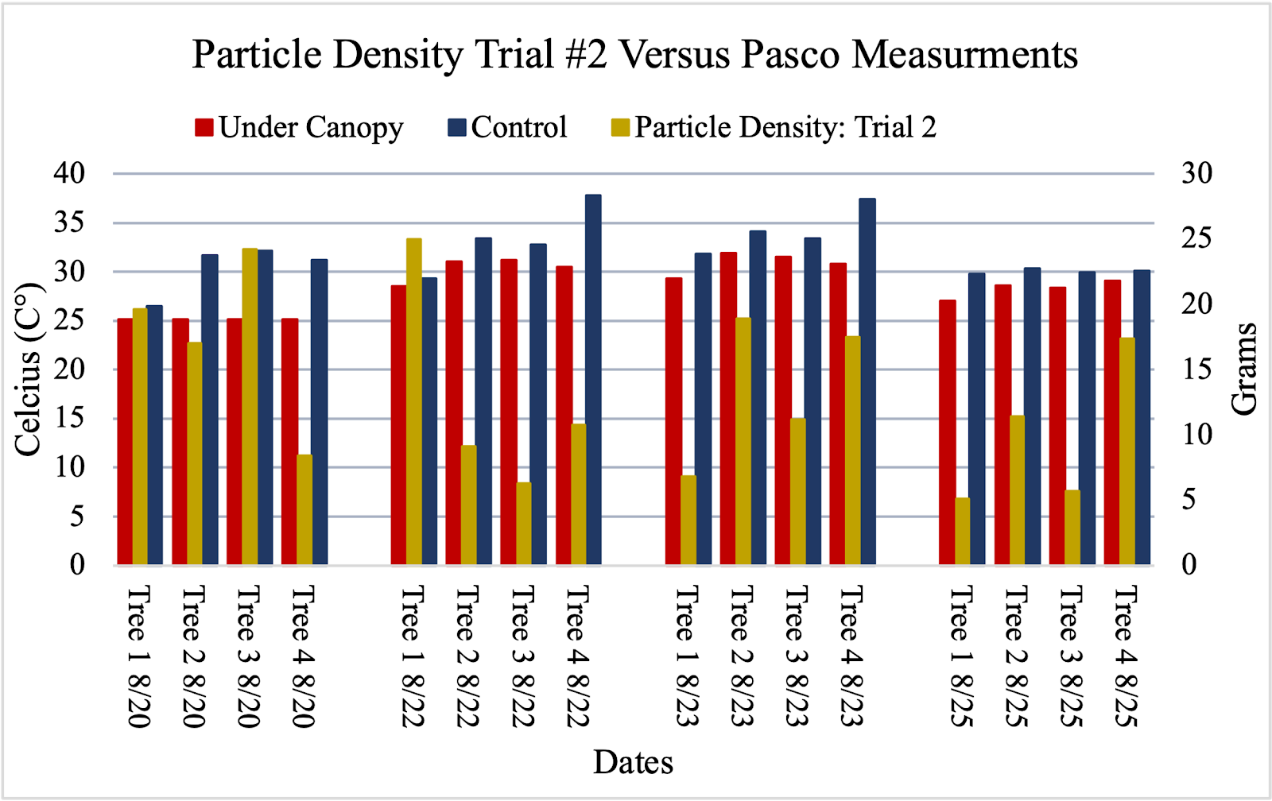
Possible Effects of River Flooding on Soil Parameters and Tree Growth Along an Urban River
Itidal Bazzi, Zeina Jebara, and Sana Taleb – Crestwood High School – Dearborn Heights, MI
Abstract
Research Methods
Measurement Implications
Biometry and soil protocols are a significant and essential consideration to implement
when conducting strategies to develop an advanced understanding of the tolerance of tree species growing in Southeastern Michigan. Understanding the relationship between sediments, soils, and tree growth on floodplains is an important issue to investigate to better understand the impact of frequent river flooding. The parameters incorporated in the investigation varied between soil pH, soil particle density, surface temperatures, and canopy size. During the investigation period, rainfall and river water levels often varied due to heavy precipitation events. A Pasco wireless weather sensor to record a variety of atmospheric parameters. The GLOBE Observer App for trees was used to obtain tree height(s) and circumference(s). This research suggests that of the trees and soil sampled, the physiochemical environment of pH varies somewhat daily and seasonally. Soil porosity and density appear to be heavily dependent on the distance between the tree and the Rouge River itself. Soil density is important in determining how deep roots are grow on a floodplain. This research attempted to determine how different floodplain locations affect soil pH, vegetation differences, and tree tolerance to frequent flooding.
Due to Southern Michigan’s topography being rather extensive, flat, and full of fertile plains not only being a contributing factor of perpetual flooding, the urban area of Detroit is congested with impermeable surfaces due to infrastructure. In correlation of flooding, vegetation becomes at great risk, a term known as “Plant Drowning” typically seen in fully submerged plants, which are posed at the greatest risk. As flooding occurs and vegetation is submerged after a three-to-ten day, it is then decided whether the plants survival is deemed fit. Due to the flooding after moisture is soaked, vegetation is left in crop residue, decreasing the vegetation and tree’s ability to conduct photosynthesis and creating oxygen deprivation further accelerating the decrease in survival rates. Continuing on, not only are vegetation placed at risk after floods but as well as the tolerance of the soil itself. Flooding significantly alter the level of vegetation nutrients, pH, and soil particle density. If flooding was to continue on a flood plain, trees are more likely to fall into the river due to erosion. It would be difficult and expensive to add more trees to the location to hold the soil in place; however, floods may bring other associations with it such as increased phosphorous, silicon, potassium, and nitrogen levels. soil pH levels, soil particle density, and a multitude of other atmospheric parameters allow us to keep a thorough track of weather behaviors that affect these species specifically.
Use a spherical crown densiometer, to assess
the percent of canopy coverage.
Collection of soil taken under the canopy was gathered.
Analysis of soil protocols were completed and resulted.
Set up a PASCO device, connect it to sparkvue application, and let it run for ten minutes.
Collect the DBH of the trees from the breast of the tree 1.37 meters from the base
Measure height using a suunto clinometer three times per partner
.
Discussion
Conducting research during a pandemic has a few disadvantages to it, but as a team we were able to establish that any of the data that was collected would still benefit the research and the Rouge River Watershed community. Data was only collected over a period of four (4) days that were unable to be done consecutively due to the variation of weather Michigan endures or events, one date had (8/21) had flooding and the other (8/24) Edward Hines was closed. Ideally, it would have been significant to do a month’s analysis rather than a week, but this also being a limitation due to Covid-19 restrictions. Due to the Rouge River anytime it rains Hines Drive is left to be flooded for days.. The clinometers were also not at the highest accuracy, there were three researchers measuring the trees, there could have been difficulties getting precise readings due to each researcher being a different height. Lab space was hard to come by because if the state was in lockdown, it meant we were locked out of the labs as High Schools were not allowing students and at time even faculty into the building, due to this we had to cut down our trials from three (3) to two (2) and could not add more parameters to our research such as dew point, wind speed, wind chill, and humidex. Be-that-as-it-may the time period of data collection be minimal creating a decline in accuracy and precision, the data collected may still be used to predict following trends;
Background
Results
Urban flooding is an all-too-common occurrence for many residents of the Rouge River
Watershed in Southeastern Michigan. With so many impermeable surfaces in this region, even moderate amounts of rain can lead to flooding and wild swings in the height of river water. Edward Hines is a major roadway that gets closed frequently because of repeated flooding. In the past high-water levels have released raw sewage into the river along with runoff full of oil, grease, pet feces, fertilizer, pesticides, etc. Record floods that were uncommon a few centuries ago has become a commonplace for this watershed. The Middle Branch of the Rouge River flows through a heavily populated portion of the watershed. When the glaciers melted back 10,000 years ago, they left a landscape with poor drainage and many wetlands. Unfortunately, early settlers drained these wetlands for easier farming. Without many natural wetlands remaining, precipitation that would normally soak in, becomes runoff. The regions relatively flat (low) topography has allowed communities to develop in a sprawling fashion rather than within the confines of an urban center. Because the data in this investigation was collected for only a week, any analysis or conclusions must be viewed with caution and remain tentative.
Bibliography and acknowledgements
Conclusion
Conclusion
Discussion With Results
Figure Nine: Within the graph due to the flood water on 8/21, examining Tree 4, while not only being the tree with the closest proximity to the Rouge River and the lowest elevation it was also heavily affected by visible leaching and weathering of the soil. The pH read as 6.2 which may have been lowered due to the acidification. However, on 8/25 the pH read as 7.2 due to a possible decrease in weathering and leaching.
Figure Ten: Similar as to figure nine, most of the pH readings throughout stayed consistent and match along trial #1. Therefore, establishing a directly proportional form that higher water elevations cause pH to decrease due to possible acidification altering soil. With the exception of the date 8/25, although the soil was collected and tested from the same gathering of soil, the pH readings are significantly varied. This may be a procedure mistake or limitation done when conducting the lab.
The locations of trees and their associated soil conditions were found to be somewhat related to air temperature. This was true for areas both under the canopy and the control (outside of the canopy). These parameters being air temperature collected by two PASCO Wireless Weather Systems for ten (10) consecutive minutes, canopy size effectiveness, tree height, soil pH, and soil particle density. Comparing trees of multiple species in river-fluctuated ecosystems helps create clarification between the effects each tree must endure. This research determined that air temperature and consistent rainfall affect the ability to cause possible leaching and weathering in soil floodplain soils. Although, in dry periods of time, since leaching and weathering are to be less intense it may cause soil pH be neutral, which was concluded in our research. However, due to not being fully educated on all soil parameters, the data collected and examined for particle density is to be taken as an estimate rather than a precise scientific conclusion. Information on particle density is valuable for estimates of other soil parameters such as, porosity, air-filled voids, settling rates of particles in fluids, nutrient transportation. All are proportionally correlated but cannot be confidently concluded and will be considered for future conducted research on soil parameters.
Figure Eight: It is shown that canopy size is effective when being compared to under canopy air temperatures and air temperatures taken outside of the canopy (control) the data being collected through the PASCO weather device. The visualization in heat reduction is physically noticeable within the graph. As Tree 4 had the largest percent of canopy cover (83.5%) while also having the largest difference in temperatures of Canopy vs. Control (approx. 7.34 C°).
Research Question(s)/ Null Hypotheses:
Initial Research Question(s):
Is the pH of soil directly proportional to the intensity of climate in the specific region?
Does soil particle density have any relation, whether proportional or inversely, to soil compaction? Does that affect uprooting/bulk density/ nutrient penetration?
Is the distance between the Tree itself and the Rouge River impactful to the Tree’s tolerance?
Figure 11: Within the figure, Tree 3 has the lowest particle density with the exception of 8/20 (which was a rainy day). The other trees present an average particle density which may likely correlate with moderate soil porosity and soil compaction. However, Tree 3 having unusually low particle density alters the soil possibly decreasing the porosity and compaction.
Figure 12: While conducting the second trial of the particle density lab, the soil being from the exact same gathering as the first, was precisely accurate. Each soil particle density is < 1 in difference compared to trial 1.
Bibliography/Acknowledgments
Null Hypotheses:
Large Canopy Cover does not reduce air temperatures when compared between under the canopy and the control (outside the canopy).
Proximity of tree location has no correlation in decreasing or increasing pH levels due to leaching and weathering.
Particle density does not vary along floodplain gradients.
Cotrone, Vincent. “The Role of Trees and Forests in Healthy Watersheds.” Penn State Extension, 17 Aug. 2015, extension.psu.edu/the-role-of-trees-and-forests-in-healthy-watersheds.
Forgottenwoods. “Soil Bulk Density and Its Influence upon Tree Root Growth.” Arboriculture, 10 Jan. 2016, arboriculture
Michigan State University. “Physiographic Regions and Unique Places.” Physiographic Regions of Michigan, project.geo.msu.edu/geogmich/phy-regions.html.
- We’d like to thank our adviser, Mrs. Diana Johns, for assisting us throughout this project and helping to supply the necessary materials, with whom we would not be able to accomplish as much as we had without her.
- We would also like to thank Mrs. Lisa Perez with the USDA for offering her expertise in biometry and the pedosphere and also offering aid and support with resources provided by the USDA Forest Service.

