Slide 1


The effectiveness of using Moringa oleifera leaves as an organic fertilizer.
Done by:
Rayan Awad Rashid Al Farsi
Fars i Maryam Khamis Ali Al Farsi

Slide 2
Abstract :
The effectiveness of using Moringa oleifera leaves as an organic fertilizer.
Done by :1- Rayan Awad Al Farsi
2- Maryam Khamis Al Farsi
Supervisor: Hidaya Sulaiman Al farsi
Asma bint Omais for basic education (1- 8) school:
Our research aims to study the effectiveness of using Moringa oleifera leaves as an organic fertilizer by answering the following questions:
- What is the effect of fertilizing Moringa oleifera leaves on plant growth (stem length and number of leaves)?
- How does the use of Moringa oleifera leaf extract affect soil properties (acidity, salinity, and conductivity)?
To answer these questions, we used leaves powder in different quantities to fertilize tomato plants and compare growth rates. We also prepared liquid fertilizer from moringa leaf extract and used to fertilize tomato plants and compared growth rates with another tomato plant fertilized with organic fertilizer, using ground cover protocol. The soil protocol was applied studying the soil characteristics (acidity, salinity, and conductivity) to study the fertilization effect of moringa leaves on these characteristics.
The results indicated the effectiveness of using Moringa oleifera leaves as an organic fertilizer, as the plant that was fertilized with Moringa leaf extract recorded higher growth rates within 5 weeks (37 cm) compared to the growth rate of (29.5 cm) for the plant that was fertilized with organic fertilizer and (22 cm) for the plant that was not. As it turned out, there were also higher values for the acidity, salinity and conductivity of the soil that was fertilized with moringa leaves, because the leaves contain high chemical elements percentages. Therefore, we must add specific powder amounts to get better plant growth.
Based on the research results, we recommend the need to intensify guidance campaigns for farmers to encourage them to grow moringa and use as organic fertilizer instead of chemical fertilizers and as fodder for their livestock . Also, by planting more moringa trees , the carbon will decrease in the atmosphere.

Slide 3
Research question:
1- What is the effect of fertilizing Moringa oleifera leaves on plant growth (stem length and number of leaves)?
2- How does the use of Moringa oleifera leaf extract affect soil properties (acidity, salinity, and conductivity)?

Slide 4



Research methodology:
Collect information on the subject of the research from the books available in the Learning Resource Center and from the internet
Develop a search plan.
Set a timetable for the implementation of the research plan.
Adopting experimental research to study the effect of fertilization with moringa leaf powder and extract (stem length and number of leaves)..
Determine the protocols needed to perform the research( land cover protocol and soil protocol )
Determine the equipment and tools necessary to perform the work (pH meter and the instrument of measuring salinity and conductivity).
Collect data and organize them in tables.
Insert data in the program’s website
Data analysis and representation
Conclusions and recommendations.

Slide 5


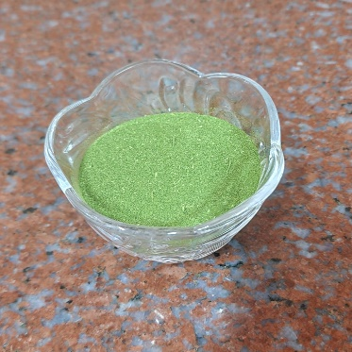
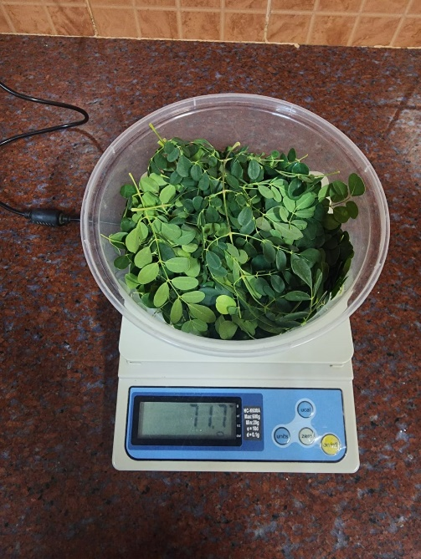
  2- Put the same amount and type of soil in 3 pots, adding 10 grams of moringa leaf powder to one of the pots, 20 grams to the second pot, and leaving the third without adding anything.
3 - Choose tomato seedlings of the same type, with the same height and number of leaves, and plant them in three pots, irrigating them with the same amount of water, and placing them in the same lighting and temperature for five weeks
1- Collect moringa leaves, then dry and grind them to obtain a powder
Methods of data collection:
4- Measure the growth rate of each seedling by measuring the height and number of leaves weekly and recording the results in a table.
5 - Measuring the acidity, salinity and conductivity of the soil at the beginning of the experiment and five weeks after the experiment was conducted

Slide 6
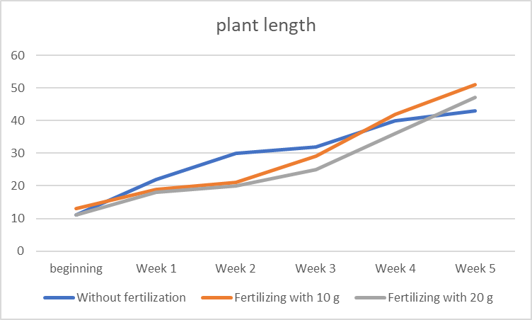
Experiment (1): Fertilizing with different amounts of moringa powder
Results:
:

Slide 7
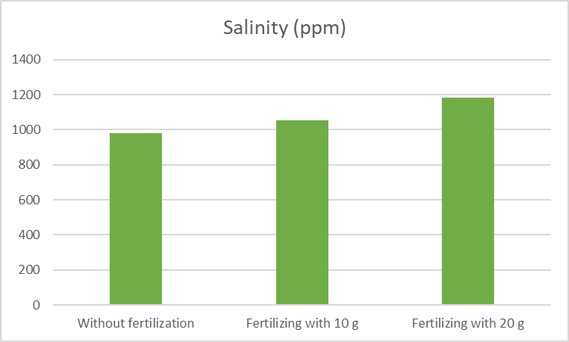
Soil characteristics
Sample | Without fertilization | Fertilizing with 10 g | Fertilizing with 20 g
Acidity (pH) | 8.25 | 7.6 | 7.8
Salinity (ppm) | 981 | 1055 | 1185
Conductivity (µS/cm) | 980 | 1100 | 1137

Slide 8
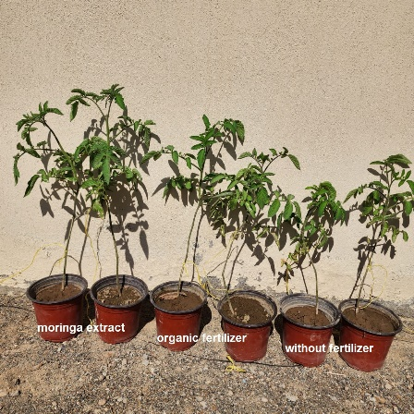
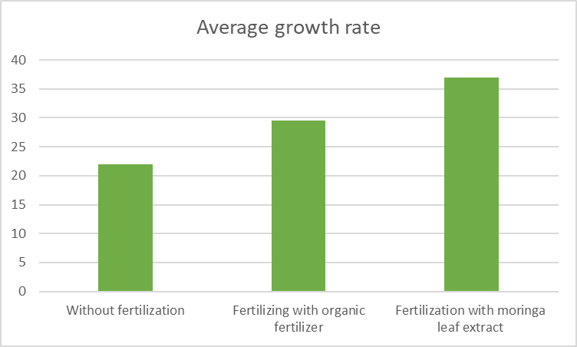
Monitoring the growth rate of tomato plants according to the type of fertilizer:

Slide 9
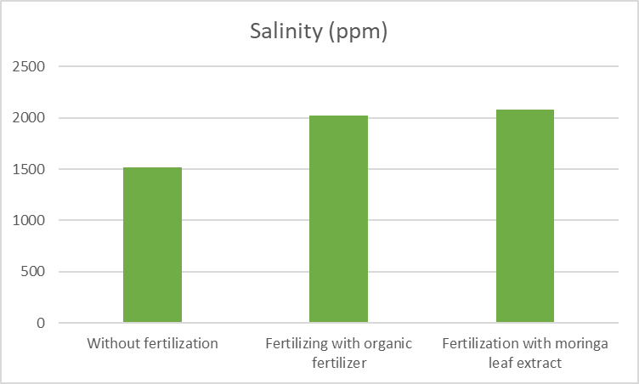
Soil characteristics in expirement 2:
Sample | Without fertilization | Fertilizing with organic fertilizer | Fertilization with moringa leaf extract
Acidity (pH) | 8.71 | 8.22 | 8.34
Salinity (ppm) | 1515 | 2026 | 2078
Conductivity (µS/cm) | 1606 | 2320 | 2740

Slide 10
Results analysis:
ϖ From the graph in Figure (5), the tomato plant that was fertilized with moringa leaf extract recorded a higher growth rate (37 cm), and the number of its leaves increased at a greater rate (8 leaves), and its stem appeared thicker and its leaves were wider, and it began to flower and bear fruit in a shorter period. It is clear from Table (4) that the plant that was fertilized with organic fertilizer (29.5 cm) follows it and appears healthy in appearance, but its stem is thinner than the plant that was fertilized with moringa leaf extract, while the plant that was not fertilized had a lower growth rate (22 cm) and appears quite healthy. But its stem is less thick and the number of leaves is less.
As for the growth rate of tomatoes according to the amount of moringa powder used, Figure (1) shows that adding (10 grams) of leaf powder to fertilization gave better growth results (38 cm) and it also took less time for flowering and fruiting than fertilizing with 20 grams (36 cm) or not. Fertilization (32 cm)
Through the previous results, we conclude the effectiveness of using extract or powder of moringa leaves in fertilizing the plant, as this was evident in the greater and faster growth rates of tomato plants compared to organic fertilizer, and this is due to the fact that moringa leaves contain all elements that plant needs, and whose availability in moringa leaf powder was confirmed through examination in the laboratories of Sultan Qaboos University (Appendix 1),
ϖ On the other hand, leaf powder or extract should not be added to the soil in large quantities, as the leaves containing high percentages of chemical elements lead to an increase in soil salinity, which in turn will negatively affect plant growth, as shown in Table (3) (from 981 to 1185ppm) and Table (5) (from 1515 to 2078ppm) and graphs (3) and (7). The plant should also never be left without fertilization because that weakens the plant’s growth as it does not get enough of the nutrients necessary for its growth, as this appears in Charts (1 and 5).

Slide 11
Conclusion:
The GLOBE protocols (the soil protocol, the ground cover protocol, and the water protocol) to study the effectiveness of using Moringa oleifera leaves as an organic fertilizer, as it became clear from the data collected that the effectiveness of its use as an organic fertilizer is through what we observed of the growth rates. The highest fertilizer is for plants, but it must be added to the plant in regulated quantities so that it does not negatively affect its growth, because it contains large quantities and high percentages of chemical elements.

Slide 12
References:
1. Technical office of Globe program. (2014) document of soil protocol for the training program for Globe teachers.
2. Technical office of Globe program. (2014) document of land cover protocol for the training program for Globe teachers.
3. Ministry of Education (2013) Science book for grade 8
4- Moringa - the miracle tree (2-23-2017) - retrieved on 10/15/2023 from
Moringa...the miracle tree Panorama | Ammon News Agency ( (ammonnews.net))
5- Ahmed Sheeta. (December 22, 2022). Learn how to prepare a natural home fertilizer from the leaves of the moringa tree. Retrieved on November 20, 2023 from
https://www.worldofagri.com/
6- Wikipedia. Retrieved on 10/1/2023 from
https://ar.wikipedia.org

Slide 13
References:
7- Tasneem Atallah Jabr - To feed dairy cows, use the Moringa oleifera plant - Horizons for Environment and Development electronic magazine - Issue 133 - April 2021. Retrieved on 1/10/2024 from
https://www.maan-ctr.org/magazine/article/2948/
8- Uses of moringa in the field of plant production - 2/18/2016. Retrieved 11/1/2023 from
https://www.facebook.com/farmers.net.ly/posts/839564776169905/
9- Hilal Al-Ghaferi - Moringa cultivation is popular with farmers in Al-Dhahirah Governorate - 4/12/2023. Retrieved on 1/25/2024 from
https://omannews.gov.om/topics/ar/124/show/416473

