Slide 1












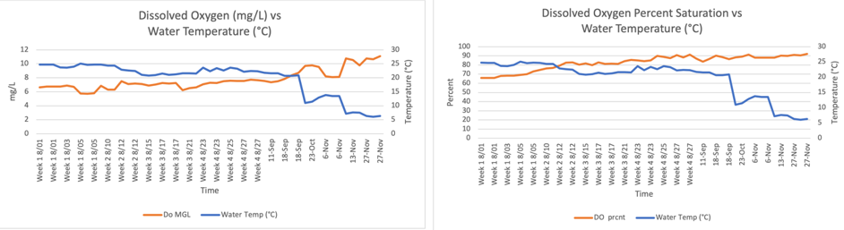
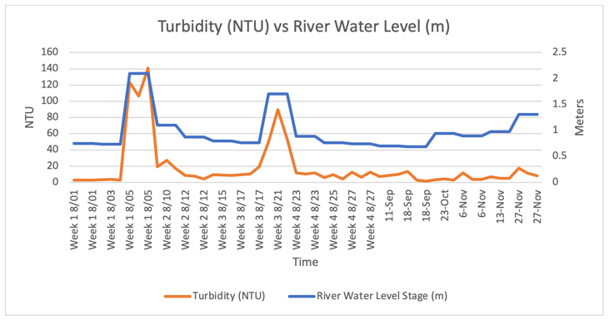
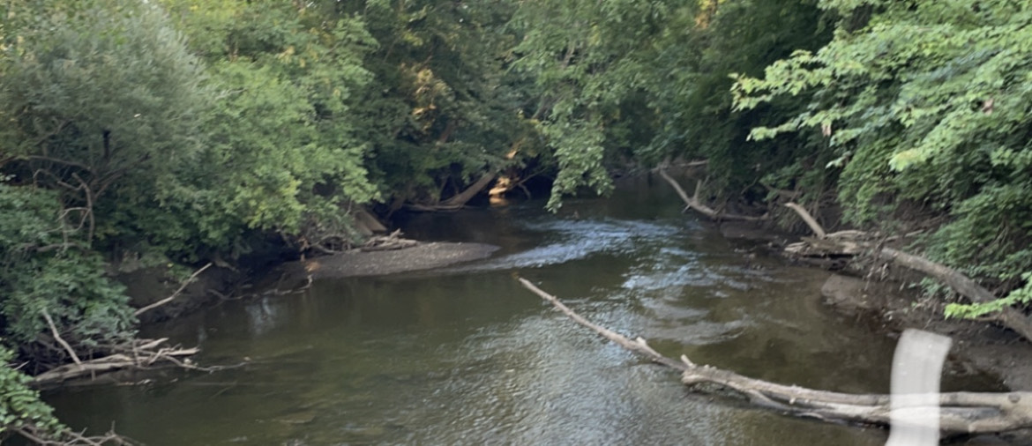
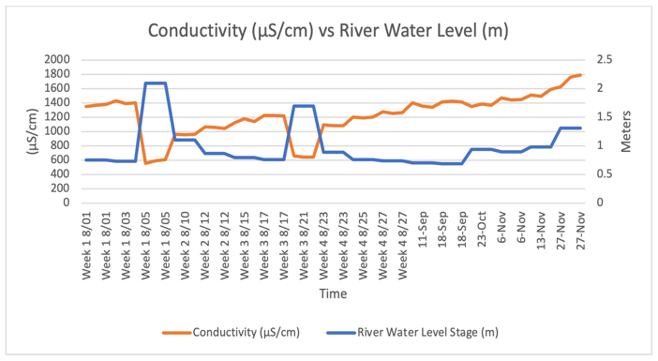
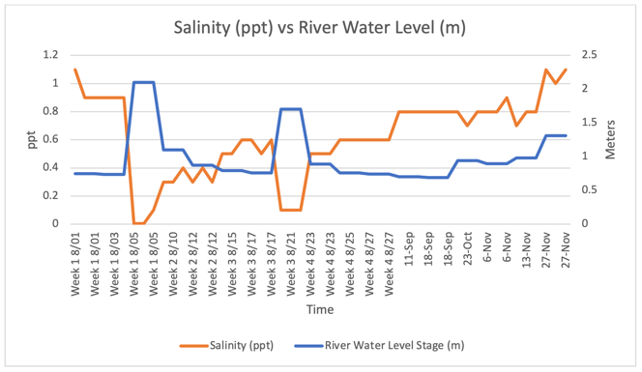
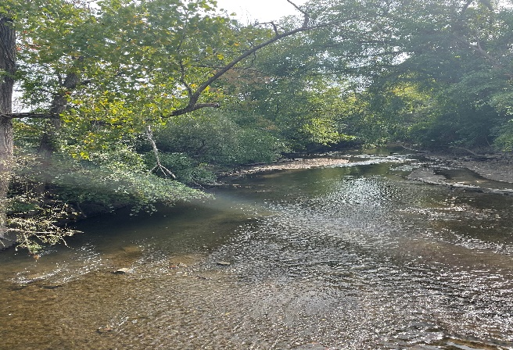
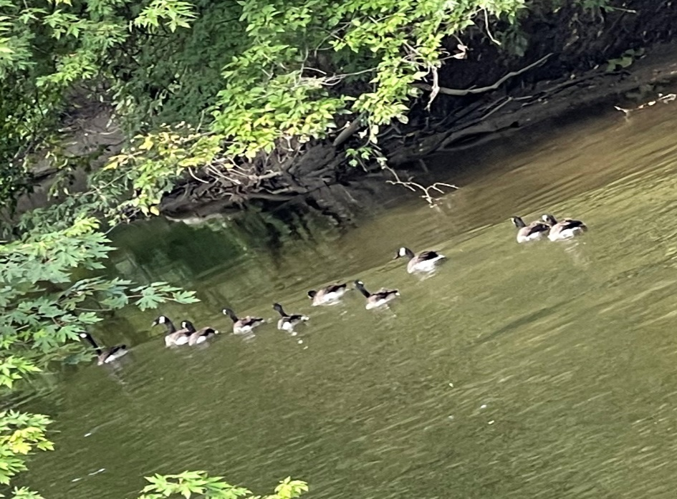
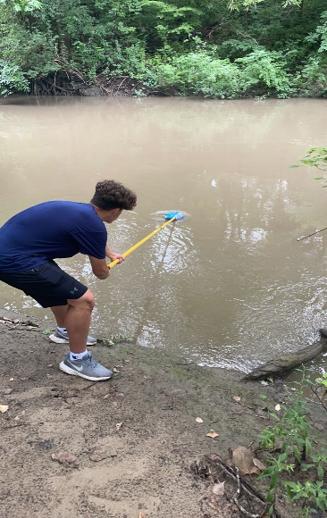
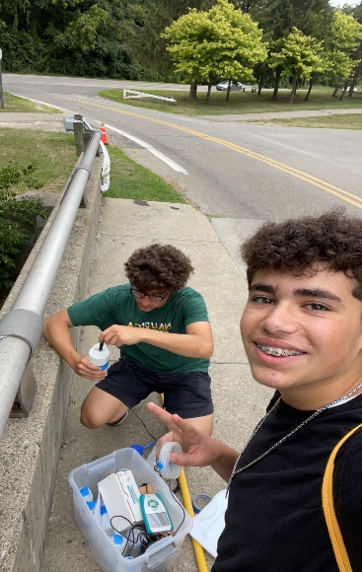
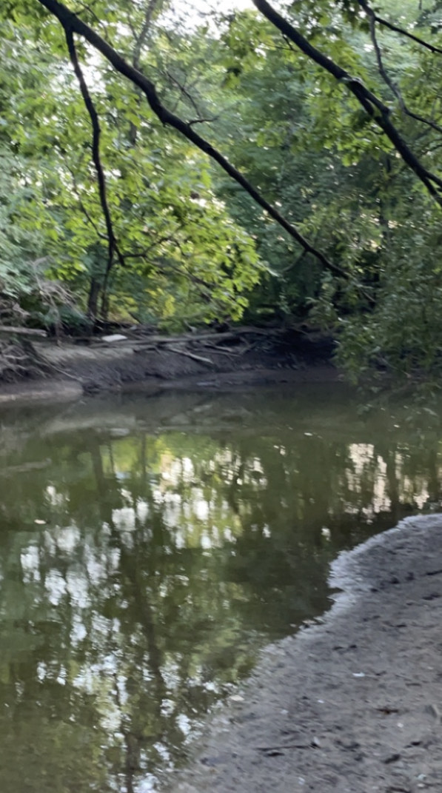
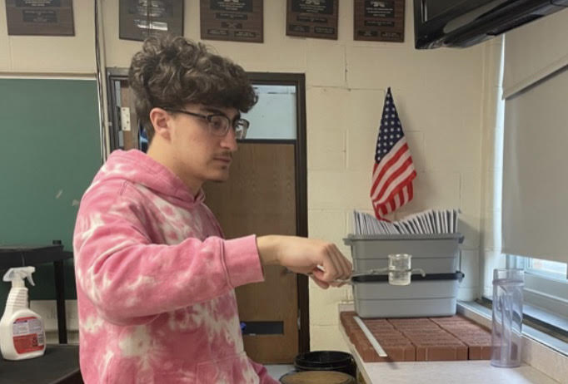
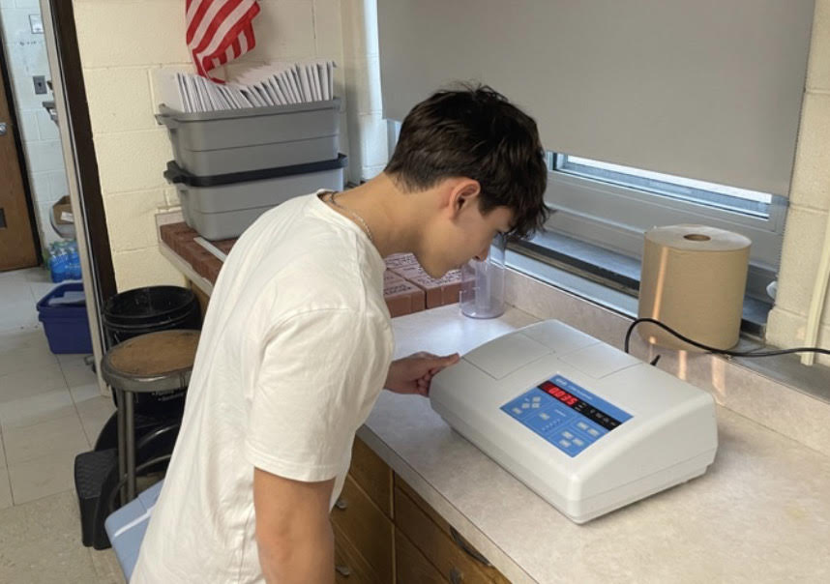
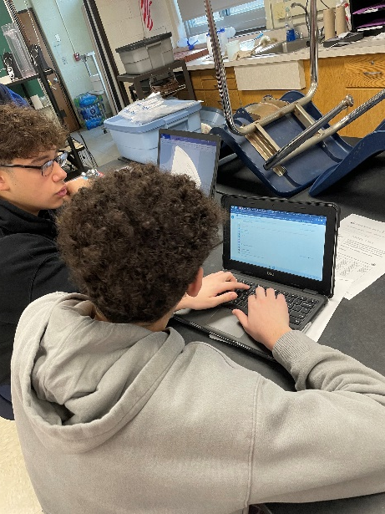
Assessing Seasonal Change and its Effect on Select Parameters Along Southeast Michigan’s Rouge River
Rami Eter, Ali Mezher, Mohamad Nasser,
Rawad Rahal, Yasmeena Serhane
Abstract
Hypotheses
Results
The Rouge River Watershed of Southeastern Michigan is located in a region where urbanization has led to negative effects. Increased attention and research must be prioritized if we want to continue to restore, preserve, and protect the river and the wide variety of species living there. We investigated the potential effects of seasonal change (summer to fall) on dissolved oxygen, conductivity, pH, turbidity, salinity, total solids, precipitation, water temperature, and air temperature. Water temperature decreased from summer to fall, causing dissolved oxygen levels to increase. precipitation events had no significant effect on dissolved oxygen levels. Salinity, total solids, conductivity, and pH levels were all unaffected by cooling temperatures. As river levels increased, turbidity levels rose. For the future, we would like to expand and extend our research to include additional water quality parameters and collect data during different seasons.
.
Null Hypotheses:
1. The seasonal change from summer to fall and accompanying precipitation will not affect salinity, total solids, conductivity, pH, turbidity, and dissolved oxygen levels of the Middle Branch of the Rouge River.
Significant precipitation events do not affect salinity, total solids, conductivity, pH, and turbidity levels in the Middle Branch of the Rouge River.
Researchers located three safe sites along the Rouge River to collect samples, determining GPS location of each site.
Dissolved Oxygen levels increased as the temperature decreased
Methodology
Researchers located three safe sites along the Rouge River to collect samples, determining GPS location of each site.
Turbidity levels increased as the water level increased, regardless
of intensity. This was a variation, as it was the only parameter affected by rainfall, that was not affected by the intensity of the rainfall. The parameters of conductivity, salinity, pH, and total solids all decreased in the event of significant rainfall, but turbidity increased.
Researchers collected 1 sample per site multiple times from August through November,.
following GLOBE protocols to measure parameters using the Vernier Lab Quest 2, and Vernier GoDirect probes, also testing the air and water temperature.
.
.
Conductivity and Salinity decreased in the event of large rain events, but increased as the river water level increased steadily. The same trends applied to pH and total solids.
Conclusion
Recommendations
Introduction
The data analysis provided clear results. We rejected each of the null hypotheses. There is clear evidence, from our research methods, that the seasonal change from summer to fall and accompanying precipitation significantly affected salinity, total solids, conductivity, pH, turbidity, and dissolved oxygen levels of the Middle Branch of the Rouge River. We found that significant precipitation events, in fact, did affect salinity, total solids, conductivity, pH, and turbidity levels, and that the seasonal drop in temperature from summer to fall affected dissolved oxygen levels in the Middle Branch of the Rouge River. Due to these consistent correlations, we rejected each of the null hypotheses. pH, total solids, salinity, and conductivity all followed the same trend, decreasing as significant rain events occurred, but increasing as the river water level increased steadily. Dissolved oxygen, as expected rose with the decrease in temperature, and turbidity rose with the river water level, regardless of precipitation intensity. Dissolved oxygen was unaffected by the river water level, and all other parameters were unaffected by the temperature shift.
A possible source of error in our data was human error. In the beginning weeks of our research, our team, having limited experience with the apparatus, contributed to some human error. In comparison to other hydrologic IVSS GLOBE research on the Rouge conducted by former students of Crestwood High school, their results were somewhat different. This may have been due to unorthodox weather. This 2022 summer was significantly dry. The 22nd driest summer on record, according to the NOAA.
A potential improvement in research methods that could be utilized for future research would be the addition of both more sites and faster lab equipment. The Rouge River lower branch runs through a more industrial area, with the riparian zone demolished for channelization. If future researchers were to measure the parameter variations through different branches, or compare the parameter measurements to those of neighboring bodies of water, such as the Ecorse Creek, greater variation could be considered and implemented. With faster lab equipment, the research process would be more efficient and take less time. This would allow more time for researchers to more accurately analyze the data and showcase it in a more professional manner.
Researchers returned to the laboratory to test for total solids and turbidity of the samples using the HACH 2100N Turbidimeter and GLOBE protocols.
The Rouge River flows eventually empties into the Detroit River and ultimately flows into Lake Erie. The river flows through a very urbanized region of Southeastern Michigan that became very industrialized, causing many negative effects. However, more recent legislation and regulations have been enacted to reduce these impacts. Although our high school science department has been making bi-annual water quality measurements on the river, no analysis of seasonal change has been conducted in this branch of the river. Our research was developed to see how various seasonal change and accompanying precipitation events contribute to potential changes in river water quality. This GLOBE research seeks to create a database for future investigators to compare throughout subsequent years as climate changes going forward. Analyzing the impacts of runoff on water quality over a long period of time will hopefully lead to changes in how our local population perceives the river and how they can help to remediate its many problems. With continued research, hopefully plans can be enacted to bring the river back to much of what it used to be like.
Acknowledgements
1. To what extent does the seasonal change from summer to fall and accompanying precipitation affect salinity, total solids, conductivity, pH, turbidity, and dissolved oxygen levels of the Middle Branch of the Rouge River?
2. Do significant precipitation events affect, salinity, total solids, conductivity, pH, and turbidity levels in the Middle Branch of the Rouge River?
Researchers compiled data and entered it in a spreadsheet then uploaded them directly into the GLOBE website database, then analyzed data for trends and/or patterns.
Thank you to Mr. David Bydlowski of the GLOBE AREN Project and Dr. Kevin Czajkowski of the University of Toledo Mission Earth for providing Vernier probes and LabQuests for our use. Thank you also to Friends of the Rouge for the protocols we used that were in addition to the GLOBE hydrosphere protocols. Thanks also to Mrs. Diana Johns for her advice and support.
Research Questions

