Slide 1
Hydrology of Lake Viljandi
Helgi Muoni, Kent Gregor Mahla, Adeele Must, Daniil Nikitin, Jarek Kurul, Ksenija Jarmuhhamedova, Mattias Ilp, Mihkel Jakobson, Rosmarii Ilp, Stefania Grati, Xenia Voronovich, Yulia Nechipor

Slide 2
Aim and Hypotheses
Aim: To compare water conditions in the different parts of the lake.
Hypotheses:
There is higher Oxygen concentration in the streams.
The higher water temperature is, the lower Oxygen concentration is.
The more vegetated sites are the higher the concentration of Oxygen is.
The closer the sites are to the Viljandi city the higher the concentration of Nitrates and Nitrides is.

Slide 3
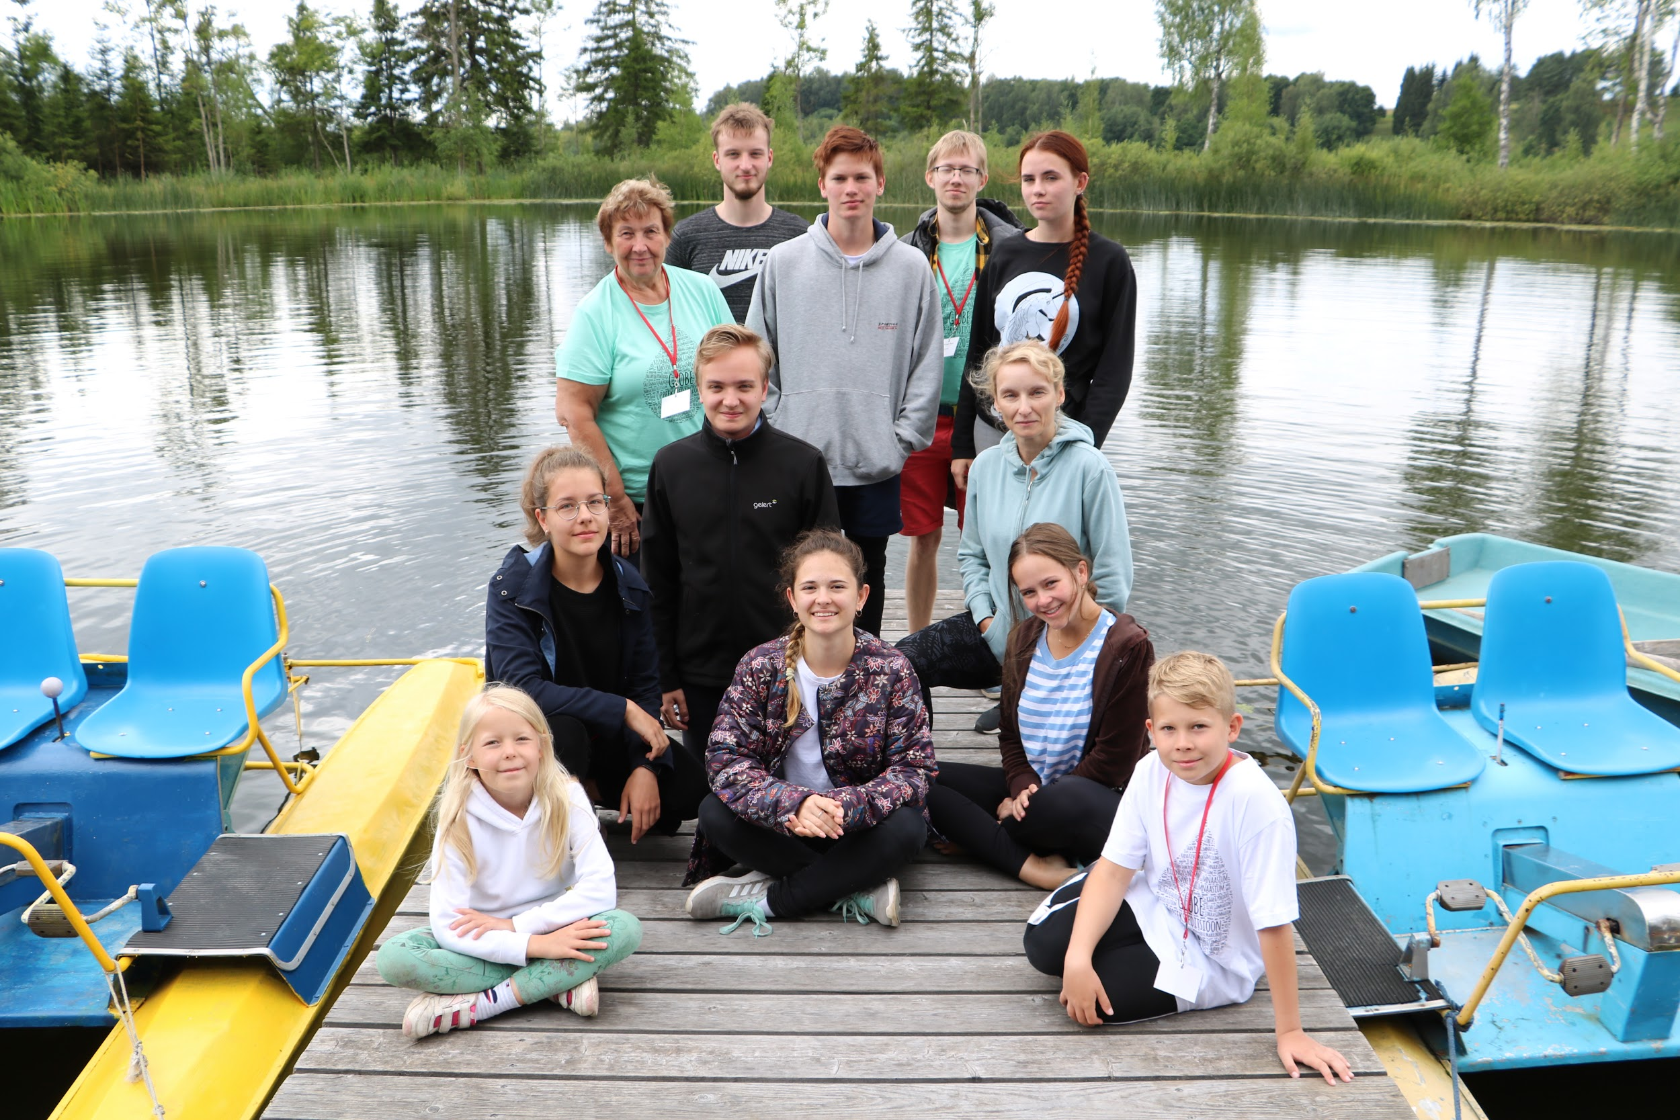

Slide 4
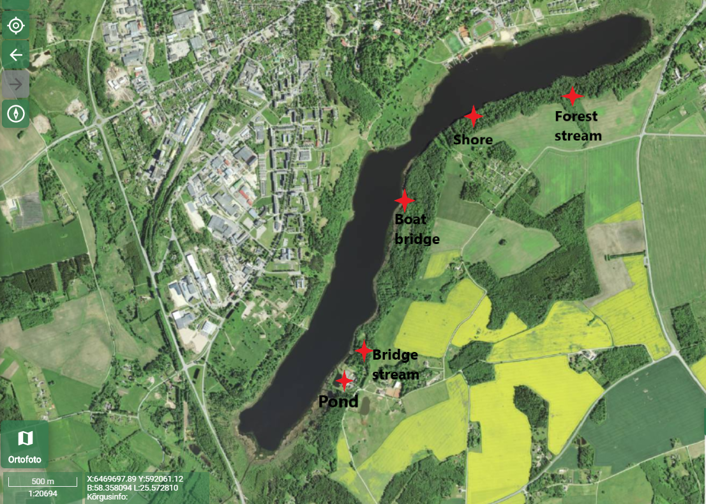
The Route

Slide 5
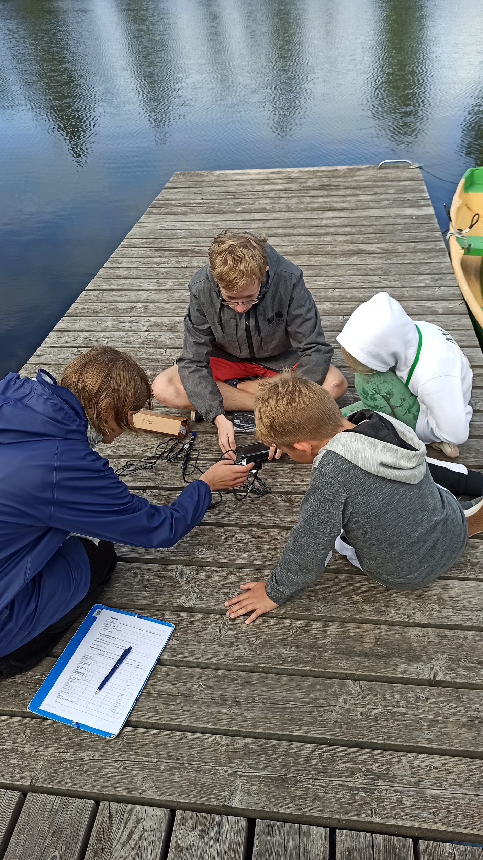
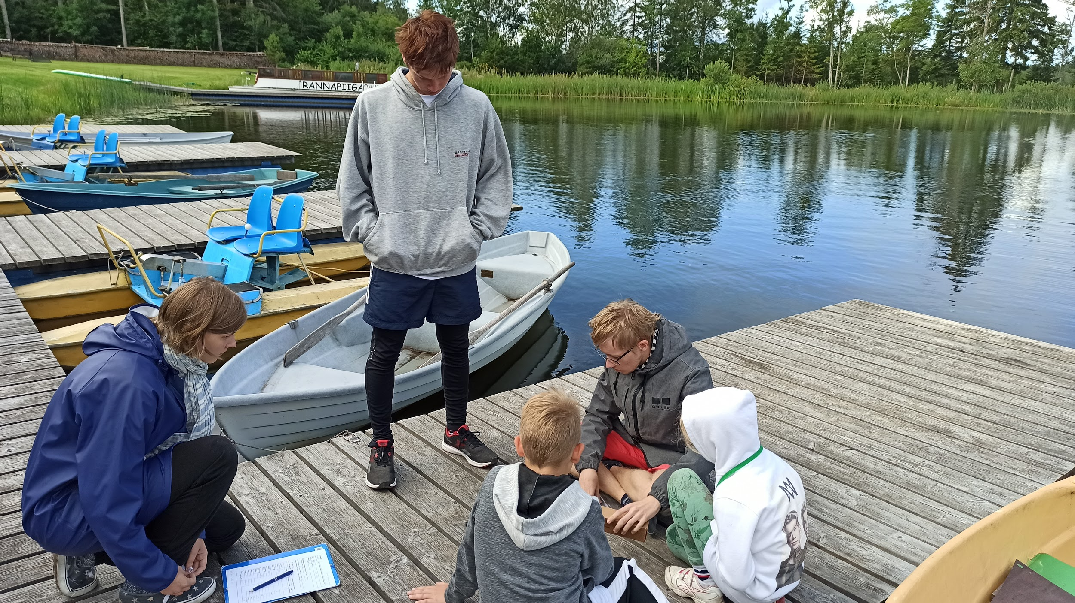
Observation site 1 - Pond

Slide 6
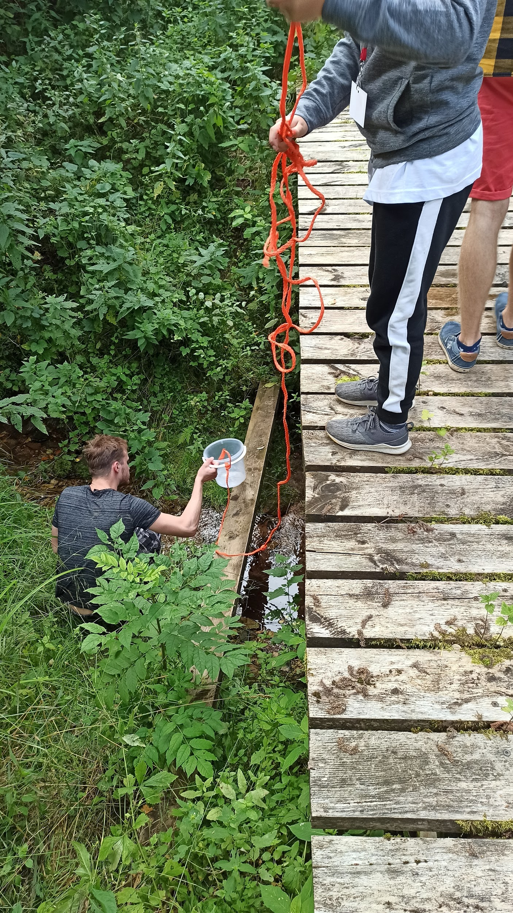
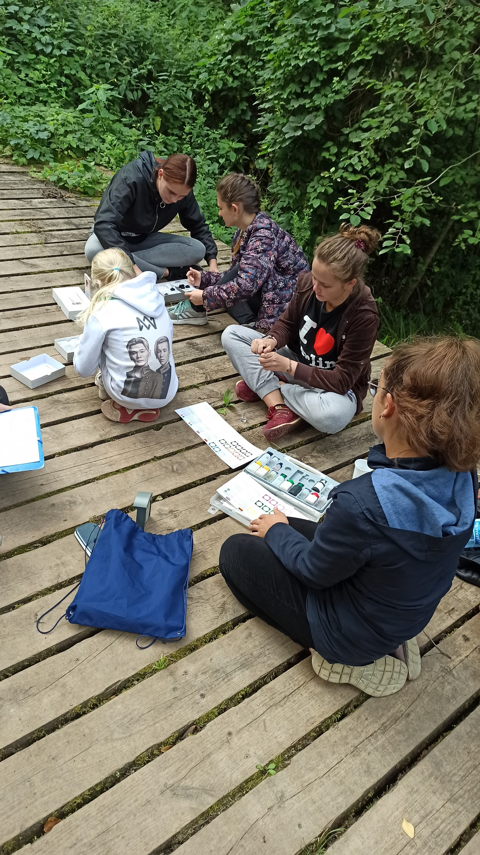
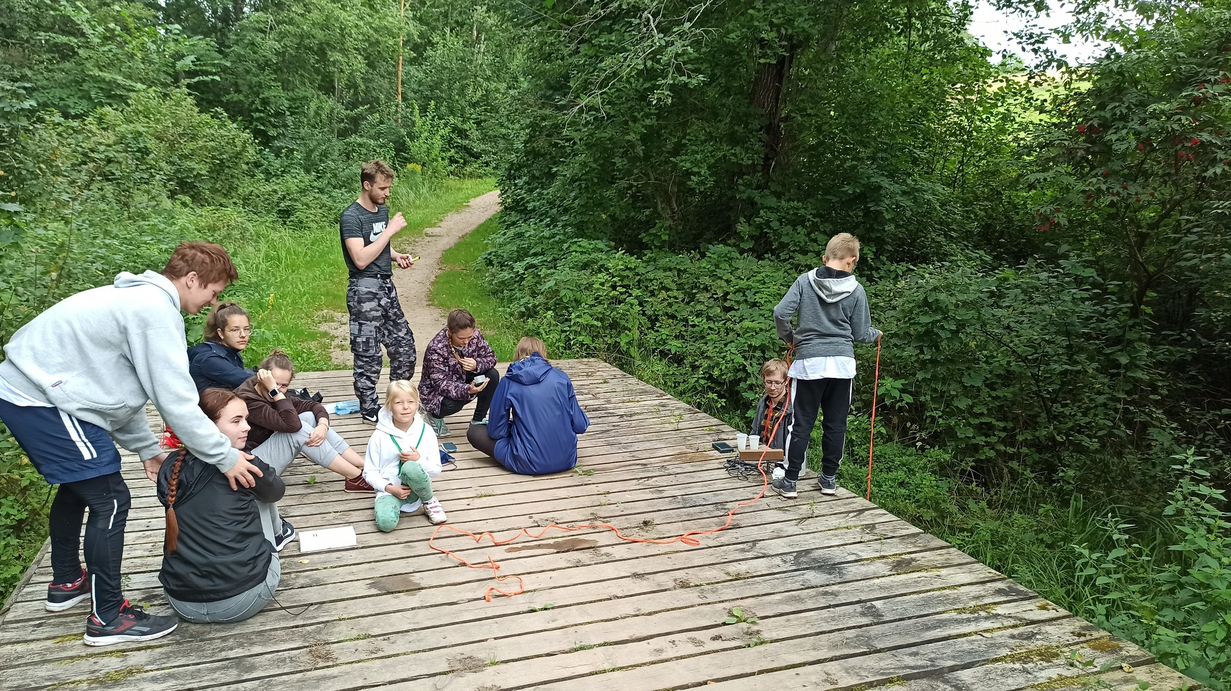
Observation site 2 - Bridge Stream

Slide 7
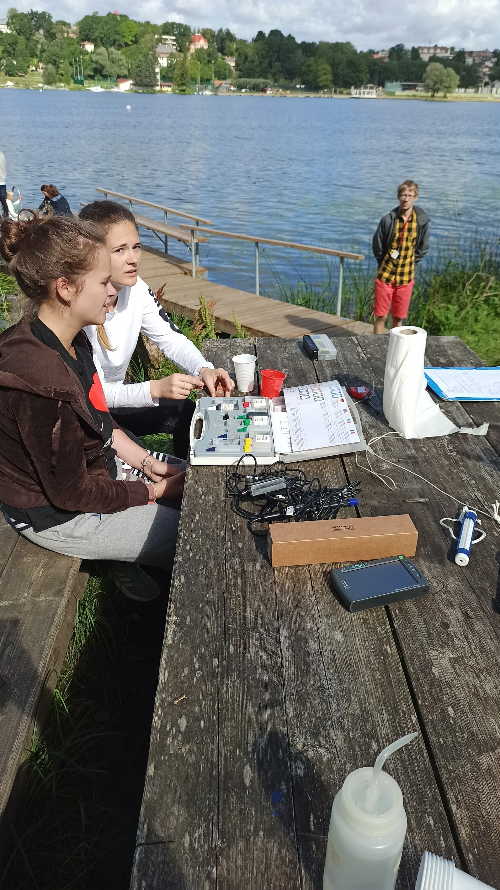
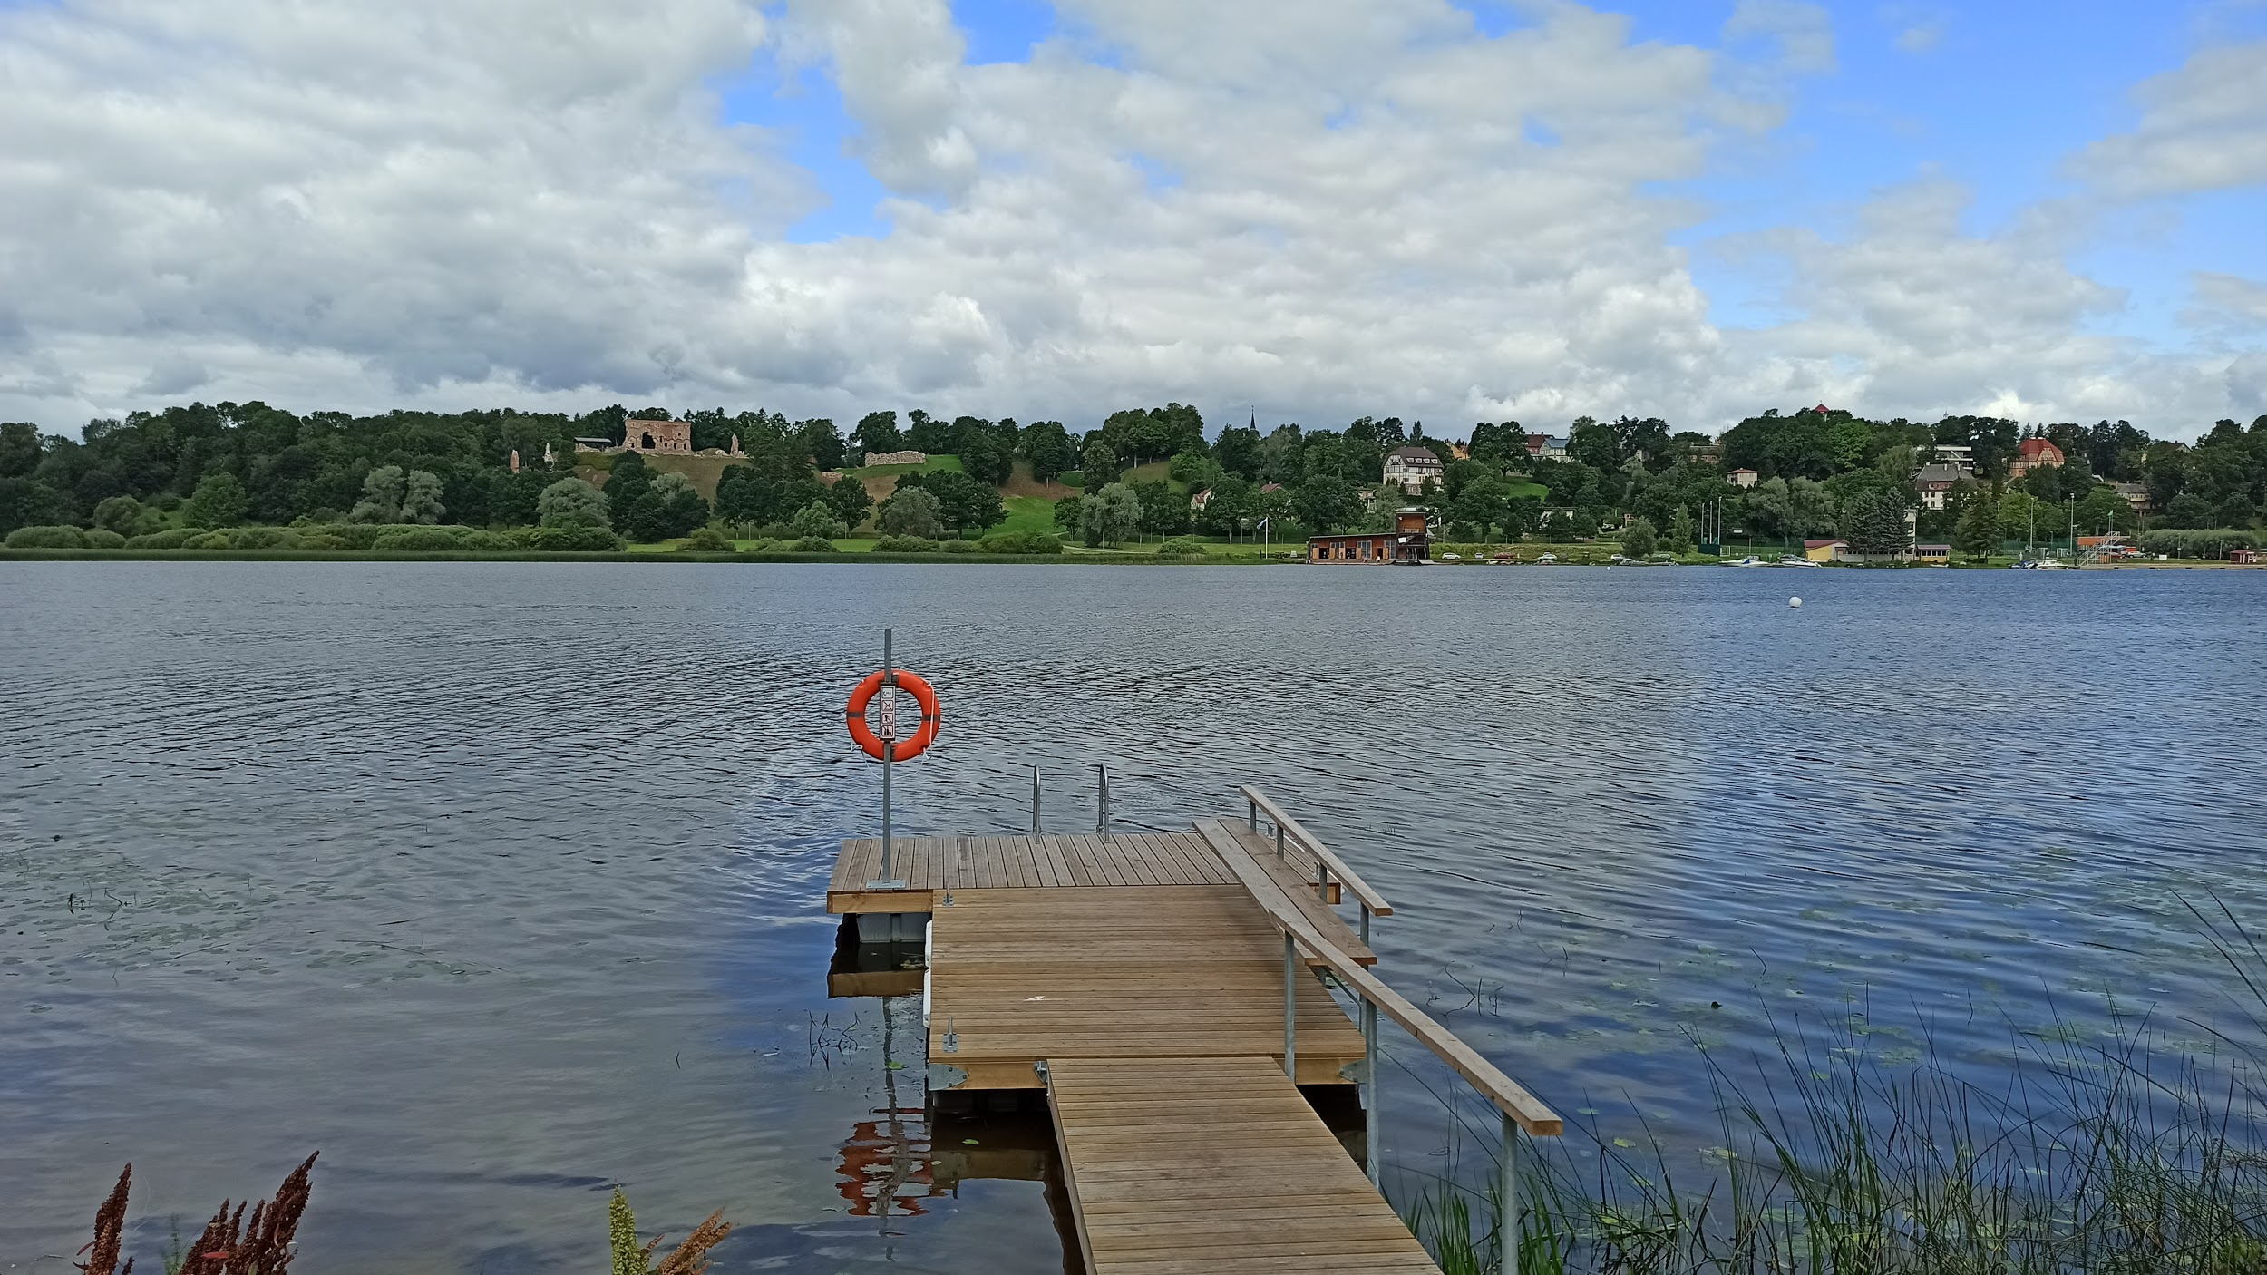
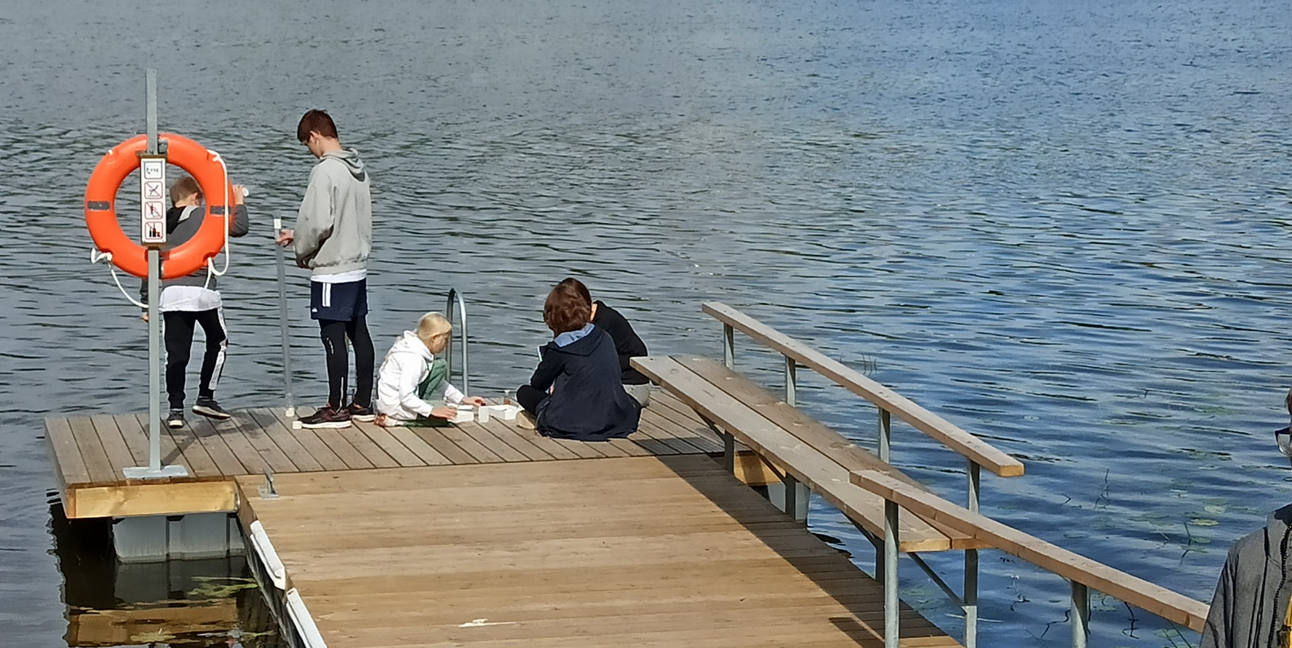
Observation site 3 - Boat bridge

Slide 8
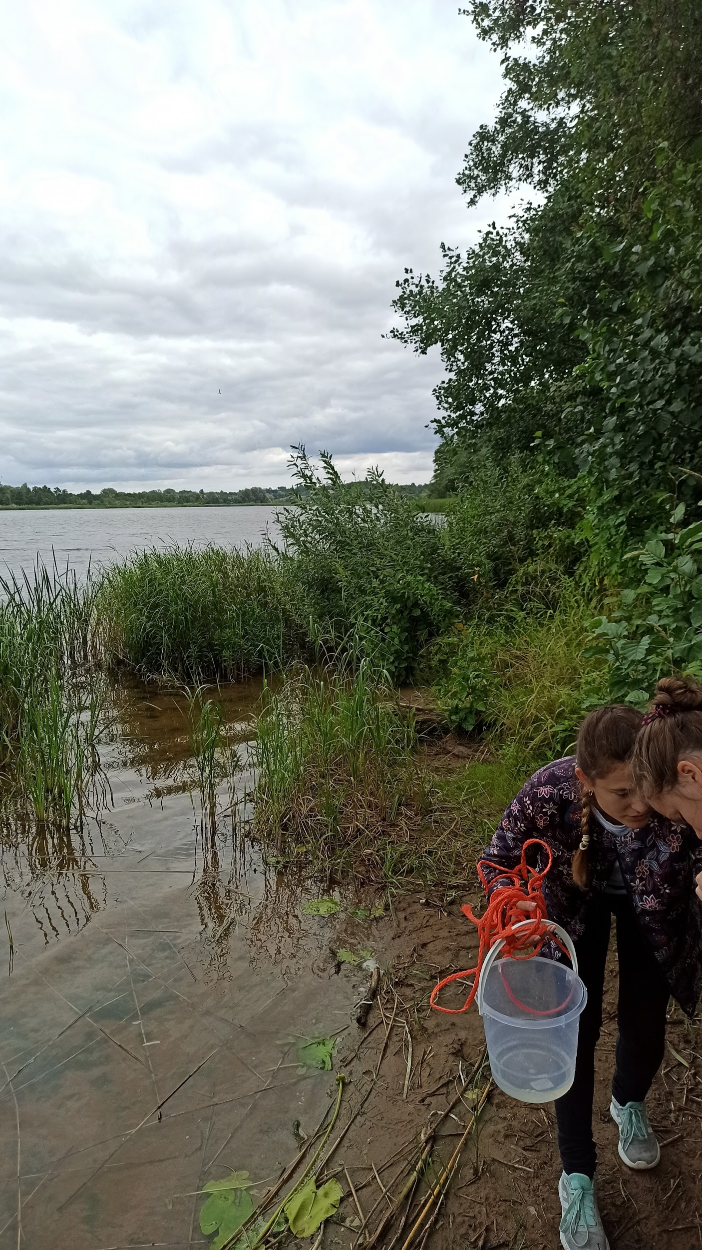
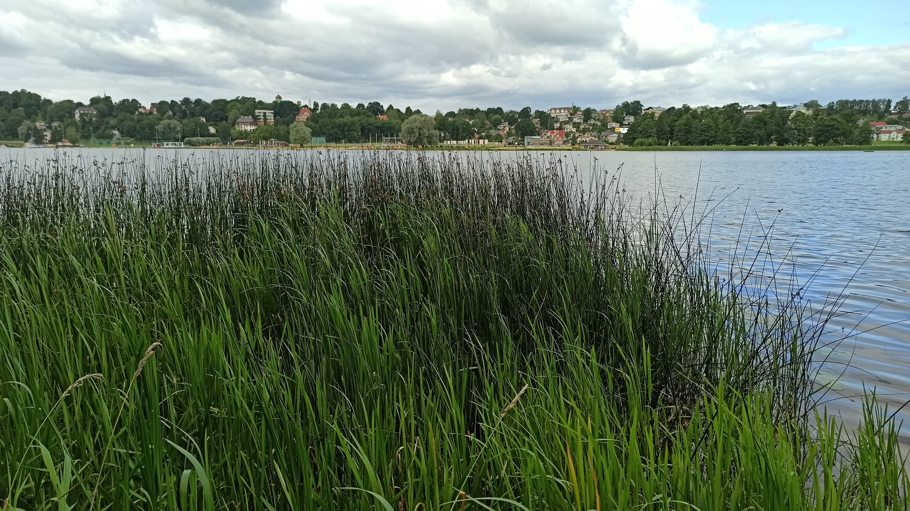
Observation site 4 - Shore

Slide 9
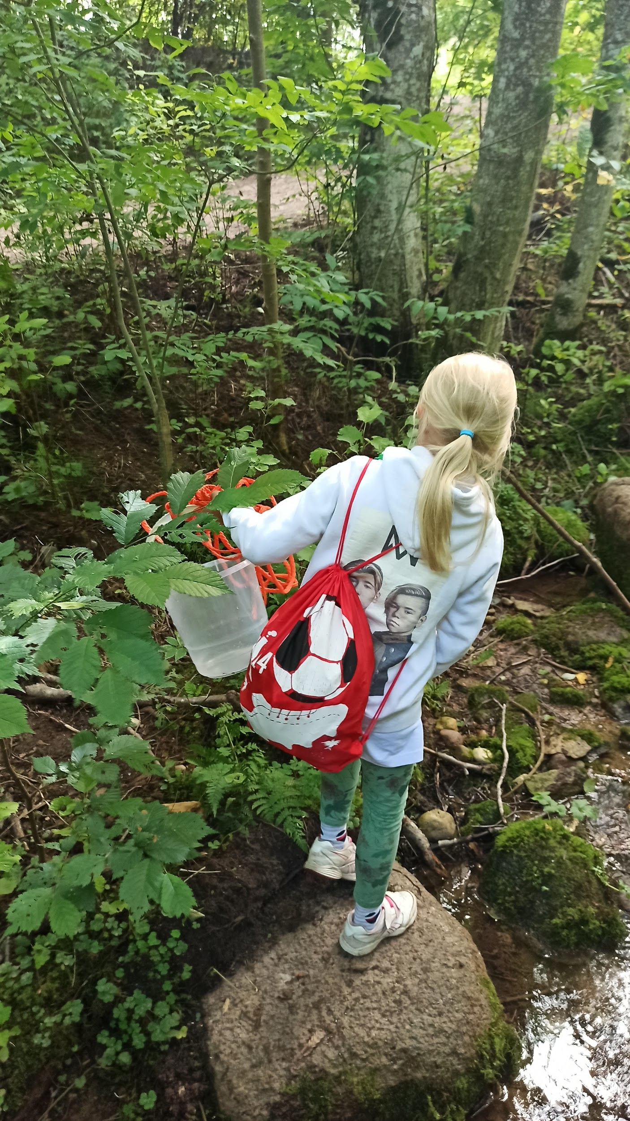
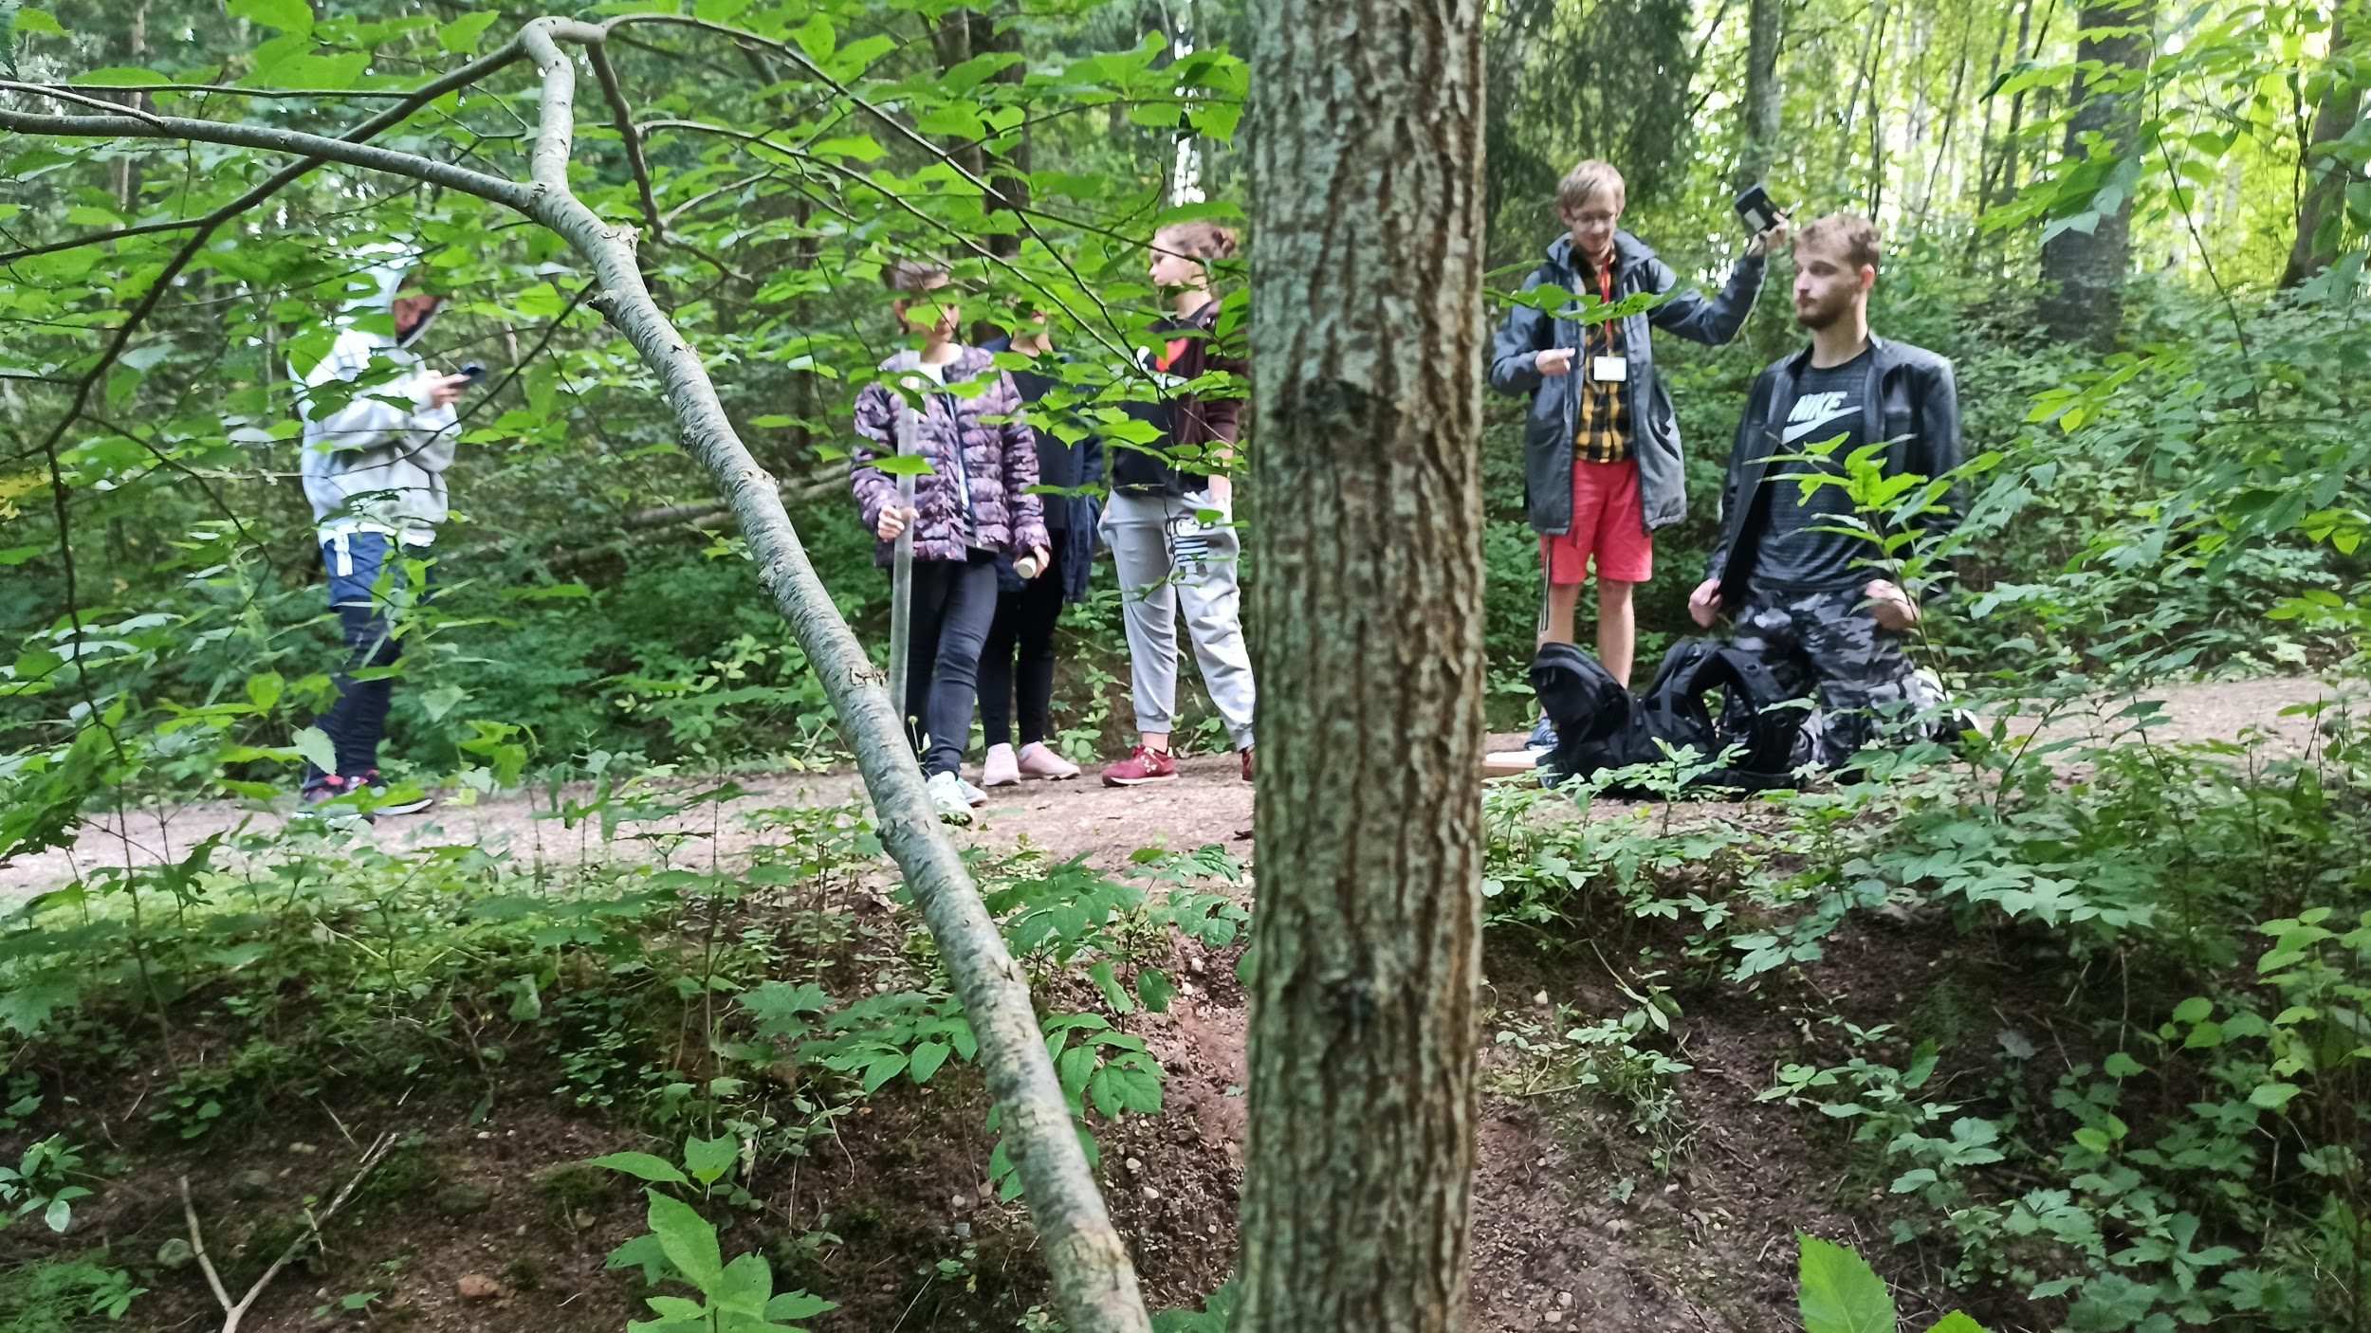
Observation site 5 - Forest stream

Slide 10
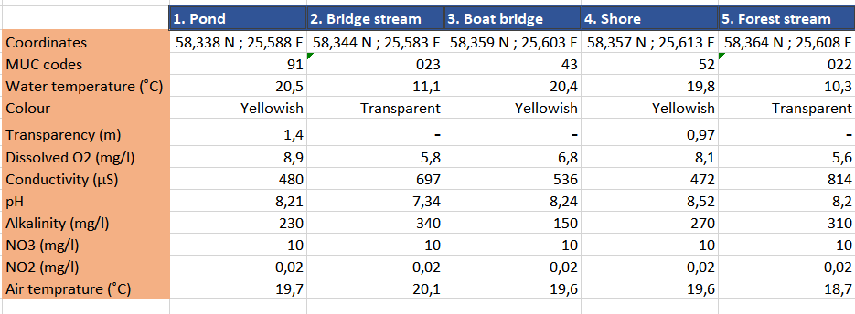
Data from the sites

Slide 11
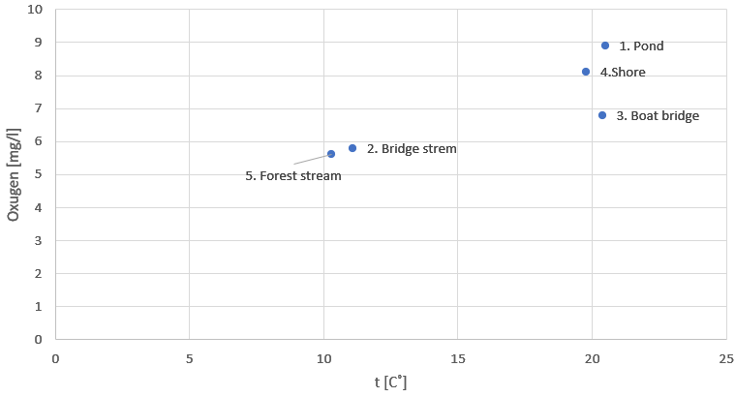
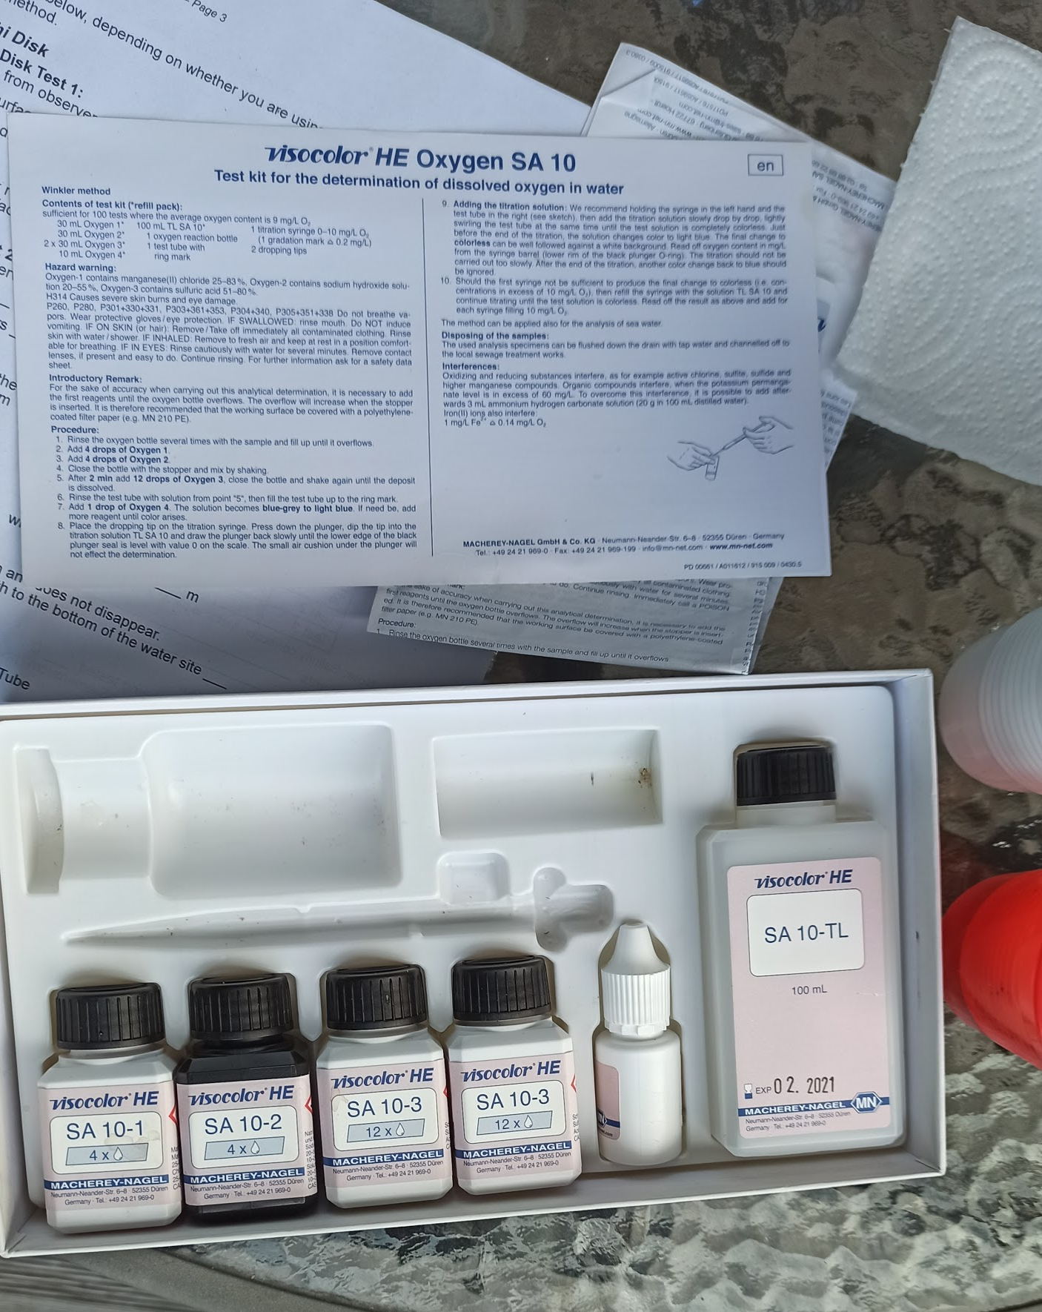
Validity of Hypotheses
1. There is more dissolved O₂ in the streams, than in the lake - wrong, the data showed the opposite.

Slide 12
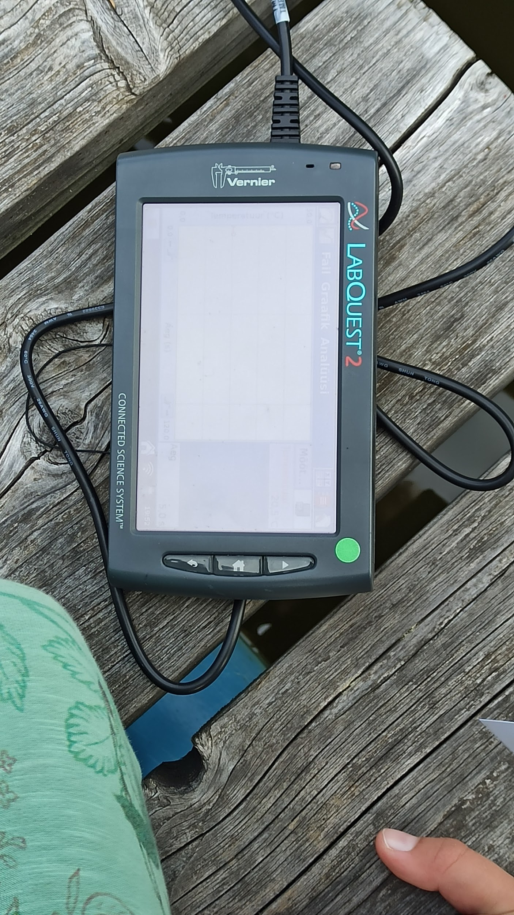
2. The higher water temperature is, the lower Oxygen concentration is - wrong, the data showed the opposite.

Slide 13
3. The more vegetated sites are the higher the concentration of Oxygen is - the gathered data supported the hypothesis.
Vegetation in streams:
Forest stream < Bridge stream
Vegetation in lake:
Boat bridge < Shore < Pond

Slide 14
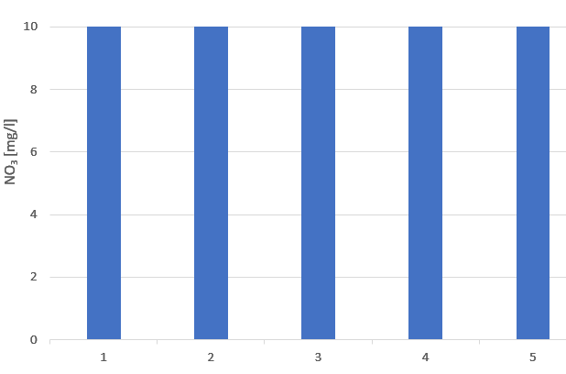
4. The closer the sites are to the city the higher the concentration of Nitrates and Nitrides is - wrong, the data showed that concentration did not differ between sites.

Slide 15
Conclusion
3 out of 4 hypotheses were wrong and only 1 was correct.
During our expedition we found diverse ecosystems around the lake.
We got acquainted with new scientific tools and now we know how to use this equipment!
We had fun!

Slide 16
Thank you!

