Slide 1
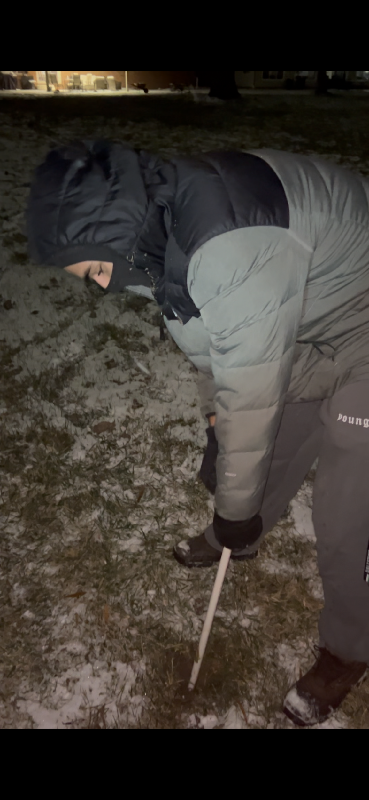
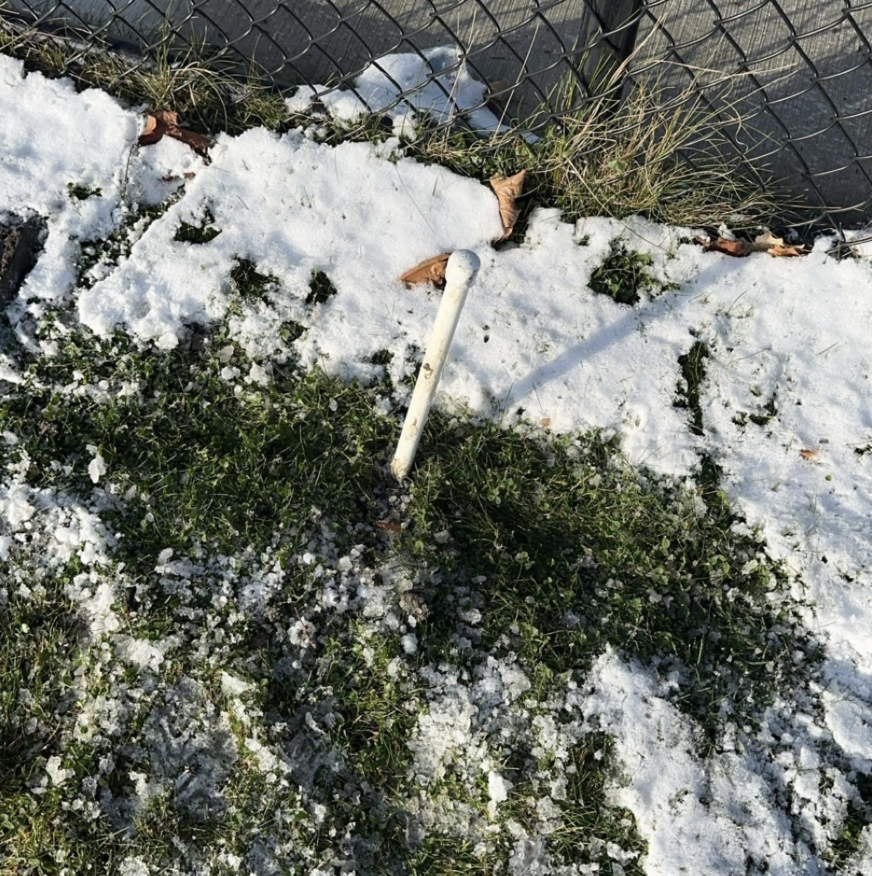
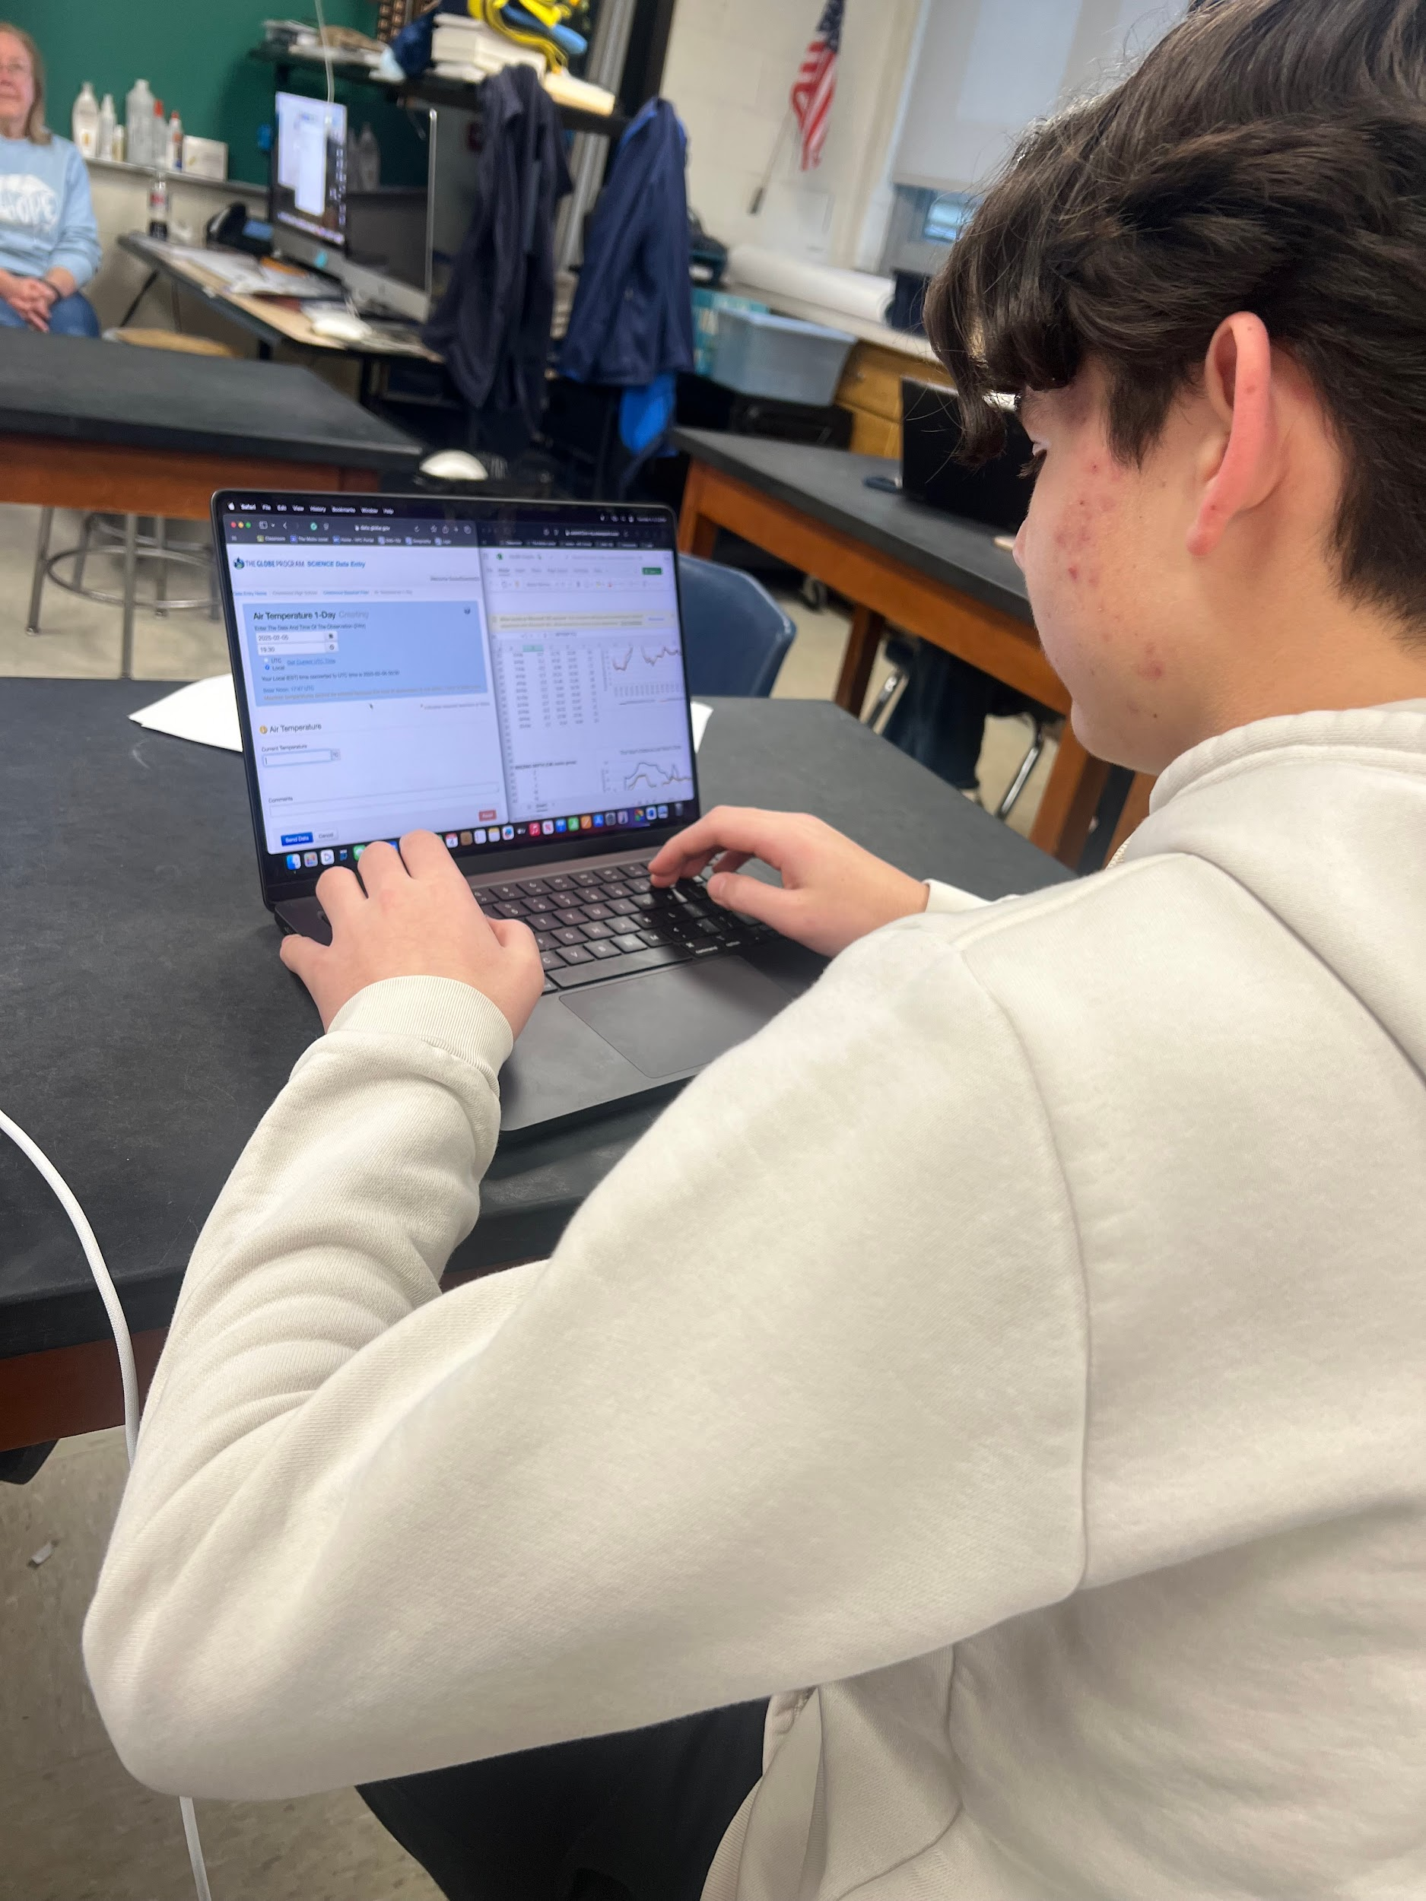
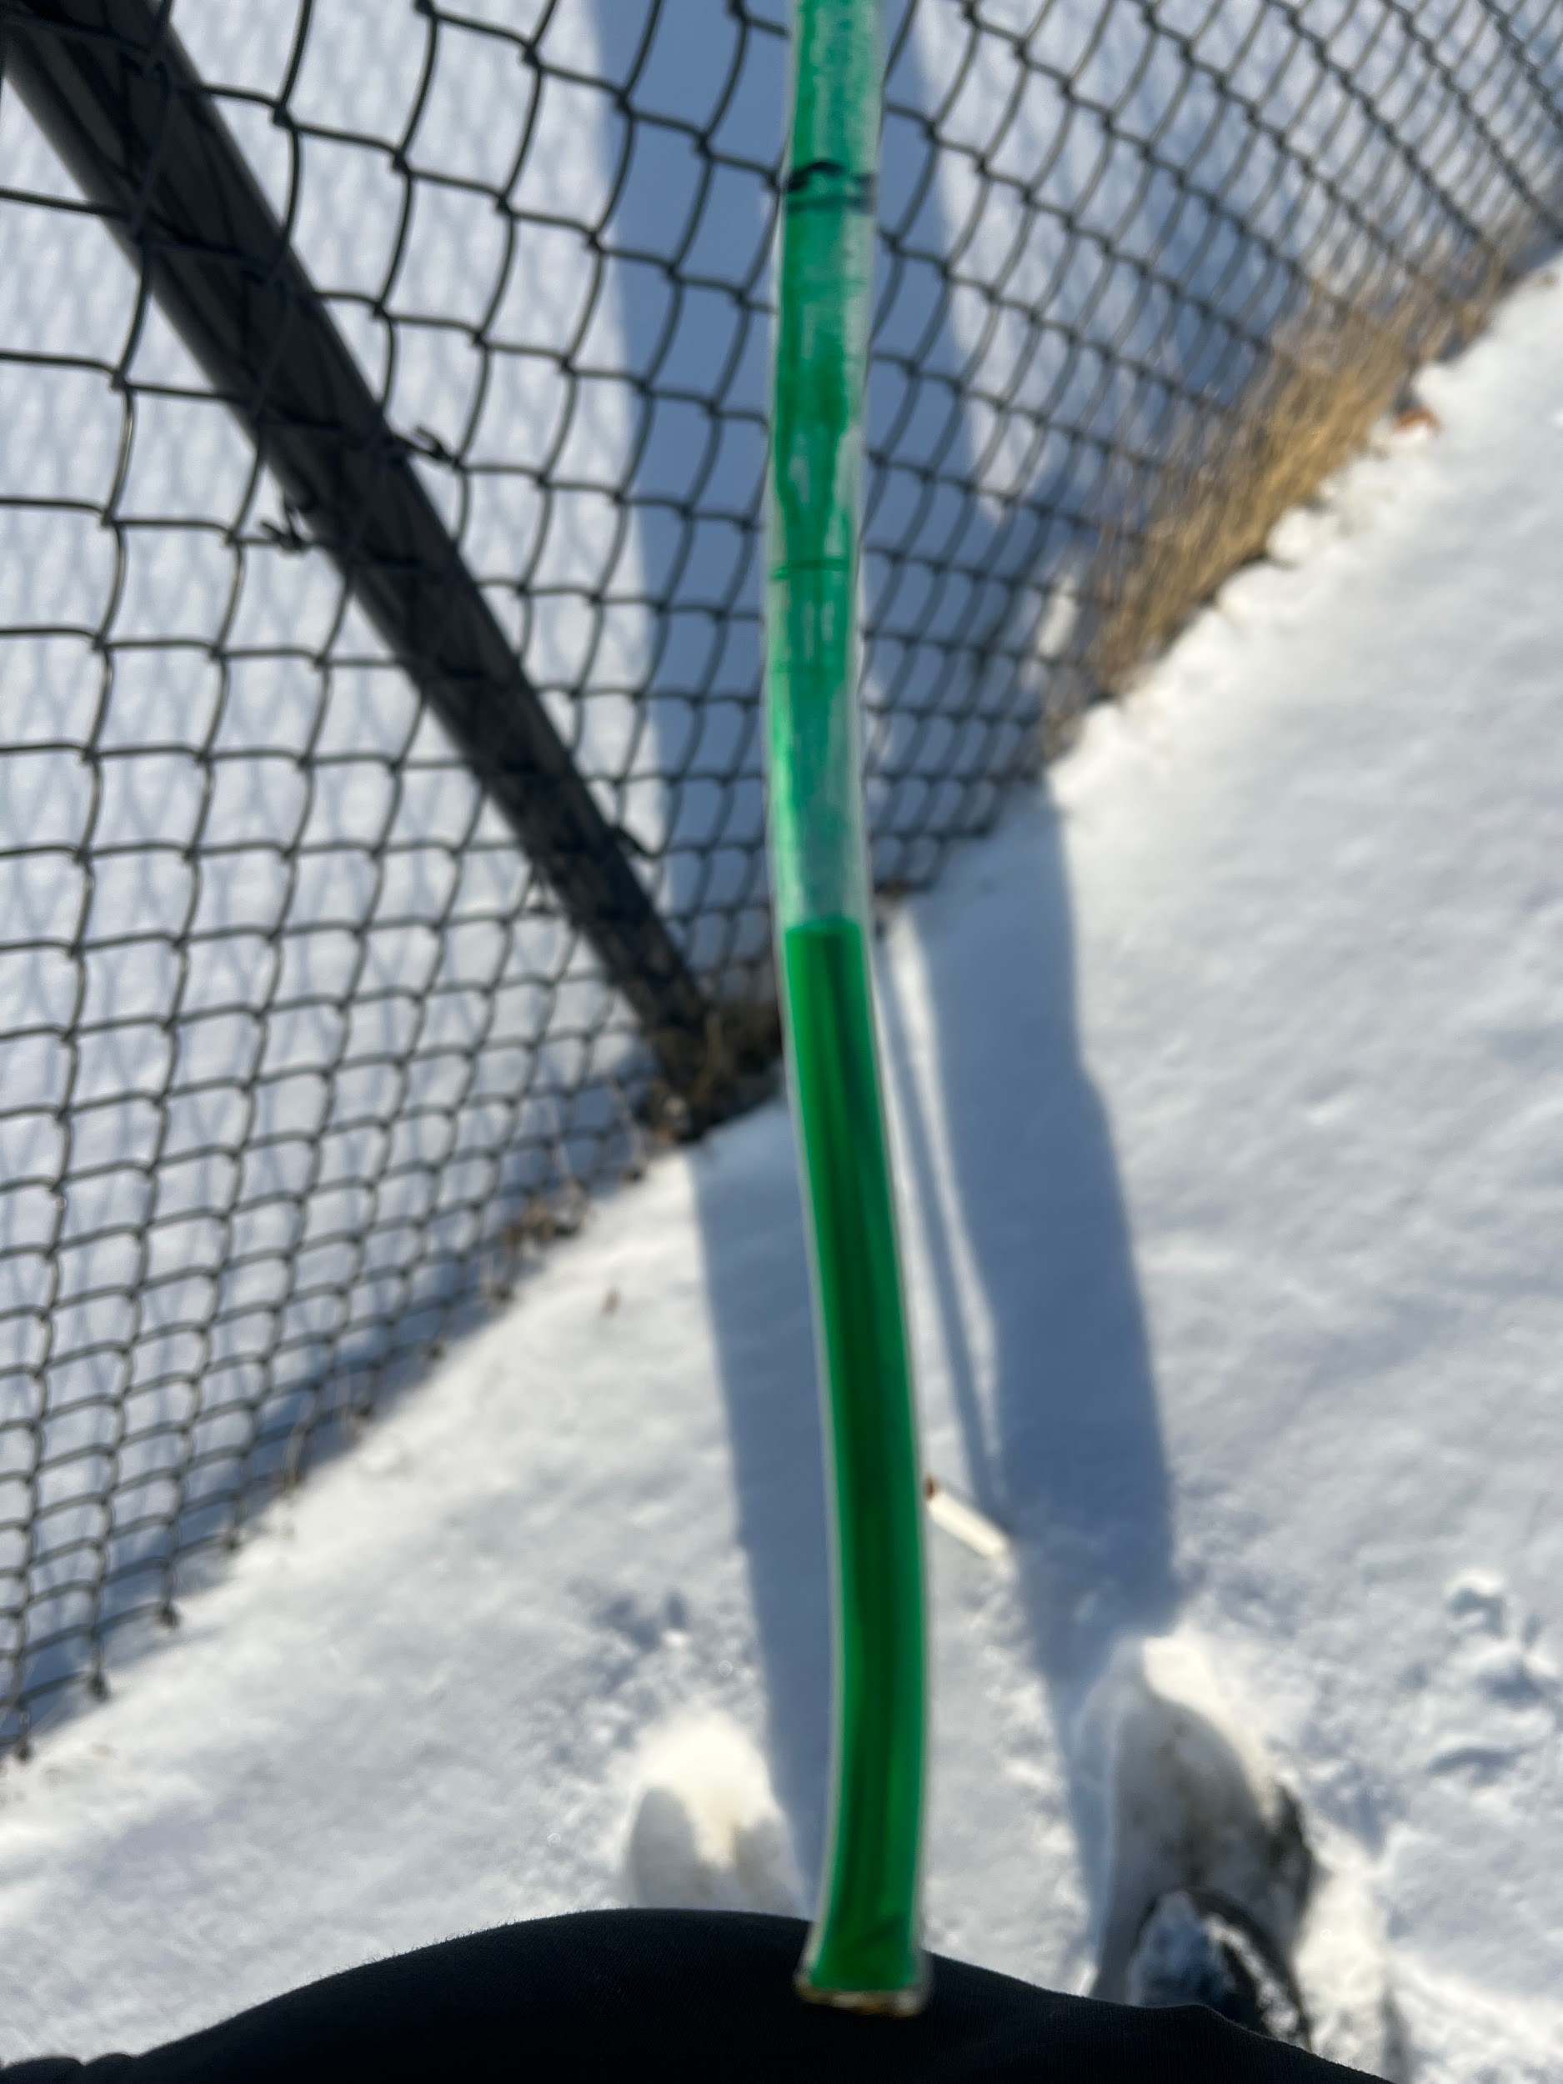
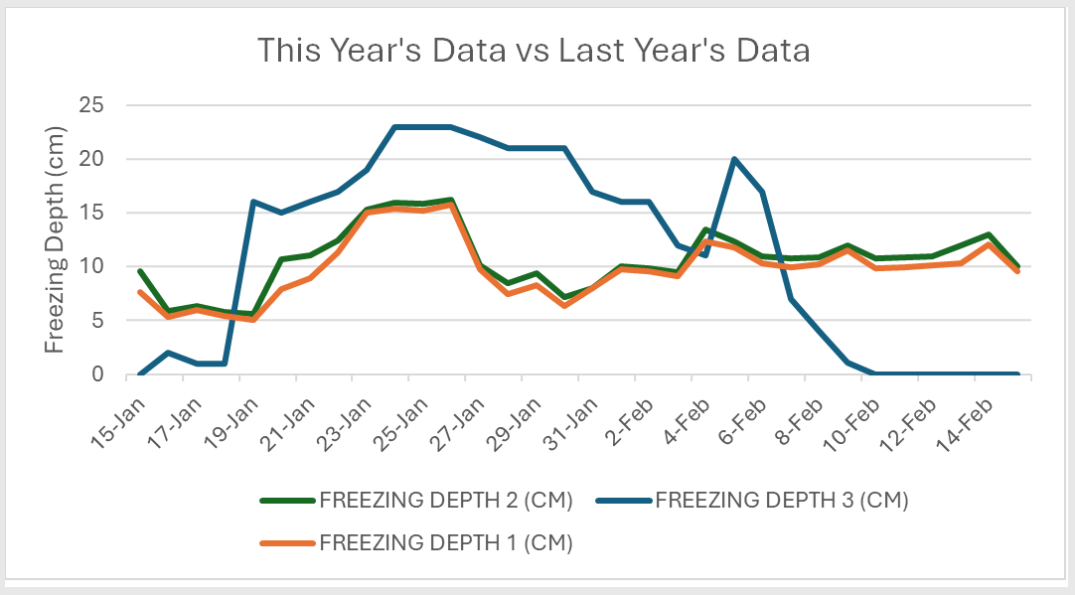
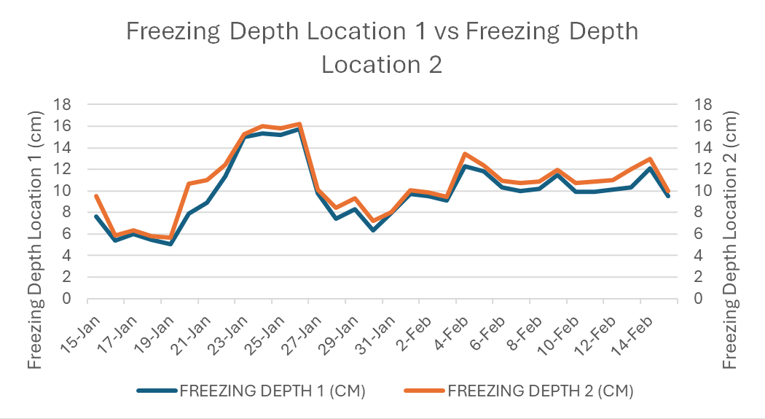
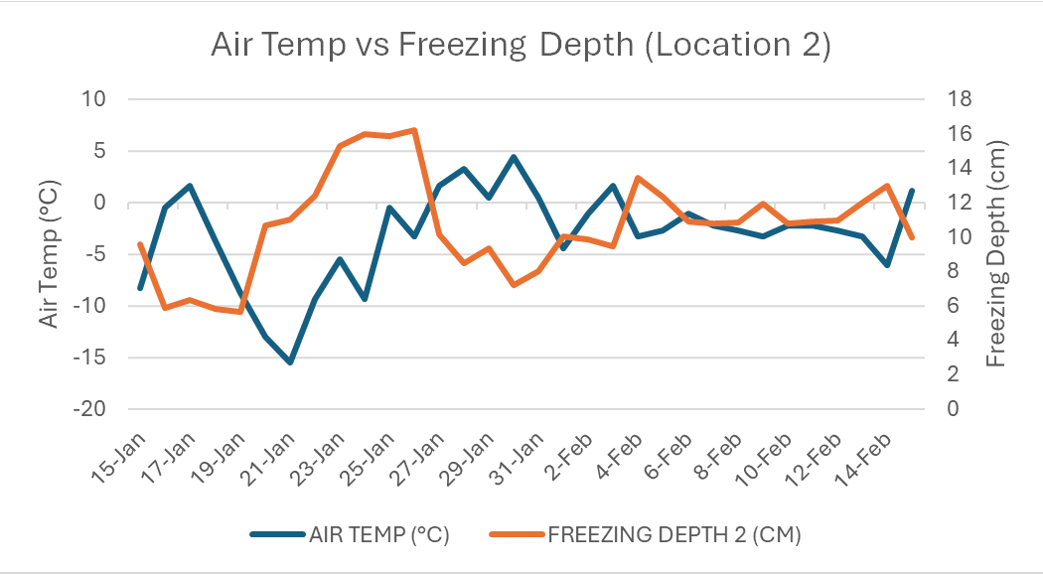
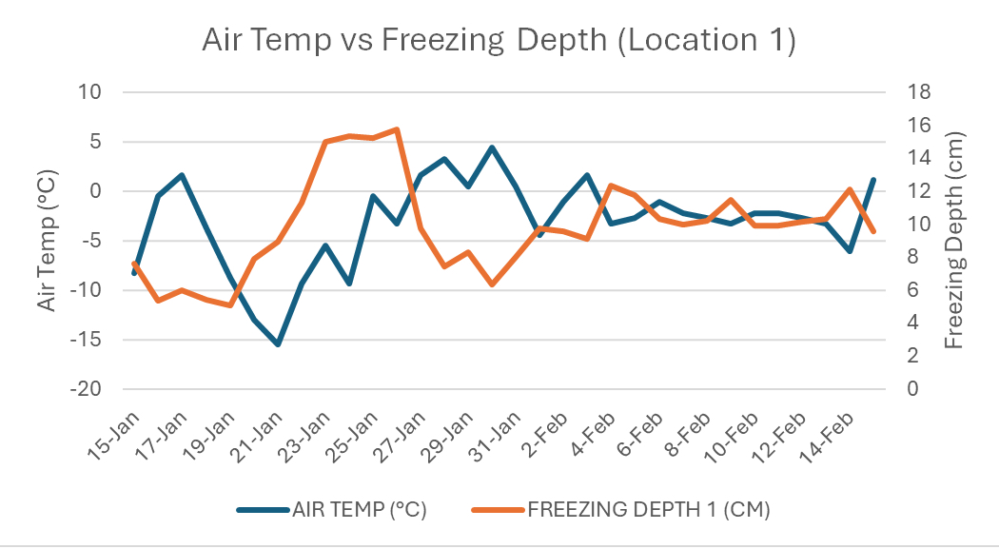
Analyzing Ground Depth Freezing Variability During a La Niña Winter
Mohamad Abouzenni, Fatimah Alrishood, Hannah Darwiche, Jawad Hamade, John Hashem Saleh
Crestwood High School, Dearborn Heights, MI
Abstract
Methodology
Conclusion
This study investigates the relationship between atmospheric conditions and soil freezing depth in Southeast Michigan during the winter of 2024-2025. Conducted at two locations in Dearborn Heights, MI, the research aimed to compare frost tube data collected during a La Niña winter to data from the previous year’s El Niño winter. Using GLOBE protocols, air temperature was recorded nightly, and ground freezing depth was measured using the frost tube method. Results indicated an inverse correlation between air temperature and freezing depth—colder temperatures led to deeper ground freezing, while warmer temperatures resulted in shallower freezing. The study also compared Crestwood test site data with that of other GLOBE schools, particularly the University of Alaska Fairbanks. Findings revealed significant differences, likely due to variations in frost tube design, data collection methods, and geographic location. Additionally, factors such as soil composition and snow cover influenced freezing patterns. The study emphasizes the importance of continued frost depth monitoring, especially as climate patterns shift. Understanding its importance is crucial for assessing the impact of ground freezing on plant survival, insect populations, and infrastructure stability. Future research should focus on multi-season data collection, incorporating additional atmospheric variables, and refining measurement techniques to enhance accuracy and reliability.
This study emphasizes the relationship between atmospheric conditions and soil freezing depth in Southeast Michigan. Data collected from frost tubes at two locations during the Winter of 2024-2025 show a clear inverse correlation between air temperature and ground freezing depth. While being in a La Niña year introduced variability in temperature patterns, freezing depth trends remained generally consistent with those recorded during the previous El Niño winter. This suggests that while seasonal weather patterns influence soil freezing, other factors such as soil composition, snow cover, and site-specific conditions may also play a role. When comparing data from Crestwood test sites to the University of Alaska Fairbanks, however, results showed significant differences. These differences can likely be attributed to geographic location, variations in frost tube design, and differences in data collection methods. The lack of correlation between the two data sets highlights the importance of regional environmental conditions in ground-freezing patterns. This study demonstrates the importance of continued monitoring of frost depth, particularly as climate patterns shift. Future research should focus on collecting data over multiple winter seasons, incorporating additional atmospheric variables, and refining measurement techniques to improve accuracy and consistency. Understanding frost depth trends is essential for assessing impacts on plant survival, insect populations, and structural stability..
Student researchers collecting equipment in order to install the frost tubes
Picture of installed frost tube
Student researcher installing the frost tube
Discussion
Based on the observed correlation between air temperature and freezing depth measurements, the researchers reject the null hypothesis that there is no significant difference between ground depth measurements taken at certain atmospheric parameters. The researchers found that as air temperature varied, there was a significant difference in the measured ground freezing depth. Observing the graphs for the two locations, it appears that there is an inverse relationship between air temperature and freezing depth. When air temperature rises, the freezing depth decreases, and when air temperature drops, the freezing depth increases. This is due to the fact that colder temperatures lead to deeper ground freezing. While on the other hand warmer temperatures lead to melting and a shallower freezing depth. The researchers reject the null hypothesis that there is no significant difference between ground depth measurements taken during last year's El Niño winter and this year's La Niña winter. Based on the graph, which shows noticeable differences in the data measurements in freezing depth between last year’s El Niño winter and this year’s La Niña winter leads the researchers to conclude that there is in fact a significant difference. The differences in freezing temperatures between last year’s El Niño winter and this year’s La Niña winter align with expected climate patterns. La Niña’s colder, drier conditions lead to deeper and more variable freezing, while El Niño’s warmer, wetter conditions result in more stable freezing depths. There are other factors that contribute to ground freezing that the researchers couldn’t account for. Soil type is one of those factors.
Student researcher checking and taking measurements on how deep the frost tube frooze
Student researcher inputting data into an Excel sheet
Acknowledgements
Results
Thank you to Dr. Kevin Czajkowski of the University of Toledo Mission Earth, who provided a sample frost tube. Thank you to Rami Eter, Youssuf Hassan, Mohamad Nasser, and Rawad Rahal for offering guidance and instruction on how to install the frost tubes. Lastly, thank you to Mrs. Diana Johns and Ms. Lina Abbas for providing constant support and knowledge throughout the research process..
Citations
Ambroise, V., et al. (2020). “Effects of soil freezing on fine roots in a northern hardwood forest.” The Roots of Plant Frost Hardiness and Tolerance, Plant and Cell Physiology, 61(1), 3–20. https://doi.org/10.1093/pcp/pcz196
MacQuarrie, C. J. K., Derry, V., Gray, M., Mielewczyk, N., Crossland, D., Ogden, J. B., Boulanger, Y., & Fidgen, J. G. (2024). “Effect of a severe cold spell on overwintering survival of an invasive forest insect pest.” Current Research in Insect Science, 5, 100077. https://doi.org/10.1016/j.cris.2024.100077
Cleavitt, N. L., Fahey, T. J., Groffman, P. M., Hardy, J. P., Henry, K. S., & Driscoll, C. T. (2008). “Effects of soil freezing on fine roots in a northern hardwood forest.” Canadian Journal of Forest Research, 38(1), 82-91. https://doi.org/10.1139/X07-133
Mauget, S. A., & Upchurch, D. R. (1999). “El Niño and La Niña related climate and agricultural impacts over the Great Plains and Midwest.” Journal of Production Agriculture, 12, 203-215. https://doi.org/10.2134/jpa1999.0203
Photo “La Nina diagram” NOAA 2020 Copyright.

