Slide 1




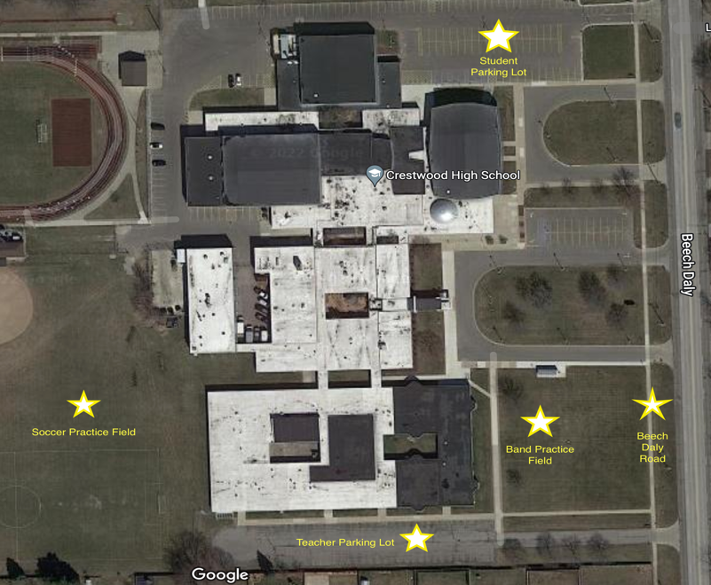
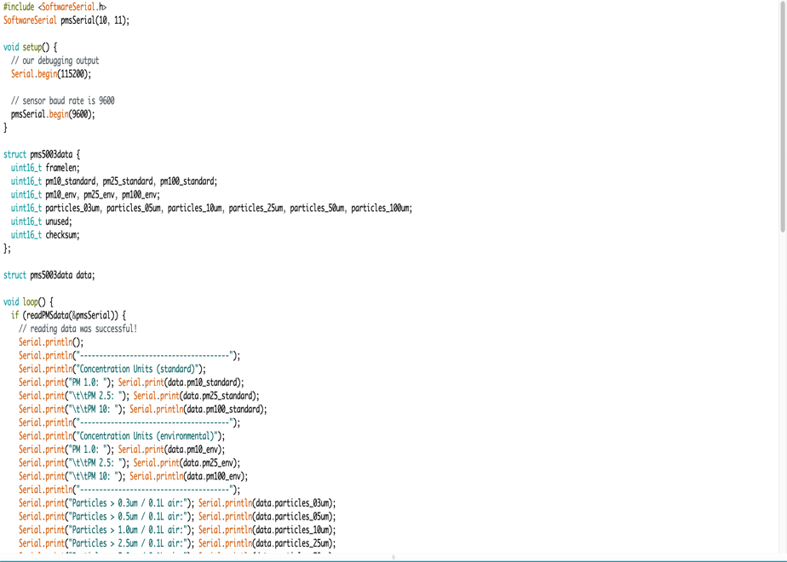
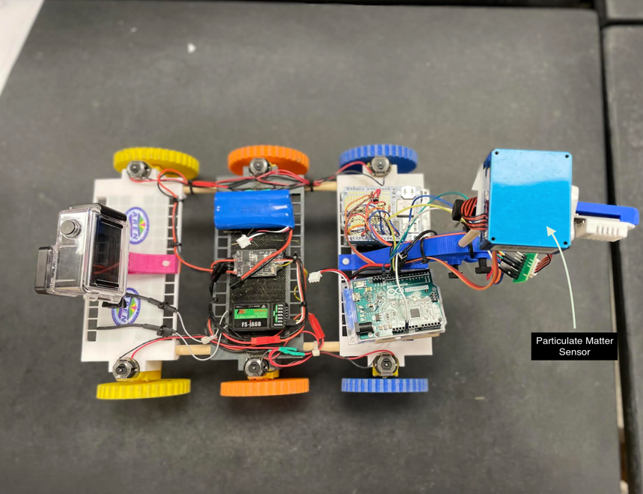
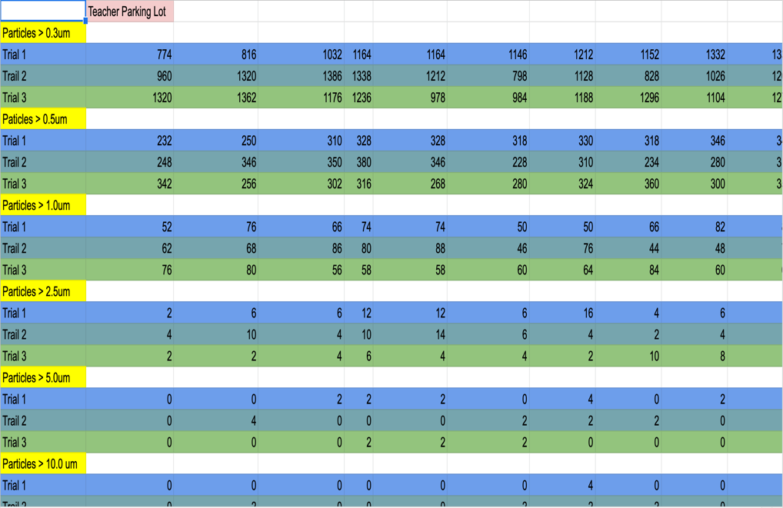
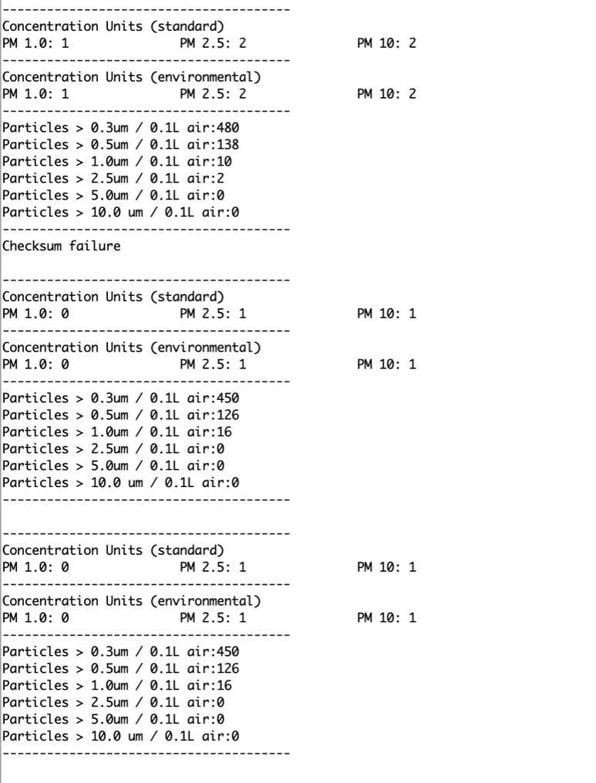
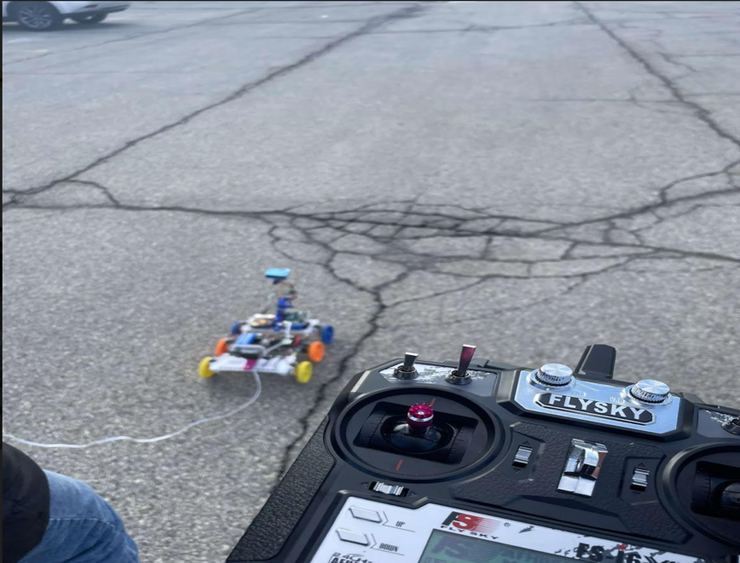
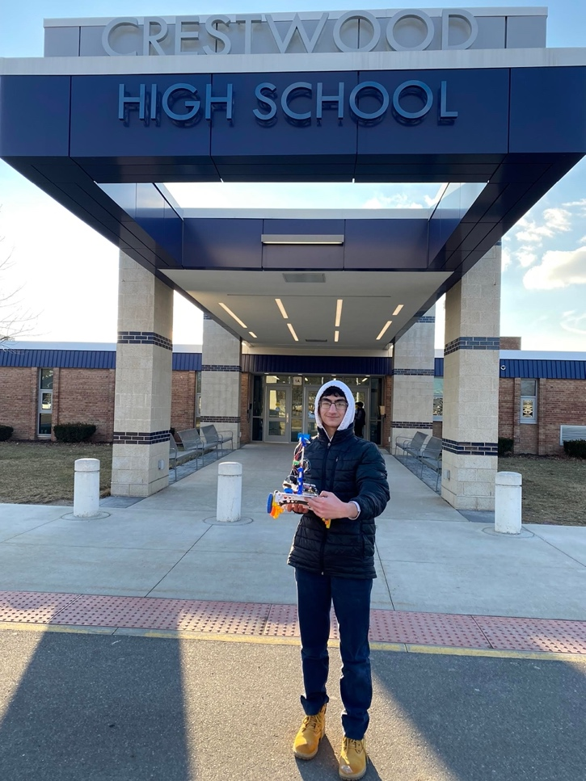
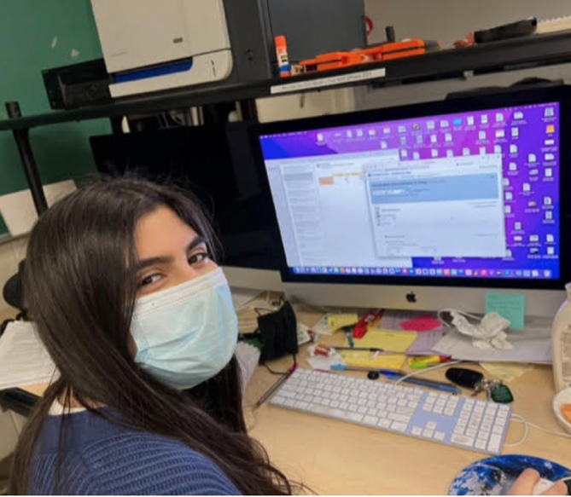
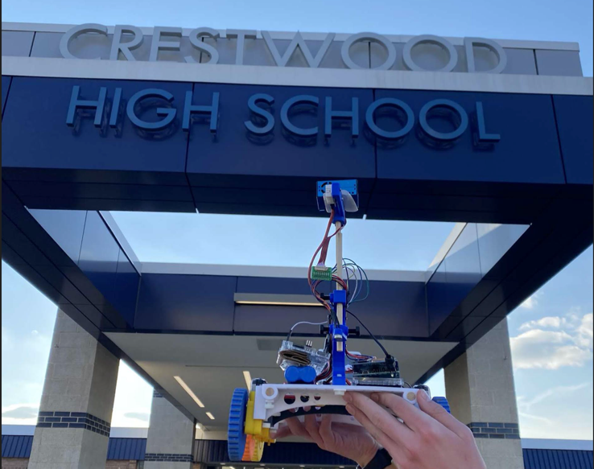
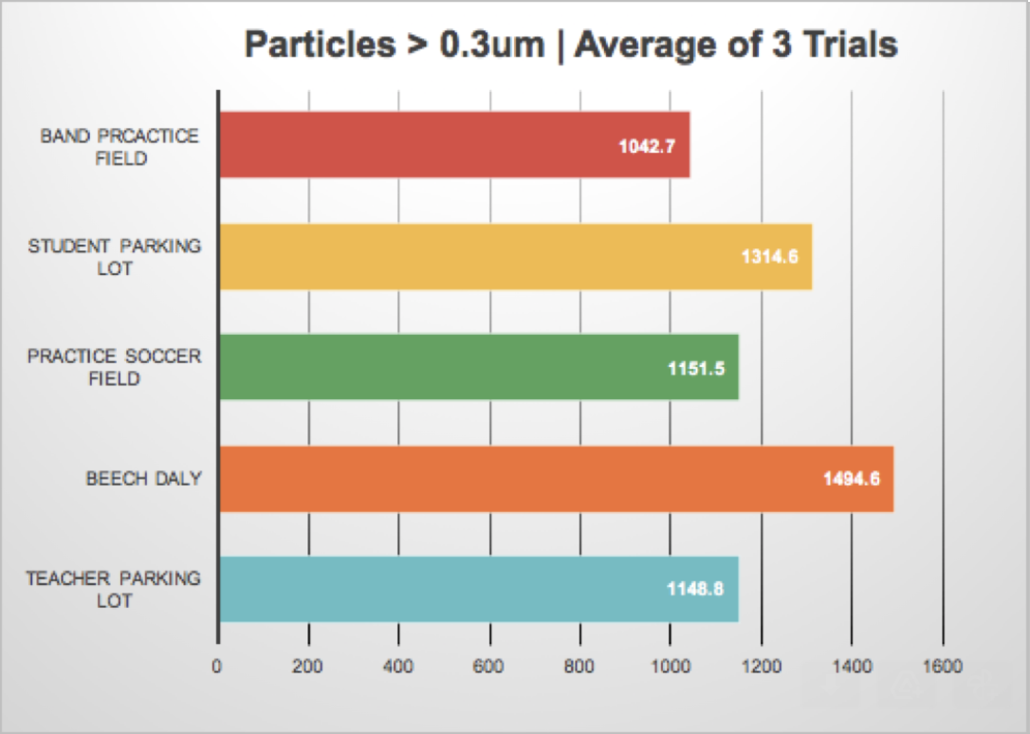
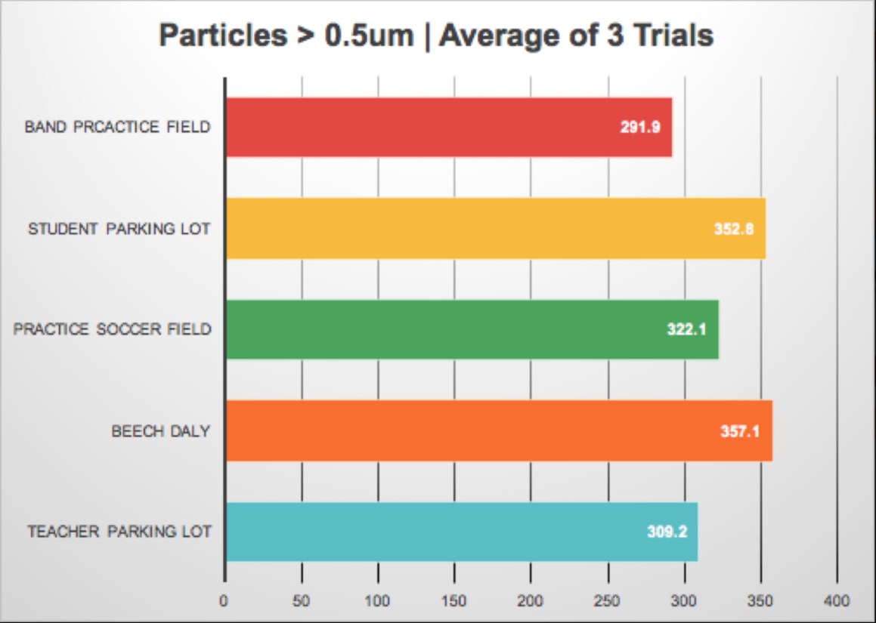
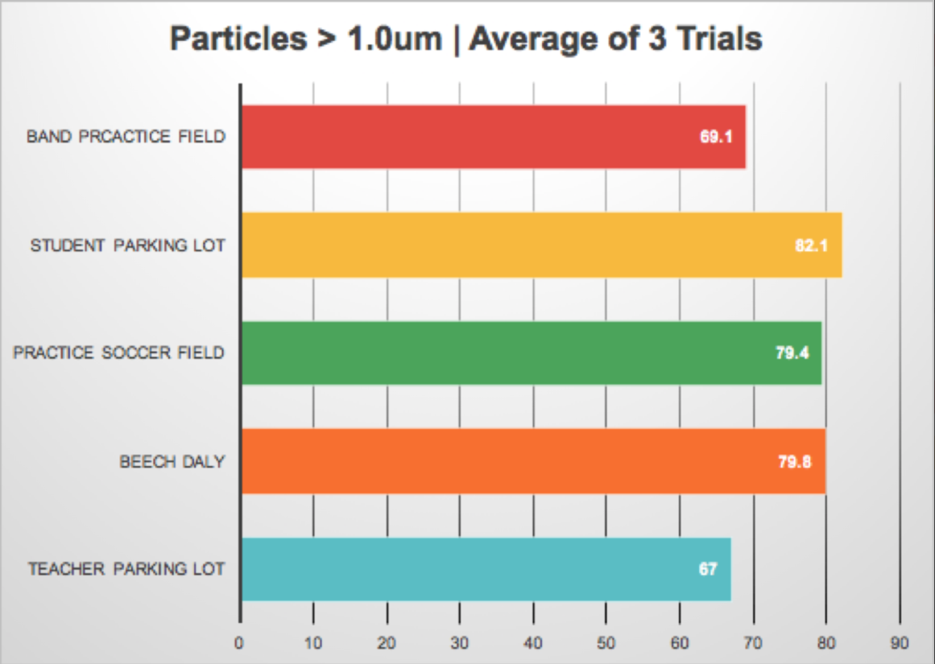
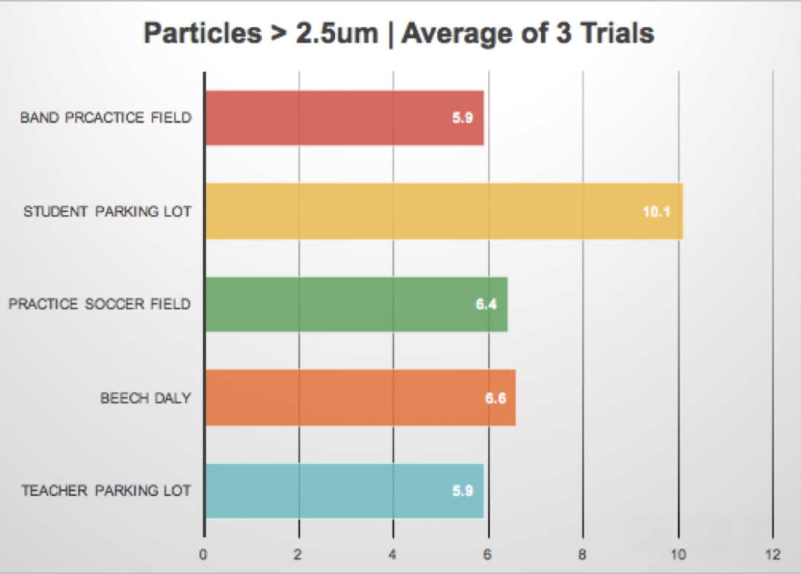
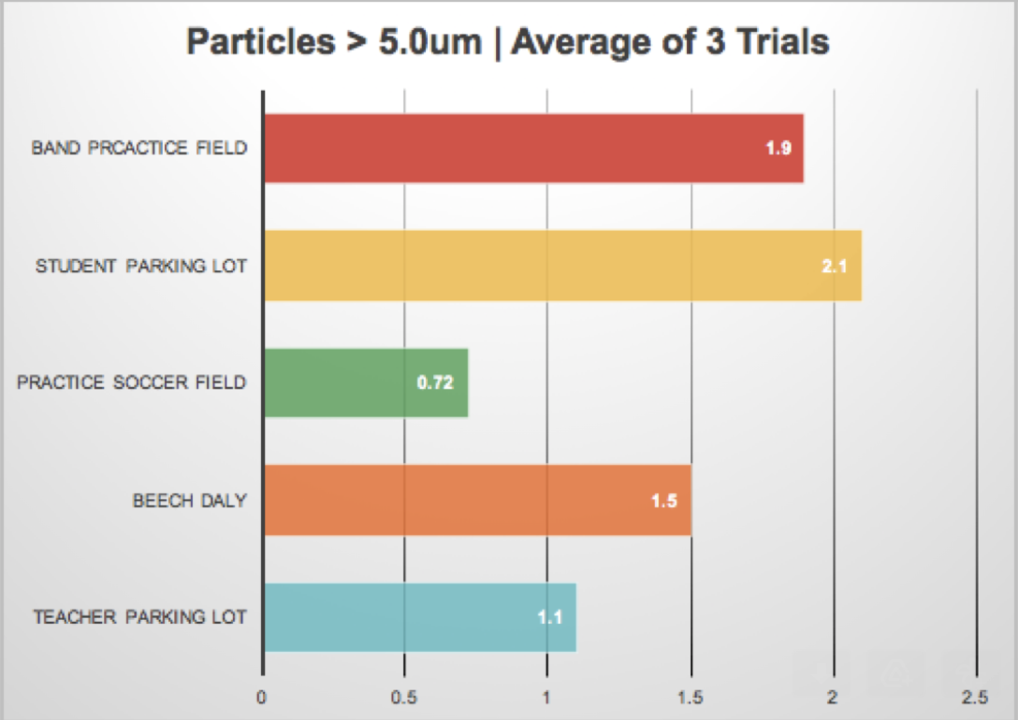
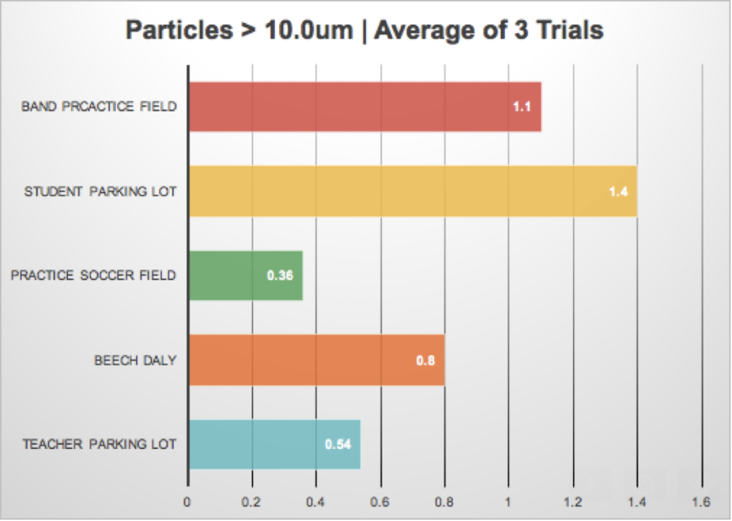
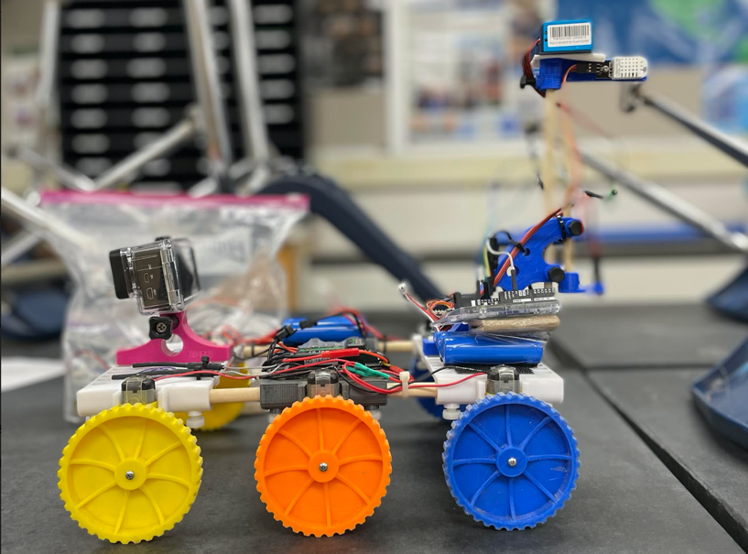


Use of a TerraRover 2 Collect Fine Particle Matter Using Arduino Related Technology
Maher Harp and Hala Komaiha
Crestwood High School, Dearborn Heights, MI
Abstract
Methodology
Conclusion
In this research, a NASA TerraRover 2 was modified to sense and record fine particulate matter along with its normal measurement of surface temperature. A micro PM 2.5 air quality sensor was independently programmed using the programming language of Arduino and the Arduino Leonardo Board. Multiple trial runs were made with the concentrations of particle size ranging from 1.0 microns to 10.0 microns (0.3 microns, 0.5 microns, 1.0 microns, 2.5 microns, 5.0 microns, 10.0 microns) in the Crestwood High School Teacher Parking Lot, Student Parking Lot, along Beech Daly Road, Band Practice Field, and the Student Practice Soccer Field. The PM 2.5 Air Quality Sensor was mobilized using the TerraRover 2, a robot using 3D printed components and a controller, to collect measurements of different sized particles around the designated area. The goal of this research was to use the data collected by the PM 2.5 air quality sensor to compare data from several different areas around Crestwood High School. Ground level PM concentrations are critical to collect and analyze because inhaling such fine particles, especially over a long period of time may cause respiratory health issues. Knowing the levels of particulate matter, may help alert school personnel know when it is safe for outdoor athletic activities. An analysis of the data showed difference between PM and their location around the school. However, the difference was less than expected. In the future, other air quality sensors can be added to the TerraRover 2, allowing a suite of air quality data to be collected.
The rising importance of research in the area of particulate matter and its concentrations lead to negative health effects on the population as a whole. Developing and Developed countries. After analyzing the data collected during this research, it was evident that the location of Beech Daly Road had the most concentration of Particles > 0.3um with an average value of all 3 trials of 1494.6 particles and Particles > 0.5um with an average value of all 3 trials of 357.13 particles. This may be due to the constant contact with cars and its exhaust settling fine particles on the cement. Furthermore, our data expressed that the location of the Student Parking Lot had the most concentration of Particles > 1.0um with an average value of all 3 trials of 82.1 particles, Particles > 2.5um with an average value of all 3 trials of 10.1 particles, Particles > 5.0um with an average value of all 3 trial of 2.133 particles, and Particles > 10.0um with an average value of all 3 trial of 1.4 particles. This may be due to the fact that the student parking lot is a main way for all students, buses, and track-related sport teams. In other words, the student parking lot at Crestwood High School is in constant use. Although we have gotten this data, these numbers may have been skewed because the PM2.5 Air Quality Sensor is at an elevation and was in constant movement as it drives over dips and cracks on all surfaces. The results of this investigation points to how particulate matter is varied by the conditions of the area being tested. The other locations still impact our research. Because of COVID-19’s effects on the upper respiratory system, ultra-fine or fine particles such as particle sizes less than 2.5um will be even more detrimental to human health, possibly increasing mortality due to their numerous negative health effects on the human heart and lungs. By measuring local particulate matter of all sizes, students involved in school outdoor activities can be warned on days that they might be exposed to high levels of particulates within the air. In the future, the researchers plan on adding a radio module connected to an Arduino Mega because of the larger storage found.
Satellite image of data collection site, Crestwood High School
Arduino code to collect Particulate Matter levels and print them on the laptop
Particulate Matter Sensor and Arduino Leonardo mounted onto TerraRover 2
Discussion
Data collected gets exported into a spreadsheet and averaged out
Particulate Matter values get printed on laptop
Driving the TerraRover 2 in the Teacher's Parking Lot
PM concentration levels slightly vary in different locations. While most of the data did not differ much, the data taken near Beech Daly road had higher levels of Particulate Matter greater than 0.3um (ultra fine particles). This location is directly near a major road meaning that car exhaust is the most probable cause for this shift in data. Possible sources of error include weather changes between location switches, the time of day that the data was collected, accuracy of the Particulate Matter sensor, the instability of the Particulate Matter Sensor while driving, and altitude of Particulate Matter Sensor. Globe research previously written by Nazih Baydoun, Hassan Berry, and Nour Kochaiche at Crestwood High School using a PurpleAir device at higher altitudes whereas the high school researchers hope to advance their robot to collect data at a human’s breathing level to accurately measure how much Particulate Matter humans breathe. The previous research also included data on the topic of wind speed, relative humidity, and temperature all impacted the particulate matter of the area. As the research develops, the researchers are going to monitor the differences of particulate matter levels compared to weather conditions including wind speed, relative humidity, and temperature. The researchers had to accept their first null hypothesis as there was little difference in Particulate Matter levels in different locations. The researchers rejected their second null hypothesis, as there were more particles with a size less than 2.5um at Beech Daly road than every other area in which data was collected. The researchers also rejected their third null hypothesis, as the TerraRover 2’s was successfully able to drive while collecting Particulate Matter data outdoors.
Results
Acknowledgements
Working with Mr. David Bydlowski and Mr. Andy Henry of the NASA AREN program was very educational and inspiring for the researchers. He worked with and advised them on how to improve their methods approaching the Arduino Leonardo setup for the PM2.5 Air Quality Sensor, and provided instruments when the researchers needed them most. While working with both mentors, the researchers truly
understood the importance and impact of their research and how they approached the research in a technological lens, as studying particulate matter and air quality in general is as significant as it has ever been due to the recent COVID-19 pandemic, and the rising use of fossil fuels.
Citations
Justo, Di Patrick, and Emily Gertz. Atmospheric Monitoring with Arduino. O’Reilly Media Inc., 2013.
Panyacosit, Lily. Health Effects. International Institute for Applied Systems Analysis (IIASA), 2000, pp.16–19, A Review of Particulate Matter and Health: Focus on Developing Countries,
www.jstor.org/stable/resrep15725.6. Accessed 26 Feb. 2021.
Schwarze, Per E. “Particulate Matter Properties and Health Effects: Consistency of Epidemiological and Toxicological Studies.” CiteSeerX, 2006,
citeseerx.ist.psu.edu/viewdoc/download?doi=10.1.1.913.6073&amp;rep=rep1&amp;type=pdf
EPA, EPA. “Particulate Matter (PM) Basics.” EPA, Environmental Protection Agency, 2022,
https://www.epa.gov/pm-pollution/particulate-matter-pm-basics#PM.
Morishita, Masako, et al. “Exploration of the Composition and Sources of Urban Fine Particulate Matter Associated with Same-Day Cardiovascular Health Effects in Dearborn, Michigan.” Journal of Exposure Science &amp; Environmental Epidemiology, vol. 25, no. 2, 2014, pp. 145–152.,
https://doi.org/10.1038/jes.2014.35.
Redon Maître-assistante, Nathalie. “Fine-Particulate Pollution: Can We Trust Microsensor Readings?” The Conversation, THE CONVERSATION, 10 Feb. 2022, https://theconversation.com/fine-particulate-pollution-can-we-trust-microsensor-readings-84406.

