Slide 1
Monitoring Multispecies Vectors in School Environments
Integrating the GLOBE Protocol, CDC Traps, and Low-Cost Technologies.
Sandra Maria Nascimento et al.
Colégio Militar Tiradentes V – Timon, Maranhão, Brazil
Introduction & Objective
• Investigate mosquito vectors of public health importance in a school environment.
• Integrate citizen science, entomological surveillance, and STEM education using the GLOBE Program.
Methods
• Three CDC-type light traps installed overnight (Sept 22–23, 2025).
• Environmental conditions: 27 °C, 71% relative humidity.
• Specimens identified in the Zoonosis Surveillance Unit laboratory.
• Data uploaded to the GLOBE Mosquito Habitat Mapper.

Slide 2
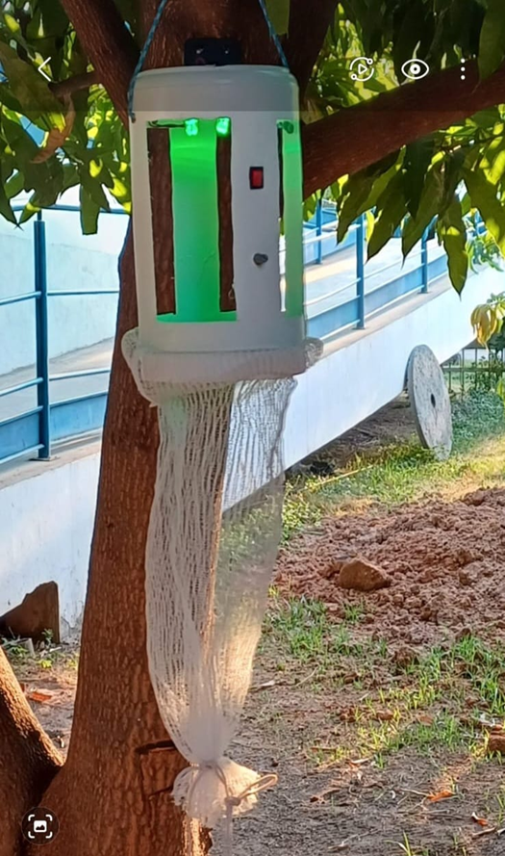
Results
• 38 insects collected.
• Culicidae: 15.79% (Culex pipiens).
• Simuliidae: 50%.
• Psychodidae: 34.21% (Lutzomyia longipalpis).
Conclusion
• Presence of disease vectors highlights need for school-based monitoring.
• Low-cost Arduino trap supports education and public health awareness.
Low-cost mosquito trap prototype (BE25)

