Slide 1
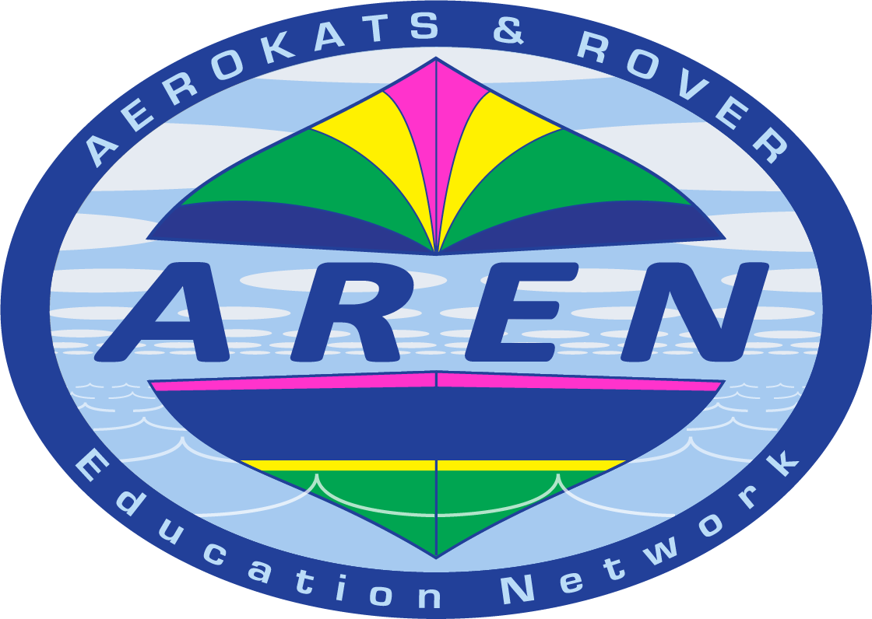
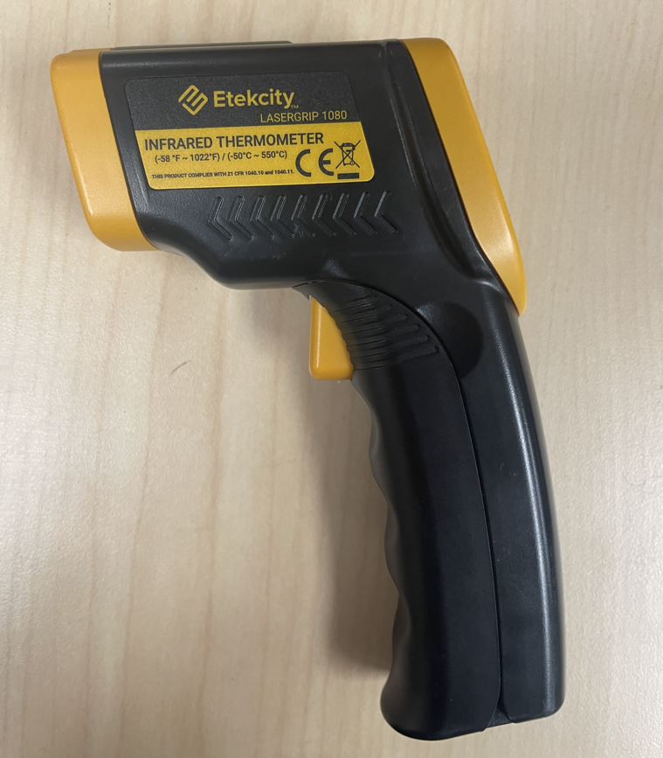
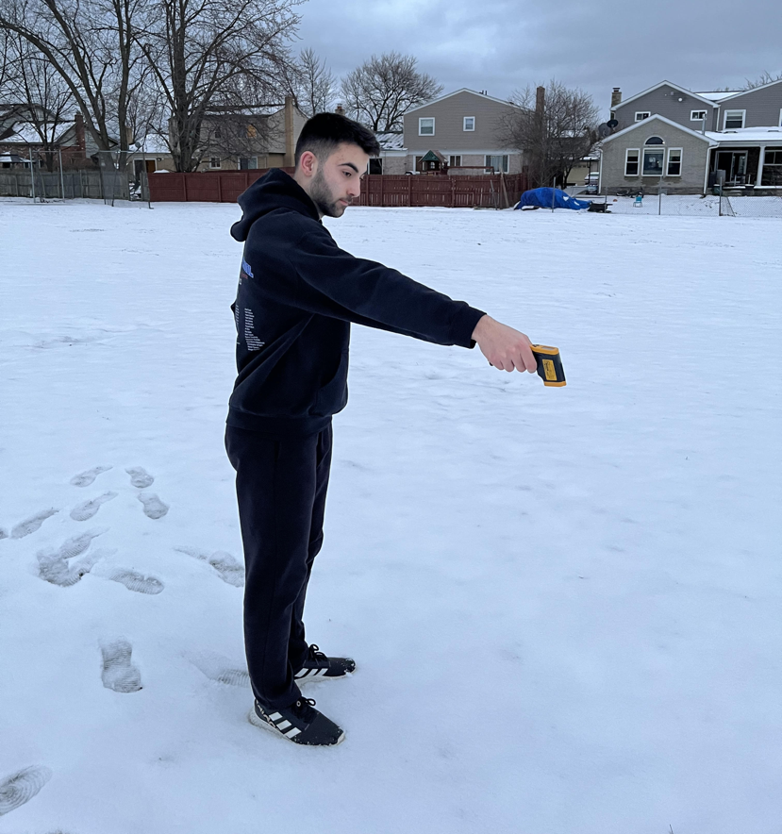
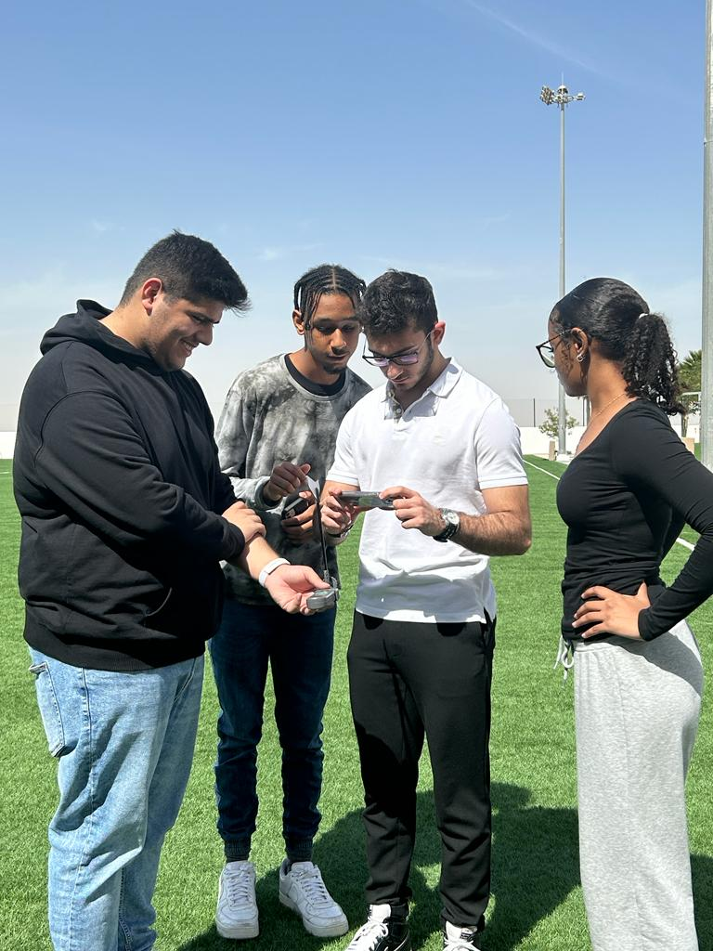
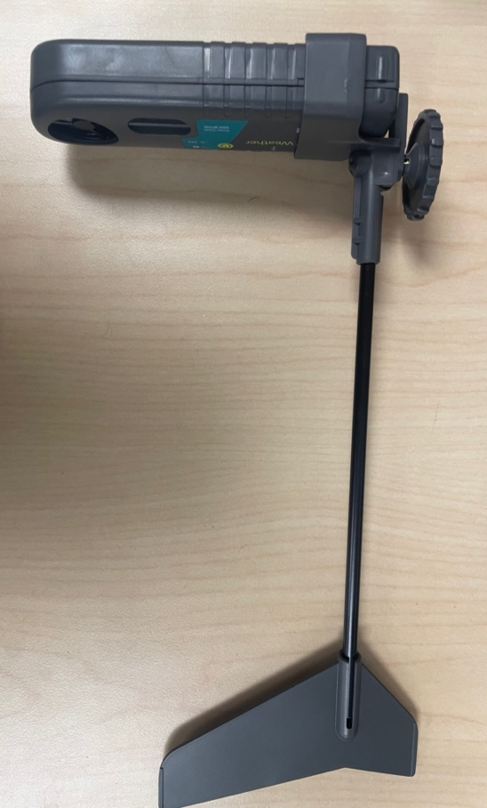
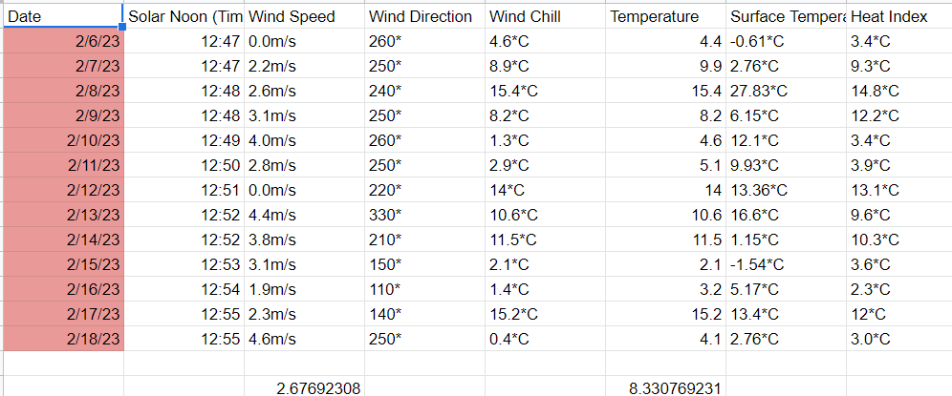
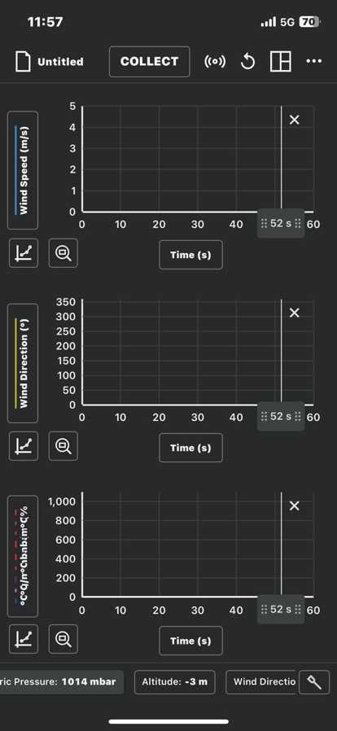
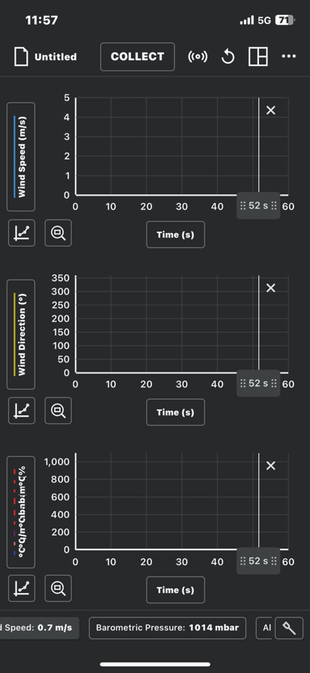
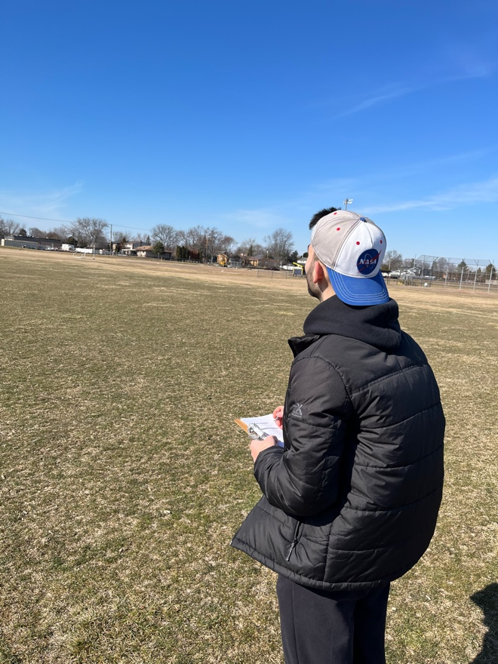
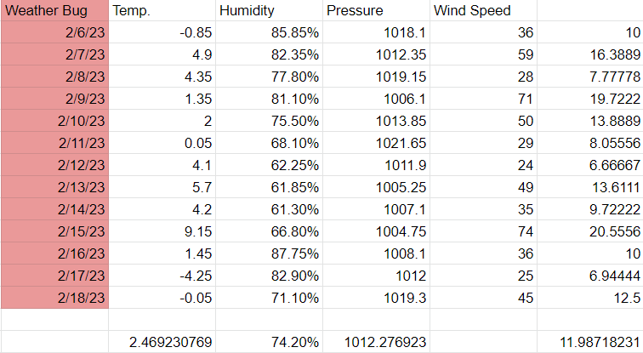
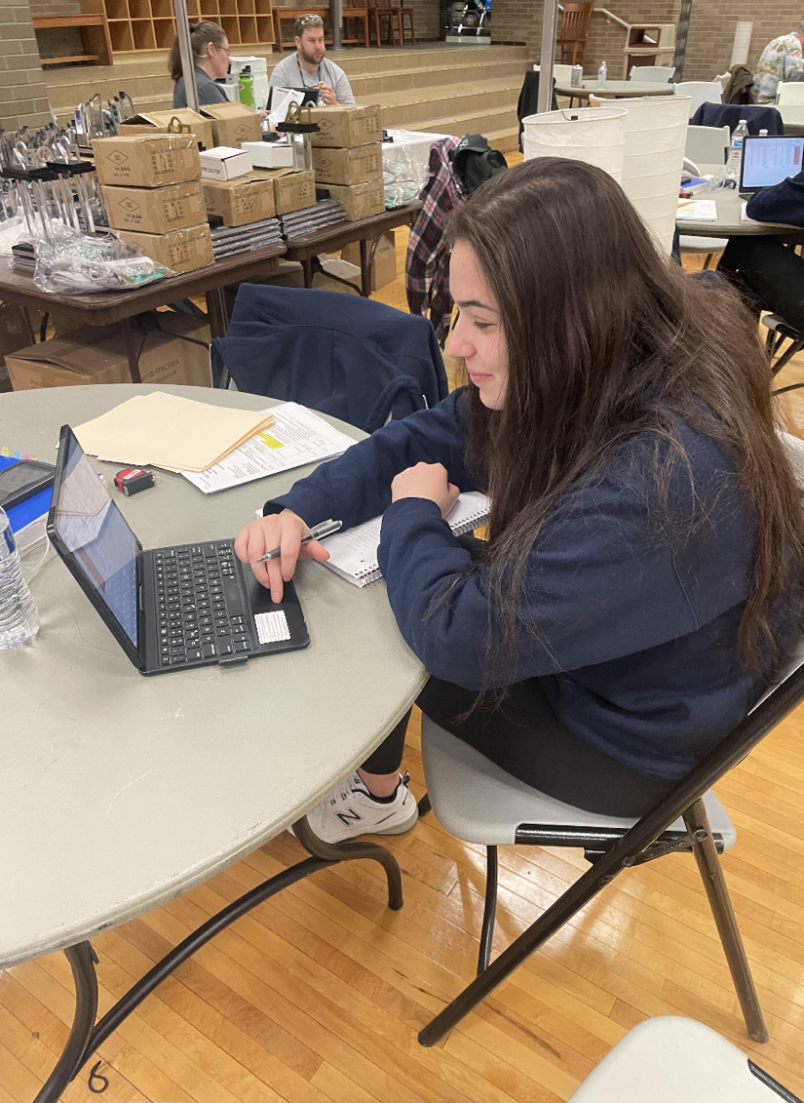
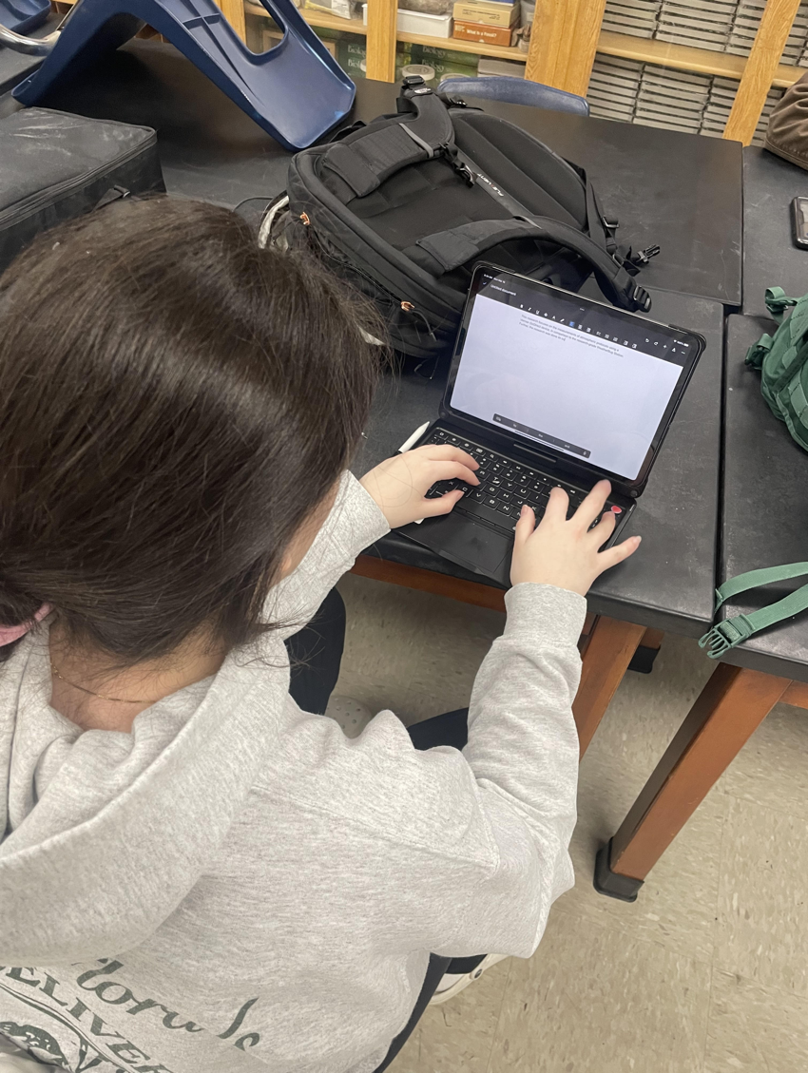
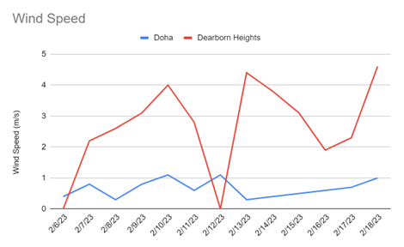
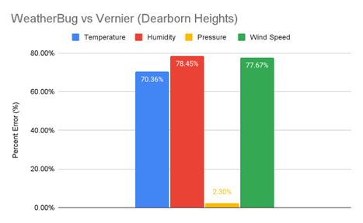
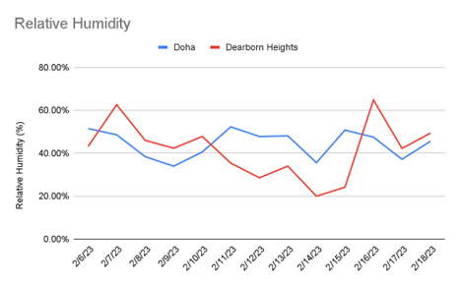
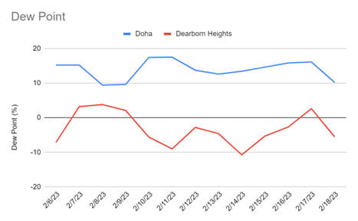
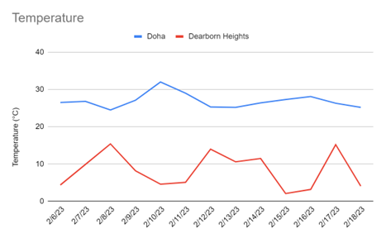
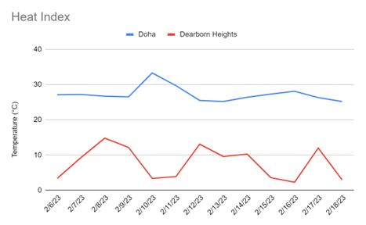
Comparing Select Atmospheric Parameters Between Disparate Geographic Locations Using Collaboration Between Two GLOBE Schools
Savannah Jomaa, Isabella Jomaa, Adam Baydoun, and Malik Mashlab
Crestwood High School, Dearborn Heights, MI
Abstract
Methodology
Conclusion
During the 2022-2023 school year, a group of researchers from Crestwood High School in Dearborn Heights, Michigan and the ACS International School in Doha, Qatar collected data on select GLOBE atmospheric protocols in their two different geographic locations using portable, consumer-grade Vernier Weather Stations. Using the device, a variety of data was collected on each of the two schools’ soccer fields. The Vernier Weather Device was fitted with a wind attachment and held at an elevation of one (1) meter from the ground to collect data. Following the data collection with that device, surface temperature was measured using GLOBE protocols with an infrared thermometer. Additionally, for Dearborn Heights only, the data from the portable weather station was compared to the data collected by our permanent, research-grade WeatherBug station located on the corner of the roof of our new science classrooms. Atmospheric protocols, including wind speed, wind direction, wind chill, temperature, heat index, dew point, relative humidity, absolute humidity, station pressure, altitude, and barometric pressure collected in both Michigan and Qatar. Since all data was taken by both schools on the same day and close to solar noon, it was possible to analyze the data and make some comparisons between the two sites. Furthermore, noting the differences in the measurements from the portable and stationary weather station allowed us to test the accuracy of the portable Vernier weather station. Additionally, testing the accuracy of the relatively inexpensive, portable weather station may allow for the collection of data by numerous other students around the globe, transcending geographical boundaries and drawing scientific conclusions that would have not been made otherwise. Moving forward, the researchers recommend the Vernier Weather Station be considered for use by other schools and citizen scientists to facilitate greater collaboration and scientific data in microclimates across the globe.
Using the relatively inexpensive, portable Vernier Go Direct Weather Station, researchers in Dearborn Heights, Michigan and Doha, Qatar found a significant difference in atmospheric measurements taken at ground level in both geographic locations. Further, the measurements in the Michigan location using the Vernier Go Direct were compared to measurements taken by the research-grade WeatherBug Weather Station. As a result, the Vernier device was concluded to be an appropriate educational-grade device to predict and monitor weather and climate trends. Therefore, the Vernier Go Direct atmospheric measurements can in fact be utilized effectively by students across the world as an inexpensive medium to collect weather related data as the data collected by this device is extremely accurate at a level that is on par to research grade devices like the aforementioned WeatherBug.
The usage of the Vernier device will allow students and other citizen scientists across the globe to take relatively accurate atmospheric measurements for their geographic location, helping to mitigate the meteorological gaps present in current data. Additionally, this device will open greater collaborative efforts between student scientists across the globe, allowing for an accurate microscale collection of data and corresponding global weather patterns. The use of this device could transcend country boundaries, religions, cultures, and language barriers to unite student researchers in a collective effort to better understand atmospheric phenomena and patterns on a micro and global scale.
In the future, this research may be expanded to other geographic locations across the globe. For future reference, similar data should be collected over longer periods of time, spanning more than one season. Also, ground-level data should be taken simultaneously with reports from the WeatherBug station, so as to have the highest accuracy of comparison between the two data sets.
Finally, working with collaborators across the globe, as well as a mentor, provided a unique experience for all researchers. Collaborating with students in an entirely different geographic location allowed researchers to expand their knowledge and perspectives on the topic, formulating a truly memorable experience in which all participants were able to grow as citizen scientists. A project like this under the design of a NASA scientist would make a great GLOBE Measurement Campaign or intense observation period.
Etekcity Lasergrip 1080 Infared Thermometer
Measuring surface temperature
Using Vernier Go Direct Weather Device to measure atmospheric
Discussion
The researchers reject the null hypothesis that there is no significant difference in atmospheric measurements taken at ground level in Dearborn Heights, Michigan and Doha, Qatar in terms of wind speed, temperature, station pressure, relative humidity, heat index, and dew point. The wind speed average taken by the Michigan researchers was significantly higher and varied greatly as the respective lower temperature and higher pressure in Michigan. The station pressure remained predominantly consistent between the two areas with the Michigan data being slightly lower. The relative humidity fluctuates at a similar rate in both Doha and Dearborn Heights with the exception of Dearborn Heights fluctuating at a more extreme degree. Doha likely has a greater heat index as their geographical location is closer to the equator and the sea breeze from Persian Gulf creates greater moisture in Doha's atmosphere while cooling off the land. The Vernier Go Direct Weather Station(s) and the WeatherBug device(s) are comparable to research grade equipment and can be used effectively by students across the world as an inexpensive medium to collect weather related data. This device will allow student scientists to compare and track correlations between data across the globe, but there are potential sources of error due to the distance between the Michigan researchers and the Doha researchers. Additionally, the measurements taken by both groups of researchers could be slightly skewed due to inconsistencies between the placement of the Vernier and surface temperature devices. Finally, the data involved in this report was taken during a limited period of time, in the winter of Michigan and Doha, which is significantly colder for the former. Future research should compare the atmospheric data collected in both geographic regions during a different season, or perhaps, a longer period of time to the fact that for pressure, specifically, the altitude difference is small enough to be negligible.
The Michigan researchers wrote this paper as a collaboration with the researchers from Doha, but due to the 2022 World Cup, the Michigan researchers are the sole authors of the report. Despite the large margin of error between the Vernier device and the WeatherBug station in the graphs, this margin of error can be explained by numerous factors. Temperature and humidity both decrease as altitude increases, while wind speed has a percent error 77.67%. Pressure has a very low percent error of 2.3%, due to the fact that for pressure, specifically, the altitude difference is small enough to be negligible.
Data gets compiled onto a spreadsheet
Clouds, surface temperature and other data gets recorded on paper
Data gets outputted as a graph on phone
Results
Citations
Caluwaerts, S., Top, S., Vergauwen, T., Wauters, G., De Ridder, K., Hamdi, R., Mesuere, B., Van Schaeybroeck, B., Wouters, H., Termonia, P. (2021, June 7). Engaging schools to explore meteorological observational gaps. American Meteorological Society. https://journals.ametsoc.org/view/journals/bams/102/6/BAMS-D-20-0051.1.xml
Costa, H., Sprout, E., Teng, S., McDaniel, M., Hunt, J., Boudreau, D., Ramroop, T., Rutledge, K., Hall, H. (2022, November 7). Atmospheric pressure. National Geographic . https://education.nationalgeographic.org/resource/atmospheric-pressure/
Fondriest Staff. (2010, August 12). Wind speed and direction. Environmental Monitor . https://www.fondriest.com/news/wind-speed-and-direction.htm#:~:text=Wind%20speed%20and%20direction%20are,of%20seiches%20and%20storm%20surges.
Klausen, J., Volosciuk, C., Tarasova, O., Netcheva, S. (2021). Benefits of atmospheric composition monitoring and international data exchange. World Meteorological Organization. https://public.wmo.int/en/resources/bulletin/benefits-of-atmospheric-composition-monitoring-and-international-data-exchange#:~:text=Without%20access%20to%20and%20exchange,emission%20hotspots%20to%20ta
Melillo, J., & Gribkoff, E. (2021, April 15). Soil-based carbon sequestration. MIT Climate Portal. https://climate.mit.edu/explainers/soil-based-carbon-sequestration .
Acknowledgements
A special thank you to Ms. Dorothy Grace Manalac and her students, Darin Chebib, Ahmad Kachmar, Hamad Almuhannadi, and Jumanah El Hassan from the ACS International School of Doha, Qatar for their assistance and collaboration on this project. Thank you to our advisor for this project, Mrs. Diana Johns, as without her knowledge as our teacher and guidance as our advisor, this project would not have been possible. Thank you to Mission Earth, for providing equipment and sponsoring students from the Crestwood High School Science Club to attend the Student Research Symposium (SRS) in Wisconsin, in order to present their research projects. Last but not least, thank you to the AREN Project for supplying the Michigan researchers with the Vernier Go-Direct device, free of cost.

