Slide 1





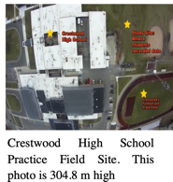

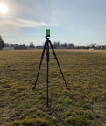
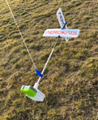



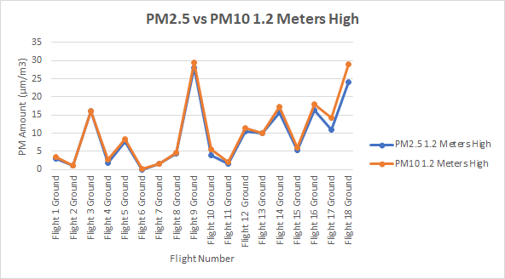
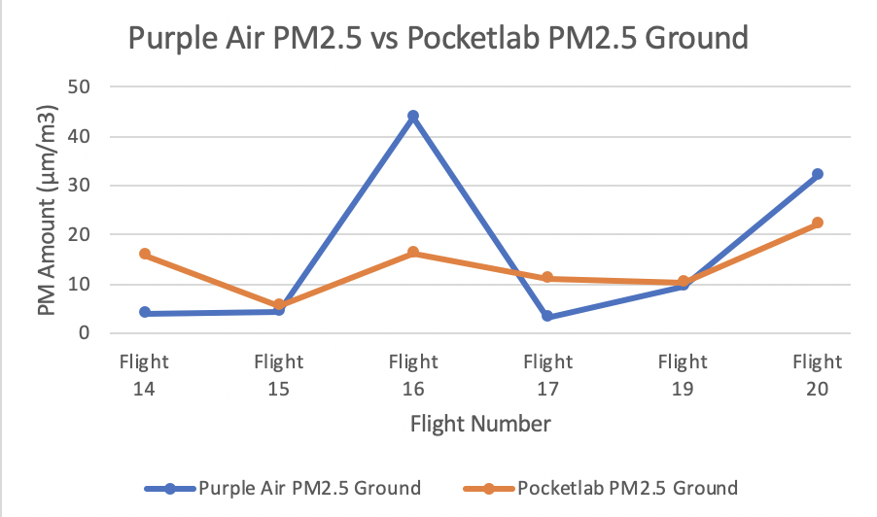
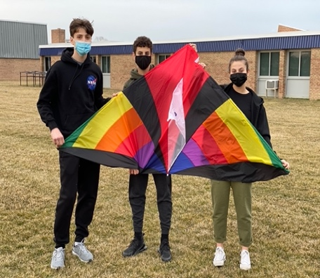
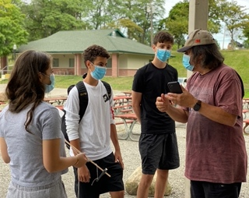
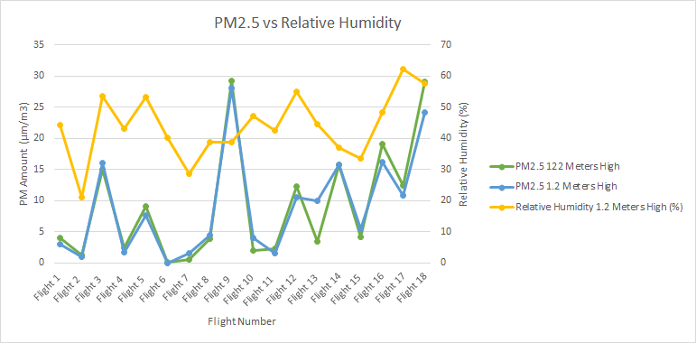
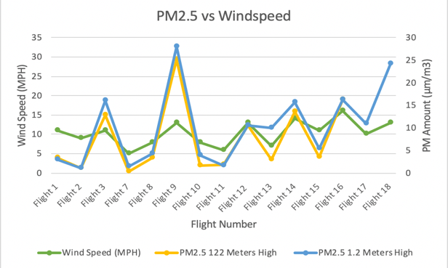
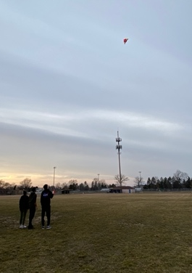
An Analysis of Particulate Matter Data Collected by Monitoring at Various Altitudes Using Aeropod Technology
Nazih Baydoun, Hassan Berry, and Nour Kochaiche
Crestwood High School- Dearborn Heights, MI
Abstract
Methods
Significance of Research
During the 2020-2021 school year, a group of researchers from Crestwood High School in Dearborn Heights, Michigan, collected data on particulate matter (PM) concentrations as measured at two different altitudes using a consumer grade PocketLab Air device. Various surface weather parameters and PM counts were taken on the school’s soccer field. An “Into the Wind” 7 ft Levitation Delta Kite (outfitted with a PocketLab Air device attached to a Globe-certified custom, 3D printed aeropod) was flown at 122 meters high to collect the same atmospheric parameters as those measured at the surface. PM data collected was compared with a permanently mounted PurpleAir device located in a school courtyard to validate the reliability of the PocketLab Air. The goal of this research was to see what differences might exist between ground and high altitude PM. PM levels were measured at a higher altitude to determine if particulates produced from local factories and landing aircraft at a nearby regional airport might be detectable. Ground level PM concentrations are important because of the health risks of inhaling ultrafine particles over long periods of time. Knowing what atmospheric conditions exacerbate PM_{2.5} and PM₁₀ levels could possibly be utilized by high school sports teams to modify their activities during episodes of poor air quality. An analysis of the data showed little variation between PM levels on the ground and at higher altitudes. However, PocketLab Air PM concentrations are somewhat positively correlated with relative humidity and directly correlated with wind speed. Moving forward, more research on PM should be conducted where sports and other physical exertion takes place because this increases the inhalation of fine PM, which other research has found to be involved in potentially negative health outcomes.
The site by which the research was conducted is relatively close to the original factory complex of the Ford Motor Company (Dearborn, MI) and on a major flight pathway of the Detroit Metropolitan Airport located (Wayne, MI). Both these factors combined make Dearborn a heavily industrialized city. Of the six (6) criteria air pollutants regulated by the U.S. Environmental Protection Agency, levels of particulate matter often exceed safe levels at our school, as shown by the researchers’ PurpleAir sensor. High concentrations of particulate matter in the atmosphere are linked to numerous health issues in humans including asthma, bronchitis, and cardiovascular problems (Morishita 2014). Measuring particulate matter levels at our school allows us to assess the air quality specific to the microclimate of our study site and allows us to make safety recommendations to our school’s outdoor sport teams regarding safe exercise and physical exertion. The trends the researchers discovered in PM may play an important predictive role in determining the types of atmospheric conditions that could potentially be hazardous for rigorous outdoor exercise. The AREN Project, in contrast to drones, is able to use NASA based Aeropod technology to carry heavier devices that can be used to measure particulate matter and other weather parameters relatively inexpensively. This research validates the premise that Aeropod technology can be deployed globally to retrieve accurate and relatively inexpensive data as long as there's some wind. Large-scale weather conditions can be investigated remotely through the use of satellites. However, microclimates and their associated weather conditions are not as well understood because weather satellites currently do have the ability to collect precise data (higher resolution) in small areas like our high school campus.
Crestwood High School Practice Field Site. This image is 305 M high (caught by researchers’ Aeropod).
PocketLab Air was used to take PM2.5, PM10, and surface weather parameters.
PocketLab Air mounted on tripod
PocketLab Air attached to custom, 3D printed Aeropod
Aeropod attached at 122 M, continuously collecting PM data.
Data imported and averaged in Excel.
Results
Investigation Plan
Discussion
An Aeropod equipped kite was flown throughout the summer 2020 in order to find the safest way to collect data on particulate matter at higher altitudes. The PocketLab Air is a heavier device than other instruments that had been flown previously and adjustments had to be made regarding optimal launch and landing procedures. Flights were made from September 2020 through January 2021 whenever the weather was suitable for the launch of equipment. A 7-ft Levitation Delta Kite outfitted with NASA/AREN aeropod technology was used to fly the PocketLab Air to collect data on PM_{2.5.} After mastering kite flying and developing the data collection protocol, a series of 21 flights were made and data collected. Mr. David Bydlowski of the NASA/AREN Program assisted the researchers by guiding them on proper equipment maintenance and answering any questions that arose.
PM_{2.5} and PM₁₀ collected from the PocketLab Air both do not vary significantly from ground levels as compared with those values obtained with the kite at higher altitudes. The amounts of PM_{2.5} and PM₁₀ obtained by the PocketLab Air were relatively the same each time values were collected, with PM₁₀ being just a bit higher at both altitudes. The Purple Air is a higher quality, more research-grade device as compared with the PocketLab Air, which could help explain this. PM_{2.5} and PM₁₀ from the PocketLab Air compared with relative humidity showed positive correlation. As relative humidity increased, levels of PM_{2.5} and PM₁₀ also increased.
Our data suggests that wind speed appears to show a positive correlation with higher PM counts. The researchers had to accept their first null hypothesis, as there was not a significant difference in PM2.5 and PM10 values at the ground surface vs air. The researchers rejected their second null hypothesis, as there was variation in the PM_{2.5} and PM₁₀ data collected by both devices, but both showed similar trends. The researchers rejected their third null hypothesis, as they found positive correlation between PocketLab Air PM data with humidity and wind speed. The researchers rejected their fourth null hypothesis, as they were able to talk with Crestwood’s administration and are making a plan for the future to regulate high school athletics while taking into account PM levels to ensure athletics are safe to hold.
Figure 1: PocketLab Air PM_{2.5} ground level as compared to a higher altitude. Data obtained from the PocketLab Air PM_{2.5} shows little variation at different altitudes. Notice the close relationship that PM_{2.5} and PM₁₀ amounts have on both graphs. Either the air column does not have perceptible differences in the size of PM present from the ground upwards or the device is unable to sufficiently resolve size differences in a measurable way.
Figure 2: Comparison of PurpleAir PM_{2.5} and PocketLab PM_{2.5} two meters above the surface. While there are differences in values derived from the Purple Air and PocketLab,
the general trends of each of the devices are relatively similar. Because the Purple Air is a near research grade level device, it happens to be much more sensitive to particulate matter and measures the concentrations present with greater accuracy.
Conclusion
Mr. Andy Henry also helped with the 3-D printing of a device to secure the PocketLab sensor. Appropriate weather conditions, such as adequate wind speeds, were necessary in order to ensure safe flying. Weather parameters, such as temperature, dew point, relative humidity, barometric pressure, and PM_{2.5} were measured at ground level, and then compared with measurements at an altitude of 122 meters. The site used for this investigation was the Crestwood High School soccer/football practice field lot - exact location of latitude 42º32’10.60” N and longitude - 83º29’45.25” W.
After analyzing the data collected during this research, it was evident that PM_{2.5} and PM₁₀ values were consistently similar no matter what vertical height they were measured at. Because of Crestwood’s close proximity to the airport, the researchers are not permitted to fly any objects at higher altitudes. Due to the global pandemic affecting nations worldwide, studying PM_{2.5} and PM₁₀ is now more important than ever. Because of COVID-19’s effects on the upper respiratory system, ultrafine or fine particles such as PM_{2.5} and PM₁₀ will be even more detrimental to human health, possibly increasing mortality due to their numerous health effects on the human heart and lungs. By measuring local PM_{2.5} and PM₁₀, the researchers can protect students involved in school-ran sport activities within their high school from exposure to high levels of particulates within the air, possibly lowering the severity of the COVID-19 virus. The researchers also hope to plan to implement a system within Crestwood High School that allows school administrators to determine if PM_{2.5} and PM₁₀ levels are too high for outside sporting events to be held on certain days.
Research Questions
1. How does PM_{2.5} and PM₁₀ measured at ground level (1.2 meters from the ground surface) vary from PM_{2.5} and PM₁₀ measured at an altitude of approximately 122 meters or 400 feet above the surface?
2. How does PM data derived from the PocketLab compare with PM data reported from a PurpleAir device?
3. How does PM data compare with select atmospheric data such as humidity and wind?
4. Can PM_{2.5} and PM₁₀ measurements be utilized effectively by high school sports teams to modify their activities during episodes of poor air quality (high particulate matter counts).
Null Hypotheses
Working with Mr. David Bydlowski of the NASA AREN program was
very educational and inspiring for the researchers. He worked with and advised them on how to improve their research methods, and provided instruments even amidst the restrictions put in place by the COVID-19 pandemic. In working with him, the researchers truly understood the importance of their research, as studying PM is as significant as it has ever been due to the COVID-19 pandemic.
1. There is no difference in PM_{2.5} and PM₁₀ values at the ground surface as compared with PM_{2.5} and PM₁₀ data collected at a height of 122 meters.
2. There is no difference in Particulate Matter (PM) data collected by either the PocketLab or PurpleAir device.
3. There is no relationship between PM data with humidity and wind speed.
4. PM_{2.5} and PM₁₀ measurements cannot be utilized effectively by high school sports teams to modify their activities during episodes of poor air quality (high particulate matter counts)
Figure 3 : Comparison of PocketLab Air PM_{2.5} and surface relative humidity . PM_{2.5} from the PocketLab Air and relative humidity appear to be somewhat correlated with each other throughout the study period. As relative humidity increases, levels of surface and upper level particulate matter increase as well. A possible explanation for this positive correlation is suspended chemicals and ultrafine particulates might adsorb to water droplets in the air, thus causing higher PM 2.5 levels on days with higher relative humidity.
Figure 4: Comparison of PocketLab Air PM_{2.5} and wind speed. PocketLab Air PM_{2.5} and wind speed seem to have a positive correlation with one another. Higher wind speeds appear to relate fairly closely to higher PM_{2.5} amounts. A possible explanation for this might be that higher wind speeds cause friction at the Earth’s surface allowing loose fine-grained particles to be picked up and become airborne.
Citations
Ebi, Kristie L., and Glenn McGregor. “Climate Change, Tropospheric Ozone and Particulate Matter, and Health Impacts.” Environmental Health Perspectives, vol. 116, no. 11, 2008, pp. 1449–1455. JSTOR, www.jstor.org/stable/25148444. Accessed 26 Feb. 2021.
Morishita, Masako. “Exploration of the Composition and Sources of Urban Fine Particulate Matter Associated with Same-Day Cardiovascular Health Effects in Dearborn, Michigan.” Nature News, Nature Publishing Group, 28 May 2014, www.nature.com/articles/jes201435.
Panyacosit, Lily. Health Effects. International Institute for Applied Systems Analysis (IIASA), 2000, pp. 16–19, A Review of Particulate Matter and Health: Focus on Developing Countries, www.jstor.org/stable/resrep15725.6. Accessed 26 Feb. 2021.
Parker, Stuart, and Anthony Lacey. “Studies Find Aircraft ‘Ultrafine’ PM Emissions Spread Far Beyond Airports.” Inside EPA's Clean Air Report, vol. 26, no. 11, 2015, pp. 4–5. JSTOR, www.jstor.org/stable/48530238. Accessed 26 Feb. 2021.
Schwarze, Per E. “Particulate Matter Properties and Health Effects: Consistency of Epidemiological and Toxicological Studies.” CiteSeerX, 2006, citeseerx.ist.psu.edu/viewdoc/download?doi=10.1.1.913.6073&rep=rep1&type=pdf
Zaidi, Zona. CHANGES IN PARTICULATE MATTER CONCENTRATIONS AT DIFFERENT ALTITUDINAL LEVELS WITH ENVIRONMENTAL DYNAMICS. The Journal of Animal & Plant Sciences, 2015, www.researchgate.net/publication/282942769_Changes_in_particulate_matter_concentrations_at_different_altitudinal_levels_with_environmental_dynamics.

