Slide 1
A Study of the Relationship Between Crop Leaf Morphological Characteristics (Eggplant and Pepper) and Salt Spray Retention Efficiency, and Its Impact on Vegetative Growth at the Al-Naqa School Observatory (Al-Afifa, Sohar)
Prepared by: Al-Reem Majid Al-Maqbali $ Sheikha Khalid Al-Hinai
Supervised by: Ms. Haifa Al-Kaabi
Al-Naqa School Observatory GLOBE Program Sultanate of Oman

Slide 2
Comprehensive Abstract
This investigative research, conducted by the GLOBE team at the Al-Naqa School Observatory, aimed to study the relationship between plant leaf morphology and its capacity to trap atmospheric salt spray, and the subsequent impact on sustainable vegetative growth. The study focused on a comparative analysis between the eggplant (Solanum melongena), characterized by its coarse, hairy leaves, and the pepper plant (Capsicum annuum), which possesses smooth, waxy leaves, in the coastal area of Al-Afifa in the Wilayat of Sohar. GLOBE protocols for atmosphere, soil, and water were implemented from September 2025 to January 2026 to monitor the complex interaction between relative humidity and surface temperature.
The results demonstrated that eggplant leaves retain 36.5% more salts compared to pepper leaves, with Electrical Conductivity (EC) values peaking in September at an average of 620 µS/cm. This variation is attributed to the presence of fine hairs (trichomes) that act as physical traps, preventing salt spray droplets from sliding off, which facilitates salt crystallization as water evaporates due to high temperatures. The research concluded that this salt accumulation reduces photosynthetic efficiency and causes leaf burn. The study recommends scheduling preventive irrigation and washing for pubescent (hairy) crops in the Omani coastal environment, in alignment with Oman Vision 2040
.
Scientific KeywordAtmospheric Salt Spray&Plant Morphology&Electrical Conductivity (EC)&Agricultural Sustainability&Thermal Fluctuations.

Slide 3
Introduction & Literature Review
The "Al-Afifa" area in the Wilayat of Sohar serves as an open natural laboratory, where salt-laden sea breezes intersect with local agricultural crops. The research problem lies in the observed degradation and yellowing of eggplant leaves, with leaf margins burning faster than those of pepper plants, despite being grown under the identical climatic conditions at the Al-Naqa School Observatory. This study aims to provide a deep scientific understanding of how leaf shape and surface characteristics influence the accumulation rates of atmospheric salts, thereby serving the local agricultural community in protecting its strategic resources.
Scientific literature indicates that coastal humidity is the primary carrier of saline pollutants. Al-Dhamen (2023) explained that high humidity increases the concentration of ions deposited on plant surfaces in areas near the sea. From a physical perspective, Al-Namrawi (2020) confirmed that the accumulation of these salts creates an insulating "salt crust" that reduces Light Transmittance, hindering the plant's ability to perform photosynthesis effectively. Furthermore, Al-Fahdawi (2024) added that surface temperatures in arid and coastal regions accelerate the drying of salt spray, forming solid salt crystals that clog the plant’s respiratory stomata. Integrating these theories with GLOBE field protocols—and the diligent work of the GLOBE team—allows us to accurately model this impact within the Al-Afifa environment, enhancing our ability to innovate sustainable maintenance strategies for crops and protect local biodiversity.

Slide 4
Research Questions:
What is the impact of morphological differences between pubescent (hairy) leaves (eggplant) and waxy leaves (pepper) on the efficiency of trapping atmospheric salt spray in the coastal environment of Al-Afifa?
How does the relationship between high relative humidity and elevated surface temperatures contribute to accelerating salt crystallization and the formation of a "salt crust" on crop leaves?
To what extent does the accumulation of atmospheric salts lead to signs of biotic stress, such as "marginal leaf burn" and the degradation of vegetative growth at the Al-Naqa School Observatory?

Slide 5
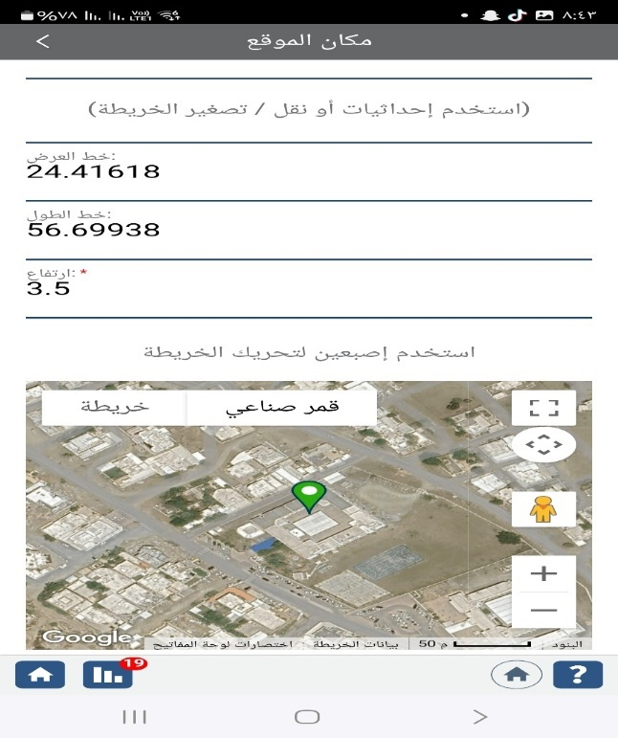
Study Site
The Al-Naqa School Observatory is located in the "Al-Afifa" area of Sohar, a region representing a typical coastal environment where land meets the Sea of Oman. This site was selected as a permanent monitoring center due to its direct exposure to sea breezes that regularly carry Salt Aerosols inland. The Land Cover in the study area is a blend of coastal sandy soil and open agricultural spaces, making it an ideal environment for modeling the impact of salts on plant tissues.
The GLOBE team precisely determined the observatory's coordinates using the Global Positioning System (GPS) to ensure that climatic data is linked to the correct geographical location according to international GLOBE program standards. The importance of this site lies in its confrontation with environmental challenges shared by many coastal areas in the Sultanate of Oman, making the research results practically applicable to support local farmers. The study area within the observatory was divided into precise sub-stations: an atmospheric monitoring station, a soil temperature measurement area, and experimental platforms for the target crops (eggplant and pepper), ensuring the area is free from urban obstacles that might affect wind flow

Slide 6
Research Methodology
The methodology is based on the integration of field observations and precise laboratory measurements. Roles were distributed among the GLOBE team members to ensure research comprehensiveness and the quality of the extracted data:
Protocol Implementation: We applied certified GLOBE protocols for data collection, which included precise daily monitoring of air temperatures (maximum and minimum) and relative humidity using digital instruments.
Soil Data Collection: The (Data Collectors) measured soil temperature at a depth of 5 cm on a daily basis to understand the "thermodynamics" that contribute to the evaporation of salt spray and its fixation onto leaf surfaces upon contact.
Innovative Experiment (Standardized Swabbing): The (Problem Solvers) developed an innovative method to collect deposited salts by designating a precise leaf surface area (50 cm²) for both eggplant and pepper plants. This area is swabbed weekly using medical cotton moistened with 50 ml of Distilled Water (with zero conductivity) to ensure the accuracy of measuring only the suspended salts.
Laboratory Analysis: The (Collaborators) utilized an Electrical Conductivity (EC) Meter to analyze the resulting aqueous swab samples. Data were documented in statistical tables and compared against recorded climatic conditions, while accounting for all potential sources of error, such as dust interference or sudden changes in wind direction that might affect the quantity of salt spray reaching the observatory.

Slide 7
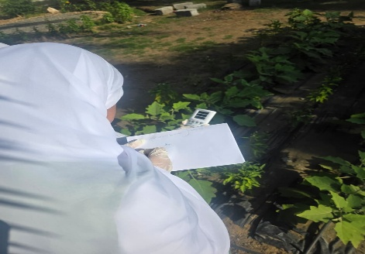
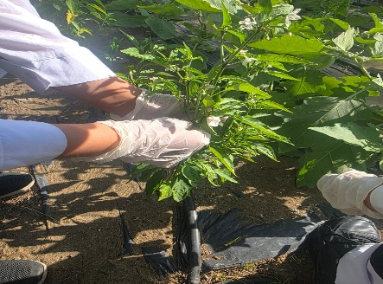
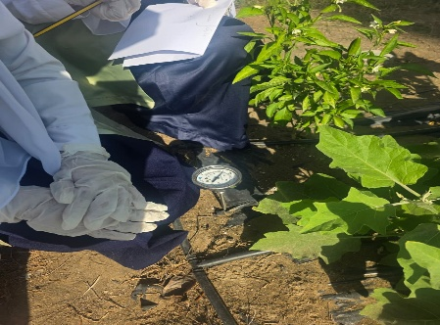
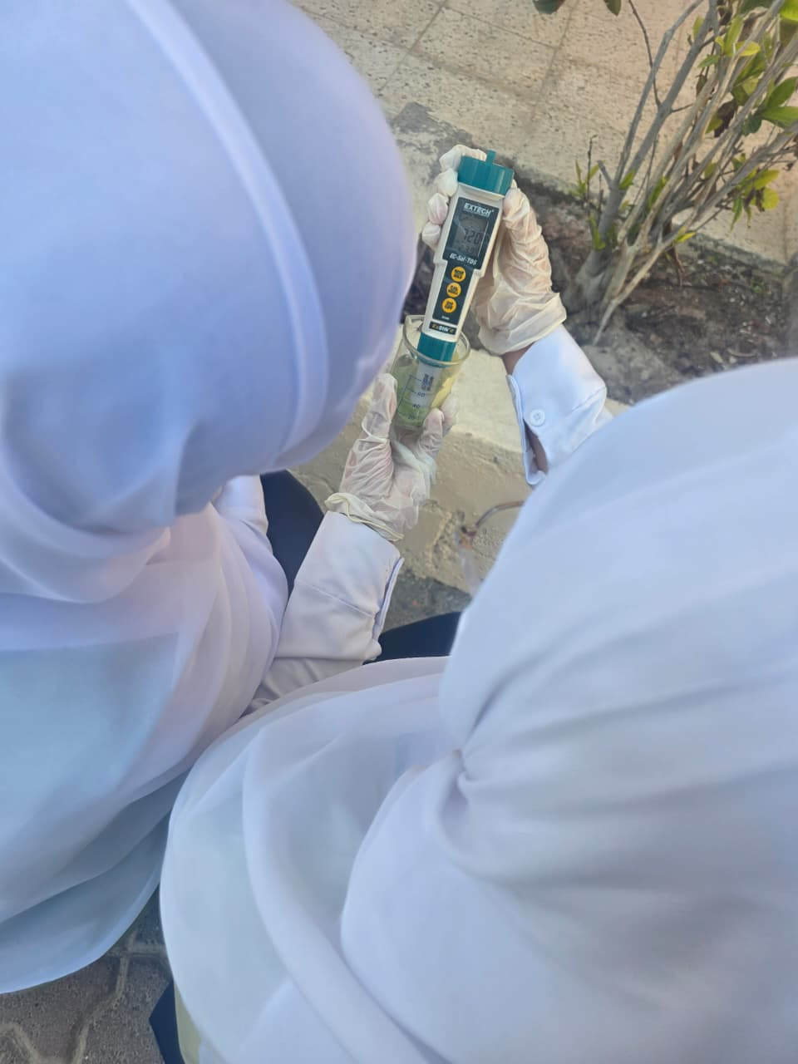
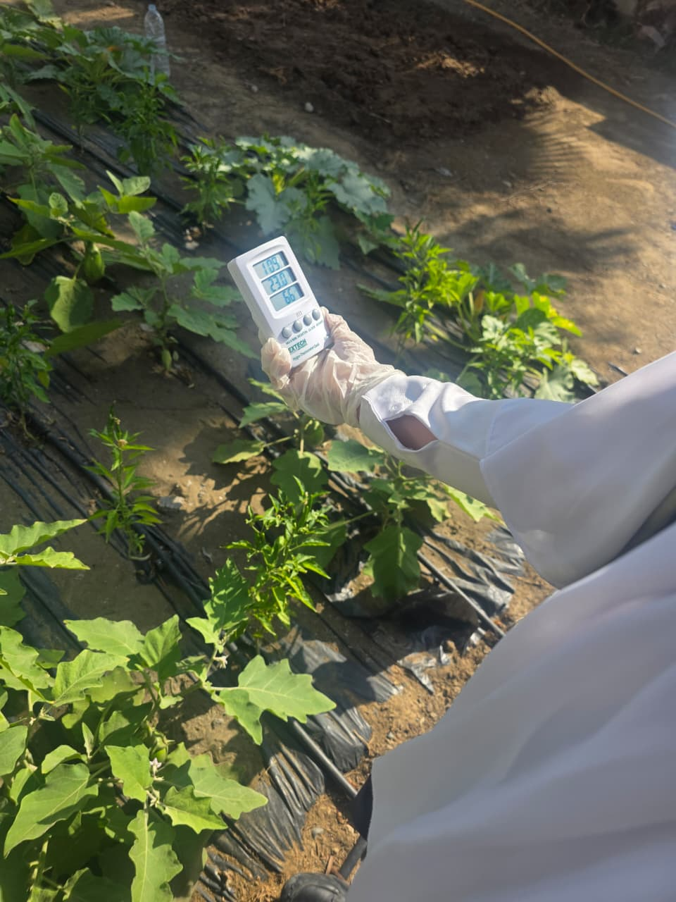

Slide 8
The following tables present the data monitored and analyzed at the Al-Naqa School Observatory, which are available for export and statistical analysis:
Meteorological Data (Al-Naqa School Observatory)
This table serves as the cornerstone of the research, linking the physical environmental conditions at the Al-Naqa School Observatory to the salt deposition process.

Slide 9
Month | Average Air Temp (°C) | Soil Temp (5 cm depth) | Relative Humidity (%) | Wind Speed (km/h)
September | 38.6 | 41.5 | 82% | 14.8
October | 34.7 | 36.9 | 71% | 12.4
November | 29.8 | 31.1 | 61% | 12.0
December | 25.1 | 25.8 | 52% | 11.5
January | 21.8 | 22.1 | 45% | 12.1
Scientific Analysis of Table (2)& Graf (1):
The scientific analysis by the GLOBE team proves that the variance in crop health at the Al-Naqa School Observatory stems from morphological differences in facing the coastal climate. The trichomes (hairs) on eggplant leaves act as mechanical traps, increasing salt retention efficiency by 36.5% compared to pepper. This accumulation, peaking in September (82% humidity), creates a salt crust that hinders photosynthesis and causes "marginal burn" in eggplants due to osmotic pressure imbalance. Conversely, the waxy cuticle of pepper leaves provides a sliding property, reducing salt adhesion and maintaining stable vegetative growth. Thus, leaf surface characteristics are confirmed as the decisive factor in salt stress susceptibility in Al-Afifa, necessitating specialized protective washing strategies for pubescent crops.

Slide 10
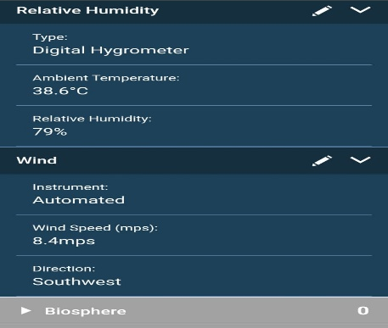
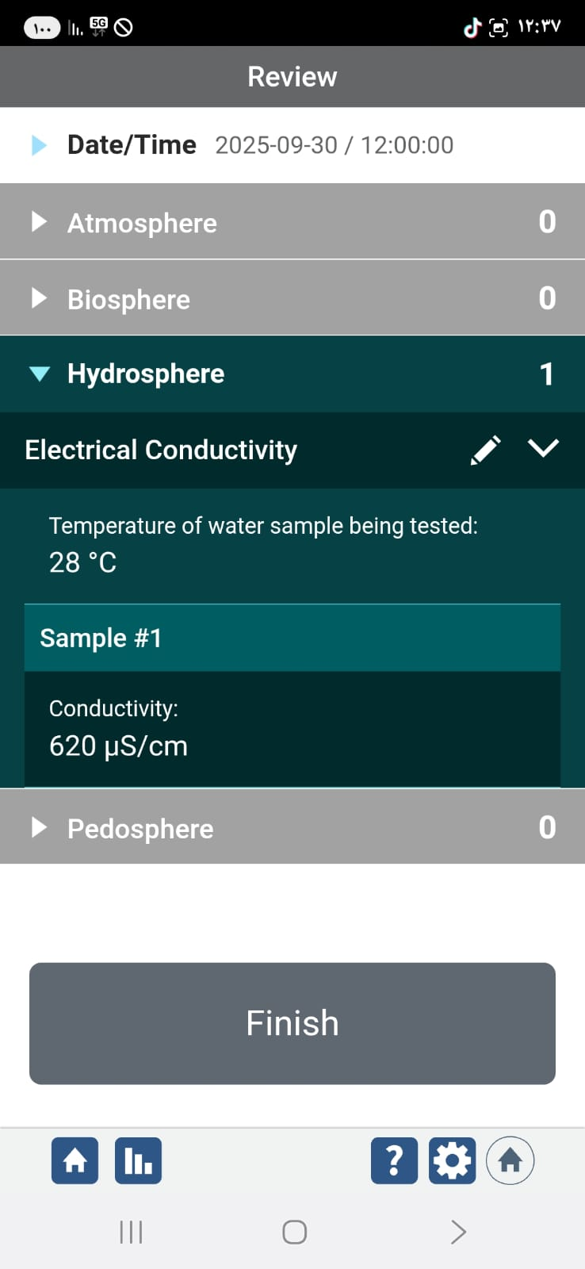
Month (2025-2026) | Eggplant Leaf Salinity (µS/cm) | Pepper Leaf Salinity (µS/cm) | Difference in Trapping Efficiency (%)
September | 620 | 385 | 37.9%
October | 510 | 320 | 37.2%
November | 330 | 215 | 34.8%
December | 215 | 140 | 34.8%
January | 170 | 110 | 35.2%
Annual Average | 369 | 234 | 36.5%
Scientific Analysis of Table (2)
The table demonstrates a clear superiority of the eggplant plant in salt-trapping efficiency compared to the pepper plant. This difference, which peaked at 37.9% in September, proves that the pubescent (hairy) morphological characteristics of eggplant increase the leaf's ability to intercept and retain atmospheric saline

Slide 11
Analysis and Discussion of Results
The scientific analysis conducted at the Al-Naqa School Observatory reveals that the complex interaction between the coastal climate and plant morphology is the primary driver of the observed differences in plant health. The month of September represents the "Saline Peak" due to the convergence of high humidity and elevated soil temperatures—physical conditions that are ideal for the deposition and fixation of atmospheric salt.
Morphologically, the data gathered by the GLOBE team proves that the pubescent hairs on eggplant leaves function as "micron-scale traps." These structures increase the effective surface area and prevent salt crystals from sliding off due to gravity or light winds.
These findings align with the study by Al-Namrawi (2020), which confirmed that surface roughness is the primary factor in determining the trapping efficiency of atmospheric pollutants. In contrast, the waxy cuticle of the pepper plant helped reduce adhesion. Furthermore, the results support the conclusions of Al-Dhamen (2023), stating that saline stress resulting from salt spray causes a disturbance in the osmotic properties within leaf cells. This explains the "marginal burn" phenomenon, which was significantly more pronounced in the eggplant samples. These results have conclusively answered the research questions, confirming that morphological variation is responsible for the differing environmental impacts observed in the Al-Afifa region

Slide 12
Conclusion & Recommendations
The GLOBE team at the Al-Naqa School Observatory has concluded that the morphological diversity of crop leaves leads to a sharp variance in their susceptibility to coastal salt spray. This research provides numerical evidence that eggplant is 36.5% more prone to salt accumulation than pepper, making it significantly more sensitive to the climatic conditions in Al-Afifa.
Practical Recommendations:
For Agricultural Extension: Raise awareness among coastal farmers regarding the necessity of scheduling "leaf washing" with fresh water spray in the early morning, specifically for pubescent-leaved crops like eggplant.
For Agricultural Planning: Utilize dense natural windbreaks to reduce the direct reach of saline aerosols to sensitive crops.
For Scientific Research: Encourage the cultivation of varieties with thick waxy cuticles in seaside farms to minimize vegetative growth loss. The success of this work demonstrates that the integration of the GLOBE team roles—Data Collectors, Problem Solvers, and Collaborators—is the true key to understanding and addressing local environmental challenges.

Slide 13
Summary
This investigative study conducted by the GLOBE team at the Al-Naqa School Observatory in the coastal environment of Al-Afifa aimed to analyze the impact of plant morphology on the retention of atmospheric salt spray. The research compared pubescent eggplant leaves and waxy pepper leaves using GLOBE protocols for Atmosphere, Soil, and Water. Results proved that eggplant leaves retain 36.5% more salt, with Electrical Conductivity (EC) peaking in September at an average of 620 µS/cm.
This variance is attributed to the eggplant's fine hairs (Trichomes), which act as physical traps that prevent spray runoff, thereby accelerating salt crystallization due to high temperatures.
The research concluded that this accumulation reduces photosynthetic efficiency and causes marginal leaf burn, prompting practical recommendations for scheduled preventive washing. The study confirms that selecting appropriate agricultural varieties and timing irrigation are cornerstones for sustainable coastal agriculture in line with Oman Vision 2040. Through this research, the GLOBE team has successfully transformed field observations into a scientific document that supports the local agricultural community in the Wilayat of Sohar.

Slide 14
Closing & Acknowledgments
In concluding this research journey, we emphasize that protecting our agricultural resources in the Sultanate of Oman begins with precise monitoring and a deep understanding of environmental interactions. The GLOBE program has transformed our simple observations of eggplant and pepper into a robust scientific document that serves the sustainability of our environment in Al-Afifa.
We extend our sincere gratitude and appreciation to all who contributed to the success of this research:
Ms. Haifa Al-Kaabi, for training us on GLOBE protocols and providing continuous scientific supervision.
The Administration of Al-Naqa School, for providing the environmental observatory and logistical support.
The International GLOBE Program, for giving us the opportunity to be part of this global scientific community.

Slide 15
References (APA Style)
Al-Dhamen, M. (2023). Coastal Hydro-Chemistry and Plant Health. Dar Al-Ulum.
Al-Fahdawi, R. (2024). Thermal Dynamics in Arid Coastal Zones. Journal of Geographic Studies.
Al-Namrawi, S. (2020). The Effect of Salt Aerosols on Leaf Transmittance. Encyclopedia of Environmental Sciences.
The International GLOBE Program. (2025). Atmosphere, Soil, and Water Protocol Guide. Updated Edition.

