Slide 1
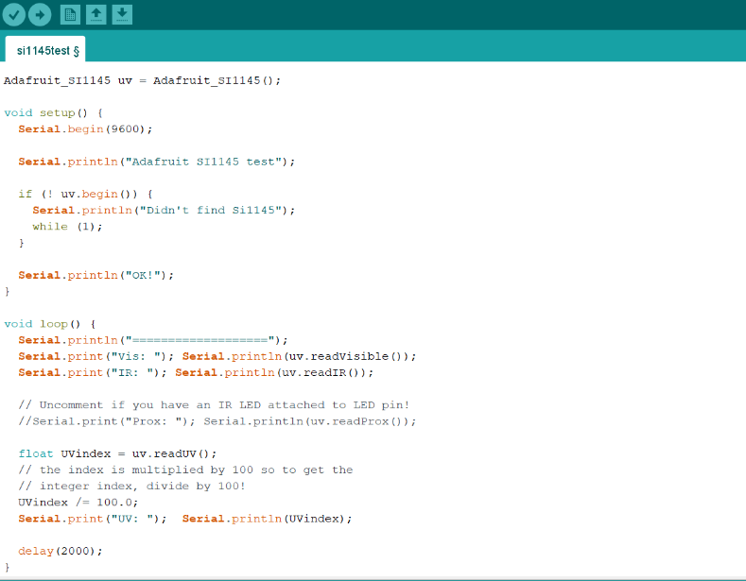
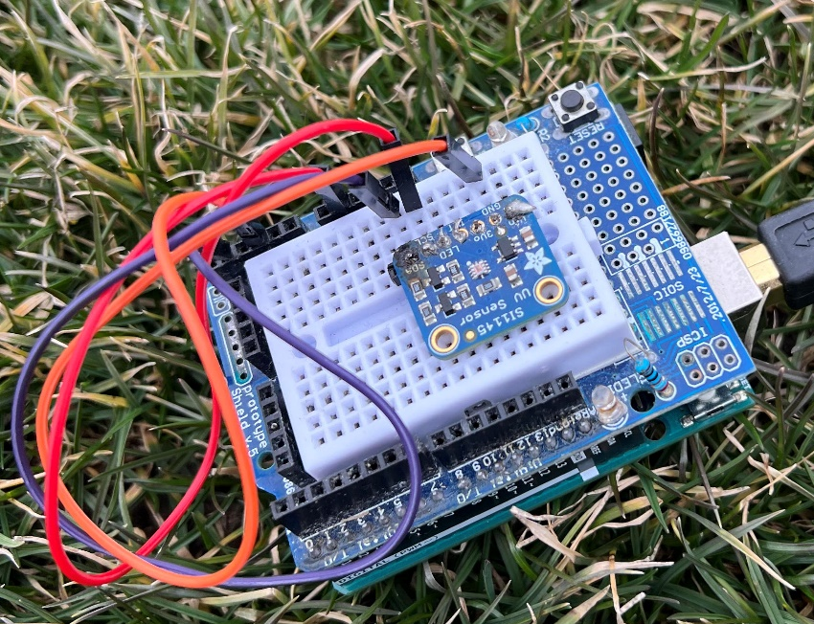
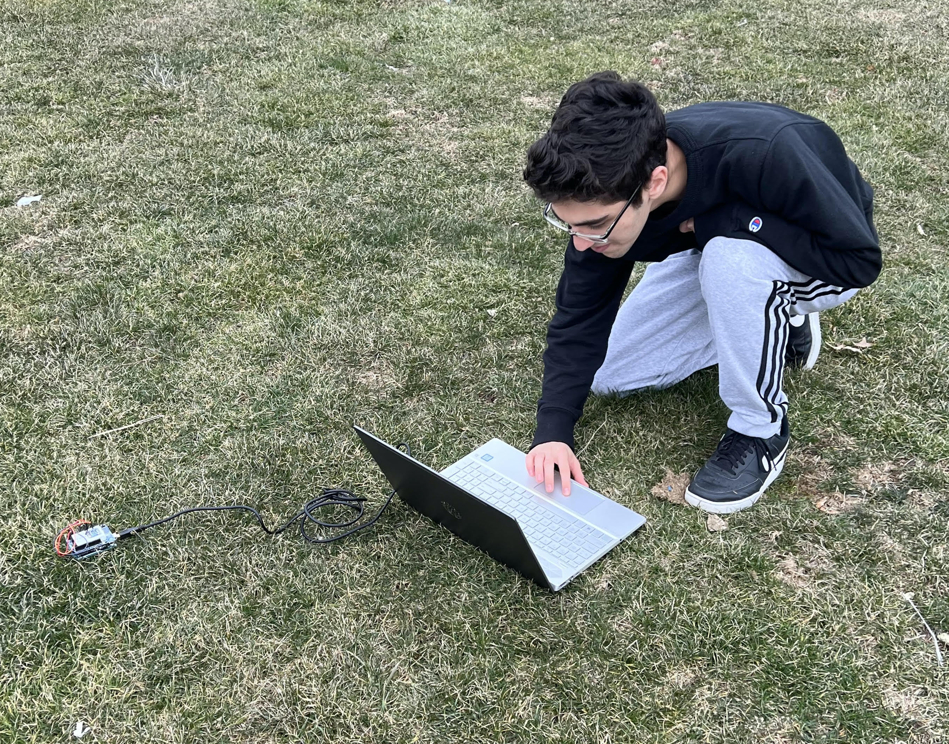
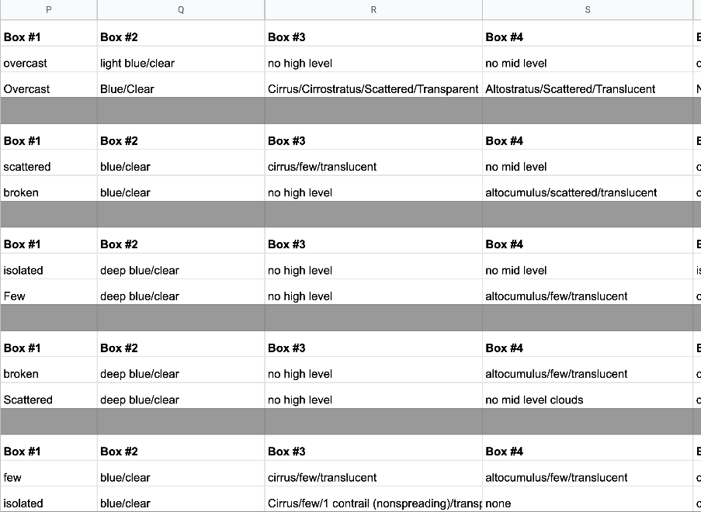
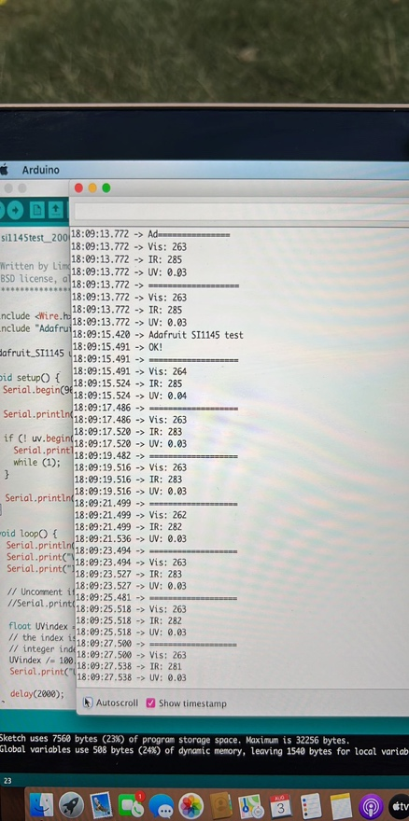
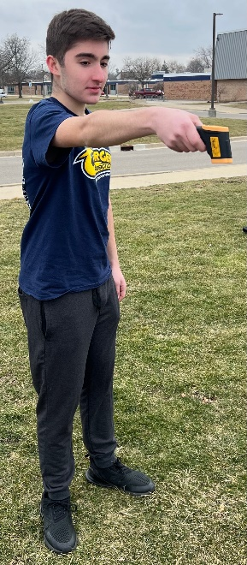
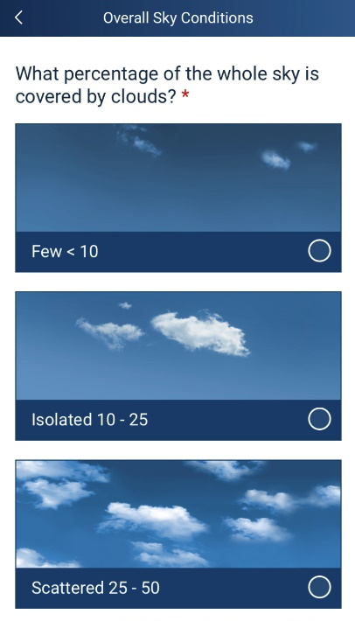
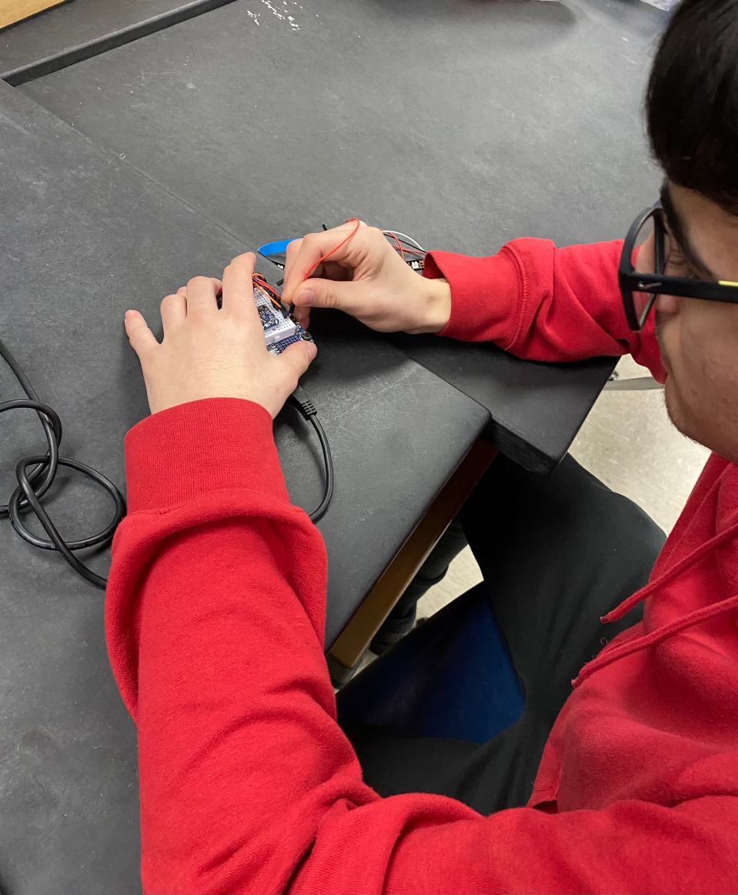
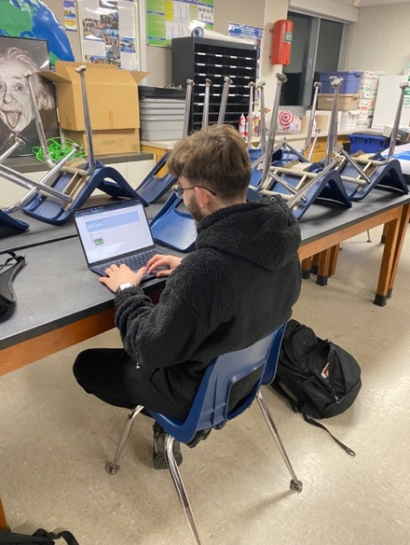
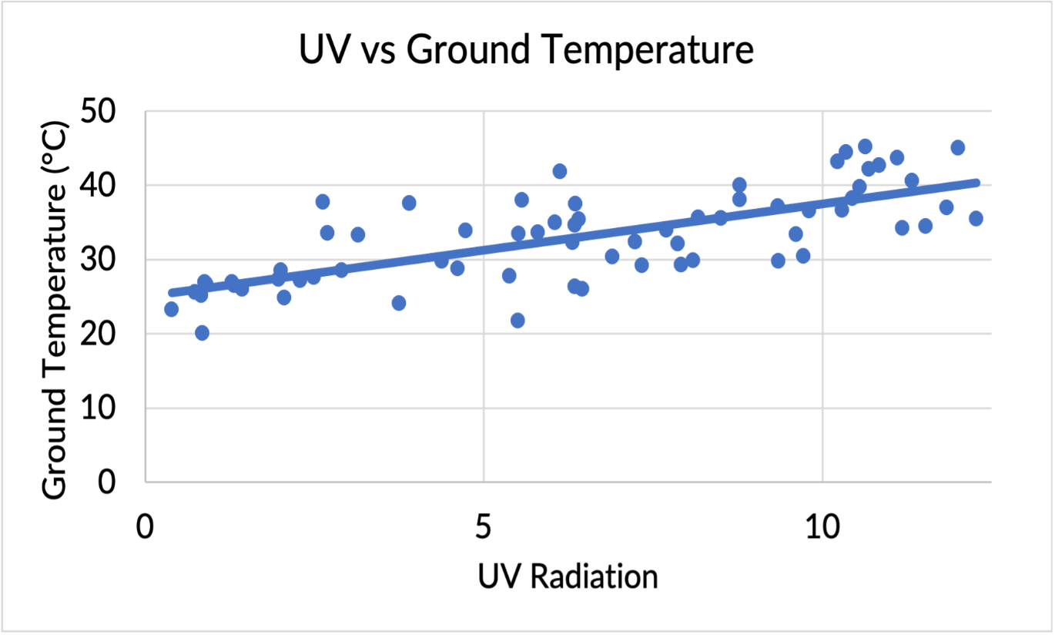
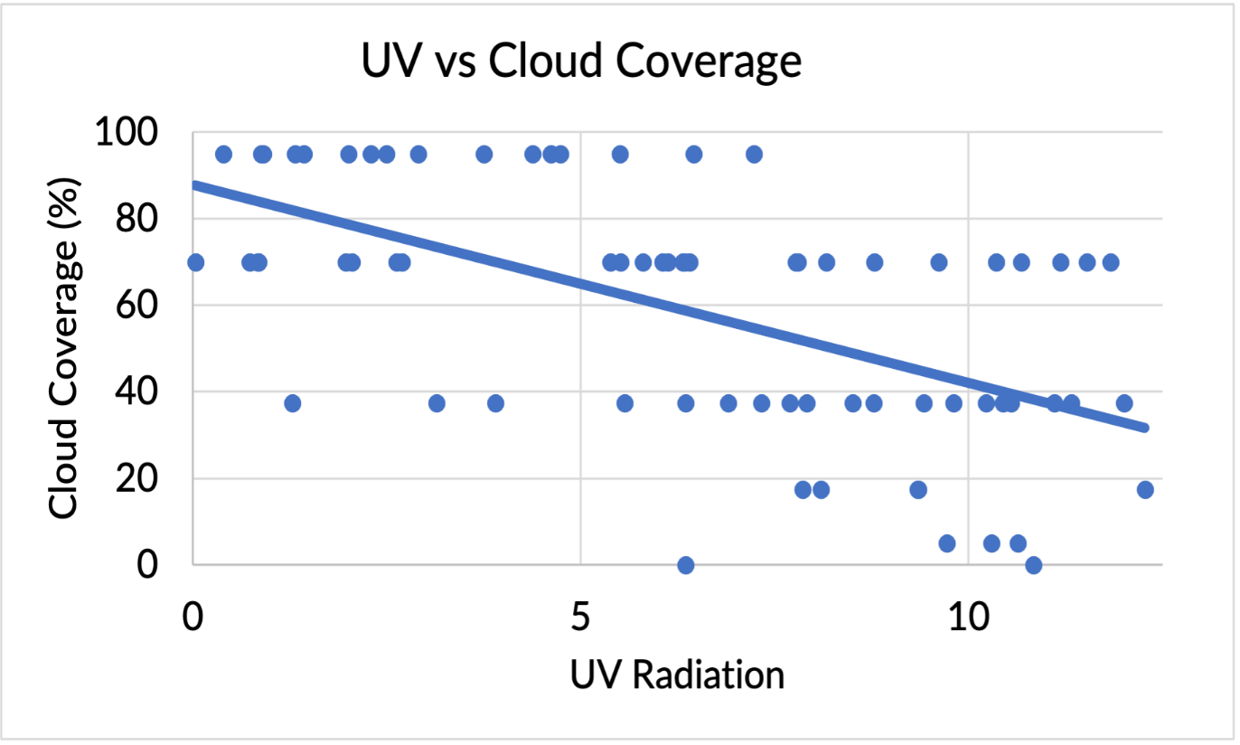
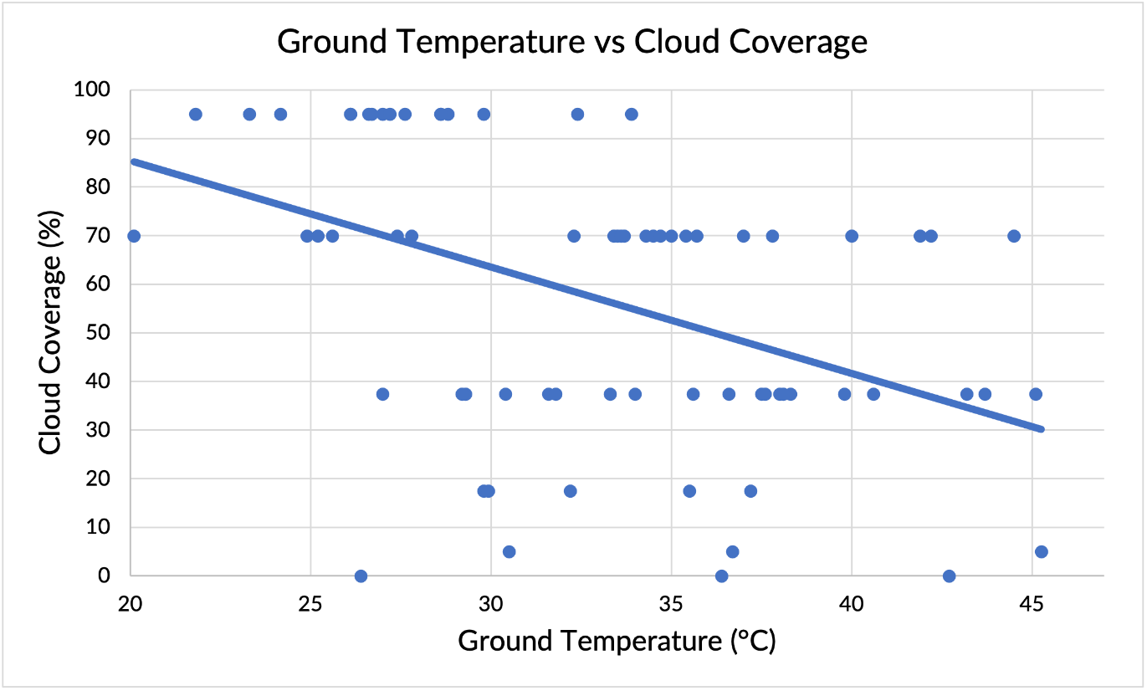
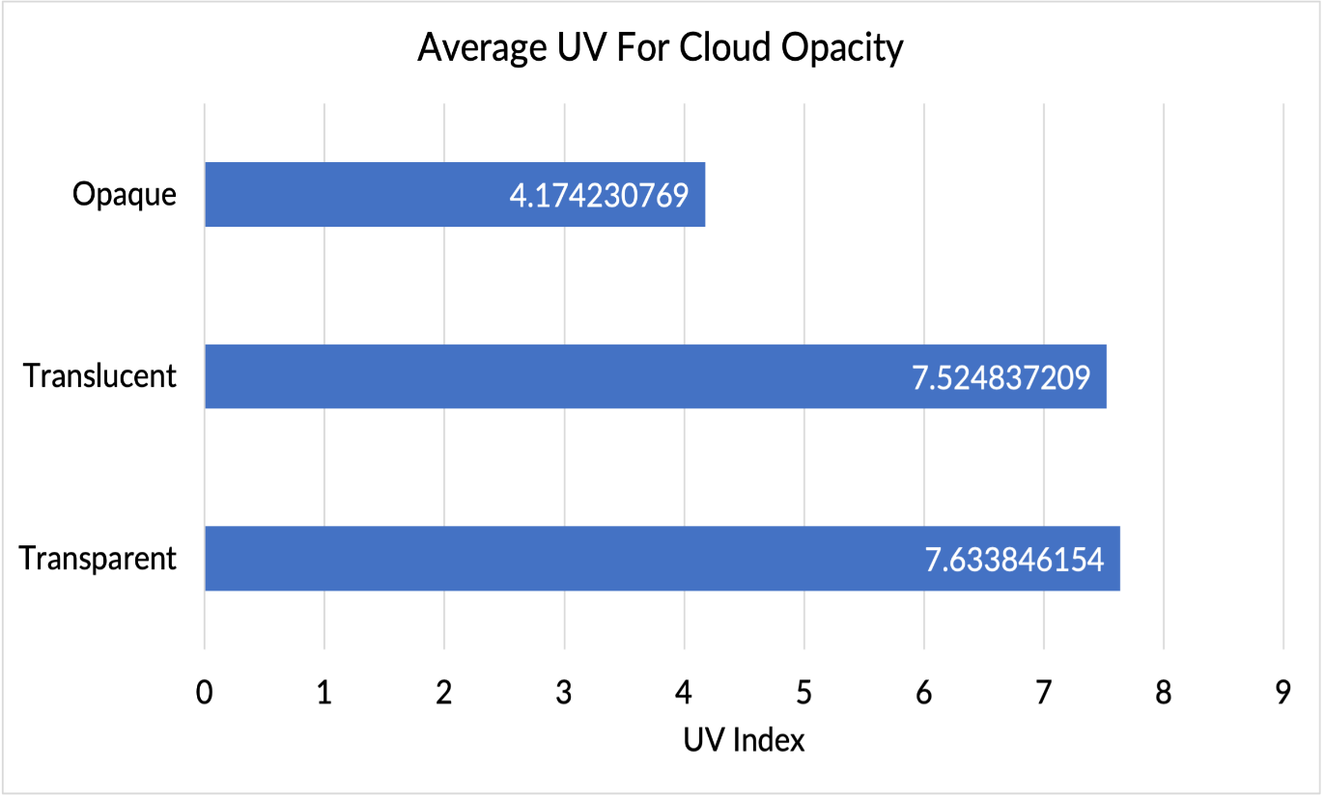
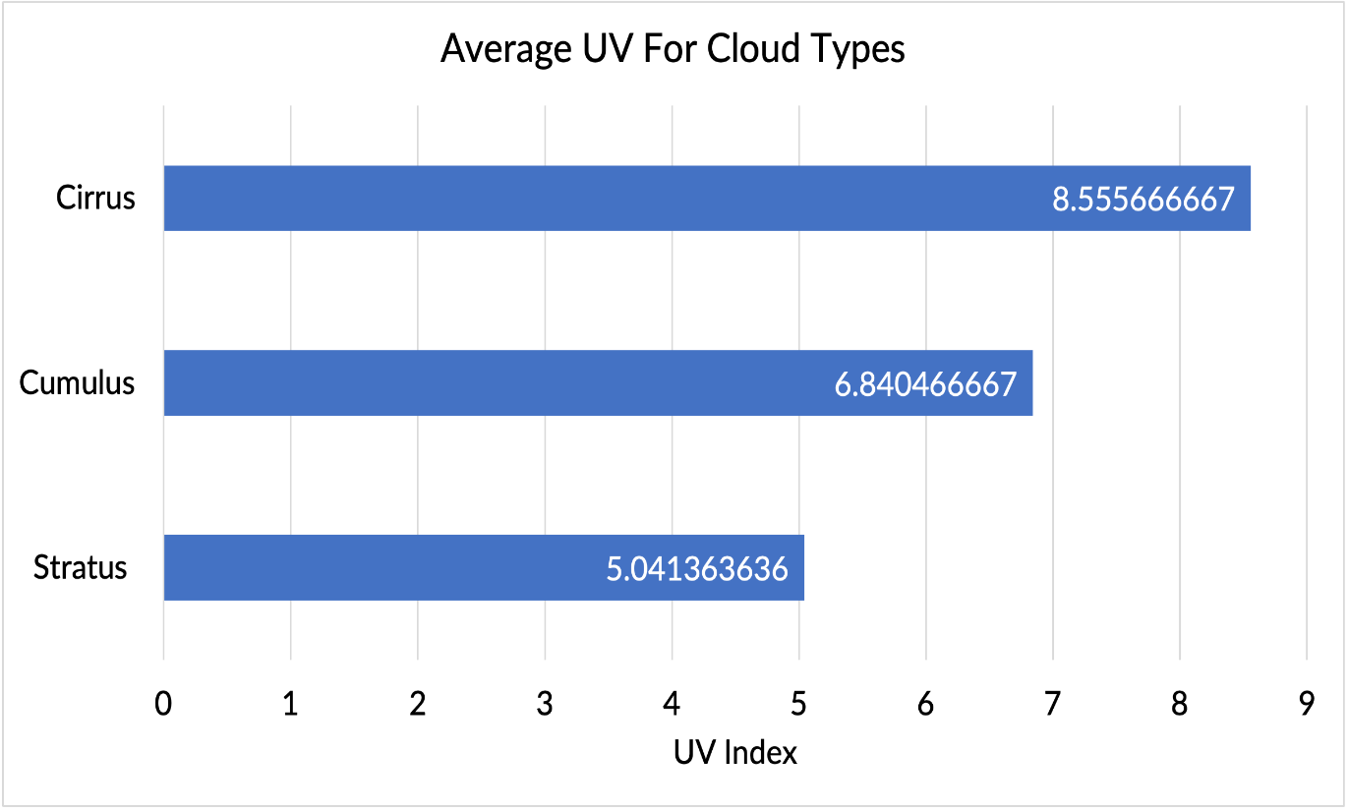
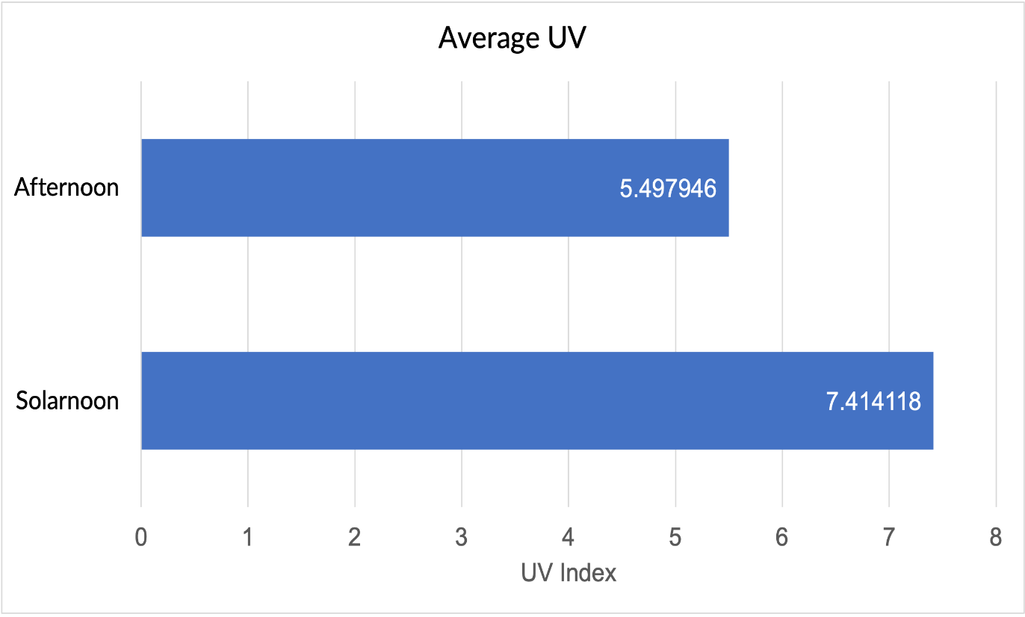
An Analysis of Surface Ultraviolet Radiation Levels in Southeastern Michigan Compared with Select Atmospheric Data
Ali Elakari, Youssef Hamood, Ali Mzannar, Mahdi Nassereddine, Ali Slim
Crestwood High School, Dearborn Heights, MI
Abstract
Methodology
Conclusion
An Arduino Uno Rev3 using a SI1145 UV IR Visible sensor was constructed to collect UV index levels. A commercial grade UV Detector was also used to collect data to compare with the data from the Arduino based sensor. Cloud data was also obtained using the GLOBE Observer App. We followed the clouds protocols within the Observer App and collected numerous types of data including cloud type, coverage, opacity, etc. We also measured surface temperature data using an Etekcity Lasergrip 774 infrared thermometer. All data was collected twice daily on a uniformly grassy area in front of Crestwood High School in Dearborn Heights, Michigan from August through September 2022. This research sought to quantify possible relationships between UV index levels based on cloud coverage and type and other associated atmospheric parameters. We also sought to determine whether there was a correlation between UV index levels and ground temperature. We found clear relationships between cloud coverage and UV levels, cloud type and UV levels, cloud opacity and UV levels, and UV levels and ground temperature. Our data showed that increased cloud coverage and opacity decreased UV levels. Cirrus clouds were found to block the least amount of UV, whereas stratus and cumulus blocked the most. Knowing how atmospheric data can affect UV index levels may help school personnel know how best to assure that students are safely protected when engaging in outdoor activities. In the future, we would like to extend our research to see how sun angle and clouds affect UV levels through changing seasons at mid-latitudes.
From the data we collected, we saw several correlations between the variables. With these correlations we were able to answer our 4 research questions. We found a strong positive correlation between ground temperature and UV index. This shows that with an increase of UV rays there will most likely be an increase of ground temperature. We also found a correlation between cloud coverage and UV index. The correlation found here was a moderate negative correlation, meaning as cloud coverage increased UV radiation would decrease and vice versa. If cloud coverage is high, you would likely have a higher UV. If cloud coverage is low, you would likely have lower UV. We also found a moderate correlation between ground temperature and cloud coverage. This is also another indicator of solar intensity. We were also able to find the average UV for differing cloud types. We found that cirrus cloud types has the highest average UV index levels, cumulus clouds found an average in the middle, and stratus clouds were found to have the lowest average of UV index levels. However, there is a limitation to this. When the averages between cloud types and UV rays were being constructed, certain days may have multiple cloud types, but only one cloud type was considered, which can skew the calculated average.
This data can be used to help predict which days will have a higher UV and what percussions should be taken to avoid the harmful effects of prolonged exposure to UV rays. Since the correlation between UV index and ground temperature is strong, ground temperature can also be used as a determinate for how dangerous it is to go outside. This can help decide whether outdoor activities should take place and what measures should be taken to reduce the risk of damage from UV rays.
Use the UV sensor on the Senior parking lot hill
Arduino code to collect UV Index levels
UV Sensor
Discussion
Ultraviolet radiation levels were found to have relationships with cloud coverage and surface temperature. UV levels were also affected by cloud type, altitude, and opacity. We found that as cloud coverage increases, UV levels decrease. We also discovered that as UV levels increase, ground temperature levels increase. We also found that as cloud coverage increases, the surface temperature decreases. UV levels were also found to be affected by cloud types. Cirrus clouds blocked the least amount of UV, while stratus clouds were found to block the most. Cloud opacity also affected UV levels. Opaque clouds blocked the most UV, while transparent and translucent clouds blocked less. A significant difference in UV blocking power of transparent and translucent clouds was not found. Cloud altitude was also a significant factor in blocking UV. Days with high clouds were found to have the highest UV while days with mid and low-level clouds were found to have the lowest UV. We also found that UV is lowest in the afternoon. This is due to the sun not being directly overhead such as the case with Solar Noon. Clouds could also be more efficient at blocking UV during the afternoon.
A possible source of error in our data is the fact that days with one cloud type such as cumulus could have also had other cloud types present such as cirrus. This was not considered when finding the average UV for days that had a certain type of cloud type present. This possible source of error also exists in the averages for UV of days with different cloud altitudes and cloud opacities.
Data gets collected onto a spreadsheet
UV values get printed on laptop
Use GLOBE Observer app and measure surface temperature
Results
Citations
Calbó, J., Pagès, D., and González, J.-A. (2005), Empirical studies of cloud effects on UV radiation: A review, Rev. Geophys., 43, RG2002, doi: https://doi.org/10.1029/2004RG000155
Pfister, G., McKenzie, R. L., Liley, J. B., Thomas, A., Forgan, B. W., & Long, C. N. (2003). Cloud coverage based on all-sky imaging and its impact on surface solar irradiance. Journal of Applied Meteorology, 42(10), 1421–1434. https://doi.org/10.1175/1520-0450(2003)042<1421:ccboai>2.0.co;2
D’Orazio, J., Scott, T., Amaro-Oritz, A., &amp; Jarrett, S. (2013). International Journal of Molecular Sciences. UV Radiation and the Skin, 14(6).https://doi.org/10.3390/ijms140612222
Godar, D. E. (2007). UV Doses Worldwide. Photochemistry and Photobiology, 81(4), 736–749.https://doi.org/10.1111/j.1751-1097.2005.tb01438.x
DroneBot Workshop. (2018, September 5). Build an Arduino UV index meter. DroneBot Workshop. Retrieved March 9, 2023, from https://dronebotworkshop.com/arduino-uv-index-meter/
DroneBot Workshop. (2018, September 5). Arduino UV Index Meter - Working with Ultraviolet Light [Video]. YouTube. https://www.youtube.com/watch?v=dBljvUBZqI8
Acknowledgements
Throughout our project we worked with our former AP Environmental Science teacher and our GLOBE/science club advisor Diana Johns. Mrs. Johns helped train us in identifying cloud types and opacity. She also advised us while we wrote our research paper. This improved the quality of our research and conclusions. We’d also like to thank the GLOBE Mission Earth staff at the University of Toledo for providing both equipment and providing other resources. The GLOBE AREN Project also was instrumental in supporting us with essential materials needed to support our research.

