Slide 1
EARTH AS A SYSTEM: A CASE STUDY OF IZOMBE PETROLEUM GAS FLARING IN IMO STATE.
A
RESEARCH WORK DONE
BY THE
GLOBE TEAM (STUDENTS)
OF
CHOSEN INTERNATIONAL SECONDARY SCHOOL
MGBIDI
ORU WEST IN IMO STATE NIGERIA.
SUPERVISED AND EDITED BY THEIR GLOBE TEACHER,
AKAWUAKU, EMMANUEL O. (M.Sc)

Slide 2
ABSTRACT
Earth is a dynamic system comprising the biosphere, hydrosphere, atmosphere and the lithosphere. These parts are interrelated, interdependent or interacting and any change in one affects the rest of them.
At Izombe Imo State of Nigeria gas is flared to the atmosphere from a petroleum gas flow station, which alters adversely all the spheres of the environment. Indicating that the earth is a system (any injury in one sphere is injury to all).
From the research done by Nwagbara, M. O . & Onwudiwe, H. T (2020), Gas flaring in Izombe introduced pollutants like CO(Carbon monoxide), H2S(Hydrogen Sulphide), SO2(Sulphur Dioxide), NO2(Nitrogen Dioxide), VOCs(Volatile Organic Compounds), SPM(Suspended Particulate Matter) in the atmosphere in the quantity above acceptable limits. And through processes and cycles, which, over time, intermittently store, transform and/or transfer matter and energy throughout the whole Earth system in ways that are governed by the laws of conservation of matter and energy, these pollutants manifest adversely (directly and indirectly) on the other subsystems in Izombe by causing; acid rain, infrastructural decay, pollution of the water system, death of fishes, land pollution, malfunctioning and death of plants, health challenges and death of animals (including humans) in the area. Research also done by Ezeigbo, O.R, et al (2013) also determined the extent of land pollution caused by the flare. The report showed that the flare increased the acidity, temperature and hydrocarbon content of the land, decrease in moisture content, organic matter, and Total Viable Microbial Counts of Soil Samples of the Study Area. From the stated reports, it could be determined the cause of infertility and morbidity of plants and other environmental problems in the study area.
The protocol used is earth as a system. The research proved that earth is a system by showing that change in the atmosphere also caused changes in other subsystems.

Slide 3
INTRODUCTION
Earth is a dynamic and integrated system (GLOBE ). And a system is a complex whole, with smaller connected subsystems working together. It is a combination of interrelated, interdependent or interacting subsystems forming a collective whole or entity.
These subsystems are interconnected by processes and cycles, which, over time, intermittently store, transform and/or transfer matter and energy throughout the whole Earth system in ways that are governed by the laws of conservation of matter and energy.
Changes in one part of a subsystem can cause effects in other parts of the subsystem and/or the other subsystems like the case of Petroleum Gas flaring into the atmosphere of Izombe that have adversely altered the state of the biosphere, lithosphere and hydrosphere of the ecosystem.

Slide 4
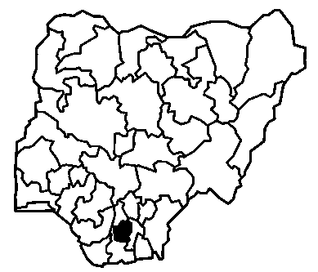
LOCATION
The research was conducted within Izombe, which is situated in Oguta local government area of Imo State, Nigeria. Its geographical co-ordinates are 5°52’00” North, 6° 52’0’’ East.
Fig. 1

Slide 5
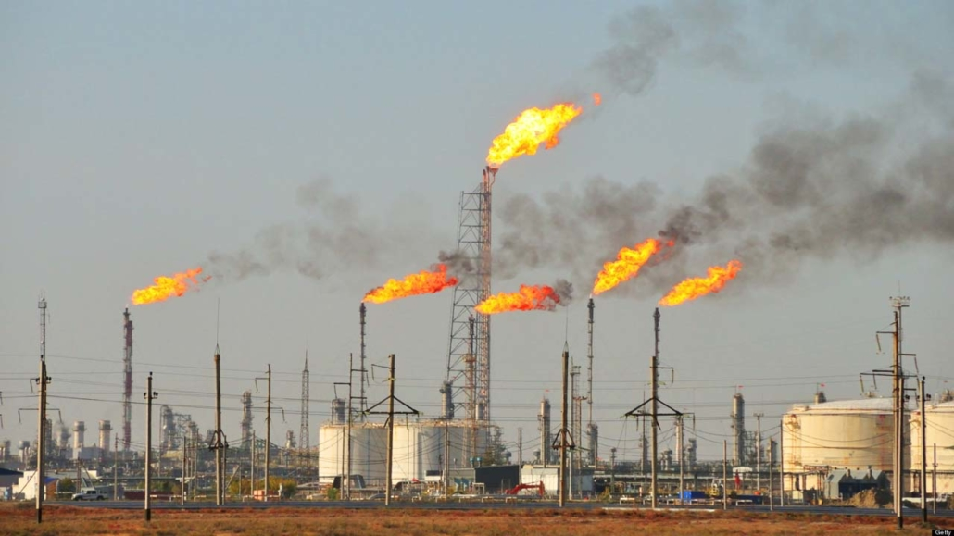
RESEARCH PROBLEM
There has been a phenomenal damage to the quality of air, water, soil and plants in Izombe community in Oguta Local Government Area of Imo state, due to high level of petroleum gas flaring emission into the atmosphere from two flare sites.
Plate: 1

Slide 6
RESEARCH QUESTIONS
Which of the subsystems in Izombe ecosystem was the gas flared to?
Does the gas flaring affect the state of other subsystems of the Environment?
Is there any connection between the subsystems as integral part of the earth to proof that Earth is a system?

Slide 7
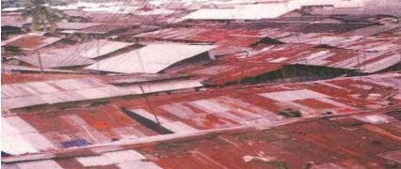
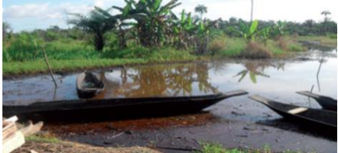
MATERIALS AND METHOD
Plate 2: CORRODED BUILDING ROOF WITH ACID RAIN IN THE STUDY AREA
Plate 3 : POLLUTED FISHING LAKE IN THE STUDY AREA

Slide 8
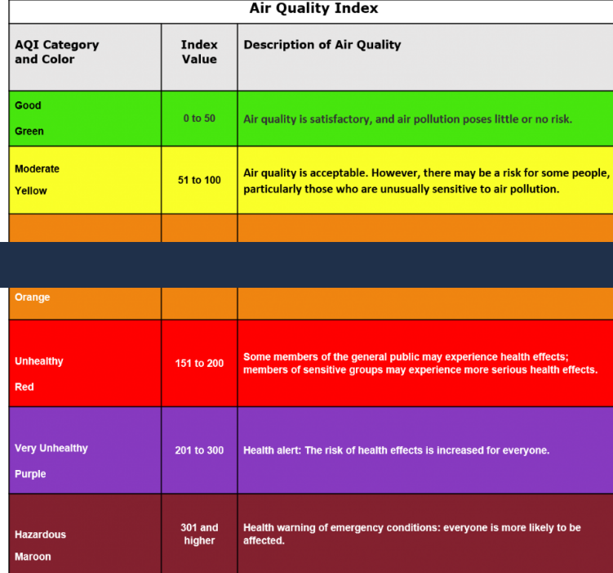
GLOBE Air quality index.
Chart: 1

Slide 9
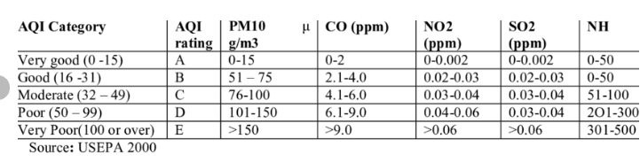
Table: 1

Slide 10
Table: 2- The air quality assessment of the study area.
Distance from flare site (m) | CO (ppm) | H2S (ppm) | SO2 (ppm) | NO2 (ppm) | VOCS (ppm) | SPM (ppm)
100 | 5.29 | 2.32 | 3.49 | 1.39 | 3.00 | 10.71
200 | 3.17 | 1.21 | 2.33 | 1.04 | 2.19 | 8.51
300 | 2.68 | 0.43 | 1.27 | 0.92 | 1.22 | 4.69
K | 0.63 | 0.01 | 0.59 | 0.03 | 0.00 | 2.17

Slide 11
Table: 3- Physical Properties of Soil Samples
Distance from the Flare (m) + | pH | Temperature (oC) | Moisture Content (%) | Organic matter (%) | Hydrocarbon Content (%)
10 | 4.0 | 48.0 | 16.84 | 5.32 | 4.8
50 | 4.3 | 45.0 | 22.66 | 5.84 | 2.2
100 | 5.2 | 42.4 | 29.32 | 6.12 | 1.4
Control | 6.8 | 32.0 | 43.50 | 8.62 | 0.2

Slide 12
DATA SUMMARY
Chart: 2

Slide 13
Chart: 3

Slide 14
SUMMARY AND CONCLUSION
The Earth is a dynamic and interconnected ecosystem with numerous processes that both influence and depend on one another . Gas flare in Izombe introduced toxic gases like SO₂, NO₂, VOCs etc into atmosphere at level when compared to GLOBE Air quality index are very unhealthy with associated risk of health effect to everyone (biosphere). Through natural dynamics and processes like rain etc, these gases adversely affects the quality of biosphere,pedosphere and hydrosphere of the ecosystem by altering their basic properties to be unfit to sustain healthy life.
However, gas flaring in atmosphere caused changes in biosphere, hydrosphere and pedosphere of Izombe ecosystem which is integral part of the earth, showing that earth is a system. What affects one affects all.

