Slide 2
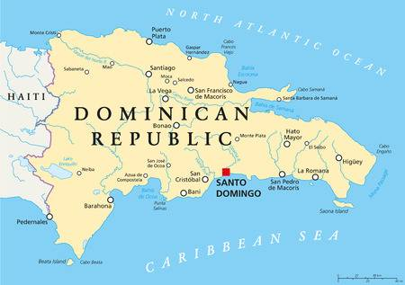
INTRODUCTION
Dengue is one of the most common mosquito-borne diseases that affect humans. These mosquitoes thrive in areas with standing water, including puddles, water tanks, containers, and old tires.
In the Dominican Republic, most of the inhabitants think that mosquitoes can only breed in clean water. Apart from the fact that Dominicans don’t know that it can also breed in dirty water, many inhabitants are not aware that there are some measures to avoid having mosquitoes reproducing near them.

Slide 3
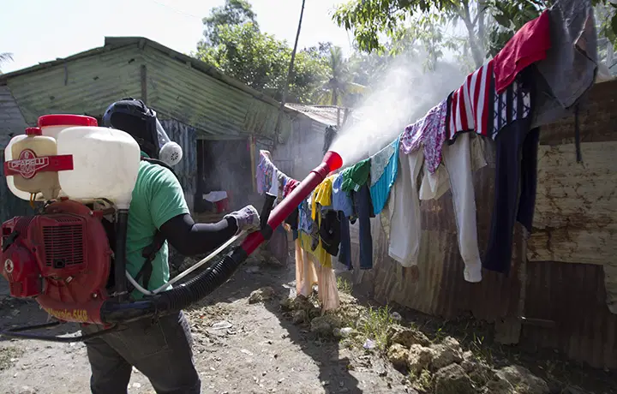
RESEARCH QUESTION
This experiment is of great importance to the research team because of all the communities in the Dominican Republic that need to store water in containers to be able to survive. Currently the only viable method for minimizing dengue incidence is vector control.
The spread of this virus is putting thousands of Dominicans at risk of infection with one or more of the four types of dengue. The team believes that this project will guide us to learn more about the virus and that it will also help to prevent more cases of dengue in Dominican households.

Slide 4
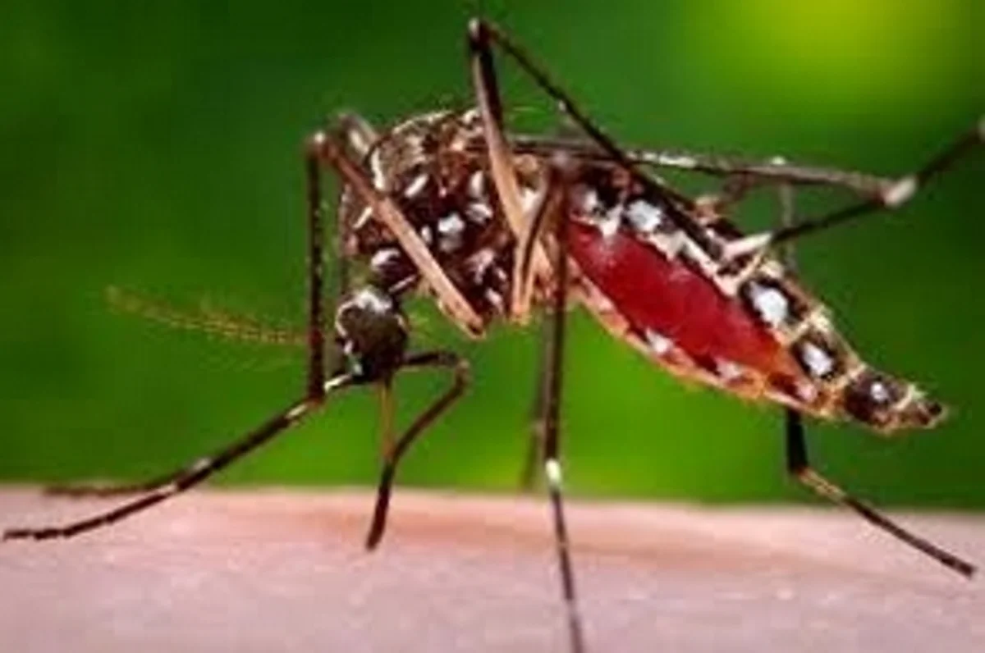
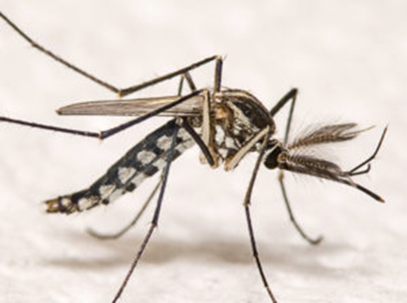
HYPOTHESIS
The researchers believe that the mosquitoes will be able to breed in dirty water too, which means that mosquitoes will have the same possibilities to reproduce in stagnant dirty water as they have in stagnant clean water.
VARIABLES
Independent Variable:
Dirty and clean standing water.
Dependent Variable:
Number of dengue cases.

Slide 5
MATERIALS PROCEDURE
The materials used to conduct the experiment were:
Phone
Tablet
Computer
Google Forms
For the experiment, the first step was the creation of a survey, which will aim to indicate to the research group sex, age, and municipality within Santo Domingo. In addition, the team asked the surveyed if they have had dengue, how long has it been since they last had it, and how many times has it affected them. Finally, the researchers asked how close they live to rivers or places where dirty and clean water accumulates and how often they clean the containers that are standing water at home.

Slide 6
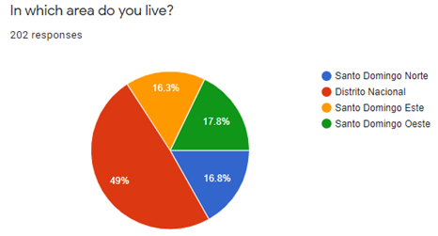
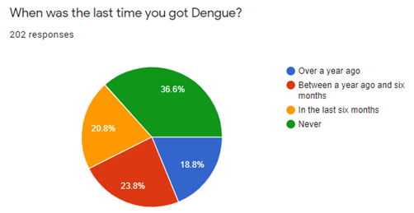
RESULTS

Slide 7
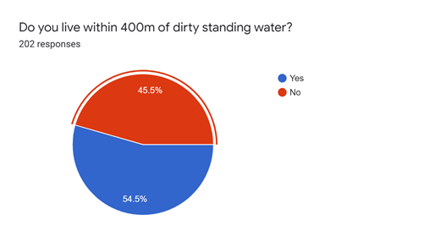
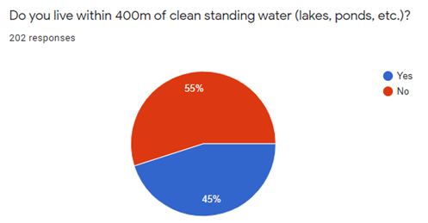
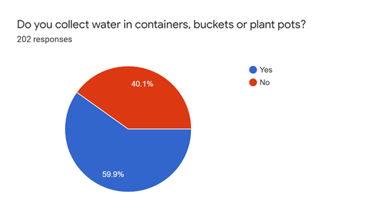
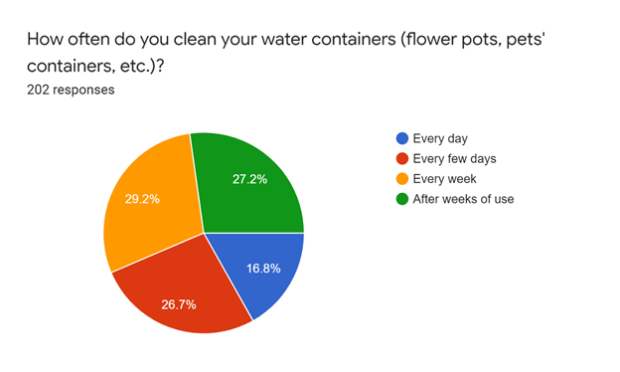

Slide 8
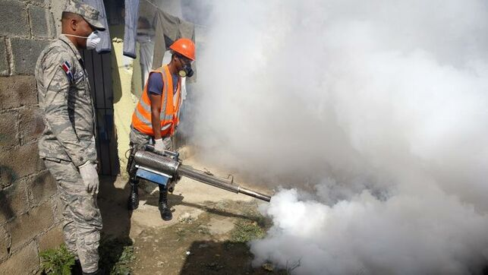
DISCUSSION
The results support the hypothesis. The researchers were able to decipher that in the survey the majority of people who lived near stagnant dirty water had dengue cases. This is how the team ended the survey, concluding that mosquitoes have the ability to reproduce in dirty standing water as well as in clean standing water. As a result, of the 202 people surveyed, 63% had dengue and lived near dirty standing water, while 36% had no dengue and lived near ponds with clean water.

Slide 9
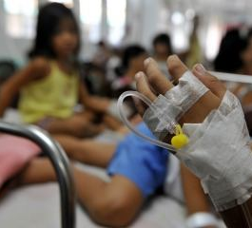
FUTURE RESEARCH
For future research, the team would like to investigate variables, like climate and vegetation. Also, survey people that live in places with poor sanitation and infrastructure. The majority of Dominicans live in such poor conditions that most of the time they don’t have access to potable water which leads them to store it in containers.

Slide 10
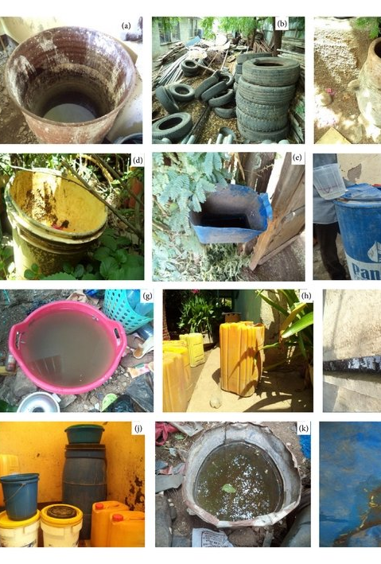
CONCLUSION
The research team proved the ability of mosquitoes to reproduce in dirty standing water, as well as in clean standing water. The researchers settled this by sending out surveys to people living in the different municipalities of Santo Domingo and asking them questions related to their proximity to water and seeing how this affected the percentage of dengue cases. From the 202 surveyed, 54.5% lived near dirty standing water and 63.4% have had cases of dengue.
As there is still no vaccine to prevent the infection of this disease, it has become a global importance to inform preventive measures to stop people from getting infected.

Slide 11
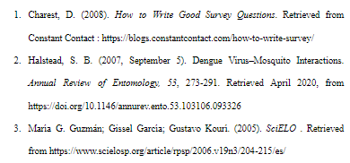
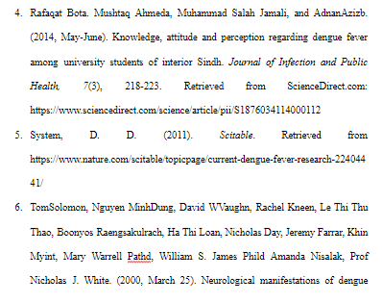
REFERENCE LIST

