Slide 1
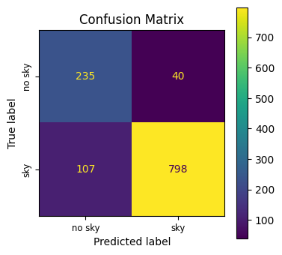
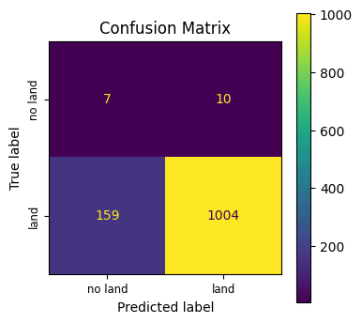
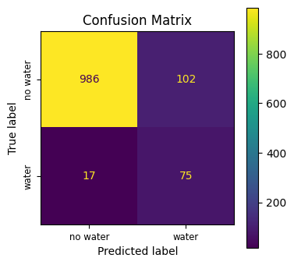
Uniting Machine Learning and Citizen Science for Automatic Land Cover Classification
Roayba Adhi, Oseremen Ojiefoh, Riya Tyagi, Haitham Ahmad, Lavanya Gnanakumar, Kavya Ram
Mentors: Dr. Russanne Low, Peder Nelson, Cassie Soeffing, Dr. Erika Podest, Andrew Clark, and Aswin Surya
Abstract
Methodology
Results
Conclusion
To complement satellite land cover data, researchers today rely on citizen science to record and analyze ground photos of land cover because of its ability to efficiently facilitate research, quickly gather data across a variety of regions, and ethically engage communities in pertinent matters on a large scale. The GLOBE Observer App, part of The GLOBE Program, is a citizen science tool used to document the planet. The process is simple, to make a land cover observation, a user takes six directional photos and classifies the estimated percentage of various land cover features present in each photo. Our surveys have found that user subjectivity and limited knowledge of land cover terminology, paired with the time-consuming nature of classification, caused 46% of survey-takers to often or always skip the step of classifying altogether, substantially decreasing data usability for scientists. In this study, we contributed to developing a geographically diverse dataset of 5,896 directional land cover photos, which were then uploaded to the GLOBE database. Using Zooniverse, a citizen science annotation tool, we collected labels determining whether three classes—sky, land, or water—were present in each land cover photo. Three Resnet-18 machine learning models were then trained to classify sky, land, and water in each photo, treating Zooniverse labels as ground truth. The sky, land, and water models received an accuracy of 94%, 92%, and 95%, respectively. We then used the trained models to predict which regions of an image contained sky, land, and water—allowing us to determine the percentages of the three classes with 85% accuracy. Our model pipeline can assist untrained volunteers with future image classifications, resulting in a higher quality dataset for scientists.
Dataset
The dataset used for this project consisted of the GLOBE SEES2023 team’s 1,477 Land Cover observations, compiled from over a dozen states and across three continents. Observations were taken from the team’s 46 Areas of Interest (AOIs), which are 3 km x 3 km regions of land that are composed of 37 individual locations, each of which cover 100 m x 100 m of land. In each of the 37 locations, members took North, East, South, and West (NESW) photos as part of their GLOBE Observer observations. Across the AOIs, 5,896 NESW photos were obtained by extracting all of the land cover observation data for SEES2023 in the GLOBE API, using Python scripts to organize the relevant image data and extract each image’s links, and downloading the useable images onto a Google Drive folder.
Analysis: Citizen Science
To investigate the research question about the use of citizen scientists to process data, a workflow was created on Zooniverse to allow volunteers to indicate whether the following three land cover classes: sky, land, and water, were present in an image subject. Users were shown one subject at a time with the ability to multi-select features as seen fit. With the use of 11 volunteers, across the span of five hours, all 5,896 subjects were classified. An algorithm was written to filter out duplicate classifications that appeared due to a bug in the Zooniverse software. Following this, another algorithm was written to organize the images based on the classifications assigned in Zooniverse. Binary classifications were then assigned to describe the presence or lack of each land cover class in the images. Finally, these classifications were used to train three Convolutional Neural Networks (CNNs) to detect the presence of sky, land, and/or water in an image.
Analysis: Machine Learning
To address the question of the effectiveness of a machine learning model in classifying land cover, three ResNet-18 binary classifiers were trained to identify the presence of sky, land, or water. Custom class weight was used to implement weight sampling and was incorporated into model loss computation to combat class imbalances. To obtain the percentage area of sky, land, or water in a photo, the image was first split into a grid of 64 squares. The three CNNs were then deployed to predict whether or not each feature category was present in each grid square. Afterwards, the area populated by each feature was calculated to derive the percentages of the land cover classes in the whole image.
Sky Detection Model
The sky detection model performed with an overall accuracy of 92%. Both the Area Under the Receiver Operator Characteristics (AUROC) and Area Under Precision Recall Curve (AUPRC) also provided high metrics, likely because of the abundance of images including sky in our dataset. (See Figure 3 for Confusion Matrix).
Land Detection Model
The land detection model provided a lower AUROC accuracy rating of 66% in comparison to the sky model. However, the AUPRC rating was approximately 99%, thus resulting in an average accuracy of 94%. This model could still be of significant use in fieldwork investigations and observational use, as many images in the dataset did not include land. (See Figure 4 for Confusion Matrix).
Water Detection Model
The water detection model displayed an AUROC of 95% and an AUPRC of 73%. This indicates a plus imbalance in the positive class. Despite this low AUPRC, the model maintained a 0.80 true positive rate (TPR), suggesting its ability to identify water in most images despite the lack of images that contained water in the dataset. (See Figure 5 for Confusion Matrix).
A citizen science approach to training a machine learning model is explored and proven to be effective in this study. Our research also explores a possible approach to developing a ‘feature suggestion model’ to aid citizens. Nonetheless, a model that can assess whether or not sky, land, or water is present in a ground photo of land cover can provide several benefits. While previous research has focused on developing a model to aggregate labels across several GLOBE Observer Land Cover directional images (Manzanarez et al., 2022), ours can specifically identify whether or not certain feature categories are contained in an image. The simpler output of this model targets untrained volunteers. Additionally, the research methods that were explored during our research demonstrated a quick and inexpensive way to gather and label large amounts of data. By allowing volunteers to gather data in their communities and label this data online, citizens are provided the benefits of engaging in meaningful scientific research.
Future Work
In the future, we plan to improve our model to more accurately predict the presence of sky, water, and land categories in GLOBE Observer images. Additionally, the model will be expanded to be able to detect and classify the presence of all of the land cover categories in the seven classes recognized in GLOBE Observer Land Cover tool for more specific feature identification. This model will also output the percentages that each feature composes in the image (sky cover for trees and ground cover for the other features). To combat data imbalances, we will adopt more consistent labeling practices and implement more comprehensive data augmentation practices. The updated model will be implemented on a mobile platform for ease of accessibility—a companion app to GLOBE Observer.
Figure 2 - Example of AOI Grid
Background
Figure 3 ~ Confusion Matrix for Sky Detection Model
The GLOBE Observer App is a mobile application designed to facilitate citizen science to aid researchers in mass data collection. The app offers an observation tool called Land Cover: Adopt a Pixel in which users take land cover observations of areas the size of a soccer field. To make an observation, users being by logging their location and surrounding atmospheric conditions. They then take six directional photos – North, East, South, West, Up, and Down – in their location area. Following this stage, users have the option of classifying their images by selecting the land cover features present and the respective percentage of image area they take up. This stage of the observation process was the primary focus of our project, namely due to the difficulties it provides for citizen scientists. Finally, users are able to upload their data and classifications to the GLOBE database, where it can be accessed by anyone.
References
GLOBE API - GLOBE.gov. (n.d.). https://www.globe.gov/ru/globe-data/globe-api
GLOBE.gov REST API Service. (n.d.). https://api.globe.gov/search/swagger-ui.html
Google Colab. (n.d.). https://research.google.com/colaboratory/faq.html
Manzanarez, S., Manian, V., & Santos, M. (2022). Land Use Land Cover Labeling of GLOBE Images Using a Deep Learning Fusion Model. Sensors, 22(18), 6895. https://doi.org/10.3390/s22186895
“SEES2022 - Create Sampling Grid.” Nesec.strategies.org, https://nesec.strategies.org/SEES2022_CreateSamplingGrid.html
The GLOBE Program. (n.d.). Get the App - GLOBE Observer. https://observer.globe.gov/about/get-the-app
Zooniverse. (n.d.). https://www.zooniverse.org/projects/mountainrobot03/analyze-ground-observed-land-cover-photos
Figure 4 ~ Confusion Matrix for Land Detection Model
Acknowledgements
These data were obtained from NASA and the GLOBE Program and are freely available for use in research, publications and commercial applications. The authors would like to acknowledge the support of Dr. Russanne Low, Cassie Soeffing, Peder Nelson, Dr. Erika Podest, Andrew Clark, and Aswin Surya for the completion of this project. The authors would also like to acknowledge the aid of the 2022 Earth System Explorers Team, NASA STEM Enhancement in the Earth Sciences (SEES) Virtual High School Internship program. The NASA Earth Science Education Collaborative leads Earth System Explorers through an award to the Institute for Global Environmental Strategies, Arlington, VA (NASA Award NNX6AE28A). The opinions, findings, conclusions, or recommendations expressed in this poster are those of the authors and do not necessarily reflect the views of NASA.
Figure 5 ~ Confusion Matrix for Water Detection Model
Figure 1 ~ GLOBE Observer Classification Diagram

