Slide 1
Soil Rehabilitation Using Biochar from Nut Waste
Aya Mahmoud Issa Al-Zadjaliya
Shatha bint Khalifa Khamis Al-Saadiya
Supervised by: Ms. Sheikha Al-Manouriya
2024–2025

Slide 2
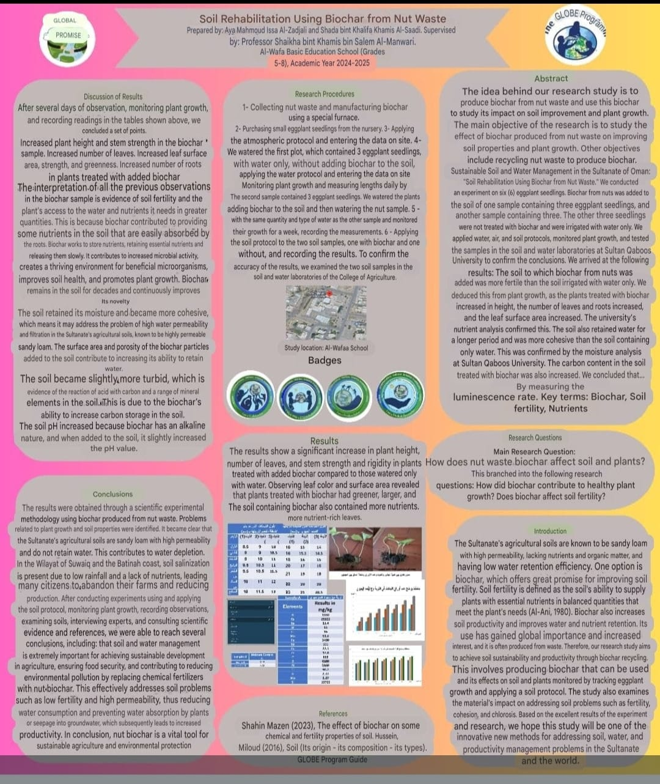

Slide 3
Abstract
This study investigates the production of biochar from nut waste and its effect on soil properties and plant growth. Results showed improved soil fertility, water retention, and enhanced plant growth when biochar was applied.

Slide 4
Research Objectives
- Produce biochar from nut waste
- Improve soil fertility
- Enhance plant growth
- Promote sustainable soil and water management

Slide 5
Research Questions
- How does nut-waste biochar affect soil and plants?
- Does biochar improve soil fertility?
- Does it enhance healthy plant growth?

Slide 6
Methodology
- 6 eggplant seedlings used
- 3 with biochar, 3 without
- Same water quantity applied
- Growth monitored for one week
- Soil analyzed in laboratories

Slide 7
Results
- Increased plant height
- More leaves and roots
- Stronger stems
- Improved soil moisture retention
- Higher nutrient content

Slide 8
Discussion
Biochar improves soil structure, retains nutrients and water, enhances microbial activity, and slowly releases nutrients to plants.

Slide 9
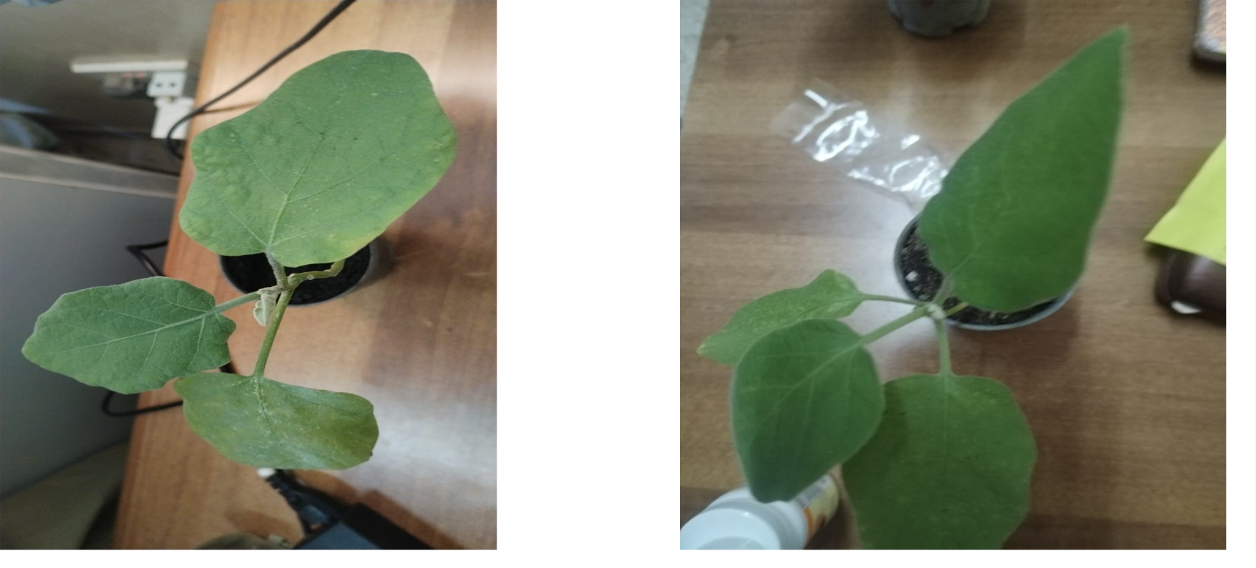
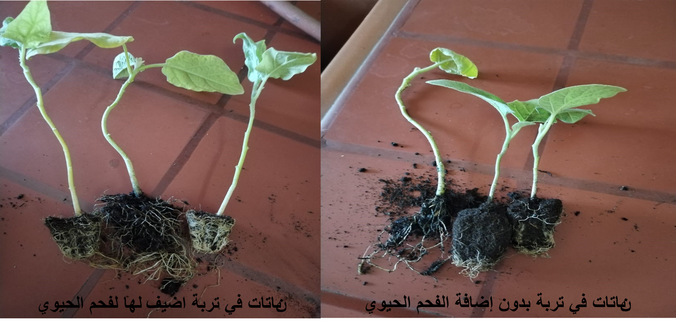

Slide 10
Plant Length Measurements during the First Week of the Experiment
 | Lengths of Plants Grown in Soil Without Biochar (cm) |  |  | Lengths of Plants Grown in Soil Amended with Biochar (cm)
Days | Plant (1) | Plant (2) | Plant (3) | Plant (1) | Plant (2) | Plant (3)
First | 8.5 | 9 | 10 | 16 | 15 | 14
Second | 9 | 9 | 10.5 | 16 | 15.5 | 14.5
Third | 9 | 10 | 11 | 18 | 16 | 15
Fourt | 9.5 | 10.5 | 11 | 20 | 17 | 16
Fifth | 9.5 | 10.5 | 11.5 | 21 | 19 | 18
Sixth | 10 | 11 | 12 | 22 | 20 | 20
Seventh | 10 | 11.5 | 12 | 23 | 21 | 20.5
Average | 9.357143 | 10.21429 | 11.14286 | 19.428571 | 17.642857 | 16.857143

Slide 11
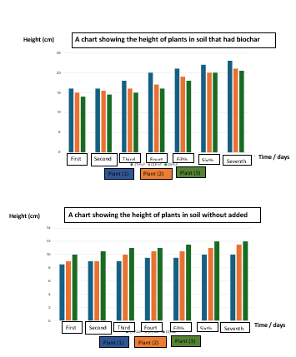

Slide 12
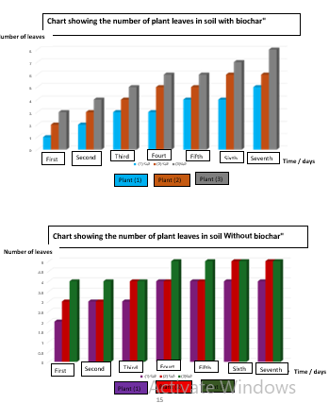

Slide 13
Conclusions
Nut-waste biochar is an effective, sustainable solution for improving soil fertility, reducing water loss, and enhancing agricultural productivity.

