Slide 1
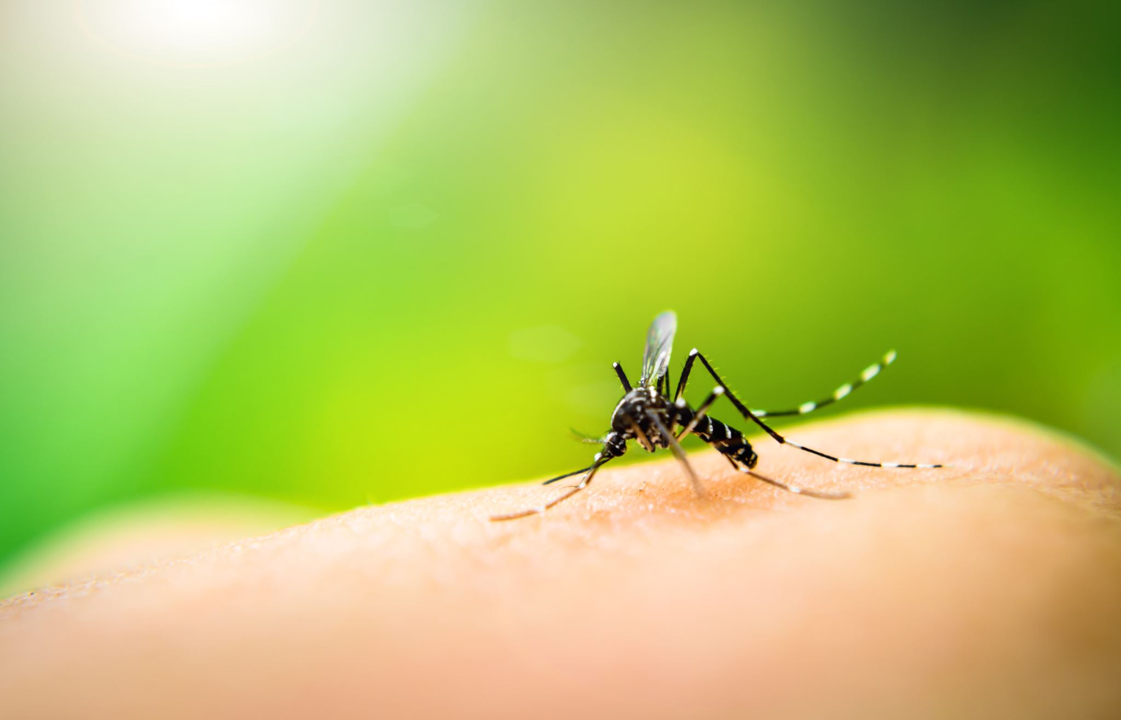




Research of Mosquito Habitats
Dallas Balentine

Slide 2
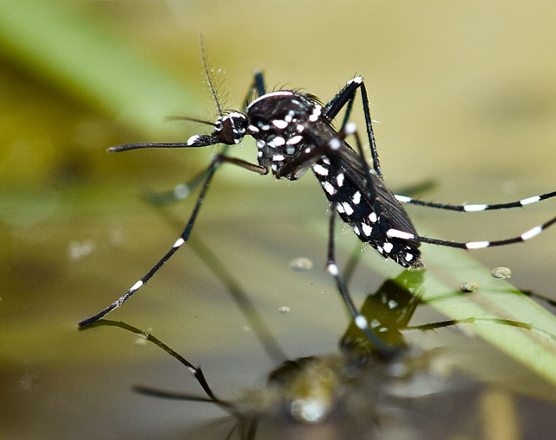
Purpose and Objective
Purpose: Conduct research and a experiment of Mosquito larvae in Minnesota
Objective: To collect observational and photographic data of larvae and compare it to other data across the world

Slide 3
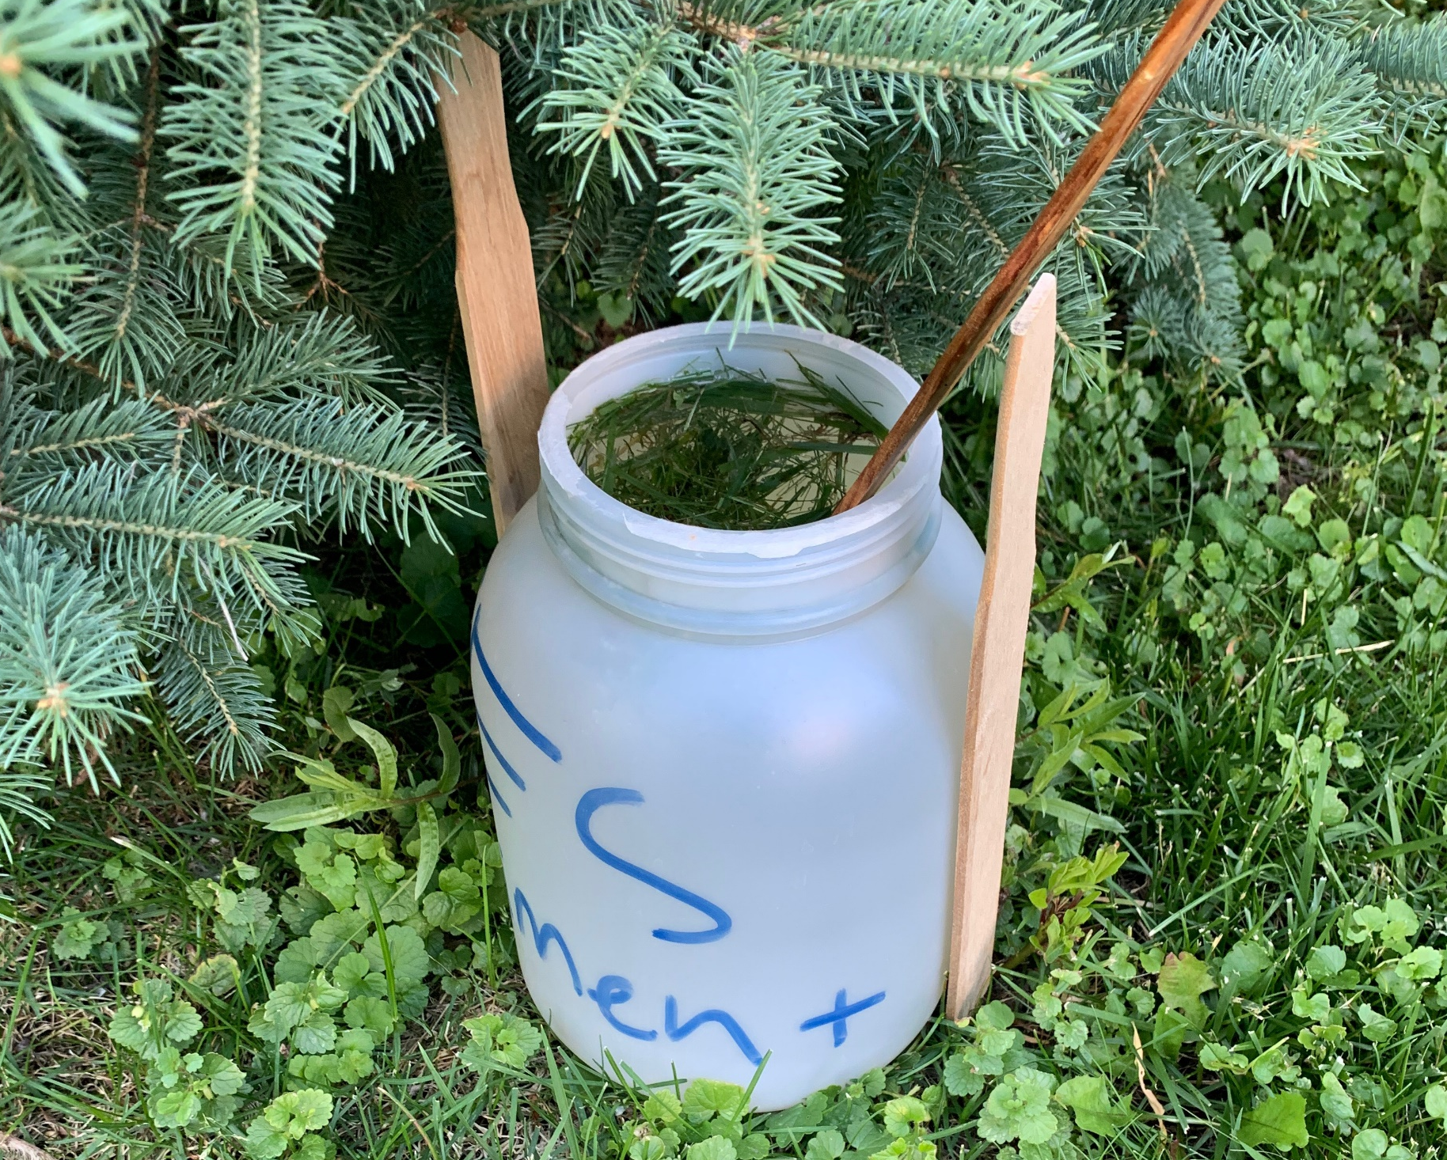
Research
Time Span: June 16-July 23 (5 weeks and 2 days)
Location: Minnesota

Slide 4
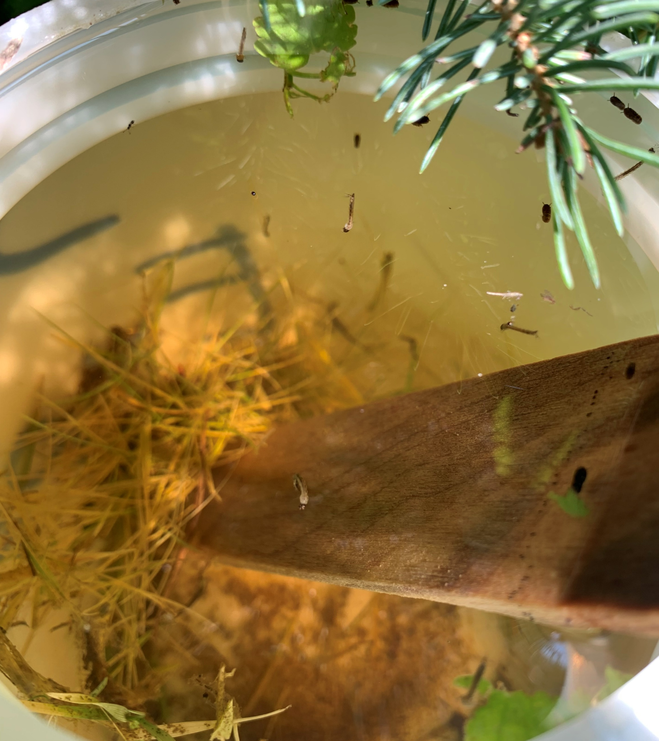
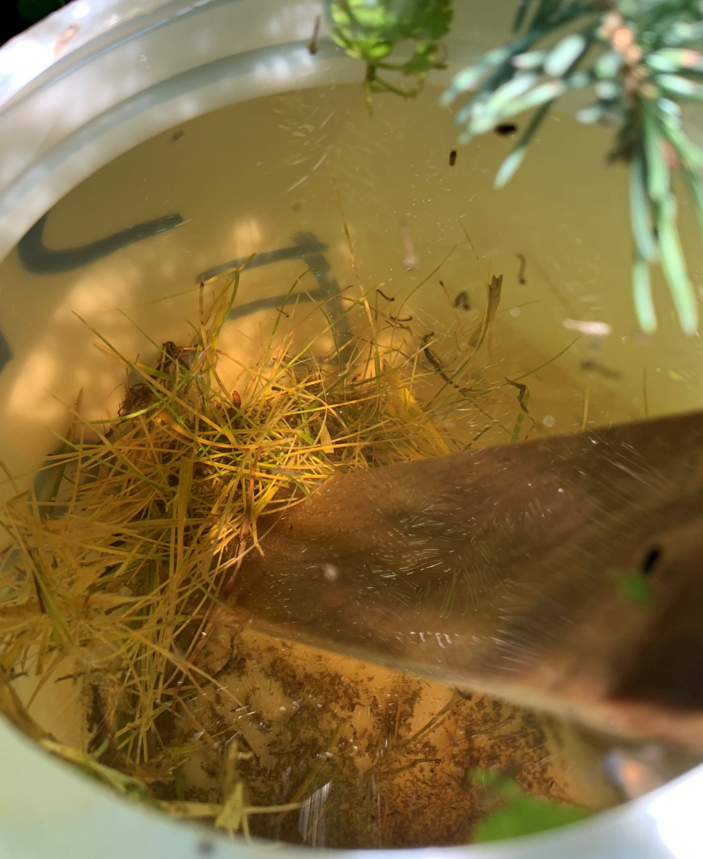
Data
About 35 larvae were counted on July 16

Slide 5
Conclusion
Mosquitos tend to strive in warm, humid areas near a body of water but tend to struggle in areas that are hot and arid/dry

