Slide 1
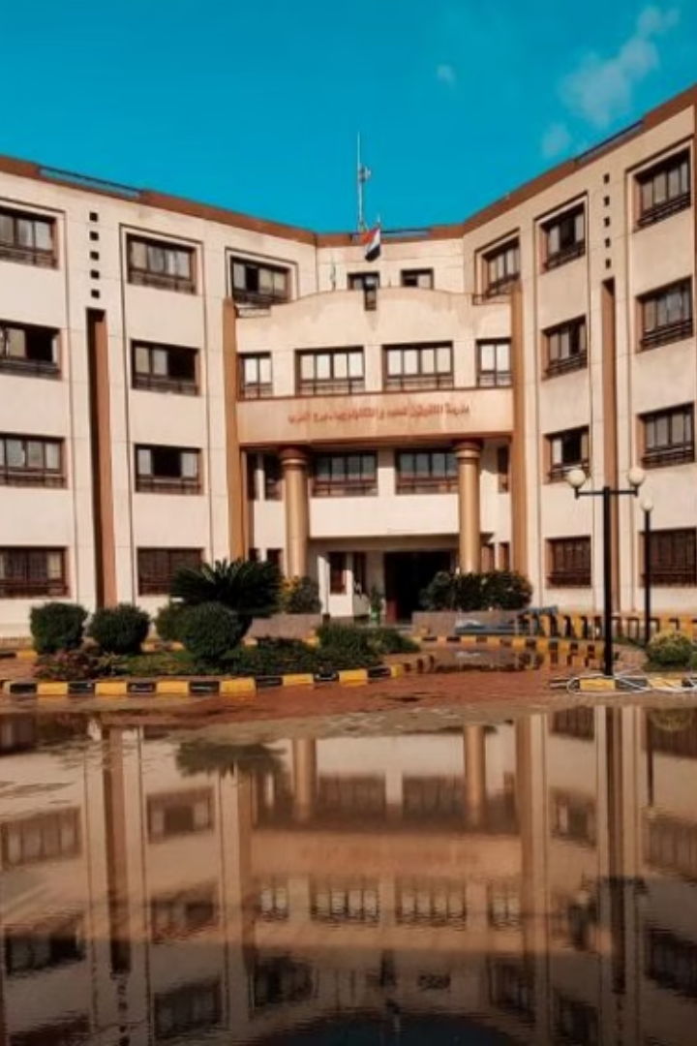
Geo-Glow Magnet: Evaluating Heavy Metals in Borg Al Arab Soil After Biochar and Organic Waste Treatments
This presentation addresses the critical issue of heavy metal contamination in the soil of Borg El Arab, Egypt. We will explore the impact of wastewater disposal on soil composition. We will propose innovative remediation strategies using biochar and organic waste. Finally, we will present a cost-effective detection method.
By/ Nourhan Osama, Sama Muhammed
under supervision/ Miss Nora Said

Slide 2
Problem Statement: Wastewater Impact on Soil
Initial Observation
Long-Term Effect
Heavy Metal Concerns
Wastewater from school projects initially damaged the soil.
Surprisingly, plant growth was observed in the long term.
Increased heavy metal concentrations are a major concern.

Slide 3
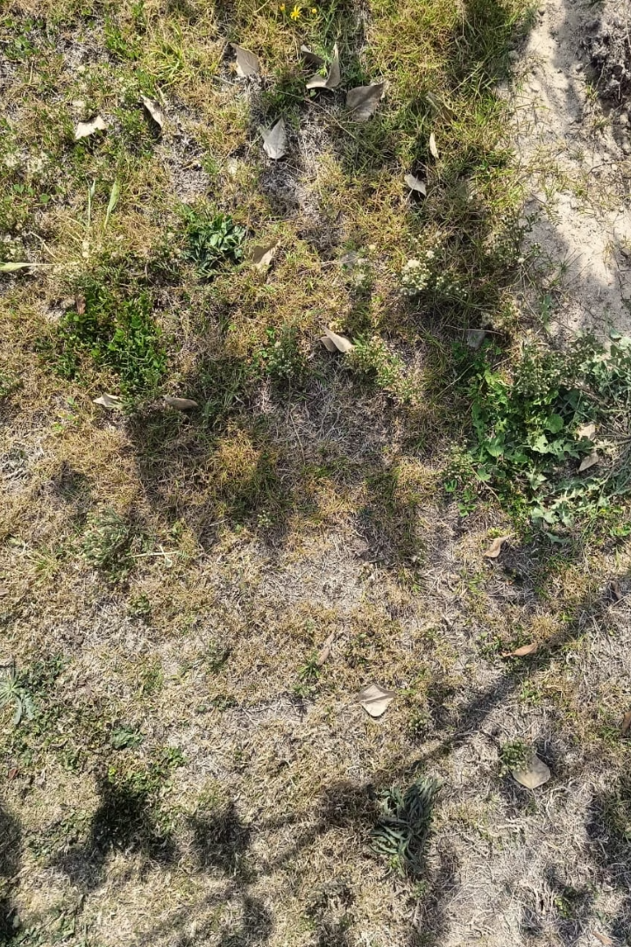
Proposed Solutions: Biochar and Organic Waste
1
Biochar Application
2
Organic Waste Utilization
Biochar can effectively immobilize heavy metals in soil.
Organic waste can enhance soil properties and reduce metal mobility.
3
Zeolite
Zeolite effectively removes Cd²⁺ from soil solutions through ion exchange, adsorption, and precipitation, making it a powerful filtration medium.

Slide 4
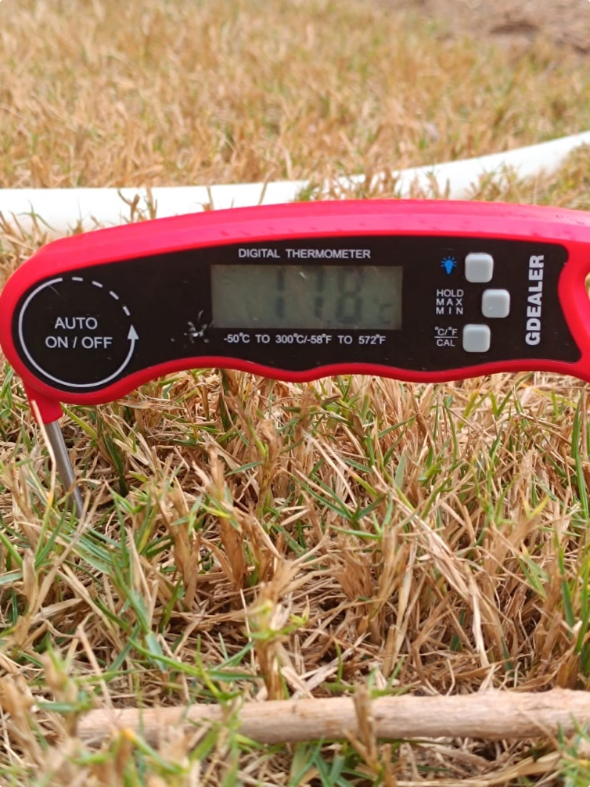
Detection Methodology: A Cost-Effective Approach
Soil Filtration
Mix soil with water and filter sediments to obtain an ion solution.
Geo Filter
Filter the solution from sediment using gravel, sand and cotton balls.
Magnetic Separation
Apply a magnetic field to segregate heavy metal ions.

Slide 5
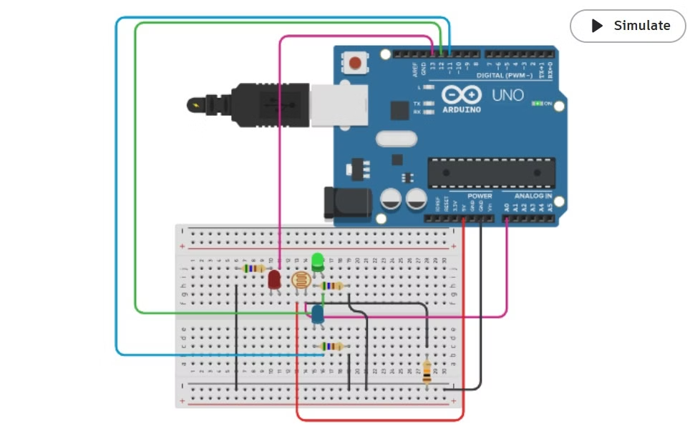
Dithizone-Based Colorimetric Method
"aka: Geo-Glow magnet"
1
Cadmium detection
Extract cadmium from soil suspension.
2
Complex Formation
Complex cadmium with dithizone for color change.
3
Color Sensing
Use a color sensor to quantify cadmium concentration. "converting qualitative into quantitative data acc. to frequency of color"

Slide 6
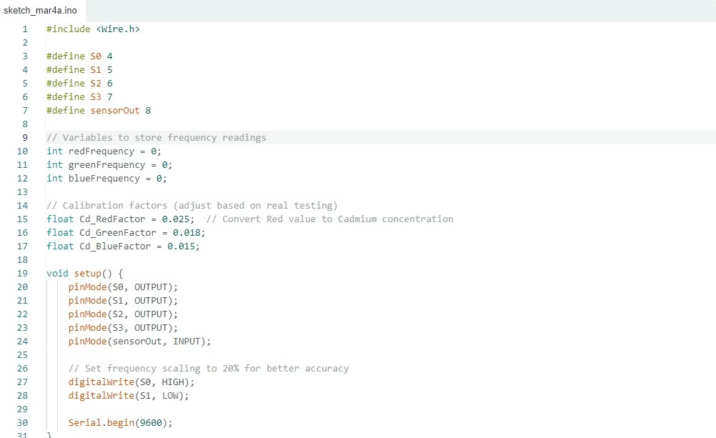
Dithizone-Based Colorimetric Method
"aka: Geo-Glow magnet"
1
Color Sensing
To connect a color sensor like the TCS3200 to an Arduino Uno, connect VCC to 5V, GND to GND, S0 & S1 to D4 & D5 (to set frequency scaling), S2 & S3 to D6 & D7 (to select color filters), and the OUT pin to D8 (to read frequency signals). The sensor detects color by filtering red, green, and blue light, converting it into a frequency output that the Arduino reads using the pulseIn() function. By measuring the frequency values for each color, the Arduino can determine the object's color. Therefore, the higher the frequency, the greater the quantity that's detected creating a solution of converting qualitative data from color charts to quantitative data.

Slide 7
Expected Outcomes and Benefits
Enhanced Plant Growth
Improved Water Quality
Soil Remediation
Reduced heavy metal toxicity promotes plant health.
Lower metal concentrations reduce water contamination risks.
The treatments restore soil fertility and ecological function.

Slide 8
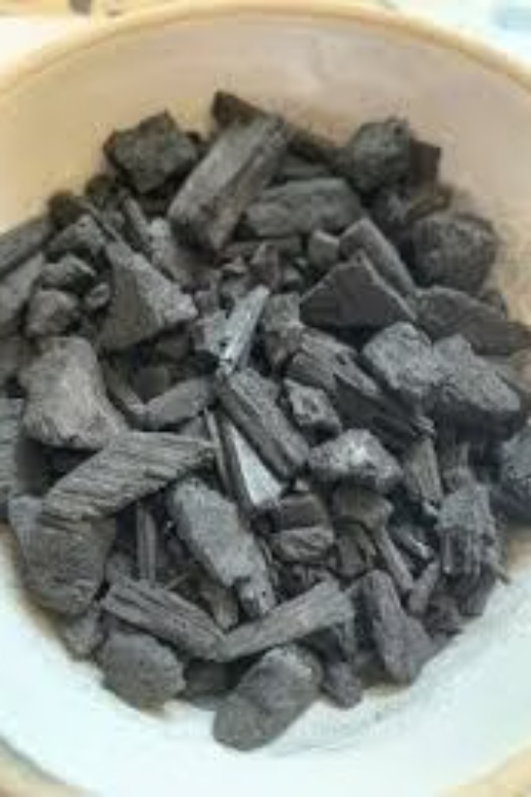
Prior Solutions and Research
Soil Organic Matter
Soil Quality Studies
Influence of soil organic matter on the distribution of Cd, Ni, and Zn.
Methods for accurately and quickly studying soil quality are reviewed.
Heavy Metal Determination
Spectroscopic methods for direct determination of heavy metals in soil.

