Slide 1


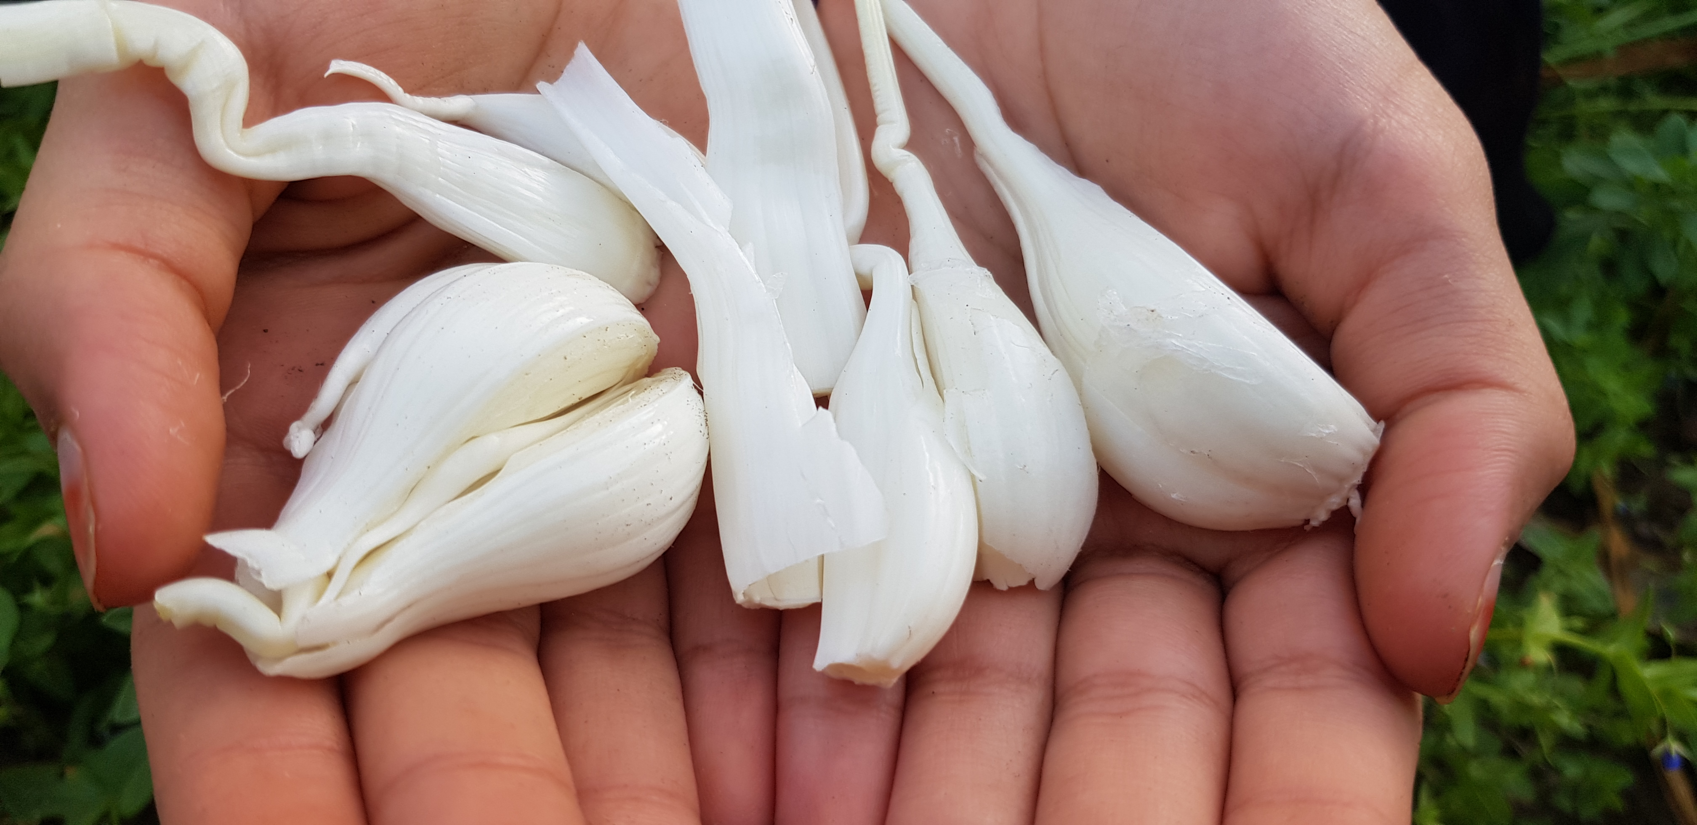
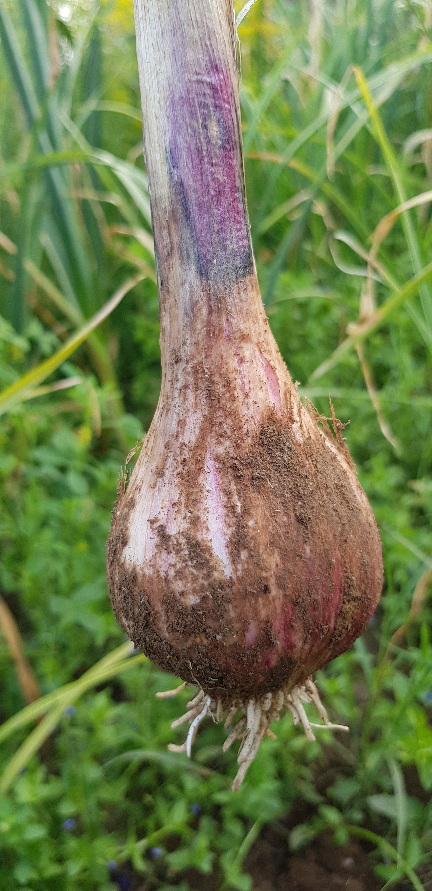
Soil characteristics and their impact on Omani garlic plant growth
Done by:
Abrar Saif Khalifa Alfarsi

Slide 2
Abstract :
Study comparing soil characteristics and their impact on Omani garlic plant growth
Done by :
Abrar Saif al-Farsi
Supervisor:
Hedaya Sulaiman Al farsi
Asma bint Omais for basic education (1- 8) school:
My research aims to study a comparsion between the characteristics of two types of soil and their impact on Omani garlic plant growth and I asked the following question:
- What is the impact of soil characteristics (acidity, salinity and conductivity) on Omani garlic plant growth?
To answer this question, I decided to study the characteristics of two types of soil on the growth of the Omani garlic plant, where this crop is frequently grown at this time of year . So I applied the soil protocol to study the characteristics of each sample in terms of acidity, salinity, conductivity and water protocol to study the characteristics of the water source in terms of salinity, acidity, conductivity and the protocol of land cover to observe the growth of the garlic plant.
The results indicated that the growth of the plant is influenced by soil characteristics. The garlic plant in area (2) was weak in growth and the size of the bulb was small, while in area (1) the growth of the plant was good and the size of the bulb is large .This is because of the difference in acidity, salinity and soil conductivity in the two areas and since the garlic plant needs neutral or low acidity soil in order to be able to absorb nutrients well from the soil. So, that was available in the area (1) and was not available in the area(2).
Based on the results, the researcher recommends that the farmers need to know the characteristics of the soil before planting any crop, in order to modify its properties in proportion to the appropriate conditions for the growth of the crop to obtain abundant and good production.

Slide 3
Research question:
What effect does the characteristics of the soil (acidity, salinity and conductivity) have on the growth of the garlic plant?

Slide 4



Research methodology:
Collect information on the subject of the research from the books available in the Learning Resource Center and from the internet
Develop a search plan.
Set a timetable for the implementation of the research plan.
Adoption of experimental research to study the effect of soil properties on garlic plant growth.
Determine the protocols needed to perform the research
Determine the equipment and tools necessary to perform the work (pH meter and the instrument of measuring salinity and conductivity).
Collect data and organize them in tables.
Insert data in the program’s website
Data analysis and representation
Conclusions and recommendations.

Slide 5


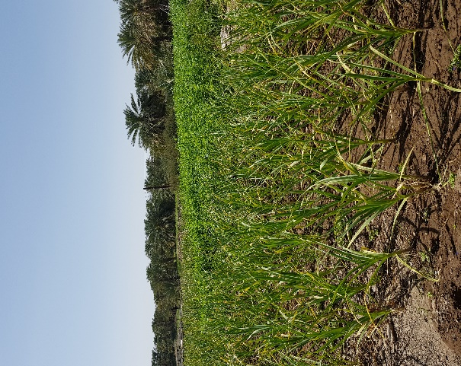
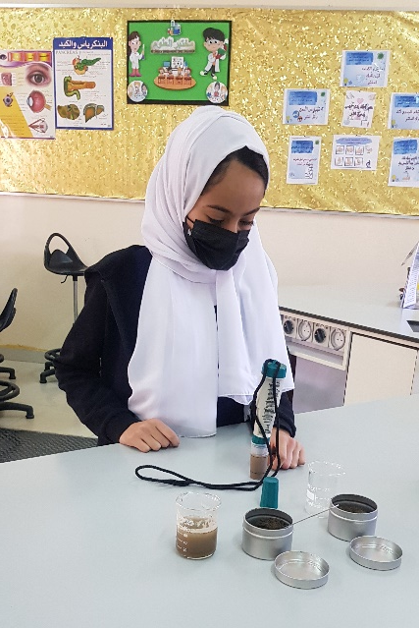
  Determine two areas that are irrigated with the same water source and the same amount of water and are exposed to the same amount of light (fixed factors) and differ in soil type (independent factor).
2 - Water and soil samples were collected to measure acidity, salinity and conductivity using globe instruments.
5- Comparison of garlic plant growth in the two areas after 4 months of planting it in terms of the general appearance of the pant ,the size of the bulb and the number of cloves .
3- The two areas were planted with 20 cloves of the same type of garlic for each area .
Methods of data collection:
4 - The same amount of organic fertilizer was added to the soil
( approx 5Kg) .

Slide 6
Results:
First: Water properties data (falaj water) using GLOBE devices
Value | characteristics
8.9 | ( pH)Acidity
352 | ( ppm )Salinity
498 | (µS/cm )Conductivity
Second: soil
characteristics data in the two regions:
(2 )Area | ( 1 )Area | Area Characteristics
8.8 | 7.4 | ( pH)Acidity
499 | 623 | ( ppm )Salinity
719 | 908 | (µS/cm )Conductivity

Slide 7
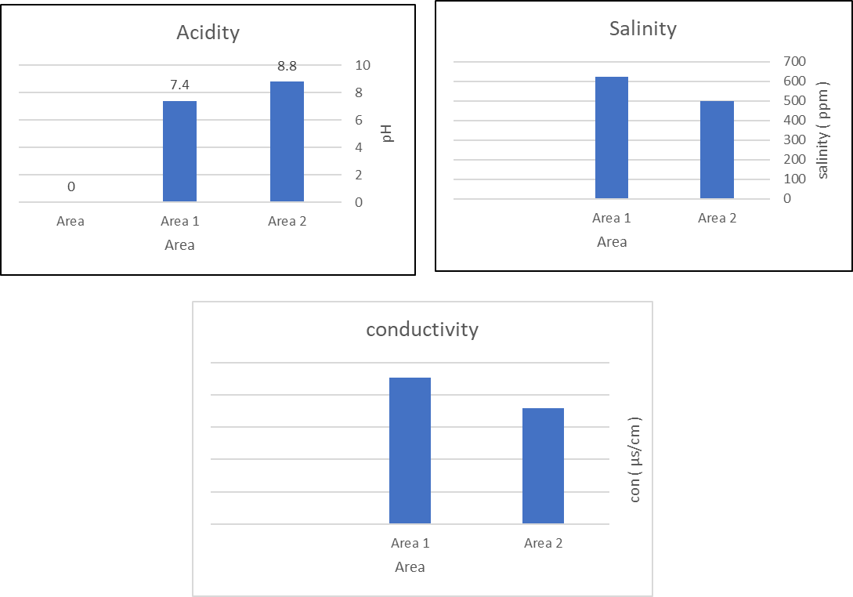
Soil characteristics

Slide 8
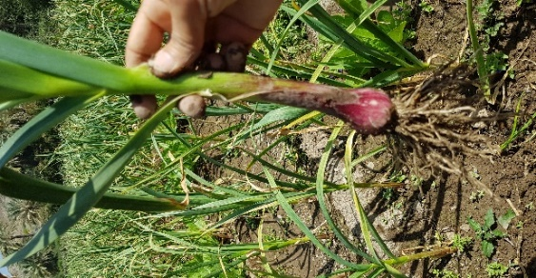
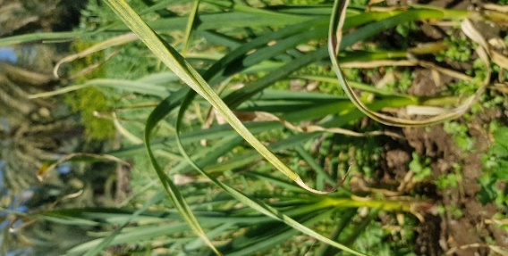
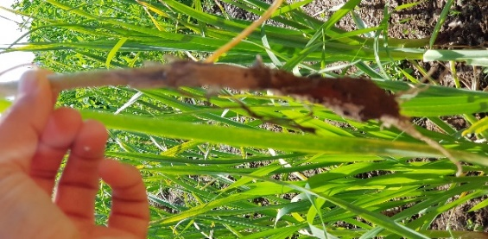
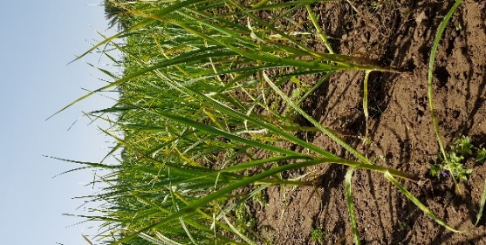
Third: Note the growth of the garlic plant after 4 months of planting it in terms of appearance:
( 2 ) | ( 1 ) | Area
Weak stem,weak striped leaves, little rootstock and small bulb size. | Strong stem,slightly broadstriped leaves,large rootstock and large bulb size. | General appearance
 |  | photo

Slide 9
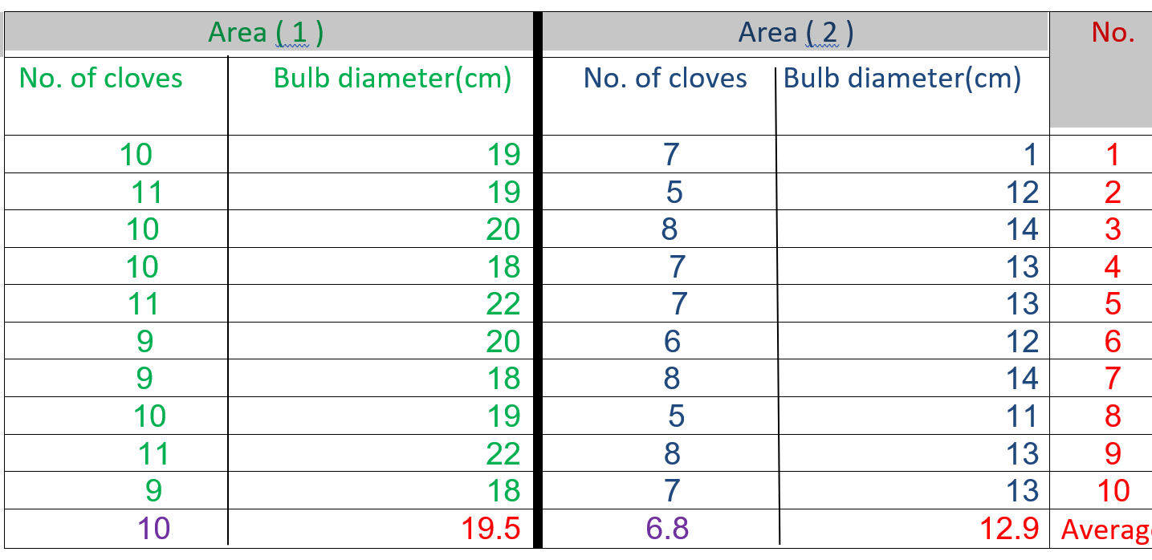
Fourth : follow -up the growth of the garlic plant after 4 months of planting it ,where a random sample was taken from each area to take measurements (10 bulbs).The diameter of the bulb and the No. of cloves were measured.

Slide 10
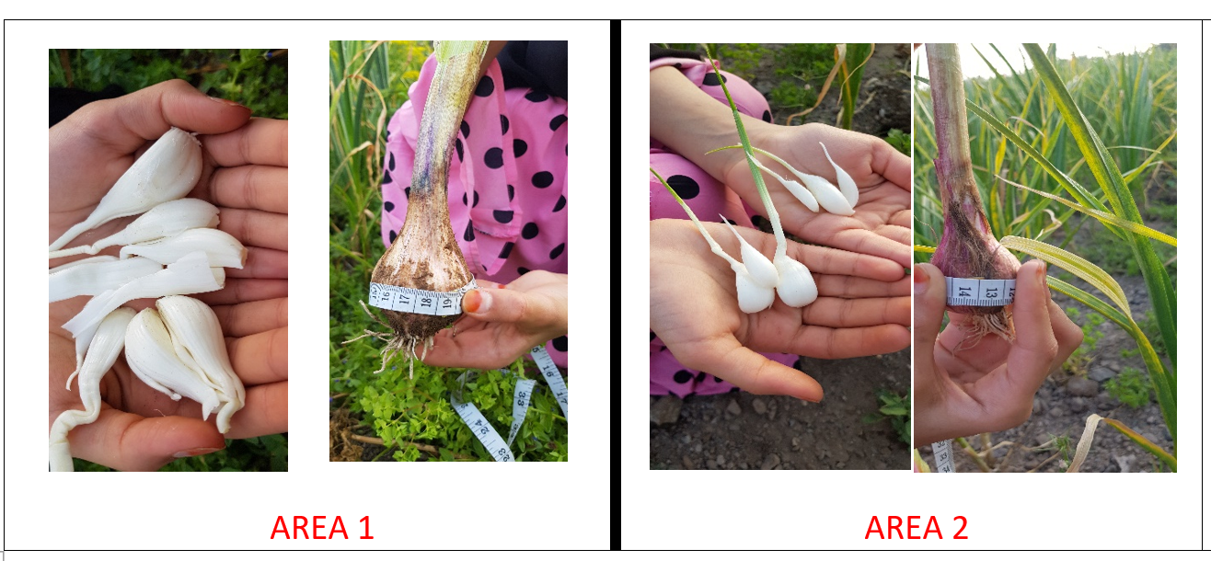

Slide 11
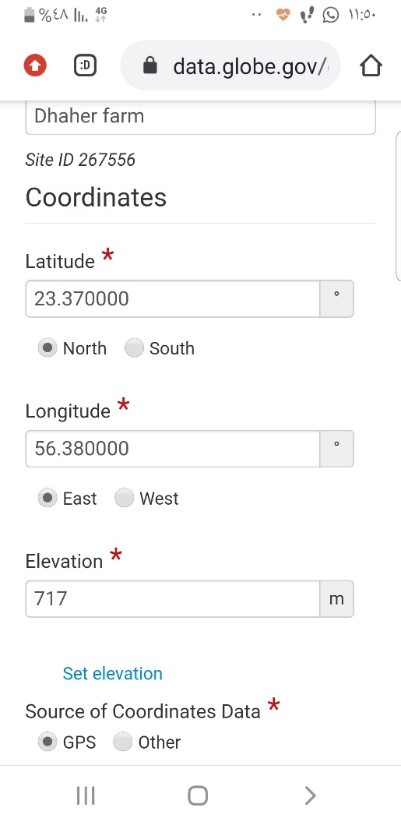
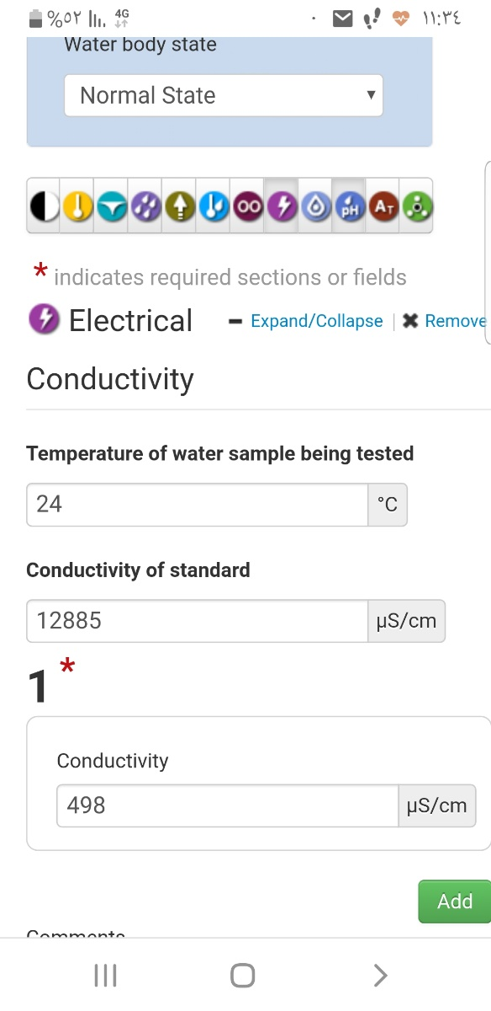
The data have been inserted and sent to the program website (www.globe.gov) through the application (DATA ENTRY).

Slide 12
Conclusion:
The globe protocols (the soil protocol, the land cover protocol and the water protocol) were used to compare the characteristics of the soil in two different areas and their impact on the growth of the garlic plant. The plant varies according to the characteristics of the soil and I knew that this plant needs a soil of low acidity or neutral in order to give good production. These conclusions lead us to educate farmers to know the appropriate soil characteristics for each crop before planting, so that the soil characteristics are modified before planting to ensure a good marketable crop.

Slide 13
References:
1. Technical office of Globe program. (2014) document of soil protocol for the training program for Globe teachers.
2. Technical office of Globe program. (2014) document of land cover protocol for the training program for Globe teachers.
3. Ministry of Education (2013) Science book for grade 8
4. Garlic soil: soil properties and acidity
. https://ar.techexpertolux.com
5. Dr. Mohammed Fahim. How do you grow garlic in the new season and get a high productivity of acres?
https://alfallahalyoum.news
6. Wikipedia. Retrieved on 12/1/2020 from
https://ar.wikipedia.org

