Slide 1


Reasons for the variation in annual rainfall in the village of Dhahir Al-Fawaris and its relationship to annual temperatures
Done by:
ALMarwa khalifa Alfarsi

Slide 2
Abstract :
This research aims to study the reasons for the variation in annual rainfall in the village of Dhahir al-Fawaris during the period 2015-2025, and to analyze the potential relationship between rainfall and annual temperatures.
The research revolves around the following questions:
  1. What is the pattern of variation in annual rainfall in the village of Dhahir al-Fawaris during the period 2015–2025?
  2. Is there a relationship between the amount of annual rainfall and annual temperatures?
  3. What are the possible factors that explain the observed variation in rainfall?
To answer these questions, the study relied on monthly and annual climate data extracted from NASA files (NASA POWER) and from recorded measurements of temperatures and rainfall amounts for GLOBE students, extracted from Visualize Data. This data was then statistically processed, converted into annual averages, and displayed in tables and graphs using Microsoft Excel. The observed variation in rainfall amounts was then interpreted.
The results showed a significant variation in the amount of annual rainfall between years, with some years recording relatively high amounts, while other years were dry. Annual temperatures also recorded a general increase with slight differences between years. A relative inverse relationship was also observed when comparing rainfall data with annual temperature data The high average annual temperature is associated with low rainfall in most years, with limited exceptions due to exceptional weather conditions.
Based on these findings, the researcher recommends raising public awareness about the importance of water conservation during years of low rainfall and encouraging future studies that incorporate other climatic factors such as wind and humidity, and that utilize the research results findings in agricultural and water planning.

Slide 3
Research question:
1. What is the pattern of variation in annual rainfall in the village of Dhahir al-Fawaris during the period 2015–2025?
2. Is there a relationship between the amount of annual rainfall and annual temperatures?
3. What are the possible factors that explain the observed variation in rainfall?

Slide 4


Research methodology:
Gather information on the research topic from books available at the Learning Resources Center and from the internet.
Develop a research plan.
Create a timeline for implementing the research plan.
Select appropriate tools for data analysis.
Determine the necessary protocols for conducting the research.
Extract data from Globe Data Visualization and the NASA Power website.
Analyze and graphically represent the data.
Insert data in the program’s website

Slide 5
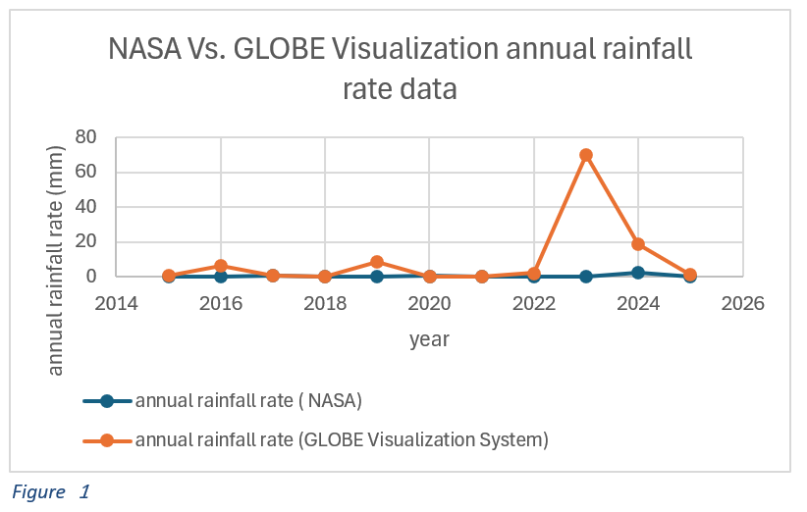
Results:

Slide 6
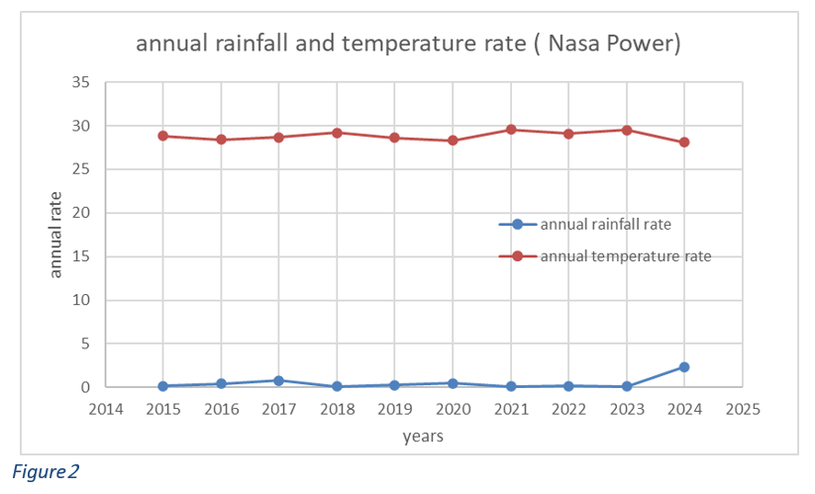

Slide 7
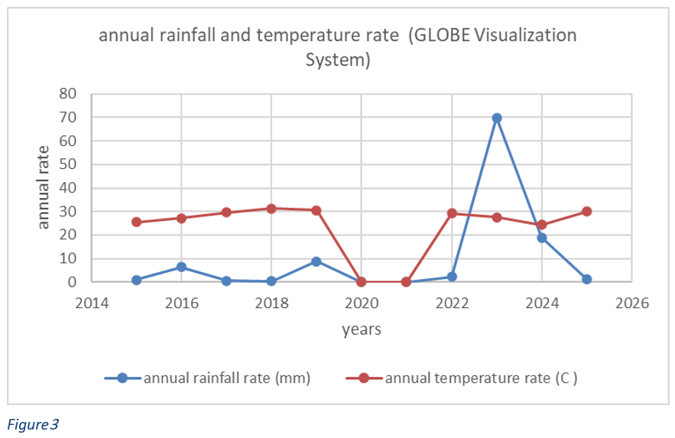

Slide 8
Interpretation of results:
The variation in annual rainfall in the village of Dhahir Al-Fawaris can be explained by several factors, the most important of which are:
Regional climate changes: These affect atmospheric pressure patterns and monsoon wind patterns.
Higher temperatures: These lead to increased evaporation rates, reducing the chances of cloud condensation and rainfall.
Irregularity of low-pressure systems: These do not occur with the same intensity or frequency each year.
Comparing rainfall data with annual temperature data reveals a relatively inverse relationship, Higher average annual temperatures are associated with lower rainfall in most years, with limited exceptions due to unforeseen weather events.
The graphs(Figure 2, Figure 3) show that years with higher temperatures were generally less rainy, while years with lower temperatures recorded higher rainfall.
This is explained by the fact that higher temperatures lead to increased evaporation, which reduces the chances of cloud condensation and rainfall. Global climate change may also be contributing to the irregularity of rainfall patterns.

Slide 9
Conclusion:
This research aims to investigate the reasons for the variation in annual rainfall in the village of Dhahir Al-Fawaris during the period from 2015 to 2025, and to analyze the potential relationship between rainfall and annual temperatures. Analysis of graphs extracted from NASA Power and GLOBE data reveals a clear variation in annual rainfall in Dhahir Al-Fawaris during the study period. Most years were characterized by low and irregular rainfall, with some years experiencing near-complete drought, in contrast to years with exceptionally high rainfall. The data also showed that annual temperatures were more stable than rainfall, fluctuating within a relatively narrow range. Comparing the curves reveals that years with higher temperatures often coincided with lower rainfall, while years with relatively lower temperatures saw a significant increase in rainfall, as is evident in years with high rainfall values. These results indicate a moderate inverse relationship between temperature and rainfall. Higher temperatures increase evaporation rates and reduce the likelihood of rain cloud formation, while lower temperatures create more favorable conditions for precipitation. However, some years show that rainfall can increase unexpectedly due to other climatic factors, such as low-pressure systems, demonstrating that temperature is not the sole factor influencing rainfall, but it is a significant factor in explaining its annual variability.
Therefore, we recommend raising public awareness about the importance of water conservation during years of low rainfall and encouraging future studies that incorporate other climatic factors such as wind and humidity, and utilizing the research findings in agricultural and water management planning.

Slide 10
References:
1- NASA POWER. Retrieved on (December 18, 2025) from https://power.larc.nasa.gov/data-access-viewer
2- GLOBE Program. Retrieved on (December 18, 2025 ) from
https://www.globe.gov
3. Ministry of Education (2013) Grade 8 Science Textbook
4. Weather in Oman. Retrieved on (December 5, 2025) from
https://heritageoman.wordpress.com
5. Climate in the Sultanate of Oman . Retrieved on (December 5, 2025) from
https://omananalyzer.com/ClimateAr

