Slide 1
Identifying Anopheles Larvae using a Convolutional Neural Network
Spencer Burke (SpencerBurke22@gmail.com)
Juan Durante (juan.durante2005@gmail.com)
Christopher Grizzaffi (grizzaffichristopher@gmail.com)
Amyn Macknojia (amyn.macknojia@gmail.com)

Slide 2
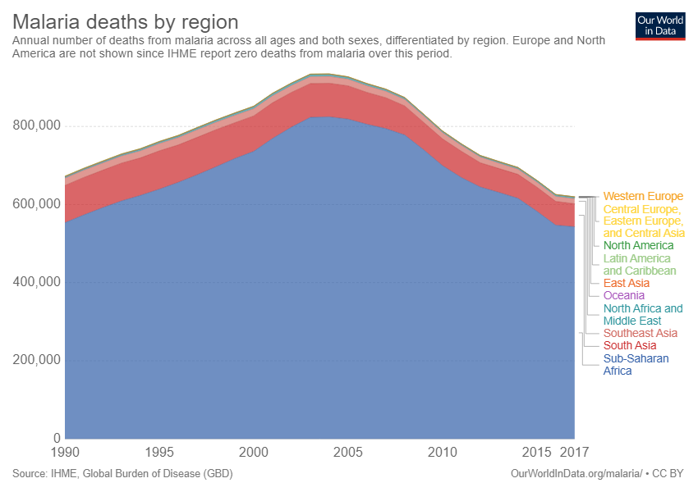
Context
Anopheles mosquitoes are the main carriers of malaria
Using a classifier to identify mosquito larvae can help track and reduce outbreaks
Yearly malaria deaths by region (image from ourworldindata.org)

Slide 3
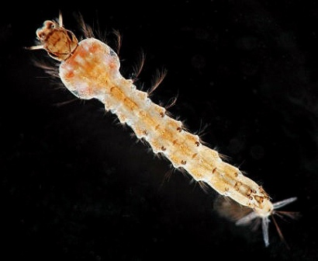
Research Questions
Can deep learning models accurately identify Anopheles mosquito larvae?
Can a deep learning model be used to aid malaria initiatives like the President’s Malaria Initiative?

Slide 4
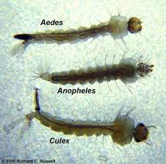
Data Collection
Collected full-body larval images taken by SEES interns over the months of June and July
No prefabricated datasets available
Not enough Anopheles images could be selected from the SEES program's GLOBE Observer dataset, additional images pulled from other studies and scientists to improve our training set
Notes:
(Culex,Aedes,etc….)
Collection was easy to find non-Anopheles larvae, however, it was difficult to collect Anopheles larvae photos

Slide 5
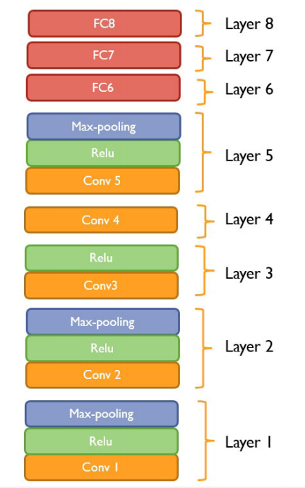
Model Design
The model was built upon a convolutional neural network (CNN), which is a form of a deep learning model
Deep network allows it to extract more information from the images
AlexNet architecture used
8 layers, with dropout in layers 6 and 7 to reduce overfitting

Slide 6
Results
Results were promising and displayed future potential for this model
Training accuracy around 98-100%, but the testing accuracy was much lower
We believe this to be related to overfitting and an insufficient dataset
Early-stage results show that more data could improve model accuracy

Slide 7
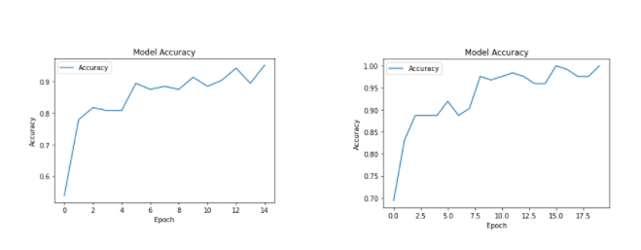
Error Analysis
Possible Errors
  Lack of Data
    124 Larvae Photos total
  Inconsistency with Pictures
    Differences in Cameras and lighting
  Overfitting
    Accuracy in the training Data is high yet significantly lower in tests
Training accuracies of the same classifier trained for 15 epochs (above) and 20 epochs (below)

Slide 8

Future Applications
Refining the model and creating a larger training set could open up citizen science applications
Further applications could distinguish different species of larvae and genus of mosquitoes
Implementation into apps like GLOBE Observer could allow for citizen scientists and researchers to identify larvae quickly and reliably

Slide 9
Thank you!
We’d be happy to answer any questions now

