Slide 1




Cottonwood Creek Water Quality Assessment
Jameson, Lyra, Josh
Knik Charter School
Wasilla, Alaska

Slide 2
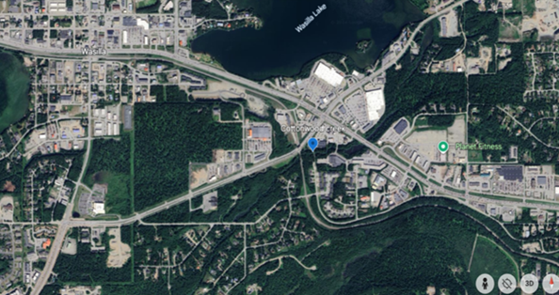
Introduction
Study site: Pedersen Park, Wasilla AK
Latitude N 61.57460, longitude W -149.4173
Elevation: 384 meters
Site name: L’ashch’i Betnu, the traditional Dena’ina name given to this area according to Shem Pete’s Alaska.
Meaning: “Silt (Mud) Place Creek” or “Ashes Creek”.
Salmon & creek health
The lower 1 mile of Cottonwood Creek is open to salmon fishing (except king salmon).
Thousands fish here each summer, mainly for sockeye salmon and some coho salmon.
All lakes in the Cottonwood Creek drainage, including Wasilla Lake, are closed year-round to all salmon fishing. (ADF&G).
Salmon spawn in the upper portion of Cottonwood Creek, including our study site and Wasilla Lake.
Spawning occurs late July through August, with some salmon staying into early fall.
Figure 1: Map of the study site location Pedersen Park on Cottonwood Creek, Wasilla, AK. Google Earth October 29, 2024
Notes:
Sentence starters:
We did this research because we wondered…
This topic is important because…
We already knew…

Slide 3
Introduction
Why we did this Research
Based on ADF&G Salmon in the Classroom curriculum:
➤ Water temp: 5–9°C
➤ pH: 6.0–8.5
➤ Dissolved oxygen: >8–9 mg/L for adults, >11 mg/L for eggs
➤ These are needed for salmon to survive and develop.
Our goal:
➤ Ensure the water is habitable for salmon.
➤ We knew salmon need dissolved oxygen, cool, clean, uncontaminated water, little light, and steady flow.
According to the Alaska DEC Waterbody Field Report – Cottonwood Creek
➤ The water is impaired by fecal coliform and E. coli levels exceeding water quality criteria.
➤ Due to new development, the site is in worse condition than in 2009.
Observations during our study:
➤ Large amounts of foam and trash in the park and creek.
➤ Between our 2023–2024 school year trips, trees were cut down to expand the park area.
Notes:
Sentence starters:
We did this research because we wondered…
This topic is important because…
We already knew…

Slide 4
Research Question
Is the water habitable for salmon to live in, and if it isn’t habitable, why? In the past 21 years, what has changed?
Prediction for Salmon Habitat Suitability:
If water temperature is 5–9ºC, pH is 6.0–8.5, and dissolved oxygen levels are above 8–9 mg/L for adults or above 11 mg/L for eggs, then the creek should support healthy salmon rearing. Other factors may also influence overall creek health.
Notes:
Sentence starters:
Our research question is…
Our prediction was…

Slide 5
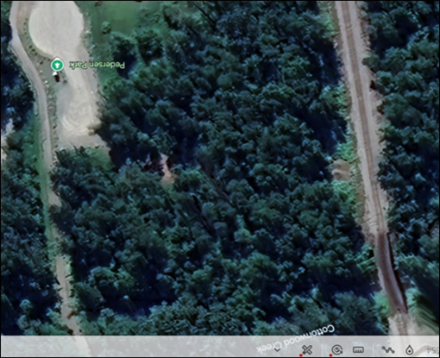
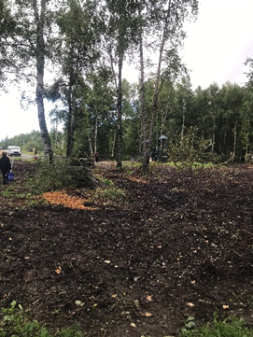
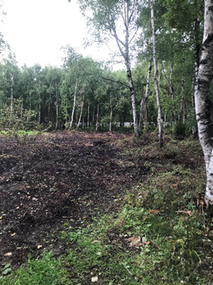
Research Methods
Data collection (GLOBE Hydrosphere Protocols):
Water temperature, pH, and dissolved oxygen with probes, and transparency using a transparency tube.
Data collected:
Spring of 2024 by the High School AK Wildlife Class and the Middle School Science Class (7 weeks).
Fall 2024 by the Ecology Class (7 weeks).
Spring 2025 High School AK Wildlife Class (7 weeks).
Compared our data sets with:
Alaska Department of Environmental Conservation data was collected at various times of the year in 2003-2005, 2006 (winter), 2010-2012 (spring/summer), 2023 (summer/fall).
We compared the data sets with each other as well as DEC data.
We used the GLOBE app for data entry and retrieval.
Figure 2: Aerial photo of Pedersen Park prior to removing trees. Google Earth retrieved October 29, 2024
Figure 3: Creek-level photo of Pedersen Park after trees were removed.Photo credit: Faith Lussow. August 29, 2024
Notes:
Sentence starters:
We collected… (what types of data)
Our study location was…
We collected data on… (dates)

Slide 6
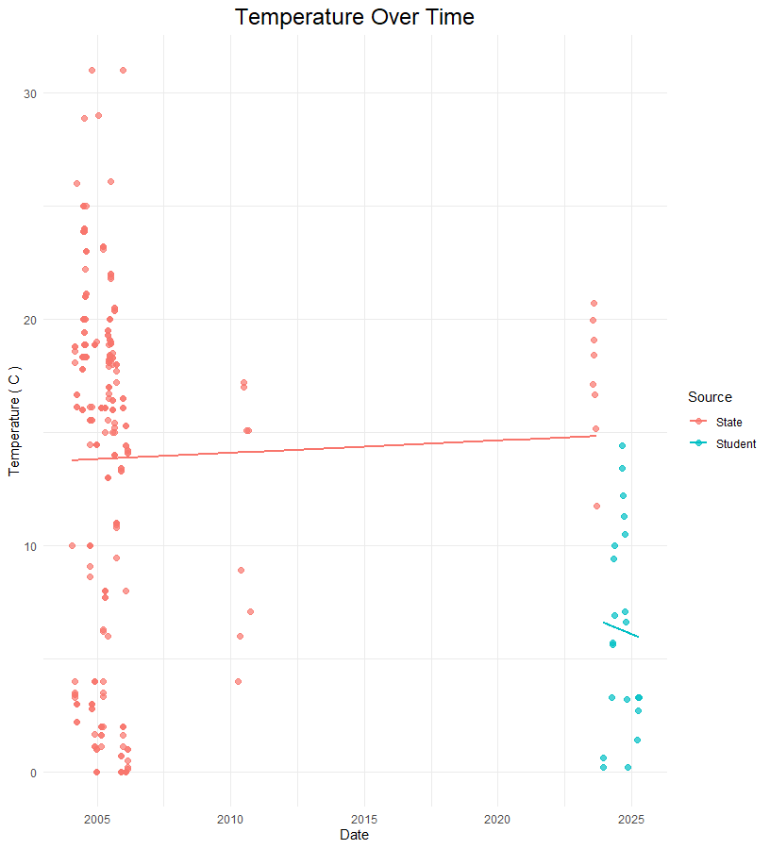
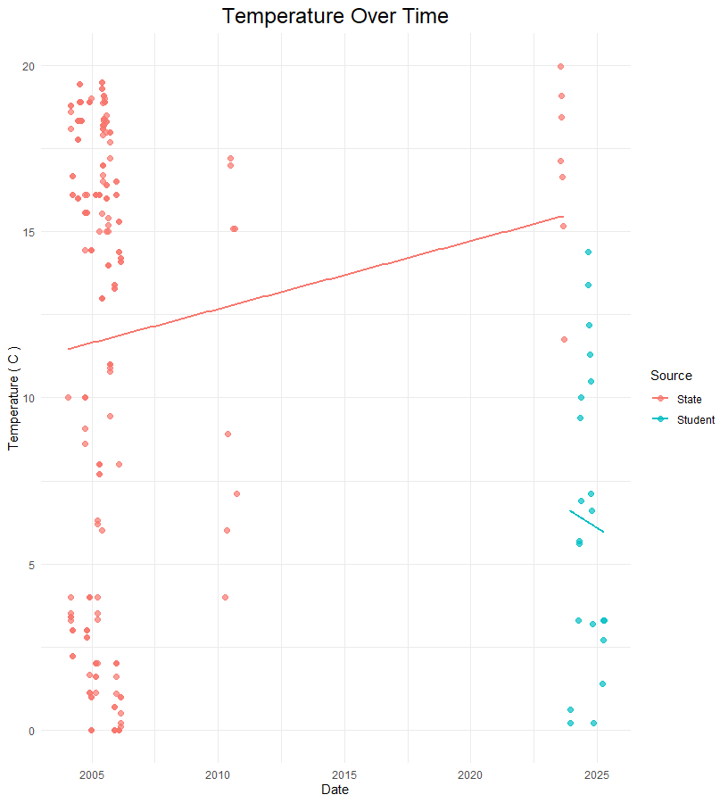
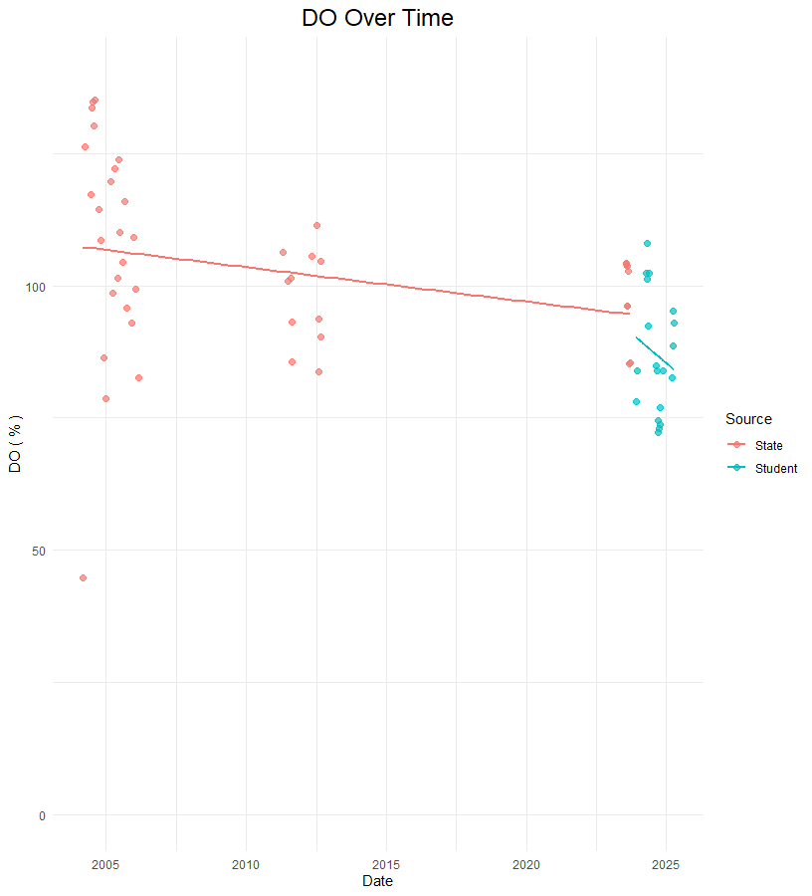


Our Results
Figure 4: Plot of all DEC and student temperature data over time shows a gradual increase. Several data were above 30 C, which we questioned for Alaska waters, even in summer
Figure 5: Plot of temperature data below 20 C. In the 2023 DEC Report, the maximum temperature was 20.7, so we eliminated possible sources of error. The plot shows a steeper increase in temperature than Figure 4.
Figure 6: Plot of Dissolved Oxygen data over time shows a steady decrease from 2003 to 2025. This follows our expect pattern that as the temperature increases, dissolved oxygen decreases.

Slide 7
Discussion
Temperature:
First we included all of the raw data. The DEC had recorded temperatures above 30° C. According to the 2023 DEC Field Report, the temperature ranged was 11.75° - 20.7° C for the data collected in 2023. The temperature range for our data was 0.6° - 14.4° C. Because of that we analyzed the data again looking just at temperatures below 20° C. Our analysis of the DEC data and our data showed that the water temperature is steadily increasing over time.
Dissolved Oxygen:
According to the 2023 DEC Field Report, the dissolved oxygen range was 8.48 - 9.93 mg/L. The dissolved oxygen range for our data was 7.7- 12.8 mg/L. The DEC data that was recorded between 2010 and 2012 was recorded in % DO, whereas, the rest of the data was recorded in mg/L, so we converted all data to % DO. Our results show that the dissolved oxygen is steadily declining making the creek less habitable for the salmon the more time passes.
This is important because there are fewer places for salmon to spawn, and can eventually make the salmon population decline which will make subsistence less for the people who rely on the salmon to live.
Notes:
Sentence starters:
Our results showed…
The data did/did not answer the research question because…
We used to think… but now we think…
Because of our research we…

Slide 8
Possible Sources of Error and Limitations
While doing this study, we had sources of error, including:
Seasonal changes in water temperature and Dissolved Oxygen
Timeframe: time of day that data was collected
Protocols different from the Department of Environmental Conservation
Errors in recording data (example: some entries were recorded as Fahrenheit, we were unable to find out/ ask about past data)
Our school schedule limited our time for data collection, due to class times and summer break.

Slide 9
Next Steps
We plan on taking action and spreading awareness about the declining quality of the water, and finding what’s causing this decline then eventually bring our data to the city.
We will publish our full report
The class will continue to monitor the creek
Suggestions
Replant trees and shrubs to increase shade
Have trash cleanup days to decrease the amount of trash
Septic tank inspections (residents and businesses)
Notes:
Sentence starters:
Possible sources of error/uncertainties were…
Improvements to our investigations could be…
Now we wonder…

Slide 10
References
GLOBE.gov
Kraus, Fritz. (1999). A Guide to Classroom Salmon Egg Incubation in Alaska. Alaska Department of Fish and Game Special Publication No 99-2, Anchorage, Alaska.
Matanuska-Susitna Basin Salmon Habitat Partnership. (2009) Healthy Salmon Healthy Communities.
Anchorage School District. (2009). Salmon in the Classroom Curriculum. Anchorage, Alaska.
Kari, James and Fall, James A. (2016). Shem Pete’s Alaska: The Territory of the Upper Cook Inlet Dena’ina. Fairbanks, Alaska: University of Alaska Press.
Oleksiak, A. 2023. Alaska Department of Environmental Conservation Waterbody Field Report Cottonwood Creek: Wasilla, Alaska.
Opalski, D. February, 2015. Alaska Department of Environmental Conservation Final Report. Total Maximum Daily Load for Fecal Coliform Bacteria in Waters of Cottonwood Creek, Wasilla, Alaska.

Slide 11
Acknowledgements
We acknowledge the Dena’ina People on whose traditional lands we gather in Wasilla. We also acknowledge all Indigenous people of Alaska. Thank you for your past and present stewardship of the waters, plants and animals of this place.
Ky Friedman, DOE Energy Innovator Fellow, Knik Tribe
Jackie McConnell, Environmental Project Coordinator, Knik Tribe
Meghan Montagne, Aquatic Wildlife Project Manager, Knik Tribe
Jessyka Diaz, Lead Media Expert, Benteh STEAM Academy
Cail Hubert, Media Expert, Benteh STEAM Academy
Laura Eldred, Section Manager, Nonpoint Source Water Quality Alaska Department of Environmental Conservation
Benteh STEAM Academy Staff: Komisa, Kat, Lily, Brock and others for transportation to the study site.

Slide 12
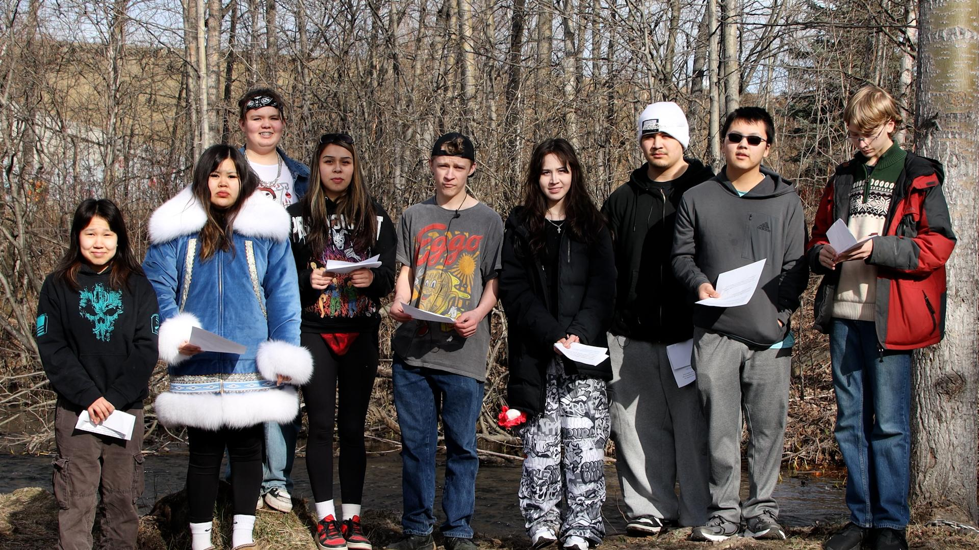
2024-2025 AK Wildlife Class at
Knik Charter School

Slide 13
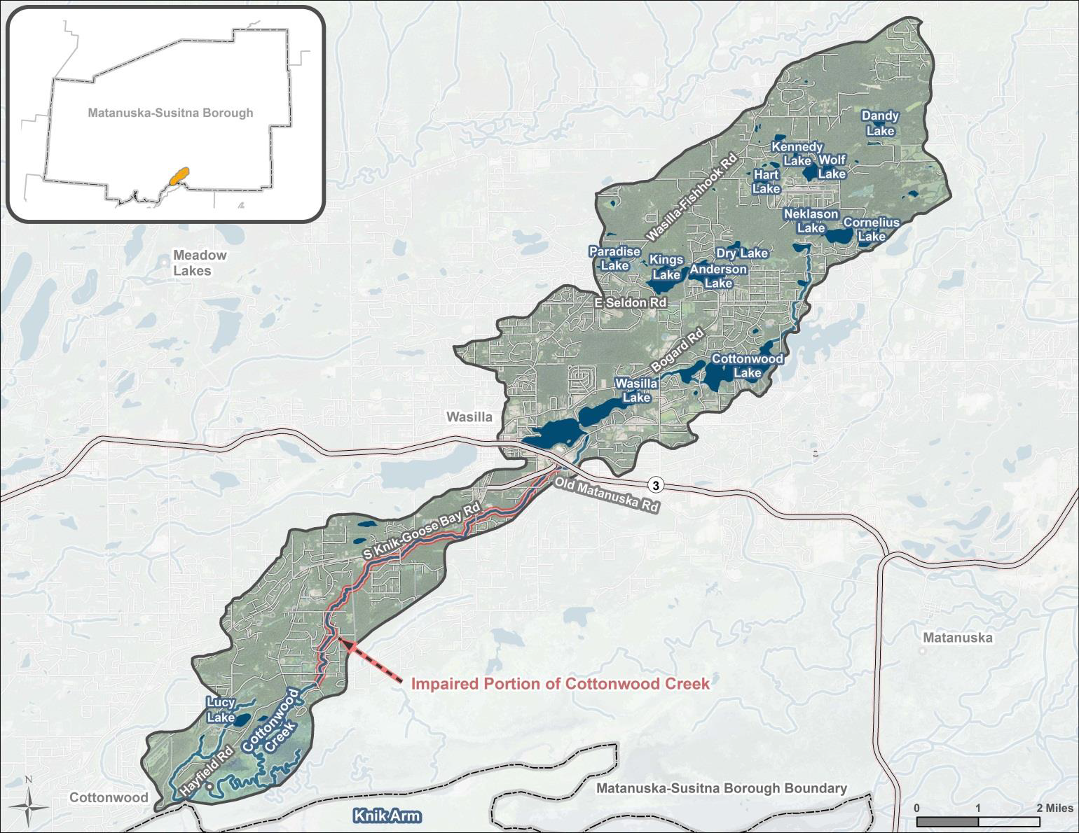

Cottonwood Creek Water Quality Assessment by Knik Charter School, Wasilla, Alaska
Water quality data from Cottonwood Creek shows increasing temperatures and decreasing dissolved oxygen levels over time, indicating a growing risk to salmon habitat and long-term sustainability.
This research helps the community by identifying changes in water quality that threaten salmon habitat, supporting efforts to protect local ecosystems and subsistence resources.
Figure 7.
Map of Alaska DEC study area for the Final Report Total Maximum Daily Load for Fecal Coliform Bacteria in Waters of Cottonwood Creek, Wasilla, Alaska. 2015

