Slide 1
The Effect of the Properties of Water Sources on Mosquito Attraction in Texas
By Louis Geer

Slide 2
How does the size, vegetation, and shade that a water source has affect the amount of mosquitos it attracts?

Slide 3
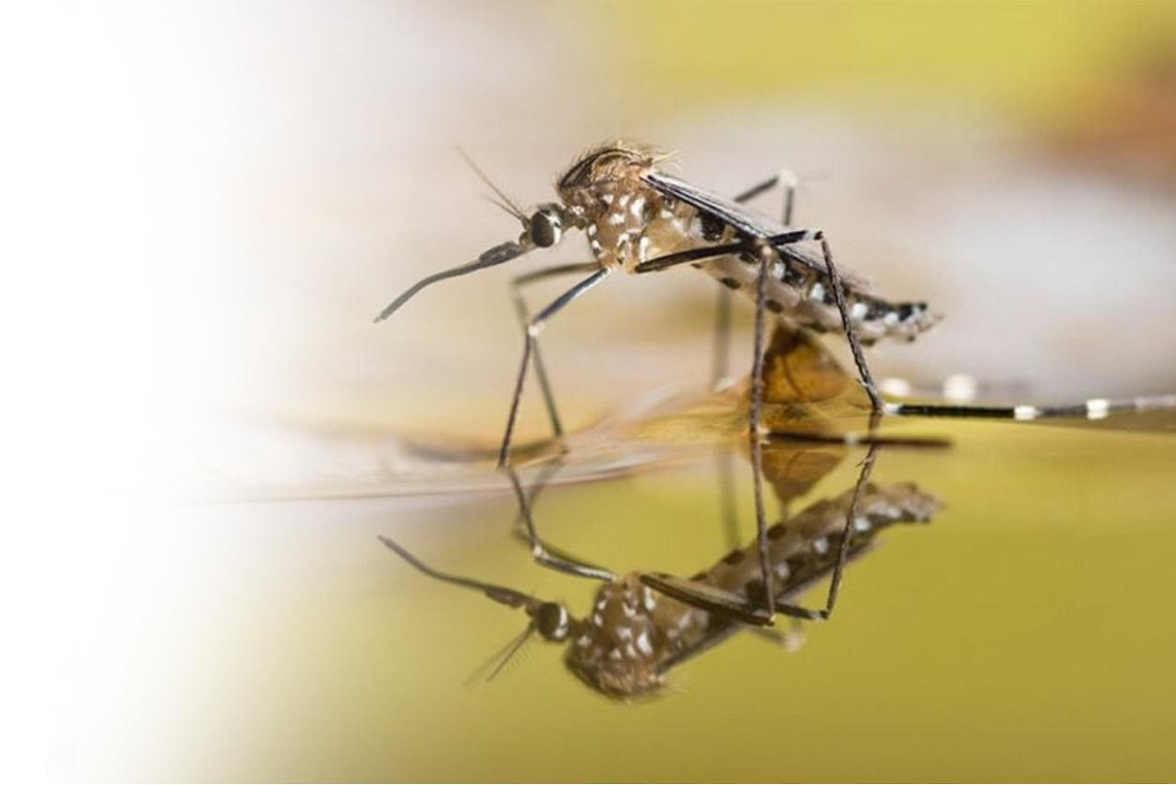
Why is this important?
Mosquitos play a large role as a vector of many diseases
West Nile
Zika
dengue
Knowing the types of water sources that highly attract mosquitos is essential to prevent them.

Slide 4
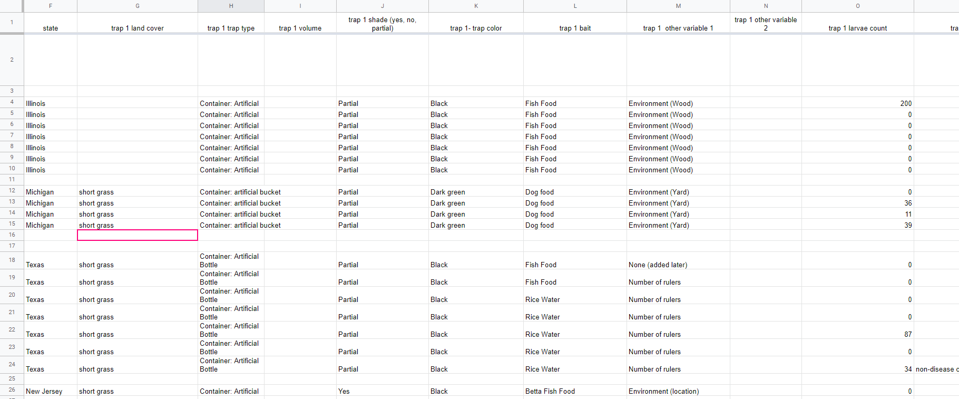
Methods of Data Collection
I mainly used the 2021 SEES internship mosquito trap data to reach my results.
I also used my own traps in which I varied small changes in each trap, in similar locations.

Slide 5
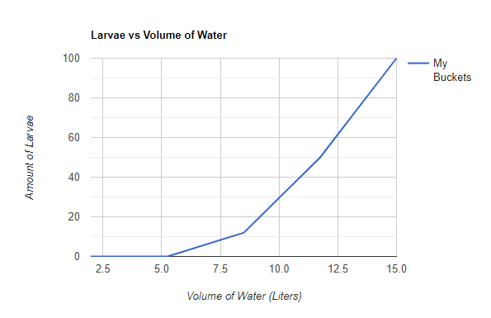
Effect of the Size of Water Sources
Low volumes of water attracted little to no mosquitos.
As the volume increased, I recorded larvae also increasing at an exponential rate.
This was expected behavior
However, it is worthy to note that this experiment was all done in small, 20L buckets.

Slide 6
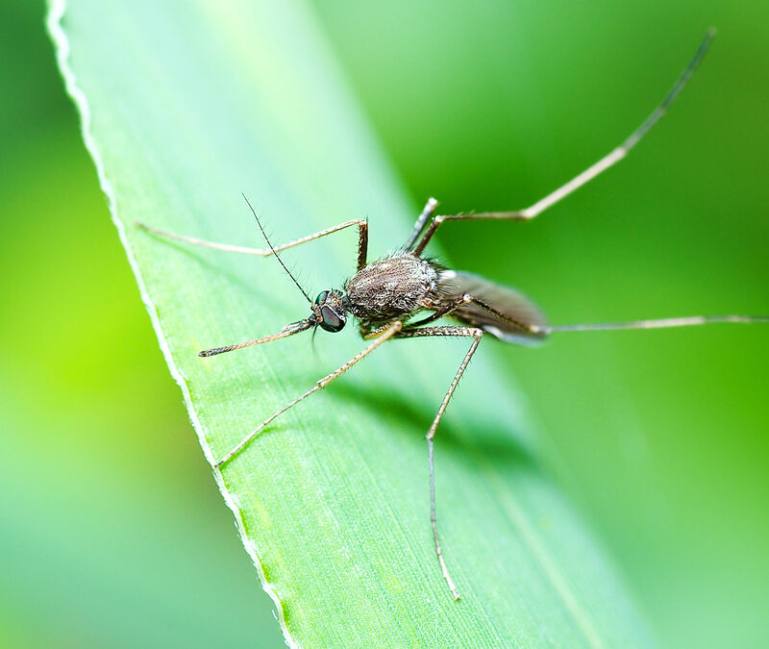
Effect of the Surrounding Vegetation of Water Sources
Right next to vegetation vs near vegetation: not much of a difference
Both containers placed in grass / near trees and containers placed on hard surfaces like patios saw many larvae
As long as there is some vegetation nearby, mosquitos are likely to find the body of water.

Slide 7
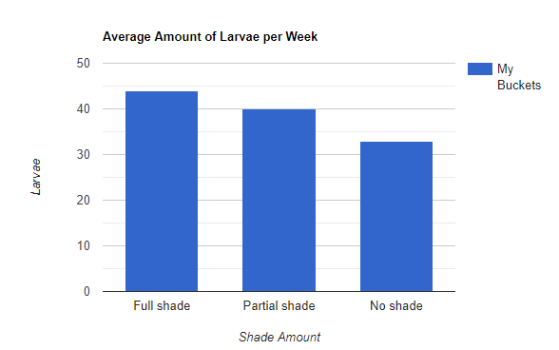
Effect of the Shade of Water Sources
There was a small increase in mosquito larvae as the amount of shade increased.
This is expected, as research tells us mosquitos prefer cooler areas as opposed to hotter sun-exposed places.

Slide 8
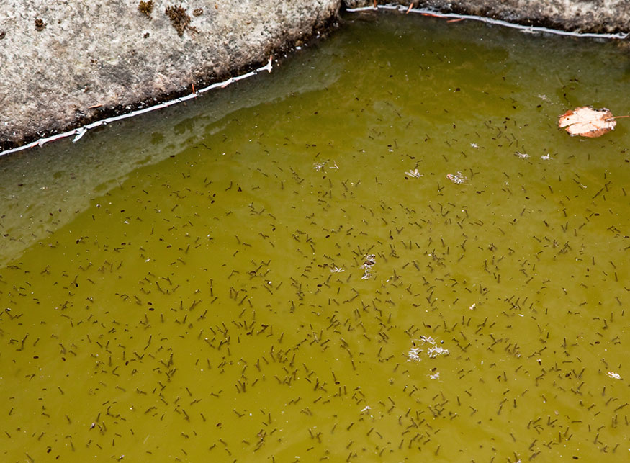
Main Takeaways
From this data, we can see how to most effectively prevent mosquito reproduction using source reduction.
Focus on targeting medium to large containers first
Whether it’s dense in vegetation or not dense will not matter too much.
Be wary of areas with lots of shade and overhead cover.

Slide 9
Reflections+Thanks
The NASA SEES Internship allowed me to be more involved in Earth Science and opened the door for me to see what real research is like.
Was a fun and challenging experience!
Thank you to all the mentors and organizers that made the internship what it is today
Hope to do more programs like this in the future.

