Slide 1
Analyzing the twenty-four solar terms using Globe observational data
Taiwan Partnership
Lotung High School, Yilan, Taiwan, R.O.C
Huang, J.-X., Chen, L.-E., and Wang, Y.-J.

Slide 2
Motivation
Solar terms serve various purposes in daily life. In meteorology, the changes in solar terms are often associated with weather patterns, providing some assistance in predicting weather changes.
However, we have noticed that from 2022 to 2023, many solar term characteristics seem to not align with the actual weather conditions on the day and in the following days. Therefore, we want to delve into the correlation between solar term types and actual climate, as well as explore the underlying reasons for further research.

Slide 3
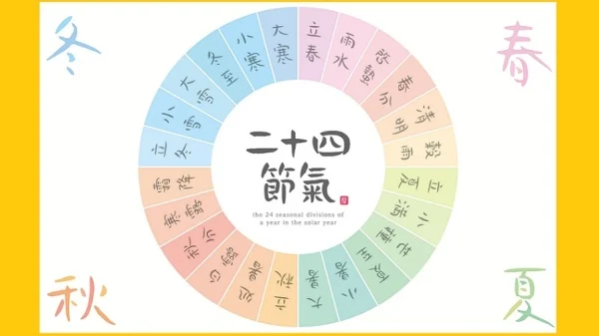
Purpose
Understand the characteristics of the four seasons' solar terms and explore their correlation with the observed data in 2022 and 2023.
2. Investigate the factors influencing the temperature and
precipitation changes in 2022 and 2023.

Slide 4
Research materials
Luodong High School Atmospheric Observation Station

Slide 5
Research methods
This study utilizes the climate data of daily weather between 2022 and 2023 collected by the atmospheric observatory equipment owned by our school.
It compares the data with eight distinct climate characteristics from the 24 solar terms, using Excel-generated temperature and precipitation line charts for comparison.

Slide 6
Research architecture and background
This experiment primarily involves the use of data collected by our school's atmospheric observation team through Globe atmospheric observations and records from automatic weather stations for the years 2022 and 2023.
The data is organized and plotted using Excel, creating charts for precipitation and daily average temperature for each of the 24 solar terms, with a 15-day period before and after each term. By comparing the different line graphs, we attempt to identify patterns of change and explore which weather factors may be influencing them.

Slide 7
Research results---spring
Rains on the day of Yushui, heralding a bountiful harvest
Does not match

Slide 8
Research results---spring
If it's sunny on Qingming day, there will be more rain in the days to come,
and rain on that day will lead to drought disasters
Does not match

Slide 9
Research results---summer
Xiazhi：High temperatures, high humidity, and occasional thunderstorms are common during this period
Matches

Slide 10
Research results---summer
Dashu：It's the hottest and most intense solar term of the year, characterized by scorching heat, and frequent typhoons.
Matches

Slide 11
Research results---Autumn
The weather is hot during Chushu, unlike the autumn season, and people call this hot weather "autumn tiger“
Matches

Slide 12
Research results---Autumn
As the time of Hanlu approaches, the autumnal atmosphere gradually thickens, and the air becomes cool and crisp with less rain
Not quite matches

Slide 13
Research results---Winter
During the period of Major Snow, influenced by cold air masses, snowfall may occur
Does not match

Slide 14
Research results---Winter
During Dahan, influenced by cold air masses from Siberia, it is often the coldest period of the year
Matches

Slide 15
Conclusion
1.The seasonal changes in Yushui and Qingming do not align with observations over the past two years. Since Taiwan's main precipitation occurs during typhoons in July and August, the description of precipitation in the seasonal changes doesn't necessarily imply a bountiful harvest.
2.The seasonal changes in Xiazhi and Dashu align with observations over the past two years. Southeastern China and Taiwan both belong to the Northern Hemisphere. Although China exhibits characteristics of a continental climate due to its geography, the latitudes are similar, and the summer climates are generally alike.

Slide 16
Conclusion
3.The seasonal changes in Chushu and Hanlu roughly correspond to observations over the past two years. One explanation for the formation of the "autumn tiger" phenomenon is the weakening of the northeasterly monsoon, which affects both China and Taiwan. This is naturally related. Furthermore, due to Taiwan's surrounded-by-sea geography, the northeasterly monsoon brings maritime moisture, which contrasts with the dryness of the Chinese mainland.

Slide 17
Conclusion
4.The seasonal changes in Daxue and Dahan may or may not correspond to observations over the past two years. Due to China's continental climate, temperatures can drop below freezing in winter, while Taiwan is surrounded by oceans with ocean currents passing through, resulting in smaller annual temperature differences, making snow rare. However, the times of lowest temperatures are generally similar.

Slide 18
Quote
1. https://www.moa.gov.tw/ws.php?id=2506893 -二十四節氣

