Slide 1
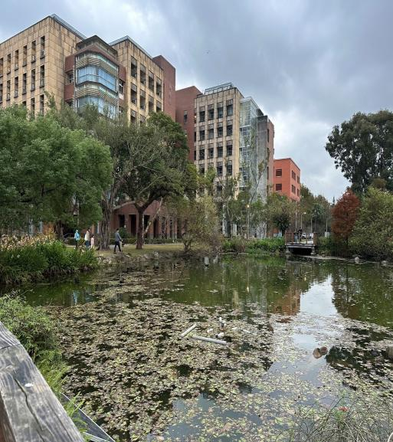
Protecting Wetlands for Our Common Future
Protecting Wetlands for Our Common Future-Water quality and sample analysis, taking the Taipei Daan Forest Park Ecological Pond and NTU Drunken Moon Lake as examples
Yunhan Lu, Taipei Municipal Wanfang Senior High School, Taiwan
Teacher: YiChen,Chiu

Slide 2
Abstract
This report was inspired by a trip to the park with my teacher and classmates to conduct a water quality inspection when we were a freshman in high school.
This sparked our interest in protecting water quality and prompted us to explore the water near our home.

Slide 3
Introduction
We use extracurricular time or after school hours to conduct this activity. This report is about water quality and sample analysis. Taking Taipei Daan Forest Park Ecological Pond and NTU Drunken Moon Lake as examples.
We use three sample at different times and three sample sites at each location. There are 18 data sets in total for comparison.
Using tools such as dissolved oxygen (DO)

Slide 5
pH test reagents, an electronic thermometer, and a turbidity meter, we aimed to analyze and explain the related data.We think the water quality of the Daan Forest Park Ecological Pond should be better because it is managed by the Taipei City Government.
As for the National Taiwan University Drunken Moon Lake, it is managed by the school, so it may not be as strictly controlled as the government.​

Slide 6
The water quality of closed type lakes such as Taipei Druken Moon Lake
(醉月湖）can be improved by using both biological and physical methods. These improvement included to increase the dissolved oxygen content, to reduce the water purification time, and to reduce the chance of eutrophication in the water( Chen et al., 2016)

Slide 7
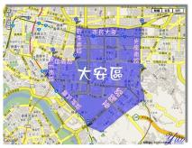
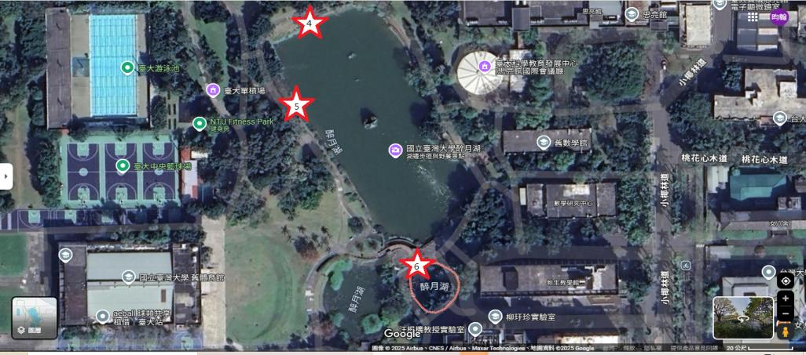
Sample Location
Taipei Daan Forest Park Ecological Pond
NTU Drunken Moon Lake
ThePhoto (作者: PhotoAuthor) 已透過 CCYYSA 授權。

Slide 8
Methodology
Sample Location: The ecological pond at Daan Forest Park and Drunken Moon Lake at National Taiwan University
Experimental method: Refer to Figure 1
Data Collection Tools:
Data Analysis: Refer to Figure 2

Slide 9
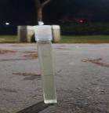
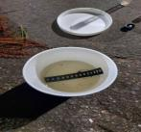
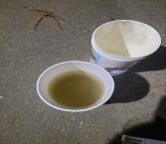
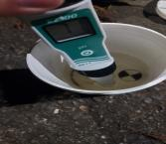
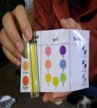
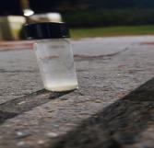
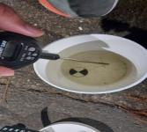
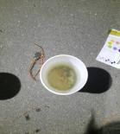
Experimental method

Slide 10
1. Bagging water |  | Bagging water from the water to the water fill line.
2 .Measuring the pH value |  | When measuring the pH value of water with an electronic pH meter, be careful not to touch the measuring end to the wall or bottom of the cup during measurement.
3.Measure the temperature |  | Use an electronic thermometer to measure the temperature of water. Be careful not to knock the probe against the wall or bottom of the cup when measuring.
4.Measuring dissolved oxygen |  | Put two DO(Dissolved oxygen) pills into the glass bottle, add the water you just scooped out, lock the bottle cap after filling it up, and wait for the pills to completely dissolve in the water.

Slide 11
5.Measuring the pH value |  | Put a PH medicine into a plastic bottle, add the water you just scooped out, fill it to the mark of 10 ml, lock the bottle cap, and wait for the medicine to completely dissolve in the water.
6.Measure the temperature |  | After putting the paper thermometer into the water, take it out after 15 seconds, the water temperature value will turn blue.
7.Compare |  | Then compare it to the chart to determine why the value.
8.Measure the turbidity |  | Finally, if there is sediment, it is more accurate to observe the turbidity when it settles to the bottom of the water.

Slide 12
Daan Forest Park
Numbers | Date | Time | Electronic Thermometer(°C) | Paper Thermometer (°C) | Turbidity (JTU) | pH Value | Dissolved Oxygen (DO ppm) | Electronic pH Meter
1-1 | 2024/12/31 | 18:13 | 18.6 | 17 | 0 | 7 | 2 | 7.1
1-2 | 2025/1/3 | 19:13 | 18.5 | 17 | 40 | 6 | 1 | 6.5
1-3 | 2025/1/4 | 13:12 | 19.5 | 19 | 0 | 7 | 1 | 6.5
2-1 | 2024/12/31 | 18:59 | 17.2 | 17 | 0 | 7 | 1 | 7.2
2-2 | 2025/1/3 | 19:33 | 19 | 17 | 0 | 7 | 2 | 6.7
2-3 | 2025/1/4 | 13:37 | 19.4 | 19 | 0 | 7 | 0 | 6.9
3-1 | 2024/12/31 | 19:22 | 18 | 15 | 50 | 8 | 1 | 7.5
3-2 | 2025/1/3 | 19:52 | 18.7 | 17 | 30 | 7 | 2 | 6.6
3-3 | 2025/1/4 | 13:46 | 19.4 | 19 | 0 | 7 | 0 | 6.8

Slide 13
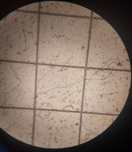
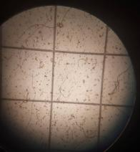
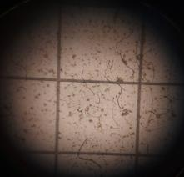
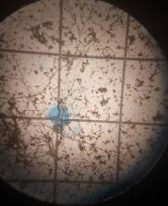
Sample3-3
(2,-4)
(-1,-1)
(-4,-4)
(1,1)

Slide 15
NTU Drunken Moon Lake
Numbers | Date | Time | Electronic Thermometer(°C) | Paper Thermometer (°C) | Turbidity (JTU) | pH Value | Dissolved Oxygen (DO ppm) | Electronic pH Meter
4-1 | 2025/1/4 | 10:42 | 18.7 | 17 | 0 | 7 | 0 | 6.7
4-2 | 2025/1/5 | 14:06 | 20.7 | 19 | 0 | 6 | 1 | 6.3
4-3 | 2025/1/5 | 16:14 | 20.6 | 19 | 40 | 7 | 0 | 6.6
5-1 | 2025/1/4 | 11:10 | 19.3 | 17 | 0 | 7 | 1 | 7.1
5-2 | 2025/1/5 | 14:22 | 20.6 | 19 | 0 | 8 | 2 | 8.3
5-3 | 2025/1/5 | 16:23 | 20.1 | 19 | 0 | 8.5 | 3 | 8.2
6-1 | 2025/1/4 | 11:31 | 19.2 | 17 | 0 | 6 | 0 | 6.7
6-2 | 2025/1/5 | 15:00 | 21.0 | 19 | 0 | 8.5 | 3 | 8.3
6-3 | 2025/1/5 | 16:39 | 20.3 | 19 | 40 | 7 | 1 | 7.3

Slide 16
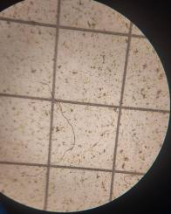
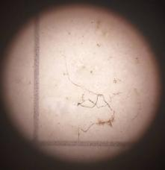
Sample
6-1
6-3
(-1,-3)

Slide 18
Table 1
The water quality at Taipei Daan Forest Park and NTU Drunken Lake
 | Daan Forest Park | NTU Drunken Lake
 | n=9 | n=9
 | AVG.(Max, Min) | M(Max, Min)
PH value | 7.0(8.0,6.0) | 7.4(8.5,6)
Temperature(℃) | 18.0(19.4,15.9) | 18.0(19.4,15.9)
Water Temperature(℃) | 18.7(19.5,17.2) | 20.1(21.0,18.7)
Turbidity(JTU) | 13.3(50,0) | 8.9(40,0)
Dissolved Oxygen(ppm) | 1(2,0) | 1.4(3,0)

Slide 20
Results:
The final result of the comparison is that Daan Forest Park has lower dissolved oxygen, higher turbidity, lower water temperature, and similar pH values.

Slide 21
Discussion
★What are the ecological differences between the ecological pond in Daan Forest Park and the Drunken Moon Lake at National Taiwan University?
★Water Quality Differences in Drunken Lake, National Taiwan University ？
★What is the thin film on the water surface?
★Factors like, pH values in water quality can indeed vary due to the presence of plants and animals in wetlands？

Slide 22
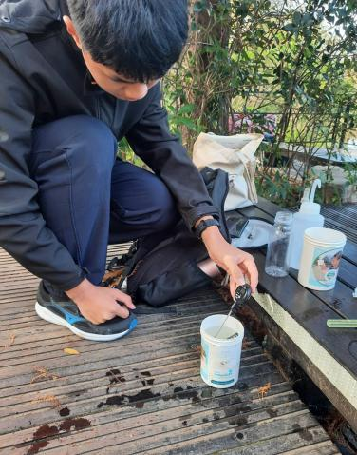
WHAT I FOUND
What are the ecological differences between the ecological pond in Daan Forest Park and the Drunken Moon Lake at National Taiwan University?
Due to Dann Forest Park extremely low dissolved oxygen levels, there are very few animals. In contrast, the Drunken Moon Lake at National Taiwan University boasts a rich ecosystem. In terms of birds, there are Muscovy ducks, black swans, moorhens with red crests, and western cattle egrets. The fish species are mainly koi, and there are reptiles like red-eared sliders.

Slide 23
Water Quality Differences in Drunken Moon Lake, National Taiwan University
The pH values at the two upper points are slightly alkaline, ranging between 7.5 and 8.4, while the pH value at the lower point ranges between 6.2 and 7.35.

Slide 24
What is the thin film on the water surface?
Reduced Oxygen Exchange: The film hinders gas exchange between the water surface and the atmosphere, reducing dissolved oxygen in the water, which may negatively affect aquatic organisms, especially oxygen-dependent species.
Changes in pH: Certain substances in the film may release acidic or alkaline compounds, altering the pH of the water body.
Oxygen Deficiency Issues: The film causes lower dissolved oxygen levels, impairing the respiration of aquatic organisms.
Limited Reproduction and Growth: Oxygen deficiency restricts the reproduction and growth of aquatic life, adversely affecting the ecosystem.

Slide 25
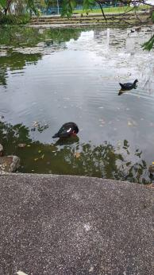
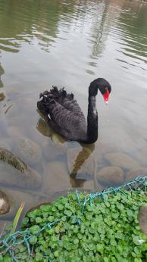
Factors like, pH values in water quality can indeed vary due to the presence of animals in wetlands.
Through our observations, we found that the water in Zones 4 and 5 of NTU's Drunken Moon Lake was slightly alkaline, while the water in Zone 6 was slightly acidic. The key difference between these areas is that Zones 4 and 5 had waterfowl and no surface film, whereas Zone 6 had no waterfowl but did have a surface film. Based on this, we hypothesize that the slightly alkaline nature of Zones 4 and 5 may be related to the presence of waterfowl. Furthermore, we observed that the waterfowl excreted waste near our observation sites, leading us to reasonably infer that their feces may contribute to the alkalinity of the water.

Slide 26
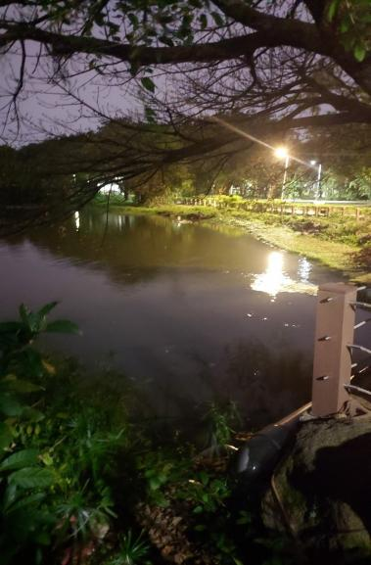
Conclusion and Recommendations
We know from our own observation data and related literature that the results of the research we have put forward have been confirmed, for example, the film on the water surface is determined to be an oil film, and I have observed that there is a difference in the pH value and dissolved oxygen content of the same water area without the oil film, which in turn affects the ecology of the water and also causes damage to the water quality, so we need to protect this water area even more.

Slide 27
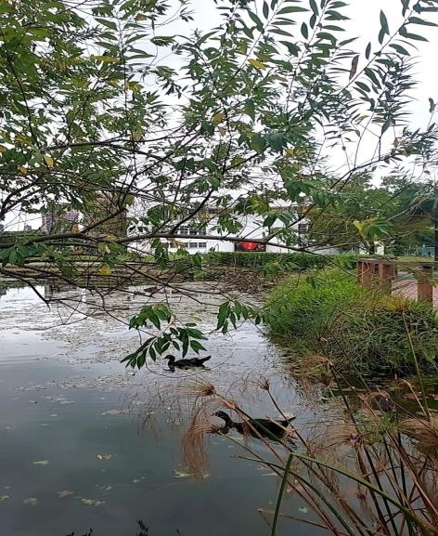
References

Slide 28
陳以容、侯文祥、周楚洋、林懿蘋 (2016)。結合生物水質管理法與物理曝氣法處理景觀湖水質之研究-以臺灣大學醉月湖為例。農業工程學報, 62(3), 13-22.
Chen Y., Hou W., Xiang Z., Chu Y., & Lin Y.(2016).Integrated Biomanipulation and Micro-Bubble Aerator Treatment Landscape Ponds Water for National Taiwan University Drunken Moon Lake. Journal of Taiwan Agricultural Engineering,62(3), 13-22.

