Slide 1




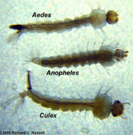
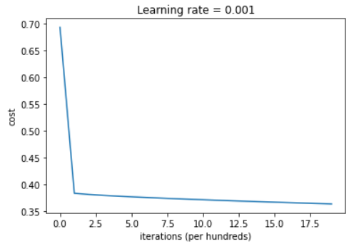
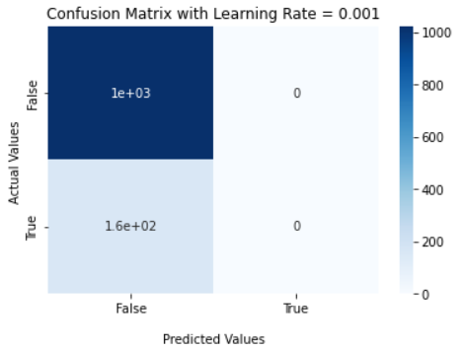

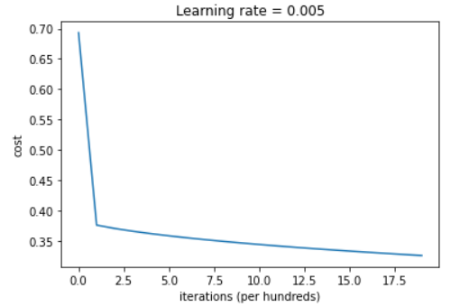
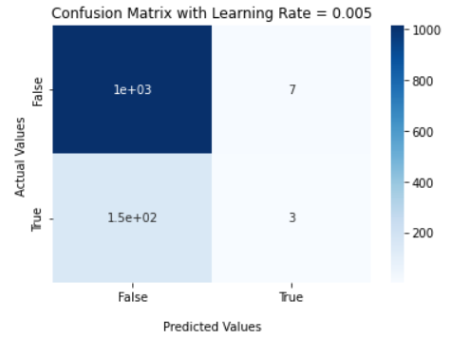
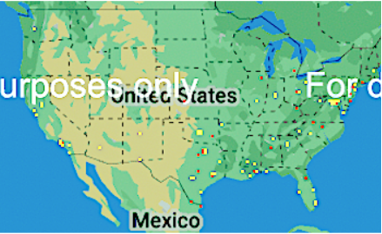
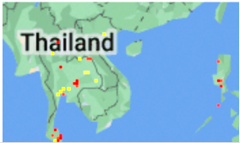

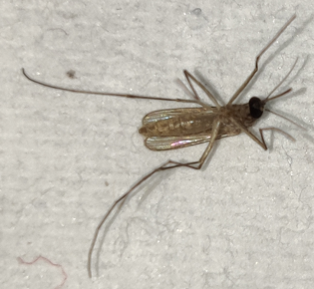
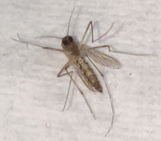
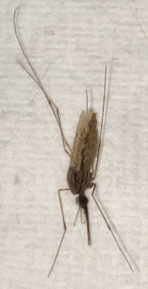
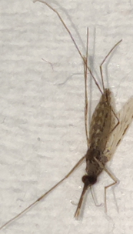
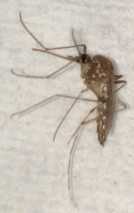
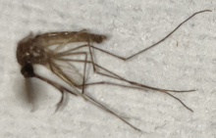
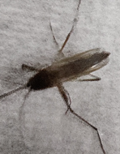
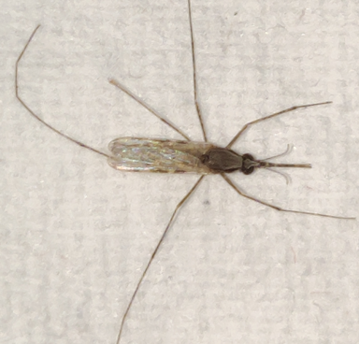
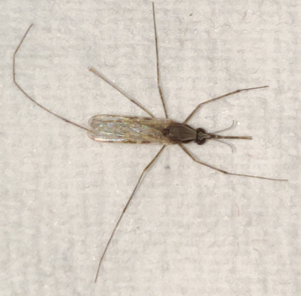
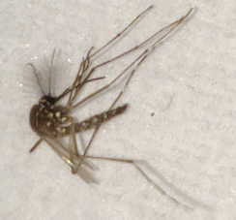
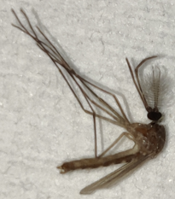
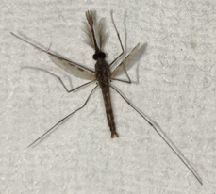
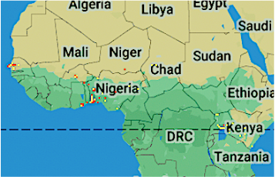
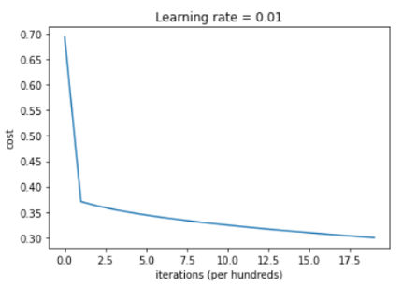
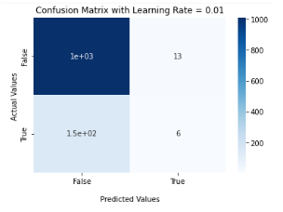
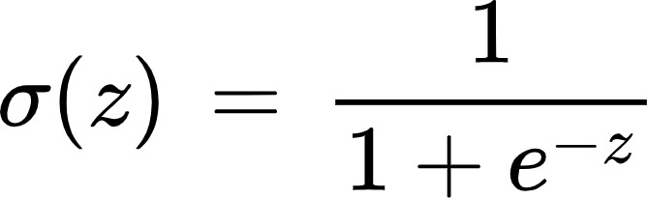
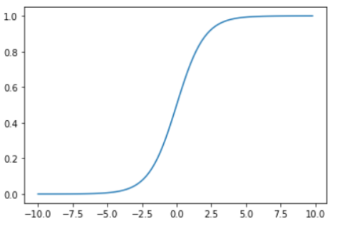
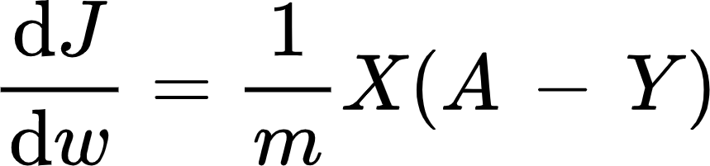

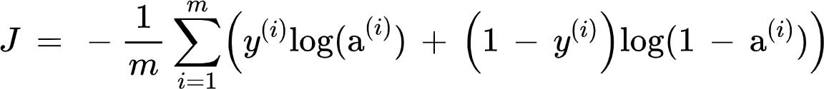
MASC AI: Novel Method for Effective Mosquito Data Classification and Mapping
Nikita Agrawal, Samhitha Duggirala, Elizabeth Gorman, William Hong, Joseph (Alex) Kim, Nithin Reddy, and Aesha Shah
NASA SEES 2022 GLOBE Earth System Explorers
Introduction
Key Findings
Results
Mosquitoes are the deadliest animal to humans, causing over 700,000 deaths annually worldwide
A specific genus of mosquitoes, Anopheles, accounts for around 500,000 of said deaths due to their transmission of the disease malaria. This parasitic disease enters the bloodstream through the liver and targets red blood cells (CDC, 2021)
The GLOBE Mosquito Habitat Mappers tool in the GLOBE Observer app allows anyone worldwide with a smartphone to photograph and document mosquito larvae/habitats and add them to the global database. However, many of these classifications are either inaccurate or incomplete due to a lack of accountability and training of the remote citizen scientists.
The novel AI model created can be applied to accurately classify mosquito species, mapping to geographical regions
Classification Model 1: Learning Rate = 0.001
You can add to NASA’s mosquito database! Start by downloading the GLOBE Observer App on your phone by scanning the QR Code
train accuracy: 87.47433264887064 %
test accuracy: 86.70618120237087 %
Model Mapping
Classification Model 2: Learning Rate = 0.005
Anopheles
Aedes
Culex
Map 1
Map 2
Research Question
What is the general understanding of Anopheles population demographics worldwide, and how does it compare to the GLOBE MHM app’s database?
train accuracy: 87.47433264887064 % test accuracy: 86.36748518204911 %
What percentage of the GLOBE MHM database species classification was inaccurate before correction from the data verification team?
United States Region mapping of mosquito by species as generated by the MASC AI model
East Asia Region mapping of mosquito by species as generated by the MASC AI model
Map 3
Map 4
Classification Model 3: Learning Rate = 0.01
To what accuracy can the MASC AI classify images of mosquitoes between three genera that are the leading cause of vector-borne diseases by mosquitoes?
Experimental Design
Sigmoid Function Equation:
Sigmoid Function Graph
West Africa Region mapping of mosquito by species as generated by the MASC AI model
East Africa Region mapping of mosquito by species as generated by the MASC AI model
The derivatives of the parameters:
train accuracy: 88.24435318275154 %
test accuracy: 86.11346316680779 %
σ (Output)
Acknowledgements
Equation used to update the parameters:
This project was successful thanks to the guidance of SEES Earth System Explorer mentors, Dr. Russanne Low, Ms. Cassie Soeffing, Mr. Peder Nelson, Dr. Erika Podest, Andrew Clark, and Dr. Di Yang, and peer mentors, Bill Lam, Kellen Meymarian, and Matteo Kimura.
The material contained in this paper is based upon work supported by the National Aeronautics and Space Administration (NASA) cooperative agreements NNX16AE28A to the Institute for Global Environmental Strategies (IGES) for the NASA Earth Science Education Collaborative (NESEC) and NNX16AB89A to the University of Texas Austin for the STEM Enhancement in Earth Science (SEES). Any opinions, findings, conclusions, or recommendations expressed in this material are those of the authors and do not necessarily reflect the views of NASA.
Conclusion
z (Input)
Mosquitoes are found in tropical/subtropical areas and densely populated in East African countries such as Ethiopia, Sudan, and Kenya. This was consistent with the GLOBE MHM data, with around 80% of the mosquito larvae classified through MASC AI as Anopheles from the Africa database.
90% of the data was either inaccurate or not even classified in the first place which shows how severely inaccurate the current classification system is.
MASC AI returned a train accuracy of 88.24% and a test accuracy of 86.11%, which is higher than originally expected. Compared to other alternatives for Anopheles verification, such as through molecular protein profiling, the accuracy metrics from our AI model continued to outperform, indicating that MASC AI serves as a plausible solution for reclassification
The cost function is given by:

