Slide 1

Modeling the Dynamic Relationship Between Atmospheric Salt Spray and Air-Soil Thermal Fluctuations and Their Impact on Environmental Sustainability and Light Transmittance at Al-Naqaa School Observatory (Al-Afifa, Sohar)
Prepared by: Jana Abdullah Al-Maqbali
Lina Mohammed Shawky
Supervised by: Ms. Haifa Al-Kaabi

Slide 2
Abstract:
This investigative research, conducted by the GLOBE team at Al-Naqaa School Observatory, serves as an integrated scientific document aimed at understanding the complex interactions between the climate and the coastal ecosystem in the Al-Afifa area of Sohar. The study focuses on modeling the dynamics of atmospheric salt deposition and its impact on light transmittance by applying Atmospheric, Hydrologic, and Soil protocols. The methodology was implemented through defined roles based on program badges: the (Problem Solvers) innovated micron-scale spray collectors and designed the "calibrated slide washing" experiment; the (Data Collectors) committed to daily monitoring of soil temperature, air temperature, and humidity levels from September 2025 to January 2026; while the (Collaborators) played a pivotal role in coordinating operations, ensuring sample quality, and unifying laboratory measurement standards.
The results revealed a strong positive correlation between high humidity, sea breeze activity, and an increased saline footprint. Conductivity values peaked in September at an average of 540 µS/cm, coinciding with a maximum soil temperature of 41.5°C. The research concluded that the accumulation of the "salt crust" causes a reduction in light energy transmittance by up to 21.6%. This necessitates sustainable maintenance strategies, including periodic washing and thermal insulation of both technical and biological surfaces in the Omani coastal environment.
Scientific Keywords: Salt Spray, Electrical Conductivity (EC), Light Transmittance, Environmental Sustainability, Thermal Fluctuations.

Slide 3
Introduction & Literature Review
The Al-Afifa area in Sohar is considered an open natural laboratory where direct marine influences intersect with human, agricultural, and technical activities. The research problem lies in the team's observation of "salt accumulations" that gradually deposit on surfaces, causing deterioration in physical properties and a decline in light transmittance efficiency. The significance of this research is in addressing the issue of "imperceptible efficiency loss"; farmers and institutions may not realize that declining productivity is caused by a transparent salt crust that obstructs light and alters surface chemistry.
This research directly serves the local environment by providing a chronological roadmap of peak salt deposition times, aiding in the scheduling of maintenance for crops and equipment in Sohar. Previous studies, such as Al-Fahdawi (2024), indicate that heat and humidity are the primary drivers for atmospheric pollutant accumulation, while Al-Namrawi (2020) clarified that salt aerosols directly affect the transparency of media. Furthermore, Al-Dhamen (2023) confirmed that salt accumulation alters hydrochemical properties, a factor this research seeks to link to the field reality of the Al-Afifa region. This study does not only serve science but also enhances local sustainability by protecting resources from the corrosive effects of salt spray, making it perfectly aligned with the needs of the Omani coastal community and the goals of Oman Vision 2040.

Slide 4
Research Questions
First Question (Atmosphere): What is the impact of changes in humidity percentages and sea breeze speed on the electrical conductivity values of salt spray deposited weekly at Al-Naqaa School Observatory?
Second Question (Soil & Heat): How do fluctuations in soil and air temperatures (Maximum and Minimum) affect the drying rate of the spray and the formation of a solid salt crust?
Third Question (Sustainability): What is the quantitative loss in light transmittance resulting from salt accumulation under climatic variations from September to mid-January?

Slide 5
Methodology
The methodology is based on the integration of field observations and laboratory measurements at the study site (Al-Naqaa School Observatory in Al-Afifa).
1- Study Site:
Al-Naqaa School Observatory, located in the coastal area of Al-Afifa in the Wilayat of Sohar, was chosen as the primary center for this research. The site is characterized as an open area directly exposed to sea breezes coming from the Sea of Oman, making it an ideal natural laboratory. Students in the (Problem Solvers) role surveyed the site and accurately determined geographic coordinates using GPS. The monitoring station was placed away from urban obstacles to ensure the accuracy of atmospheric measurements. The land cover at the site consists of coastal sandy soil with specific thermal properties that affect evaporation rates. The (Collaborators) supervised site security and the distribution of measurement stations (Stevenson Screen, soil measurement area, and salt spray collector platforms) to ensure a smooth workflow according to GLOBE standards.
2-Climatic Characteristics:
Al-Afifa area is subject to a dry tropical coastal climate, characterized by sharp thermal and humidity fluctuations. The (Data Collectors) team recorded the following:
Temperature: High maximum summer temperatures reaching 38.6°C and a moderate winter climate.
Humidity: Very high relative humidity levels exceeding 80%, which is the factor responsible for carrying salt particles from the sea to the land.
Wind: Active sea breeze activity that acts as a driving force for salt spray toward the observatory.
Soil Temperature: Recorded high levels reaching 41.5°C, leading to the immediate drying of salt spray upon contact with surfaces and the formation of a solid crust.

Slide 6
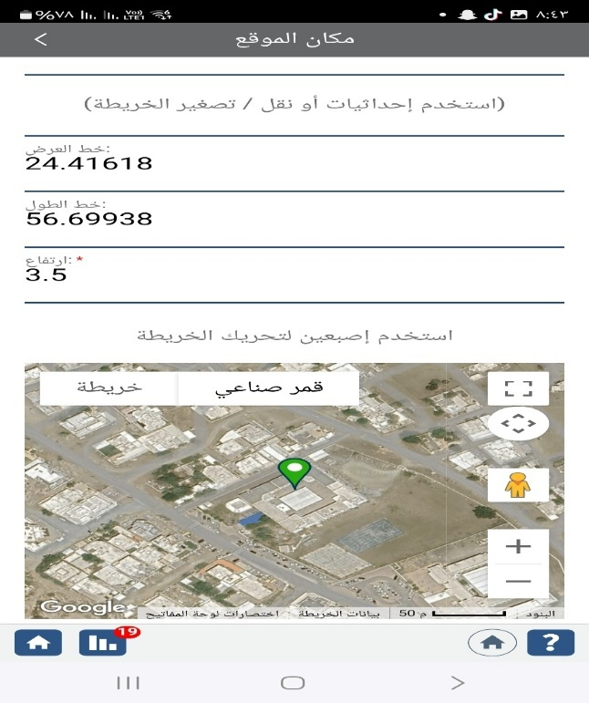
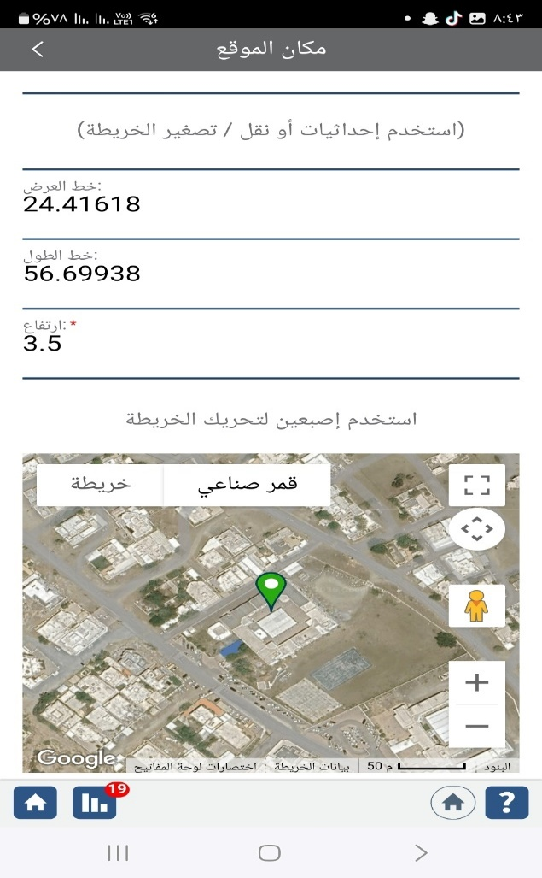
Picture (1): School Location

Slide 7
Student Roles & Instruments Used:
The (Data Collectors) team performed daily monitoring using a Digital Soil Thermometer for temperature at a 5 cm depth, and a Maximum/Minimum Thermometer inside the Stevenson Screen, in addition to a Digital Anemometer for wind speed and a Digital Hygrometer for humidity.
The (Problem Solvers) team innovated glass "spray collectors" (10cm x 10cm) and fixed them to face the sea breezes, designing a "standardized dissolution" process for salts by washing them with 50 ml of distilled water.
The (Collaborators) organized weekly sample collection and ensured unified measurement standards using a Multi-parameter Meter to measure Conductivity (EC) and Salinity (TDS).
Protocol Application:
The Atmosphere Protocol was applied daily, the Soil Protocol was used to monitor the impact of surface heat, and the Hydrology Protocol was utilized to analyze the quality of the wash water resulting from the salt spray, creating a direct link between the data and the research questions.

Slide 8
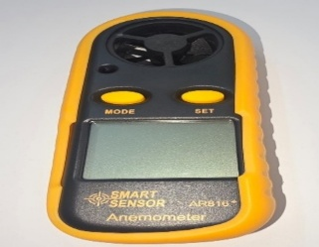
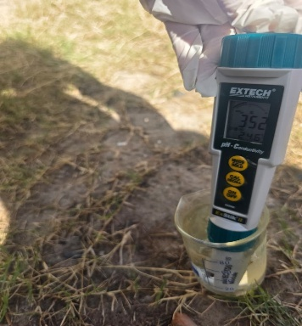
Picture 2: Demonstration of Protocol Implementation and Field Instruments Used by Students

Slide 9
Month | Max Air Temp (°C) | Min Air Temp (°C) | Soil Temp (°C) | Relative Humidity (%)
September 2025 | 38.6 | 29.5 | 41.5 | 82%
October 2025 | 34.5 | 26.2 | 37.9 | 75%
November 2025 | 28.9 | 21.0 | 31.4 | 68%
December 2025 | 25.0 | 18.5 | 27.0 | 62%
January 2026 | 23.8 | 16.2 | 25.5 | 58%
Table (2): Monthly Averages for Temperature and Humidity (Atmosphere and Soil Protocols)

Slide 10
Scientific Analysis of Table (1)&Graf(1): The analysis indicates that September represents the "Thermal Peak" at Al-Naqaa School Observatory, where the highest recorded humidity (82%) coincided with the highest soil temperature (41.5°C). This high humidity level acts as a carrier for atmospheric salts, while the elevated soil temperature functions as a "fixation" agent; it triggers the rapid evaporation of water, leaving solid salt crystals firmly deposited on the surfaces.
GRAF (1): Monthly Averages for Temperature and Humidity (Atmosphere and Soil Protocols)

Slide 11
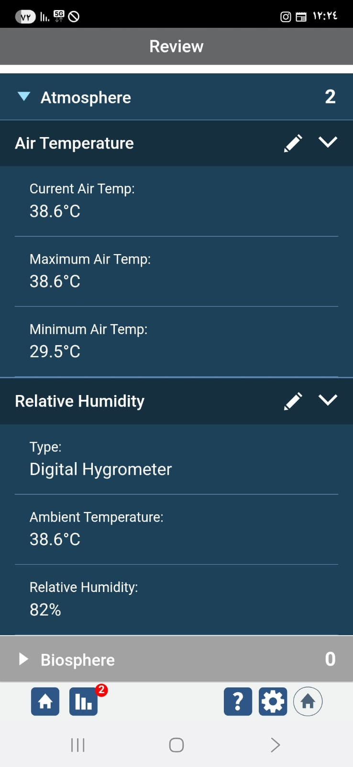
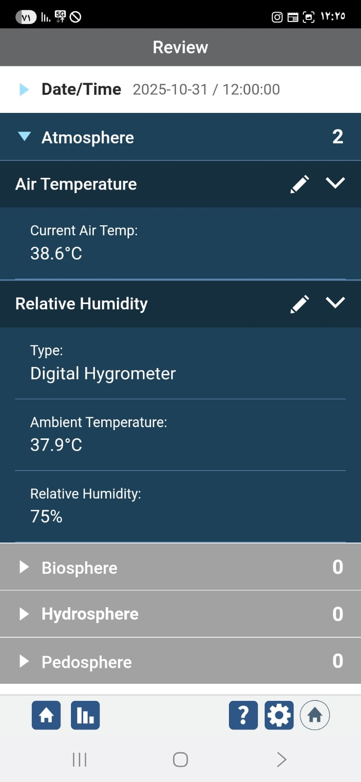
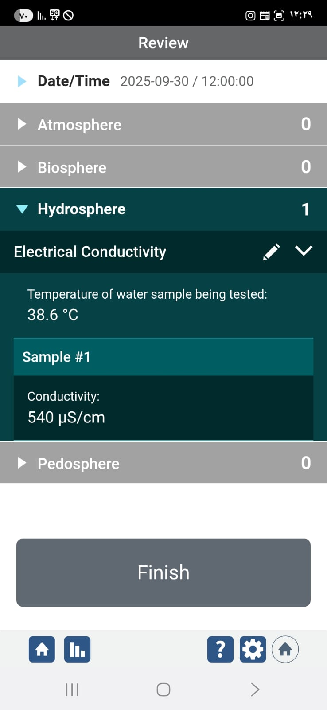
Picture 3: Field Documentation and Real-time Data Logging at the Study Site

Slide 12
Month | Conductivity () | Salinity () | Light Transmittance (%) | Light Obstruction (%)
September 2025 | 540 | 345 | 78.4% | 21.6%
October 2025 | 410 | 262 | 81.4% | 18.6%
November 2025 | 290 | 185 | 87.7% | 12.3%
December 2025 | 185 | 118 | 93.7% | 6.3%
January 2026 | 160 | 102 | 95.2% | 4.8%
Table (3): Average Conductivity, Salinity in Salt Spray, and Light Obstruction
Scientific Analysis of Table (2): This table reveals a direct physical impact; electrical conductivity reached its peak (540 µS/cm) in
September, resulting in the obstruction of 21.6% of light. There is a strong negative linear correlation between atmospheric salinity and light transmittance; as salinity decreases (as observed in January), light transmittance increases, reaching 95.2%
Here is the professional English translation for the final sections of your research, ensuring the inclusion of the GLOBE team as requested and maintaining high academic standards.

Slide 13
Discussion of Results
The results at Al-Naqaa School Observatory showed a strong positive correlation between climatic variables and the density of deposited salt spray, confirming the research hypotheses. September recorded the highest saline footprint due to the synchronization of high humidity and heat, which physically explains the process of "concentrated evaporation" of salts. These findings align with the study by Al-Dhamen (2023) regarding the impact of climatic elements on increasing salinity concentrations. The results categorically answered the research questions, proving that seasonal variation is the primary driver of atmospheric purity and light transmittance efficiency.
Potential Sources of Error: The interference of terrestrial dust with salt spray, and humidity fluctuations that may affect the drying speed of samples. When comparing the results with the study of Al-Namrawi (2020), we find that the coastal location of Al-Naqaa School makes it more susceptible to salinity stress, providing added value to the understanding of the micro-environment of the Al-Afifa region.

Slide 14
Conclusion
The research concluded that the interaction between salt spray, thermal fluctuations, and humidity constitutes a decisive factor in the sustainability of coastal systems at Al-Naqaa School Observatory. It was proven that the application of Atmospheric, Hydrologic, and Soil protocols revealed a "seasonal saline cycle" causing a loss in light transmittance exceeding 21% during the summer.
We emphasize that the integration of team roles among the Problem Solvers, Data Collectors, and Collaborators at Al-Naqaa School Observatory (with constant credit to the GLOBE team) was the cornerstone of this research's success.

Slide 15
Closing Statement
"As we conclude our research journey at Al-Naqaa School Observatory, we affirm that this work is not merely numbers and tables, but a scientific message confirming that our understanding of coastal climate details is the true key to achieving environmental sustainability in the Sultanate of Oman. Through the GLOBE program, we have learned that accurate monitoring and team-spirited cooperation are what transform environmental challenges, such as salt spray, into opportunities for innovation and development. Our results, which revealed the seasonal impact of salinity on light transmittance, provide the local community and researchers with a scientific database that serves Oman Vision 2040 in preserving environmental resources. Thank you for your kind attention, and we hope this research serves as a new brick in the edifice of Omani scientific research."

Slide 16
Acknowledgments
Ms. Haifa Al-Kaabi, Project Supervisor, for her precise scientific supervision and protocol implementation.
Eng. Azhab Al-Rushdi from the Water Authority, for her technical contribution to innovating salt spray measurement methods.
Mr. Yusuf Al-Maamari, Program Supervisor at the Directorate, for his logistical support and provision of scientific instruments.
The Al-Naqaa School family and the international GLOBE program.

Slide 17
References
Al-Dhamen, M. (2023). The Impact of Climate Change on Surface Water Quality in Coastal Areas. Dar Al-Ulum.
Al-Rahaifeh, A. (2023). Environmental Sustainability and Atmospheric Purity: A Study in Atmospheric Aerosols. Cultural Center.
Al-Fahdawi, R. (2024). Evaporation Dynamics and Climatic Water Demand in Coastal Regions. Journal of Geographic Studies.
Al-Namrawi, S. (2020). The Effect of Salt Spray on Light Transmittance. Encyclopedia of Environmental Sciences.
The International GLOBE Program. (2025). Atmosphere, Soil, and Water Protocol Manual. Updated Version.
Al-Otaibi, N. (2022). Chemical and Physical Characteristics of Marine Aerosols in Arid Regions. Journal of Environmental Research.

Slide 18


