Slide 1
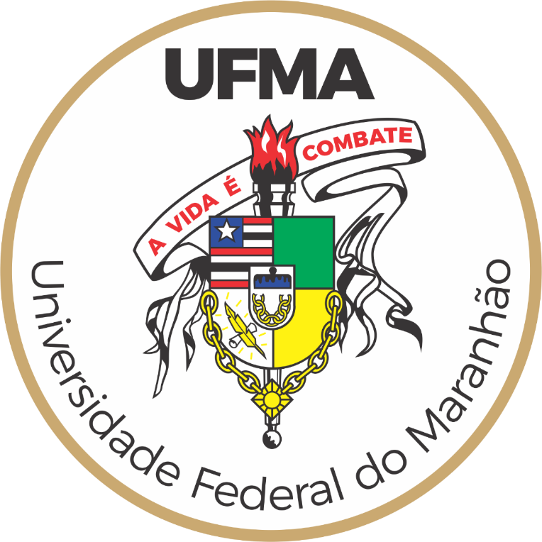
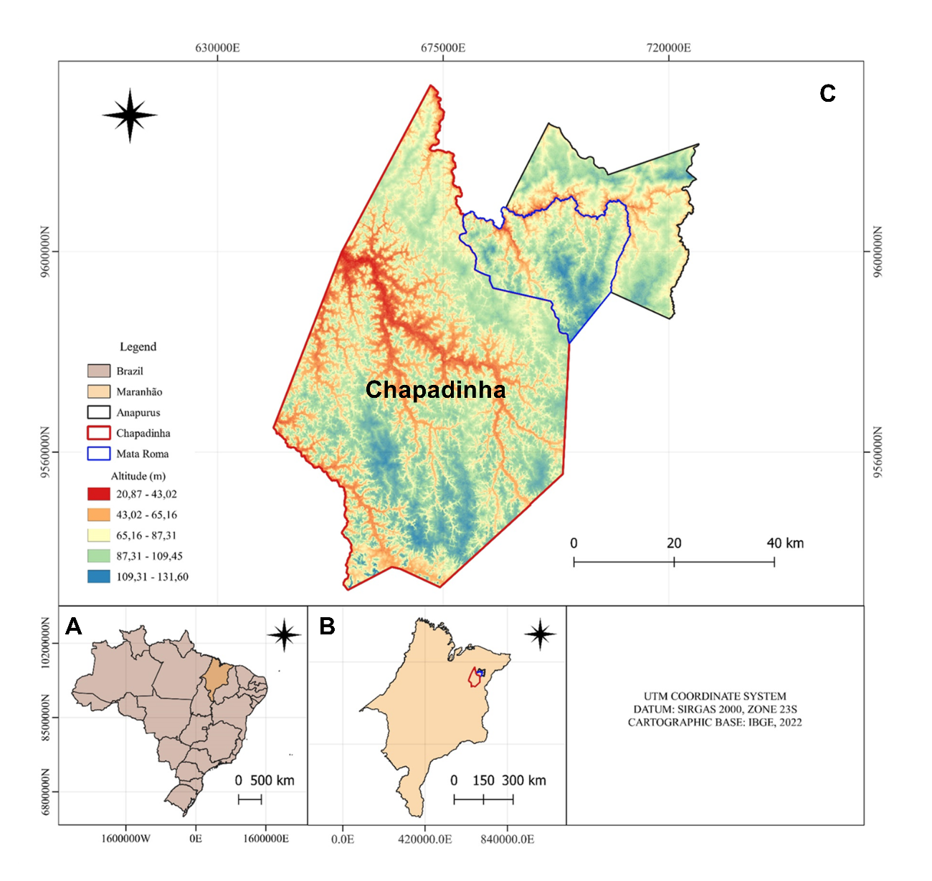
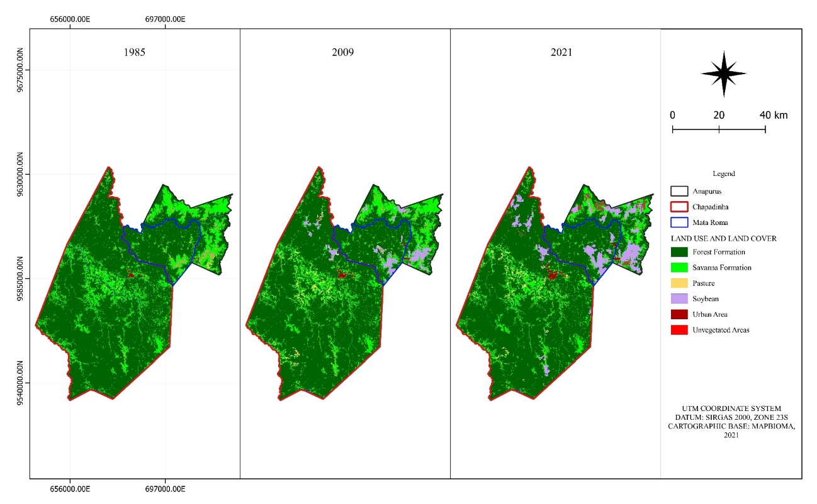
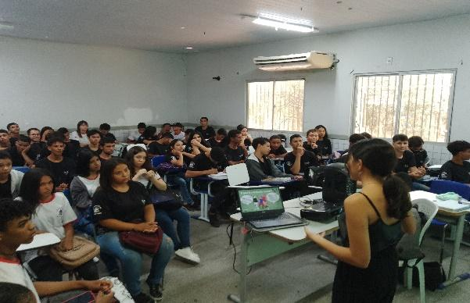
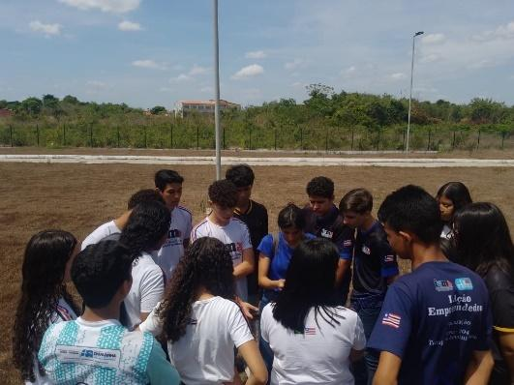
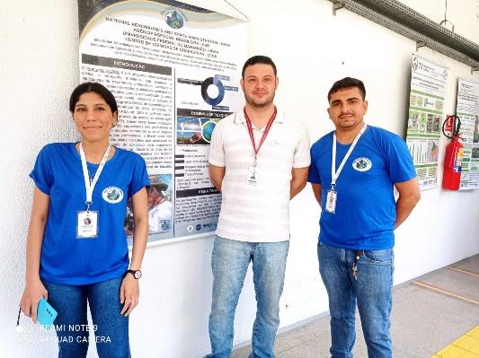
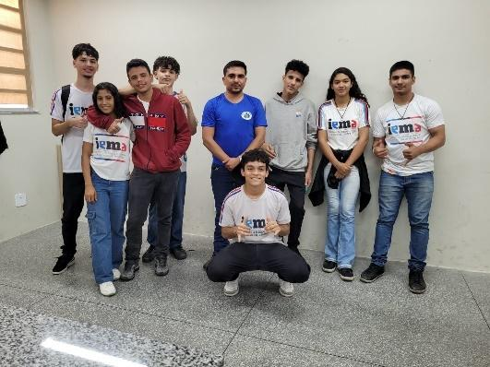
Dynamics of land use and occupation in areas of expansion of soybean cultivation in the Chapadinha microregion, state of Maranhão (Brazil).
Lorenzo Silva¹, Max da Silva², Andreza de Sousa², César dos Reis², Maria Araujo², Joaquim Júnior², Nítalo Machado²
¹State Institute of Education, Science and Technology of Maranhão – IEMA
²Federal University of Maranhão - UFMA
Abstract
Figure #1
Results
Conclusions
This study examines the dynamics of land use and cover in Chapadinha, Maranhão, Brazil, focusing on the years 1985, 2009, and 2021.
The study highlights the environmental impacts of these changes, including deforestation, biodiversity loss, and soil degradation. It emphasizes the need for sustainable agricultural practices to mitigate these effects and ensure the preservation of natural resources in Chapadinha.
Analyzing Data
In 1985, Chapadinha was mainly covered by Forest Formation (84.5%) and Savanna Formation (14.2%). Pasture, Non-vegetated, and Urbanized Areas were just 0.2% each; Soy was negligible.
By 2009, Forest and Savanna cover slightly decreased, while Pasture and Soy grew to 1.7% and 0.7%, respectively.
In 2021, Forest and Savanna continued to shrink, Pasture reached 1.8%, and Soy increased to 2.0%. Non-vegetated and Urbanized Areas grew to 0.5% each.
Drawing Conclusions & Next Steps
A significant state of progressive degradation of the Forest Formation vegetation has been observed, accompanying the expansion of infrastructure in Chapadinha and a considerable increase in agricultural and livestock production in the area. This scenario raises concerns about environmental impacts, such as deforestation, biodiversity loss, and soil degradation.
The expansion of agricultural and livestock production in the Chapadinha microregion, particularly the increase in soybean cultivation, has significant implications for biodiversity and the environment. The conversion of natural ecosystems, such as forests and savannas, into agricultural land leads to the loss of habitat for a wide range of species, resulting in a decline in biodiversity. This loss of biodiversity can disrupt ecosystem services, such as pollination, pest control, and nutrient cycling, which are vital for maintaining agricultural productivity and environmental sustainability.
The initiative leveraging the GLOBE Observer Land Cover protocol, with the support of NASA's resources, tem ajudado a melhorar a compreensão da comunidade local sobre a dinâmica do uso da terra, incutindo um sentido de responsabilidade ambiental e orientando um esforço colaborativo para o desenvolvimento sustentável e a preservação do ecossistema.
Table #1
Research Question
Asking Questions
Human interaction with the environment, especially regarding the use of natural resources, results in a series of environmental impacts. Given this scenario, we propose the hypothesis that the application of geoprocessing techniques will allow for a detailed analysis of landscape transformations, enabling the identification of patterns and relationships between economic growth and changes in land use and cover.
Planning Investigations
Describes the planning process
This project leverages the GLOBE Observer Land Cover protocol and NASA's tools to promote sustainable farming and protect Chapadinha's environment.
Training workshops were held for IEMA students, led by previously trained UFMA monitors, with a focus on practicality for the students' context.
Using UFMA's computer labs and MapBiomas Project Collection 8 data, satellite images were processed to examine land use changes in Maranhão.
These images were categorized and analyzed in Excel®, looking at various land categories over 1985, 2009, and 2021 to measure the alterations in land use and cover.
Figure #2
Introduction
Content Knowledge
The state of Maranhão, especially municipalities within the cerrado biome such as Chapadinha, faces social vulnerability and a lack of data on land use dynamics. The region is under environmental stress from climate change and agricultural growth, worsened by insufficient public policy and government action, leading to concerns about haphazard land use.
The project emphasizes the need for sustainable farming to alleviate negative impacts and protect Chapadinha's natural resources. Combining research with education, it seeks to enhance local understanding of land use changes and encourage environmental care, utilizing the GLOBE Observer Land Cover protocol.
Bibliography
References
ALVARES, C.A. et al. Köppen’s climate classification map for Brazil. Meteorologische Zeitschrift, v. 22, n. 6, p. 711–728, 2013. https://doi.org/10.1127/0941-2948/2013/0507
CORRÊA, W., et al. Atualização da classificação climática e balanço hídrico climatológico no estado do Maranhão. Revista Brasileira De Climatologia, v. 32, n. 19, p. 517–543, 2023. https://doi.org/10.55761/abclima.v32i19.16727
FIORESE, C. H. U. Uso e ocupação das terras na sub-bacia do córrego dos pontões, no município de Mimoso do Sul, Espírito Santo – Brasil. Pensar Acadêmico, v.19, n. 2, 2021. https://doi.org/10.21576/pa.2021v19i2.1939
IBGE. Monitoramento da cobertura e uso da terra do Brasil: 2018/2020 / IBGE, Coordenação de Meio Ambiente. - Rio de Janeiro: 2022. 39 p.
SILVA JUNIOR, C. H. L. et al. Northeast Brazil’s imperiled Cerrado. Science, v. 372, n. 6538, p. 139–140, 2021.
SOUZA, C. M. et al. Reconstructing Three Decades of Land Use and Land Cover Changes in Brazilian Biomes with Landsat Archive and Earth Engine. Remote Sensing, v. 12, n. 17, p. 2735, 2020.
Discussion
Interpreting Data
Land use in Chapadinha, Brazil, has shifted over 36 years, with a decline in natural vegetation and a rise in agriculture and urban areas.
Minimal anthropogenic impact on land cover was noted in 1985.
By 2009, pasture and soybean cultivation increased, due in part to the relocation of southern producers and the entry of large companies.
Soybean area and production grew notably from 2009 to 2021, intensifying deforestation.
This agricultural expansion threatens biodiversity and ecosystem services, underscoring the need for sustainable practices.
Students from IEMA and UFMA have gained a profound understanding of the significance of monitoring changes in land use and coverage. They now recognize the role of forest conservation in protecting the environment.
Research Methods
Planning Investigations
Describes the planning process
The study area encompassed the municipalitie of Chapadinha (Latitude: 3° 44' 26'' South, Longitude: 43° 21' 33'' West), with a territorial extension of 3247.385 km², (Figure 1). This region, located in the Cerrado Biome, is characterized by the Aw and Aw' climate, according to the Köppen classification.
Average annual precipitation of 1400 mm and average air temperature between 23°C and 29°C (Alvares et al., 2013; Corrêa et al., 2023). Additionally, it assumes significant socioeconomic relevance for the state of Maranhão,.
Field Photos

