Slide 1
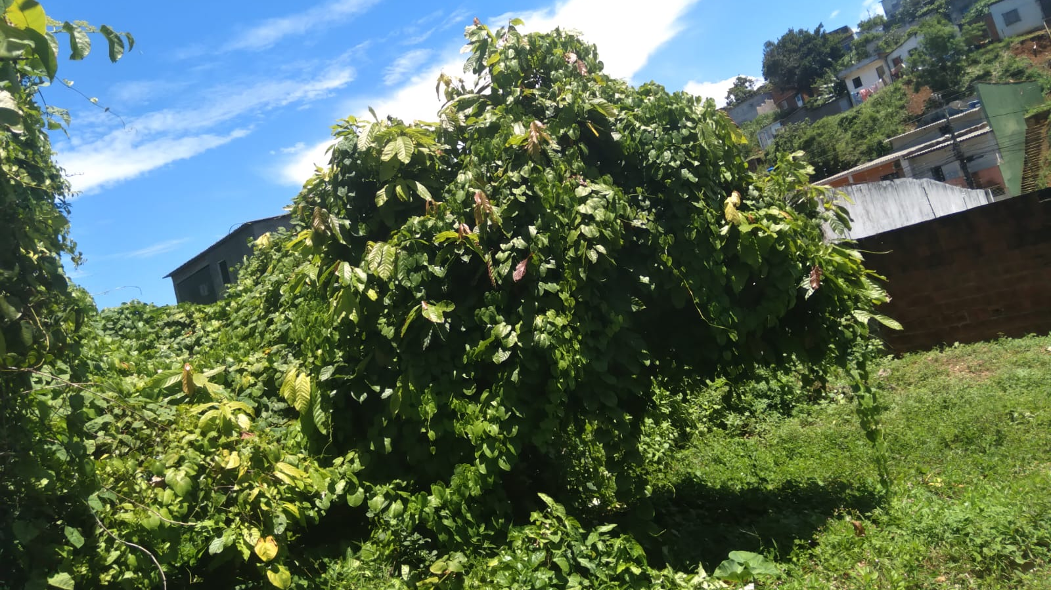
"Investigations on Climate: Understanding Earth as a System and TREES."
Project for Monitoring Tree Falls using Globe Observer Trees

Slide 2
Cocoa Trees in Ilhéus:
Ilhéus, located in the Brazilian state of Bahia, is renowned for its historic cocoa plantations. Cocoa trees (Theobroma cacao) are native to the Americas and are the source of cocoa beans used to produce chocolate and other cocoa-based products. Ilhéus was once a major center of cocoa production, shaping the region's economy and cultural identity.

Slide 3


Slide 4
Our project focuses on the critical role that trees play in mitigating climate change and enhancing environmental resilience. By monitoring and conserving iconic trees worldwide, we aim to raise awareness and promote sustainable practices that contribute to climate resilience.
Our initiative encompasses the monitoring of several iconic trees renowned for their historical, cultural, and ecological significance. From Isaac Newton's legendary apple tree to the majestic baobabs of Africa, each tree symbolizes a unique aspect of our natural and cultural heritage.
Through the utilization of the Globe Observer platform, we engage citizen scientists and communities in the monitoring process. Participants collect valuable data on tree health, growth patterns, and environmental conditions, contributing to scientific research and conservation efforts

Slide 5
The iconic trees we monitor serve as essential carbon sinks, sequestering carbon dioxide from the atmosphere and helping to mitigate the effects of climate change. Additionally, they play crucial roles in regulating local climates, conserving soil and water, and providing habitats for diverse ecosystems.
By highlighting the significance of these trees and fostering community involvement, our project aims to inspire action and promote stewardship of our natural resources. Through collective efforts, we can safeguard these invaluable assets for future generations and build a more resilient and sustainable world.
Join us in our mission to monitor, conserve, and celebrate the remarkable diversity and importance of iconic trees in combating climate change and fostering environmental stewardship. Together, we can make a lasting impact on the health of our planet and ensure a brighter future for all.

Slide 6
Here's how these trees help in climate:
1. Carbon Sequestration: Trees absorb carbon dioxide (CO2) from the atmosphere during photosynthesis, helping to reduce the amount of this greenhouse gas responsible for global warming. Carbon is stored in trees and soil, aiding in mitigating climate change.
2. Oxygen Production: During photosynthesis, trees release oxygen into the atmosphere, providing the vital gas for human, animal, and other living organism respiration. This process helps maintain the balance of oxygen in the atmosphere, crucial for life on Earth.

Slide 7
3. Reduction of Urban Heat Island Effect: In urban areas, the presence of trees can help reduce the urban heat island effect, where temperatures are significantly higher than surrounding areas due to heat absorption and retention by urban structures. Tree shade and evaporation from leaves help cool the local environment.
4. Regulation of Humidity: Trees release water through a process called transpiration, contributing to air humidity and cloud formation. Tree transpiration can also influence precipitation patterns in certain regions, helping regulate the climate.
5. Soil and Water Conservation: Tree roots help prevent soil erosion, keeping it stable and preventing sedimentation in watercourses. Additionally, trees help regulate the hydrological cycle by absorbing water from the soil and releasing it gradually, which helps maintain water levels in rivers, streams, and groundwater.
6. Creation of Microclimates: Forests and wooded areas can create favorable microclimates, offering shelter from the wind, protection against extreme temperatures, and habitats for a diversity of plant and animal life.

Slide 8
The use of Globe Observer Trees as a tool for monitoring tree falls due to heavy rain allows for a collaborative, community-based approach to identifying and mitigating risks. By empowering citizens to actively participate in monitoring trees in their communities, we can improve safety and resilience in the face of extreme weather events.

