Slide 1
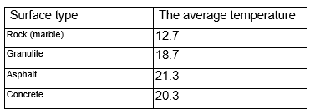
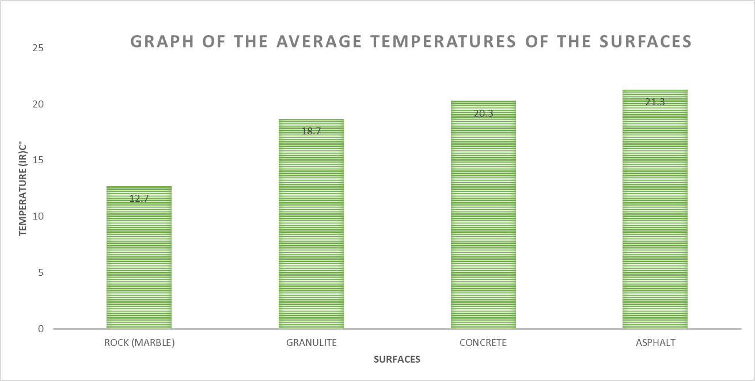
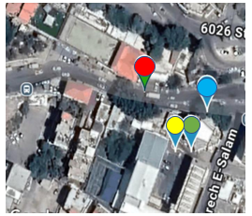
what is the relation between the type of surface and the temperature reflected from it
Nazareth Baptist school
9th grade students (Raya, Aleen, Jude)
School Logo
Abstract
Research Methods
Results
Conclusions
The research studied how different pavement materials (marble, asphalt, granulite, and concrete) affect surface temperatures and urban heat. The results showed that marble reflects the most light and retains the least heat (12.7°C), making it the best option for reducing heat. granulite, while not as effective, also performs better than concrete (20.3°C) and asphalt (21.3°C), which retain more heat. The recommendation is to use marble to help reduce urban heat in schools and cities.
GLOBE Badges
Be a Data Scientist
As scientists we collected data and measured the temperature of each surface and analyzed them. We calculated the average of the temperature of each surface. We created a graph of the results, that helped us reach the conclusions. And the conclusion helped us find a solution for urban heat and global warming to make an impact.
Be an Engineer
As engineers we want to find solutions for urban heat and global warming through engineering. In addition to that we also want to optimize a design to address the problem. We want to buy and put solar cells on the school’s roofs so that it can absorb the heat and reduce it and the sun’s radiation from reaching the surfaces.
Make an Impact
As scientists that want to make an impact, we want to recommend the school’s council and community to use solar cells, plant more trees, use surfaces that reflect the most heat and radiation such as rock(marble) and lessen the use of surfaces that absorbs the most heat such as asphalt and concrete.
the average temperature of the surface types
This research demonstrates the significant role of surface materials in influencing urban temperatures. We found that materials with higher reflectivity, such as marble, absorb less heat and maintain lower temperatures, while darker surfaces like asphalt and concrete absorb more heat, contributing to the urban heat island (UHI) effect. Our findings show that marble had the lowest temperature (12.7°C), followed by granulite (18.7°C), concrete (20.3°C), and asphalt (21.3°C). This supports the hypothesis that lighter surfaces reflect more sunlight, reducing heat absorption, while darker surfaces absorb more heat.
The implications of these findings are critical for urban planning, as cities with higher temperatures experience increased energy consumption, health risks, and environmental degradation. Therefore, choosing appropriate surface materials is a crucial strategy in mitigating the urban heat island effect and contributing to climate change mitigation.
Based on these results, we propose several solutions to reduce urban heat and combat global warming. First, we recommend replacing heat-absorbing materials like asphalt and dark-colored concrete with lighter-colored alternatives such as marble, light-colored concrete, or granulite. These materials will reflect more sunlight and help keep urban areas cooler. Second, increasing green spaces by planting trees and vegetation, particularly around schools, roads, and buildings, will provide shade and cool the environment through evapotranspiration. Third, installing solar-powered roofing on buildings will not only reduce heat absorption but also generate electricity, reducing reliance on air conditioning and lowering energy consumption. Finally, advocating for urban planning policies that require the use of reflective materials and green spaces in construction projects will set a precedent for other cities to follow in reducing the urban heat island effect.
By implementing these strategies, we can create more sustainable, cooler cities with lower energy costs, better public health, and enhanced environmental quality.
Research Question
How does the type of surface (concrete, marble, granolite, and asphalt) affect the infrared radiation and the temperature it reflects?
Introduction
“How do different surface materials (asphalt, marble, granite, and concrete) affect urban temperatures, and which material is most effective in reducing the urban heat island effect?”
Why This Is a Strong Scientific Question?
Scientific Interest: Helps understand how surface materials contribute to local climate changes and urban heating.
Environmental Relevance: Addresses the global issue of urban heat islands and local climate adaptation.
New Perspective: Compares multiple materials rather than focusing on just one.
In-Depth Knowledge: Involves concepts like albedo, heat absorption, and thermal conductivity.
Clearly Stated & Testable: Can be investigated using temperature sensors, satellite data, and thermal models.
In today’s society we face a serious problem with global warming which is the long-term increase in the earths average surface temperatures.
Due to human activities like burning fossil fuels like coal and oil. Deforestation, cutting down trees which causes reduction in the earths ability to absorb CO2 agriculture which is a significant contributor to global warming, responsible for about 16%-20% of global greenhouse gas (GHG) emissions, these emissions come from livestock (cows, sheep, goats) -(CH4) Methane.
Another important contributor is urban heat which refers to the phenomenon where urban areas have higher temperatures than surrounding rural areas
Urban heat contributing factors such as heat absorption by buildings and roads (concrete, asphalt, and other man-made materials absorb and retain heat more than natural landscapes) in addition to waste heat from human activities (cars, air conditioners, and industrial processes release additional heat into the urban environment).
So were conducting research to test the affect the global warming has on the urban heat which affects the temperatures of the lands surface
The year 2024 we experienced the warmest year on record.
with world breaking temperatures where earths average surface temperatures reached 15.10C adding to that the past decade has been the warmest on record with 2024 specifically standing out as approximately 1.60c warmer than the pre-industrial era.
Int addition to that as of January 2025 which was recorded the warmest January on record, the global average surface air temperatures were documented 1.75c above pre- industrial levels global-climate-highlights-2024.htm
The importance of the research was conducting is to check and find out the best surface to have on ground in our community to reduce the effect of urban heat.
The research on surface temperatures is highly relevant to the community as it helps address local climate challenges and promotes sustainable urban development by identifying which materials can retain and reflect heat. So, us as a community would come together and make informed decisions on infrastructure to reduce the urban heat leading to cooler and more liveable cities.
Map of Study Site(s)
Interpretation of results:Based on the results it seems that marble’s surface temperature is cooler than the other surfaces (12.7) which means that it absorbs the least amount of light and heat and reflects most of it. Then we have granulite, it’s surface temperature was higher than marble’s but cooler than asphalt and concrete (18.7), which means that it absorbs a not too much amount of light but not that little, and reflects a little less than marble but more than asphalt and concrete. On the other hand, concrete’s surface temperature was way higher than marble’s and granulite’s but a bit less than asphalt (20.3), which means that it absorbs a big amount of heat and light (more than marble and granulite but less than asphalt) and it reflects a small amount of light and heat. Lastly, we have asphalt which its surface temperature was the highest (21.3), which means that it absorbs the most light and heat and reflects a small amount of it. Possible sources of error: In the places that the measurements were made, the streets are old and dusty which can change the surface temperature and cause an error. Discuss whether results support the hypothesis or not, and why: Yes we did, we predicted that asphalt will absorb the most light and reflects the least amount. In addition to that we predicted that marble will absorb the least amount and will reflect a big amount of light.
GLc
Bibliography
Materials cited: materials on urban heat were taken from (to enter the links press ctrl and clock on the link)
https://sites.google.com/view/uhieforstudents, (from globe)
https://www.globe.gov/web/surface-temperature-field-campaign,
(sources beyond those powered by globe)
https://www.epa.gov/heatislands,
https://www.who.int/news-room/fact-sheets/detail/climate-change-and-health,
https://www.globes.co.il/news/article.aspx?did=1001252152
https://magazine.isees.org.il/?p=52581
https://magazine.isees.org.il/?p=16749
https://magazine.isees.org.il/?p=27734
https://magazine.isees.org.il/?p=56319

