Slide 1


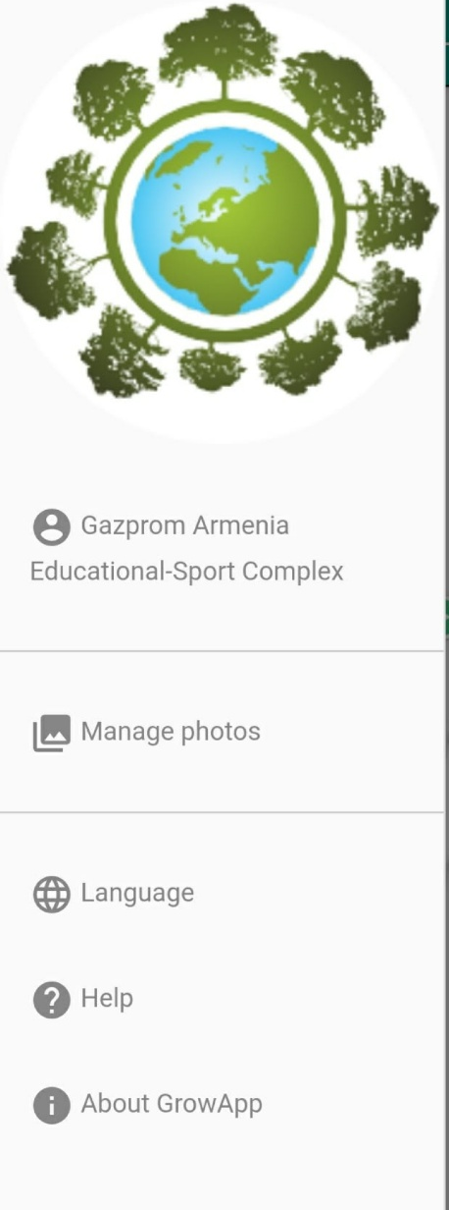
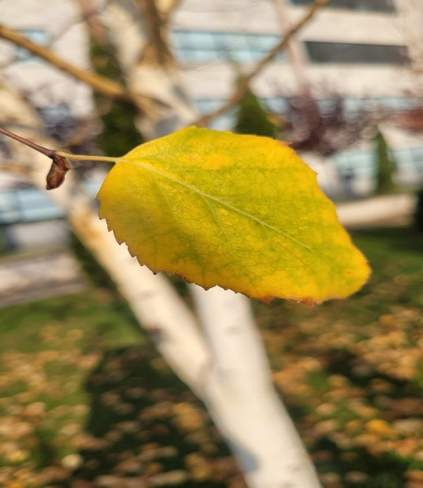

Research Proposal:Study of the color change and leaf fall process of birch using GrowApp
Researchers Names: Izabella Azatyan, Lili Arsenyan, Ani Matevosyan, Mari Martirosyan, Emilia Mkrtchyan, Mariam Mkrtchyan
School/Organization Name: “Educational-Sport Complex” Enterprise of “Gazprom Armenia”
Teacher Names: Lusine Hakobyan, Irina Pahlevanyan

Slide 2
Research Question(s) and Hypothesis
In which month does birch lose its leaves in Armenia?
What color are birch leaves in different months?
What are the sizes of birch leaves?
What characteristics does the birch tree have?
AND
We hypothesize The change in color and leaf fall of the birch
growing in our school garden can be easily
visualized using GrowApp.

Slide 3
Description of Study Site
Our study site is located in Yerevan (40° 10′ 52″ N
44° 30′ 49″ E), Armenia․ It is an urban area with a continental and semi-arid climate, characterized by hot, dry summers and cold, relatively dry winters, with low annual precipitation (about 250–300 mm)․ The landscape here is mostly man-made․

Slide 4
Data Collection Plan
A. Data Types and Sources
We use Biometry Protocol
We collect our own data.
We don’t use data from other sources.
B. Data Collection Schedule
● We began collecting data from the last week of September until mid-December.
● Weekly
● 7 weeks
C. Equipment and Tools
● We have conducted our own research on the birch tree. We used a leaf color change scale and the Crow App tool.
D. Who Will Collect the Data?
This is a team research project; we collected and analyzed the data as a team.

Slide 5


Background and Supporting Information
We have studied this topic because our teacher had also collaborated with the GLOB program in previous years, within the framework of cloud research. She motivated us. We have also collaborated with the UNESCO Chair on Education for Sustainable Development at CENS.

Slide 6
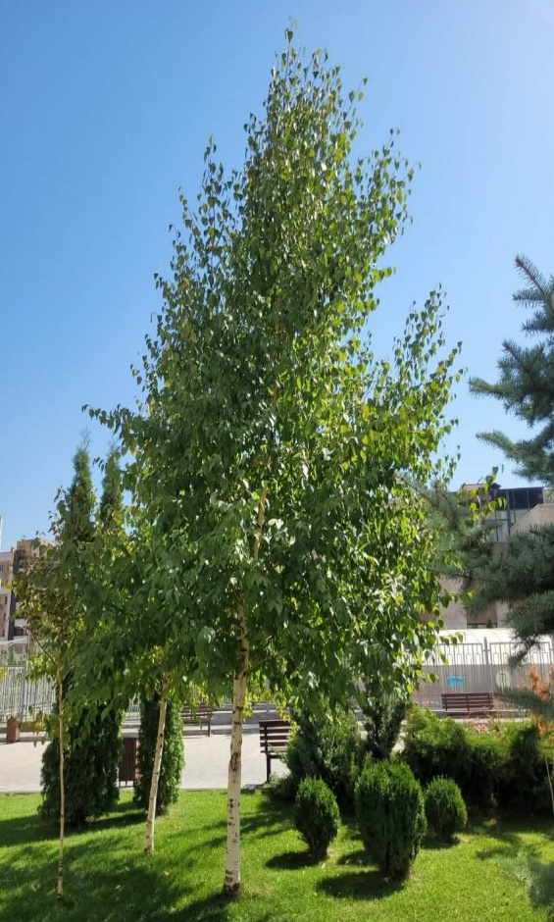
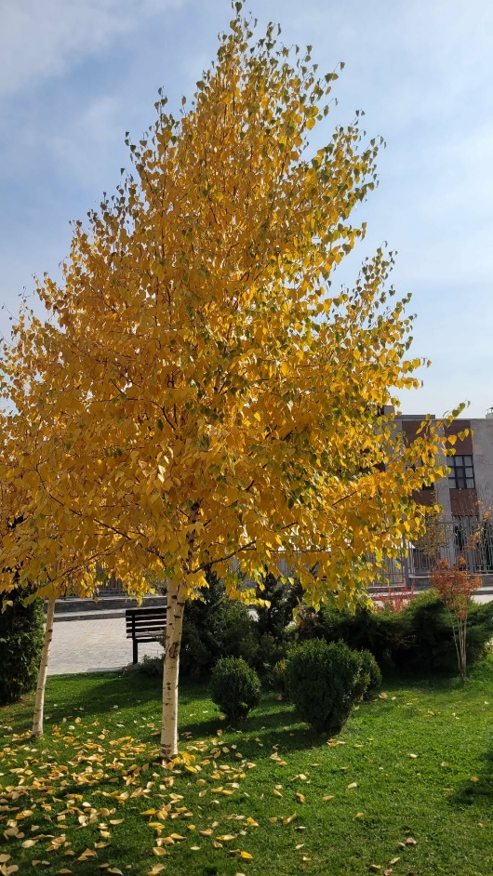
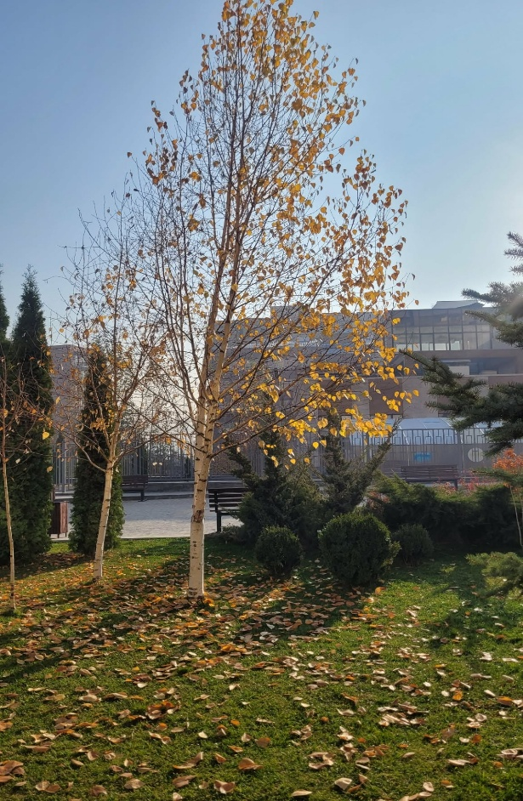
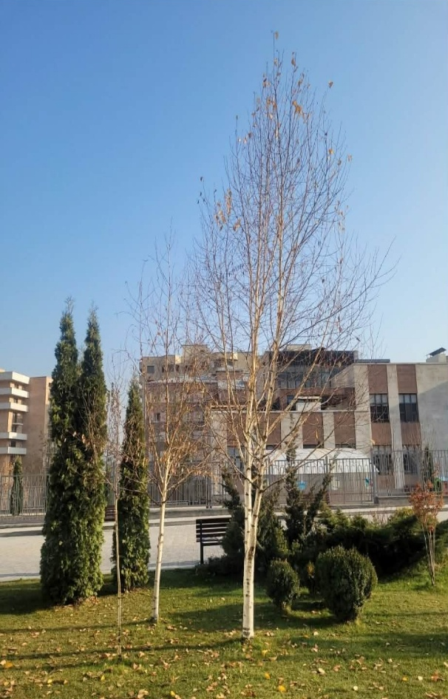
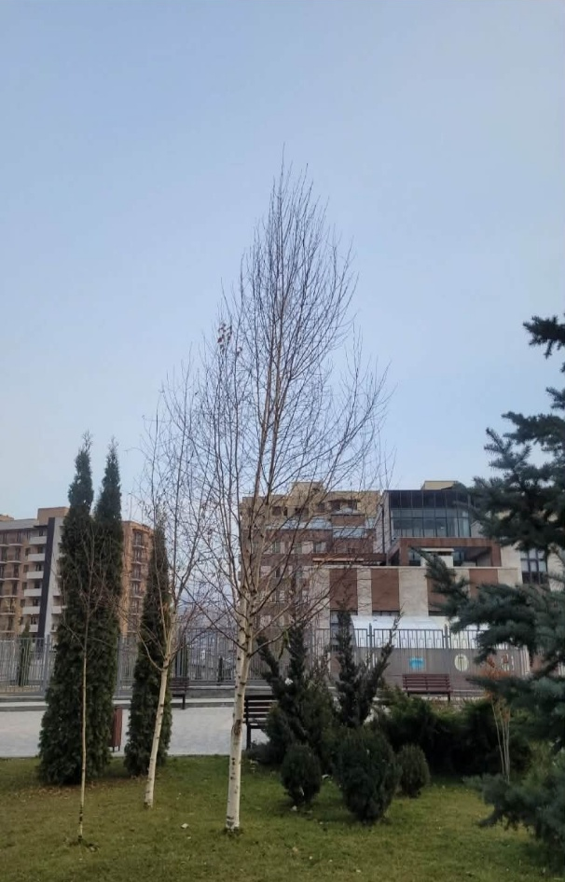
Expected Outcomes or Goals
We wanted to post photos of the birch tree growing in our schoolyard on the Grow App so that people from all over the world could visit and watch the change in the color of its leaves and the leaf fall. We wanted to understand when the birch sheds its leaves compared to other trees around and what colors its leaves change to.

Slide 7
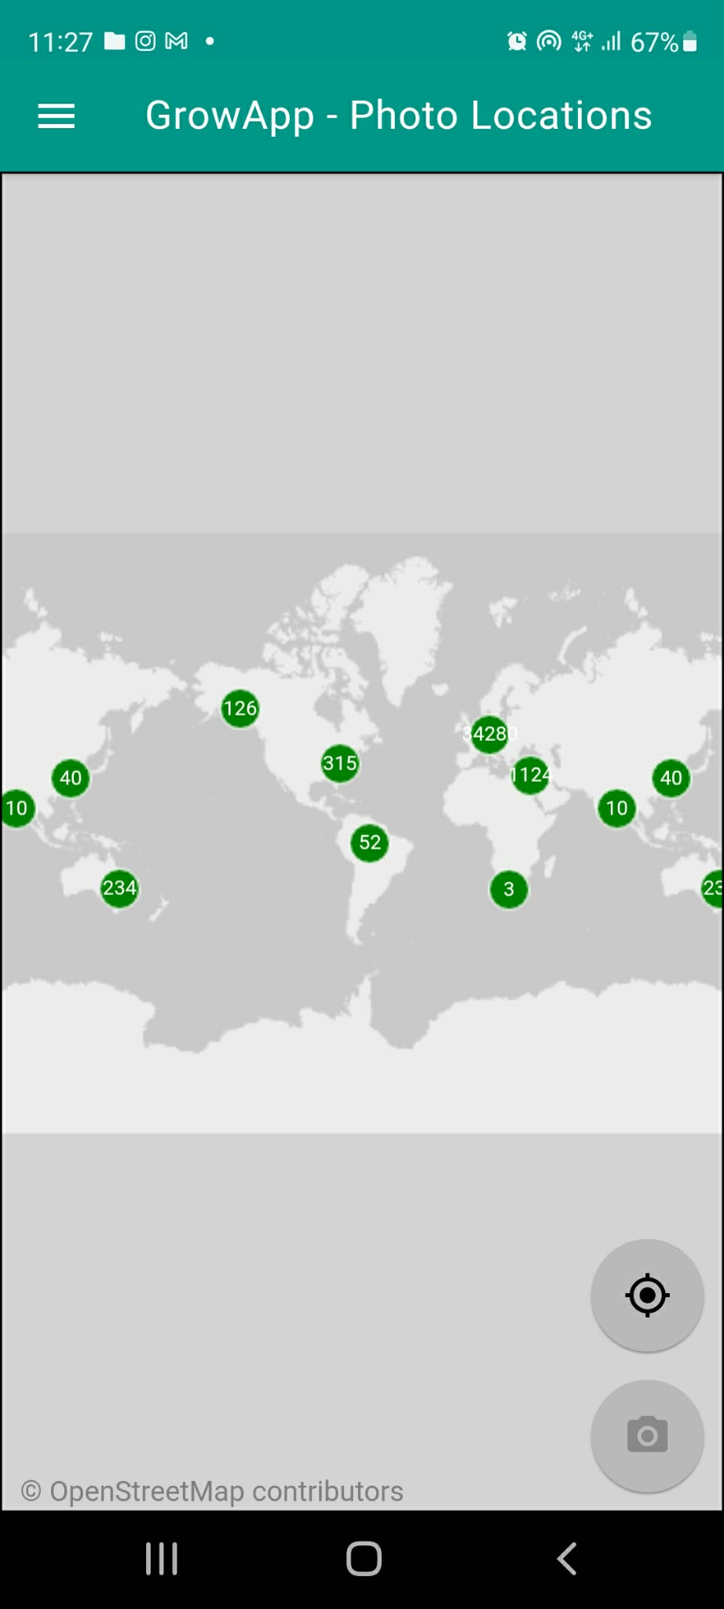
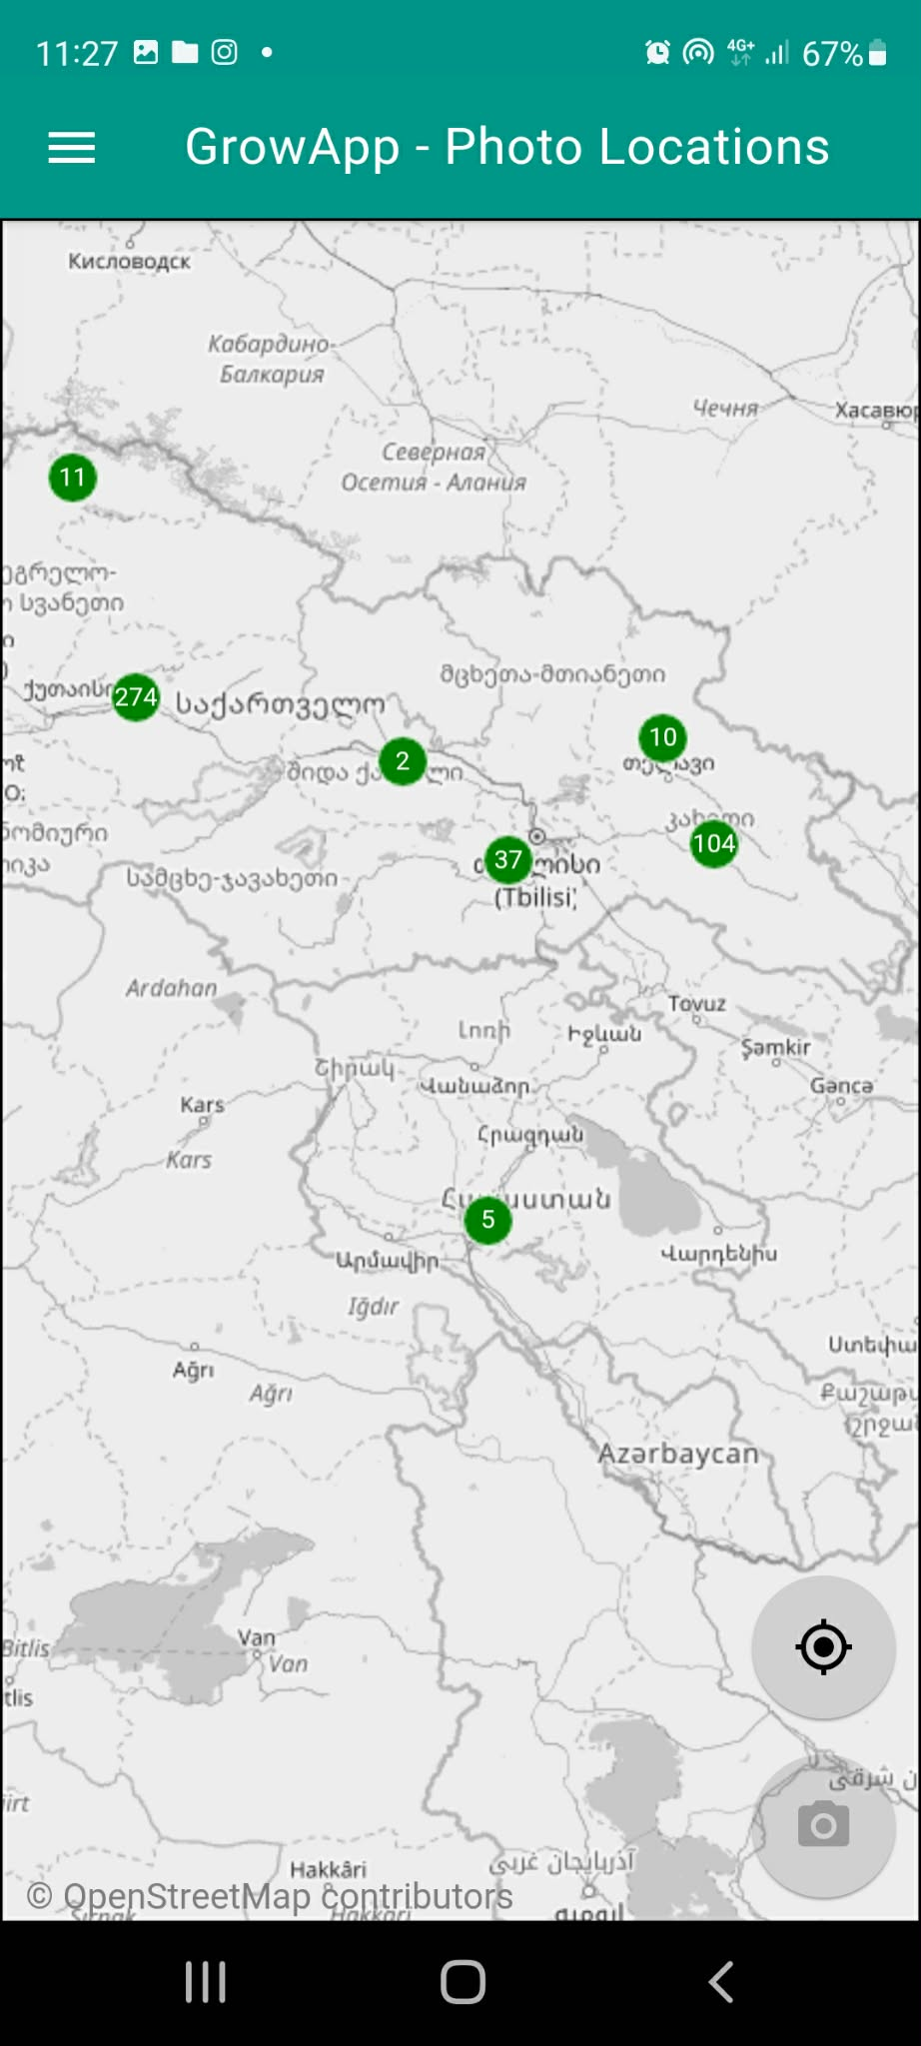
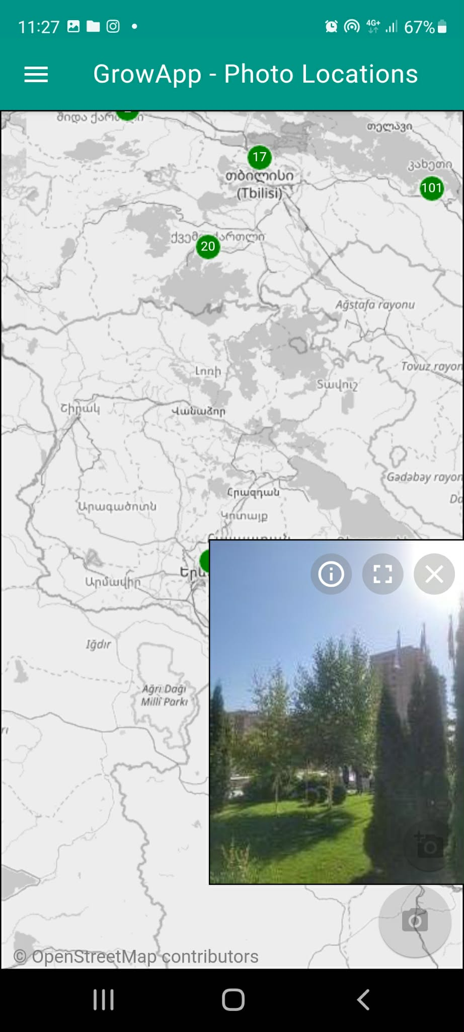
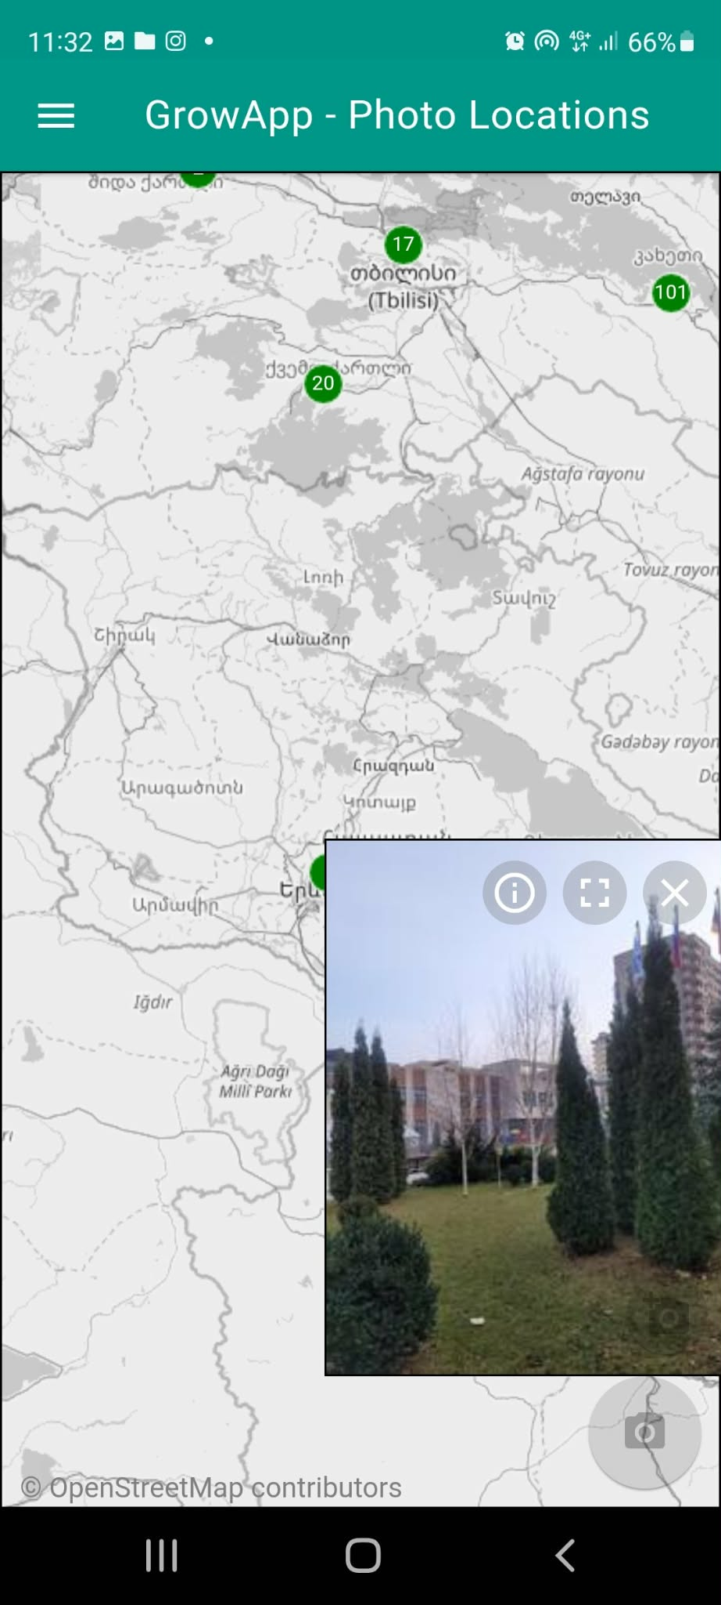
GLOBE Data Use Plan (Optional)
We will compare our collected data with the data from nearby countries, such as Georgia, to identify regional trends.

Slide 8
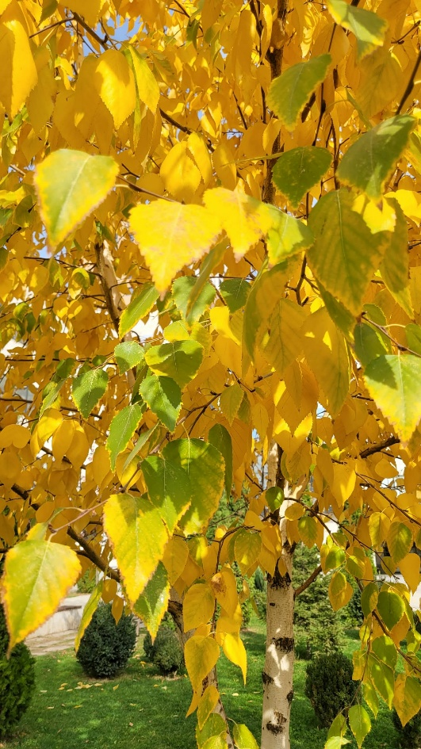
SUMMARY`
In this project, we present the birch tree that is the subject of our research. We studied its leaf fall period using the GrowApp application. We divided the leaves into five categories: smallest, small, medium, large, and largest. In each category, we examined 35 leaves, measured their width and length, and calculated the average values.

Slide 9
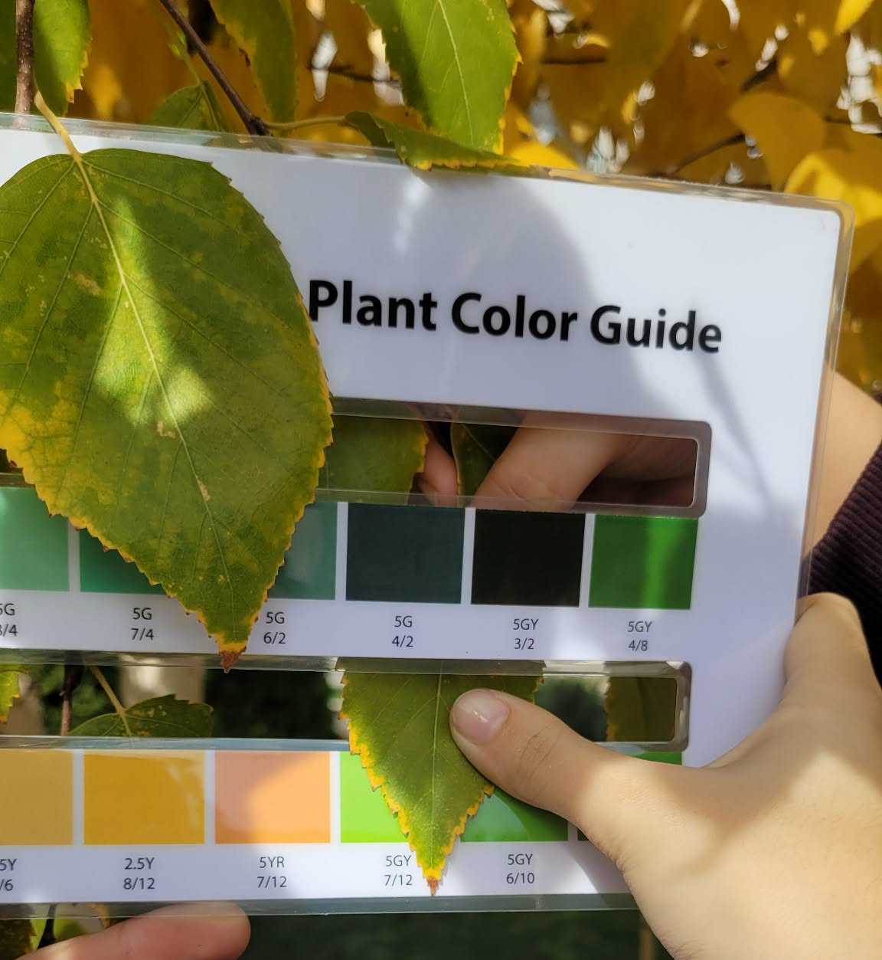
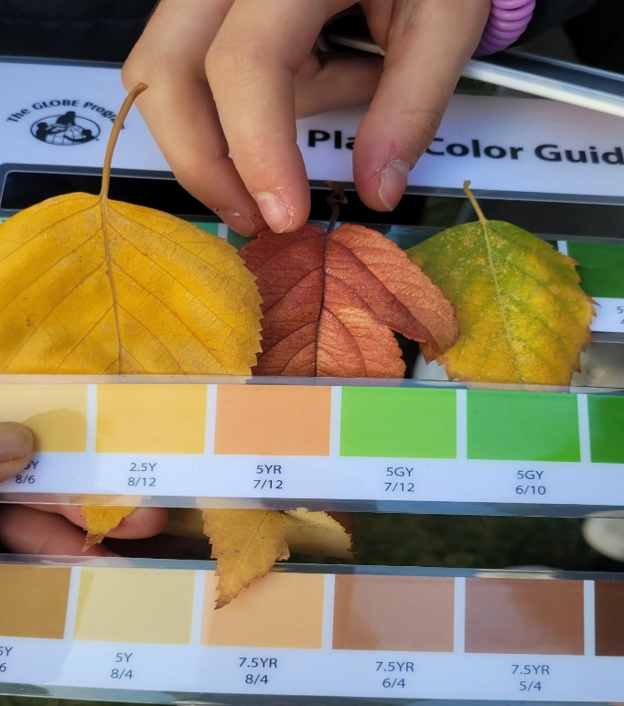
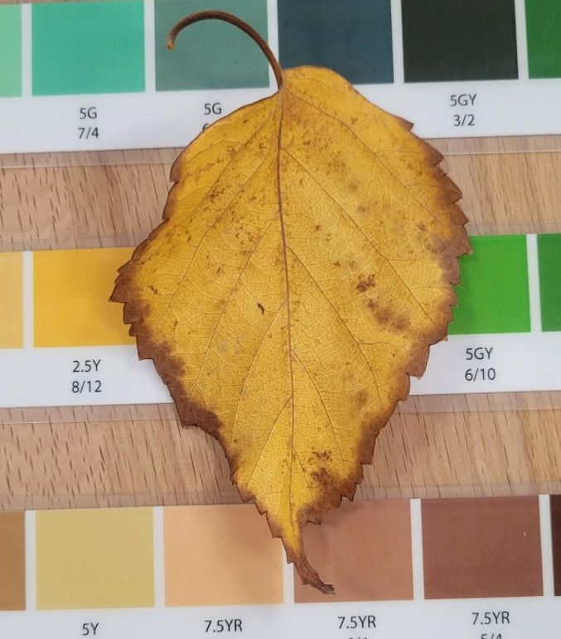
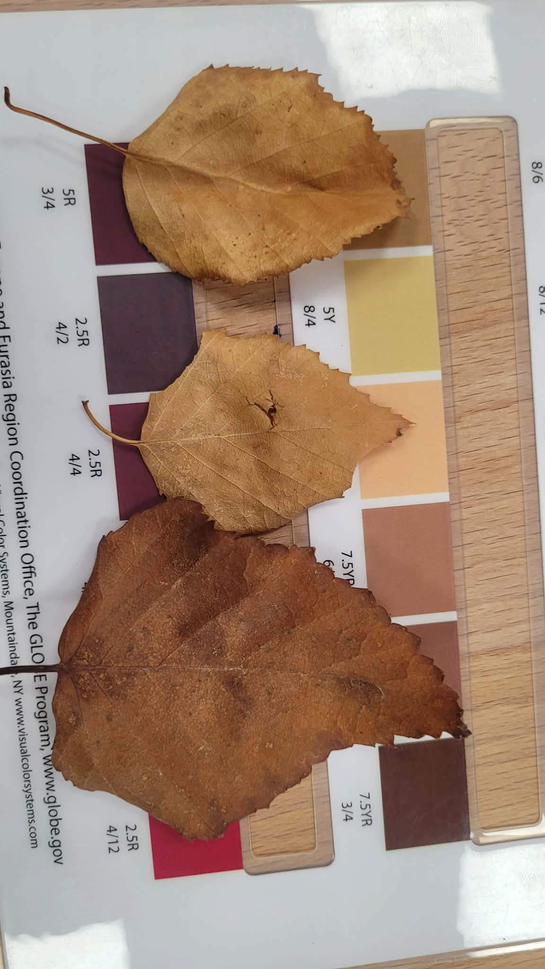
Basic research
We regularly observed a birch tree growing on our school grounds. We compared the color change of its leaves with a color palette and monitored their fall. We began our study in September; the tree began to lose its leaves in early November and by the second half of December it was completely bare.
20.09(5GY 7/12),11.11(5GY 7/12, 2.5Y 8/12), 21.11 (7.5YR 8/4, 2.5Y 8/6), 16.12 (2,5Y 8/12, 7,5YR 6/4, 5y8/4)

Slide 10
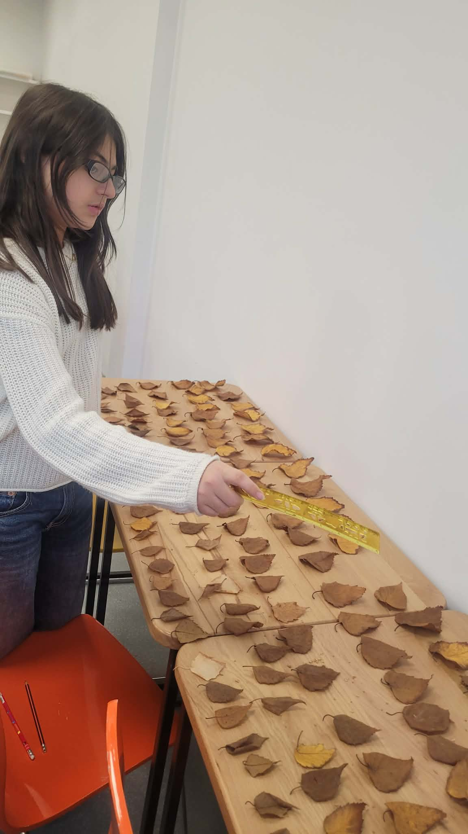
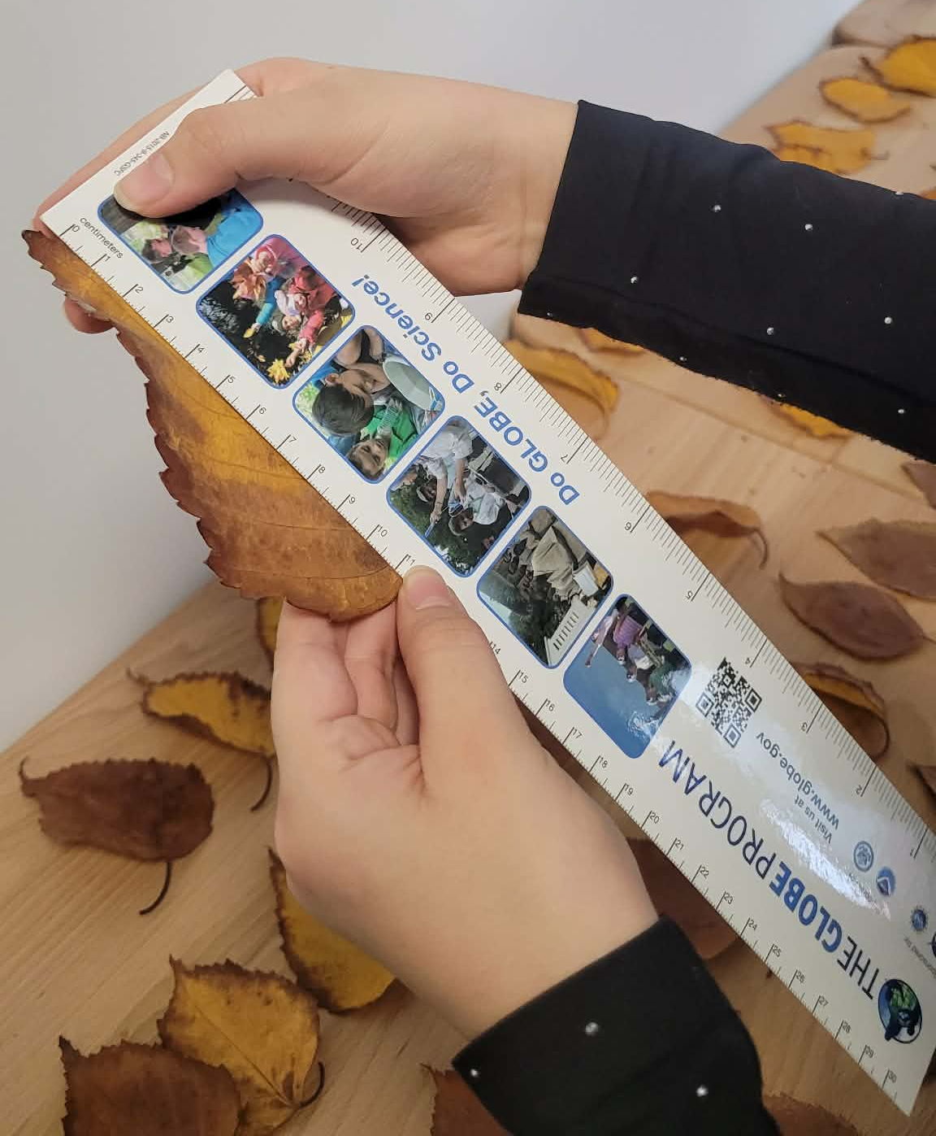
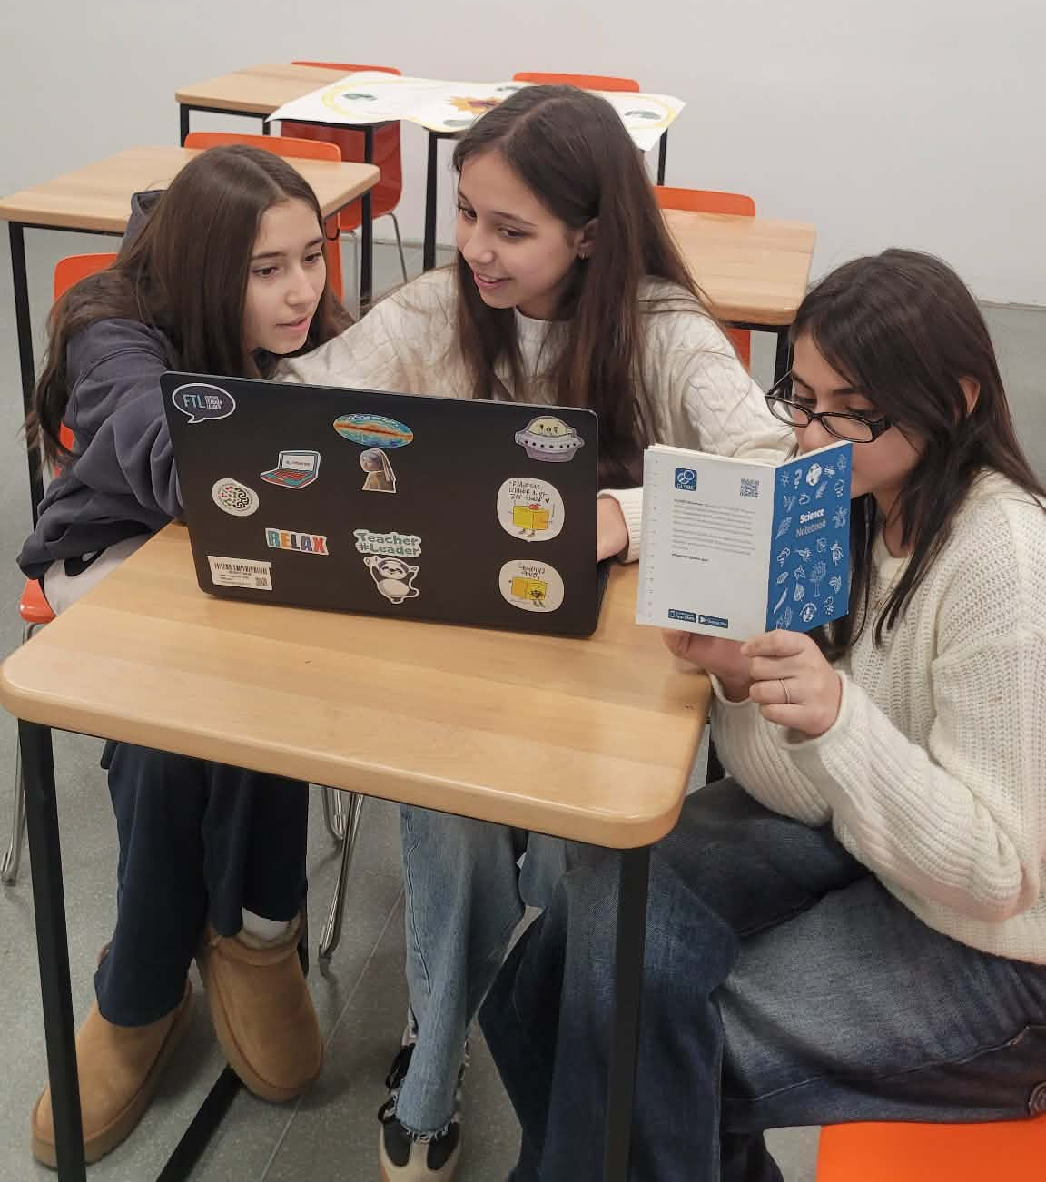
We collected tree leaves and categorized them into groups: largest, large, medium, small, smallest. We included 35 leaves in each group. We measured the length and width of the leaves and calculated their arithmetic mean. The results were presented in tables. For seven weeks, we regularly monitored the color changes and leaf fall of our selected tree. We uploaded the results to the Grow App. We compared the color changes of the leaves with a corresponding palette and observed that they transform from light green to bright yellow, then to light and dark brown.

Slide 11
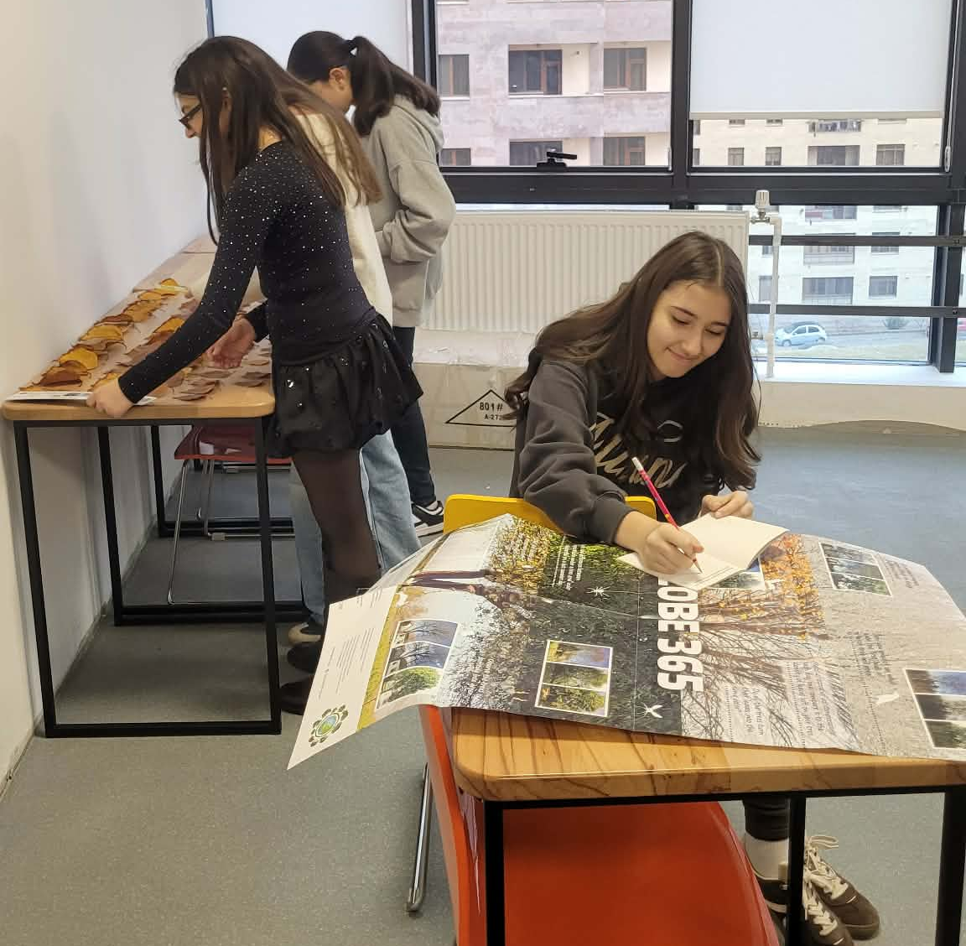
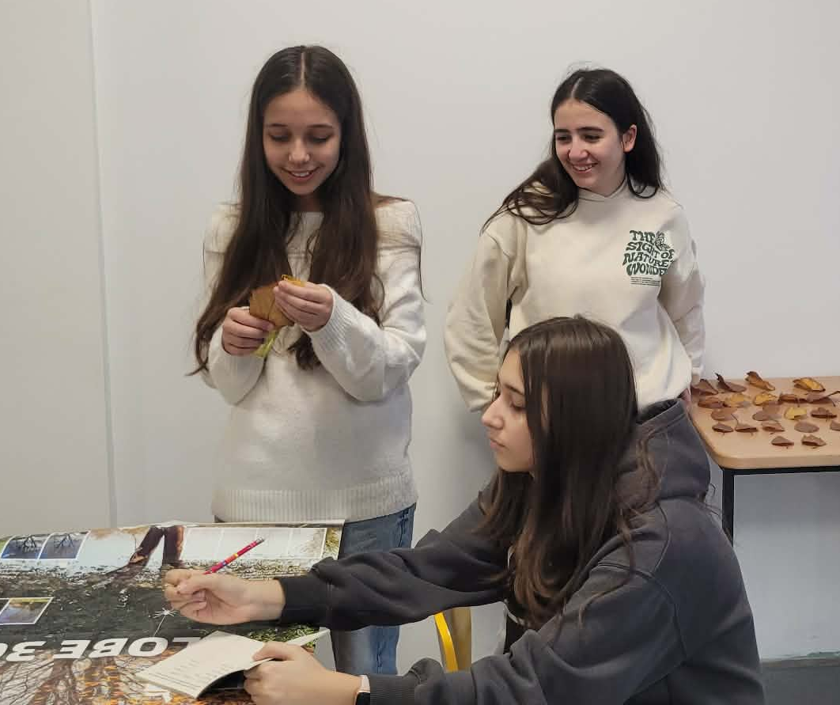
Results and average data
Largest: length 10,4cm
Width 7,1cm
Large: length 8,7 cm
Width 6.6 cm
Medium: length 7,3 cm
Width 5,7cm
Small: length 6,3 cm
Width 3,9 cm
Smallest: length 4,9 cm
Width 3,3 cm

Slide 12
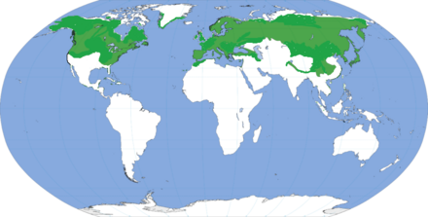
The Birch (Latin: Betula) is a broad-leaved, deciduous tree. Since it is widely distributed across the temperate and cold zones of the Northern Hemisphere, it also grows in Armenia, where it is found in both endemic and introduced species. The color of the leaves changes with the seasons; the seeds ripen and the tree eventually undergoes leaf fall. The four seasons of the year are distinctly pronounced in Armenia. This is due to the country's geographical position in the Northern Hemisphere—located between 38 ∘ and 41 ∘ North latitudes—as well as the Earth's revolution around the Sun and the tilt of its axis.

Slide 13
Reflection
As a result of the study, our hypothesis was confirmed: working with the CrowApp better visualizes the change in the color of tree leaves and the fall period. We learned to compare leaf colors using the Plant Color Guide. We realized that it is important to work as a team and had a great time.

Slide 14
Resources
https://observer.globe.gov/documents/19589576/52072924/NASA+Go+Trees+Tutorial.pdf/b8f8c436-90e0-404e-a919-64608c382376?t=1553526242769
globe-data-user-guide_v3-nov-2025
https://www.youtub

Slide 15
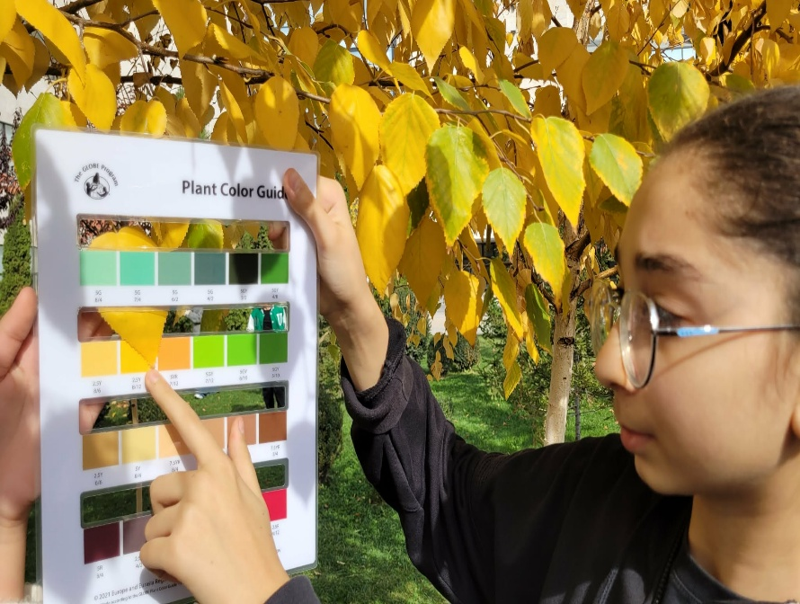
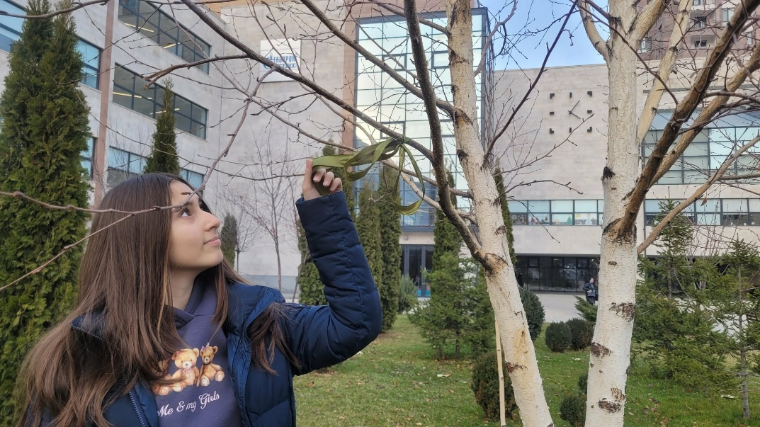
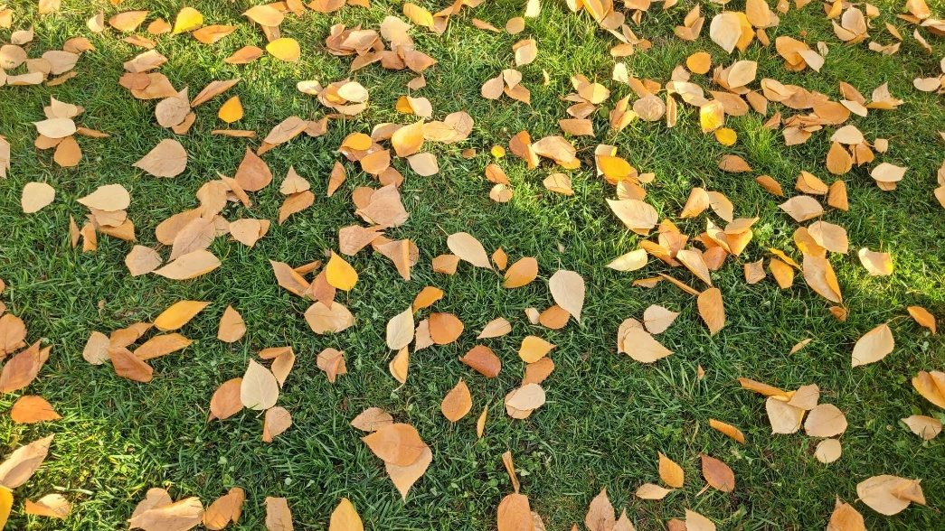
Thank You

Slide 16
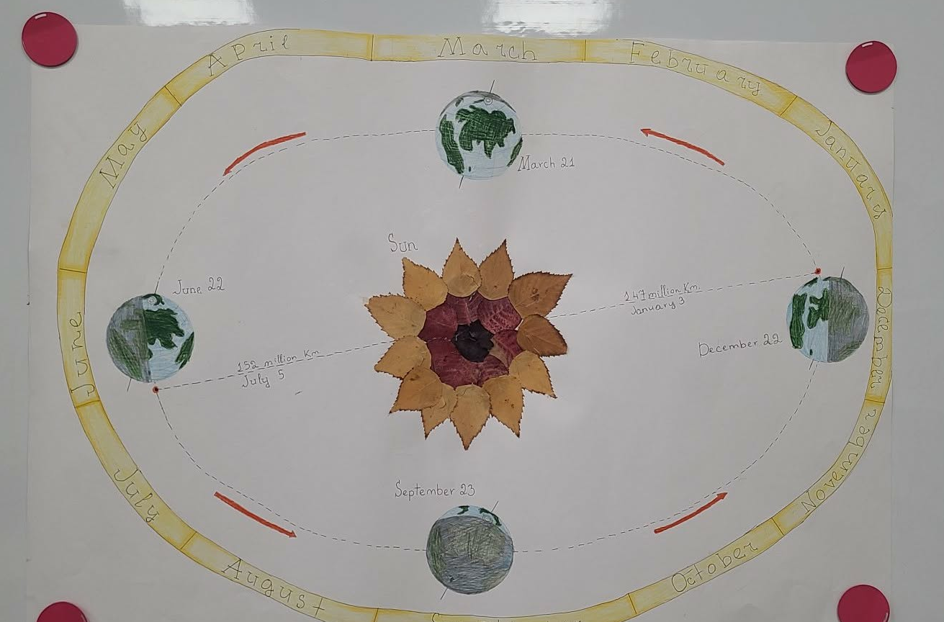
The Earth's rotation around the Sun: a project with birch leaves․․․

