Slide 1



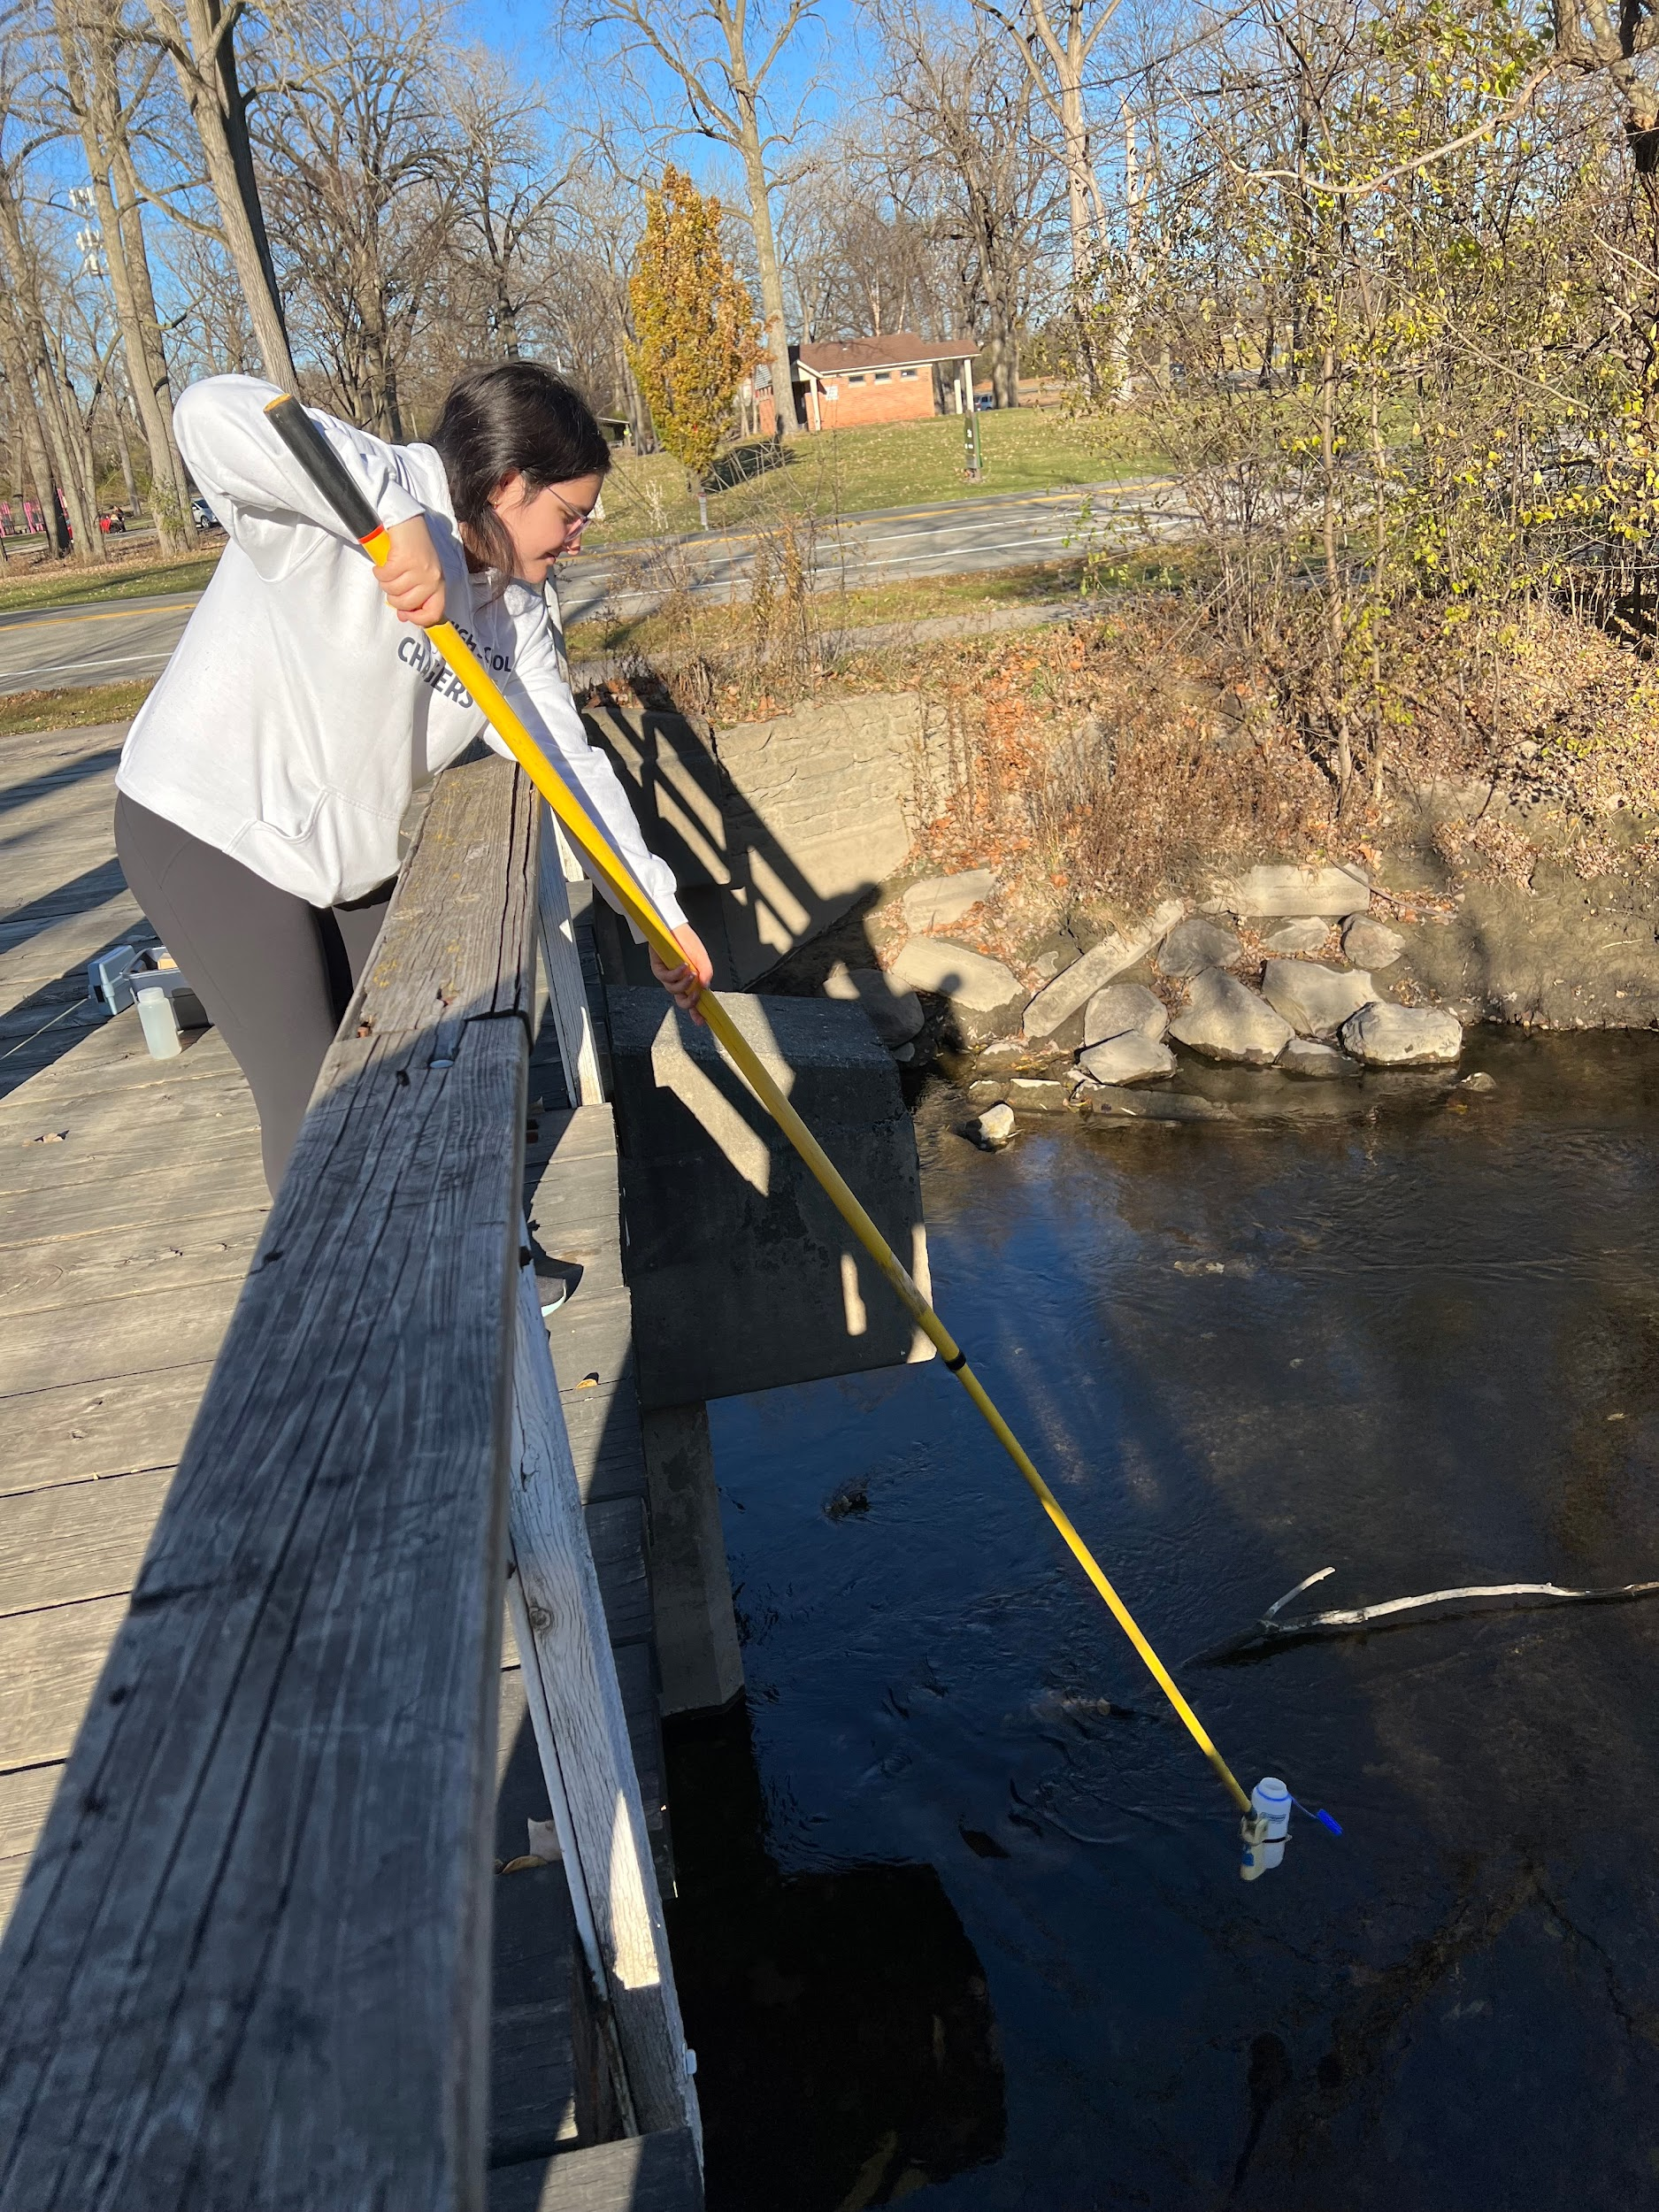
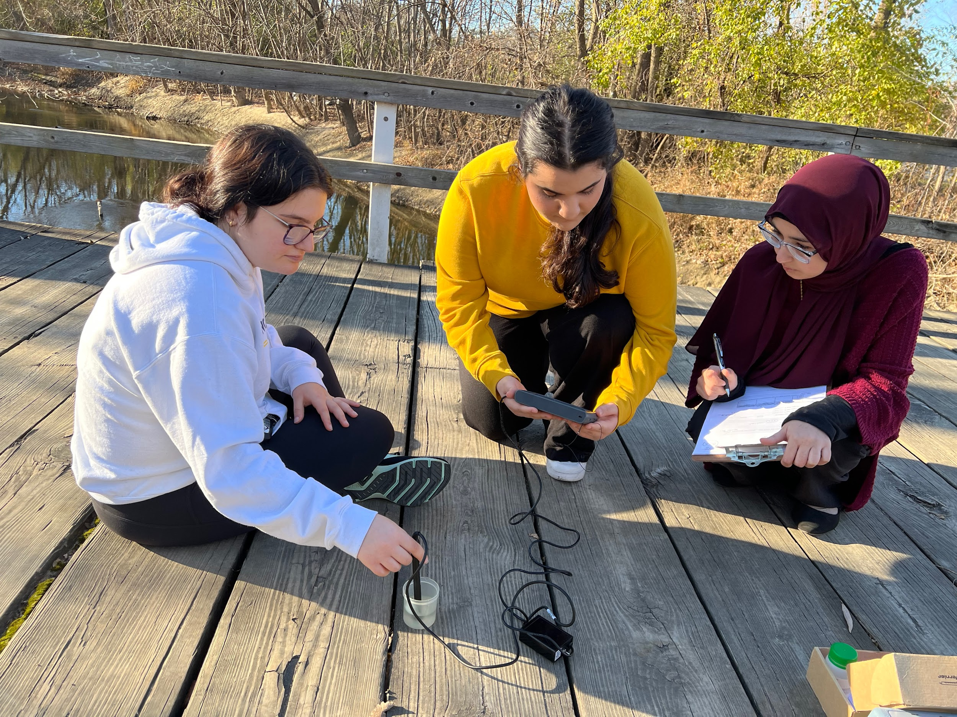
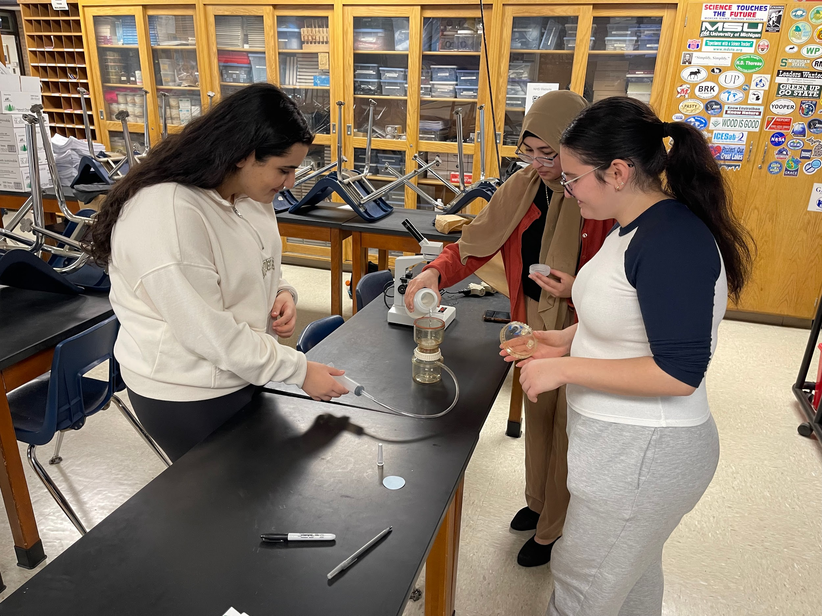
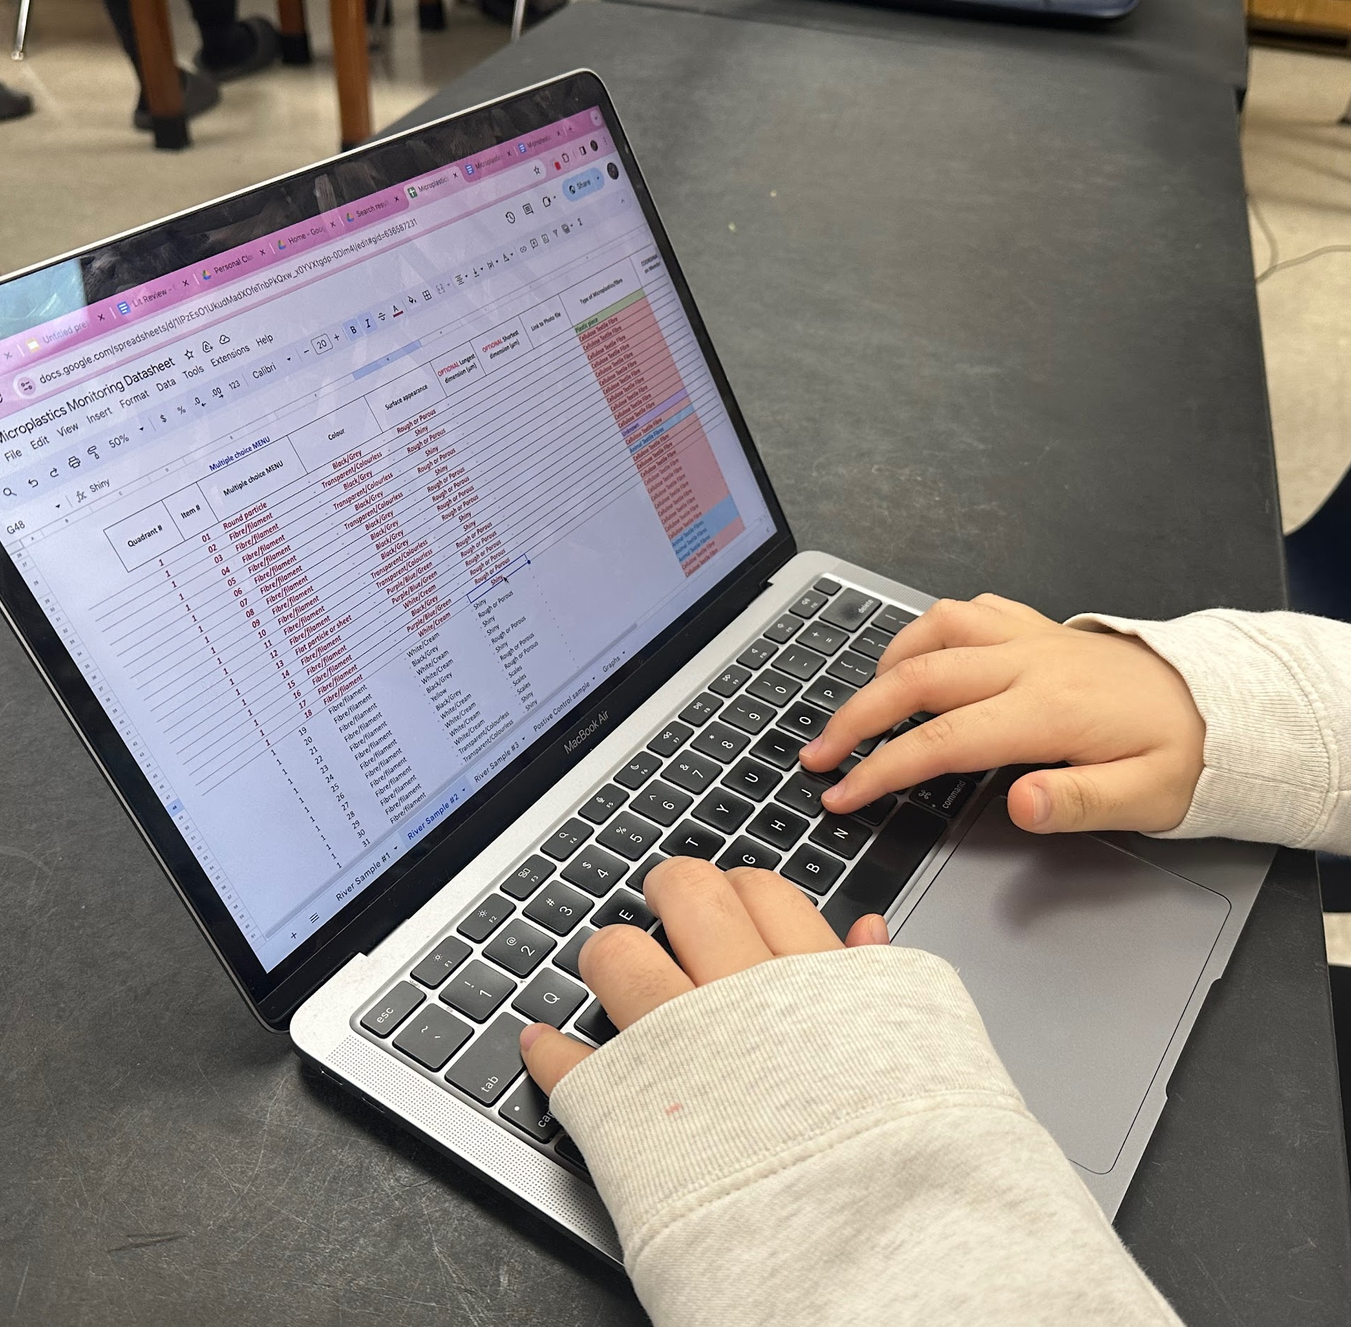
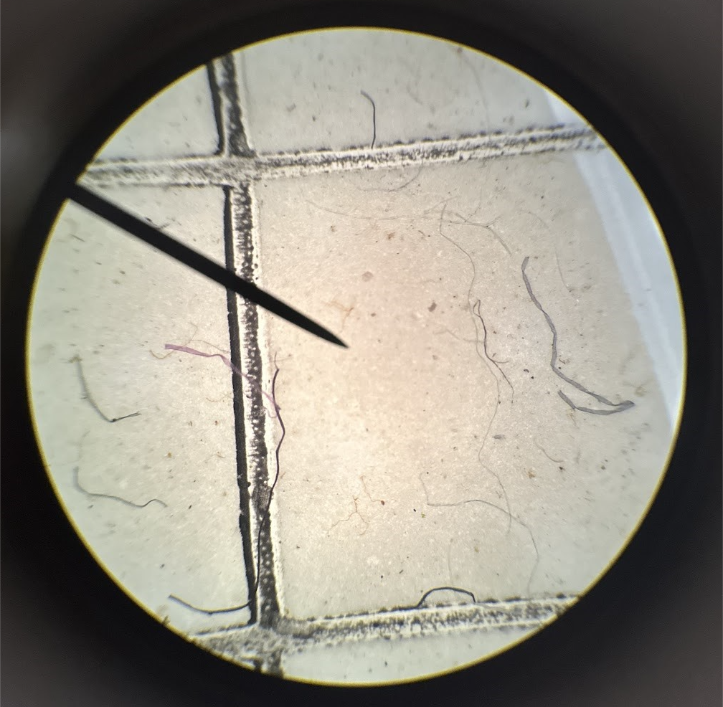
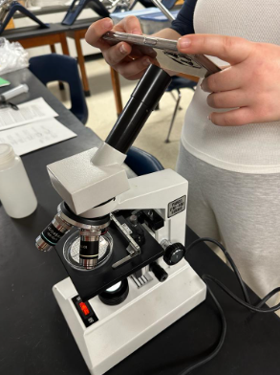
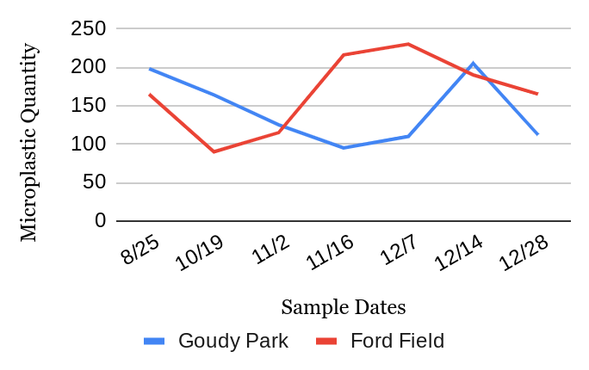
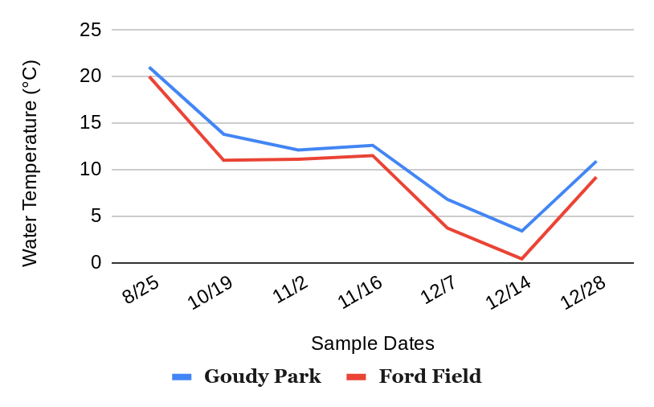
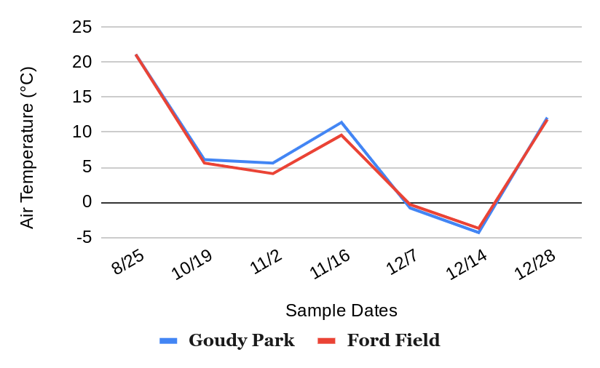
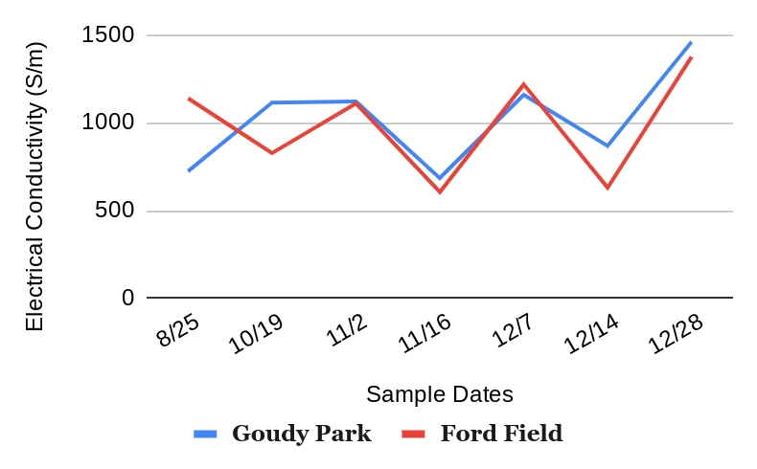
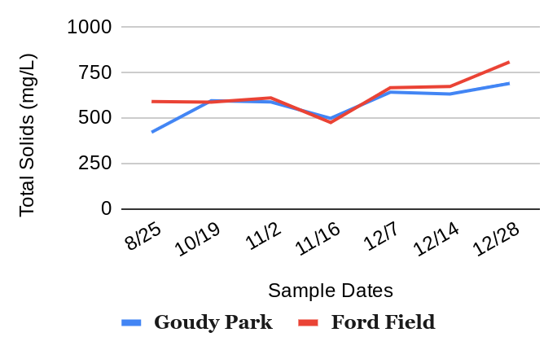
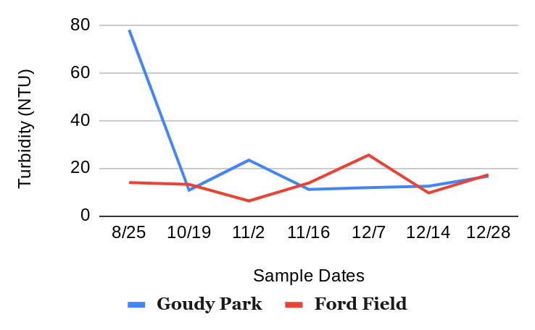
Analyzing Microplastic Distributions in Urban and Industrialized Locations along the Rouge River
Sally Nasserdine, Huda Yaseen, Nour AbuAlaywa, Yasmin AbuAlaywa
Crestwood High School, Dearborn Heights, MI
Abstract
Methodology
Conclusion
This research examined the impact of a wastewater treatment plant on microplastic accumulation by comparing concentrations at two sites in the Detroit, Michigan area: Ford Field Park and Goudy Park. Ford Field, situated downstream of the wastewater treatment plant, offers insight into how proximity to waste water discharge influences microplastic levels. Over a four-month period, a total of 14 water samples were collected, one from each site per sampling session. GLOBE protocols such as water temperature, air temperature, conductivity, turbidity and total solids were measured using Vernier sensors, Hach 2100N turbidimeter, Hach utility oven, and the Ohaus Pioneer analytical balance. The data suggests variations in microplastic concentrations between the two sites, with potential influences from wastewater discharge. This research study found microplastic concentrations were higher near locations of industrialization and factories. While there was not enough data to draw concrete conclusions between the relationship between microplastic quantities and GLOBE hydrological parameters, there was an inverse relationship between total solids and microplastic concentrations. This research contributes to understanding the role of wastewater discharge in freshwater ecosystems and supports the development of effective pollution management strategies. Further analysis will be necessary to create definite conclusions about the long-term impact of wastewater treatment plant discharge on microplastic accumulation.
The researchers conducted experiments to determine the impact of proximity to wastewater treatment plants along the Rouge River influenced microplastic distribution. While some trends were observed, the results did not draw sufficient evidence to draw conclusions that environmental factors significantly affect microplastic concentrations, indicating the need for further research to draw more certain conclusions. The null hypotheses stated that proximity to suburban areas would not impact microplastic concentrations. The results suggest no significant correlation between the proximity to wastewater treatment plants and microplastic distribution, supporting the null hypothesis regarding proximity to suburban areas. Additionally, the distribution of microplastics did not show clear differences between upstream and downstream locations, meaning the null hypothesis remains unchallenged. The analysis of water quality parameters did not reveal a clear relationship between microplastic presence and changes in turbidity, conductivity, total solids, or temperatures, reinforcing the null hypothesis for these variables. However, the limited data and sampling size indicate that further research is needed to establish more definitive conclusions. Future studies with expansion of sampling locations, increasing the frequency of data collection, and consider more environmental factors to better evaluate the relationship between wastewater treatment processes, environmental factors, and microplastic concentrations in the Rouge River.
Student researcher collecting a sample from the testing location
Student researchers analyzing their sample at the testing location
Researchers filtering their sample to draw out the microplastics for counting
Discussion
The goal of this research was to compare microplastic accumulations between an urban area (Goudy Park) to a more industrialized location (Ford Field). Over the four months of data collection, there were significant changes in temperature, turbidity, and total solids. During late summer, the water temperature was higher, and turbidity at Goudy Park was notably elevated. As the seasons transitioned into fall and winter, water temperature, turbidity, and total solids fluctuated. Goudy Parks high turbidity may have been influenced by Urban Runoff, as it includes lots of impervious surfaces like parking lots. So, these surfaces may have carried sediments and pollutants into the river. The parks riverbanks are also very susceptible to erosion due to natural wear and man-made activities that lead to greater sediment levels. However, the data collected is insufficient to conclusively determine the influence of seasonal changes on these primaters. Another error that may have impacted the analysis of microplastics is the possibility that some microplastics were not visualized. This could have been due to the increased sediment in Goudy Park, which hindered the visibility of microplastics, resulting in a decreased quantity being documented. Additionally, some microplastics may have become trapped at the top of the filtration system, as proper dilution was not performed. Without flushing the samples, the microplastics may not have been fully directed to the filter paper, leading to an incomplete capture of all microplastics present.
To improve this study, a longitudinal study would be preferable as it would account for the potential correlation between seasonal changes and microplastic densities which in turn can affect concentrations. A larger data sample would allow a more comprehensive and statistically significant conclusion as it will reduce standard error and outliers. In addition, the researchers would also like to expand testing locations, having made plans to test the lower Rouge River near Lilley Road bridge in Canton, Michigan. Expanding testing locations to include other branches of the Rouge River allows us to conclusively analyze the distribution of microplastics and the possible source of these microplastics. With all these modifications, the researchers know that the project can be monumental for their community.
A filter paper under the microscope showing microplastics
Acknowledgements
Student researcher inputting data into an Excel sheet
Student researcher taking images of the filter paper under the microscope
Results
The researchers would like to thank Ms. Tracy Ostrom, Co-Program coordinator and trainer at the University of California Berkely, for guiding them through their research. She provided them with the materials needed such as complete filtration units, training manuals and guides, and online resources to complete their research. She also trained them in the identification of microplastics and the filtration processes. With her support researchers were able to clarify questions and continue with their research. They would also like to thank the Friends of the Rouge for their financial support, which helped them with equipment needed for their research. Finally, the researchers would like to give big thanks to Mrs. Diana Johns for her guidance and great support as they continued to pursue their research.
Citations
Alibekov, A., Meirambayeva, M., Yengsebek, S., Aldyngurova, F., & Lee, W. (2025). Environmental impact of microplastic emissions from wastewater treatment plant through life cycle assessment. The Science of the Total Environment, 962, 178378. https://doi.org/10.1016/j.scitotenv.2025.178378
Bajt Oliver, “From plastics to microplastics and organisms”, 2021 Apr;11(4):954-966, https://pubmed.ncbi.nlm.nih.gov/33595903/
Browne Anthony Mark, “Accumulation of Microplastic on Shorelines Woldwide: Sources and Sinks”, September 6, 2011 Environ. Sci. Technol. 2011, 45, 21, 9175–9179 https://pubs.acs.org/doi/abs/10.1021/es201811s
Carr, S. A., Liu, J., & Tesoro, A. G. (2016). Transport and fate of microplastic particles in wastewater treatment plants. Water Research, 91, 174182. https://doi.org/10.1016/j.watres.2016.01.002
Cheng-Hua Wu, Cyuan-You Syu, “Microplastics Monitoring in Two Main Rivers of Central Taiwan", 2022 March 11, https://www.globe.gov/documents/10157/0/10754848/6fbae67d-d5f1-c3e2-1ad0-09c5a3218fb3
Daniela De Jesus Rodriguez, Luis David Lugo Guzman, “Comparing the Amount of Microplastics in the Isabela and Haina Rivers”, 2023 April 28, https://docs.google.com/document/d/10yw7YS3kACeBg_cC9m2XYEawGfUJXrzh/edit
J.P.G.L. Frias, V. Otero, P, “Sobral Evidence of microplastics in samples of zooplankton from Portuguese coastal waters”, Volume 95, April 2014, Pages 89-95 https://www.sciencedirect.com/science/article/abs/pii/S0141113614000099

