Slide 1


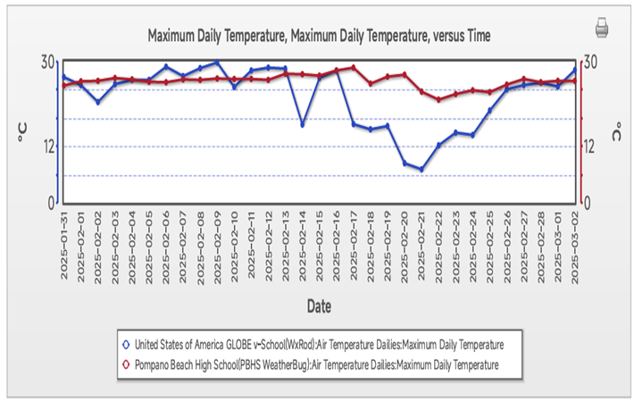
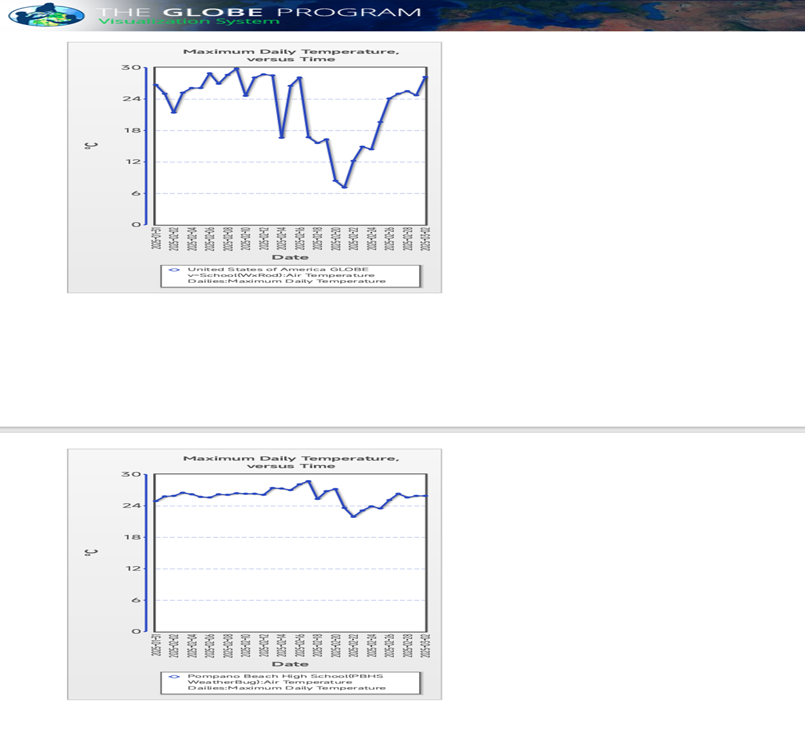
Comparative Analysis of Maximum Daily Temperature Trends in Pompano Beach High School and GLOBE v-School Sites WxRod
School Logo
Abstract
Research Methods
This study employed a quantitative research approach to analyze the maximum daily temperature trends in Pompano Beach High School (PBHS) and GLOBE v-School sites. The methodology is outlined below:
Data Collection
The data used in this study was collected from the GLOBE Program's online database using the Mu]ti-Site Plot tool. The tool allowed for the selection of multiple sites and protocols, enabling a comparative analysis of temperature trends.
Site Selection
Two site were selected for this study: 1. Pompano Beach High School (PBHS), located in the United States of America, with site ID PBHS and protocol Air Temperature Dailies.2. GLOBE v-School, located in the United States of America, with site ID WxRod and protocol Air Temperature Dailies.
Data Range Selection: The data range was selected from 2023-01-26 to 2025-03-02 for GLOBE v-School and 2014-02-21 to 2025-03-02 for PBHS. However, for optimum performance, the maximum recommended date range is 5 years using both Single Line Plot and Stacked plot.
Plot Selection: The plot selected for this study was the Maximum Daily Temperature Range, with a Y-Axis range of -50°C to 50°C.
Data Analysis: The data analysis involved calculating the daily maximum temperature trends for both sites. The trends were analyzed using descriptive statistics, including means, medians, and standard deviations.
Results
Discussion
This study undertakes a comparative analysis of maximum daily temperature trends in Pompano Beach High School (PBHS) and GLOBE v-School sites, located in the United States of America. The research examines the past, present, and future trends in maximum daily temperatures at both locations, utilizing data collected from the GLOBE Program's online database.
The results of this study highlight the differences in maximum daily temperature trends between Pompano Beach High School (PBHS) and GLOBE v-School sites. The relatively stable temperature trends at PBHS suggest that this location experiences a more consistent climate, while the more variable temperature trends at GLOBE v-School suggest that this location experiences a more dynamic climate.
These differences in temperature trends may have implications for local ecosystems, human health, and economic activities. For example, more variable temperature trends may lead to increased stress on local plant and animal populations, while more stable temperature trends may lead to increased crop yields and economic benefits.
The maximum daily temperature in PBHS ranged from 21.9°C to 28.7°C, with an average temperature of 25.6°C.
- The maximum daily temperature in WxRod ranged from 7.1°C to 29.8°C, with an average temperature of 23.4°C.
- The air temperature patterns in PBHS and WxRod show a significant difference, with PBHS experiencing a more consistent temperature range.
Research Question
1. What are the past, present, and future trends in maximum daily temperatures in PBHS and GLOBE v-School sites?
2. How do the temperature trends in PBHS and GLOBE v-School sites compare?
3. What are the implications of these temperature trends for the local environment and communities?
Introduction
Climate change is one of the most pressing issues of our time, with far-reaching consequences for the environment, human health, and the economy. Understanding local temperature trends is crucial for developing effective climate change mitigation and adaptation strategies. This study undertakes a comparative analysis of maximum daily temperature trends in Pompano Beach High School (PBHS) and GLOBE v-School sites, located in the United States of America.
Temperature is a critical aspect of climate, and analyzing its patterns is essential for predicting future trends. The GLOBE Program, an international environmental education initiative, provides a unique opportunity for students and educators to collect and analyze environmental data, including temperature trends. By leveraging this data, this study aims to contribute to our understanding of local temperature trends and their implications for the environment and communities.
The selection of PBHS and GLOBE v-School sites as case studies is motivated by their distinct geographical locations and environmental characteristics. PBHS is located in a coastal area with moderate climate, while GLOBE v-School site is situated in a region with more variable climate conditions. This comparative analysis will provide insights into the similarities and differences in temperature trends between these two locations.
Conclusions
This study provides a comprehensive analysis of the air temperature patterns in PBHS and WxRod. The results show a significant difference in the air temperature patterns between the two locations. The study highlights the importance of understanding the past, present, and future air temperature patterns in different locations, which can have implications for climate change, agriculture, and human health.
Figure #1
GLOBE Badges Claimed
We make impact
We are a problem solver
We are data Scientists
We are students researcher.
Bibliography
This project was conducted by adeleke B E and students[FGC,Ilorinl]. The project aims to contribute to the understanding of air temperature patterns and their implications for different locations.
Figure #2

