Slide 1
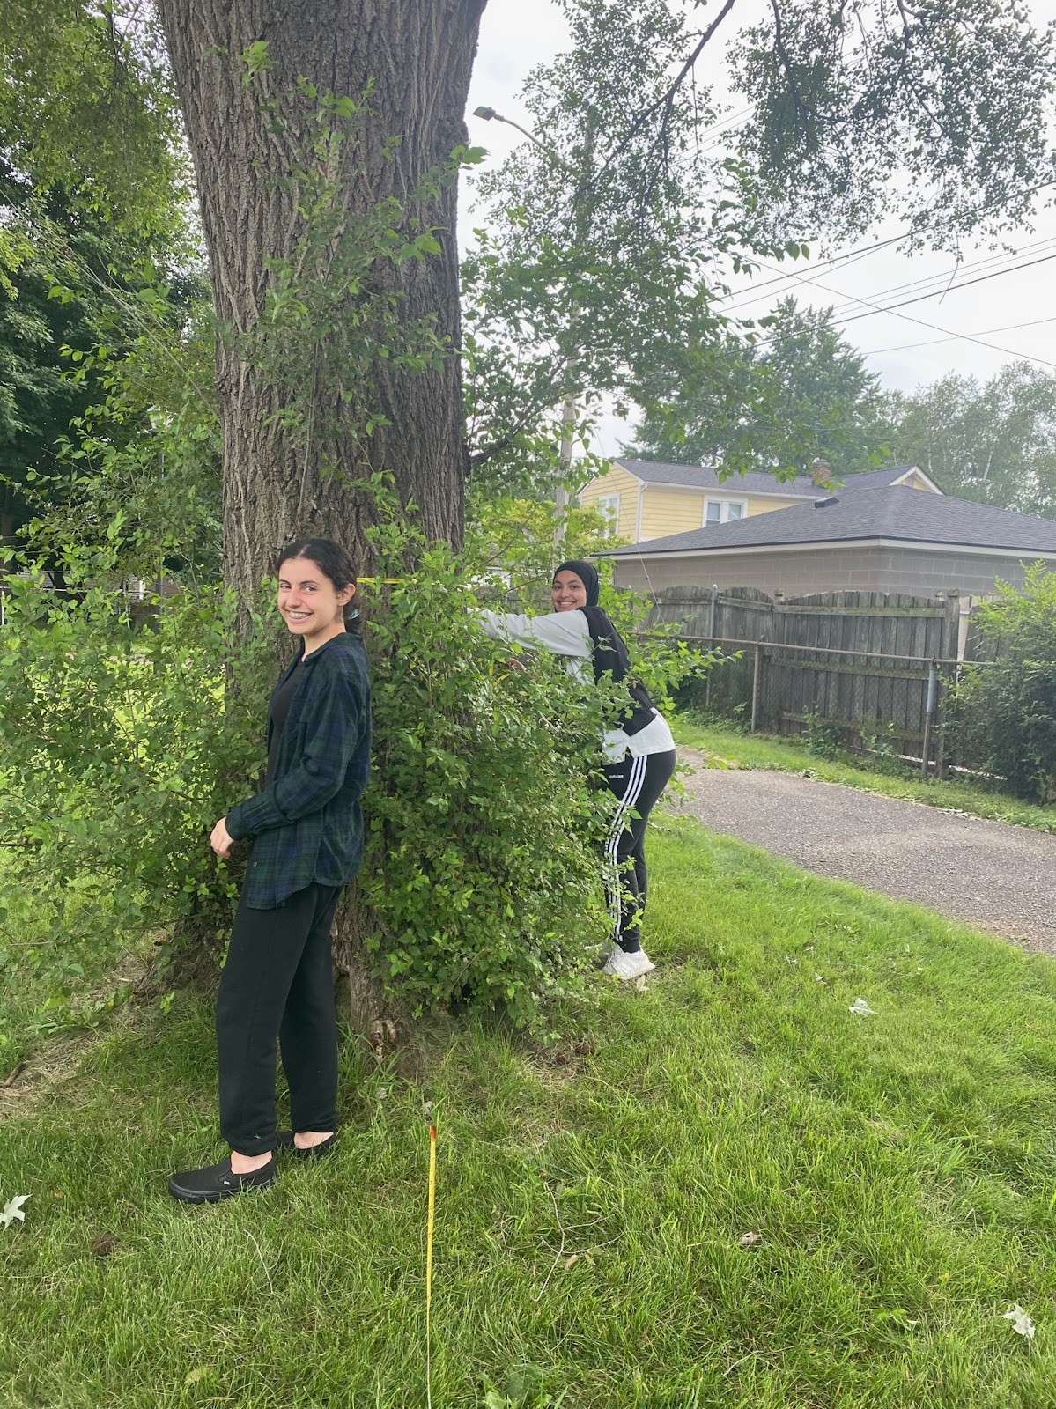
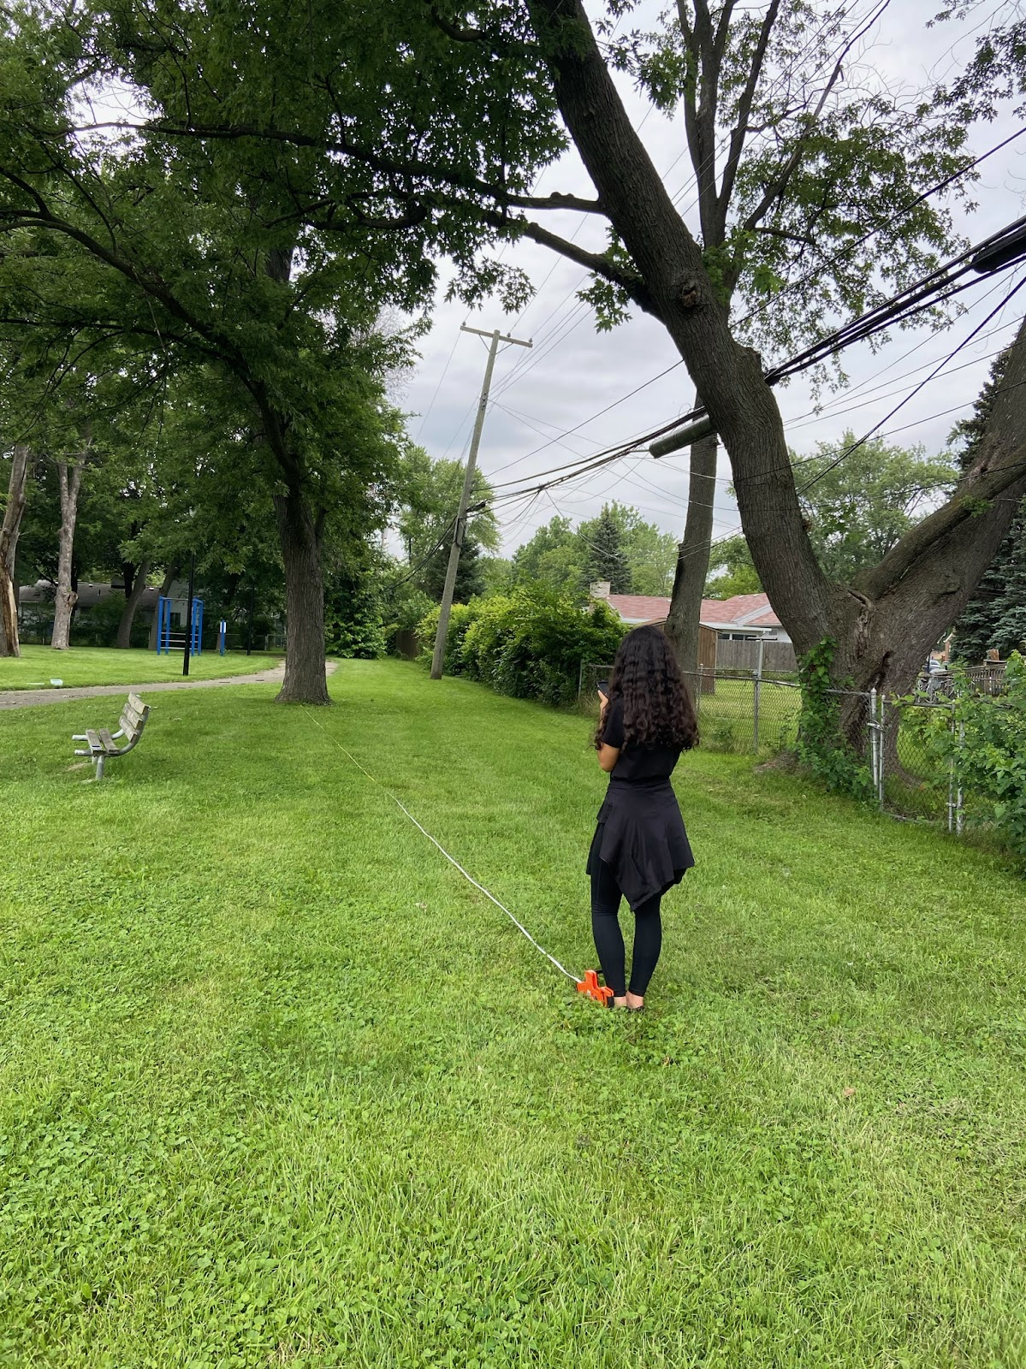
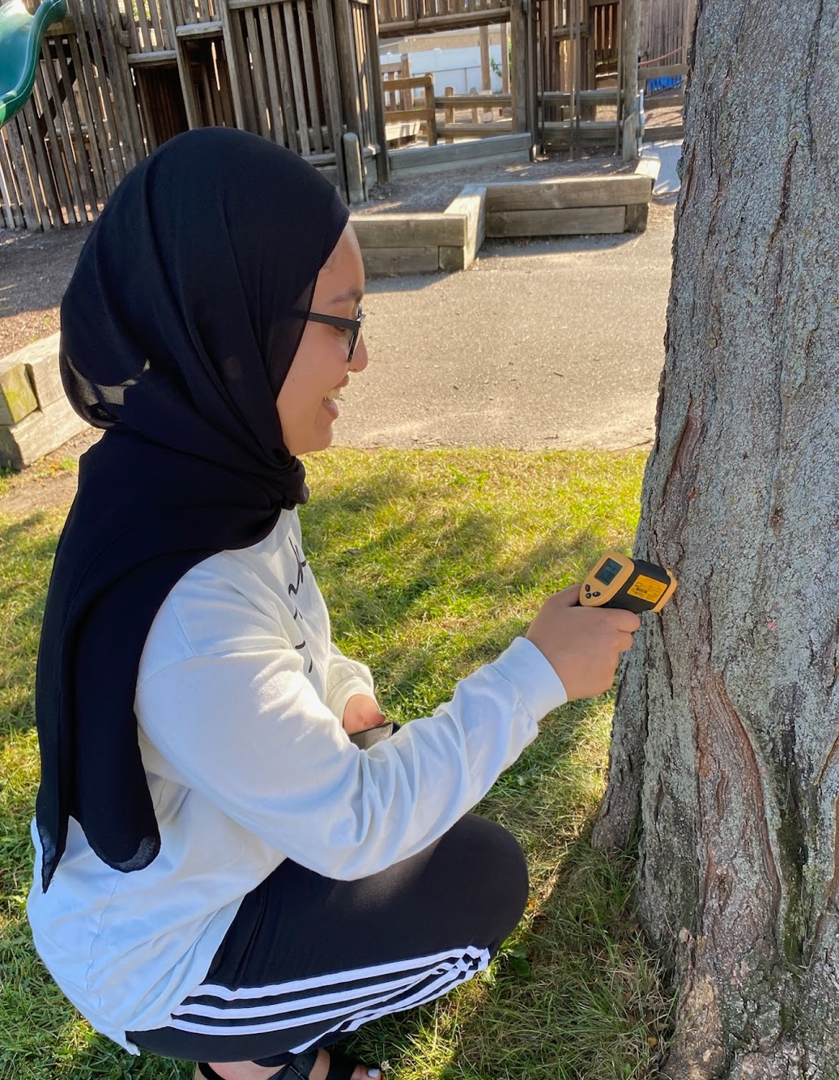
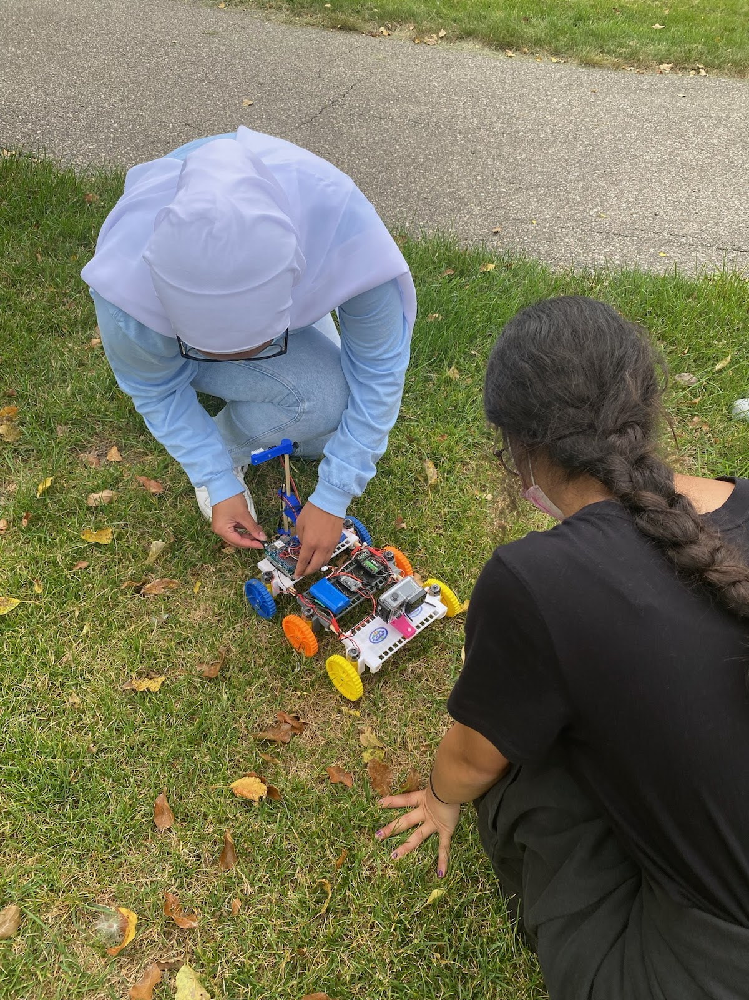
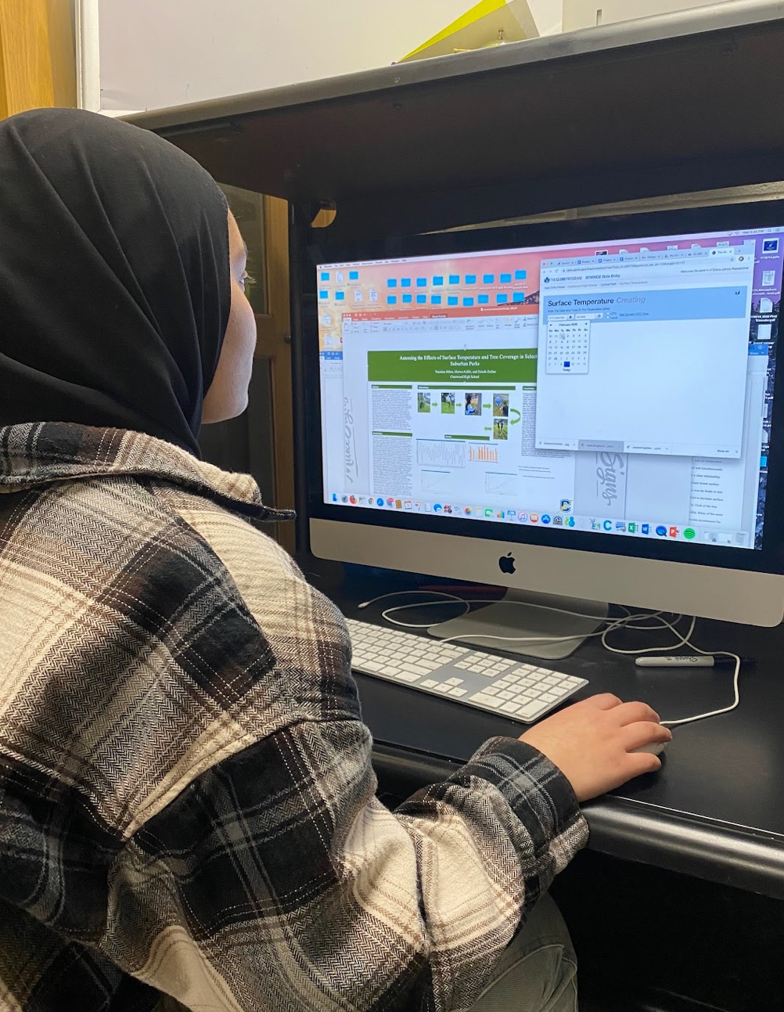
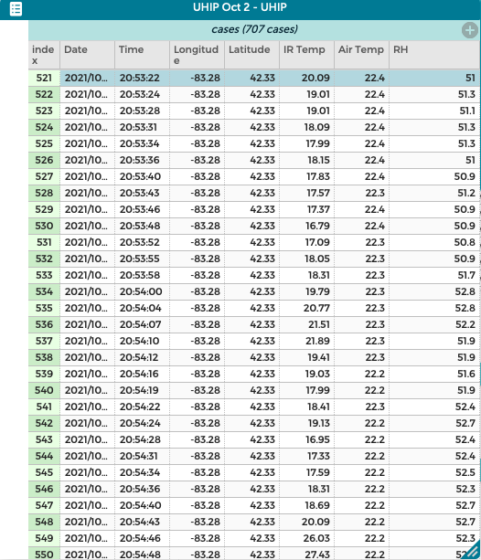
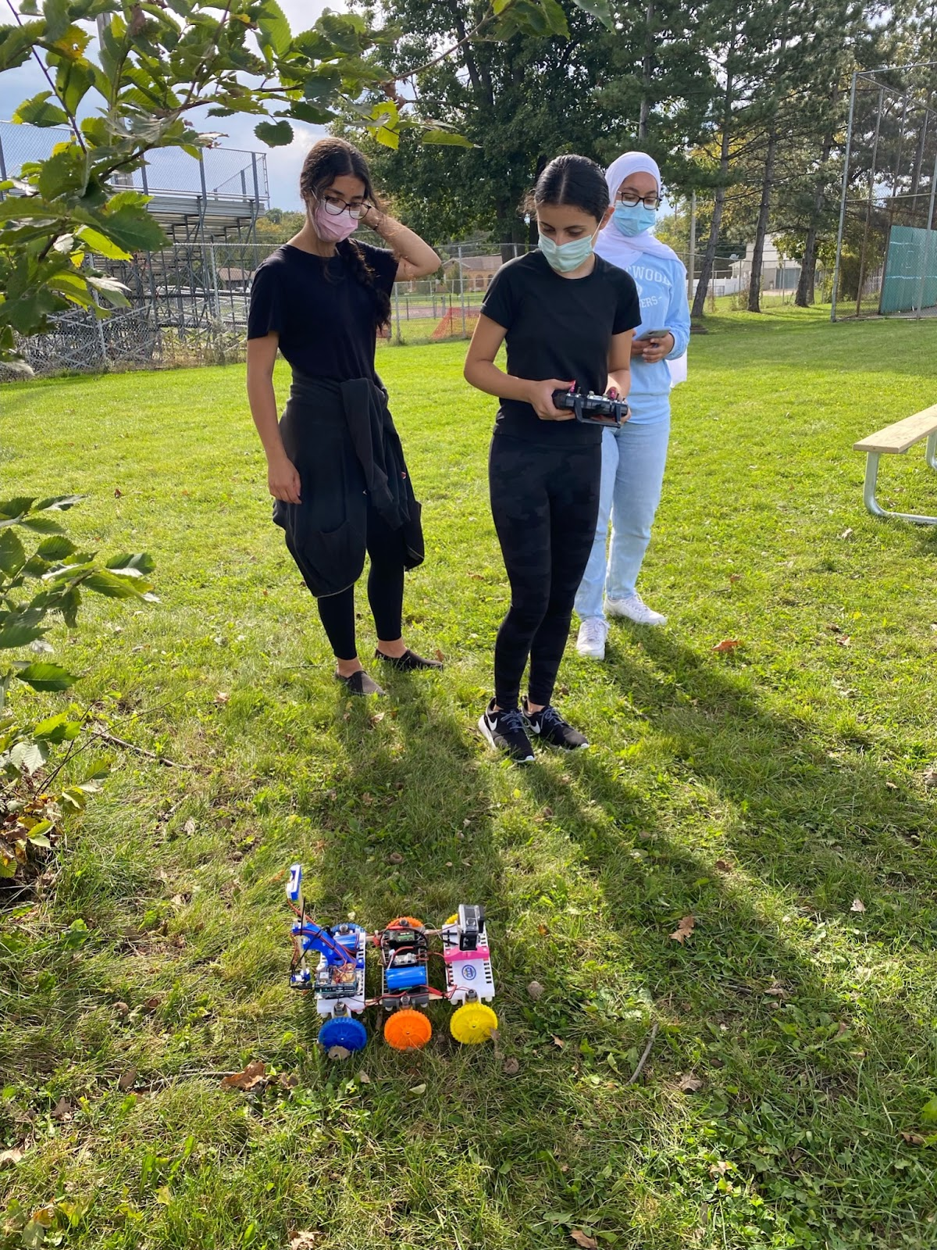
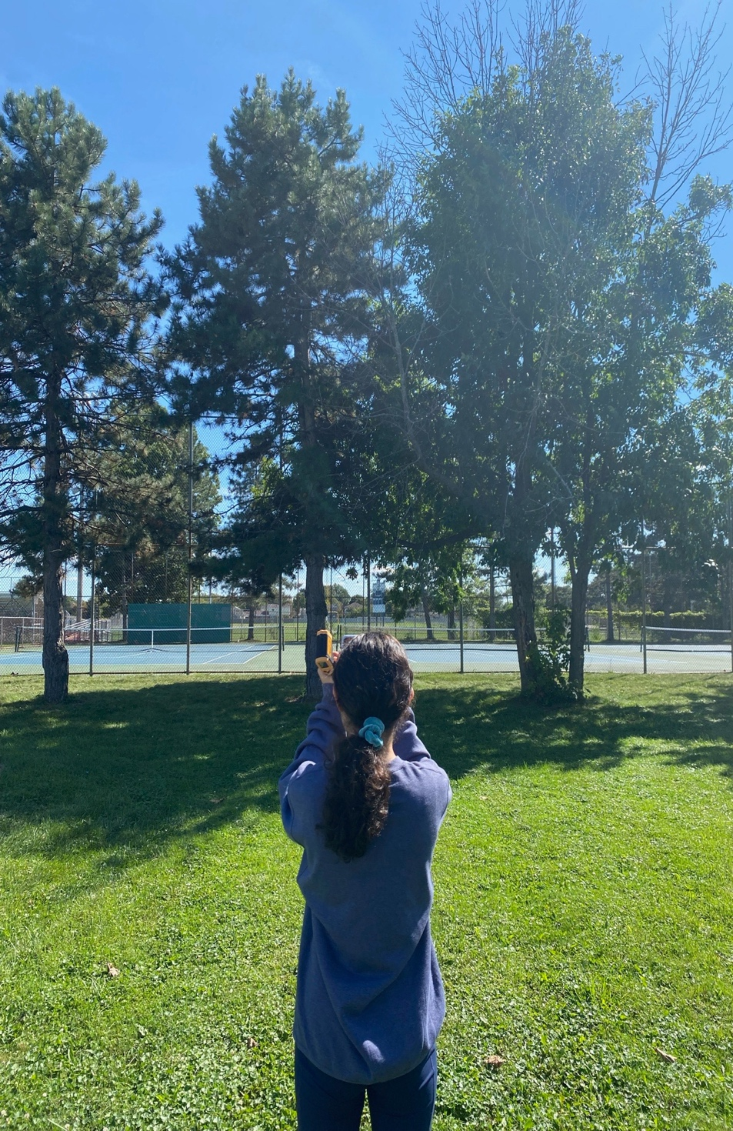
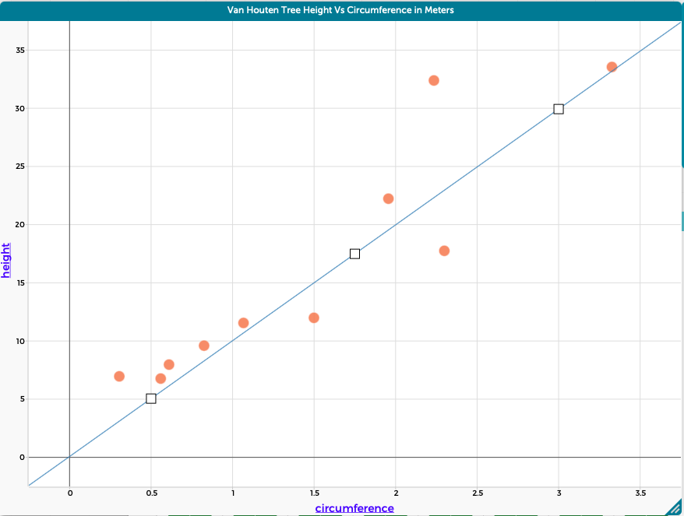
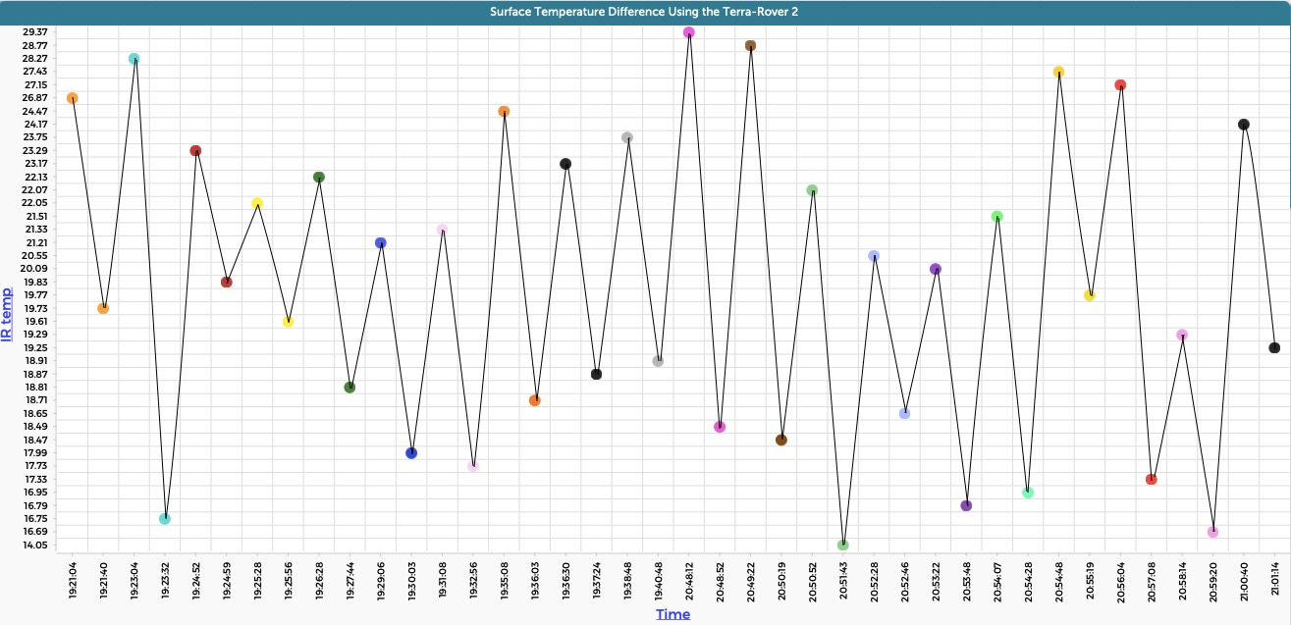
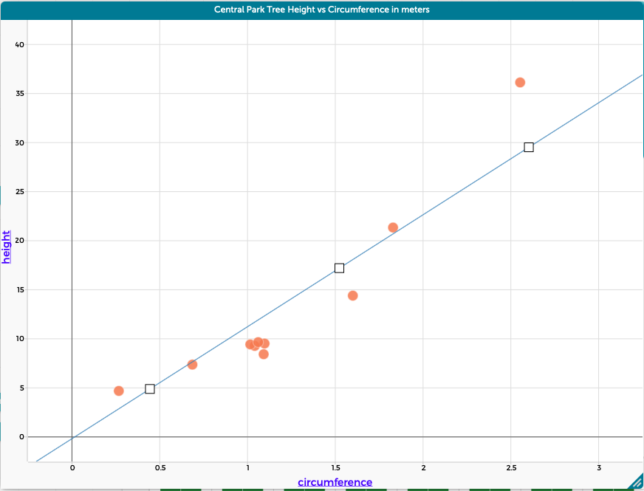
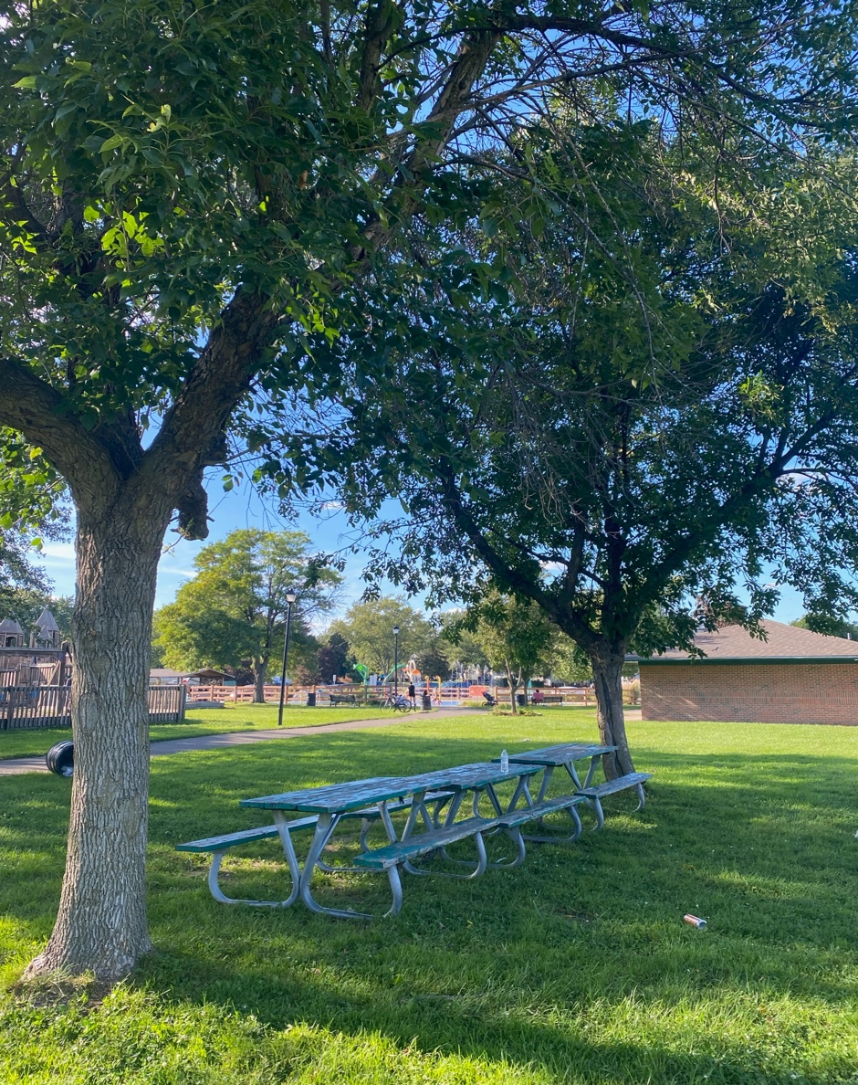
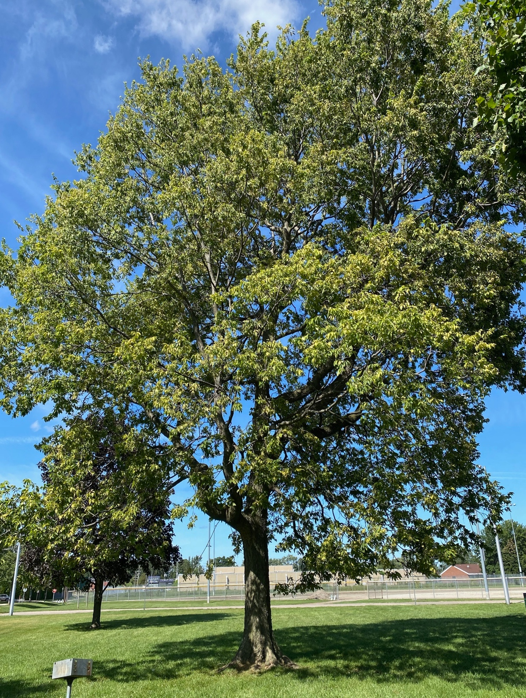
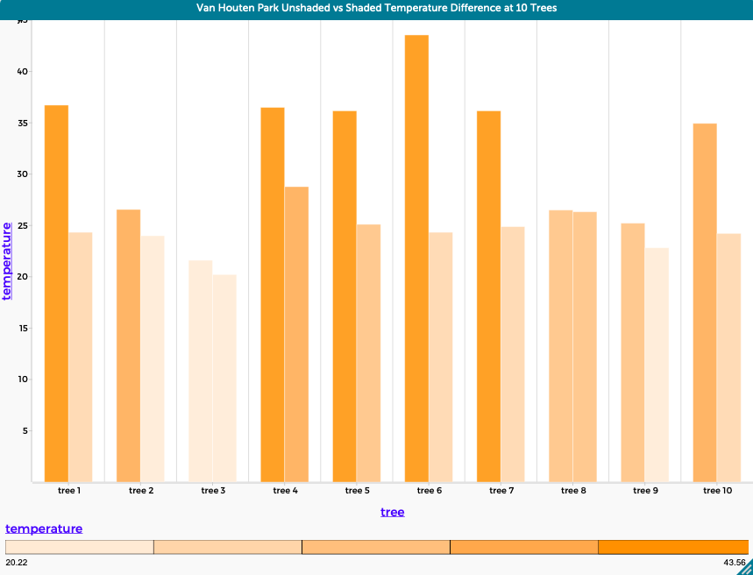
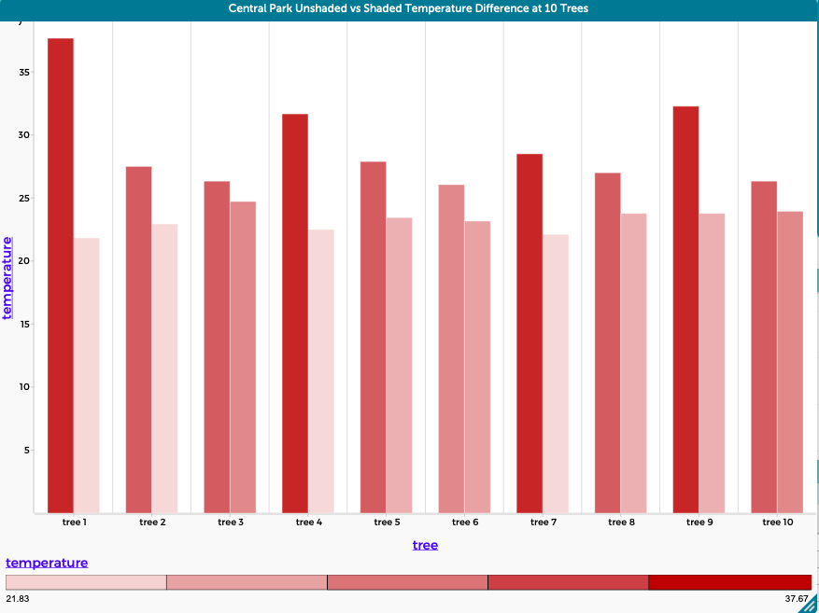
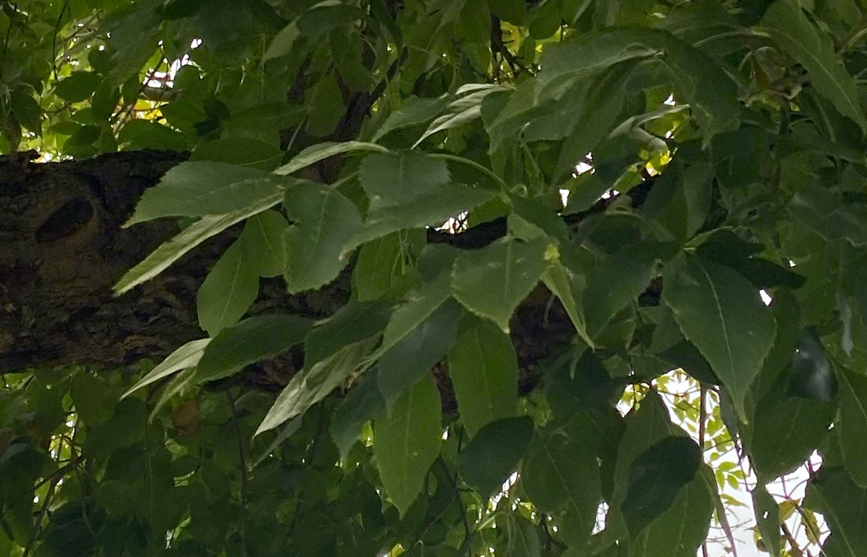
Assessing the Effects of Surface Temperature and Tree Coverage in Select Suburban Parks
Yasmina Abbas, Marwa Aidibi, and Zainab Zaidan
Crestwood High School, Dearborn Heights, MI
Abstract
Methodology
Discussion
Parks are a significant and positive addition to any urban area for their recreational use and as places where families can gather in groups to enjoy the outdoors. This research focused on examining the relationship between tree height, tree circumference, and their relationship to surface temperature. An iPhone with the GLOBE Observer Trees App was used to measure tree height and a DBH (diameter breast height) measuring tape allowed tree circumference to be determined. A digital infrared thermometer and a GLOBE AREN TerraROVER were both used to determine surface temperatures at two suburban parks in Dearborn Heights, Michigan. Ten trees per park were measured and the highest and lowest surface temperatures were determined. Temperature data was collected in both July and October. The TerraROVER 2 was used at both parks to determine GPS, surface temperature, and air temperature. All of our data suggests a clear relationship between tree height/circumference and surface temperatures. There were significantly lower surface temperatures in areas under largely shaded trees as compared to areas where there was no shade or tree coverage. To increase the quality of use in parks during the summer, it is essential to decrease surface temperatures to create ambient air temperatures that people want to be outside in. Each of the two parks that were assessed need to have more native trees planted as soon as possible.
The trees’ natural ability to shade and decrease the temperature of the regions near each tree is extremely significant to the issue of climate change, with the difference as the drastic dips in temperature between the unshaded and shaded regions highlighting the need for increased tree coverage. In general, through the data of tree circumference and height that was calculated, there was a clear correlation between these two variables: as circumference increased, the height also showed a noticeable increase. Furthermore, trees with larger circumferences and heights are often older trees that have large canopies. Comparing the tree canopies of younger trees to those of older trees indicates that smaller, younger trees have less of a surface temperature difference than taller, older trees. Originally, the null hypotheses created prior to data collection indicated that (1) tree coverage neither affects surface temperatures nor plays a role in the quality of a park and (2) that there is not a significant difference between the data collected at Site 1 (Central Park) and Site 2 (Van Houten Park). The data collected indicates that the first (1) null hypothesis stated is rejected and that there is a connection between tree coverage, surface temperature, and the quality of a park. Contrastingly, the second (2) null hypothesis proved to be accepted, as there was not a major difference in the data collected at Sites 1 and 2. Throughout this research, the evidence that tree canopies heavily influence a park-goer’s experience illuminates the need for increased care for tree maintenance and preservation. The trend of increased temperatures in the unshaded regions compared to the decreased temperatures in the shaded region was highly prevalent and significant in its effect on the quality of a park visit; shaded regions are preferred, while unshaded regions are neglected.
Student researchers are taking measurements of the circumference of the trees.
Student researcher takes tree height measurements through the GLOBE app, standing 50 feet away.
Student researcher reads surface temperature measurement using an IR thermometer.
Student researchers set the GPS on the TerraROVER to prepare it for surface temperature measurements.
Introduction
Throughout the past few decades, many public parks have grown less popular in the summer. As temperatures rise with climate change, the role of trees has become increasingly important in preserving the usage of the park. Despite trees being known for their most important role, acting as carbon sinks, they also hold another important feature related to cooling, decreasing surface temperatures with their large canopies of beautiful leaves that cool down areas in direct sunlight and make a park visit more enjoyable. In recent years, park trees have been cut down, ignored, or, most importantly, planted in areas that do not maximize their potential to decrease surface temperatures. In our research, we analyzed how much the shade trees provide changed the temperature of the ground, and how this could positively affect the usage of parks. In recent years, trees have been planted and evaluated in terms of aesthetics, valuing neat rows of trees, all of which are the same species which does not follow patterns typical of natural ecosystems. Native trees planted in response to local soil types and moisture are better ways to mimic nature and this would help the trees to thrive and at the same time provide much needed habitat for local organisms. Oftentimes, larger trees at parks that are actually providing shade are not well maintained and are left to die and decay. Poor yearly maintenance also makes trees more susceptible to storm breakage and this further reduces the opportunity to reduce surface temperatures. The planning of how space is utilized in parks should not only focus on the present but also the future and how we will need to rely on the shade provided by trees in subsequent years. Overall, the main focus should be on trees, especially native trees, and how they can be utilized to reduce urban temperatures.
Conclusion
The data collected during Summer 2021 showed that the relative heights and circumferences of each tree had a positive correlation with the radius of tree coverage, as taller and wider trees often covered much larger areas than smaller, thinner ones. Using an infrared (IR) thermometer a notable difference in temperature was noted between areas in direct sunlight, such as the tennis courts and baseball fields, versus the areas that had more shade coverage, such as the picnic tables under trees (as noticed at Van Houten Park). It is suggested that park personnel consider placing picnic tables in cooler and more shaded portions of the park to attract more local citizens to visit. In order for us to combat climate change properly, we must plant more native species versus nonnative plants, as we saw at Central Park. Along the curb of Central Park, we saw newly planted trees, and among further examination of the leaves, we found out that the tree was the Ginkgo biloba, or Maidenhair, which is a tree native to China. Most non-native trees do not provide the same ecosystem services as native trees. In the future, we encourage parks to plant trees in areas where park-goers frequently like to stay. For example, if a family would like to have a picnic at their local park, they tend to find a shady part of the park, so they are not in direct sunlight. With many trees at local parks being cut down, there are fewer spots for people to enjoy their experience at the park, although trees are very crucial to parks.
Student researcher inputs data into the GLOBE website.
Inputting and analyzing data from the TerraROVER into CODAP.
Student researchers drive the TerrraROVER around the sites.
Results
Null Hypotheses
1.) Tree coverage does not affect surface temperatures or play a role in the quality of a park.
2.) There is no significant difference in surface temperature data collected at Site 1 (Central Park) and Site 2 (Van Houten Park).
Acknowledgments/Bibliography
Thank you to the NASA Mission Earth Project coordinated by Dr. Kevin Czajkowski of the University of Toledo. Much of the equipment we utilized in our research was made available through this project. Thanks also to Mr. David Bydlowski and Mr. Andy Henry of the NASA AREN project for providing access to the TerraROVER 2 for collecting data. They were both always available to answer questions that helped guide our research. Thanks also to Mrs. Johns, for supplying for providing background information and helping us to focus our investigation.
Almas, Andrew David. “Native Trees, Urban Forest Management Planning, and Residents: Knowledge, Attitudes, and Actions.” Department of Geography and Planning University of Toronto, 2017.
Pandit, Ram, et al. “The Importance of Tree Cover and Neighbourhood Parks in Determining Urban Property Values.” Australian Agriculture and Resource Economics Society, 7 Feb. 2012.
Schroeder, Herbert W, and Thomas L Green. “Public Preference For Tree Density In Municipal Parks.” Journal of Arboriculture, 11 Sept. 1985.
Stagoll, K, et al. “Large Trees Are Keystone Structures in Urban Parks.” Conservation Letters, 2012
“Why Native Plants Matter.” Audubon, 18 May 2017, https://www.audubon.org/content/why-native-plants-matter

