Slide 1
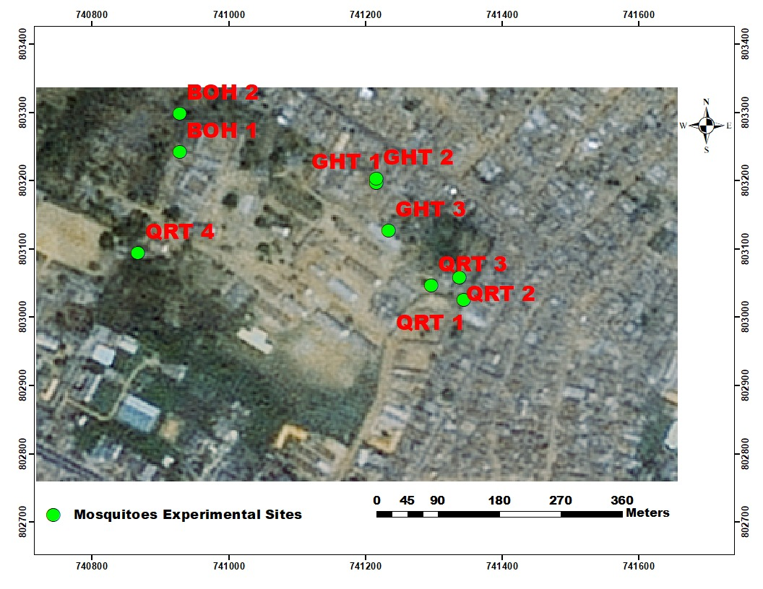
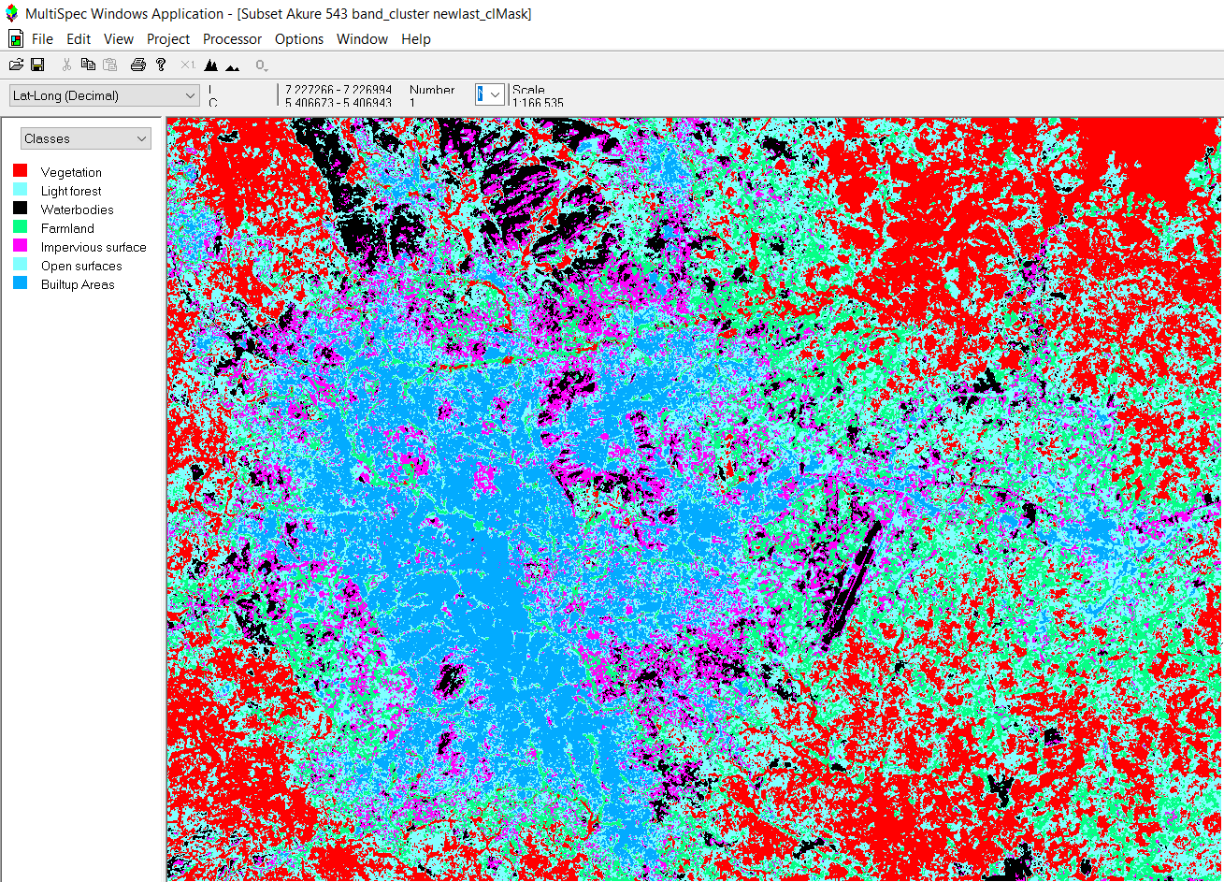
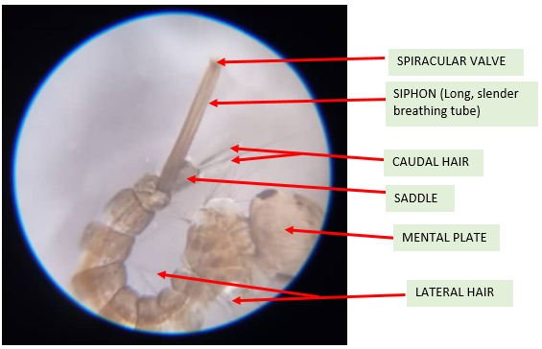
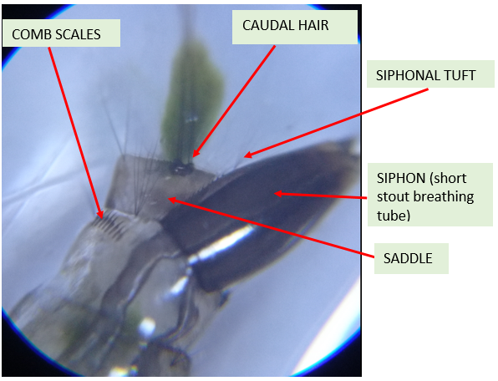
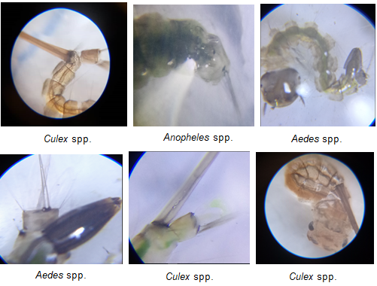
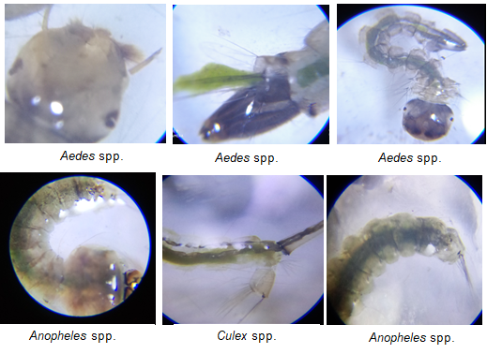
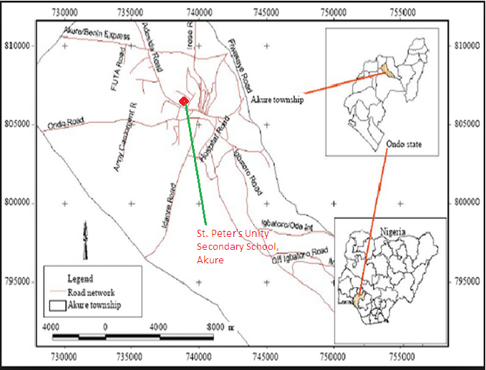
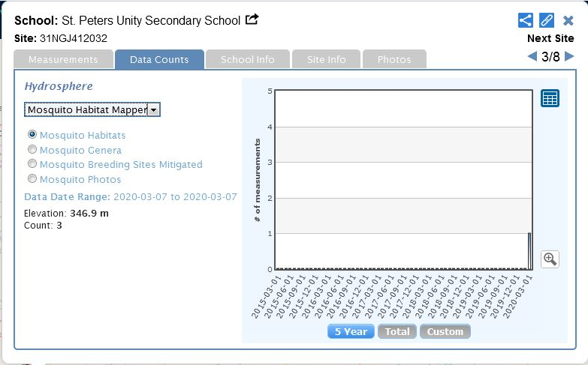
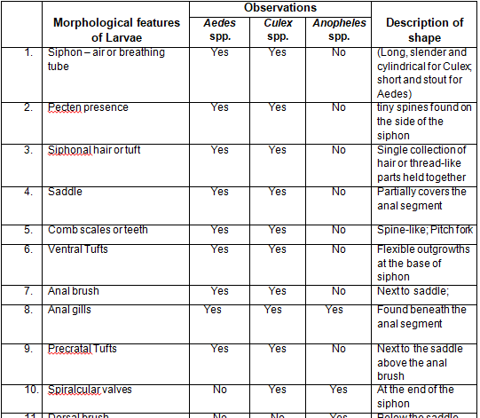
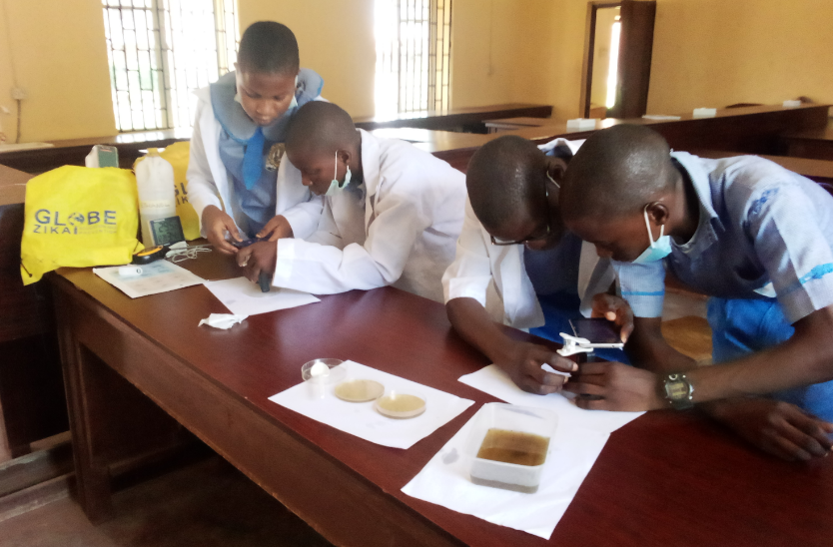
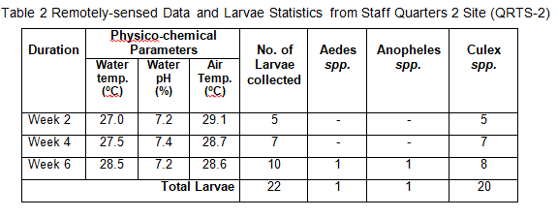
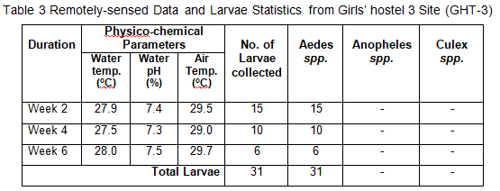
CLIMATIC CHANGE IMPLICATIONS ON GEOSPATIAL DISTRIBUTION AND MORPHOLOGY OF MOSQUITO LARVAE FOR MALARIA CONTROL
Principal: Mrs. F. M. Arowosade. Teacher: Mr. Olawunmi Fasakin. Students: Favour Semudara, Nneka Obiogba, Dominion Oloda,
Semire Victor, Princewill Orungbemi and Goodness Morakinyo
ST. PETER’S UNITY SECONDARY SCHOOL, AKURE, ONDO STATE, NIGERIA
Abstract
Research Methods
Results
Discussion
Planning Investigations
Nine breeding experimental locations were observed within the study area from which mosquito larvae were collected. They are the GHT-1, GHT-2 and GHT-3 sites (three habitats within the Girls’ hostels), BOH-1 and BOH-2 sites (two sites around the Boys’ hostels), while four sites QRTS-1, QRTS-2, QRTS-3 and QRTS-4 are breeding habitats within the Staff Quarters. Each surveyed site was geo-referenced using a hand held Global Positioning System (GPS) device.
The GLOBE protocols applied in this research are Hydrosphere (water temperature and water pH), Atmosphere (air temperature) and Mosquito protocols.
Carrying Out Investigations
The clip-on macro lens was used to identify which genera the larva belongs to by attaching it to an android camera phone with the GLOBE Mosquito Habitat Mapper app. Taxonomy keys from GLOBE Mosquito Larvae chart and The Animalfiles.com were also used for the morphological identification. Physico-chemical properties which favour the breeding sites were measured by using digital hygro-thermometer (air temperature) and 4-in-1 soil tester (water temperature and pH). Landsat 8, ArcGIS and MultiSpec software were used to develop multispectral hypersectral image data analysis and land use classification of the study area. Mean statistics was used to compute the percentage proportions of the collected larvae from the breeding sites.
Safety Precautions
All larval habitats sampled as specimens for the research work were immediately discarded and destroyed. We sampled the larvae at or near solar moon.
Geographical Location of Akure City
Akure metropolitan city is in south-western Nigeria, and is the capital of Ondo State. It lies about 7°25’ north of the equator and 5°19’ east of the Meridian (Figure 1). Figure 2 is the Print screen of GLOBE.
Visualization Mosquito Habitat Mapper page of St. Peter’s Unity Secondary School, Akure, Nigeria.
Geospatial and hypersectral images of the study area have been developed to identify environmental characteristics which are related to larval breeding locations. MultiSpec remote sensing image produced from unsupervised land use classification for the study area, on Windows application, identified seven different land use class types.
A total of 198 mosquito larvae were sampled. The sampled data shows a total of 5 Anopheles spp., 90 Aedes spp. and 103 Culex spp. larvae, that is, Anopheles has 3%, Aedes (45%) and Culex (52%) by proportion. Therefore, Culex spp. is the most abundant in the study area. This result is in agreement with Afolabi et al. (2019).
The climatic parameters measured from the breeding sites are water temperature ranging from 27.0 – 28.9⁰C, air temperature ranging from 28.6 – 30⁰C and pH range of 7.1 – 7.5. These readings relatively fall within the values obtained by Afolabi et al. (2019).
The findings of the unsupervised land use classification shows that the classification process identified seven land use types namely: Built-up areas, vegetation, light forest, water bodies, impervious surfaces, farmlands and open surface. The breeding sites were all located in the built-up areas.
.
Remote Sensing technology and geospatial distribution of mosquito larvae were applied to identify morphological features with respect to larval development sites for malaria control in ‘SPUSSA’ community, Akure, Nigeria. The objectives are to carry out land use classification, locate breeding sites, collect samples of larvae, identify different parts of mosquito larva, and assess physico-chemical properties of the habitat. Larval survey was carried out in nine breeding sites. Three sites from the Girls’ hostels, two from the Boy’s hostels, while four are within the Staff Quarters. The larvae collection was done within six weeks. Various parts were identified and photographed using the micro-clip on lens attached to an android camera phone with installed GLOBE Observer app. Landsat 8 was acquired from USGS Earth Explorer for the study area. MultiSpec software was used to carry out unsupervised land use classification for the study area. The study identified seven different land use class types. The results also reveal that morphological features of mosquito larvae are divided into three main parts – head, thorax and abdominal segments. Three larvae genera were identified which are Aedes, Culex and Anopheles species. Other important features studied and identified include siphon, anal segment, pecten, saddle, caudal hair and anal brush. A total of 198 mosquito larvae were sampled. The data shows a total of 5 Anopheles (3%), 90 Aedes (45%) and 103 Culex (52%) larvae by proportion. Hence, Culex is the most abundant. Certain climatic parameters contributed to the survival of these larvae. The parameters measured from the sites are water temperature ranging from 27.0 – 28.9⁰C, air temperature ranging from 28.6 – 30⁰C and pH ranging from 7.1 – 7.5. It is necessary to develop control strategies that will target the vector species. Therefore, effective vector control programmes on human activities that encourage mosquito breeding are recommended.
Keywords: Remote sensing, Anopheles, Aedes, Culex, climatic parameters
Analyzing Data
Figure 4: ArcGIS software imagery showing the nine geo-referenced larvae sites
Figure 5: Unsupervised classification of the study area showing different class types
Research Questions
i) What are the hyper spectral images of the mosquito larvae development sites?
ii) What are the key morphological features that distinguish those larval species that are found in the study area?
iii) What are the climatic parameters that are favourable for breeding mosquito larvae in the study area?
iv) What are the land use types in the study area?
Figure 6: Anatomical parts of a Culex spp.
Figure 7: Morphological parts of Aedes spp.
Sample of Anopheles, Aedes and Culex larvae
Conclusions
The study has established that multispectral hypersectral images can be used to accurately identify environmental characteristics associated with larval sites.
The three genera (Aedes spp., Anopheles spp. and Culex spp.) sampled in this study are of interest because they contain species that can transmit pathogens to humans and cause diseases. The mosquito larva anatomy is divided into three major parts namely the larva head, the thorax and the abdomen.
The sampled data shows a total of 5 Anopheles spp., 90 Aedes spp. and 103 Culex spp. larvae, that is, Anopheles has 3%, Aedes (45%) and Culex (52%) by proportion from the study area. The climatic parameters measured from the breeding sites are water temperature ranging from 27.0 – 28.9⁰C, air temperature ranging from 28.6 – 30⁰C and pH range of 7.1 – 7.5.
Recommendation
Adaptive policies should be formulated to reduce unexpected climate-related risk at global, regional or local level. It is therefore recommended to develop effective control strategies that will target the vector species.
Limitation
We could not distinguish the gender of the mosquito larvae observed.
Introduction
Remote Sensing/GIS techniques and geospatial distribution of mosquito larvae have been used to identify morphological features of the larvae with respect to their development sites for malaria control in SPUSSA community in Akure, Nigeria.
Changes in climatic factors such as temperature, rainfall, precipitation, and extreme weather conditions have been attributed to transmission of mosquito-borne diseases (Bai, Mortons & Liu, 2013). Climatic extremes such as heat waves, flash floods and cyclones are highly impacted by changing climate.
St. Peter’s Unity Secondary School, Akure (SPUSSA), Ondo State, Nigeria lies in the tropics where mosquitos breeding sites are naturally found or could be created artificially. The school consists of hostels , classroom blocks with staff quarters.
The objectives are to carry out land use classification, locate breeding sites, collect samples of larvae, identify different parts of mosquito larva, and assess physico-chemical properties of the habitat.
The accurate determination of these morphological features of larvae of various mosquito genera is significant for surveillance and mosquito-borne diseases control programmes.
Table 1 Some Morphological features of Mosquito genera and their shape description
Figure 1: Geographical map of Akure city, Nigeria showing the location of the study area – SPUSSA.
Figure 2: The Print screen of GLOBE Visualization Mosquito Habitat Mapper page of St. Peter’s Unity Secondary School, Akure, Nigeria
Bibliography/References
Afolabi, O. J., Akinneye, J. O. & Igiekhume, A.M.A. (2019). Identification, abundance and diversity of Mosquitoes in Akure South local Government Area, Ondo State, Nigeria. Journal of Basic and Applied Zoology, 80(39), 1 – 7.
.
Bai, L., Morton, L.C., & Liu, Q. (2013). Climatic change and Mosquito-borne diseases in China: A review. Globalization and Health, 9(10), 1-22.
Figure 3: GLOBE students collecting samples of Larvae from site QRT 1.
Figure 4: Students of GLOBE capturing entomological features of Mosquito Larvae.

