Slide 2
Methodology using the GLOBE Observer:
Water pH Data Collection:
Using the "Water" function of the GLOBE Observer app, we conducted pH measurements of water in different bodies of water, such as rivers, lakes, and reservoirs. We followed the standard protocols provided by the GLOBE Observer to ensure the accuracy and consistency of the measurements.
By recording water pH readings in the app, we contributed important data to monitor water quality and identify potential changes in environmental conditions, which may be related to climate change and human activity.
https://photos.app.goo.gl/KXiFXE9SuUTTU7Wa8

Slide 3
Observation of Clouds and Hailstorms:
We used the "Clouds" function of the GLOBE Observer app to record detailed observations of clouds and weather conditions during hailstorms. We captured photos of clouds at different stages of development, including cumulonimbus and storm clouds.
Observations of clouds and hailstorms contribute to understanding local and regional meteorological patterns, as well as identifying extreme events that may be related to climate change.

Slide 5
Monitoring Damage Caused by Storms and Intense Heat:
We documented damage caused by severe storms, including fallen trees and property damage, using the "Trees" function of the GLOBE Observer app. We took photos of the damage and provided information on the location and extent of the impacts.
We tracked patterns of heavy rains and days with high temperatures, followed by storms, using the "Weather" function of the app. By recording these events, we contribute to monitoring and understanding climate change and its effects on local and regional climates.

Slide 6
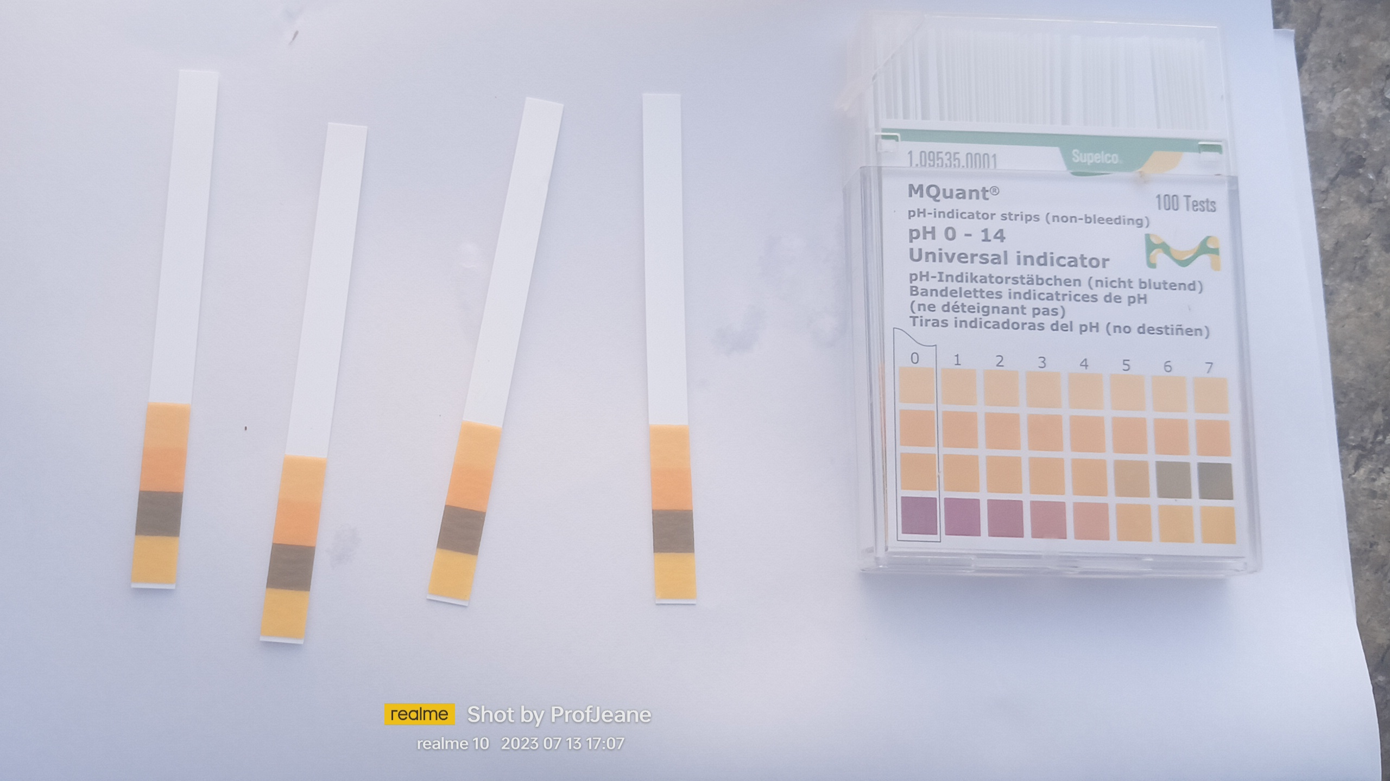

Slide 7
Data Analysis and Interpretation:
The data collected through the GLOBE Observer app are analyzed and interpreted to identify local and regional climate patterns and trends. We compare observations of water pH, clouds, storms, and extreme events with historical and climatological data to assess changes over time.
Data analyses contribute to a comprehensive understanding of the impacts of climate change in the studied region, aiding in the development of adaptation strategies and mitigation of risks associated with extreme weather events.

Slide 9
By integrating the methodology with the GLOBE Observer app, we are able to collect relevant environmental data and actively participate in monitoring and understanding climate change and its effects on the environment and society.
https://photos.google.com/memory/grid/1695475408/1697142550/1696118399/1696118399/AF1QipO1ORwE0mE644iV88EGMm8WYfO3iTmv_-PdICkBPw

