Slide 1


The effect of soil type and characteristics on alfalfa plant growth
Done by:
Bayan Alfarsi
Alanood Alfarsi

Slide 2
Abstract :
My research aims to know the type of soil suitable for growing alfalfa plants using GLOBE protocols and following the scientific method in finding appropriate solutions to environmental problems by answering the following questions:
1- What is the effect of soil characteristics (acidity and salinity) on the growth of alfalfa plants?
2- What type of soil is suitable for growing alfalfa?
To answer this question, I decided to study the properties of the soil in two farms, one of which had alfalfa growing in a healthy way and the other where it had unhealthy growth. I applied the soil protocol to study the properties of each sample in terms of acidity, salinity, color, consistency, texture, amount of rocks, soil, and carbonates, and the water protocol to study the properties of the water source used to irrigate the soil in terms of salinity, acidity, and conductivity, and the land cover protocol to compare plant growth in the two farms
The results I obtained indicated that plant growth is affected by the characteristics of the soil, as the alfalfa plant in the farm (1) had healthy growth, as it had a longer stem and more leaves, while in the farm (2) its growth was unhealthy due to the difference in acidity and salinity of the soil in the two farms, as well as the type of soil, and since the alfalfa plant needs low alkaline soil so that it can absorb nutrients well from the soil, and it also grows best in sandy and clay soil.
Based on the results, the researcher recommends that the farmers need to know the characteristics of the soil before planting any crop, in order to modify its properties in proportion to the appropriate conditions for the growth of the crop to obtain abundant and good production.

Slide 3
Research question:
1- What is the effect of soil characteristics (acidity and salinity) on the growth of alfalfa plants?
2- What type of soil is suitable for growing alfalfa?

Slide 4



Research methodology:
Collect information on the subject of the research from the books available in the Learning Resource Center and from the internet
Develop a search plan.
Set a timetable for the implementation of the research plan.
4. Adopting experimental research to study the effect of soil characteristics on the growth of alfalfa plants. .
Determine the protocols needed to perform the research
6. Determine the necessary devices and tools to carry out the work (pH meter, salinity measuring device, metric tape, and soil color notebook). .
Collect data and organize them in tables.
Insert data in the program’s website
Data analysis and representation
Conclusions and recommendations.

Slide 5


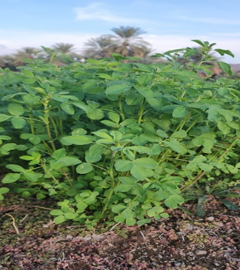
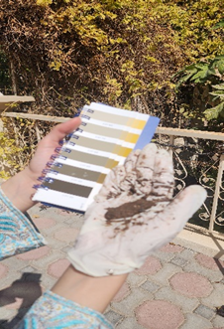
  Identify two farms that are irrigated with the same water source and the same amount of water and are exposed to the same amount of light and planted with the same alfalfa seeds (fixed factors) and diffirent alfalfa growth (independent factor).
2 - Water and soil samples were collected to measure acidity, salinity and conductivity using globe instruments.
5- Comparing the growth of alfalfa plants on both farms and determining which soil is best for growing alfalfa. .
3- Collect alfalfa samples (30 branches from each farm) and calculate the stem length and number of leaves for each sample. .
Methods of data collection:
4 - Calculate the arithmetic mean of the number of leaves and stem length for each sample .

Slide 6
Results:
First: Water properties data (falaj water) using GLOBE devices
Value | characteristics
8.9 | ( pH)Acidity
352 | ( ppm )Salinity
498 | (µS/cm )Conductivity
Second: soil
characteristics data in the two regions:
(2 )farm | ( 1 )farm | farm Characteristics
8.5 | 7.6 | ( pH)Acidity
710 | 632 | ( ppm )Salinity

Slide 7
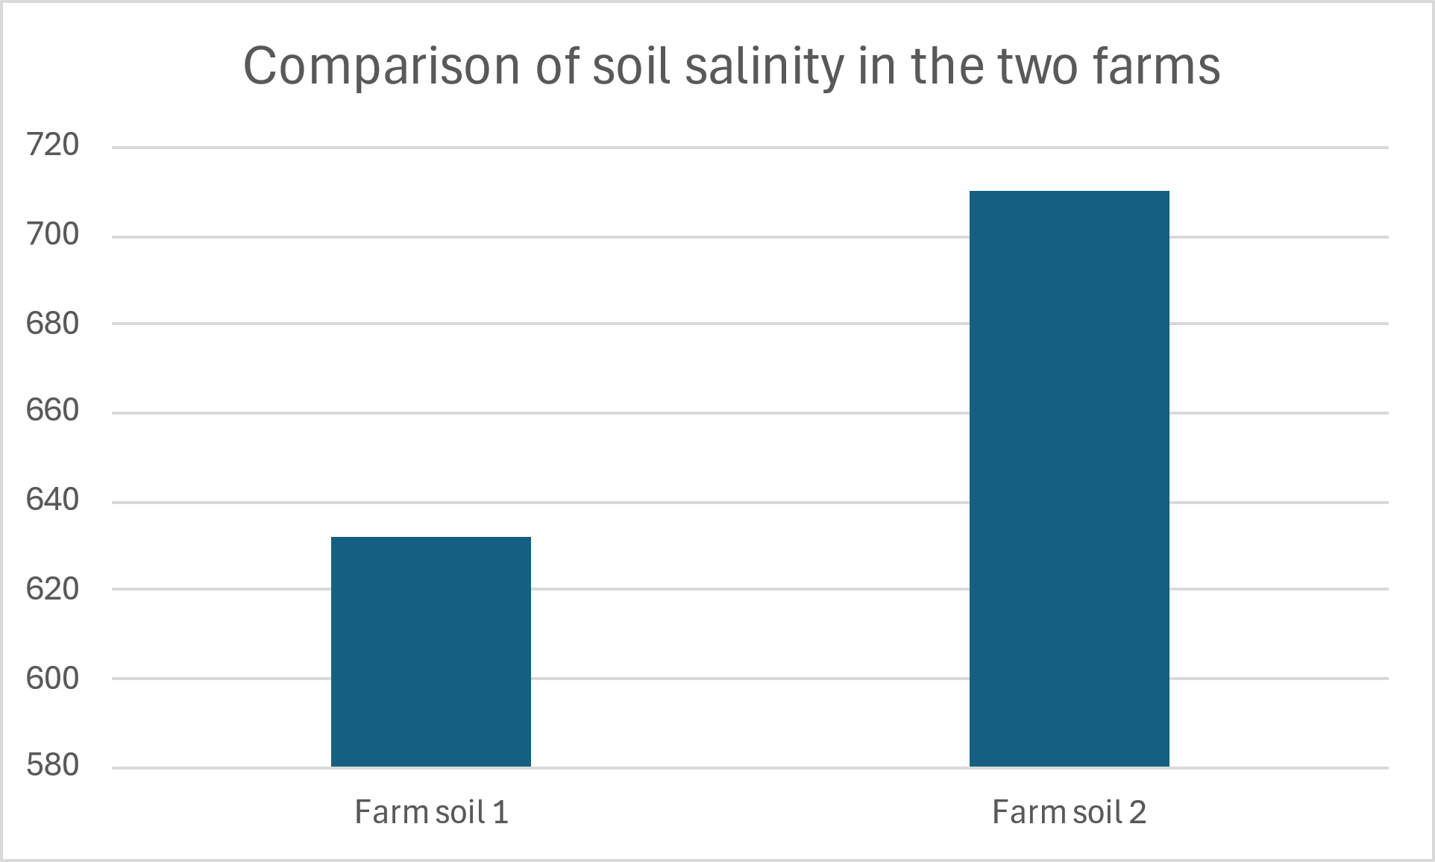
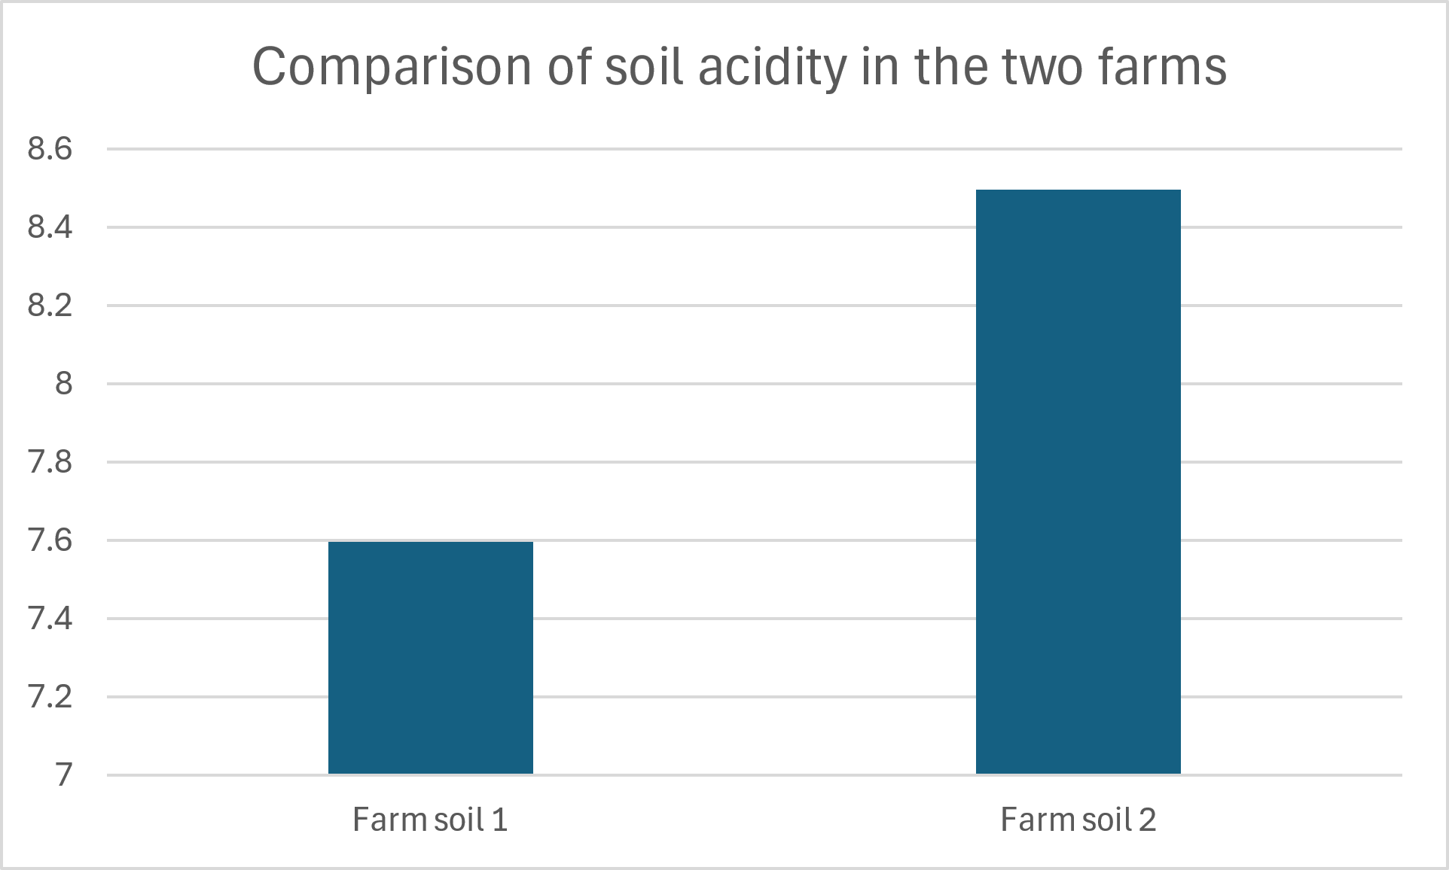
Soil characteristics
Figure 2
Figure 1

Slide 8
Third:: Observing the growth of alfalfa plants in the two soils in terms of their general appearance: :

Slide 9
Fourth : : Calculating the arithmetic average of stem length and number of leaves for a random sample consisting of (30) alfalfa branches from each soil..

Slide 10
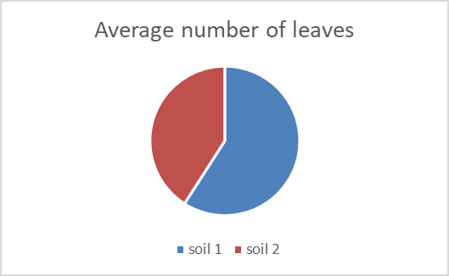
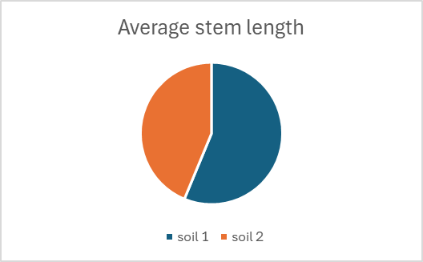
Figure 4
Figure 3

Slide 11
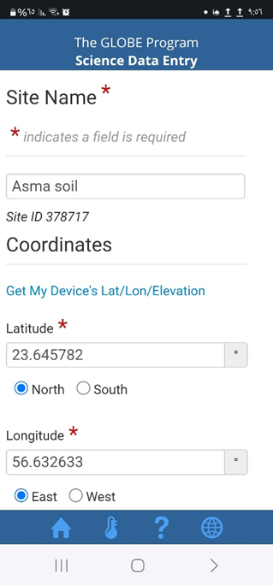
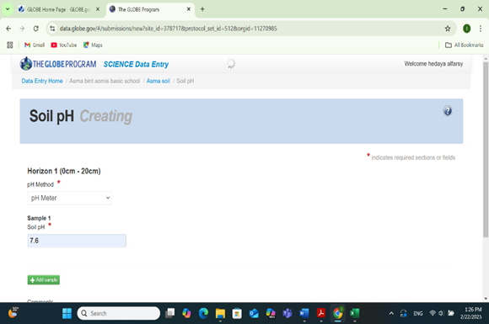
The data have been inserted and sent to the program website (www.globe.gov) through the application (DATA ENTRY).

Slide 12
Conclusion:
I thank God Almighty for completing this research, in which I used the GLOBE protocols (the soil protocol, the ground cover protocol, and the water protocol) to compare the characteristics and type of soil in two different farms and their impact on the growth of the alfalfa plant, as this crop is widely cultivated in these months of the year and for its economic importance to farmers. I noticed that plant growth was affected by different soil characteristics, and I learned that this plant needs a low-alkaline, sandy-clay soil in order to give good production
These conclusions lead us to the need for farmers to know the appropriate soil properties for each crop before planting, so that the soil properties are modified before planting to ensure obtaining a good, marketable crop
If I have the opportunity, next year, God willing, I will study the characteristics of the water source and its effect on the characteristics of the soil
.

Slide 13
References:
1. Technical office of Globe program. (2014) document of soil protocol for the training program for Globe teachers.
2. Technical office of Globe program. (2014) document of land cover protocol for the training program for Globe teachers.
3. Ministry of Education (2013) Science book for grade 8
4. Wikipedia. Retrieved on 12/11/2024 from
https://ar.wikipedia.org
5- Alfalfa. Retrieved on 1/25/2024
https://damanhour.edu.eg/pdf/agrfac
6. Oman News Agency - Alfalfa cultivation in the Sultanate - 10/25/2024. Retrieved 11/12/2024 from
https://omannews.gov.om/topics/ar/112/show/379862

