Slide 1
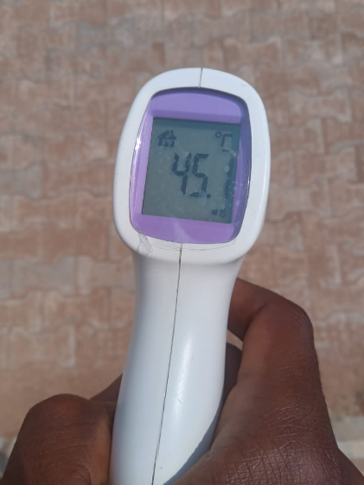
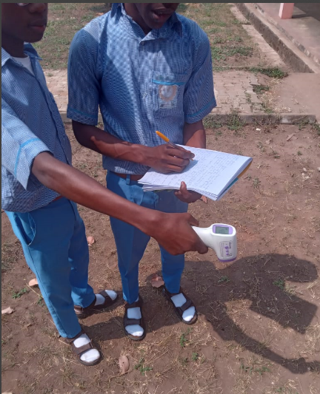
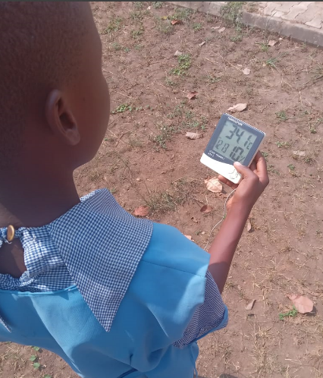
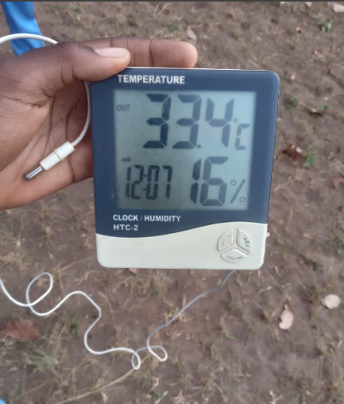
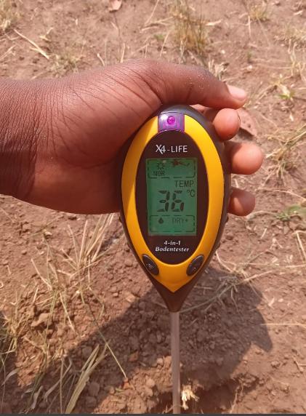
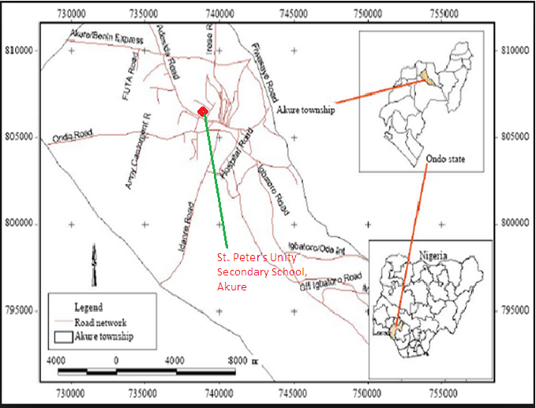
Evaluating Urban Heat Island and Climate Parameters
Teacher: Mr. Olawunmi Fasakin. Students: Ayomiposi Ojumu, Adedemeji Odunjo and Titilayo Olatunji
ST. PETER’S UNITY SECONDARY SCHOOL, AKURE, ONDO STATE, NIGERIA
Abstract
Research Methods
Results
Discussion
Planning Investigations
Surface (Land) Temperature @ SPUSSA Atmosphere Study and Soil Moisture Sites, Akure, Nigeria
Figures 1 and 2 show surface temperature measurements on cemented interlocking pavers floor while Figures 3 and 4 illustrate surface temperature measurements on bare soil surface. GLOBE students from St. Peter’s Unity Secondary School, Akure (SPUSSA), Ondo State, Nigeria participating in the December UHIE campaign for the month of December 2023. The infrared thermometer (IRT) was used by the GLOBE students. The device measures temperature by sensing the infrared radiation (light) coming from a surface. All observed measurements or our ground observations were sent to the GLOBE database via the GLOBE observer app for satellite comparisons and matching reports.
Geographical Location of Akure City
Akure metropolitan city is in south-western Nigeria, and is the capital of Ondo State. It lies about 7°25’ north of the equator and 5°19’ east of the Meridian (Figure 1).
GLOBE Protocols in this research work: Surface Temperature Protocols; Atmosphere protocols – air temperature and relative humidity;
the ambient temperatures range from 26.50 – 34.60 (^{O}C), air temperature (27.10 – 36.40 ^{O}C), surface temperature (30.6 – 37.8 ^{O}C), humidity (10 – 35%), atmospheric pressure (756.3 – 760.6 mmHg and 1008.3 – 1014.0 mBar), wind speed (0.7 – 4.8 mps) and wind gust (1.0 – 5.4 mps). A maximum surface temperature of 37.8 ^{O}C was recorded. The wind movements were majorly observed towards the western direction of the area of investigation. The significant surface and cloud conditions observed were leaves on trees, dry ground, no clouds found.
. Between 11/12/2023 and 15/12/2023 the two graphs depict ‘sharp decreases and increases’ after which both started to have similar trend. This sharp decreases and increases could be attributed to what is referred to as ‘energy budget’ effects. Furthermore, the thermal contrasts could be attributed to radiation influences and the surface thermal properties; and, sensible heat density emanating from increased absorption of radiation and anthropogenic heat sources, mainly obtained from industrial activities and vehicles, could also be responsible for this heat differences.
a fair positive correlation between surface temperature and air temperature (correlation coefficient of R² = 0.2576, thus R = 0.5075). This means that as air temperature increases, surface temperature also tends to increase, which is statistically significant. There is a moderate positive correlation between relative humidity and air temperature, which is statistically significant.
The land transformation or land use effects such as human population growth, increase in physical buildings, road and bridge construction, development of factories and industrial estates in urban communities have impacted local or regional climates of most towns and cities. The transformation of cities into heat islands is one of the most important results of microclimate change. In this investigation, variations of some important climatic factors which are air temperature, surface temperature, ambient or room temperature, relative humidity, atmospheric pressure, wind speed, wind direction and wind gust were carried out with the view to observe microclimate changes. The infra-red thermometer (IRT) was used to measure the surface temperatures, the digital hygro-thermometer was used to record the relative humidity values, ambient and air temperatures, digital aneroid barometer was used to measure atmospheric pressure while digital anemometer app was used to measure wind speed, wind gust and wind direction. Cloud cover and surface conditions were also taken. Climatic data collected were uploaded to the GLOBE website via the GLOBE Observer app. The result of this investigation shows that the ambient temperatures range from 26.50 – 34.60 (^{O}C), air temperature (27.10 – 36.40 ^{O}C), surface temperature (30.6 – 37.8 ^{O}C), humidity (10 – 35%), atmospheric pressure (756.3 – 760.6 mmHg and 1008.3 – 1014.0 mBar), wind speed (0.7 – 4.8 mps) and wind gust (1.0 – 5.4 mps). A maximum surface temperature of 37.8 ^{O}C was recorded. The sharp decreases and increases observed in the graphs, that is, variations observed, could be attributed to what is referred to as ‘energy budget’ effects or urban heat island characteristics. Furthermore, the thermal contrasts could be attributed to radiation influences and the surface thermal properties; and sensible heat density emanating from increased absorption of radiation and anthropogenic heat sources. A moderate correlation between surface temperature and air temperature (correlation coefficient of R² = 0.2576, thus R = 0.5075) was established. This means that as air temperature increases, surface temperature also tends to increase changes showed the effect of heat island on urban climate parameters. The surface temperature across the sites suggests that this data set might be showing temperature variations that could be indicative of climate change within the short period of days. The findings of this study highlight the importance and necessity of considering urban heat island in understanding the local climate dynamics and how they might be influenced by or contribute to broader climatic trends.
Keywords: Climate change, urban heat island effect (UHIE), urban microclimate, climatic parameters.
Analyzing Data
Figure 12. Surface Land and Air Temperature Variations over time (days) from 'SPUSSA' Atmosphere Study Site, Akure, Nigeria (December 2023).
Research Questions
Does urban heat island cause climate change?
Is there any relationship between surface temperature and the other climatic parameters?
Figure 13. Surface Land and Humidity Variations over time (days) from 'SPUSSA' Atmosphere Study Site, Akure, Nigeria (December 2023).
Figure 1. GLOBE Student taking surface temperature measurement from a cement floor within the school compound.
Figure 2. GLOBE Student taking surface temperature data from a cement floor in the school site.
Figure 3. SPUSSA GLOBE Students taking surface temperature from a bare soil in the Atmosphere study site.
Conclusions
Major properties responsible for thermal contrasts could be attributed to radiation influences and the surface thermal properties. In addition, sensible heat density derived from increased absorption of radiation and anthropogenic heat sources, mainly obtained from industrial and vehicles, could also be responsible for this heat differences. A moderate correlation between surface temperature and air temperature (correlation coefficient of R² = 0.2576, thus R = 0.5075) was established.
The combined analysis of these graphs can provide insights into the environmental conditions at the study area and how they might be interrelated. For instance, higher surface and air temperature values could be indicative of increased surface heat attributes, which is a significant contributor to climate change. The relative humidity and air temperature data can help in understanding the local climate dynamics and how they might be influenced by or contribute to broader climatic trends.
Introduction
The land transformation or land use effects such as human population growth, increase in physical buildings, road and bridge construction, development of factories and industrial estates in urban communities have impacted local or regional climates of most towns and cities. The transformation of cities into heat islands is one of the most important results of microclimate change.
In this investigation, variations of some important climatic factors which are air temperature, surface temperature, ambient or room temperature, relative humidity, atmospheric pressure, wind speed, wind direction and wind gust were carried out with the view to observe microclimate changes. The infra-red thermometer (IRT) was used to measure the surface temperatures, the digital hygro-thermometer was used to record the relative humidity values, ambient and air temperatures, digital aneroid barometer was used to measure atmospheric pressure while digital anemometer app was used to measure wind speed, wind gust and wind direction. Cloud cover and surface conditions were also taken.
The aim of this study was to determine how the earth systems are impacted by climatic changes. Data collected by the measuring device were uploaded to the GLOBE website via the GLOBE Observer app. The objectives are to visualize the relationships between carbon dioxide and the predictor variables.
Figure 5. A GLOBE Student taking Air and Humidity measurements at the atmosphere sample site.
Figure 7. A GLOBE Student taking air temperature and humidity at solar noon. site. The device sensor is also shown.
Figure 8. GLOBE Student observing soil temperature at a depth at the soil study site.
Research Methods
The infra-red thermometer (IRT) was used to measure the surface temperatures, the digital hygro-thermometer was used to record the relative humidity values, ambient and air temperatures, digital aneroid barometer was used to measure atmospheric pressure while digital anemometer app was used to measure wind speed, wind gust and wind direction. Cloud cover, sky and surface conditions were also recorded. Climatic data collected were uploaded to the GLOBE website via the GLOBE Observer app.
-Data Analysis
The team was assisted with the data interpretation, analyses and processing procedures by STEAM Professionals and our GLOBE Techer. Statistical graphs were used to illustrate the trends or pattern of surface temperature, ambient temperature, air temperature, atmospheric pressure, wind speed, wind gust wind direction and humidity from the atmospheric sites over time in days in the month of December 2023.
Figure 16. Wind speed variation over time (days) from 'SPUSSA' Atmosphere Study Site, Akure, Nigeria (December 2023).
Figure 17. Correlating between surface temperatures and air temperatures.
Bibliography/References
Ayeni, A., (2011). Malaria morbidity in Akure, Southwest, Nigeria. A temporary
observation in a climate change scenario, Trends in Applied Sciences Research, 6, 488–494.
Babalola, S.O., Suara, G., & Oyelakin, L.O. (2019). Spatiotemporal dynamics digital mapping of land use, Obakekere campus Federal University of Technology, Akure, Nigeria, European Journal of Advances in Engineering and Technology, 6(9), 12-19.
Figure 11b. Geographical map of Akure city, Nigeria showing the location of the study area – St. Peter’s Unity Secondary School, Akure (SPUSSA). Adapted from Ayeni (2011).

