Slide 1


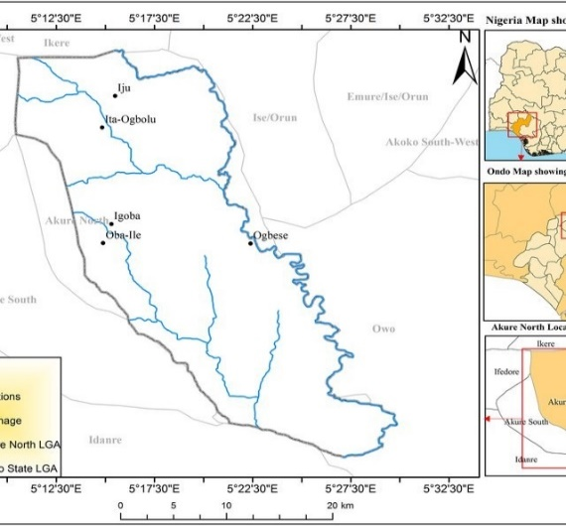
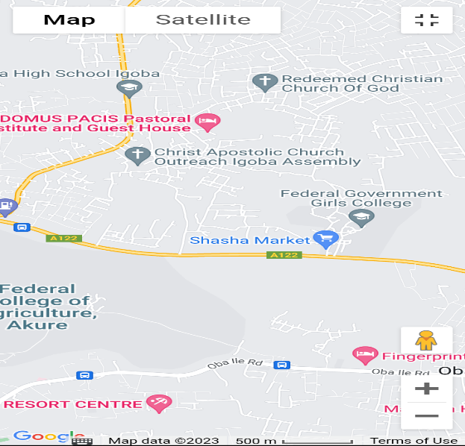
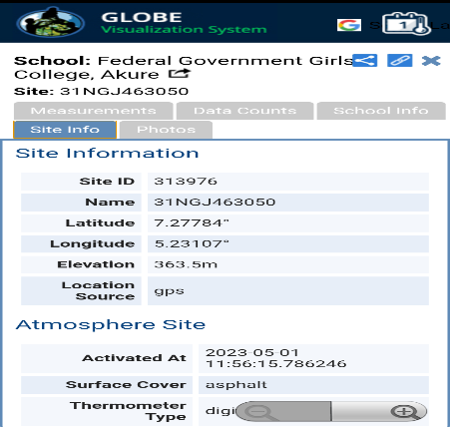
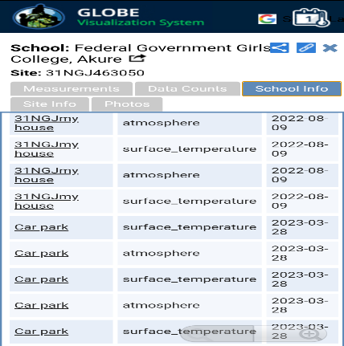
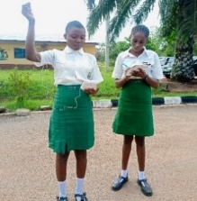
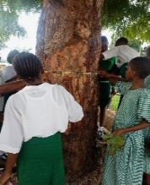
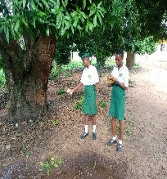
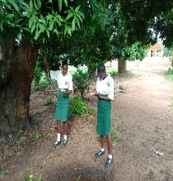
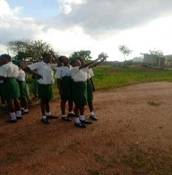
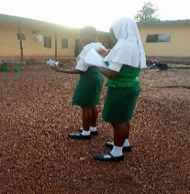
TOPIC: ENVIRONMENTAL BENEFITS OF TREES IN URBAN SECONDARY SCHOOLS
SCHOOL: FEDERAL GOVERNMENT GIRLS’ COLLEGE AKURE, ONDO STATE, NIGERIA
STUDENTS: Isah Aishat, Nwajiaku Amarachi, Mbachu Chizaram, Osewa Peace, Afolabi-Bakare Goodness, Bamidele Joy, Ojo-Abiodun Darasimi, Adeniyi Faith, Momoh Deborah, Abegunde Ayomide, Lordacquit Peculiar, Ogunsusi Grace, Idachaba Chegbe, Anjorin Fortunate, Olakunori Precious, Idachaba Ojochenemi, Fatorise Faith, Ogunsan Oluwafikayomi, Okeke Faustina, Oluwole Naomi, Olugesin Mercy, Idachaba Uredo.
ABSTRACT:
This paper presents a micrometeorological study on the environmental benefits of trees in Federal Government Girls' College Akure, Ondo State, Nigeria. Temperatures under three different surfaces (under trees and among different tree species, bare-ground and asphalted surfaces) within the school were measured. The temperature under commonly planted trees such as Neem (Azadirachta indica), Gmelina (Gmelina arborea) and Mango (Mangifera indica) found on the school compound alongside bare-ground (no vegetal coverage) and asphalted road surfaces were measured in degree Celsius for a period of six weeks. Infrared thermometer and Digital Hygrometer was used to collect surface and air temperatures respectively and their averages calculated. The GLOBE Observer App for trees was used to obtain tree height and circumference and to submit all data collected for the calculated mean average of air and surface temperatures for different surfaces. Data collected were analyzed using frequency, percentage, bar chart, and pie chart. The study showed that there is a temperature variation under different surfaces. Under the trees recorded lowest mean temperature of 23°C followed by bare-ground with 28°C whereas asphalt surface recorded the highest mean temperature of 53°C. The temperature under different tree species shows that trees with bigger crown and broad leaves had lower temperatures. Mean temperature under the Mango tree was 28°C while under the Neem tree, mean temperature was 32°C.
Keywords: Temperatures, Asphalt, Trees, Canopy, Environment, Micrometeorological, Urban.
The research was carried out using GLOBE Observer Tree App to get the accurate tree height measurements, Measuring tape for measuring tree diameter and circumference, a hand held Infrared Thermometer to measure surface temperatures and Digital Hygrometer to measure the air temperatures under three different surfaces which include under trees, bare ground and asphalted surface for a period of six weeks covering all days of the week except Sunday because Sunday, was a worship day and active school activities takes place on that day. The measurements were made between 12:35pm to 1:35pm local time for the period of study. Additionally, measurements were also made under different tree species such as Gmelaina (Gmalaina aborea), Mango (Mangifera indica) within the school compound. The trees sampled are located around the Sport Complex, hostels, PTA office area, Mosque area, Multipurpose Hall and Chapel area of the school. The entire observations was carried out during the peak period of both the dry and raining season with the dry season readings taken during the peak of the dry season around November-December and that of the raining season taken during the peak of the raining season around March-April thus affording us the opportunity to take our observations and readings in the two major weather conditions so as to get optimum results that will not be solely based on a period of time or a particular weather condition.
GLOBE Protocols used: (1) Atmosphere: Cloud, Air temperature, Surface temperature. (2) Biosphere: Biometry.
Materials used: Infrared Thermometer, Digital Hygrometer, Measuring tape, GLOBE Clouds Chart and GLOBE Observer App Data entry.
DAYS | BARE GROUND (℃) |  | UNDER TREE (℃) | ASPHALTED (℃)
WEEK ONE
Monday | 31.1 | 29 |  | 44.1
Tuesday | 31.8 | 30 |  | 40
Wednesday | 32.5 | 26.7 |  | 35
Thursday | 30.3 | 27 |  | 36.8
Friday | 30.5 | 29.4 |  | 30.6
Saturday | 31 | 26 |  | 33
WEEK TWO
Monday | 32.8 | 26 |  | 52.7
Tuesday | 31.4 | 25.4 |  | 53
Wednesday | 30 | 28 |  | 47.7
Thursday | 31.6 | 27.3 |  | 42
Friday | 33.1 | 30 |  | 44
Saturday | 32 | 29.7 |  | 41
WEEK THREE
Monday | 31 | 29 |  | 40
Tuesday | 30 | 29 |  | 35
Wednesday | 32.5 | 30 |  | 33
Thursday | 30 | 23 |  | 33
Friday | 32 | 28.8 |  | 40
Saturday | 32.5 | 29.3 |  | 37.5
WEEK FOUR
Monday | 35 | 30 |  | 48
Tuesday | 30 | 34 |  | 49
Wednesday | 29 | 23 |  | 31
Thursday | 30 | 23 |  | 33
Friday | 28 | 25 |  | 30
Saturday | 32 | 30 |  | 40
WEEK FIVE
Monday | 30 | 31.3 |  | 40
Tuesday | 32.5 | 29.5 |  | 38
Wednesday | 40 | 37 |  | 49
Thursday | 35.7 | 30.8 |  | 48
Friday | 32 | 29.7 |  | 39.5
Saturday | 38.6 | 32 |  | 45
WEEK SIX
Monday | 37.2 | 30.4 |  | 40.7
Tuesday | 38 | 32.9 |  | 43
Wednesday | 33 | 31.4 |  | 34
Thursday | 30 | 29.1 |  | 35
Friday | 32 | 30 |  | 37
Saturday | 30 | 23 |  | 33
RESULT AND DATA ANALYSIS
DISCUSSION:
Pie Chart shows the species of trees that were identified in the school environment and their respective rate of occurrence on a pie chart on a scale of 100%. The tree with most population is Oil Palm with an occurrence percentage of 36%, followed closely by Gmelina which makes up about 34% of all tree species within the school compound and the distant third is the Mango tree which made up 9.63% of all trees.
The trees with the littlest representation are Flambouyant Tree and Moringa at 2% respectively, Sandpaper and Trema which occur at 1% respectively. This result shows that Oil Palm and Gmelina were identified as the most common tree species in the school.
Table 3 and Bar Chart shows the average temperature (surface and air) in the school compound based on three parameters which are the temperature on bare ground, under the different tree species and on asphalted ground.
This measurements further showed that Week 2 recorded the highest temperature on Asphalted ground which was on Tuesday of Week 2 at 53°C and the lowest temperature on asphalted ground occurring at 30°C on Friday Week 4. Wednesday, week 5 recorded the highest temperature on bare ground at 40°C and the lowest temperature on bare ground at 28°C on Friday of Week 4. Finally, the day with the highest temperature under tree was Wednesday week 5 at 37°C and lowest temperature occurring under the tree at 23°C on Wednesday and Thursday of week 4 which showed a constant temperature on two consecutive days.
This temperature variation is associated with rainfall and overall weather and atmospheric conditions. The days that had rainfall including days following the day it rained indicates low temperatures, but days that are sunny and dry had high temperatures except the locations or environments that were around trees and vegetation which exhibited lower temperatures compared to other locations and it also goes on to prove that trees will always be useful in the environment in alleviating heat and exposure to the direct ultraviolet rays of the sun.
The result is a proof of the environmental benefit of trees in the school environment especially during the dry season months of November to April. During this period, one could feel the heat directly from asphalted surfaces during the day. The trend of temperature is similar throughout the course of the study. There is a consistency of higher temperature on asphalted surfaces over bare ground and under trees. This indicates that asphalted surfaces have higher temperature because of heat absorption of the tar. Albedo level for asphalted surface is 0.05-0.20 as it is a black surface which all have albedo levels close to Zero. Albedo is the fraction of solar radiation (light) reflected by a surface or an object. Albedo is measured on a scale from zero (0) to one (1), where 0 reflects no light and 1 reflects all light. It plays an important role in the thermal behaviour of pavements and other ground surfaces and their resultant impacts on humans and the environment.
RESEARCH METHODS
Map of Akure North Local Government Area
GLOBE Observer App showing the location of FGGC Akure
Pie chart showing tree species identified and the rate of occurrence in FGGC Akure in percentage
RESULY AND DATA ANALYSIS
RESEARCH QUESTION OF THE STUDY:
What roles do trees play at reducing air and surface temperatures?
INTRODUCTION:
The role of trees in the environment, especially as it relates to climate change is one issue that has been emphasized by climate scientist and that is why afforestation is a key component of climate change adaptation. Functions inherent to forests, according to [1] offer solutions to water availability and cooling [1,2,3]. Through evapotranspiration, trees recharge atmospheric moisture, contributing to rainfall locally and in distant locations [1] Cooling is unequivocally entrenched in the capacity of trees to capture and redistribute the sun’s energy [4]. Trees enhance soil infiltration and, under suitable conditions, improve groundwater recharge. Precipitation filtered through forested catchments delivers purified ground and surface water [5,6]. Urban vegetation is very important for people’s living because it does not only provide visual joy for people, but also influences directly or indirectly, urban environment through its physical characteristics [7]. For example, it influences urban environmental conditions and energy fluxes by selective reflection and absorption of solar radiation and by modulation of evapotranspiration [8]. Thus, a reliable measure of the distribution of urban vegetation is getting more significant.
The benefits of trees are not only well recognized by the academic community, but by municipalities and institutions around the country and the world [23]. However, even when general benefits of trees are understood and desired, it is difficult to manage and maximize their benefits without quantitative information on the direct benefits of an urban forest [24]. Without trees, the world would be bleak, and life as it is known would be impossible. Man is already acquainted with the vast importance of trees to his survival. Primitive people were dependent on trees for food. Fossilized products of trees like coal (carbonized and fossilized wood) supply fuel for the energy need of man. Modern man is no less dependent upon trees, particularly the soaring demand for tree products in the manufacture of newsprint and in the manufacture of papers as well as cardboard and similar packaging including the making of furniture and general construction that requires wood.
Trees play important roles in maintaining a virile and sustainable environment. Trees provide the means of paying “carbon debt”, this is done as it absorbed carbon IV oxide (CO₂) and gives out oxygen. When most of these trees are destroyed and used as fuel wood, planks for building, etc we have more carbon IV oxide circulating in the air causing more havoc [32]. Too much carbon IV oxide in the atmosphere causes more heat to be trapped within the atmosphere which contributes immensely to global warming and climate change [33,34]. Trees are indicators of a community’s ecological health. When trees are large and healthy, the ecological systems – soil, air and water – that support them are also healthy. In turn, healthy trees provide valuable environmental benefits [16]. The greater the tree cover and the less the impervious surface, the more ecosystem services are produced in terms of reducing storm, water runoff, increasing air and water quality, storing and sequestering atmospheric carbon and reducing energy consumption due to direct shading of residential buildings [32].
Federal Government Girls' College, Akure compound has many buildings of architectural excellence and more are being constructed as the years go by but plans for greening the environment seem not to be in the pipeline as trees are cut down to put up more facilities, student classroom and office blocks. It is on the basis of this that the study accessed the environmental benefits of the few remaining tree stands by measuring temperatures under these trees and on two other surfaces devoid of trees; bare-ground and asphalted surfaces (tarred roads).
DATA ENTRIES THROUGH GLOBE OBSERVER APP
Air temperature measurement on asphalted road, tree circumference measurement using measuring tape, surface temperature measurement under mango tree, air temperature measurement under tree, cloud measurement taken and air temperature measurement on bare ground.
BADGES DESCRIPTION
I Am A Collaborator:
During the development of the research, students were grouped, (Nwajiaku Amarachi, Mbachu Chizaram, Osewa Peace, Afolabi-Bakare Goodness) engaged in taking solar noon daily air and surface temperature measurements of different surfaces (asphalt, under tree and bare ground), (Bamidele Joy, Ojo-Abiodun Darasimi, Adeniyi Faith, Momoh Deborah, Abegunde Ayomide) engaged in taking different tree species height and circumference measurements, (Olakunori Precious, Idachaba Ojochenemi, Fatorise Faith, Ogunsan Oluwafikayomi) engaged in taking cloud measurement, (Oluwole Naomi, Okeke Faustina, Olugesin Mercy, Lordacquit Peculiar, Ogunsusi Grace, Idachaba Chegbe, Anjorin Fortunate) engaged in collating the field data collected during the course of the study and (Isah Aishat, Bamidele Joy, Momoh Deborah, Adeniyi Faith, Abegunde Ayomide, Idachaba Ojochegbe, Idachaba Uredo) were involved in the video presentation of the project, all the students worked together to provide a qualitative research work.
I Am A Stem Storyteller:
Story about our research work was shared on you-tube and also included in the research presentation submitted to GLOBE International Virtual Science Symposium, so that others can also learn from our creative research work. Students engaged in the video blogs include; Isah Aishat, Bamidele Joy, Momoh Deborah, Adeniyi Faith, Abegunde Ayomide, Idachaba Ojochegbe, Idachaba Uredo.
I Am A Data Scientist:
During the study, it was observed that there was an increase in air and surface temperature, through the data collected and infered to the previous year data. One of the reasons is the deforestation of trees going on in the school compound just to use them as fuel and also to erect more buildings.
I Make An Impact
Our school compound has many buildings of architectural excellence and more are being constructed as the years go by but plans for greening the environment seem not to be in the pipeline as trees are cut down to put up more facilities, student classrooms and office blocks. It is on the basis of this that we accessed the environmental benefits of the few remaining tree stands by measuring temperatures under these trees and on two other surfaces devoid of trees; bare-ground and asphalted surfaces. We recommended that: (1) creation of awareness for tree planting in our community should be intensified, (2) Students should be encouraged to plant by incentisizing the process to encourage students to engage in planting trees in the School, (3) Seedlings of trees and water should also be made available in order to maintain the planting and maintenance of trees.
BAR CHART SHOWING DAILY TEMPERATURE RECORD UNDER DIFFERENT SURFACES
CONCLUSION:
The study was conducted to evaluate the environmental benefits of trees in an urban secondary school using Federal Government Girls’ College Akure as a case study. The objectives were to examine temperature differences under three (3) different surfaces which include: under trees, bare ground and asphalted surfaces. In addition, we evaluated temperature differences under different tree species in our school such as: Gmelina, Mango and Neem trees. The study shows that there is temperature variation between the three variables measured which were bare grounds, under tree and on asphalt surface. It was observed that temperatures under trees were lower compared to bare grounds and asphalt surfaces. This was expressed from the means of temperature collected for six weeks. The work also covered the benefits of tree planting in our school, and it was shown that the benefits include the following: Furniture making, firewood and provision of timber for building constructions and serving as wind break which is capable of protecting houses and properties from being wrecked by wind storm. Other benefits include provision of food, shade and for research purposes.
BIBLOGRAPHY/CITATION:
1. Ellison D, Cindy E.M, Locatellie B, Sheil D, Cohen J, Murdiyarso D, Gutierrez V, van Noordwijk M, Creed .IF, Pokorny J, Gaveau D, Spracklen D.V, Tobella AB, Ilstedt U, Teuling A.J, Gebrehiwot GS, Sands D.C, Muyst B, Verbist B, Springgay E, Sugandi Y, Sullivan CA. Trees, forests and water: Cool insights for a hot world. Global Environmental Change. 2017(43):51–61.

